Slide 1
Mastering asyncio applications
Andrew Svetlov
andrew.svetlov@gmail.com
https://github.com/asvetlov/europython2015

Slide 2
About me
Python core developer
asyncio library co-author
aiohttp co-creator
Co-founder of aio-libs community (bunch asyncio-based libraries) : aiopg, aiozmq, aioredis, aiomysql, aioes, aiocouchdb, aiohttp_jinja2, aiohttp_session, aiorwlock etc.

Slide 3
Today
aiohttp
aiopg
aiomysql
aioredis
aiozmq
aioes
aiomcache
aiohttp_jinja2
aiohttp_session
aiorwlock
aiokafka
aiocouchdb
aio-s3
aio-beanstalk

Slide 4
Today 2
aiodns
asyncio-mongo
aioamqp
aioetcd
qualmash (Qt)
aiogevent
asyncssh
irc3
autobahn
pulsar
aiogreen (eventlet)
gbulb (GLib)
rose (libuv)
aiomultiprocessing

Slide 5
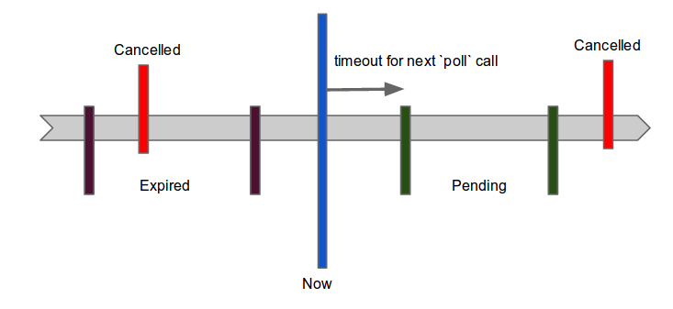
Timeline

Slide 6
Questions?
andrew.svetlov@gmail.com

