Slide 1
NOVEMBER 30, 2023
PREDICTING DEMAND FOR BIKESHARING IN WASHINGTON DC
Semester Presentation for ECE 381.3: Applied Machine Learning
LAKSHYA JAGADISH, FADEEL KHAN, ASVIN KUMAR, POWELL LOWE
The University of Texas at Austin

Slide 2
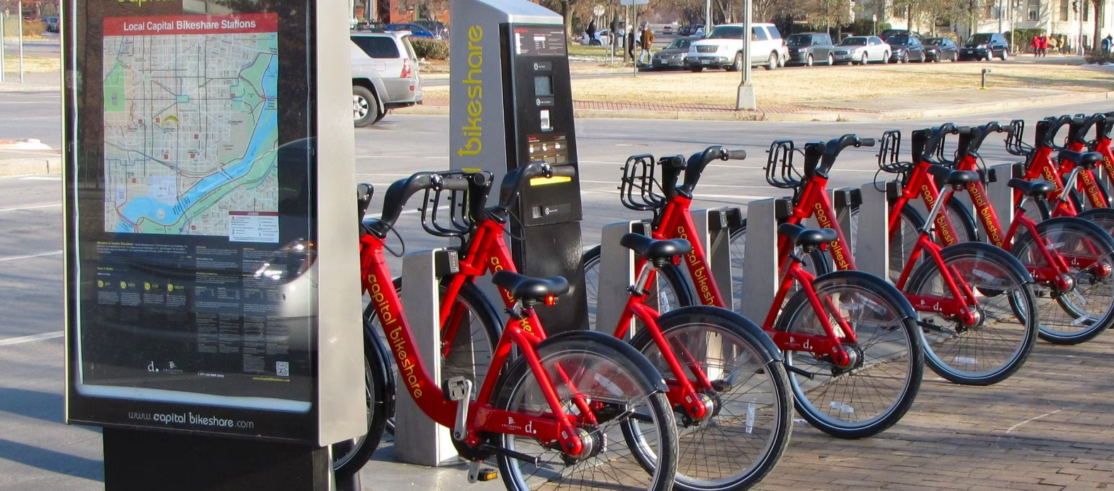
BACKGROUND: CAPITAL BIKESHARE
Capital Bikeshare: government-run bike share company with 3.4 million annual bike ridership (~9k daily riders) in Washington D.C. and surrounding areas
Riders can buy annual memberships (“registered” riders) or pay per trip (“casual” riders)
Understanding variations in ridership an important consideration for future government city development
City planning
Strategies for advertisements on bikes
Strategies for marketing for more ridership
Figure Adapted from Capital Bikeshare
Notes:
fadeel

Slide 3
DATA DESCRIPTION
day.csv (aggregated by day between 2011-2012)
Size: 731 samples x 16 columns
hour.csv (aggregated by hour between 2011-2012)
Size: 17379 samples x 17 columns
*all features same for both except for “hour” feature in hour.csv
DATASET BREAKDOWN
Time series data, aggregated by both day and hour
Feature set:
Time series (date, day, year, month, hour)
Seasonal information
Weather information (humidity, windspeed, temperature, state of weather)
Day information (weekday, weekend, holiday)
Target variables:
“Registered” riders using bikes
“Casual” riders using bikes
Total riders (registered + casual)
Notes:
fadeel

Slide 4
PREVIOUS WORK
Recurrent Neural Network (RNN) regression for predicting rider counts (Petnehazi et al.)
R² = 0.78-0.96
Decision Trees multi-class prediction of seasons based on rider count and other features (Al-Otaibi et al.)
Classification accuracy = 0.4-0.7
Kaggle Competition
Non-neural network models (LR, ensemble methods); R² = ~1.0
No model/feature interpretation
Statistical visual interactions between features (Britton et al.)
No predictive modeling
Notes:
fadeel

Slide 5
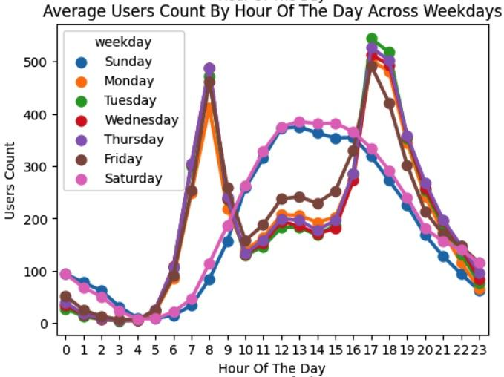
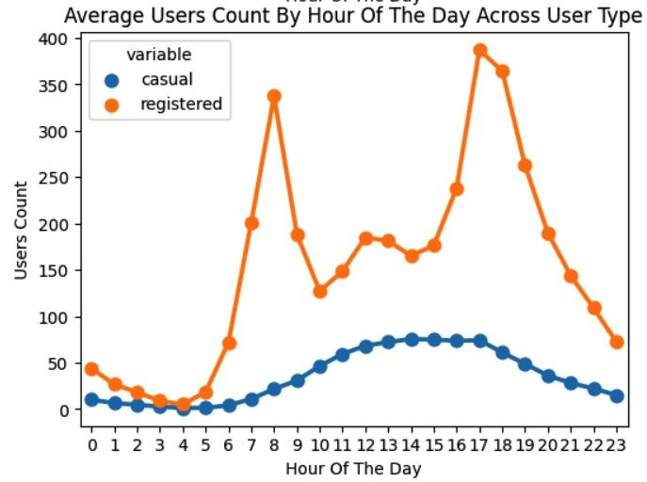
EXPLORATORY
DATA ANALYSIS
Multiple seasonalities
Weekends vs Weekdays
Winter vs Summer
Morning/Evening versus Midday
Commutes dominated by Registered Users
Temperature is most correlated weather
feature with Count
Humidity and Wind Speed → minimal correlation
Notes:
Powell

Slide 6
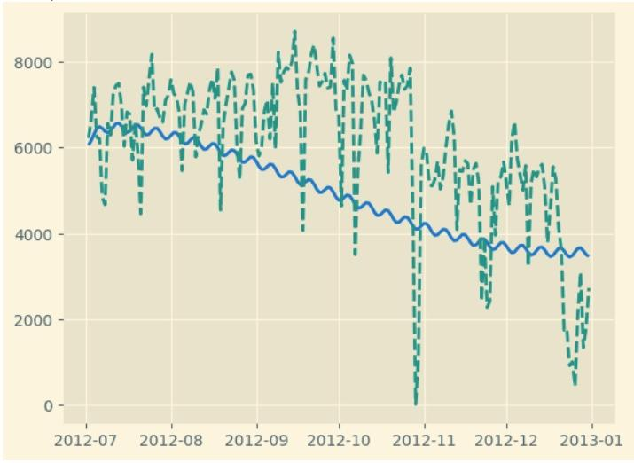
TBATS Baseline
Incorporates:
Trigonometric seasonality
Box-Cox Transformation
ARMA
Trend
Pros:
Multiple seasonalities
Performs exponential smoothing
Poor performance and extremely slow
Notes:
Powell
Trigonometric seasonality. Box-Cox transformation. ARMA errors. Trend

Slide 7
PRE-PROCESSING
Normalization of feature set
Seeding data, 80-20 train-test split
3-fold cross validation
GridSearchCV for hyperparameter tuning
Top 3 principal components explained 94-97% of variance → data inverse-transformed based on PCA
Model evaluation pre- and post-PCA
Notes:
fadeel

Slide 8
MODEL SELECTION
Linear Regression
Support Vector Regression
Random Forest
XGBoost Forest
Recurrent Neural Network (Long Short-Term Memory)
Emphasis placed on the simplicity and interpretability of models
Notes:
fadeel
Hoping to use models that were the most simple and explainable so stuck with them
Dataset size too small to actually do advanced deep neural networks
Did ARIMA because it is a classical time series model and is not tested in literature on this dataset
Did RNN only because we found another study doing it + we wanted to see if we could outperform them with our incorporation of PCA transformations

Slide 9
MODEL RESULTS – REGISTERED RIDERS
hourly dataset
daily dataset
Model | RMSE | R^2
Linear Reg. | 831.3 | 0.83
Random Forest Reg | 10.64 | 0.99
RF Reg (w/ PCA) | 10.14 | 1.00
XGBoost | 36 | 0.95
XGBoost (w/ PCA) | 1.90 | 1.00
LSTM | 117.053 | 0.613
LSTM (w/ PCA) | 112.747 | 0.641
Model | RMSE | R^2
Linear Reg. | 925.06 | 0.76
Random Forest Reg | 80.11 | 1.00
RF Reg (w/ PCA) | 81.02 | 1.00
XGBoost | 523 | 0.90
XGBoost (w/ PCA) | 42.46 | 1.00
LSTM | 915.016 | 0.664
LSTM (w/ PCA) | 968.066 | 0.624
Notes:
lakshya
LSTMs have less data in general
Generally good performance. Performance increases with PCA
DAILY dataset has around 700 data points whereas the hour dataset has around 17000 - explains why LSTMs perform better on the hourly dataset

Slide 10
MODEL RESULTS – CASUAL RIDERS
hourly dataset
daily dataset
Model | RMSE | R^2
Linear Reg. | 36 | 0.88
Random Forest Reg | 4.89 | 0.99
RF Reg (w/ PCA) | 4.91 | 0.99
XGBoost | 14.5 | 0.91
XGBoost (w/ PCA) | 1.08 | 1.00
LSTM | 20.129 | 0.871
LSTM (w/ PCA) | 20.138 | 0.871
Model | RMSE | R^2
Linear Reg. | 342 | 0.71
Random Forest Reg | 144.57 | 0.97
RF Reg (w/ PCA) | 116.33 | 0.97
XGBoost | 251 | 0.84
XGBoost (w/ PCA) | 38.92 | 1.00
LSTM | 450.143 | 0.591
LSTM (w/ PCA) | 483.997 | 0.527
Notes:
lakshya

Slide 11
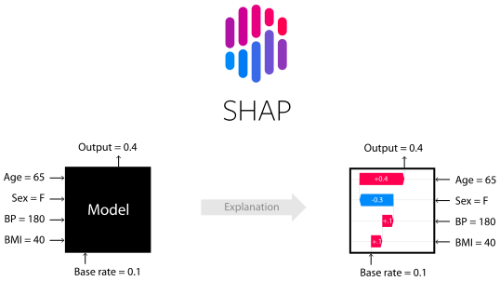
KEY TAKEAWAYS + INTERPRETATION
SHAP is a game theoretic approach to explain the interpretability of any machine learning model.
SHAP values describe how each feature of each input modifies a “base rate” to get the target value.
Generally, higher absolute values have higher impact on model output.
Image from SHAP Repository
Notes:
To interpret all of our models, we used a method called SHAP that uses principles from game theory to allocate *credit* to the input features for predicting the output.
It does this by starting with a base rate and adding/subtracting different contributions from each feature until the final sum equals the target value.
Naturally, features with higher absolute values have higher impact on the model’s output.

Slide 12
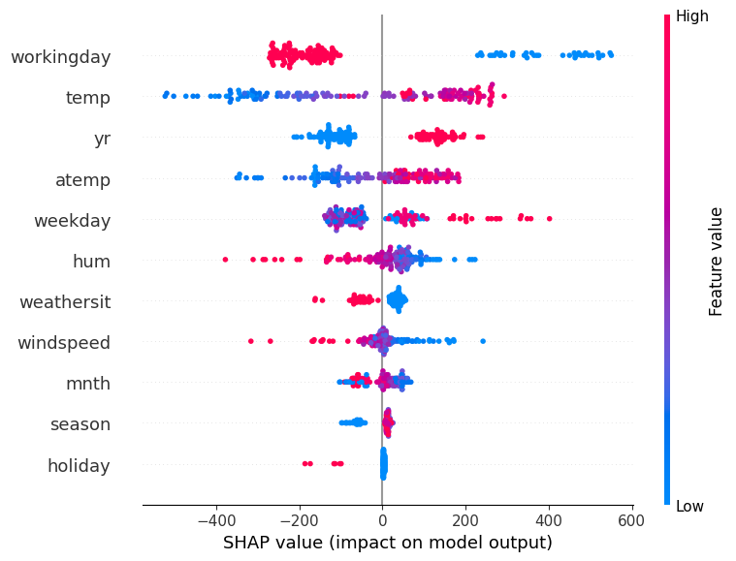
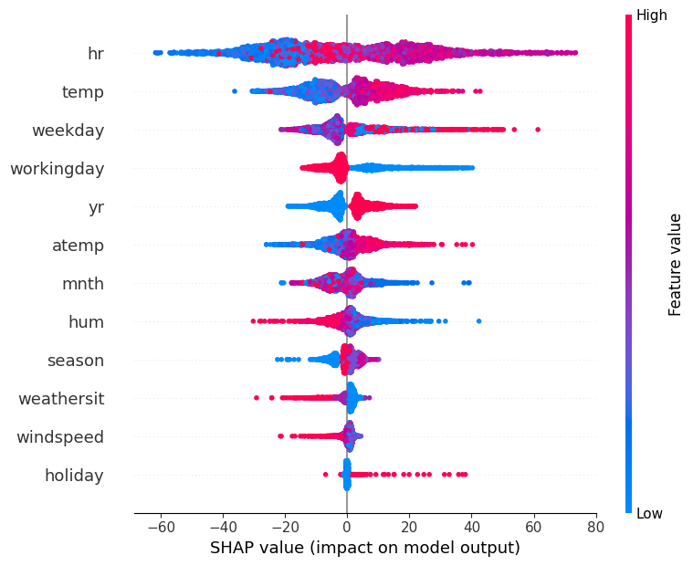
XGBOOST - CASUAL
Day
Hour
Notes:
Here are some sample SHAP summary plots.
Both the tree based models we considered give high priorities to similar features.
We see that daily casual rider count depends on factors like workingday, temperature, and humidity.
Workingday and weekday are highly correlated. And the year feature is important because ridership increased overall from 2011 to 2012.
For hourly data, the most important factor is naturally the hour of the day followed by the other factors we saw for daily data.

Slide 13
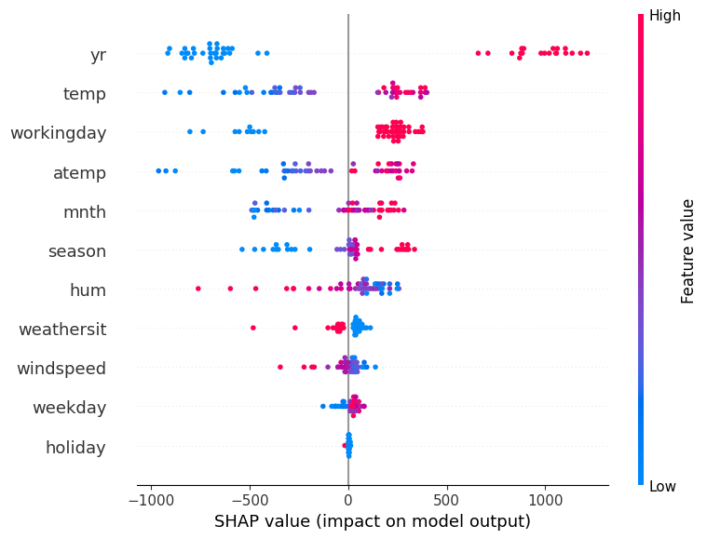
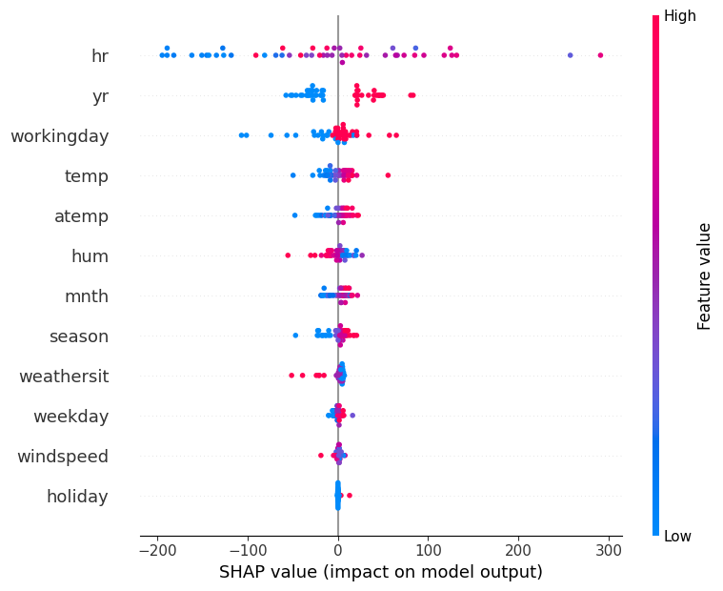
RANDOM FOREST - REGISTERED
Day
Hour
Notes:
Looking at registered riders, we see that the year feature is still high on the list.
Once again features like temp and workingday are important but it’s interesting to note that the yr feature is higher on the list than all these other factors. We also see features like month and season rising up the list. This is probably because registered users make a commitment to using bikes by purchasing annual memberships and follow through with regular bike usage.
We also notice that the holiday feature contributes the least and that’s probably because of how sparse the data is and how rarely it helps with predicting the target.

Slide 14
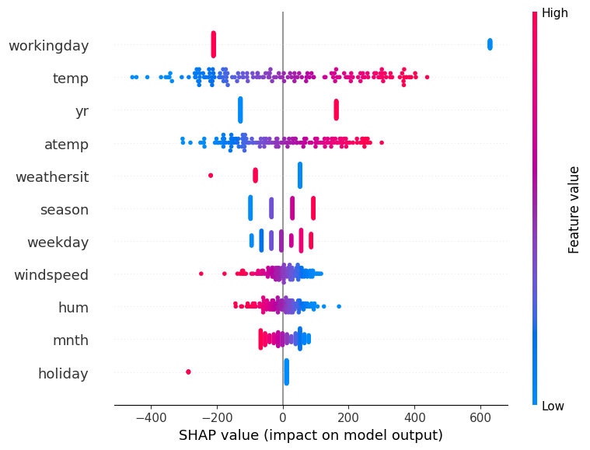
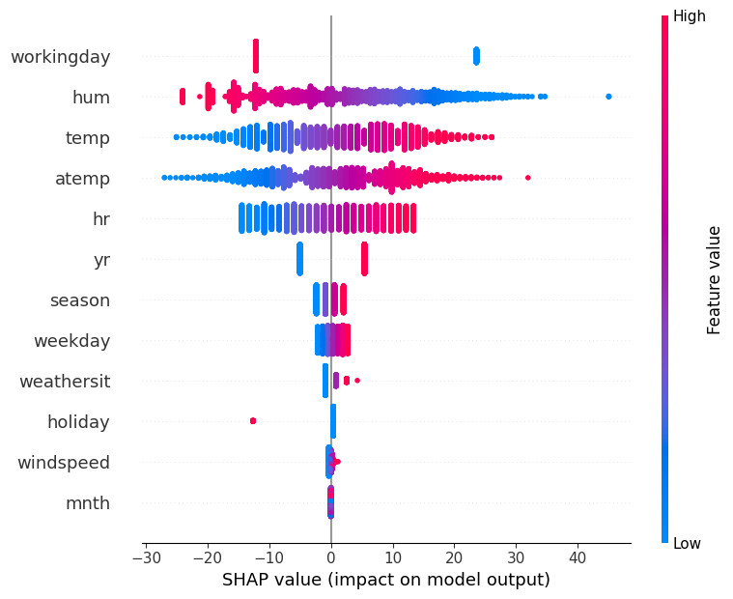
LINEAR REGRESSION - CASUAL
Day
Hour
Notes:
Next we look at the SHAP summary plot for the linear regression model.
It’s interesting to see how the binary variable “working day” is now at the top of the list and how the numeric features like weekday and month are lower. Weekday values, for example, are assigned from 1-7. These values make sense to us as categories but aren’t as useful to the linear model.

Slide 15
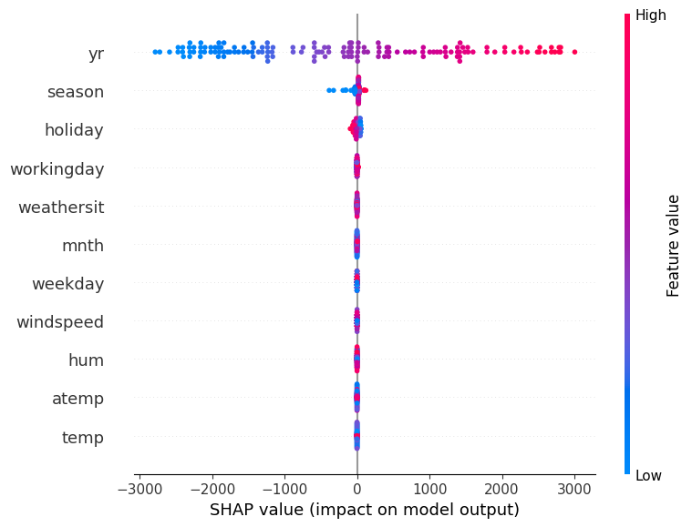
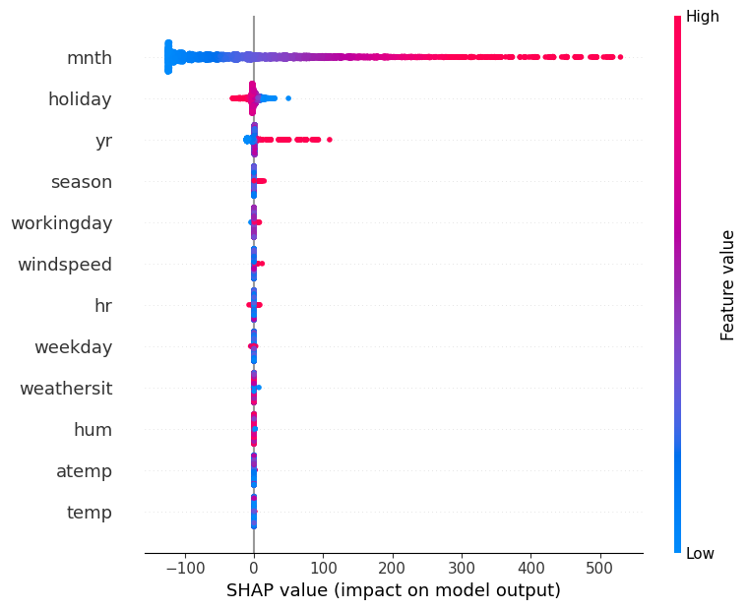
XGBOOST (PCA) - REGISTERED
Day
Hour
Notes:
Here’s the SHAP plot for XGBoost but with PCA applied to the input features to restrict information to the top two PCA components.
It’s interesting to see how almost all the information for predicting the model output comes from just about 2-3 input features.

Slide 16
KEY LIMITATIONS
DATASET
Size (2 years) limits training of yearly trend behavior
MODELS
TBATS is difficult to train and interpret
Hard to tell whether these models will perform on longer-duration data
Notes:
powell
limitations: not updating with time, data only for some seasons

Slide 17
FUTURE WORK
Continuously validating and updating the model as new data becomes available - the current model is dated at 2011, it is important to keep up with the current trends.
Real-time prediction capabilities - learn to adapt to sudden changes in demand.
Explore use of RL for optimizing bike-sharing operations over-time.
Integrate other data sources such as social media or locations information which can provide insights into user behaviour, sentiments and preferences.
Using ensemble models to combine the inferences from different models could be interesting to see how the model can perform in comparison to the XGBoost model.
Model interpretation - Could explore other frameworks like LIME and ELI5.
Notes:
lakshya
Use the prophet model?

Slide 18
REFERENCES
Lichman, M.: UCI machine learning repository (2013). http://archive.ics.uci.edu/ml
M. Britton, ‘VINE: Visualizing statistical interactions in black box models’, arXiv [cs.LG], 01-Apr-2019.
A. Appice et al. (Eds.): ECML PKDD 2015, Part I, LNAI 9284, pp. 184–199, 2015. DOI: 10.1007/978-3-319-23528-8 12
G. Petneházi, ‘Recurrent neural networks for time series forecasting’, arXiv [cs.LG], 31-Dec-2018.
Notes:
lakshya

