Slide 1
CSS-321 • DATA ANALYTICS PROJECT
Review Trust Analyzer
Detecting Fake Product Reviews Using Machine Learning, Sentiment Analysis & Network Graph Analytics
Aswin M (2023BCS0012) • Divon John (2023BCS0024)
Mahadev P Nair (2023BCS0018) • Zewin Jos (2023BCS0063)
Department of Computer Science | 2026

Slide 2
01
Problem Statement
Why fake review detection matters in modern e-commerce
● Online reviews are the primary trust signal for consumers — 93% of buyers read reviews before purchasing.
● Malicious actors generate fake reviews to artificially inflate or deflate product ratings for financial gain.
● Computer-generated (CG) fake reviews are becoming increasingly sophisticated and harder to spot manually.
● This undermines consumer trust, distorts fair marketplace competition, and damages platform credibility.
● Manual moderation at scale is infeasible — automated ML-based detection is essential.
$152B
30-40%
Fake review industry value
Reviews estimated to be fake
93%
4.7★
Consumers influenced by online reviews
Average fake ratings inflated
⚡ THE CHALLENGE
Can we build an automated system that accurately distinguishes genuine human reviews from computer-generated fake ones using text analysis, sentiment scoring, and behavioral pattern recognition?

Slide 3
02
Our Solution Overview
An end-to-end machine learning pipeline for fake review detection
🔍 Text Analysis
💡 Sentiment Engine
🌐 Network & Anomaly
NLP-driven feature extraction using TF-IDF vectorization, text cleaning, tokenization, stemming, and handcrafted linguistic features like review length, exclamation count, and capitalization ratio.
VADER sentiment scoring to detect emotional inconsistencies. A 5-star review with negative sentiment is a strong fake signal. We flag rating-sentiment mismatches as behavioral features.
Reviewer graph analysis to find co-review clusters (same product within 48hrs). Product-level Isolation Forest anomaly detection to flag coordinated review flooding.
🎯 APPROACH SUMMARY
We train and compare three classifiers — Naive Bayes, Logistic Regression, and Random Forest — on a unified 106-feature matrix combining TF-IDF terms with handcrafted behavioral indicators. The best model (Random Forest, 200 trees) achieves 85.9% accuracy with balanced precision and recall.

Slide 4
03
Dataset
Two complementary Kaggle datasets for robust training and validation
📦 Amazon Fine Food Reviews
120K
106
● Source: Kaggle (SNAP Stanford)
● 80,000 genuine reviews sampled for analysis
● Contains: text, rating, reviewer ID, product ID, timestamps
● Rich metadata enables network graph and anomaly analysis
Total reviews analyzed
Engineered features
5,000
80/20
TF-IDF vocabulary terms
Train-test split ratio
🤖 Fake Reviews Dataset
📋 KEY ATTRIBUTES
● Source: Kaggle (Mexwell)
● 40,000 reviews — both computer-generated and authentic
● Binary labels: CG (fake) vs OR (genuine)
● Primary dataset for training the fake review classifier
● text / text_ → Raw review content
● rating → Star rating (1–5)
● label → CG (Fake) or OR (Genuine)
● review_length, exclaim_count, caps_ratio
● sentiment_score, rating_mismatch

Slide 5
04
System Architecture
End-to-end system design — from raw data to live predictions
Raw Data (CSV)
Preprocessing & EDA
Feature Engineering
Sentiment & Graph Analysis
Classification & Evaluation
Web App (Plumber API)
Amazon + Fake Reviews Kaggle
→
Cleaning, Tokenization, Stemming
→
TF-IDF + Handcrafted (106 features)
→
VADER + Network Clusters
→
NB, LR, Random Forest (Best: 85.9%)
→
Real-time prediction interface
⚙️ TECHNOLOGY STACK
R Language — Core analysis, statistical computing, modeling
tidyverse / tidytext — Data wrangling, text tokenization, TF-IDF
VADER — Sentiment analysis with compound scoring
igraph — Reviewer network graph construction & community detection
isotree — Isolation Forest for product-level anomaly detection
caret / randomForest / e1071 — ML model training, evaluation, hyperparameter tuning
Plumber — REST API serving predictions from trained models
HTML / CSS / JavaScript — Frontend web interface for real-time testing

Slide 6
05
Processing Pipeline
9-stage sequential R pipeline from raw data to model deployment
01
EDA
02
Preprocessing
03
Feature Extraction
Exploratory Data Analysis — rating distributions, review lengths, class balance checks
Text cleaning, lowercasing, URL removal, tokenization, stopword removal, Porter stemming
TF-IDF vectorization (5000 terms) + handcrafted features: review_length, exclaim_count, caps_ratio, avg_word_len
04
Sentiment Analysis
05
Topic Modeling
06
Graph Analysis
VADER compound scoring on all reviews. Flag rating-sentiment mismatches as behavioral features
Latent Dirichlet Allocation (LDA) with 8 topics to discover hidden review patterns
Co-review detection (same product within 48hrs), reviewer-reviewer network, community clustering
07
Anomaly Detection
08
Classification
09
Visualization
Isolation Forest at product level — flag products with abnormal review patterns (top 10%)
Train Naive Bayes, Logistic Regression, Random Forest on unified 106-feature matrix
Word clouds, confusion matrices, feature importance plots, model comparison charts

Slide 7
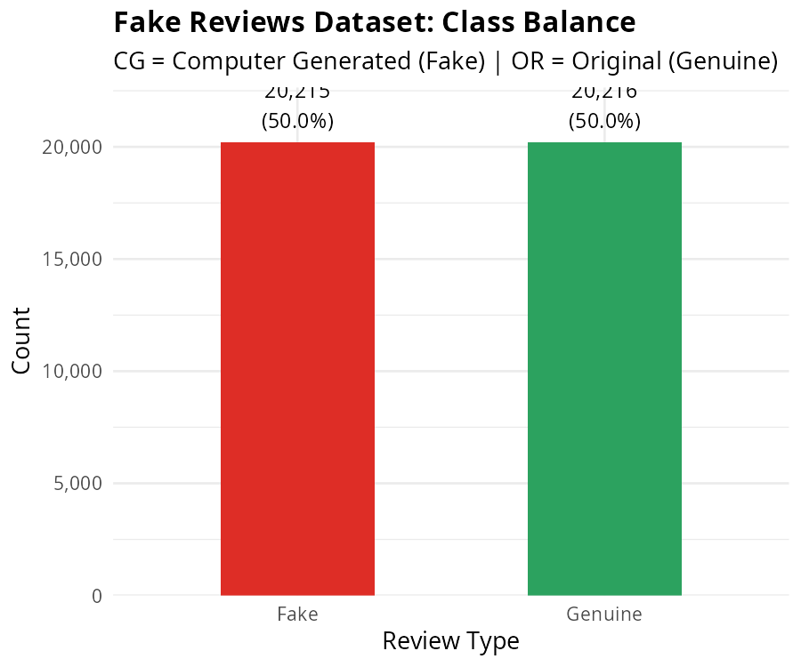
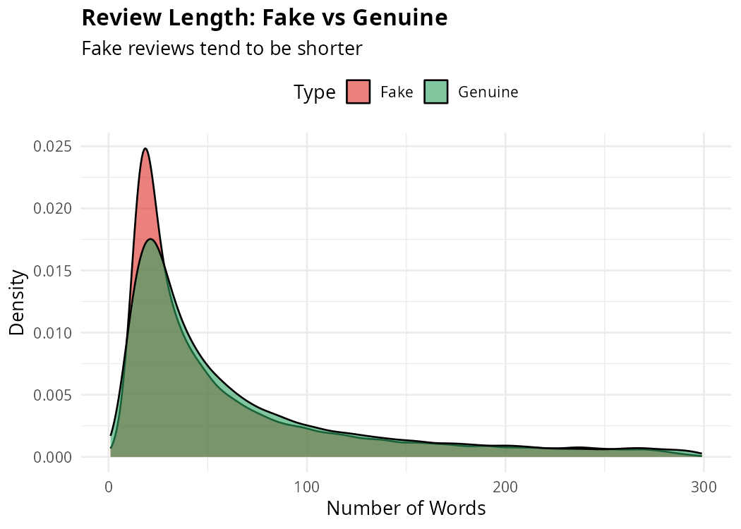
06
Pipeline Deep Dive — Stages 1–3
Data preprocessing, EDA, and feature engineering
📊 Exploratory Data Analysis
⚙️ Feature Engineering Pipeline
● Text Cleaning: Remove URLs, punctuation → lowercase
● Tokenization: Split into individual words
● Stopword Removal: Filter common English words
● Stemming: Porter stemmer reduces to root forms
● TF-IDF: Top 5,000 terms weighted by importance
● Handcrafted Features:
review_length → Word count of review text
exclaim_count → Number of '!' characters
caps_ratio → Uppercase letters / total chars
avg_word_len → Average word length in chars
sentiment_score → VADER compound score [-1, 1]
rating_mismatch → High rating + neg sentiment → flag

Slide 8
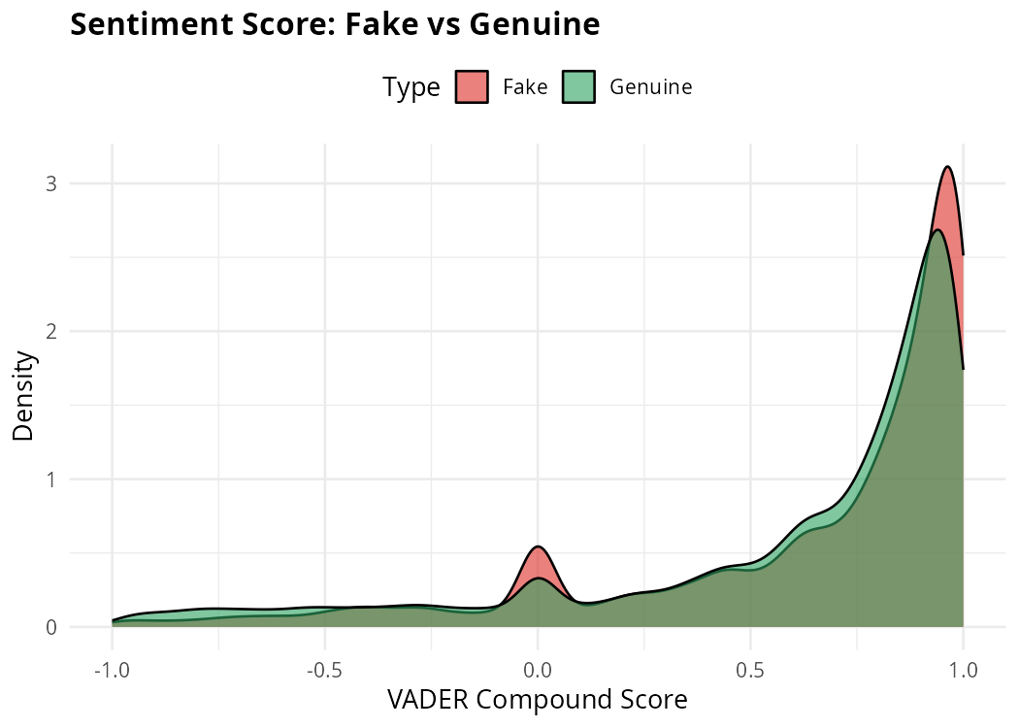
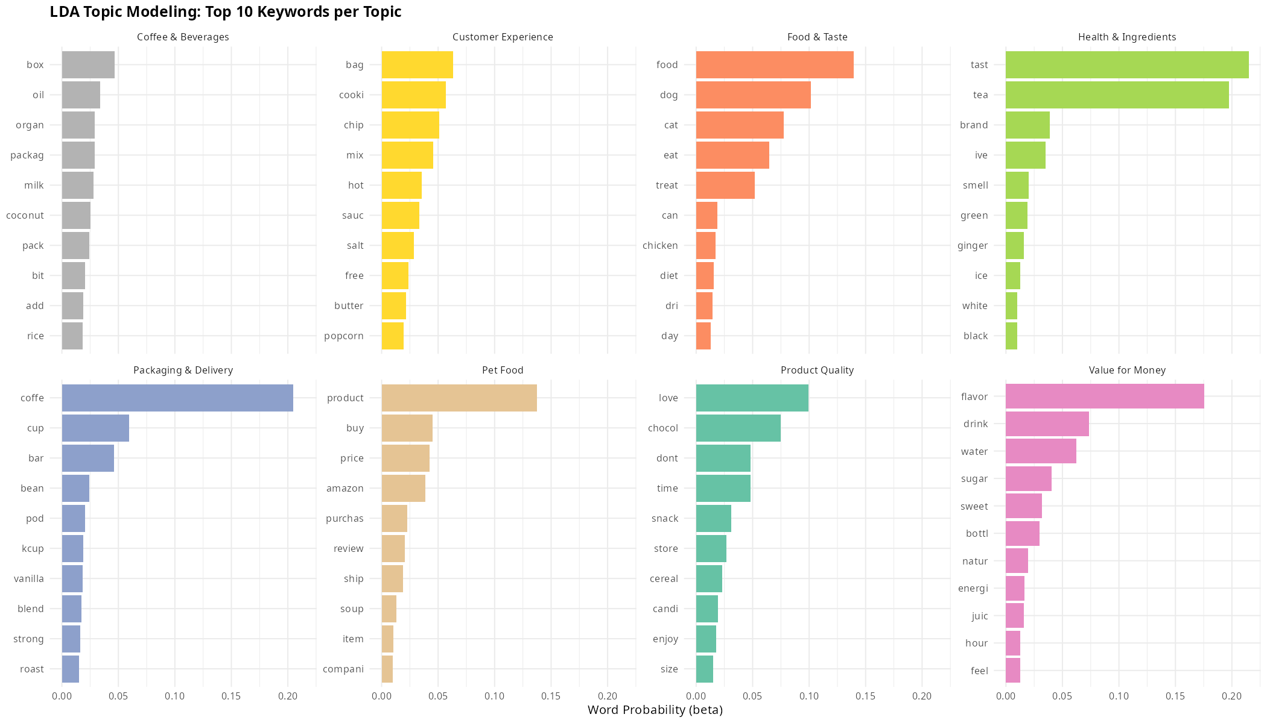
07
Pipeline Deep Dive — Stages 4–5
Sentiment analysis with VADER and topic modeling with LDA
💡 VADER Sentiment Analysis
📚 LDA Topic Modeling
● VADER: Valence Aware Dictionary for Sentiment Reasoning
● Compound score range: -1 (negative) to +1 (positive)
● Batch processing: 1000 reviews per batch with progress tracking
● Key insight: Fake reviews show different sentiment distributions
● Rating Mismatch Feature: 5★ review + negative sentiment → suspicious
● Latent Dirichlet Allocation with k=8 topics
● Discovers hidden thematic patterns in review text
● Reveals that fake reviews cluster around specific generic topics
● Genuine reviews show more specific, product-related vocabulary

Slide 9
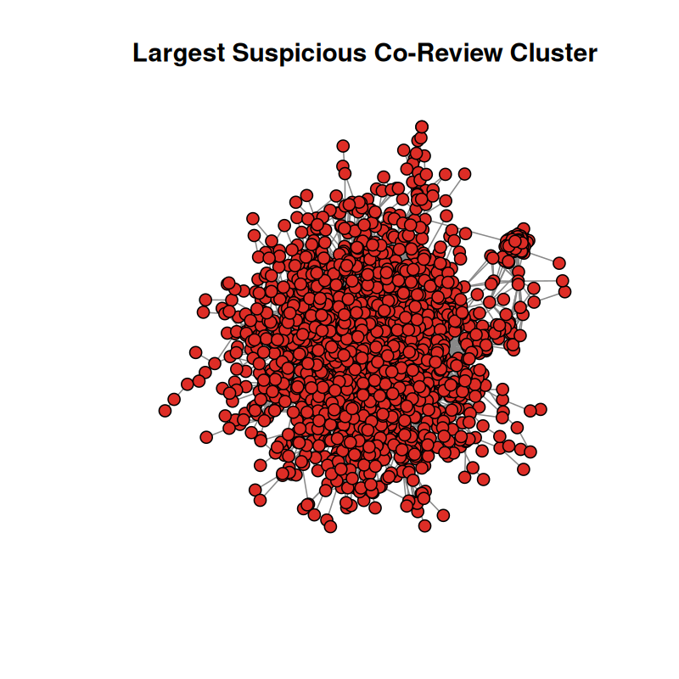
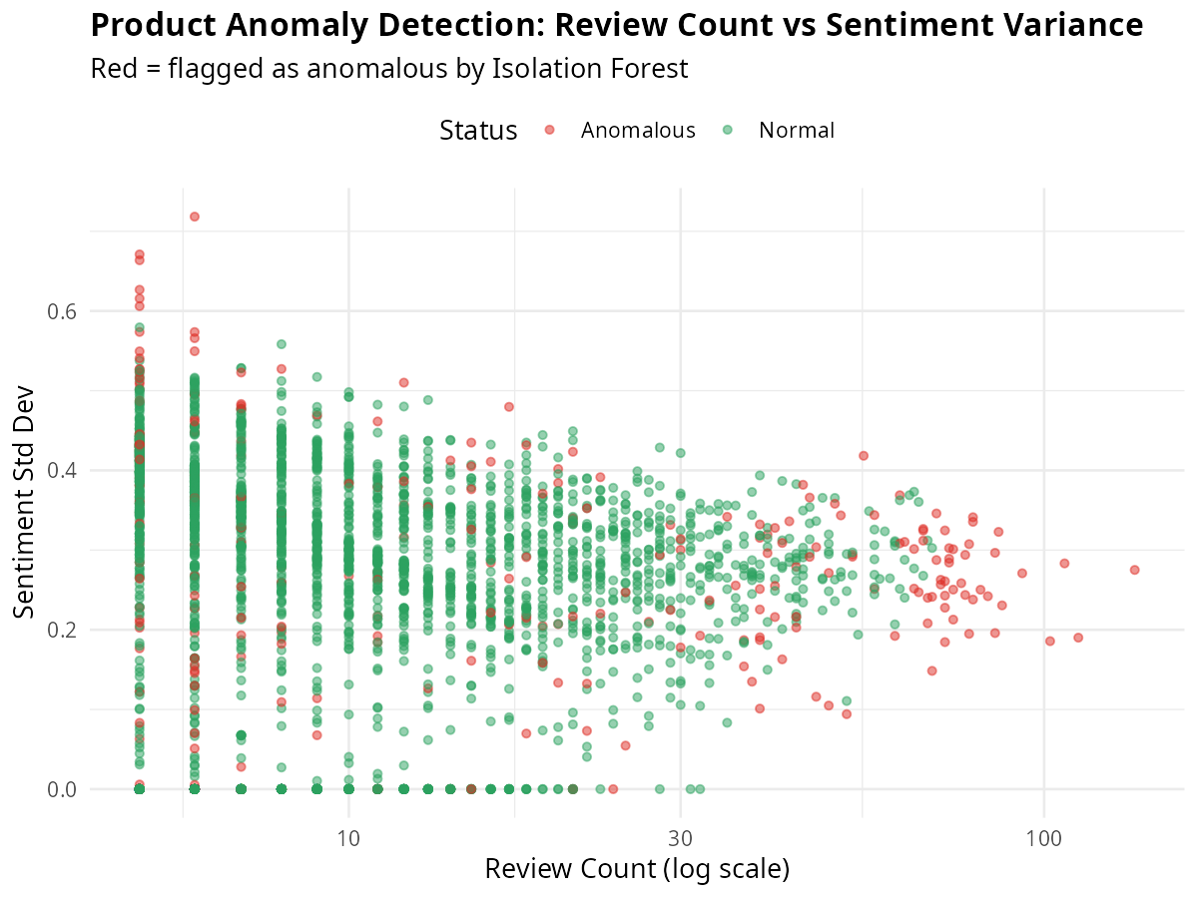
08
Pipeline Deep Dive — Stages 6–7
Network graph analysis and Isolation Forest anomaly detection
🌐 Reviewer Network Analysis
🔍 Isolation Forest Anomaly Detection
● Co-review detection: Reviews on same product within 48 hours
● Builds reviewer↔reviewer edges weighted by shared activity
● Connected component analysis to find suspicious clusters
● Clusters with >3 members flagged as coordinated fraud rings
● Features: five_star_ratio, review_velocity, burst_score
● Product-level aggregation: review_count, avg_rating, rating_variance
● Isolation Forest with 100 trees, contamination threshold at 90th %ile
● Detects products with statistically abnormal review patterns
● Top 10% most anomalous products flagged automatically
● Flags coordinated review flooding on specific products

Slide 10
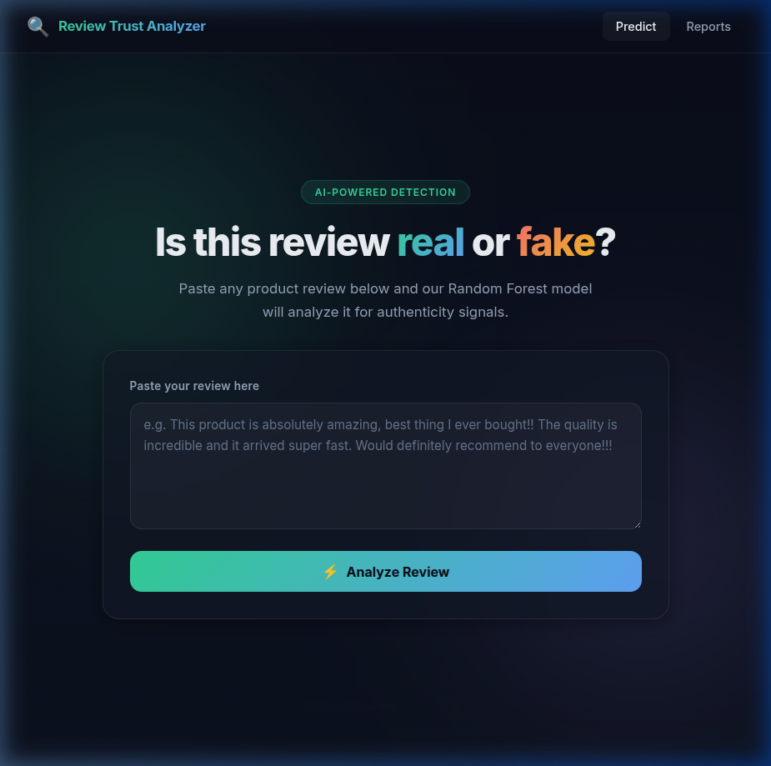
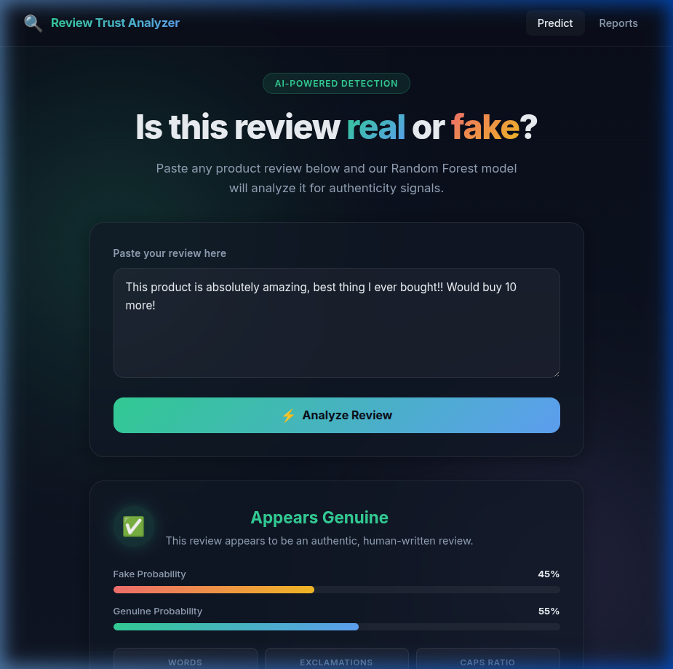
09
Output — Web Application
Real-time fake review prediction through a modern web interface
🖥️ Live Prediction Interface
● Users paste any review text and select a star rating
● Backend Plumber API processes the text through the full pipeline
● Returns prediction: Genuine or Fake with confidence percentage
● Displays individual feature scores (sentiment, length, caps ratio)
● Shows visual risk breakdown and trust score
● Built with modern HTML/CSS/JS — responsive design
API ENDPOINT
POST /predict → { text, rating } → { prediction, confidence, features }

Slide 11
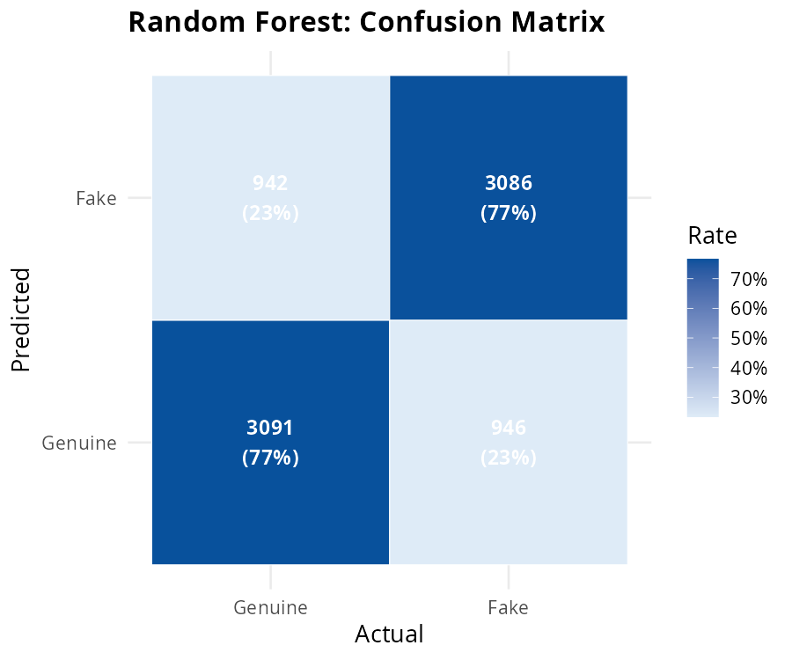
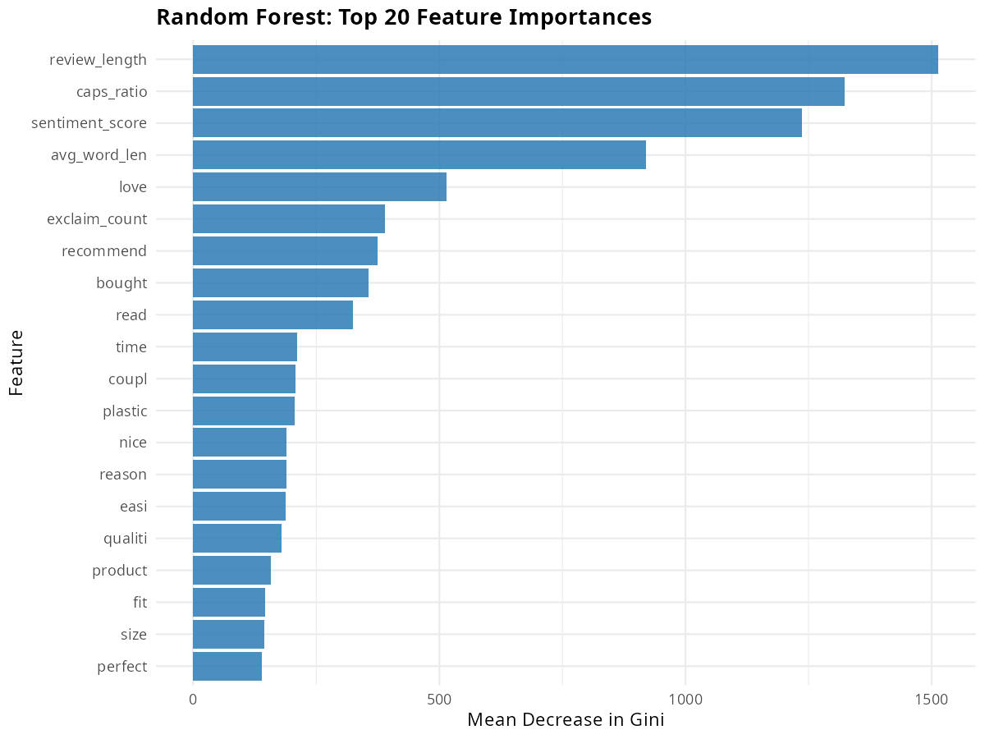
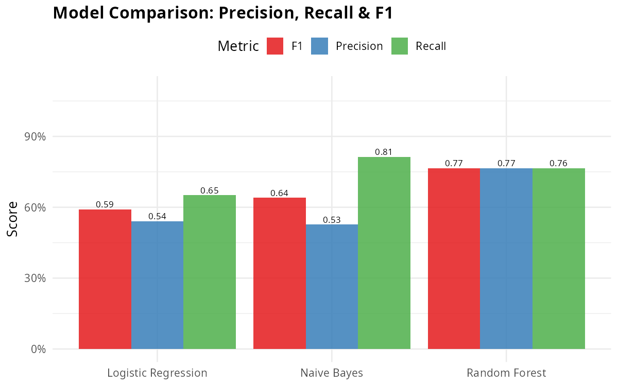
10
Model Evaluation
Confusion Matrix (RF)
Comprehensive performance comparison across three classifiers
📊 Performance Comparison
Model
Accuracy
Precision
Recall
F1-Score
Naive Bayes
0.668
0.694
0.584
0.634
Logistic Regression
0.685
0.664
0.767
0.712
Random Forest ★
0.859
0.857
0.862
0.860
🏆 Feature Importance (Random Forest)
📈 Model Comparison Chart

Slide 12
11
Novelty & Key Contributions
What makes our approach unique and impactful
🔗 Multi-Signal Fusion
🌐 Graph-Based Fraud Ring Detection
Unlike single-approach systems, we combine three distinct analysis dimensions — textual (TF-IDF + NLP), behavioral (sentiment mismatches), and structural (reviewer networks + anomaly detection) — into a unified 106-feature matrix.
Novel application of co-review temporal analysis with a 48-hour sliding window to construct reviewer-reviewer graphs and detect coordinated fake review campaigns using connected component analysis.
📊 Rating-Sentiment Mismatch Feature
🔍 Product-Level Isolation Forest
Innovative cross-modal feature engineering: flagging reviews where star ratings contradict VADER sentiment scores (e.g., 5★ review with negative text) as a powerful fake review signal.
Applying unsupervised anomaly detection at the product level rather than review level — detecting products with abnormal review patterns (flooding, unnatural rating distributions) that indicate coordinated manipulation.
🖥️ End-to-End Deployable System
Complete pipeline from raw data to live prediction via Plumber REST API with a modern web interface — making the research practically deployable, not just an academic exercise.

Slide 13
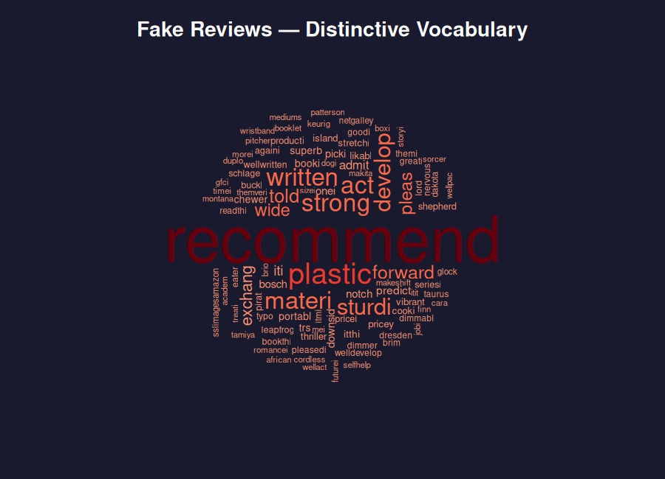
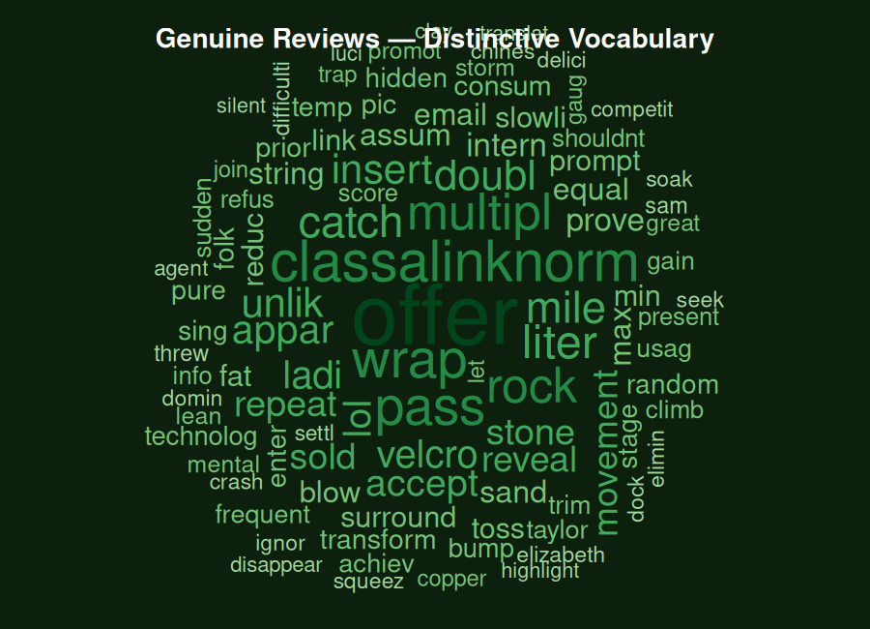
12
Word Cloud Insights
Visual comparison of language patterns in fake vs genuine reviews
🤖 Fake Reviews — Word Cloud
✅ Genuine Reviews — Word Cloud

Slide 14
13
Conclusion
Summary of findings and future directions
✅ Key Findings
🚀 Future Work
● Random Forest with 106 features achieved 85.9% accuracy — best among all models tested.
● Combining TF-IDF with behavioral features (caps, exclamations, sentiment) is more powerful than text alone.
● Rating-sentiment mismatch is one of the strongest fake review signals discovered.
● Graph analysis successfully identified coordinated fraud rings invisible to text classifiers.
● The end-to-end system is deployable via REST API for real-time fake review screening.
● Deep learning (BERT/transformers) for text classification
● Temporal pattern analysis with LSTMs
● Cross-platform generalization testing
● Explainable AI (SHAP/LIME) integration
● Large-scale production deployment
85.9%
106
120K
9 Stages
Best Accuracy (Random Forest)
Engineered Features
Reviews Analyzed
Complete Pipeline
Aswin M Feature Eng. + Random Forest + Anomaly Detection
Divon John Data Preprocessing + EDA + Web Frontend
Mahadev P Nair Sentiment + Topic Modeling + API
Zewin Jos NB + Logistic Regression Baselines

Slide 15
Thank You!
Review Trust Analyzer • CSS-321 • Team 1
Questions & Discussion
Aswin M • Divon John • Mahadev P Nair • Zewin Jos

