Slide 1
Robo-advisory portfolio design
Adwaaiit Pande & Ayushi Mishra
MBA680 Behavioral Finance · Assignment 2
EUT vs SP/A Behavioral Portfolio Theory, with personality
Notes:
[ADWAAIIT · 0:15 · clock 0:15]
Good morning, Professor. I'm Adwaaiit Pande, and this is Ayushi Mishra. We advised five classmates on their portfolios, then built a robo-advisor that does the job automatically. I'll cover how we measured preferences; Ayushi will cover the results and our advice.
[Ayushi nods at her name. Click.]

Slide 2
The answer first: three findings
1
2
3
EUT can't personalise this group
SP/A-BPT can, through loss aversion
Personality shapes the advice, not the weights
All five: 100% in the same tangency portfolio (13.2% return, 16.2% volatility), because every γ is below the market's price of risk (2.48).
A safety account (30–40% of capital, two-thirds in G-Secs) grows with λ. Kshitij, the only loss-averse client, gets the most protection and the least risk.
3 of 5 profiles are flagged (say-vs-do gap, straight-lining, inconsistent repeats) and need a human conversation first.
Scope: a five-person pilot of classmates, including both presenters. Assumed client profile: ₹1 crore corpus (from Problem 1), 5+ year horizon, no near-term liquidity needs. Goals and risk capacity were not surveyed.
Adwaaiit
Notes:
[ADWAAIIT · 0:35 · clock 0:50]
Let me give you the answer first. Three findings.
One: classical Expected Utility Theory can't personalise this group. All five of us end up 100% in the same equity portfolio.
Two: Behavioral Portfolio Theory can, through loss aversion. The safety account, mostly government bonds, grows from 30 to 40 percent.
Three: personality should shape how we advise, not the portfolio weights. Three of our five profiles need a human conversation before we invest.
One caveat up front: this is a five-person pilot, and both of us are in it.
[Touch each card as you count. Click.]

Slide 3
Six steps, three stages: measure, model, recommend
Brief: act as a personal investment adviser to a peer group, then automate it as a robo-advisory product
Step 5 inputs reused from Problem 1: 66 NSE stocks, 3-year covariance, rf 6.75%
Measure
Steps 2–3: survey risk, time and personality
Model
Step 4: Bayesian engine estimates
utility and value functions
Recommend
Steps 5–6: EUT vs SP/A-BPT portfolios, personality overlay
Adwaaiit
Notes:
[ADWAAIIT · 0:25 · clock 1:15]
Here's how we got there, in three stages. Measure, Steps 2 and 3: risk, time and personality. Model, Step 4: turn each person's choices into a utility and a value function. Recommend, Steps 5 and 6: build both portfolios on our Problem 1 universe of 66 NSE stocks, and add personality-aware advice.
[Point to the three chevrons left to right. Click.]

Slide 4
Only the choice task yields the parameters both theories need
WHY NOT ONE STANDARD SURVEY?
  One score can't give γ, λ, time preference or a plottable utility function
EVERY PART HAS A JOB
  Benchmark, context, personality, parameters
SAY VS. DO
  Scales show what people say; choices show what they do
INSTRUMENT | ITEMS | MEASURES | WHY WE NEED IT
Self-rating anchors | 2 | Risk, patience (0–10) | Say-vs-do check
Grable & Lytton (1999) | 13 | Financial risk tolerance | Industry benchmark
DOSPERT financial (Blais & Weber, 2006) | 6 | Investing vs. gambling | Risk-taking is context-specific
BFI-2 (Soto & John, 2017) | 60 | Big Five, 15 facets | Step 3; flags careless answers
Adaptive choice engine (ours) | 18 + 2 | γ, λ, α, β, δ | Only source of the parameters
About 100 items in one sitting, 20–25 minutes.
Adwaaiit
Notes:
[ADWAAIIT · 1:30 · clock 2:45]
Why build a five-part survey, instead of one standard questionnaire? Because one questionnaire can't give us what the brief asks for.
A standard risk questionnaire gives you one score, say '40, High'. But for Step 4 we need an actual utility function we can draw. For Step 5 we need two separate numbers: gamma, which is risk aversion, for the EUT portfolio, and lambda, which is loss aversion, for the behavioral one. One score gives you neither, and it can't tell them apart.
So each part has a job. The self-ratings and the Grable–Lytton scale, the one advisers actually use, tell us how people see themselves. DOSPERT separates investing from gambling. The 60-item BFI-2 gives personality, and it's long enough to catch careless answers. And our choice engine is the only part that gives us the parameters, from real decisions, because nobody knows their own gamma.
The real payoff is the cross-check. The scales show what people say. The choices show what they do. Where those two disagree is where an adviser needs to step in.
[First paragraph: face the examiner. Then run your hand down the table rows. Click.]

Slide 5



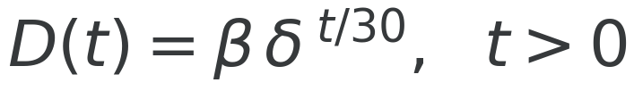

Twenty adaptive choices pin down five parameters
FIVE PARAMETERS, ONE MODEL
γ risk aversion
λ loss aversion
α probability weighting
β, δ present bias, patience
EACH OF 18 QUESTIONS
  A gamble vs. a sure amount, or now vs. later
  Mixed gain/loss gambles separate λ from γ
  Bayes update over 7,776 combinations; next question = most informative
  2 hidden repeats test consistency; Empirical-Bayes pooling
Adwaaiit
Kahneman & Tversky (1979); Prelec (1998); Laibson (1997); Toubia et al. (2013)
Notes:
[ADWAAIIT · 0:45 · clock 3:30]
Here's how the engine works. Every question is a choice: a gamble or a sure amount, money now or more money later. Some gambles mix a gain and a loss, and that's what separates loss aversion from risk aversion.
One model scores every answer with five parameters: gamma, lambda, alpha for how people weigh probabilities, and beta and delta for present bias and patience. After each answer the engine updates its beliefs and asks the most informative next question, so twenty questions are enough. Two of them are hidden repeats that check consistency.
[Point to the equations top right, then the list bottom right. Click.]

Slide 6
Step 4: Kshitij is the outlier
Shree Charan
Kshitij
Kartika
Ayushi
Adwaaiit Pande
Adwaaiit
Curves from pooled parameters. Kahneman & Tversky (1979); Prelec (1998); Laibson (1997)
Notes:
[ADWAAIIT · 1:10 · clock 4:40]
These four graphs are the visuals Step 4 asks for, and one person stands out on all of them.
Top left, utility. Shree Charan, Ayushi and I overlap at a gamma of about 2.2: moderate risk aversion by finance standards, but the most cautious in our group. Kartika is close to neutral. Kshitij is the outlier: his curve bends upward, so he's risk-seeking.
Top right, the value function. Kshitij is again the only loss-averse one: a loss hurts him 1.6 times as much as an equal gain.
Bottom left, probability weighting. Kshitij and Shree Charan overweight long shots: a 5% chance feels like 21% and 16%.
Bottom right, patience. Kshitij is the most impatient. I'm the most patient, even though I rated my own patience 4 out of 10.
Ayushi will show what this means for each portfolio.
[Move clockwise from top left. Hand the clicker to Ayushi. Click.]

Slide 7
Results
& advice
Notes:
[AYUSHI · 0:05 · clock 4:45]
Thanks, Adwaaiit. So what should each of them hold?
[Click straight on.]

Slide 8
Three of five profiles carry a flag an adviser must act on
RESPONDENT | GRABLE-LYTTON | SELF RISK / PATIENCE | γ | λ | RETEST | FLAG
Shree Charan | 27 | 7 / 7 | 2.21 | 1.000 | 1.0 | BFI-2 exactly 3.00 on all five domains
Kshitij | 31 | 3 / 6 | -0.50 | 1.600 | 1.0 | —
Kartika | 31 | 4 / 7 | 0.20 | 1.000 | 1.0 | —
Ayushi | 35 | 7 / 7 | 2.21 | 1.009 | 0.5 | Hidden repeats inconsistent (0.5)
Adwaaiit Pande | 40 | 10 / 4 | 2.19 | 1.015 | 1.0 | Says risk 10/10; choices give γ 2.2
γ and λ drive the portfolios (pooled by Empirical Bayes). Kshitij's γ = −0.50 is floored to 0.05 for portfolio maths. α, β, δ are on the Step 4 graphs.
Pilot sample: five classmates, including both presenters.
Ayushi
Notes:
[AYUSHI · 0:35 · clock 5:20]
This table has all five of us. The two numbers that drive the portfolios are gamma and lambda. The column to watch is the last one: three of five profiles are flagged. Shree Charan answered exactly 3 on every personality domain, probably clicking through. My own repeat answers were inconsistent. And Adwaaiit says he's a 10-out-of-10 risk-taker, but his choices say otherwise. We report these flags rather than hide them.
[Point to the amber cells, top to bottom. Click.]

Slide 9
EUT: all five, 100%, one portfolio
100%
in equities for all five, in the same tangency portfolio (66 stocks, none above 10%): 13.24% return, 16.17% volatility
Robustness: risky share vs. market price of risk
λ_MKT | MKT SHARPE | γ ≈ 2.2 (×3) | KARTIKA, KSHITIJ
1.5 | 0.24 | 67–68% | 100%
2.0 | 0.32 | 90–91% | 100%
2.5 (base) | 0.40 | 100% | 100%
3.0 | 0.48 | 100% | 100%
Also conditional on γ: the engine identifies γ only as above ~1 (at γ = 3.0 the share is 83%), and γ comes from small-stakes choices (Rabin, 2000).
Shree Charan
Kshitij
Kartika
Ayushi
Adwaaiit
Three dots overlap near γ = 2.2 (Shree Charan, Ayushi, Adwaaiit).
Ayushi
Two-fund separation; He & Litterman (1999); Rabin (2000). Sharpe = λ_mkt × σ_mkt (σ ≈ 16%)
Notes:
[AYUSHI · 0:55 · clock 6:15]
Step 5, first under Expected Utility Theory. Under EUT, everyone holds the same equity portfolio, with no stock above 10%; only the split between it and government bonds is personal. That split is the market price of risk, about 2.5, divided by gamma. Every gamma in our group is below 2.5, so all five of us hit the 100% cap: same portfolio, 13.2% expected return, 16.2% volatility. EUT simply can't tell us apart.
How robust is that? It depends on the market price of risk, in the table. At 2.0, the three of us near 2.2 would hold about 90% equity; at 1.5, about 68%. So the all-in result is partly our assumption, and we say so.
[Trace the flat line at 100%, then the bend at 2.5. Then point to the robustness table. Click.]

Slide 10
SP/A-BPT personalises the mix through loss aversion
RESPONDENT | λ | SAFETY | G-SECS | RETURN | VOL.
Shree Charan | 1.000 | 30.0% | 19.9% | 14.25% | 20.50%
Kshitij | 1.600 | 40.0% | 26.6% | 13.49% | 18.28%
Kartika | 1.000 | 30.0% | 19.9% | 14.25% | 20.50%
Ayushi | 1.009 | 30.2% | 20.0% | 14.24% | 20.47%
Adwaaiit | 1.015 | 30.3% | 20.1% | 14.23% | 20.44%
We fixed our first model. It had an all-equity safety layer and no stock limits: 27–29% volatility, 42% in one stock. Now G-Secs sit in the safety account (Telser rule: a loss in at most 1 year in 20) and every stock is capped at 10%: 18–21% volatility, 7.6% top stock.
Still above EUT's 16.2%: EUT is pinned at 100% equity. Unconstrained, it would hold 112–114% (≈18.3% volatility).
Ayushi
Das, Markowitz, Scheid & Statman (2010); Telser (1955); Roy (1952)
Notes:
[AYUSHI · 0:55 · clock 7:10]
Behavioral Portfolio Theory does tell us apart. Each person gets two mental accounts. The safety account holds government bonds and some equity, sized so it loses money in at most one year in twenty. The aspiration account chases a 15% target, with every stock capped at 10%. Loss aversion decides the split: 30% in safety at a lambda of 1, rising to 80% at 4. Kshitij, our only loss-averse investor, gets the most bonds and the lowest risk.
Our first version got this wrong: no bonds, no caps, 27 to 29% volatility. This fixes it. BPT is still above EUT's 16%, but only because EUT is stuck at 100% equity.
[Point to Kshitij's bar, then the 'We fixed our first model' card. Click.]

Slide 11
What we would tell each client
Per ₹1 crore. EUT gives every client the same answer: 100% in the tangency portfolio (13.2% return, 16.2% vol). SP/A-BPT splits each client's money:
Kshitij
Kartika
Shree Charan
Ayushi
Adwaaiit
Loss-averse (λ 1.6), risk-seeking in gains, most impatient
Near risk-neutral; gambling appetite above investing (6.67 vs 4.67)
Overweights long shots (α 0.57); flat BFI-2 profile
Open to new framing (Openness 4.0); inconsistent repeats
Says 10/10 risk, chooses γ 2.2; most patient
SAFETY · ASPIRATION
SAFETY · ASPIRATION
SAFETY · ASPIRATION
SAFETY · ASPIRATION
SAFETY · ASPIRATION
₹40.0L · ₹60.0L
₹30.0L · ₹70.0L
₹30.0L · ₹70.0L
₹30.2L · ₹69.8L
₹30.3L · ₹69.7L
G-Secs: ₹26.6L
13.5% return · 18.3% vol
G-Secs: ₹19.9L
14.3% return · 20.5% vol
G-Secs: ₹19.9L
14.3% return · 20.5% vol
G-Secs: ₹20.0L
14.2% return · 20.5% vol
G-Secs: ₹20.1L
14.2% return · 20.4% vol
Frame advice in drawdown terms; use SIPs and lock-ins to curb impatience.
Automate rebalancing; ring-fence speculation inside the aspiration sleeve.
Re-run the BFI-2 before finalising; cap lottery-type picks.
Confirm preferences in a five-minute follow-up before investing.
Discuss the say-vs-do gap before going all-in; long horizon suits him.
Ayushi
Notes:
[AYUSHI · 1:05 · clock 8:15]
So what would we actually tell each person? Per one crore rupees.
Kshitij: 40 lakh in safety, about 27 lakh of it in government bonds. He's loss-averse and impatient, so we'd frame everything in terms of drawdowns, and use SIPs to curb his impatience.
Kartika: 30 lakh in safety. She gambles more than she invests, so we'd automate her rebalancing and ring-fence the gambling urge inside the aspiration sleeve.
Shree Charan: 30 lakh in safety, but we'd re-run his personality survey before finalising anything.
For me, just over 30 lakh, after a five-minute follow-up to confirm my answers.
And Adwaaiit: just over 30 lakh. His words and his choices disagree, so we'd talk before he goes all-in.
[Move left to right across the five cards. Click.]

Slide 12
Personality should shape the advice, not the weights
Principle: personality changes how we advise and how much we trust the numbers; γ and λ alone set the weights.
NEGATIVE EMOTIONALITY × λ
SAY VS. DO GAPS
Both high → lead with drawdown alerts and reassurance. They disagree → human follow-up.
Self-report far from revealed γ → a short conversation before investing, never a silent average.
None of our five crosses the 3.5 threshold; the rule is built in for a larger cohort.
Adwaaiit: risk 10/10, top Grable-Lytton score (40), yet γ ≈ 2.2.
DATA-QUALITY SIGNALS
OPENNESS & CONSCIENTIOUSNESS
Flat BFI-2 or low retest → lower confidence: re-survey, or a more conservative default.
Openness → comfort with two mental accounts. Conscientiousness → will they keep rebalancing?
Shree Charan: 3.00 on all five domains. Ayushi: retest 0.5.
Kartika: open (3.17) but less conscientious (2.83) → automate rebalancing.
Ayushi
BFI-2: Soto & John (2017)
Notes:
[AYUSHI · 0:45 · clock 9:00]
That's Step 6 in action. Our principle: personality changes how we advise and how much we trust the numbers, never the weights. Four rules. Anxiety plus loss aversion means lead with drawdown alerts. A say-do gap means talk before investing. Careless or inconsistent answers mean re-survey, or start conservative. And openness and conscientiousness tell us whether a client will accept two accounts and stick to rebalancing. None of our five crossed the anxiety threshold, but the rule is built in.
[Touch each card in turn. Click.]

Slide 13
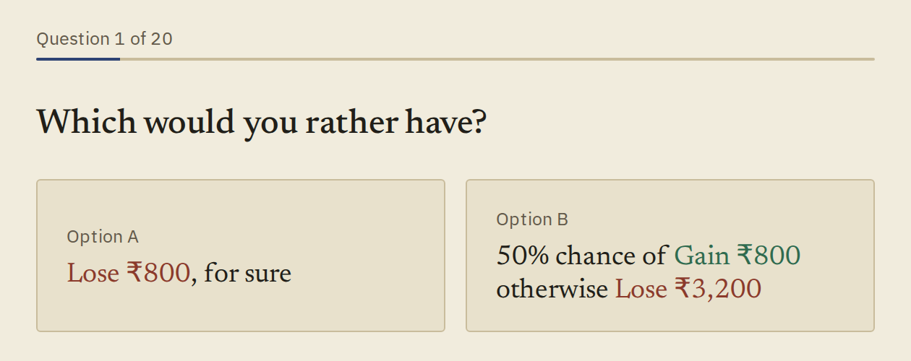
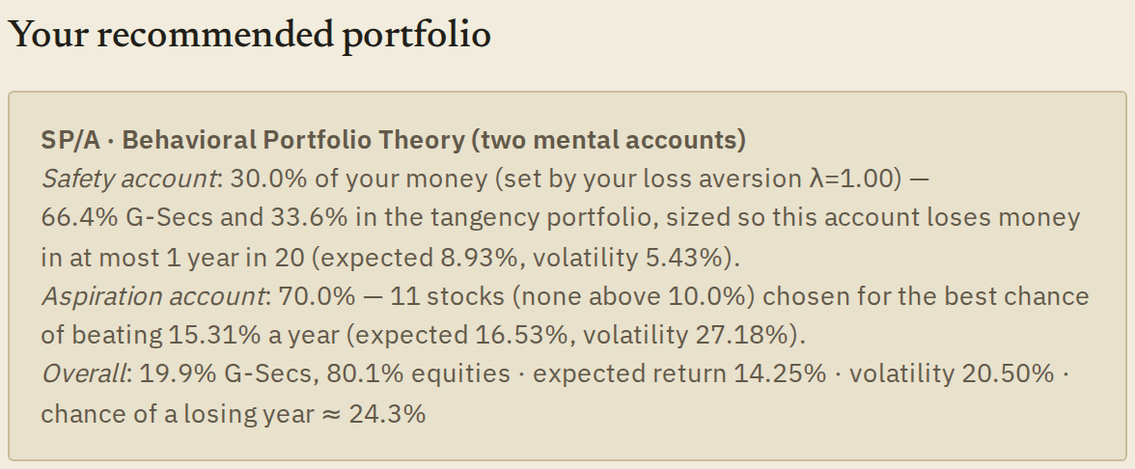
A working robo-advisor: survey to portfolio in one sitting
1
Client takes the survey
4 scales + 20 adaptive choices, 20–25 minutes
2
Instant, in-browser result
EUT and BPT portfolios, the client's own utility and value curves, personality-aware advice
3
Evaluator view
All five clients, every instrument and the full maths pre-loaded (#evaluate)
Production roadmap: adaptive engine + 15-item BFI-2-XS + goals, horizon and income questions → onboarding under 10 minutes, in line with SEBI risk profiling.
Live: mba680-robo-advisor.vercel.app · matches our Python model to 5 decimals
Ayushi
Notes:
[AYUSHI · 0:30 · clock 9:30]
Deliverable (b): a working robo-advisor, live on Vercel. A client answers the survey, and the moment they finish, the browser shows their EUT and BPT portfolios, their own curves and personalised advice. It matches our Python model to five decimals. In production we'd cut onboarding to under ten minutes and add goals, horizon and income.
[Point to the two screenshots, then the roadmap card. Click.]

Slide 14
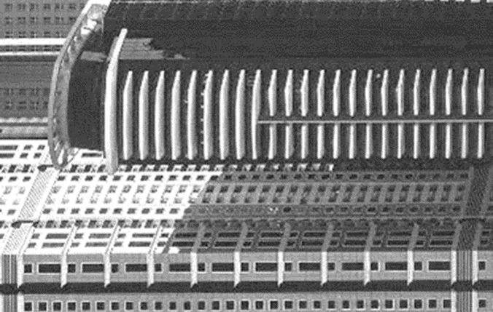
Summary
EUT alone can't personalise a young, risk-tolerant group: all five get 100% of the same portfolio.
SP/A-BPT can, through loss aversion: a bond-backed safety account that grows with λ; stocks capped at 10%.
Personality belongs in how advice is delivered and how much the numbers are trusted.
Next: goals & risk capacity
Sector caps, fat-tail rule
Larger stakes to pin down γ
Bigger, independent sample
Ayushi
Notes:
[AYUSHI · 0:20 · clock 9:50]
To sum up. EUT can't personalise a young, risk-tolerant group. BPT can, through loss aversion, with a bond-backed safety account and capped stock positions. And personality belongs in how advice is delivered.
[Click.]

Slide 15

Thank you
Adwaaiit Pande · Ayushi Mishra
Robo-advisory portal:
mba680-robo-advisor.vercel.app
Questions?
Scan: full project view
Notes:
[BOTH · 0:10 · clock 10:00]
AYUSHI: Thank you.
ADWAAIIT: The QR code opens the full project. We're happy to take questions.
[Both face the examiner. Leave this slide up through Q&A.]

