Slide 1
MT OFFTAKE PERFORMANCE REPORT
SUMMARY & KEY INSIGHTS JUNE’26 + Q1 FY27
Jun'26 NSV
May'26 NSV
L3M Avg
YoY Growth
₹ 38.24 Cr
₹ 40.26 Cr
₹ 36.16 Cr
68.4%
Best-ever June NSV
MoM ▼ 5%
GO L3M ▲ 6%
▲ ₹ 15.53 Cr
Monthly and Top-3 Chain NSV Sales Trend
Jun’26 Chain Sales Contribution % & Sales
Jun'26 NSV closed at Rs. 38.24 Cr up ▲ 68% YoY and ▲ 5.7% vs L3M Avg, adding +1,553 Lacs YoY — best-ever June on corrected chain NSV, despite a seasonal ▼5% MoM off the May record.
Q1 FY27 closed at ₹114.39 Cr, ▲ 64% vs Q1 FY26 (₹69.92 Cr) — every zone grew ≥55% (South-1 ▲84%); 2-yr Q1 CAGR of +44% confirms structural scale.
Dmart, Reliance and Apollo delivered 81.8% of Jun'26 offtake — concentration steady vs May; Walmart CNC billed nil in Jun (watch-out).
The Derma Co. remain the growth engines & Mamaearth holds 71.8% portfolio share.
Chain-wise Monthly Performance Snapshot
Chain | Jun-25 | Feb-26 | Mar-26 | Apr-26 | May-26 | Jun-26 | Cont% | L3M Avg(MAM) | GOLY | MOM
 |  |  |  |  |  |  |  |  | Jun
Dmart | 856 | 928 | 1,225 | 1,258 | 1,518 | 1,456 | 38% | 1,334 | ▲ 70% | ▼ 4%
Reliance | 592 | 756 | 804 | 868 | 990 | 948 | 25% | 887 | ▲ 60% | ▼ 4%
Apollo | 275 | 512 | 570 | 699 | 751 | 723 | 19% | 673 | ▲ 163% | ▼ 4%
Fsn | 164 | 168 | 173 | 229 | 208 | 217 | 6% | 203 | ▲ 32% | ▲ 4%
Wellness | 74 | 85 | 98 | 110 | 102 | 80 | 2% | 103 | ▲ 8% | ▼ 21%
H&G | 82 | 49 | 50 | 62 | 87 | 52 | 1% | 66 | ▼ 37% | ▼ 41%
Lulu | 43 | 70 | 78 | 101 | 116 | 116 | 3% | 98 | ▲ 169% | ▼ 0%
Metro | 44 | 48 | 53 | 48 | 48 | 61 | 2% | 49 | ▲ 39% | ▲ 28%
Delhi RMT | 36 | 28 | 42 | 58 | 46 | 40 | 1% | 49 | ▲ 11% | ▼ 14%
More Retail | 34 | 38 | 45 | 45 | 55 | 44 | 1% | 48 | ▲ 28% | ▼ 21%
Walmart | 20 | 17 | 19 | 26 | 11 | 0 | 0% | 19 | ▼ 100% | ▼ 100%
Spencer | 15 | 14 | 12 | 12 | 12 | 8 | 0% | 12 | ▼ 43% | ▼ 29%
Vmm | 12 | 15 | 25 | 28 | 37 | 31 | 1% | 30 | ▲ 156% | ▼ 18%
Others Combined | 24 | 33 | 40 | 47 | 44 | 49 | 1% | 44 | ▲ 104% | ▲ 11%
Total Channel | 2,271 | 2,761 | 3,234 | 3,589 | 4,026 | 3,824 |  | 3,616 | ▲ 68% | ▼ 5%
1 / 20

Slide 2
Q1 FY27 SCORECARD — OFFTAKE
Apr–Jun’26 vs Apr–Jun’25 | NSV ₹ Lacs | MT + EB2B
Q1 FY27 NSV
₹ 114.39 Cr
Q1 GROWTH
▲ 63.6%
BEST MONTH
May’26 ₹ 40.26 Cr
JUN’26
₹ 38.24 Cr | ▲68%
ZONE VIEW
Zone | Q1 FY26 | Q1 FY27 | Growth | Mix
East | 701 | 1,173 | ▲ 67% | 10%
North | 1,583 | 2,641 | ▲ 67% | 23%
South-1 | 1,356 | 2,489 | ▲ 84% | 22%
South-2 | 952 | 1,576 | ▲ 66% | 14%
West | 1,877 | 2,905 | ▲ 55% | 25%
Pan India (FSN) | 523 | 653 | ▲ 25% | 6%
TOTAL | 6,992 | 11,439 | ▲ 64% | 100%
TOP CHAINS
BRAND VIEW
Chain | Q1 FY26 | Q1 FY27 | Growth | Mix
D-Mart | 2,600 | 4,232 | ▲ 63% | 37%
Reliance | 1,908 | 2,806 | ▲ 47% | 25%
Apollo | 793 | 2,173 | ▲ 174% | 19%
FSN | 523 | 653 | ▲ 25% | 6%
Lulu | 124 | 333 | ▲ 169% | 3%
Wellness | 249 | 291 | ▲ 17% | 3%
Brand | Q1 FY26 | Q1 FY27 | Growth | Mix
Mamaearth | 6,142 | 8,254 | ▲ 34% | 72%
The Derma Co. | 634 | 2,951 | ▲ 365% | 26%
Aqualogica | 169 | 196 | ▲ 16% | 2%
Other Brands | 44 | 36 | ▼ 18% | 0%
Leadership takeaway: The Derma Co. contributed ₹29.5 Cr and 66% of Q1 growth; D-Mart, Reliance and Apollo delivered 81.8% of June offtake.
Source: MT offtake workbook | Q1 FY27 scorecard
2 / 20

Slide 3
GROWTH IS BROAD-BASED ACROSS BRANDS AND ZONES
June’26 offtake reached ₹38.24 Cr; every major zone remains above last year
JUN’26 NSV
₹ 38.24 Cr
MOM
▼ 5%
GOLY
▲ 68%
L3M AVG
₹ 36.16 Cr
MONTHLY OFFTAKE TREND
JUN’26 ZONE NSV
BRAND CONTRIBUTION
ZONE MIX AND GROWTH
Brand | Jun’26 | Mix | GOLY | MOM
Mamaearth | 2,757 | 72% | ▲ 38% | ▼ 3%
The Derma Co. | 996 | 26% | ▲ 381% | ▼ 9%
Aqualogica | 59 | 2% | ▲ 20% | ▼ 17%
Emerging | 12 | 0% | ▼ 44% | ▼ 8%
Zone | Jun’26 | Mix | GOLY | MOM
West | 985 | 26% | ▲ 67% | ▼ 4%
North | 860 | 22% | ▲ 72% | ▼ 10%
South-1 | 827 | 22% | ▲ 82% | ▲ 2%
South-2 | 548 | 14% | ▲ 64% | ▼ 5%
East | 387 | 10% | ▲ 72% | ▼ 6%
FSN | 217 | 6% | ▲ 32% | ▲ 7%
Key read: South-1 leads YoY growth at 82%; Mamaearth remains the scale engine while The Derma Co. is the fastest-growing brand.
Source: MT offtake workbook | Brand and zone performance
3 / 20

Slide 4
MARKET SHARE MOMENTUM — FACEWASH & SHAMPOO
Modern Trade | MAT Jun’26 | June performance and distribution health
FACEWASH SHARE
10.5% | +3.1pp
SHAMPOO SHARE
3.7% | +1.2pp
FACEWASH WD
89.0%
SHAMPOO WD
81.5%
CATEGORY SCORECARD
Category / brand | Jun value | Jun YoY | MAT value | MAT YoY | MAT share | WD L3M
Mamaearth / Facewash | ₹9.5 Cr | +58.3% | ₹90.2 Cr | +55.2% | 10.5% | 89.0%
The Derma Co. / Facewash | — | +1,957% | ₹3.1 Cr | +3,107% | 0.4% | 27.3%
Mamaearth / Shampoo | ₹6.2 Cr | +93.8% | ₹63.5 Cr | +48.5% | 3.7% | 81.5%
WHAT CHANGED VS LAST YEAR
Signal | Evidence | Implication
Modern Trade acceleration | FW volume +10.0% L3M; SH +15.6% | Both categories accelerated in June
Facewash share gain | +3.1pp share; WD reached 89% | Protect availability as reach scales
Shampoo scales ahead | Jun +93.8%; MAT +48.5% | Close distribution before broad spend
Derma Co. watch | 0.4% share; WD 27.3% | Validate chain stock and phasing
Priority action: Maintain fill-rate ≥95% and close chain-level listing gaps before increasing visibility investment.
Source: MS insights.xlsx | MT Snapshot and Raw Data
4 / 20

Slide 5
CATEGORY OPPORTUNITY — PROTECT FACEWASH, SCALE SHAMPOO
Competitive position, distribution gaps and pack demand
FACEWASH LEADERBOARD
SHAMPOO LEADERBOARD
Brand | Share | MAT YoY | WD
Himalaya | 22.6% | +2.8% | 99.8%
Garnier | 14.2% | +8.4% | 90.3%
Pond’s | 13.8% | +3.7% | 98.8%
Mamaearth | 10.5% | +55.2% | 89.0%
Clean & Clear | 7.5% | +12.8% | 98.3%
The Derma Co. | 0.4% | +3,107% | 27.3%
Brand | Share | MAT YoY | WD
Dove | 16.6% | −4.8% | 99.7%
Head & Shoulders | 13.0% | −4.7% | 99.6%
L’Oréal Paris | 12.8% | +22.6% | 91.6%
Sunsilk | 9.6% | −12.6% | 99.4%
Clinic Plus | 9.6% | +1.0% | 99.4%
Mamaearth | 3.7% | +48.5% | 81.5%
SHAMPOO PACK DEMAND
EXECUTION PRIORITIES
Pack | Jun value | Share | Use
650ml | ₹41.4 Cr | 32.0% | Largest pool
180ml | ₹22.2 Cr | 17.2% | Mainstream
340ml | ₹22.2 Cr | 17.2% | Mainstream
1000ml | ₹20.1 Cr | 15.5% | Large pack
Gap | Evidence | Move
Distribution | SH WD 81.5% | Close high-velocity gaps
Availability | Stores +15%; value +81% | Maintain fill-rate ≥95%
Pack range | 650/180/340/1000 lead | Audit listings by chain
Velocity | PDO +57% L3M | Protect shelf depth
Decision: Protect the facewash growth flywheel while expanding shampoo only where distribution, fill-rate and pack demand are proven.
Source: MS insights.xlsx | Facewash, Shampoo and Pack Mix
5 / 20

Slide 6
90-DAY ACTION PLAN — OWNERS, INPUTS AND REVIEW CADENCE
Convert share momentum into measurable distribution and productivity gains
IMMEDIATE PRIORITIES
Priority | KPI / target | Owner | Timing | First next step
Close shampoo WD gaps | WD toward 90% | NKAM / Sales | Sep’26 | Map chain-level gaps
Align shampoo pack range | 650/180/340/1000 | RKAM / Category | Sep’26 | Compare brand vs category
Protect MT availability | Fill-rate ≥95% | NKAM / Supply | Ongoing | Weekly SKU review
Sustain FW productivity | PDO above category | Trade Marketing | Ongoing | Protect shelf visibility
Resolve TDC softness | Validate stock/phasing | Sales Analytics | Aug’26 | Review chain movement
Scale winning listings | Incremental ROS | Brand / Sales | Q2 FY27 | Prioritise high-velocity chains
INPUTS REQUIRED TO CLOSE THE DIAGNOSIS
Input needed | Why it matters | Owner | Decision enabled
Chain × SKU listing / delisting | Separates assortment gaps | RKAM / Key Accounts | Priority-pack plan
Store OOS and fill-rate | Tests availability risk | Supply / Sales | Service intervention
SKU ROS / PDO by chain | Separates velocity from reach | Sales Analytics | Visibility priority
Pack sales by brand / chain | Connects demand to listings | Sales Analytics | Range expansion
Inventory and phasing | Tests trade loading | Supply / NKAM | Stock correction
SUCCESS MEASURES
DISTRIBUTION
SH WD >90%
AVAILABILITY
Fill-rate ≥95%
PRODUCTIVITY
PDO positive
MIX
Priority packs listed
SHARE
FW + SH gains hold
Leadership decisions: confirm availability investment, approve chain/pack priorities, and assign one accountable owner per KPI.
Source: MS insights.xlsx | Action tracker and input-gap review
6 / 20

Slide 7
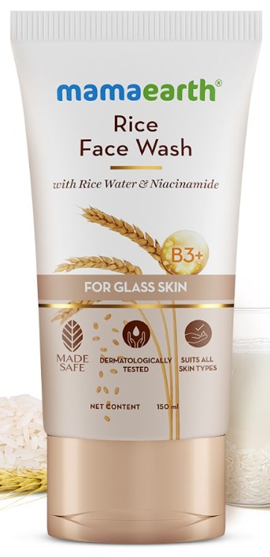
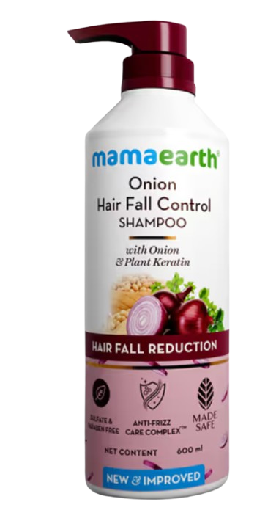
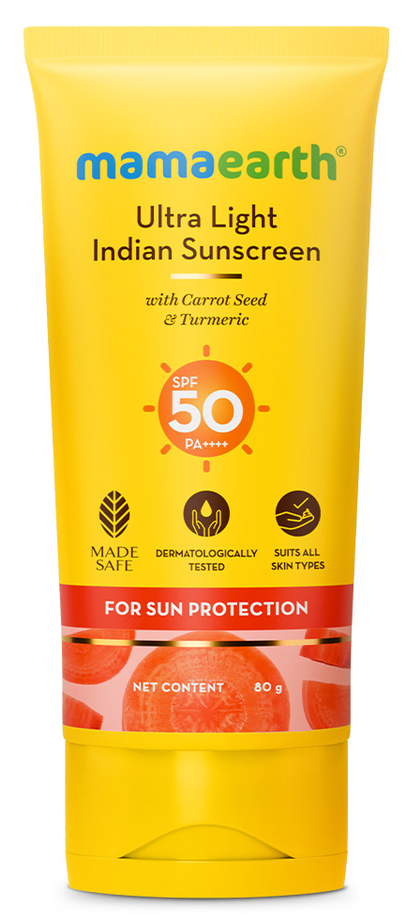
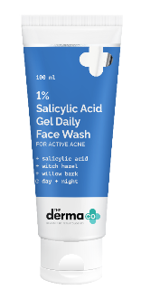
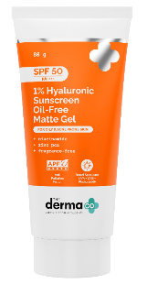
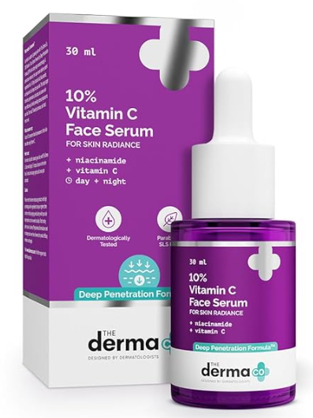
EAST ZONE PERFORMANCE
Jun-26 Sales
387
Zone Share
10.1%
L3M Avg
366
GOLY Jun
▲ 72%
Key Performance Highlights
Zone View: Jun-26 closed at 387 for East (10.1% of channel), ▼ 7% MoM off the May-26 record of 415. Q1 FY27 = 1,173 Lacs, ▲ 68% vs Q1 FY26.
Growth View: Jun-26 was ▲ 6% vs L3M and ▲ 72% vs Jun-25 — YoY momentum intact despite seasonal moderation.
Brand | Jun-25 | May-26 | Jun-26 | Cont % | L3M | GO L3M | GOLY
Mamaearth | 199 | 363 | 333 | 86% | 321 | ▲ 4% | ▲ 67%
The Derma Co. | 12 | 44 | 47 | 12% | 37 | ▲ 26% | ▲ 292%
Aqualogica | 7 | 7 | 5 | 1% | 7 | ▼ 25% | ▼ 29%
Emerging Brands | 2 | 1 | 2 | 0% | 1
East | Mamaearth — Top 3 Sub-category Monthly Trend (NSV)
FW
GOLY ▲ 58%
MoM
▼ 7%
Shampoo
GOLY ▲ 96%
MoM
▼ 10%
Sun Care
GOLY ▲ 108%
MoM
▼ 31%
East | The Derma Co. — Top 3 Sub-category Monthly Trend (NSV)
FW
GOLY
▲ 633%
MoM
▲ 22%
Sun Care
GOLY
▲ 180%
MoM
▼ 22%
Face Serum
GOLY
▲ 125%
MoM
▲ 29%
East Chain Summary
Chain | Jun-25 | May-26 | Jun-26 | Cont% | L3M | GO L3M | GOLY
Reliance | 156 | 264 | 250 | 65% | 234 | ▲ 7% | ▲ 60%
Apollo | 32 | 80 | 80 | 21% | 70 | ▲ 13% | ▲ 149%
VMM | 6 | 20 | 14 | 4% | 16 | ▼ 13% | ▲ 131%
More Retail | 7 | 11 | 10 | 3% | 10 | ▼ 5% | ▲ 39%
Frankros | 1 | 10 | 7 | 2% | 6 | ▲ 23% | ▲ 581%
Spencer | 11 | 8 | 6 | 2% | 9 | ▼ 31% | ▼ 45%
Others Combined | 12 | 21 | 21 | 5% | 22 | ▼ 3% | ▲ 76%
CHAIN KEY HIGHLIGHTS
Zone View: East closed Jun-26 at 387, ▲ 6% vs L3M and ▲ 72% vs Jun-25; Q1 FY27 ▲ 68% YoY (corrected NSV). Chain Highlights: Reliance leads; Apollo is the fastest YoY chain.
Lead Chain
Reliance - 250
Fastest YoY Chain
Apollo - ▲ 149%
Record Chain ines2
Reliance, VMM, Apollo, More Retail,
Zone Record
May-26 - 415
7 / 20

Slide 8
NORTH ZONE PERFORMANCE
Jun-26 Sales
860
Zone Share
22.5%
L3M Avg
848
GOLY Jun
▲ 72%
Key Performance Highlights
Zone View: Jun-26 closed at 860 for North (22.5% of channel), ▼ 8% MoM off the May-26 record of 936. Q1 FY27 = 2,641 Lacs, ▲ 67% vs Q1 FY26.
Growth View: Jun-26 was ▲ 1% vs L3M and ▲ 72% vs Jun-25 — YoY momentum intact despite seasonal moderation.
Brand | Jun-25 | May-26 | Jun-26 | Cont % | L3M | GO L3M | GOLY
Mamaearth | 453 | 673 | 618 | 72% | 638 | ▼ 3% | ▲ 36%
The Derma Co. | 36 | 243 | 223 | 26% | 193 | ▲ 15% | ▲ 519%
Aqualogica | 10 | 19 | 18 | 2% | 16 | ▲ 12% | ▲ 80%
Emerging Brands | 2 | 2 | 1 | 0% | 1
North | Mamaearth — Top 3 Sub-category Monthly Trend (NSV)
FW
GOLY ▲ 32%
MoM
▼ 6%
Jun'26
252
Shampoo
GOLY ▲ 78%
MoM
▼ 4%
Jun'26 182
Sun Care
GOLY ▲ 47%
MoM
▼ 26%
Jun'26
66
North | The Derma Co. — Top 3 Sub-category Monthly Trend (NSV)
FW
GOLY
▲ 1400%
MoM
▲ 2%
Jun'26 135
Sun Care
GOLY
▲ 283%
MoM
▼ 25%
Jun'26
69
Face
Serum
GOLY
▲ 88%
MoM
▼ 6%
Jun'26
15
North Chain Summary
Chain | Jun-25 | May-26 | Jun-26 | Cont% | L3M | GO L3M | GOLY
Dmart | 182 | 351 | 328 | 38% | 308 | ▲ 6% | ▲ 80%
Reliance | 193 | 337 | 309 | 36% | 295 | ▲ 5% | ▲ 60%
Apollo | 45 | 125 | 118 | 14% | 115 | ▲ 2% | ▲ 161%
Sancus(Rmt) | 36 | 46 | 40 | 5% | 49 | ▼ 18% | ▲ 11%
Lulu | 5 | 19 | 18 | 2% | 17 | ▲ 5% | ▲ 260%
Metro Cnc | 10 | 13 | 13 | 2% | 13 | ▲ 1% | ▲ 34%
Others Combined | 29 | 45 | 34 | 4% | 51 | ▼ 32% | ▲ 18%
CHAIN KEY HIGHLIGHTS
Zone View: North closed Jun-26 at 860, ▲ 1% vs L3M and ▲ 72% vs Jun-25; Q1 FY27 ▲ 67% YoY (corrected NSV). Chain Highlights: Dmart leads; Lulu is the fastest YoY chain.
Lead Chain
Fastest YoY Chain
Record Chain Lines
Zone Record
Dmart - 328
Lulu - ▲ 260%
Dmart, Reliance, Apollo,
May-26 - 936
8 / 20

Slide 9
SOUTH-1 ZONE PERFORMANCE
Jun-26 Sales
827
Zone Share
21.6%
L3M Avg
774
GOLY Jun
▲ 82%
Key Performance Highlights
Zone View: Jun-26 closed at 827 for South-1 (21.6% of channel), ▼ 8% MoM off the May-26 record of 895. Q1 FY27 = 2,489 Lacs, ▲ 84% vs Q1 FY26.
Growth View: Jun-26 was ▲ 7% vs L3M and ▲ 82% vs Jun-25 — YoY momentum intact despite seasonal moderation.
Brand | Jun-25 | May-26 | Jun-26 | Cont % | L3M | GO L3M | GOLY
Mamaearth | 366 | 586 | 559 | 68% | 522 | ▲ 7% | ▲ 53%
The Derma Co. | 66 | 286 | 248 | 30% | 230 | ▲ 8% | ▲ 276%
Aqualogica | 15 | 18 | 16 | 2% | 16 | ▼ 2% | ▲ 7%
Emerging Brands | 4 | 5 | 4 | 1% | 4
South-1 | Mamaearth — Top 3 Sub-category Monthly Trend (NSV)
FW
GOLY ▲ 41%
MoM
▼ 9%
Jun'26
173
Shampoo
GOLY ▲ 72%
MoM
▲ 5%
Jun'26 179
Sun Care
GOLY ▲ 130%
MoM
▼ 24%
Jun'26
53
South-1 | The Derma Co. — Top 3 Sub-category Monthly Trend (NSV)
FW
GOLY
▲ 721%
MoM
▼ 1%
Jun'26 115
Sun Care
GOLY
▲ 210%
MoM
▼ 29%
Jun'26 93
Face
Serum
GOLY
▲ 76%
MoM
▲ 0%
Jun'26
30
South-1 Chain Summary
Chain | Jun-25 | May-26 | Jun-26 | Cont% | L3M | GO L3M | GOLY
Apollo | 102 | 292 | 289 | 35% | 257 | ▲ 12% | ▲ 183%
Dmart | 138 | 267 | 229 | 28% | 223 | ▲ 3% | ▲ 66%
Reliance | 95 | 152 | 151 | 18% | 136 | ▲ 11% | ▲ 59%
Lulu | 36 | 84 | 86 | 10% | 72 | ▲ 19% | ▲ 139%
H&G | 53 | 58 | 35 | 4% | 45 | ▼ 23% | ▼ 35%
Metro Cnc | 14 | 15 | 14 | 2% | 16 | ▼ 11% | ▲ 2%
Others Combined | 16 | 27 | 23 | 3% | 26 | ▼ 11% | ▲ 42%
CHAIN KEY HIGHLIGHTS
Zone View: South-1 closed Jun-26 at 827, ▲ 7% vs L3M and ▲ 82% vs Jun-25; Q1 FY27 ▲ 84% YoY (corrected NSV). Chain Highlights: Apollo leads; Apollo is the fastest YoY chain.
Lead Chain
Fastest YoY Chain
Record Chain Lines
Zone Record
Apollo - 289
Apollo - ▲ 183%
Apollo, Dmart, Reliance,
May-26 - 895
9 / 20

Slide 10
SOUTH-2 ZONE PERFORMANCE
Jun-26 Sales
548
Zone Share
14.3%
L3M Avg
486
GOLY Jun
▲ 64%
Key Performance Highlights
Zone View: Jun-26 closed at 548 for South-2 (14.3% of channel), ▼ 1% MoM off the May-26 record of 555. Q1 FY27 = 1,576 Lacs, ▲ 65% vs Q1 FY26.
Growth View: Jun-26 was ▲ 13% vs L3M and ▲ 64% vs Jun-25 — YoY momentum intact despite seasonal moderation.
Brand | Jun-25 | May-26 | Jun-26 | Cont % | L3M | GO L3M | GOLY
Mamaearth | 305 | 414 | 427 | 78% | 382 | ▲ 12% | ▲ 40%
The Derma Co. | 23 | 131 | 113 | 21% | 94 | ▲ 20% | ▲ 391%
Aqualogica | 6 | 8 | 6 | 1% | 7 | ▼ 10% | ▲ 0%
Emerging Brands | 2 | 2 | 2 | 0% | 2
South-2 | Mamaearth — Top 3 Sub-category Monthly Trend (NSV)
FW
GOLY ▲ 47%
MoM
▲ 10%
Jun'26
159
Shampoo
GOLY ▲ 60%
MoM
▲ 9%
Jun'26 130
Sun Care
GOLY ▲ 93%
MoM
▼ 28%
Jun'26
29
South-2 | The Derma Co. — Top 3 Sub-category Monthly Trend (NSV)
FW
GOLY
▲ 1220%
MoM
▲ 6%
Jun'26 66
Sun Care
GOLY
▲ 250%
MoM
▼ 39%
Jun'26
35
Face
Serum
GOLY
▲ 50%
MoM
▼ 10%
Jun'26
9
South-2 Chain Summary
Chain | Jun-25 | May-26 | Jun-26 | Cont% | L3M | GO L3M | GOLY
Dmart | 142 | 218 | 229 | 42% | 187 | ▲ 23% | ▲ 62%
Apollo | 70 | 176 | 163 | 30% | 159 | ▲ 2% | ▲ 132%
Reliance | 57 | 85 | 94 | 17% | 78 | ▲ 21% | ▲ 66%
H&G | 23 | 24 | 14 | 3% | 18 | ▼ 20% | ▼ 39%
More Retail | 13 | 20 | 13 | 2% | 16 | ▼ 18% | ▲ 1%
Lulu | 2 | 13 | 12 | 2% | 9 | ▲ 27% | ▲ 485%
Others Combined | 27 | 20 | 22 | 4% | 19 | ▲ 17% | ▼ 17%
CHAIN KEY HIGHLIGHTS
Zone View: South-2 closed Jun-26 at 548, ▲ 13% vs L3M and ▲ 64% vs Jun-25; Q1 FY27 ▲ 65% YoY (corrected NSV). Chain Highlights: Dmart leads; Apollo is the fastest YoY chain.
Lead Chain
Fastest YoY Chain
Record Chain Lines
Zone Record
Dmart - 229
Apollo - ▲ 132%
Dmart, Apollo, Reliance,
May-26 - 555
10 / 20

Slide 11
WEST ZONE PERFORMANCE
Jun-26 Sales
985
Zone Share
25.8%
L3M Avg
938
GOLY Jun
▲ 67%
Key Performance Highlights
Zone View: Jun-26 closed at 985 for West (25.8% of channel), ▼ 3% MoM off the May-26 record of 1017. Q1 FY27 = 2,905 Lacs, ▲ 55% vs Q1 FY26.
Growth View: Jun-26 was ▲ 5% vs L3M and ▲ 67% vs Jun-25 — YoY momentum intact despite seasonal moderation.
Brand | Jun-25 | May-26 | Jun-26 | Cont % | L3M | GO L3M | GOLY
Mamaearth | 532 | 642 | 643 | 65% | 635 | ▲ 1% | ▲ 21%
The Derma Co. | 50 | 359 | 330 | 33% | 288 | ▲ 15% | ▲ 560%
Aqualogica | 6 | 14 | 11 | 1% | 13 | ▼ 18% | ▲ 83%
Emerging Brands | 0 | 2 | 1 | 0% | 1
West | Mamaearth — Top 3 Sub-category Monthly Trend (NSV)
FW
GOLY ▲ 19%
MoM
▲ 6%
Jun'26
308
Shampoo
GOLY ▲ 44%
MoM
▲ 9%
Jun'26 191
Sun
Care
GOLY ▲ 50%
MoM
▼ 42%
Jun'26
51
West | The Derma Co. — Top 3 Sub-category Monthly Trend (NSV)
FW
GOLY▲ 1669%
MoM
▲ 7%
Jun'26 230
Sun Care
GOLY
▲ 407%
MoM
▼ 36%
Jun'26 76
Face
Serum
GOLY
▲ 6%
MoM
▼ 5%
Jun'26
18
West Chain Summary
Chain | Jun-25 | May-26 | Jun-26 | Cont% | L3M | GO L3M | GOLY
Dmart | 394 | 680 | 668 | 68% | 614 | ▲ 9% | ▲ 70%
Reliance | 91 | 152 | 143 | 15% | 145 | ▼ 1% | ▲ 57%
Wellness Forever | 67 | 92 | 73 | 7% | 94 | ▼ 22% | ▲ 9%
Apollo | 26 | 79 | 75 | 8% | 72 | ▲ 4% | ▲ 187%
Metro Cnc | 6 | 5 | 18 | 2% | 6 | ▲ 212% | ▲ 199%
Trent | 2 | 4 | 7 | 1% | 4 | ▲ 84% | ▲ 230%
Others Combined | 5 | 4 | 2 | 0% | 4 | ▼ 60% | ▼ 70%
CHAIN KEY HIGHLIGHTS
Zone View: West closed Jun-26 at 985, ▲ 5% vs L3M and ▲ 67% vs Jun-25; Q1 FY27 ▲ 55% YoY (corrected NSV). Chain Highlights: Dmart leads; Metro Cnc is the fastest YoY chain.
Lead Chain
Fastest YoY Chain
Record Chain Lines
Zone Record
Dmart - 668
Metro Cnc - ▲ 199%
Dmart, Reliance, Wellness Forever,
May-26 - 1017
11 / 20

Slide 12
PAN INDIA PERFORMANCE
Jun-26 Sales
217
Zone Share
5.7%
L3M Avg
203
GOLY Jun
▲ 32%
Key Performance Highlights
Chain View: Jun-26 closed at 217 for FSN (5.7% of channel), ▲ 4% MoM. Q1 FY27 = 653 Lacs, ▲ 25% vs Q1 FY26.
Growth View: Jun-26 was ▲ 7% vs L3M and ▲ 32% vs Jun-25 — best month since the Apr-26 record of 229.
Zone Insight: FSN improved to +32% YoY but still trails the network (+68%); assortment plus promo refresh remains the lever.
Brand | Jun-25 | May-26 | Jun-26 | Cont % | L3M | GO L3M | GOLY
Mamaearth | 139 | 164 | 177 | 82% | 158 | ▲ 12% | ▲ 27%
The Derma Co. | 20 | 37 | 35 | 16% | 37 | ▼ 5% | ▲ 75%
Aqualogica | 5 | 5 | 3 | 1% | 6 | ▼ 47% | ▼ 40%
Emerging Brands | 1 | 2 | 2 | 1% | 3
FSN | Mamaearth — Top 3 Sub-category Monthly Trend (NSV)
FW
GOLY ▲ 46%
MoM
▲ 12%
Jun'26
108
Shampoo
GOLY ▲ 7%
MoM
▲ 23%
Jun'26 16
Sun
Care
GOLY ▲ 50%
MoM
▼ 17%
Jun'26
24
FSN | The Derma Co. — Top 3 Sub-category Monthly Trend (NSV)
FW
GOLY
▲ 433%
MoM
▲ 14%
Jun'26 16
Sun Care
GOLY
▲ 29%
MoM
▼ 25%
Jun'26
9
Face
Serum
GOLY
▲ 0%
MoM
▼ 10%
Jun'26
9
FSN Chain Summary
Chain | Jun-25 | May-26 | Jun-26 | Cont% | L3M | GO L3M | GOLY
Fsn | 164 | 208 | 217 | 100% | 203 | ▲ 7% | ▲ 32%
Others Combined | 0 | 0 | 0 | 0% | 0
CHAIN KEY HIGHLIGHTS
Chain Highlights:- FSN closed Jun-26 at 217, ▲ 7% vs L3M and ▲ 32% vs Jun-25; the Apr-26 record of 229 stands.
Lead Chain
Fastest YoY Chain
Record Chain Lines
Zone Record
Apr-26 - 229
Fsn - 217
Fsn - ▲ 32%
Fsn
12 / 20

Slide 13
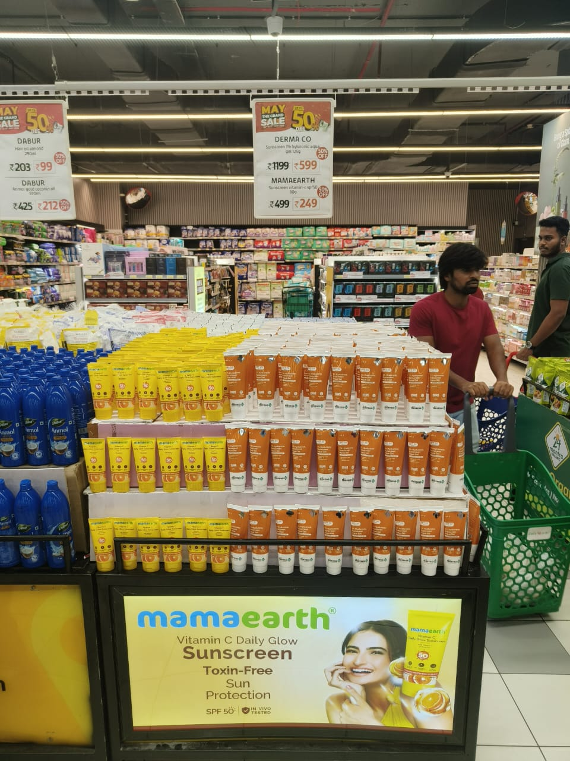
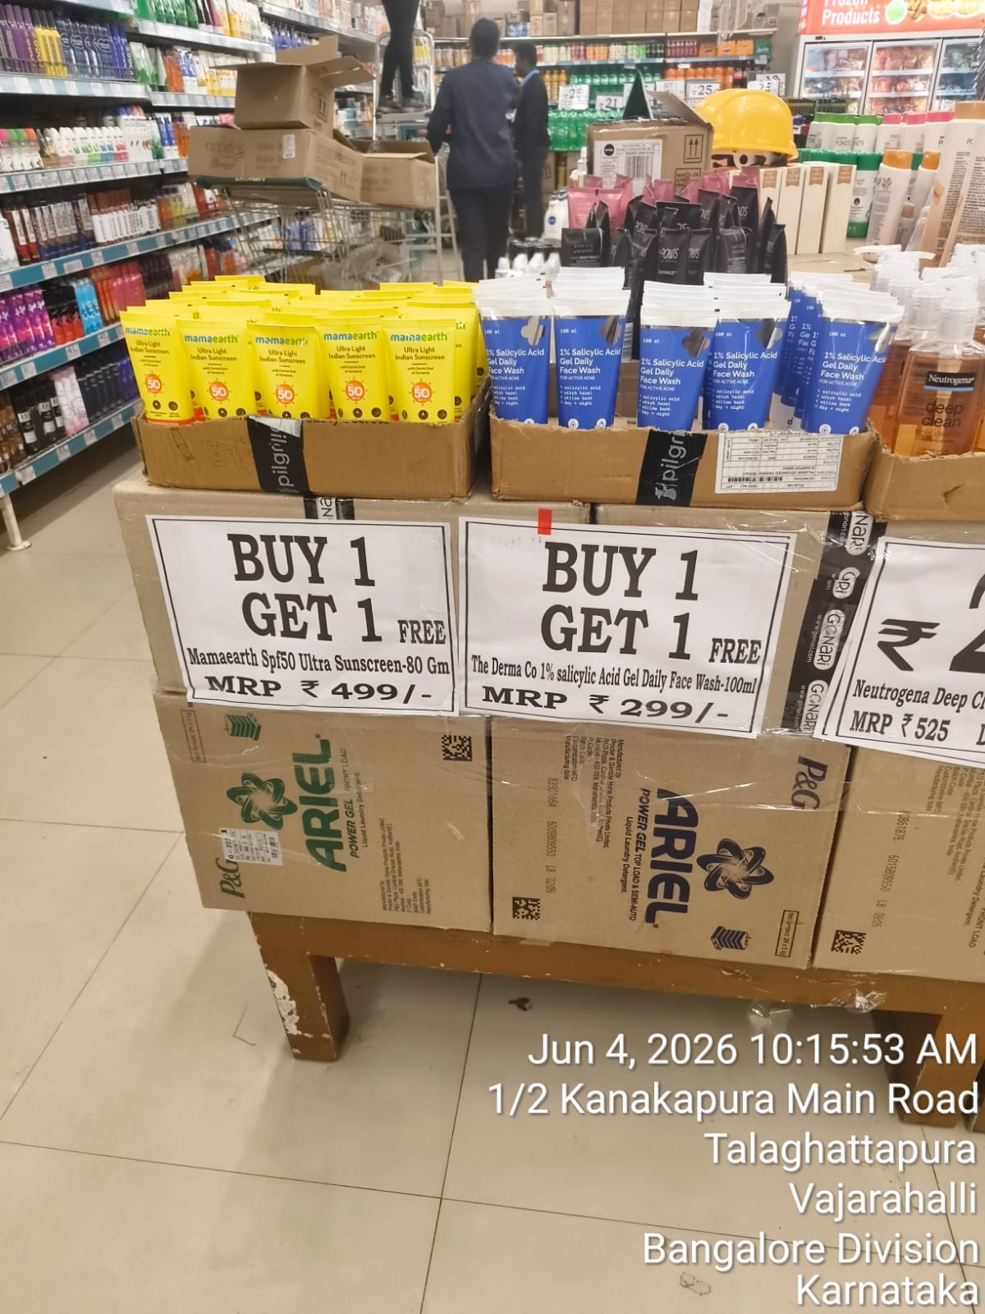
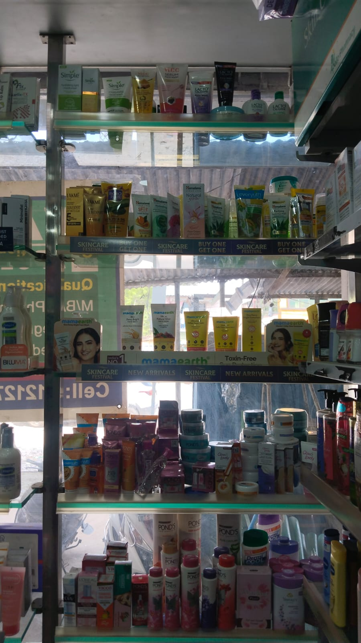
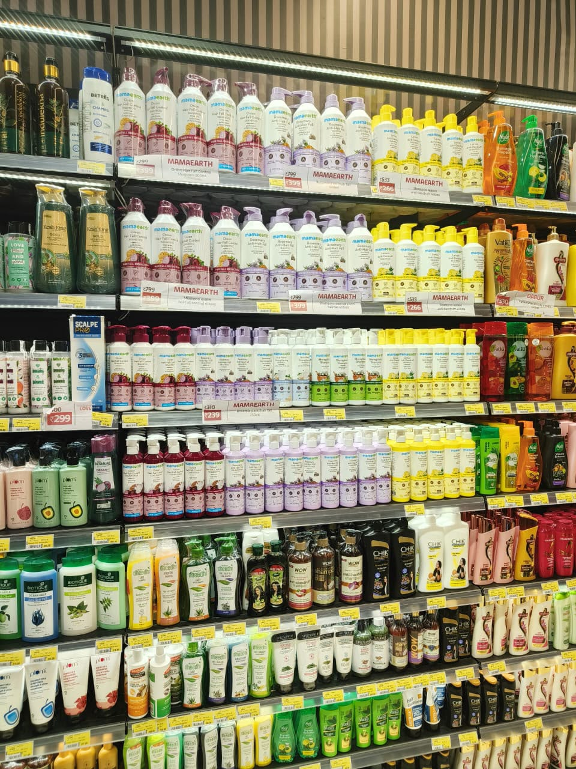
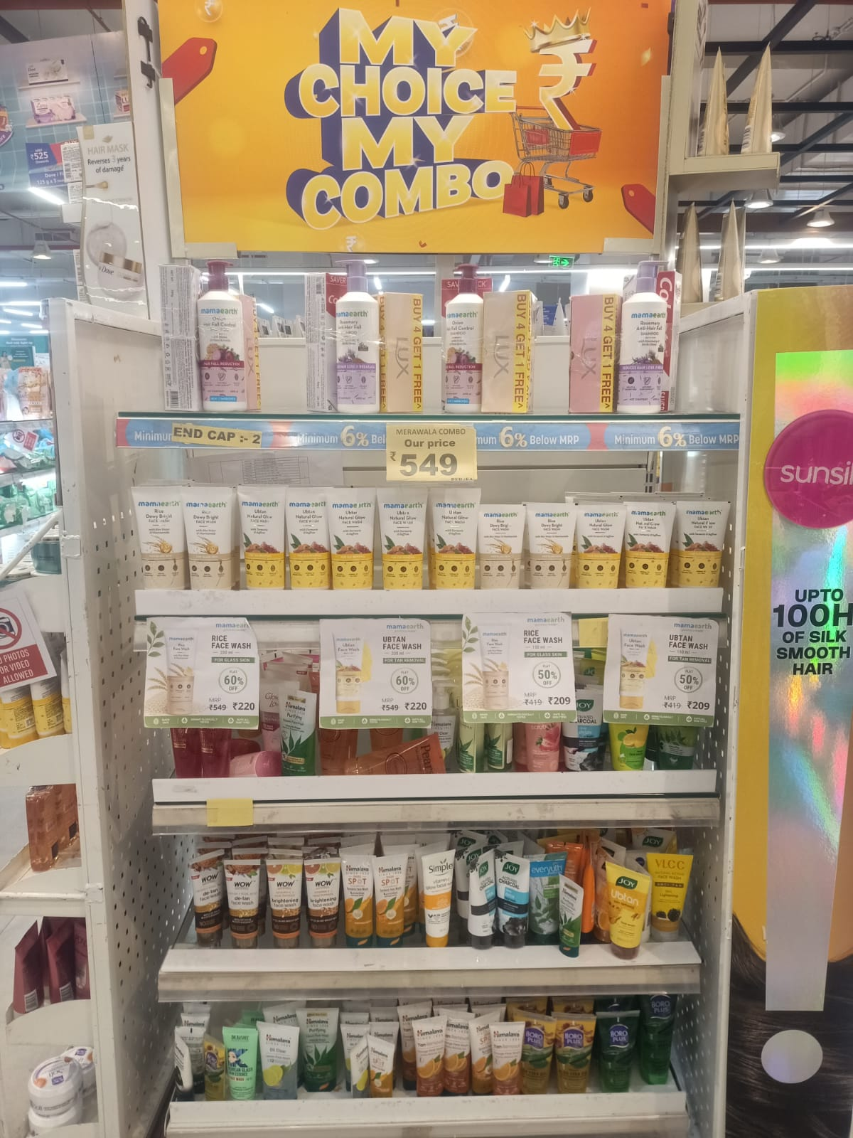
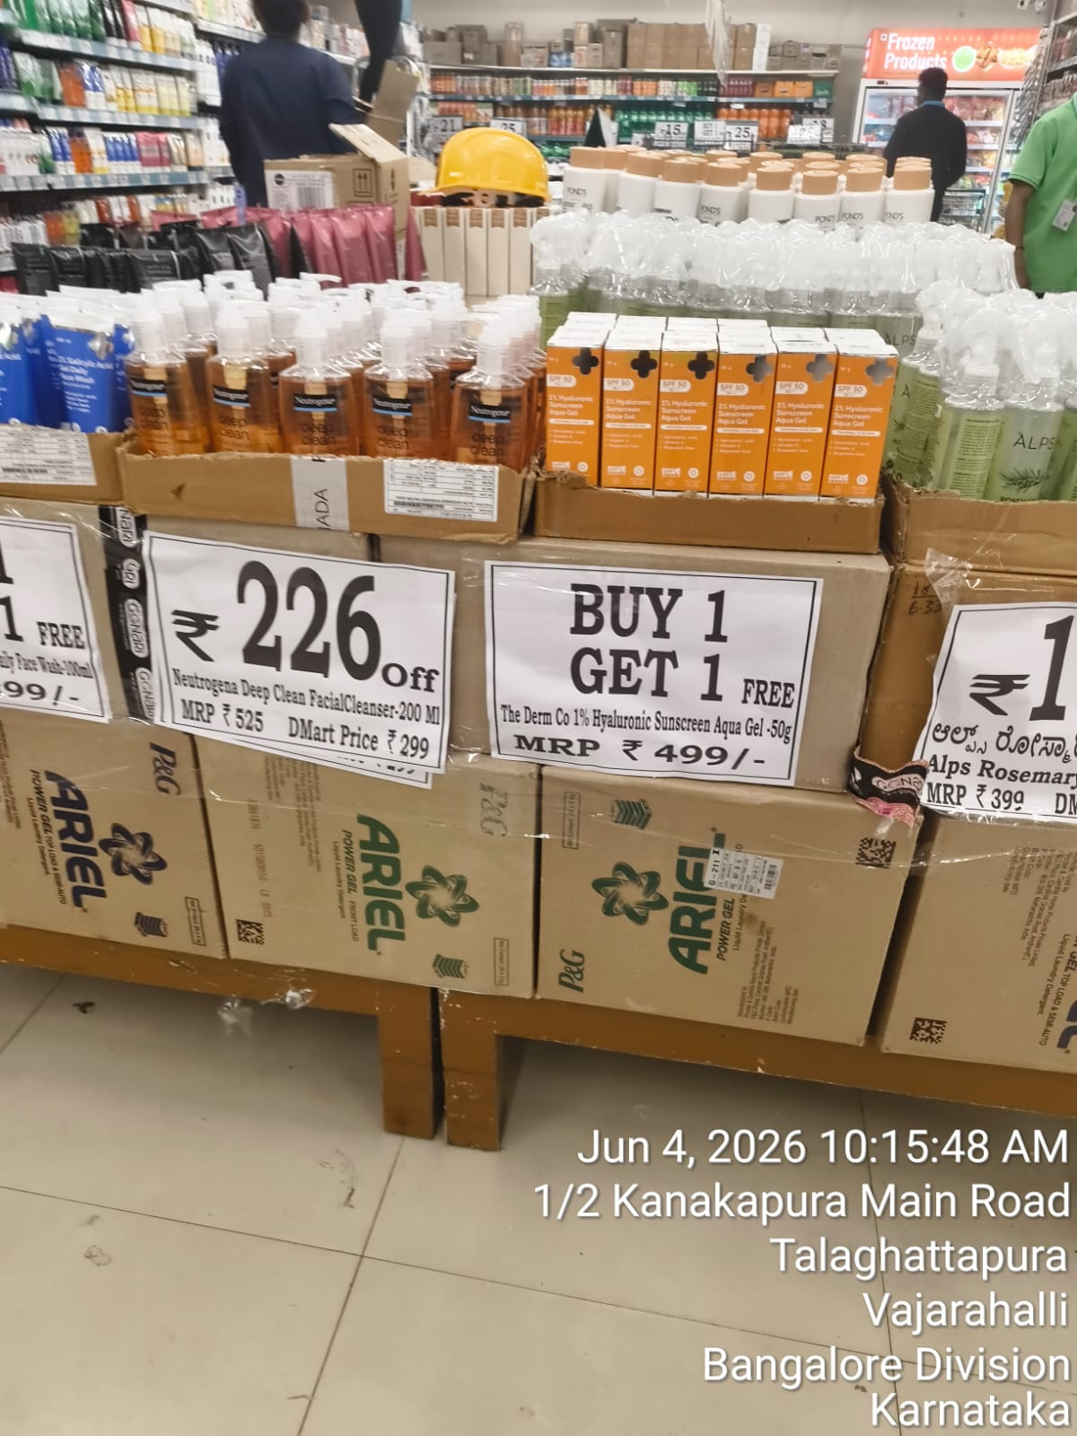
Zone-wise Best Execution Images
Best available field execution proof, by zone — and where the image bank still needs to be built
FIELD CAPTURES
SOUTH-1 — HYDERABAD
SOUTH-2 — KARNATAKA
Lulu | Hyderabad* | South-1 | Endcap / Bin-Tower
D-Mart | Bengaluru | South-2 | BOGO Bin Display
APOLLO — SOUTH-1
LULU — SOUTH-1
Apollo | Hyderabad* | Eye-Level Shelf Block
Lulu | Hyderabad* | Shampoo Aisle Block
Mamaearth Sun Care range fronted with BOGO talkers on a dedicated shelf strip.
Three uninterrupted Mamaearth shampoo shelves at eye level, ahead of competitor sets.
RELIANCE — SOUTH-1
D-MART — SOUTH-2
Reliance | Hyderabad* | Branded Endcap
D-Mart | Bengaluru | BOGO Bin Display
'Merawala Combo' endcap with Mamaearth Buy-4-Get-1 signage and combo pricing.
Derma Co. Hyaluronic Sunscreen bin (geotagged 4-Jun-2026), paired with a Neutrogena combo crate.

Slide 14
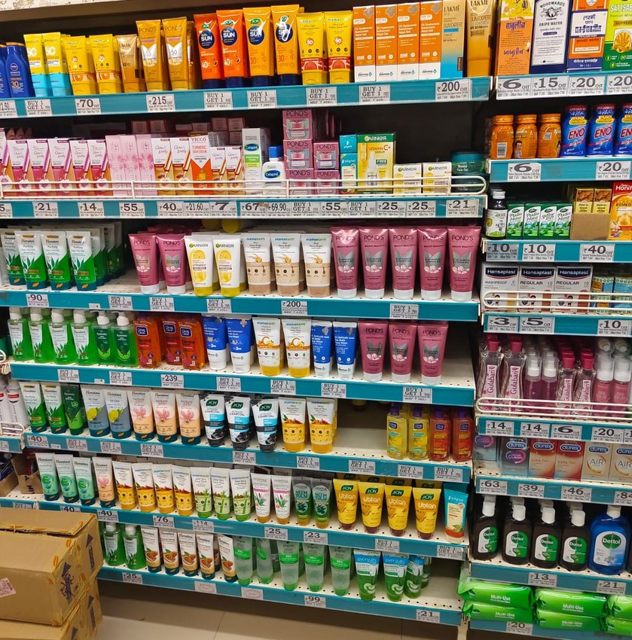
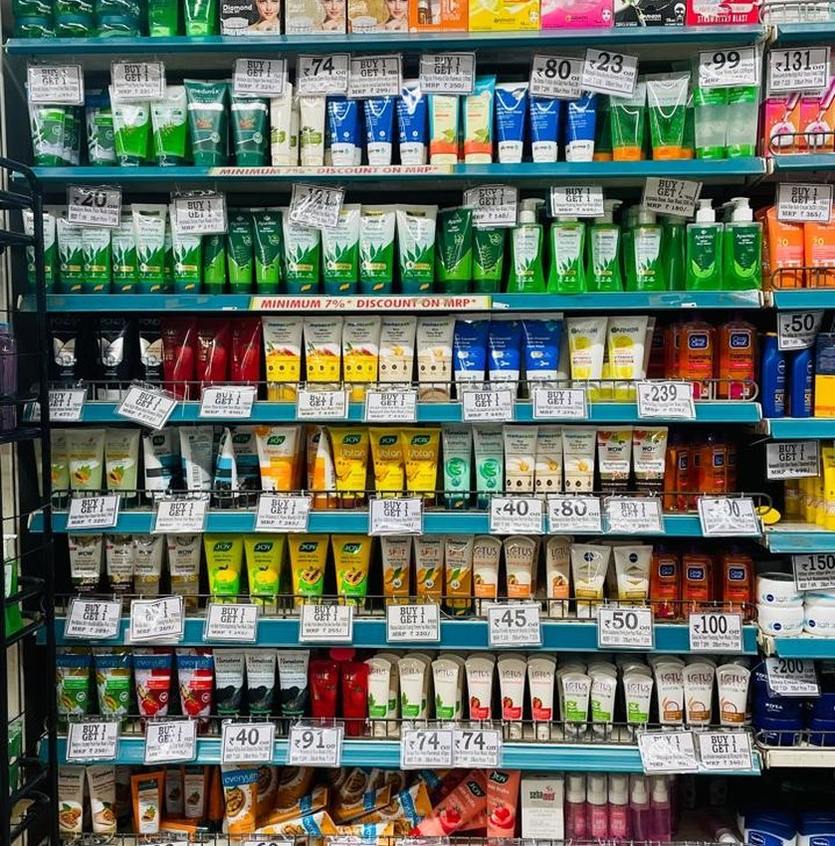
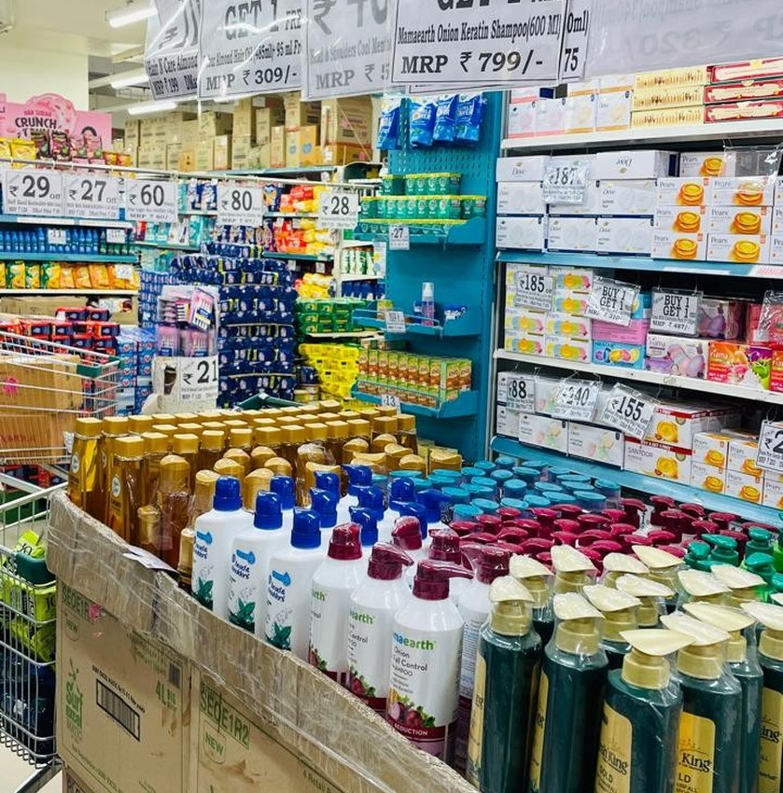
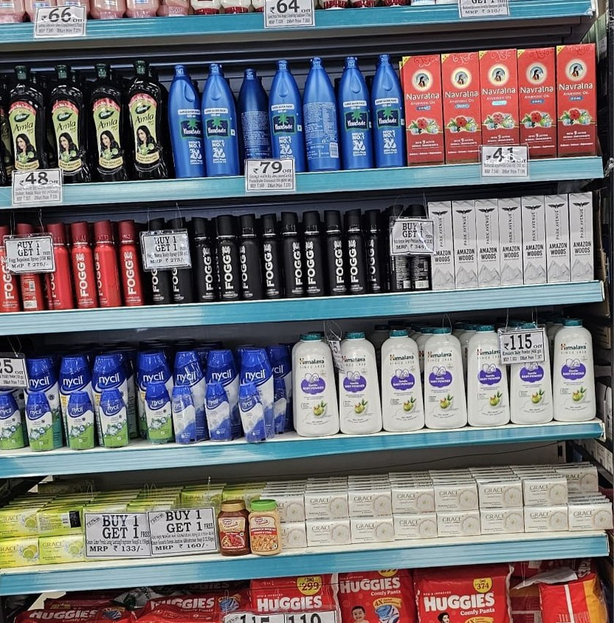
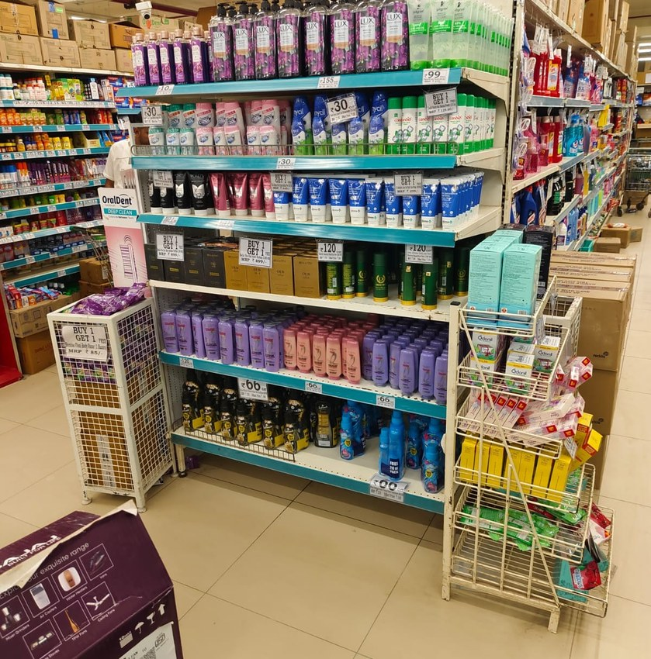
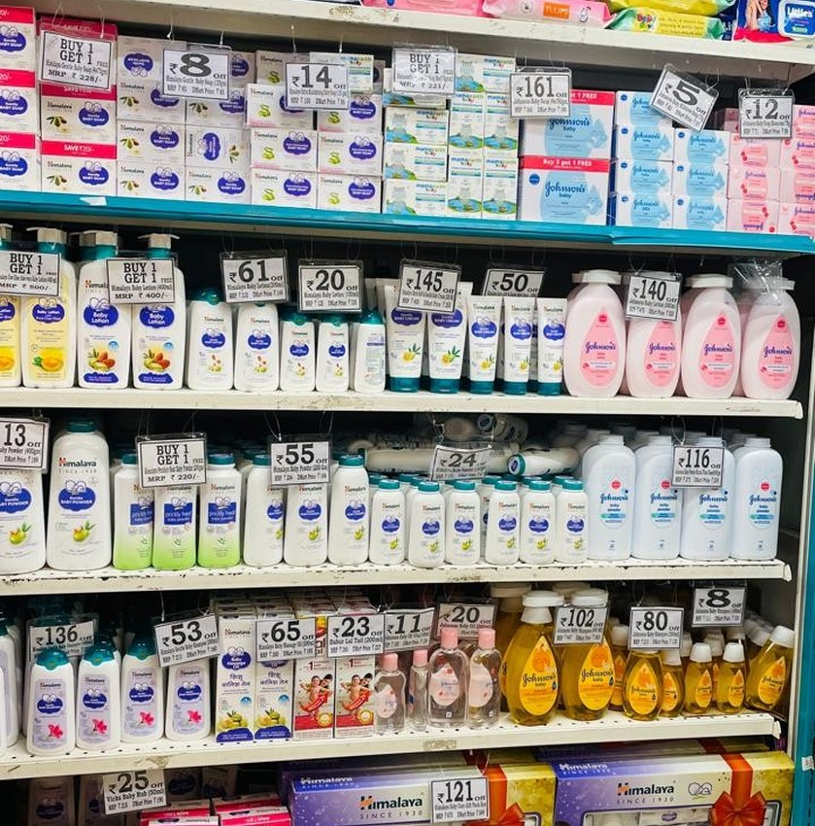
Gujarat Region – Execution Snapshot
Gujarat Region Execution May 26
Ganesh Khengre ROM May-26
Ganesh Khengre ROM May-26
Gujarat Region Execution May 26
Gujarat Region Execution May 26
Ganesh Khengre ROM May-26
14 / 20

Slide 15
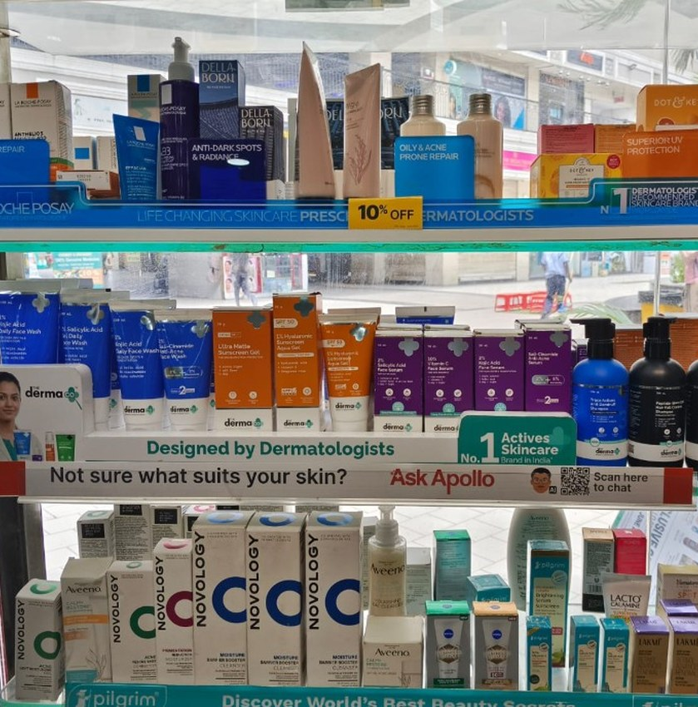
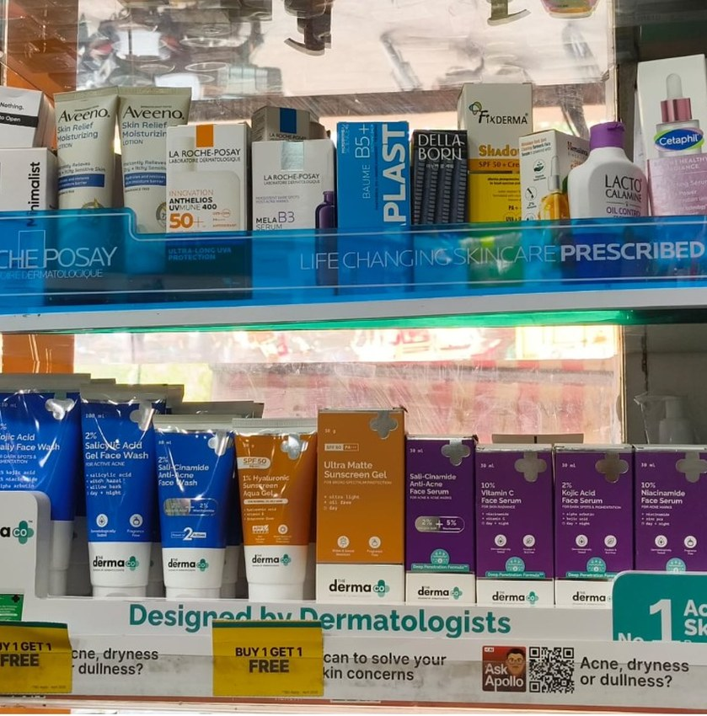
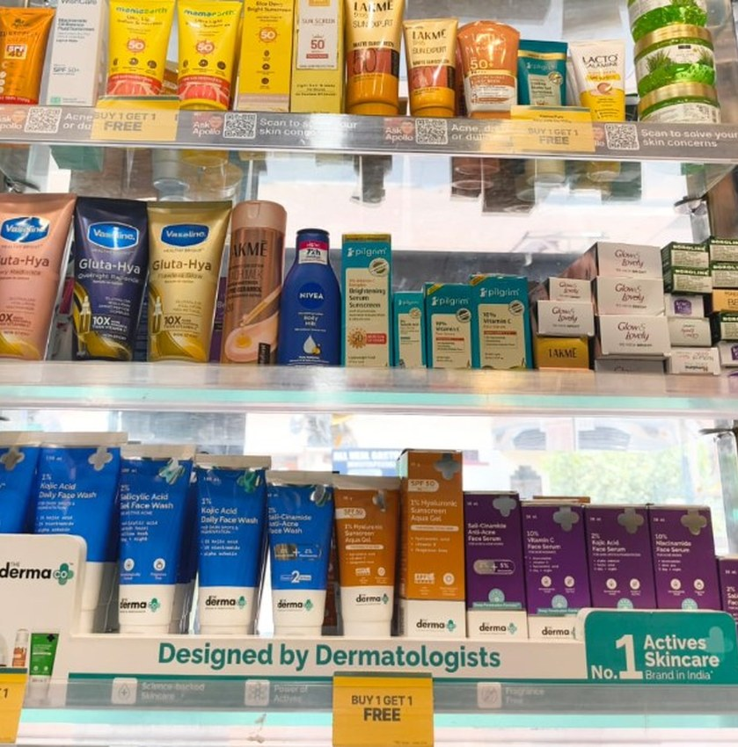
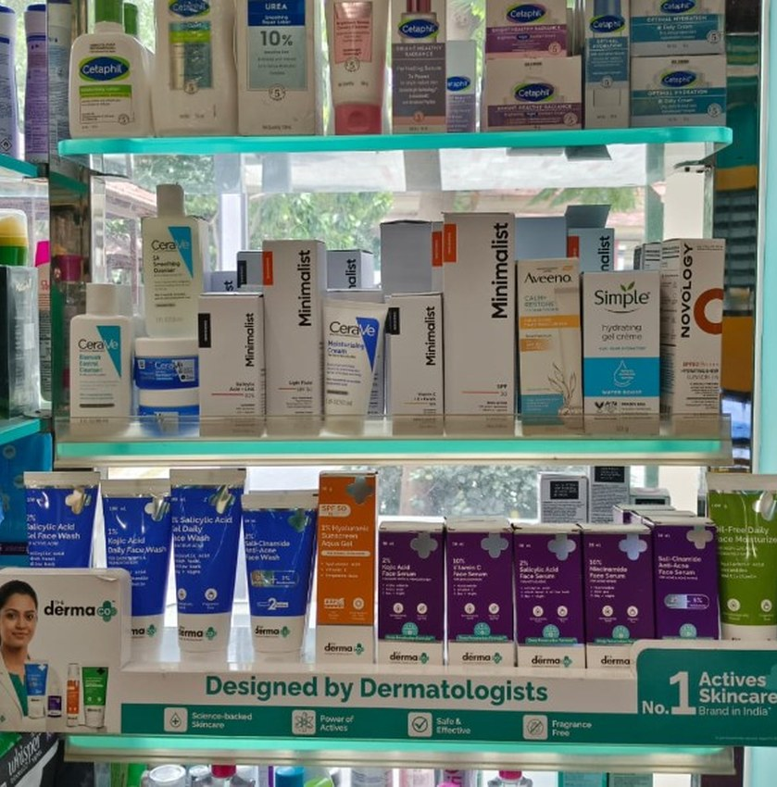
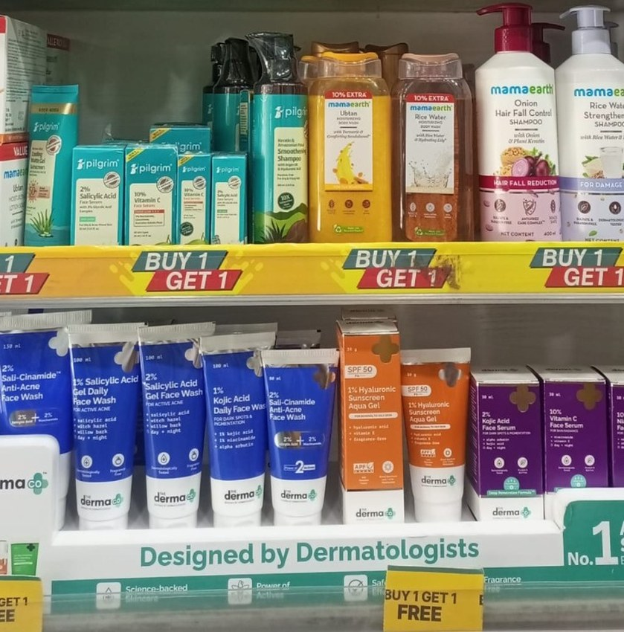
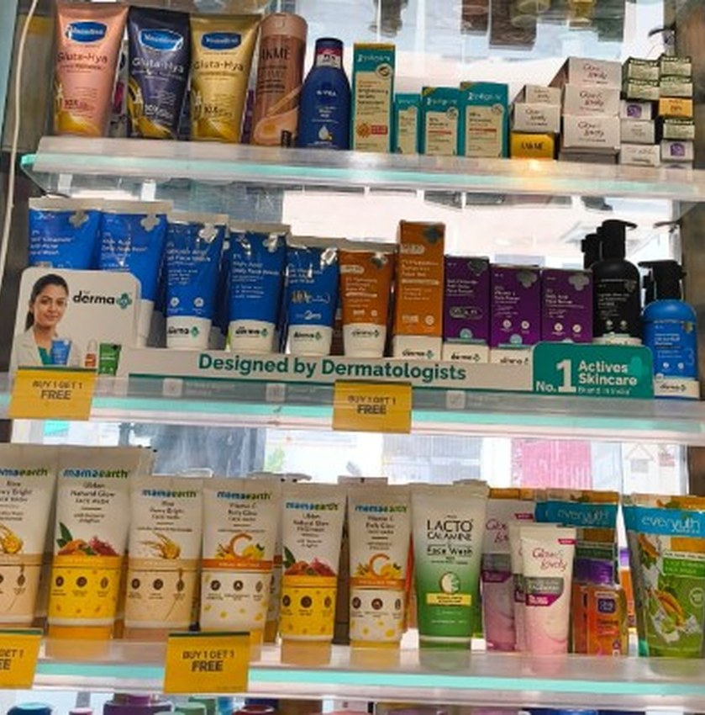
TDC / SIS Delhi NCR – Execution Snapshot
Tdc Sis Delhi Ncr PPT
Tdc Sis Delhi Ncr PPT
Tdc Sis Delhi Ncr PPT
Tdc Sis Delhi Ncr PPT
Tdc Sis Delhi Ncr PPT
Tdc Sis Delhi Ncr PPT
15 / 20

Slide 16
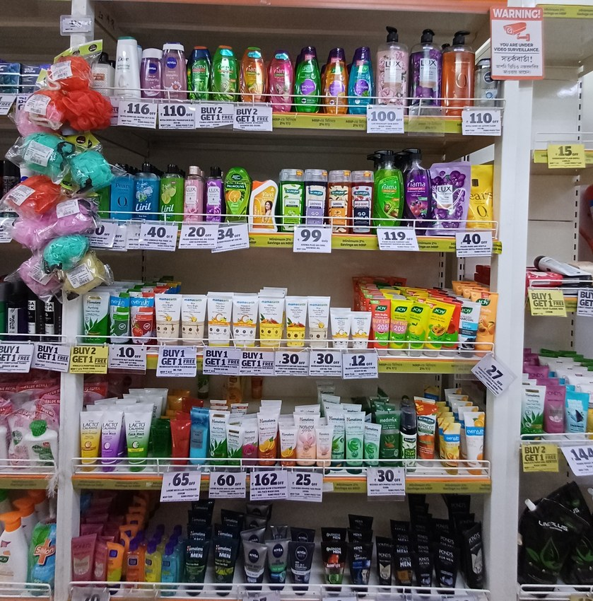
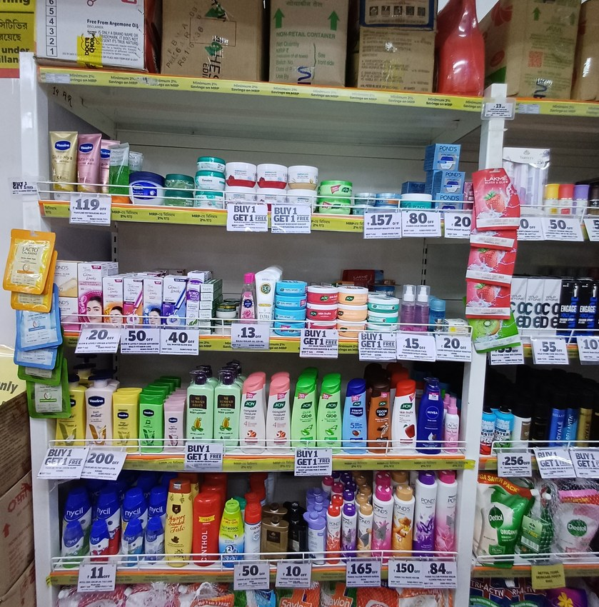
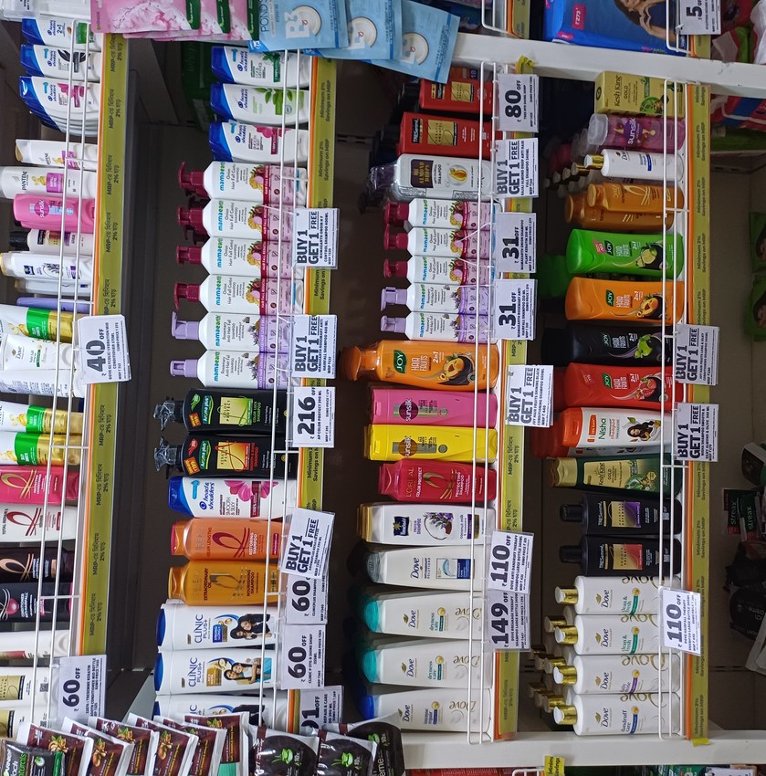
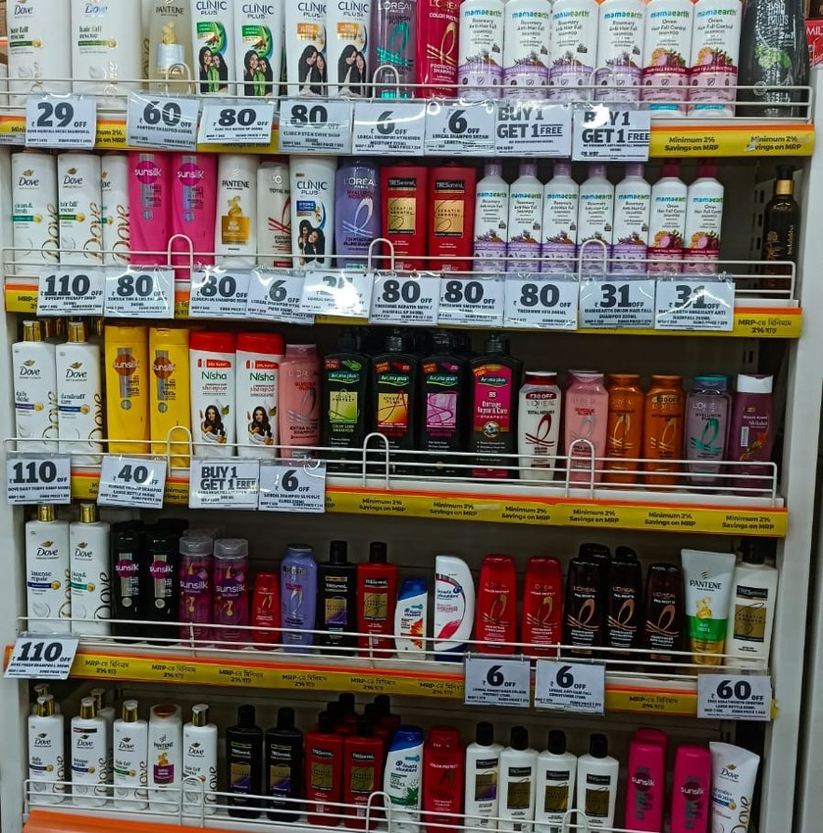
SOS / SOA – Honasa Portfolio Visibility
SUMO SAVE DISPLAY
SUMO SAVE DISPLAY
SUMO SAVE DISPLAY
SUMO SAVE DISPLAY
16 / 20

Slide 17
Portfolio | All Categories | Executive Summary
Primary vs. Offtake Sell-Out — Executive View
Q1 FY26-27 (Apr-Jun'26) consolidated | 26-chain matched universe (Primary & Offtake both report)
Total Primary (Q1 FY27)
Primary vs. Offtake — Sell-Out Tracking
SITUATION
Q1 FY27: Primary Rs13,625L vs Offtake Rs11,436L - Sell-Out 83.9%.
COMPLICATION
Rs2,188L billed but not yet sold-through - trade inventory is building faster than consumer offtake.
RESOLUTION
Slow Q2 primary billing pace vs Q1 to let channel inventory normalize; prioritize sell-out schemes.
Primary (billed-in)
Offtake (sold-out)
Q1 FY27
(Apr-Jun26)
13,625L
Rs 13,625L
84%
26-chain matched universe
11,436L
Total Offtake (Q1 FY27)
Rs 11,436L
Jun'26
4,163L
Same 26-chain universe
92%
Sell-Out %
3,823L
83.9%
Gap: Rs 2,188L billed-not-sold
Sell-Out % = Offtake / Primary Billing x 100. Matched universe = chains present in both Primary and Offtake reporting (see Chain_Mapping sheet).

Slide 18
Portfolio | All Categories | Chain-Level Deep Dive
Primary vs. Offtake Sell-Out — Chain / KAM View
Q1 FY26-27 (Apr-Jun'26) | Key accounts: Dmart, Reliance, Apollo + top format chains
Weakest Sell-Out (Q1)
Primary vs. Offtake — Sell-Out Tracking
SITUATION
Dmart Q1: Primary Rs5,527L, Offtake Rs4,232L - Sell-Out 77%, weakest large KAM.
COMPLICATION
Dmart and Lulu show Primary well ahead of Offtake - stock sitting in DC/store, near-expiry claim risk builds.
RESOLUTION
Freeze incremental Dmart/Lulu primary orders this cycle; secure urgent PO for Metro Cnc (OOS risk).
Primary (billed-in)
Offtake (sold-out)
Dmart
5,527L
77%
Dmart 77%
4,232L
Reliance
3,047L
92%
Primary Rs5,527L vs Offtake Rs4,232L
2,806L
OOS Risk Flag (Q1)
Apollo
2,555L
85%
2,173L
Metro Cnc 152%
Metro Cnc
103L
152%
Offtake exceeds Primary - stock depleting
157L
Healthiest Large KAM
Lulu
505L
66%
333L
Reliance 92%
H&G
239L
84%
Primary Rs3,047L vs Offtake Rs2,806L
201L
Chains matched via Chain_Mapping sheet (confirmed name pairs only). Chains with Q1 Primary <Rs20L excluded as immaterial.

Slide 19
MARKET SHARE MOMENTUM — FACEWASH & SHAMPOO
MT = AI (U+R) MT | MAT Jun-26 | Leadership cut
19
Mamaearth is gaining share in both categories, with current momentum materially ahead of the market.
FACEWASH
SHAMPOO
10.5%
MAT value share
3.7%
MAT value share
+3.1 pp
share gain
+1.2 pp
share gain
+58%
L3M YoY
+80%
L3M YoY
89%
weighted distribution
81.5%
weighted distribution
WHAT THE MARKET IS SAYING
1
FACEWASH
Mamaearth is the fastest-growing large brand: +55% MAT and +58% L3M versus category +10% MAT.
2
SHAMPOO
Mamaearth is scaling faster than every major brand: +48% MAT and +80% L3M; share reached 3.7%.
3
VELOCITY
The next leg must come from PDO and shelf productivity, not distribution alone; mature leaders already sit near full WD.
4
WATCHLIST
Ingredient-led challengers are expanding quickly. The Derma Co is still small in Facewash share but growing from a low base.
Decision: keep MT investment growth-led, but track weekly WD + PDO + fill rate together so share gains translate into durable sales.
Source: MS insights.xlsx | MAT Jun-26 | External market sales; internal NSV shown separately elsewhere in this deck

Slide 20
TURN SHARE GAINS INTO REPEATABLE GROWTH
Four moves for Q2 FY27
20
The opportunity is clear. Execution now decides whether momentum compounds or fades.
01
PROTECT FACEWASH LEAD
Hold availability in 150ml and 100ml heroes; prioritise South accounts where category growth and Mamaearth momentum are strongest.
KPI: WD ≥90% | Fill rate ≥95%
02
SCALE SHAMPOO SMARTLY
Expand Rosemary as the scale lever while protecting Onion. Review pack mix to prevent volume growth from over-diluting realised price/ml.
KPI: Share >4% | PDO growth > category
03
WIN THE VELOCITY BATTLE
Rank chains by share opportunity using WD × PDO. Fix the largest high-distribution, low-velocity gaps before adding broad new listings.
KPI: Top-10 gap closure weekly
04
SEPARATE THE MEASUREMENT BASES
Use external market share for competitive health and internal NSV for business delivery. Do not compare them as the same sales base.
KPI: One source label on every chart
LEADERSHIP ASK
Approve chain-level WD × PDO review and monthly pack-mix governance for Facewash and Shampoo.
Source: MS insights.xlsx | MAT Jun-26 | External market sales; internal NSV shown separately elsewhere in this deck

