Slide 1
MT OFFTAKE PERFORMANCE REPORT
SUMMARY & KEY INSIGHTS JUNE’26 + Q1 FY27
Jun'26 NSV
May'26 NSV
L3M Avg
YoY Growth
₹ 38.24 Cr
₹ 40.26 Cr
₹ 36.16 Cr
68.4%
Best-ever June NSV
MoM ▼ 5%
GO L3M ▲ 6%
▲ ₹ 15.53 Cr
Monthly and Top-3 Chain NSV Sales Trend
Jun’26 Chain Sales Contribution % & Sales
Jun'26 NSV closed at Rs. 38.24 Cr up ▲ 68% YoY and ▲ 5.7% vs L3M Avg, adding +1,553 Lacs YoY — best-ever June on corrected chain NSV, despite a seasonal ▼5% MoM off the May record.
Q1 FY27 closed at ₹114.39 Cr, ▲ 64% vs Q1 FY26 (₹69.92 Cr) — every zone grew ≥55% (South-1 ▲84%); 2-yr Q1 CAGR of +44% confirms structural scale.
Dmart, Reliance and Apollo delivered 81.8% of Jun'26 offtake — concentration steady vs May; Walmart CNC billed nil in Jun (watch-out).
The Derma Co. remain the growth engines & Mamaearth holds 71.8% portfolio share.
Chain-wise Monthly Performance Snapshot
Chain | Jun-25 | Feb-26 | Mar-26 | Apr-26 | May-26 | Jun-26 | Cont% | L3M Avg(MAM) | GOLY | MOM
 |  |  |  |  |  |  |  |  | Jun
Dmart | 856 | 928 | 1,225 | 1,258 | 1,518 | 1,456 | 38% | 1,334 | ▲ 70% | ▼ 4%
Reliance | 592 | 756 | 804 | 868 | 990 | 948 | 25% | 887 | ▲ 60% | ▼ 4%
Apollo | 275 | 512 | 570 | 699 | 751 | 723 | 19% | 673 | ▲ 163% | ▼ 4%
Fsn | 164 | 168 | 173 | 229 | 208 | 217 | 6% | 203 | ▲ 32% | ▲ 4%
Wellness | 74 | 85 | 98 | 110 | 102 | 80 | 2% | 103 | ▲ 8% | ▼ 21%
H&G | 82 | 49 | 50 | 62 | 87 | 52 | 1% | 66 | ▼ 37% | ▼ 41%
Lulu | 43 | 70 | 78 | 101 | 116 | 116 | 3% | 98 | ▲ 169% | ▼ 0%
Metro | 44 | 48 | 53 | 48 | 48 | 61 | 2% | 49 | ▲ 39% | ▲ 28%
Delhi RMT | 36 | 28 | 42 | 58 | 46 | 40 | 1% | 49 | ▲ 11% | ▼ 14%
More Retail | 34 | 38 | 45 | 45 | 55 | 44 | 1% | 48 | ▲ 28% | ▼ 21%
Walmart | 20 | 17 | 19 | 26 | 11 | 0 | 0% | 19 | ▼ 100% | ▼ 100%
Spencer | 15 | 14 | 12 | 12 | 12 | 8 | 0% | 12 | ▼ 43% | ▼ 29%
Vmm | 12 | 15 | 25 | 28 | 37 | 31 | 1% | 30 | ▲ 156% | ▼ 18%
Others Combined | 24 | 33 | 40 | 47 | 44 | 49 | 1% | 44 | ▲ 104% | ▲ 11%
Total Channel | 2,271 | 2,761 | 3,234 | 3,589 | 4,026 | 3,824 |  | 3,616 | ▲ 68% | ▼ 5%
04
1 / 34

Slide 2
Q1 FY27 SCORECARD — OFFTAKE
Apr–Jun'26 vs Apr–Jun'25 | NSV ₹ Lacs | MT + EB2B | post chain-NSV correction
Q1 FY27 NSV
₹ 114.39 Cr
vs ₹ 69.92 Cr LY
Q1 Growth
▲ 63.6%
+ ₹ 44.47 Cr YoY
Best Month
May'26 ₹ 40.26 Cr
all-time high
Jun’26
₹ 38.24 Cr
▲ 68% YoY | best-ever June
ZONE VIEW
Zone | Q1 FY26 | Q1 FY27 | Growth | Mix %
East | 701 | 1,173 | ▲ 67% | 10%
North | 1,583 | 2,641 | ▲ 67% | 23%
South-1 | 1,356 | 2,489 | ▲ 84% | 22%
South-2 | 952 | 1,576 | ▲ 66% | 14%
West | 1,877 | 2,905 | ▲ 55% | 25%
Pan India (FSN) | 523 | 653 | ▲ 25% | 6%
TOTAL | 6,992 | 11,439 | ▲ 64% | 100%
TOP CHAINS
BRAND VIEW
Chain | Q1 FY26 | Q1 FY27 | Growth | Mix %
Dmart | 2,600 | 4,232 | ▲ 63% | 37%
Reliance | 1,908 | 2,806 | ▲ 47% | 25%
Apollo | 793 | 2,173 | ▲ 174% | 19%
FSN | 523 | 653 | ▲ 25% | 6%
Lulu | 124 | 333 | ▲ 169% | 3%
Wellness | 249 | 291 | ▲ 17% | 3%
Brand | Q1 FY26 | Q1 FY27 | Growth | Mix %
ME | 6,142 | 8,254 | ▲ 34% | 72%
TDC | 634 | 2,951 | ▲ 365% | 26%
AQ | 169 | 196 | ▲ 16% | 2%
Other Brands | 44 | 36 | ▼ 18% | 0%
WHAT LEADERSHIP SHOULD TAKE AWAY
The Derma Co. multiplied ~4.7x YoY in Q1 (₹6.3 Cr → ₹29.5 Cr) and now holds 26% of the Q1 mix vs 9% LY — the structural growth engine.
Mamaearth grew +34% on the largest base (72% of mix) — Face Cleanser +35% and Shampoo +65% YoY in Jun on corrected NSV keep the anchor compounding.
Apollo (+174%) and Lulu (+171%) are the fastest-compounding chains; Apollo is now the #1 chain in South-1 — pharmacy-led premiumisation is working.
Watch-outs: H&G Q1 ▼14% YoY, Walmart CNC billed nil in Jun'26, Wellness Forever (+17%) trails the network (+64%) — chain-level JBP correction needed.
Seasonality note: Jun ▼5% MoM is Sun Care-led (▼30% MoM), in line with category; 2-yr Q1 CAGR of +44% (₹55.0 Cr → ₹114.4 Cr) confirms structural scale-up.

Slide 3
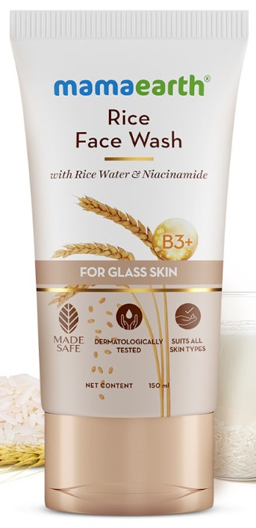
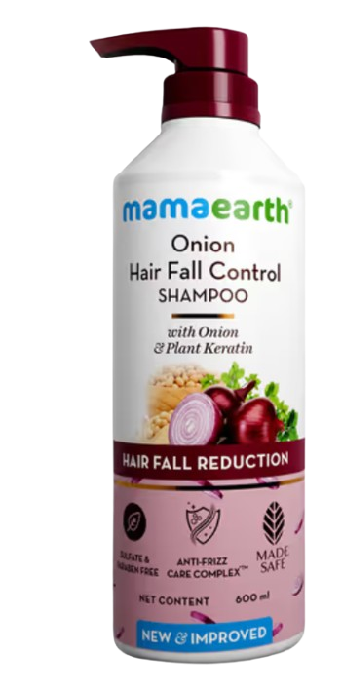
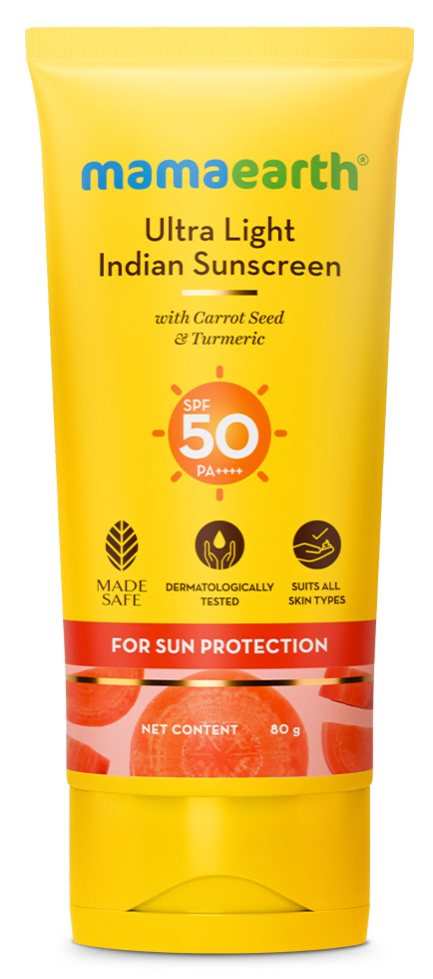
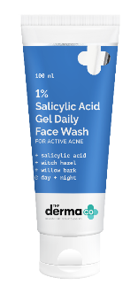
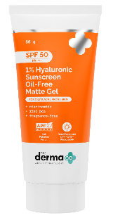
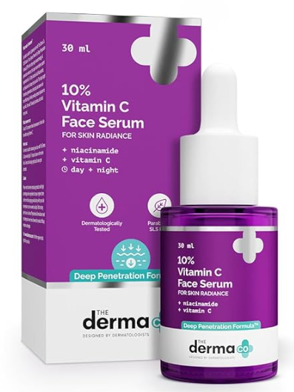
Brand & Category Segment Deep-Dive
Portfolio growth drivers and contribution view
Portfolio growth drivers and contribution view
Brand | Jun-25 | Feb-26 | Mar-26 | Apr-26 | May-26 | Jun-26 | Cont% | L3M Avg | GO L3M | GOLY Jun
Mamaearth | 1,994 | 2,184 | 2,470 | 2,655 | 2,842 | 2,757 | 72% | 2,656 | ▲ 4% | ▲ 38%
The Derma Co. | 207 | 511 | 684 | 856 | 1,100 | 996 | 26% | 880 | ▲ 13% | ▲ 381%
Aqualogica | 49 | 44 | 57 | 66 | 71 | 59 | 2% | 65 | ▼ 9% | ▲ 20%
Emerging Brands | 21 | 22 | 23 | 12 | 13 | 12 | 0% | 16 | ▼ 26% | ▼ 44%
Portfolio Total | 2,271 | 2,761 | 3,234 | 3,589 | 4,026 | 3,824 | 100% | 3,616 | ▲ 6% | ▲ 68%
Strategic Brand Portfolio
• Mamaearth stays portfolio leader: 72.1% share, +38% YoY, steady scale.
• The Derma Co. is fastest-scaling: 26.0% of NSV vs single digits a year ago.
• Aqualogica: +20% YoY, Jun cooled -16% MoM (Sun Care season); 1.5% of mix.
Overall | Mamaearth — Top 3 Sub-category Monthly Trend (NSV)
FW
GOLY
▲ 35%
MoM
▲ 0%
Shampoo
GOLY ▲ 65%
MoM
▲ 3%
Sun Care
GOLY
▲ 71%
MoM
▼ 30%
Hero SKU note (May'26 SKU basis): Rice Dewy Bright Face Wash variants from Mamaearth lead the Face Wash portfolio with NSV of ₹5.40 Cr.
Onion Shampoo variants from Mamaearth lead the Shampoo portfolio with NSV of ₹4.56 Cr.
Ultra Light Sunscreen from Mamaearth leads the Suncare portfolio with NSV of ₹1.62 Cr. 2
Overall | The Derma Co. — Top 3 Sub-category Monthly Trend (NSV)
FW
GOLY ▲ 1143%
MoM ▲ 5%
Hero SKU note (May'26 SKU basis): 1% Salicylic FW follows with NSV of ₹285 Lacs., contribute 6.4% of May’26 NSV within 1 year of launch .
Hyaluronic Acid leads the pack and contributes 96% of total Suncare sales, with NSV of ₹411 Lacs.
55% Niacinamide Serum leads with NSV of ₹28 Lacs, followed by Vitamin C Serum at ₹23 Lacs..
VOLUME VS. VALUE DECOMPOSITION — MAY'26 VS MAY'25 (QTY EXTRACT: MAY'26 BASIS — JUN'26 AWAITED)
Mamaearth
Sub Cat | Qty May-25 | Qty May-26 | Qty GOLY% | NSV May-25 | NSV May-26 | NSV GOLY% | ASP GOLY%
Face Cleanser | 6,23,925 | 7,85,723 | ▲ 26% | 865 | 1,120 | ▲ 30% | ▲ 3%
Shampoo | 2,75,067 | 3,57,736 | ▲ 30% | 516 | 789 | ▲ 53% | ▲ 18%
Sun Care | 1,12,028 | 1,67,158 | ▲ 49% | 211 | 353 | ▲ 67% | ▲ 12%
The Derma co.
Sub Cat | Qty May-25 | Qty May-26 | Qty GOLY% | NSV May-25 | NSV May-26 | NSV GOLY% | ASP GOLY%
Face Cleanser | 22,592 | 4,28,182 | ▲ 1795% | 44 | 557 | ▲ 1164% | ▼ 33%
Sun Care | 29,103 | 1,62,541 | ▲ 459% | 94 | 429 | ▲ 357% | ▼ 18%
Shampoo | 22,124 | 30,097 | ▲ 36% | 63 | 92 | ▲ 46% | ▲ 7%
3 / 34

Slide 4
Zone Performance Summary
Zone share, Jun’26 NSV and growth view
Zone Jun’26 NSV and Share
Zone Summary
Zone | Jun-25 | Mar-26 | Apr-26 | May-26 | Jun-26 | Zone Share | L3M Avg | GO L3M | GOLY Jun
East | 225 | 312 | 372 | 415 | 387 | 10% | 366 | ▲ 6% | ▲ 72%
North | 500 | 763 | 845 | 936 | 860 | 22% | 848 | ▲ 1% | ▲ 72%
South-1 | 454 | 661 | 767 | 895 | 827 | 22% | 774 | ▲ 7% | ▲ 82%
South-2 | 334 | 428 | 474 | 555 | 548 | 14% | 486 | ▲ 13% | ▲ 64%
West | 591 | 894 | 903 | 1,017 | 985 | 26% | 938 | ▲ 5% | ▲ 67%
FSN | 164 | 173 | 229 | 208 | 217 | 6% | 203 | ▲ 7% | ▲ 32%
Zone Insights | Jun’26 (post chain-NSV correction)
• West largest zone: NSV ₹985L, 25.8% of MT offtake.
• Every zone grew ≥ 64% YoY in Jun’26 — corrected NSV lifts growth network-wide (+68%).
• South-1 led YoY growth at +82%; East and North close at +72% each.
• Dmart is #1 chain in 3 of 5 zones (North, South-2, West); #2 in South-1 — national engine.
• Apollo reclaims #1 in South-1 (₹289L), +163% YoY — Derma Co.-led pharmacy momentum.
Brand & Category Repeats Across Zones
• The Derma Co. held ₹990L in Jun (record ₹1,097L in May), 25.9% of portfolio, +378% YoY.
• Face Cleanser & Sun Care are top-2 growth drivers for Derma Co. in 5 of 6 zones.
• FSN grew +32% YoY — improving, but still slower than the +68% network pace.
• Mamaearth Face Cleanser & Shampoo rank #1/#2 sub-categories by value in every zone.
• Sun Care cooled -30% MoM (seasonal) — protect sunscreen distribution into monsoon.
4 / 34

Slide 5
CHAIN-WISE MARKET SHARE — GROSS SALES BASIS
May'26 Honasa share of category Gross Sales, by chain | NEW — basis differs from NSV elsewhere in this deck
MARKET SHARE SUMMARY — MAY'26 VS APR'26
Chain | Honasa GS (Lacs) | Total Mkt (Lacs) | Mkt Share % | MoM (bps)
MRL | 59.7 | 2,128.7 | 3% | ▲ +31
Lulu | 111.5 | 2,848.0 | 4% | ▼ -21
Wellness Forever | 137.4 | 977.6 | 14% | ▼ -35
Reliance Retail | 2,052.0 | 19,298.6 | 11% | ▼ -38
Action Required by Chain
MRL
• Mkt Share 2.80% | MoM ▲ +31 bps
• Build — low share, large market; expand assortment & visibility
Lulu
• Mkt Share 3.91% | MoM ▼ -21 bps
• Fix — review listing gaps in declining sub-categories
Wellness Forever
• Mkt Share 14.06% | MoM ▼ -35 bps
• Protect — stronghold chain; monitor pharmacy-channel pressure
Reliance Retail
• Mkt Share 10.63% | MoM ▼ -38 bps
• Protect & Accelerate — largest base; review category mix shift
Data Quality Check
FW M/S
DATA BASIS: MAY’26 — JUN’26 NIELSEN / CHAIN-GS REFRESH AWAITED
• MRL's Honasa share nearly doubled over the period, 8% to 14% — the fastest-improving chain in this view.
• Wellness Forever holds the strongest relative position across all three months (15% to 18%), consistent with the stronghold-chain read on the previous page even though the absolute share level differs.
• Lulu and Reliance are comparatively flat over the period (Lulu 7% to 8%; Reliance 10% to 11%).
Key Takeaway
5 / 34

Slide 6
NIELSEN MARKET SHARE INSIGHTS| BRAND (MAMAEARTH & THE DERMA CO.| CATEGORY (FACEWASH & SHAMPOO)
Brand (Category) | MS Val % May'26 | MoM Bps | YoY Bps | MAT MS Val % | Value ₹Cr (May'26) | Value YoY % | Wtd Dist % (May'26)
Mamaearth FW | 12% | Flat | ▲ +311 bps | 10% | 9.6 | 54% | 87%
The Derma Co FW | 1% | ▲ +6 bps | ▲ +71 bps | 0% | 0.6 | 3940% | 14%
Mamaearth Shampoo | 4% | ▼ -31 bps | ▲ +134 bps | 4% | 6.5 | 64% | 81%
Key Insights for Facewash & Shampoo M/s
HONASA IS GAINING MODERN TRADE SHARE, LED BY STRONGER DISTRIBUTION
What happened — Mamaearth is the ★#4 Face Wash brand in MT at 11.6% (+3.1 pt YoY) and is gaining in Shampoo at 3.9% (+1.3 pt). The legacy leader Himalaya is down 3.3 pt.
Why — The gains are distribution-led: Mamaearth weighted handling moved 81→87% (FW) and 76→81% (Shampoo). The Derma Co is building MT from near-zero (0.6→14.2% handling).
Impact — Honasa is converting MT shelf into share in the two largest cleansing categories, worth ₹9.6 Cr + ₹6.5 Cr monthly RR and rising.
Action — Need to protect the FW Distribution gain and checked for Shampoo assortment gaps in chains to identify further growth opportunities.
FACE WASH | BRAND |MARKET SHARE
ME
FACE WASH Rank
#4
May'26
Value ₹9.6
Cr
M/S 11.6%
▲+311
Bps YOY
Dist 81→87%
The Derma Co FACE WASHz |  |  | May’26 Value .60 Lakhs |  |  | M/S 0.7% ▲ +71 bps |  |  | Dist 0.6%→14.2%
 | ▶ |  |  | ▶ |  |  | ▶
Key Insights:
Category ₹83 Cr (+13% YoY). Himalaya leads (21.6%) but down 3.3 pt. Mamaearth (#4, +3.1 pt) is the biggest gainer. ★ = Honasa.
Mamaearth is the #4 Face Wash brand in MT at 11.6% (+3.1 pt YoY). The legacy leader Himalaya is down 3.3 pt.
The gains are distribution-led: ME weighted handling moved 81→87% & The Derma Co weighted handling moved .6 →14.2%.
DATA BASIS: MAY’26 — JUN’26 NIELSEN / CHAIN-GS REFRESH AWAITED
Rank | Brand | Value ₹Cr | Val YoY | MS Val% | MoM Bps | YoY Bps | MAT % | Wtd Dist%
1 | Himalaya | 17.9 | −2% | 22% | ▲ +20 bps | ▼ -328 bps | 23% | 100%
2 | Garnier | 11.8 | 17% | 14% | ▲ +43 bps | ▲ +55 bps | 14% | 90%
3 | Pond's | 11.4 | 8% | 14% | ▼ -114 bps | ▼ -61 bps | 14% | 98%
4 | Mamaearth ★ | 9.6 | 54% | 12% | Flat | ▲ +311 bps | 10% | 87%
5 | Clean & clear | 6.3 | 16% | 8% | ▲ +3 bps | ▲ +22 bps | 8% | 97%
6 | Joy | 4.9 | 7% | 6% | ▲ +7 bps | ▼ -30 bps | 6% | 76%
7 | Lakme | 3.1 | 23% | 4% | ▲ +60 bps | ▲ +31 bps | 3% | 79%
8 | Nivea men | 3 | −2% | 4% | ▼ -7 bps | ▼ -54 bps | 4% | 86%
9 | Simple | 1.9 |  | 2% | ▲ +36 bps | ▲ +223 bps | 1% | 51%
10 | Biotique | 0.9 | −22% | 1% | ▼ -13 bps | ▼ -49 bps | 1% | 55%
11 | Patanjali | 0.9 | −3% | 1% | ▼ -6 bps | ▼ -17 bps | 1% | 58%
12 | Everyuth | 0.9 | 6% | 1% | ▼ -16 bps | ▼ -6 bps | 1% | 69%
13 | VLCC | 0.736 | -22% | 89% | ▼ -5 bps | ▼ -40 bps | 112% | 59%
14 | GLOW & LOVELY | 0.665 | 6% | 80% | ▼ -4 bps | ▼ -5 bps | 98% | 71%
15 | LOTUS | 0.615 | 35% | 74% | ▼ -10 bps | ▲ +12 bps | 76% | 58%
16 | THE DERMA CO ★ | 0.606 | 3940% | 73% | ▲ +6 bps | ▲ +71 bps | 32% | 14%

Slide 7
MAMAEARTH FACE WASH | PACK-SIZE | MAY'26
Rank | Pack size | MS Val % | Pack | MoM | YoY | MAT | Value ₹Cr | Value
 |  | May'26 | Cont % | Bps | Bps | MS Val % | May'26 | YoY %
1 | 150 ml | 7% | 58% | ▼ -40 bps | ▲ +290 bps | 6% | 5.53 | 98%
2 | 100 ml | 2% | 21% | ▼ -40 bps | ▼ -60 bps | 3% | 1.96 | -11%
3 | 200 ml | 1% | 11% | ▲ +90 bps | ▲ +130 bps | 0% | 1.06
4 | 50 ml | 1% | 11% | ▼ -10 bps | ▲ +50 bps | 1% | 1.01 | 80%
5 | 250 ml | 0% | 0% | Flat | ▼ -80 bps | 0% | 0.04 | -94%
6 | 80 ml | 0% | 0% | Flat | Flat | 0% | 0 | -25%
• 150ml is the hero pack: 6.7% MT share, ~58% of Mamaearth Face Wash, growing strongly at +98% YoY.
• 150ml has slight MoM softness at -0.4 bps but remains strong YoY with +2.9 bps gain.
• 100ml is the 2nd key pack: ~21% contribution but declining -10.7% YoY with negative share movement. Needs availability and promo check.
• 150ml + 100ml contribute ~78% of the brand, so shelf depth for both packs must be protected in MT.
• 200ml is emerging as a growth builder with ~11% contribution & positive share gain. Track chain-wise for scale-up.
• 50ml is a trial pack with ~10.5% contribution and +80% YoY growth. Use for till-points and entry visibility.
• 250ml is sharply down at -94% YoY and very low contribution.
• Action: Use 50ml at till-points, impulse counters and trial-led visibility spots.
NIELSEN MARKET SHARE READOUT: SHAMPOO
ME
Shampoo
May'26
Value ₹6.5
Cr
M/S 3.9%
▲ +134
bps YOY
Dist
76%→81%
Key Insights
Face Wash category size is ₹166 Cr.
Dove leads the category with 17.8% share.
Mamaearth ranks #7 with 3.9% share.
Mamaearth has gained ▲ +134 Bps YOY.
Shampoo distribution remains under-indexed vs Face Wash Dist.
DATA BASIS: MAY’26 — JUN’26 NIELSEN / CHAIN-GS REFRESH AWAITED
Rank | Brand | Value | Val | MS Val | MoM | YoY | MAT | Wtd Dist
 |  | ₹Cr | YoY | % | Bps | Bps | % | %
1 | Dove | 29.6 | 7% | 18% | ▲ +170 bps | ▲ +20 bps | 16% | 99%
2 | L'oreal paris | 22.1 | 20% | 13% | ▲ +70 bps | ▲ +130 bps | 13% | 91%
3 | Head & shoulders | 19 | −8% | 11% | ▲ +130 bps | ▲ +200 bps | 13% | 99%
4 | Tresemme | 17.3 | 25% | 10% | ▲ +90 bps | ▲ +140 bps | 9% | 98%
5 | Clinic plus | 16.7 | 14% | 10% | ▲ +30 bps | ▲ +50 bps | 10% | 99%
6 | Sunsilk | 14.8 | −7% | 9% | Flat | ▲ +150 bps | 10% | 99%
7 | Mamaearth ★ | 6.5 | 64% | 4% | ▲ +30 bps | ▲ +130 bps | 4% | 81%
8 | Pantene | 6.5 | −4% | 4% | ▲ +30 bps | ▲ +50 bps | 4% | 96%
9 | Himalaya | 5.7 | 2% | 3% | ▲ +40 bps | ▲ +20 bps | 4% | 91%
10 | Himalaya baby care | 3.5 | 16% | 2% | ▲ +30 bps | ▲ +20 bps | 2% | 96%
11 | Meera | 3.5 | 15% | 2% | ▲ +20 bps | ▲ +10 bps | 2% | 22%
12 | Dabur vatika | 2.5 | 35% | 2% | ▲ +10 bps | ▲ +30 bps | 2% | 78%

Slide 8
MAMAEARTH SHAMPOO | PACK-SIZE | MAY'26
Rank | Pack size | MS Val % May'26 | Pack Cont% | MoM Bps | YoY Bps | MAT MS Val % | Value ₹Cr May'26 | Value YoY %
1 | 400 ml | 3% | 76% | ▼ -16 bps | ▲ +110 bps | 3% | 4.96 | 71%
2 | 250 ml | 1% | 13% | ▼ -8 bps | ▼ -8 bps | 1% | 0.82 | -7%
3 | 650 ml | 0% | 7% | ▲ +3 bps | ▲ +26 bps | 0% | 0.43
4 | 600 ml | 0% | 2% | ▼ -2 bps | ▲ +4 bps | 0% | 0.12 | 151%
5 | 200 ml | 0% | 1% | Flat | ▼ 0 bps | 0% | 0.08 | 3%
6 | 100 ml | 0% | 1% | ▼ -1 bps | ▲ +2 bps | 0% | 0.06
7 | 180 ml | 0% | 1% | ▼ -4 bps | ▲ +2 bps | 0% | 0.04
8 | 50 ml | 0% | 0% | ▼ -5 bps | ▼ -3 bps | 0% | 0.03 | -59%
• 400ml is the hero pack: 3.0% MT share, ~76% of Mamaearth Shampoo, growing +71% YoY. • High concentration risk: Brand is heavily dependent on one pack, so any chain-level delisting or stock gap can impact overall performance. • 250ml needs recovery: Second key pack at 12.5% contribution but declining -7% YoY. Listing expansion is required. • 650ml is emerging: Small base but gaining share MoM. Track existing & Listing chain wise for future scale-up. • Action: Need to Protect 400ml availability and increase listing for gaps to secure and increase sales, need to widen 250ml listing for gaining share and to extend the listing & linking for 650ml as the next opportunity.
ME Shampoo Pack Availability vs Opportunity Gap
DATA BASIS: MAY’26 — JUN’26 NIELSEN / CHAIN-GS REFRESH AWAITED
• 400ml – 45.9 Cr (69% share) #1
• 250ml – 9.9 Cr (79% share) #-1
• Build 650ml Track chain-wise, plan for scale
WHERE WE'RE MISSING
340ml – 261 Cr Dove leads | We: 0 Cr
1000ml – 216 Cr Dove leads | We: 0 Cr
580ml – 64 Cr Tresemmé leads | We: 0 Cr
COMPETITORS STRONG:
• Dove: 250ml, 340ml, 400ml, 1000ml
• H&S: 180ml, 250ml, 400ml, 580ml
• Himalaya: 180ml, 1000ml

Slide 9
NIELSEN MARKET SHARE READOUT: FACEWASH & SHAMPOO
Category-level external validation (Nielsen MS Val, Urban) vs chain-wise performance | NEW
Headline
Nielsen confirms the chain-wise growth story: Mamaearth gained share YoY in both categories nationally. Facewash share gains held steady MoM; Shampoo share dipped slightly MoM even as category value grew.
Face Wash Market Share by Zone (%)
ZONE-WISE MARKET SHARE — Facewash & SHAMPOO (NIELSEN MS VAL)
Zone | Apr'26 | May'26 | MoM (bps) | Top Brand in Zone
North | 7% | 7% | ▼ -33 bps | Himalaya (20.1%)
South | 6% | 7% | ▲ +90 bps | Himalaya (28.3%)
East | 5% | 5% | ▲ +37 bps | Himalaya (23.0%)
West | 7% | 7% | ▼ -3 bps | Himalaya (22.1%)
Zone | Apr'26 | May'26 | MoM (bps) | Top Brand in Zone
North | 2% | 2% | ▼ -26 bps | Dove (15.7%)
South | 3% | 3% | ▲ +8 bps | Head & Shoulders (12.5%)
East | 3% | 3% | ▲ +37 bps | Dove (13.7%)
West | 2% | 2% | ▲ +5 bps | Dove (16.8%)
Facewash — Mamaearth (Nielsen MS Val, Urban India)
Shampoo — Mamaearth (Nielsen MS Val, Urban India)
Metric | May'25 | Apr'26 | May'26 | MoM | YoY
MS % | 6% | 7% | 7% | ▲+2bps | ▲+107 bps
Sales (Cr.) | 14.98 | 17.54 | 18.61 | ▲+6.1% | ▲+24.2%
Metric | May'25 | Apr'26 | May'26 | MoM | YoY
MS % | 2% | 3% | 3% | ▼-2bps | ▲+75bps
Sales (Cr.) | 5.49 | 6.94 | 7.75 | ▲+11.5% | ▲+41.1%
DATA BASIS: MAY’26 — JUN’26 NIELSEN / CHAIN-GS REFRESH AWAITED
Top Category Gainers / Decliners Facewash (Top competitors, MS Val May'26)
Top Category Gainers / Decliners Shampoo (Top competitors, MS Val May'26)
Brand | May'25 | Apr'26 | May'26 | YoY bps
Himalaya | 22% | 22% | 22% | ▲ +69
Garnier | 15% | 13% | 13% | ▼ -112
Pond's | 13% | 13% | 13% | ▼ -32
Mamaearth | 6% | 7% | 7% | ▲ +107
The Derma Co | 0% | 1% | 1% | ▲ +69
Brand | May'25 | Apr'26 | May'26 | YoY bps
Dove | 15% | 13% | 15% | ▼ -28
H & S | 12% | 12% | 11% | ▼ -106
TRESemme | 6% | 7% | 7% | ▲ +99
Mamaearth | 2% | 3% | 3% | ▲ +75
Patanjali | 2% | 2% | 2% | ▼ -34
Business Reason & Action Required
Facewash:
Gain is broad-based (category value ▲24% YoY), consistent with the strong chain-wise Face category growth seen elsewhere in this deck — reads as genuine share gain, not just category tailwind. Protect and continue distribution push.
Shampoo:
YoY gain remains strong (+75 bps) but the marginal MoM dip (-2 bps) against +11.5% category value growth suggests Honasa grew slower than the category this month — flag for next-cycle tracking.
9 / 34

Slide 10
NIELSEN MARKET SHARE READOUT: FACEWASH & SHAMPOO
Category-level external validation (Nielsen MS Val, Urban) vs chain-wise performance | NEW
FACEWASH — TOP CONTRIBUTING STATES
State | Contrib. to Category | May'26 Share | MoM (bps)
Uttar Pradesh * | 15% | 6% | ▼ -122 bps
Maharashtra * | 14% | 6% | ▲ +16 bps
West Bengal * | 8% | 5% | ▲ +28 bps
Delhi | 8% | 9% | ▼ -42 bps
Haryana | 6% | 8% | ▲ +148 bps
Madhya Pradesh | 6% | 7% | ▲ +14 bps
Bihar * | 6% | 5% | ▼ -15 bps
Gujarat | 5% | 10% | ▼ -88 bps
* High contribution to category size but share below the national average — under-penetrated opportunity
SHAMPOO — TOP CONTRIBUTING STATES
State | Contrib. to Category | May'26 Share | MoM (bps)
Maharashtra * | 15% | 1% | ▲ +11 bps
Gujarat | 11% | 3% | ▼ -61 bps
Uttar Pradesh * | 10% | 2% | ▼ -67 bps
Delhi * | 7% | 2% | ▲ +16 bps
Karnataka | 6% | 3% | ▲ +42 bps
West Bengal | 6% | 3% | ▲ +53 bps
Haryana * | 6% | 2% | ▼ -5 bps
Punjab * | 6% | 1% | ▼ -33 bps
* High contribution to category size but share below the national average — under-penetrated opportunity
High Contribution, Low Share States
Facewash: Uttar Pradesh (14.5% contrib, 6.0% share); Maharashtra (13.5% contrib, 6.0% share); West Bengal (8.4% contrib, 5.0% share); Bihar (5.5% contrib, 4.7% share). Shampoo: Maharashtra (14.8% contrib, 1.5% share); Uttar Pradesh (9.7% contrib, 2.5% share); Delhi (7.2% contrib, 1.9% share); Haryana (5.6% contrib, 2.2% share); Punjab (5.5% contrib, 1.4% share). Uttar Pradesh and Maharashtra are the two largest under-penetrated states across both categories — biggest white-space opportunity for distribution and visibility investment.
DATA BASIS: MAY’26 — JUN’26 NIELSEN / CHAIN-GS REFRESH AWAITED
CATEGORY, BRAND & PACK-SIZE DRIVING HONASA'S STATE-WISE CHAIN SALES (INTERNAL)
State | May'26 (Lacs) | Top Category | Top Brand | Top Pack
Kerala | 54.9 | Face | Mamaearth | 150 ml/g
Telangana | 32.4 | Face | Mamaearth | 150 ml/g
Karnataka | 32.1 | Face | Mamaearth | 50 ml/g
Uttar Pradesh | 16.3 | Face | Mamaearth | 150 ml/g
Tamil Nadu | 14.4 | Face | Mamaearth | 150 ml/g
West Bengal | 14.1 | Face | Mamaearth | 50 ml/g
Delhi/Ncr | 13.6 | Face | The Derma Co. | 50 ml/g
Andhra Pradesh | 3.4 | Face | Mamaearth | 100 ml/g
Punjab | 2.9 | Face | Mamaearth | 100 ml/g
Basis: MT chain extract (MRL + Lulu + Wellness), Data for=HCL rows only — Honasa's internal sales mix, not a competitive denominator. State names from this source do not map 1:1 to Nielsen's state list above (e.g. Kerala/Andhra Pradesh have no separate Nielsen state cut).
10 / 34

Slide 11
MT vs GT DEEP DIVE: EXECUTIVE SUMMARY
Facewash & Shampoo (Mamaearth) — Nielsen/Kantar Retail Audit Panel, data through Jun'26
MT Facewash (Mamaearth)
+55.2%
L12M value growth; share +3.0pp to 10.5%
GT Facewash (Mamaearth)
+13.1%
L12M value growth; share +0.3pp to 4.4%
MT Shampoo (Mamaearth)
+48.4%
L12M value growth; share +1.2pp to 3.7%
GT Shampoo (Mamaearth)
-22.8%
L12M value DECLINE; dist. -5.0pp
BOTTOM LINE
MT is winning on every axis — share, distribution, dealer productivity all compounding fast in both categories.
GT Shampoo is in active decline — value, share, distribution AND store count all falling double-digits; the single weakest pocket.
Action: root-cause GT Shampoo distribution loss before FY27 planning; replicate MT's merchandising playbook into top GT chains.
11 / 34

Slide 12
FACEWASH — MT vs GT (MAMAEARTH)
Nielsen/Kantar retail-audit panel — MT = AI (U+R) MT, GT = GT Total, L12M Jun'25→Jun'26
Metric | MT | GT | Read
Category value growth | +9.9% | +5.1% | MT category growing ~2x faster
Mamaearth value growth | +55.2% | +13.1% | MT growth ~4x GT
Mamaearth Market Share (Val) | 7.5%→10.5% | 4.1%→4.4% | MT share +3.0pp vs GT +0.3pp
Weighted Distribution | 78.7%→87.0% | 49.9%→50.1% | MT approaching distribution ceiling
PDO (Rs/dealer, productivity) | +19.9% | -3.8% | GT productivity declining
Jun'26 vs Jun'25 (latest month) | +58.3% | +9.6% | GT category itself flat (-0.2%)
Read: MT is compounding share and distribution gains; GT growth is real but far slower and productivity (PDO) is declining.
12 / 34

Slide 13
SHAMPOO — MT vs GT (MAMAEARTH)
Steepest MT/GT divergence of any category tracked — L12M Jun'25→Jun'26
Metric | MT | GT | Read
Category value growth | flat (~0%) | -0.5% | Category itself soft in both channels
Mamaearth value growth | +48.4% | -22.8% | GT Mamaearth shampoo DECLINING
Mamaearth Market Share (Val) | 2.5%→3.7% | 1.2%→0.9% | GT share eroding
Weighted Distribution | 73.5%→78.3% | 28.3%→23.3% | GT losing listings (-5.0pp)
# Stores Retailing | +17.3% | -9.0% | GT store count shrinking
Jun'26 vs Jun'25 (latest month) | +93.8% | -20.0% | Sharpest divergence of all metrics
Read: GT Shampoo is declining on every metric — value, share, distribution, store count. Needs urgent root-cause diagnosis.
13 / 34

Slide 14
WHY THIS IS HAPPENING
Distribution, productivity and pack-mix drivers behind the MT/GT gap
Distribution is the core lever
MT WD is near ceiling (87-89%) and still adding stores (+17-32%); GT Shampoo WD fell 5pp and Mamaearth GT stores shrank 9% — a de-listing problem, not demand.
Productivity gap
MT PDO growth is 20-62%; GT PDO is flat-to-declining — MT merchandising/visibility execution converts distribution into offtake far more efficiently.
Pack mix explains part of the price gap
GT Shampoo basket skews small packs (180/100/200/80ml); MT skews large packs (650/340/180/1000ml) — caps GT per-store realization and PDO.
MT — Top Packs (Jun'26) | Value (Cr) | GT — Top Packs (Jun'26) | Value (Cr)
650ml | 41.4 | 180ml | 25.3
180ml / 340ml | 22.2 each | 100ml | 16.4
1000ml | 20.1 | 200ml | 13.3
14 / 34

Slide 15
COMPETITIVE LANDSCAPE — NATIONAL URBAN (NIELSEN)
Separate source: total Urban MS Val vs named competitors, May'26 vintage (not the MT/GT panel above)
FACEWASH — top competitors
Rank | Brand | Value (Cr) | MS Val% | YoY (bps)
1 | Himalaya | 17.9 | 22% | -328
2 | Garnier | 11.8 | 14% | +55
3 | Pond's | 11.4 | 14% | -61
4 | Mamaearth | 9.6 | 12% | +311
5 | Clean & Clear | 6.3 | 8% | +22
16 | The Derma Co | 0.6 | 0.7% | +71
SHAMPOO — top competitors
Rank | Brand | Value (Cr) | MS Val% | YoY (bps)
1 | Dove | 29.6 | 18% | +20
2 | L'Oreal Paris | 22.1 | 13% | +130
3 | Head & Shoulders | 19.0 | 11% | +200
4 | Tresemme | 17.3 | 10% | +140
7 | Mamaearth | 6.5 | 4% | +130
Facewash: Mamaearth ranks #4 nationally, growing share fastest of the top 5 (+311bps YoY vs Garnier's +55bps).
Shampoo: Mamaearth is #7 in a crowded field (Dove, L'Oreal, H&S, Tresemme, Clinic Plus, Sunsilk all ahead) — consistent with GT-specific weakness above.
15 / 34

Slide 16
PACK-SIZE & STATE WHITE SPACE (NIELSEN, MAY'26)
Mamaearth Facewash pack mix + high-contribution/low-share state opportunity
Mamaearth Facewash — pack size
Pack | % of Brand | YoY Growth | Note
150ml | 58% | +98% | Hero pack — protect shelf depth
100ml | 21% | -11% | Declining — check availability
200ml | 11% | n/a | Emerging growth builder
50ml | 11% | +80% | Trial pack — till-point placement
250ml | 0% | -94% | Sharp decline, low base
High-contribution, low-share states
State | Contribution | May'26 Share | Read
Uttar Pradesh (FW) | 15% | 6% | Under-penetrated
Maharashtra (FW) | 14% | 6% | Under-penetrated
Maharashtra (Sh) | 15% | 1% | Under-penetrated
Uttar Pradesh (Sh) | 10% | 2% | Under-penetrated
Key insight: Uttar Pradesh and Maharashtra are the two largest under-penetrated states across BOTH categories — the biggest distribution/visibility white space.
16 / 34

Slide 17
EAST ZONE PERFORMANCE
Jun-26 Sales
387
Zone Share
10.1%
L3M Avg
366
GOLY Jun
▲ 72%
Key Performance Highlights
Zone View: Jun-26 closed at 387 for East (10.1% of channel), ▼ 7% MoM off the May-26 record of 415. Q1 FY27 = 1,173 Lacs, ▲ 68% vs Q1 FY26.
Growth View: Jun-26 was ▲ 6% vs L3M and ▲ 72% vs Jun-25 — YoY momentum intact despite seasonal moderation.
Brand | Jun-25 | May-26 | Jun-26 | Cont % | L3M | GO L3M | GOLY
Mamaearth | 199 | 363 | 333 | 86% | 321 | ▲ 4% | ▲ 67%
The Derma Co. | 12 | 44 | 47 | 12% | 37 | ▲ 26% | ▲ 292%
Aqualogica | 7 | 7 | 5 | 1% | 7 | ▼ 25% | ▼ 29%
Emerging Brands | 2 | 1 | 2 | 0% | 1
East | Mamaearth — Top 3 Sub-category Monthly Trend (NSV)
FW
GOLY ▲ 58%
MoM
▼ 7%
Shampoo
GOLY ▲ 96%
MoM
▼ 10%
Sun Care
GOLY ▲ 108%
MoM
▼ 31%
East | The Derma Co. — Top 3 Sub-category Monthly Trend (NSV)
FW
GOLY
▲ 633%
MoM
▲ 22%
Sun Care
GOLY
▲ 180%
MoM
▼ 22%
Face Serum
GOLY
▲ 125%
MoM
▲ 29%
East Chain Summary
Chain | Jun-25 | May-26 | Jun-26 | Cont% | L3M | GO L3M | GOLY
Reliance | 156 | 264 | 250 | 65% | 234 | ▲ 7% | ▲ 60%
Apollo | 32 | 80 | 80 | 21% | 70 | ▲ 13% | ▲ 149%
VMM | 6 | 20 | 14 | 4% | 16 | ▼ 13% | ▲ 131%
More Retail | 7 | 11 | 10 | 3% | 10 | ▼ 5% | ▲ 39%
Frankros | 1 | 10 | 7 | 2% | 6 | ▲ 23% | ▲ 581%
Spencer | 11 | 8 | 6 | 2% | 9 | ▼ 31% | ▼ 45%
Others Combined | 12 | 21 | 21 | 5% | 22 | ▼ 3% | ▲ 76%
CHAIN KEY HIGHLIGHTS
Zone View: East closed Jun-26 at 387, ▲ 6% vs L3M and ▲ 72% vs Jun-25; Q1 FY27 ▲ 68% YoY (corrected NSV). Chain Highlights: Reliance leads; Apollo is the fastest YoY chain.
Lead Chain
Reliance - 250
Fastest YoY Chain
Apollo - ▲ 149%
Record Chain ines2
Reliance, VMM, Apollo, More Retail,
Zone Record
May-26 - 415
17 / 34

Slide 18
NORTH ZONE PERFORMANCE
Jun-26 Sales
860
Zone Share
22.5%
L3M Avg
848
GOLY Jun
▲ 72%
Key Performance Highlights
Zone View: Jun-26 closed at 860 for North (22.5% of channel), ▼ 8% MoM off the May-26 record of 936. Q1 FY27 = 2,641 Lacs, ▲ 67% vs Q1 FY26.
Growth View: Jun-26 was ▲ 1% vs L3M and ▲ 72% vs Jun-25 — YoY momentum intact despite seasonal moderation.
Brand | Jun-25 | May-26 | Jun-26 | Cont % | L3M | GO L3M | GOLY
Mamaearth | 453 | 673 | 618 | 72% | 638 | ▼ 3% | ▲ 36%
The Derma Co. | 36 | 243 | 223 | 26% | 193 | ▲ 15% | ▲ 519%
Aqualogica | 10 | 19 | 18 | 2% | 16 | ▲ 12% | ▲ 80%
Emerging Brands | 2 | 2 | 1 | 0% | 1
North | Mamaearth — Top 3 Sub-category Monthly Trend (NSV)
FW
GOLY ▲ 32%
MoM
▼ 6%
Jun'26
252
Shampoo
GOLY ▲ 78%
MoM
▼ 4%
Jun'26 182
Sun Care
GOLY ▲ 47%
MoM
▼ 26%
Jun'26
66
North | The Derma Co. — Top 3 Sub-category Monthly Trend (NSV)
FW
GOLY
▲ 1400%
MoM
▲ 2%
Jun'26 135
Sun Care
GOLY
▲ 283%
MoM
▼ 25%
Jun'26
69
Face
Serum
GOLY
▲ 88%
MoM
▼ 6%
Jun'26
15
North Chain Summary
Chain | Jun-25 | May-26 | Jun-26 | Cont% | L3M | GO L3M | GOLY
Dmart | 182 | 351 | 328 | 38% | 308 | ▲ 6% | ▲ 80%
Reliance | 193 | 337 | 309 | 36% | 295 | ▲ 5% | ▲ 60%
Apollo | 45 | 125 | 118 | 14% | 115 | ▲ 2% | ▲ 161%
Sancus(Rmt) | 36 | 46 | 40 | 5% | 49 | ▼ 18% | ▲ 11%
Lulu | 5 | 19 | 18 | 2% | 17 | ▲ 5% | ▲ 260%
Metro Cnc | 10 | 13 | 13 | 2% | 13 | ▲ 1% | ▲ 34%
Others Combined | 29 | 45 | 34 | 4% | 51 | ▼ 32% | ▲ 18%
CHAIN KEY HIGHLIGHTS
Zone View: North closed Jun-26 at 860, ▲ 1% vs L3M and ▲ 72% vs Jun-25; Q1 FY27 ▲ 67% YoY (corrected NSV). Chain Highlights: Dmart leads; Lulu is the fastest YoY chain.
Lead Chain
Fastest YoY Chain
Record Chain Lines
Zone Record
Dmart - 328
Lulu - ▲ 260%
Dmart, Reliance, Apollo,
May-26 - 936
18 / 34

Slide 19
SOUTH-1 ZONE PERFORMANCE
Jun-26 Sales
827
Zone Share
21.6%
L3M Avg
774
GOLY Jun
▲ 82%
Key Performance Highlights
Zone View: Jun-26 closed at 827 for South-1 (21.6% of channel), ▼ 8% MoM off the May-26 record of 895. Q1 FY27 = 2,489 Lacs, ▲ 84% vs Q1 FY26.
Growth View: Jun-26 was ▲ 7% vs L3M and ▲ 82% vs Jun-25 — YoY momentum intact despite seasonal moderation.
Brand | Jun-25 | May-26 | Jun-26 | Cont % | L3M | GO L3M | GOLY
Mamaearth | 366 | 586 | 559 | 68% | 522 | ▲ 7% | ▲ 53%
The Derma Co. | 66 | 286 | 248 | 30% | 230 | ▲ 8% | ▲ 276%
Aqualogica | 15 | 18 | 16 | 2% | 16 | ▼ 2% | ▲ 7%
Emerging Brands | 4 | 5 | 4 | 1% | 4
South-1 | Mamaearth — Top 3 Sub-category Monthly Trend (NSV)
FW
GOLY ▲ 41%
MoM
▼ 9%
Jun'26
173
Shampoo
GOLY ▲ 72%
MoM
▲ 5%
Jun'26 179
Sun Care
GOLY ▲ 130%
MoM
▼ 24%
Jun'26
53
South-1 | The Derma Co. — Top 3 Sub-category Monthly Trend (NSV)
FW
GOLY
▲ 721%
MoM
▼ 1%
Jun'26 115
Sun Care
GOLY
▲ 210%
MoM
▼ 29%
Jun'26 93
Face
Serum
GOLY
▲ 76%
MoM
▲ 0%
Jun'26
30
South-1 Chain Summary
Chain | Jun-25 | May-26 | Jun-26 | Cont% | L3M | GO L3M | GOLY
Apollo | 102 | 292 | 289 | 35% | 257 | ▲ 12% | ▲ 183%
Dmart | 138 | 267 | 229 | 28% | 223 | ▲ 3% | ▲ 66%
Reliance | 95 | 152 | 151 | 18% | 136 | ▲ 11% | ▲ 59%
Lulu | 36 | 84 | 86 | 10% | 72 | ▲ 19% | ▲ 139%
H&G | 53 | 58 | 35 | 4% | 45 | ▼ 23% | ▼ 35%
Metro Cnc | 14 | 15 | 14 | 2% | 16 | ▼ 11% | ▲ 2%
Others Combined | 16 | 27 | 23 | 3% | 26 | ▼ 11% | ▲ 42%
CHAIN KEY HIGHLIGHTS
Zone View: South-1 closed Jun-26 at 827, ▲ 7% vs L3M and ▲ 82% vs Jun-25; Q1 FY27 ▲ 84% YoY (corrected NSV). Chain Highlights: Apollo leads; Apollo is the fastest YoY chain.
Lead Chain
Fastest YoY Chain
Record Chain Lines
Zone Record
Apollo - 289
Apollo - ▲ 183%
Apollo, Dmart, Reliance,
May-26 - 895
19 / 34

Slide 20
SOUTH-2 ZONE PERFORMANCE
Jun-26 Sales
548
Zone Share
14.3%
L3M Avg
486
GOLY Jun
▲ 64%
Key Performance Highlights
Zone View: Jun-26 closed at 548 for South-2 (14.3% of channel), ▼ 1% MoM off the May-26 record of 555. Q1 FY27 = 1,576 Lacs, ▲ 65% vs Q1 FY26.
Growth View: Jun-26 was ▲ 13% vs L3M and ▲ 64% vs Jun-25 — YoY momentum intact despite seasonal moderation.
Brand | Jun-25 | May-26 | Jun-26 | Cont % | L3M | GO L3M | GOLY
Mamaearth | 305 | 414 | 427 | 78% | 382 | ▲ 12% | ▲ 40%
The Derma Co. | 23 | 131 | 113 | 21% | 94 | ▲ 20% | ▲ 391%
Aqualogica | 6 | 8 | 6 | 1% | 7 | ▼ 10% | ▲ 0%
Emerging Brands | 2 | 2 | 2 | 0% | 2
South-2 | Mamaearth — Top 3 Sub-category Monthly Trend (NSV)
FW
GOLY ▲ 47%
MoM
▲ 10%
Jun'26
159
Shampoo
GOLY ▲ 60%
MoM
▲ 9%
Jun'26 130
Sun Care
GOLY ▲ 93%
MoM
▼ 28%
Jun'26
29
South-2 | The Derma Co. — Top 3 Sub-category Monthly Trend (NSV)
FW
GOLY
▲ 1220%
MoM
▲ 6%
Jun'26 66
Sun Care
GOLY
▲ 250%
MoM
▼ 39%
Jun'26
35
Face
Serum
GOLY
▲ 50%
MoM
▼ 10%
Jun'26
9
South-2 Chain Summary
Chain | Jun-25 | May-26 | Jun-26 | Cont% | L3M | GO L3M | GOLY
Dmart | 142 | 218 | 229 | 42% | 187 | ▲ 23% | ▲ 62%
Apollo | 70 | 176 | 163 | 30% | 159 | ▲ 2% | ▲ 132%
Reliance | 57 | 85 | 94 | 17% | 78 | ▲ 21% | ▲ 66%
H&G | 23 | 24 | 14 | 3% | 18 | ▼ 20% | ▼ 39%
More Retail | 13 | 20 | 13 | 2% | 16 | ▼ 18% | ▲ 1%
Lulu | 2 | 13 | 12 | 2% | 9 | ▲ 27% | ▲ 485%
Others Combined | 27 | 20 | 22 | 4% | 19 | ▲ 17% | ▼ 17%
CHAIN KEY HIGHLIGHTS
Zone View: South-2 closed Jun-26 at 548, ▲ 13% vs L3M and ▲ 64% vs Jun-25; Q1 FY27 ▲ 65% YoY (corrected NSV). Chain Highlights: Dmart leads; Apollo is the fastest YoY chain.
Lead Chain
Fastest YoY Chain
Record Chain Lines
Zone Record
Dmart - 229
Apollo - ▲ 132%
Dmart, Apollo, Reliance,
May-26 - 555
20 / 34

Slide 21
WEST ZONE PERFORMANCE
Jun-26 Sales
985
Zone Share
25.8%
L3M Avg
938
GOLY Jun
▲ 67%
Key Performance Highlights
Zone View: Jun-26 closed at 985 for West (25.8% of channel), ▼ 3% MoM off the May-26 record of 1017. Q1 FY27 = 2,905 Lacs, ▲ 55% vs Q1 FY26.
Growth View: Jun-26 was ▲ 5% vs L3M and ▲ 67% vs Jun-25 — YoY momentum intact despite seasonal moderation.
Brand | Jun-25 | May-26 | Jun-26 | Cont % | L3M | GO L3M | GOLY
Mamaearth | 532 | 642 | 643 | 65% | 635 | ▲ 1% | ▲ 21%
The Derma Co. | 50 | 359 | 330 | 33% | 288 | ▲ 15% | ▲ 560%
Aqualogica | 6 | 14 | 11 | 1% | 13 | ▼ 18% | ▲ 83%
Emerging Brands | 0 | 2 | 1 | 0% | 1
West | Mamaearth — Top 3 Sub-category Monthly Trend (NSV)
FW
GOLY ▲ 19%
MoM
▲ 6%
Jun'26
308
Shampoo
GOLY ▲ 44%
MoM
▲ 9%
Jun'26 191
Sun
Care
GOLY ▲ 50%
MoM
▼ 42%
Jun'26
51
West | The Derma Co. — Top 3 Sub-category Monthly Trend (NSV)
FW
GOLY▲ 1669%
MoM
▲ 7%
Jun'26 230
Sun Care
GOLY
▲ 407%
MoM
▼ 36%
Jun'26 76
Face
Serum
GOLY
▲ 6%
MoM
▼ 5%
Jun'26
18
West Chain Summary
Chain | Jun-25 | May-26 | Jun-26 | Cont% | L3M | GO L3M | GOLY
Dmart | 394 | 680 | 668 | 68% | 614 | ▲ 9% | ▲ 70%
Reliance | 91 | 152 | 143 | 15% | 145 | ▼ 1% | ▲ 57%
Wellness Forever | 67 | 92 | 73 | 7% | 94 | ▼ 22% | ▲ 9%
Apollo | 26 | 79 | 75 | 8% | 72 | ▲ 4% | ▲ 187%
Metro Cnc | 6 | 5 | 18 | 2% | 6 | ▲ 212% | ▲ 199%
Trent | 2 | 4 | 7 | 1% | 4 | ▲ 84% | ▲ 230%
Others Combined | 5 | 4 | 2 | 0% | 4 | ▼ 60% | ▼ 70%
CHAIN KEY HIGHLIGHTS
Zone View: West closed Jun-26 at 985, ▲ 5% vs L3M and ▲ 67% vs Jun-25; Q1 FY27 ▲ 55% YoY (corrected NSV). Chain Highlights: Dmart leads; Metro Cnc is the fastest YoY chain.
Lead Chain
Fastest YoY Chain
Record Chain Lines
Zone Record
Dmart - 668
Metro Cnc - ▲ 199%
Dmart, Reliance, Wellness Forever,
May-26 - 1017
21 / 34

Slide 22
PAN INDIA PERFORMANCE
Jun-26 Sales
217
Zone Share
5.7%
L3M Avg
203
GOLY Jun
▲ 32%
Key Performance Highlights
Chain View: Jun-26 closed at 217 for FSN (5.7% of channel), ▲ 4% MoM. Q1 FY27 = 653 Lacs, ▲ 25% vs Q1 FY26.
Growth View: Jun-26 was ▲ 7% vs L3M and ▲ 32% vs Jun-25 — best month since the Apr-26 record of 229.
Zone Insight: FSN improved to +32% YoY but still trails the network (+68%); assortment plus promo refresh remains the lever.
Brand | Jun-25 | May-26 | Jun-26 | Cont % | L3M | GO L3M | GOLY
Mamaearth | 139 | 164 | 177 | 82% | 158 | ▲ 12% | ▲ 27%
The Derma Co. | 20 | 37 | 35 | 16% | 37 | ▼ 5% | ▲ 75%
Aqualogica | 5 | 5 | 3 | 1% | 6 | ▼ 47% | ▼ 40%
Emerging Brands | 1 | 2 | 2 | 1% | 3
FSN | Mamaearth — Top 3 Sub-category Monthly Trend (NSV)
FW
GOLY ▲ 46%
MoM
▲ 12%
Jun'26
108
Shampoo
GOLY ▲ 7%
MoM
▲ 23%
Jun'26 16
Sun
Care
GOLY ▲ 50%
MoM
▼ 17%
Jun'26
24
FSN | The Derma Co. — Top 3 Sub-category Monthly Trend (NSV)
FW
GOLY
▲ 433%
MoM
▲ 14%
Jun'26 16
Sun Care
GOLY
▲ 29%
MoM
▼ 25%
Jun'26
9
Face
Serum
GOLY
▲ 0%
MoM
▼ 10%
Jun'26
9
FSN Chain Summary
Chain | Jun-25 | May-26 | Jun-26 | Cont% | L3M | GO L3M | GOLY
Fsn | 164 | 208 | 217 | 100% | 203 | ▲ 7% | ▲ 32%
Others Combined | 0 | 0 | 0 | 0% | 0
CHAIN KEY HIGHLIGHTS
Chain Highlights:- FSN closed Jun-26 at 217, ▲ 7% vs L3M and ▲ 32% vs Jun-25; the Apr-26 record of 229 stands.
Lead Chain
Fastest YoY Chain
Record Chain Lines
Zone Record
Apr-26 - 229
Fsn - 217
Fsn - ▲ 32%
Fsn
22 / 34

Slide 23
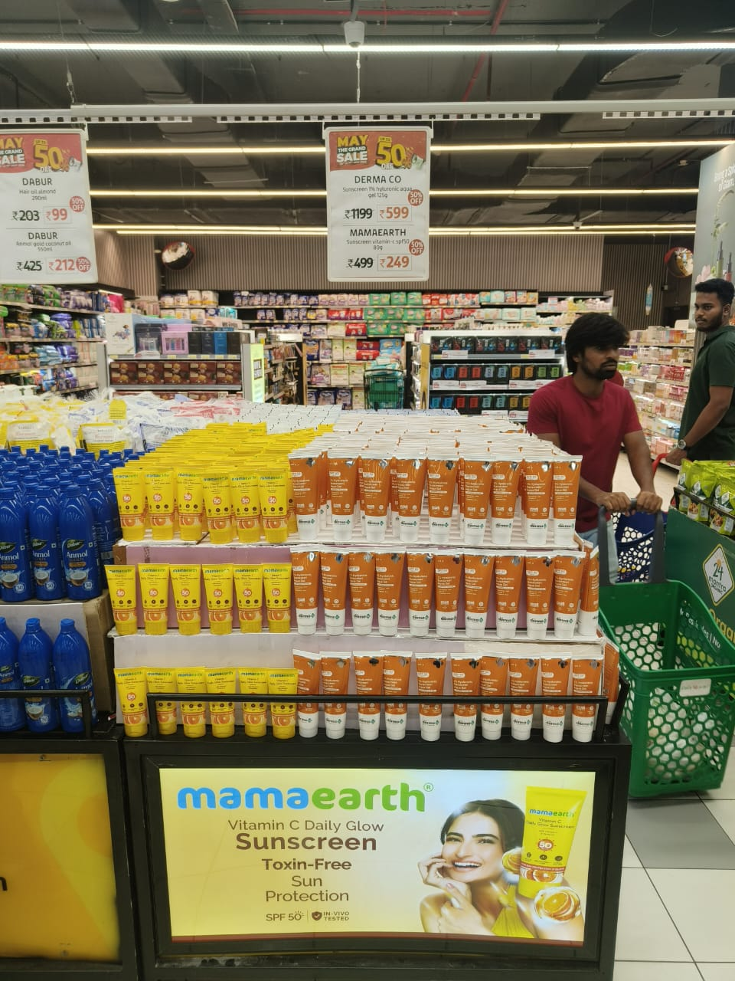
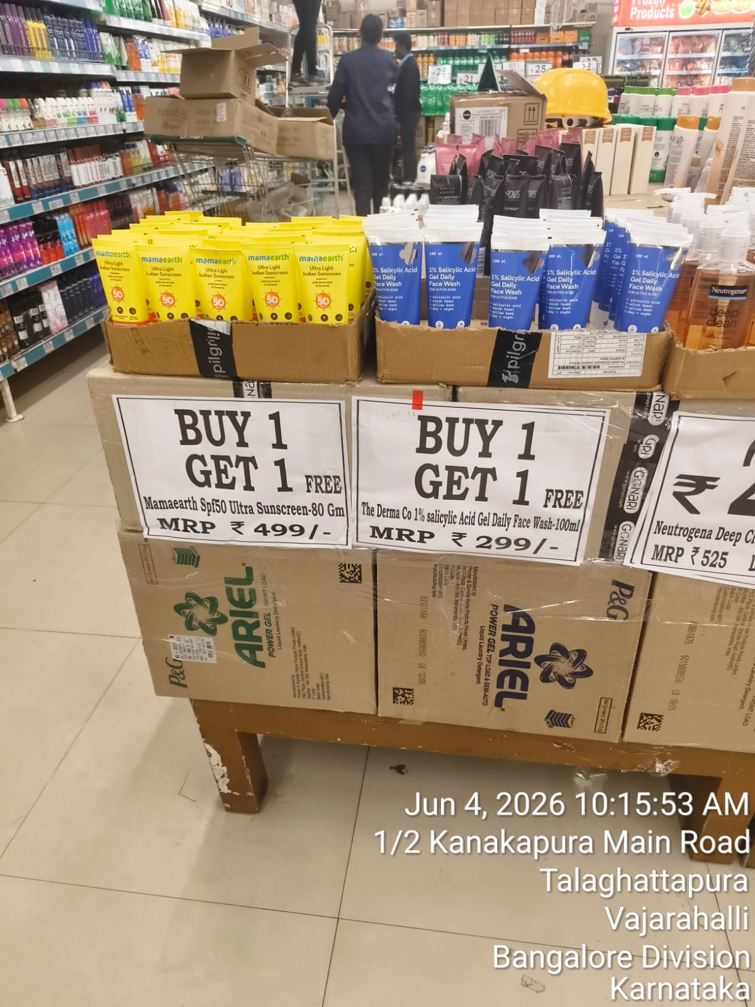
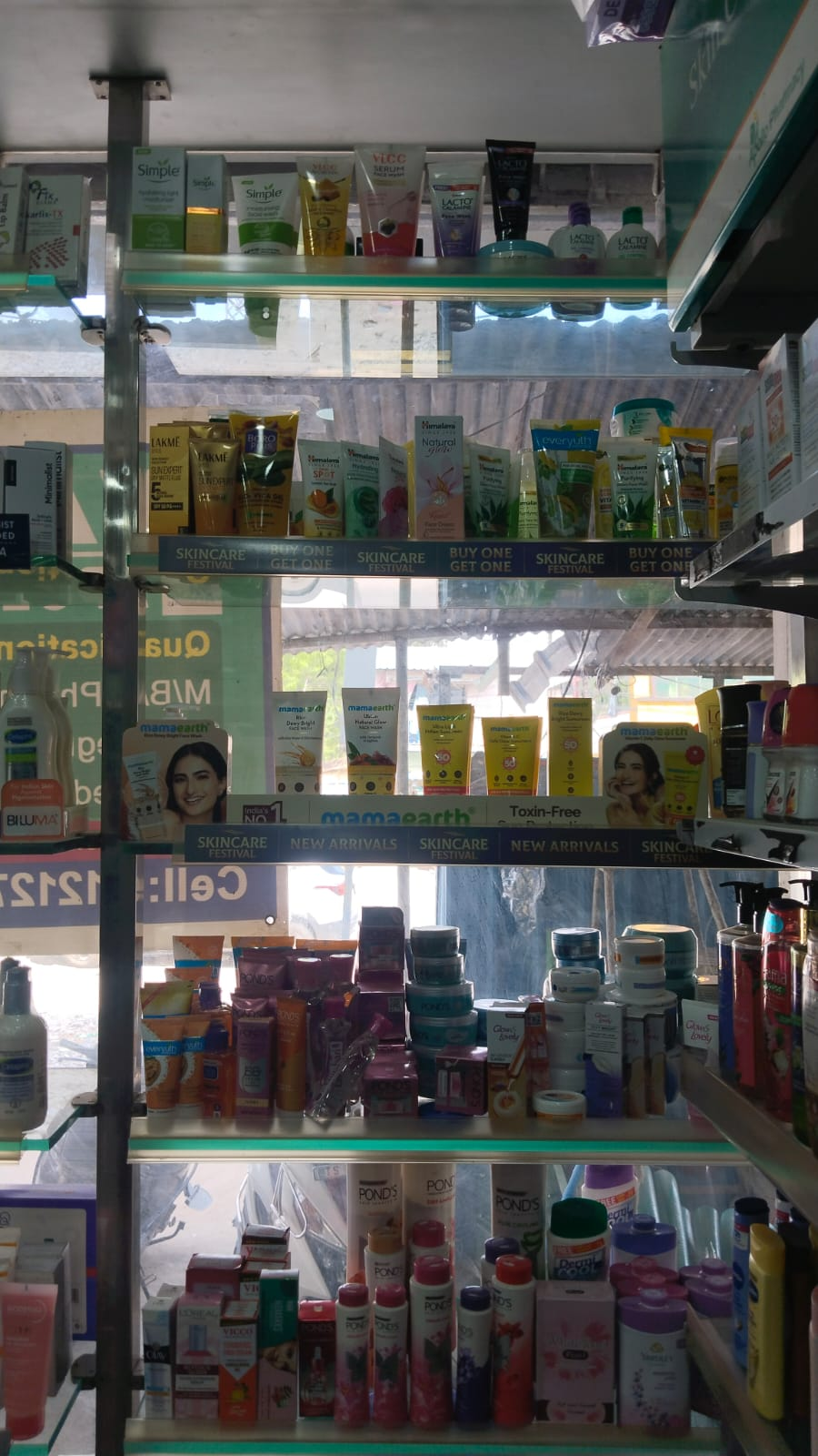
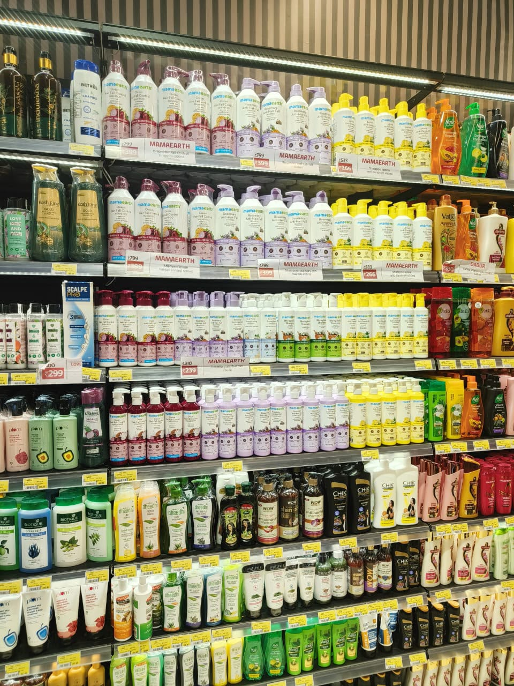
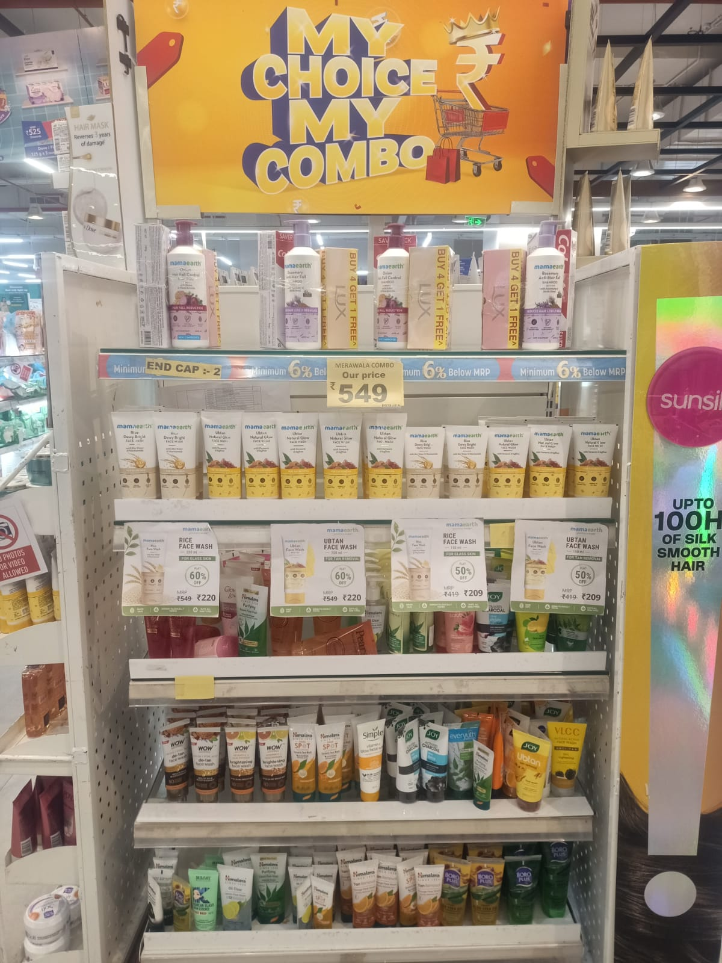
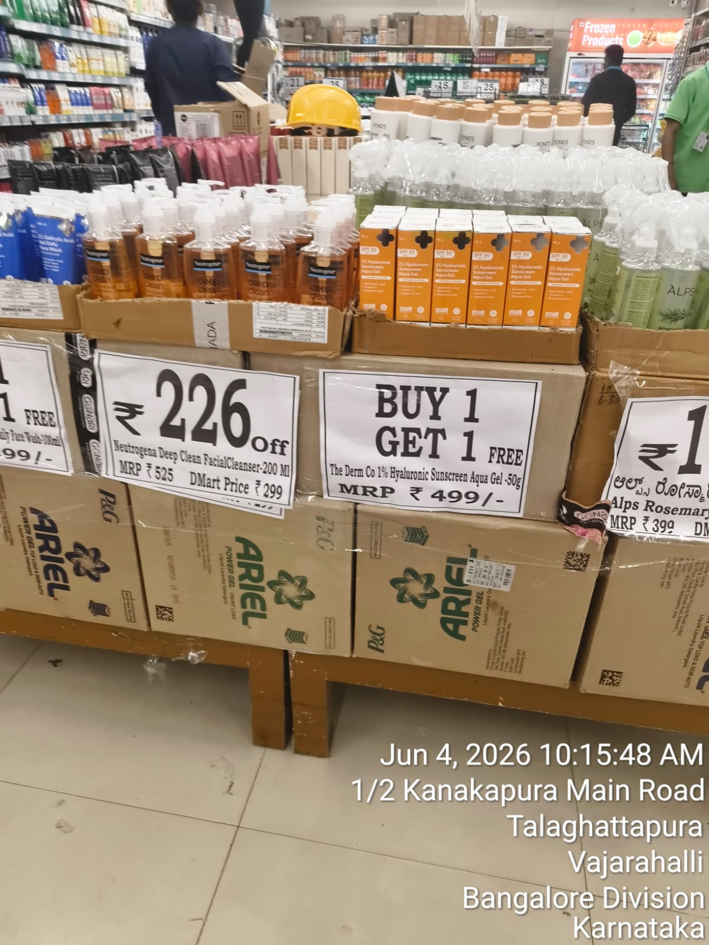
Zone-wise Best Execution Images
Best available field execution proof, by zone — and where the image bank still needs to be built
FIELD CAPTURES
SOUTH-1 — HYDERABAD
SOUTH-2 — KARNATAKA
Lulu | Hyderabad* | South-1 | Endcap / Bin-Tower
D-Mart | Bengaluru | South-2 | BOGO Bin Display
APOLLO — SOUTH-1
LULU — SOUTH-1
Apollo | Hyderabad* | Eye-Level Shelf Block
Lulu | Hyderabad* | Shampoo Aisle Block
Mamaearth Sun Care range fronted with BOGO talkers on a dedicated shelf strip.
Three uninterrupted Mamaearth shampoo shelves at eye level, ahead of competitor sets.
RELIANCE — SOUTH-1
D-MART — SOUTH-2
Reliance | Hyderabad* | Branded Endcap
D-Mart | Bengaluru | BOGO Bin Display
'Merawala Combo' endcap with Mamaearth Buy-4-Get-1 signage and combo pricing.
Derma Co. Hyaluronic Sunscreen bin (geotagged 4-Jun-2026), paired with a Neutrogena combo crate.
21

Slide 24
Chain-wise Execution Showcase
One best-in-class execution image per chain — curated to avoid repetition
FIELD CAPTURES
MT Offtake Performance Review | Jun'26 | Honasa Consumer Limited — Internal
24 / 34
22

Slide 25
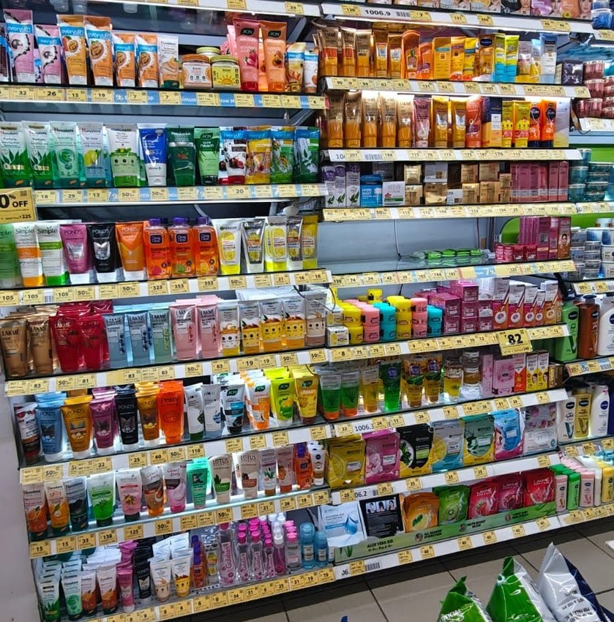
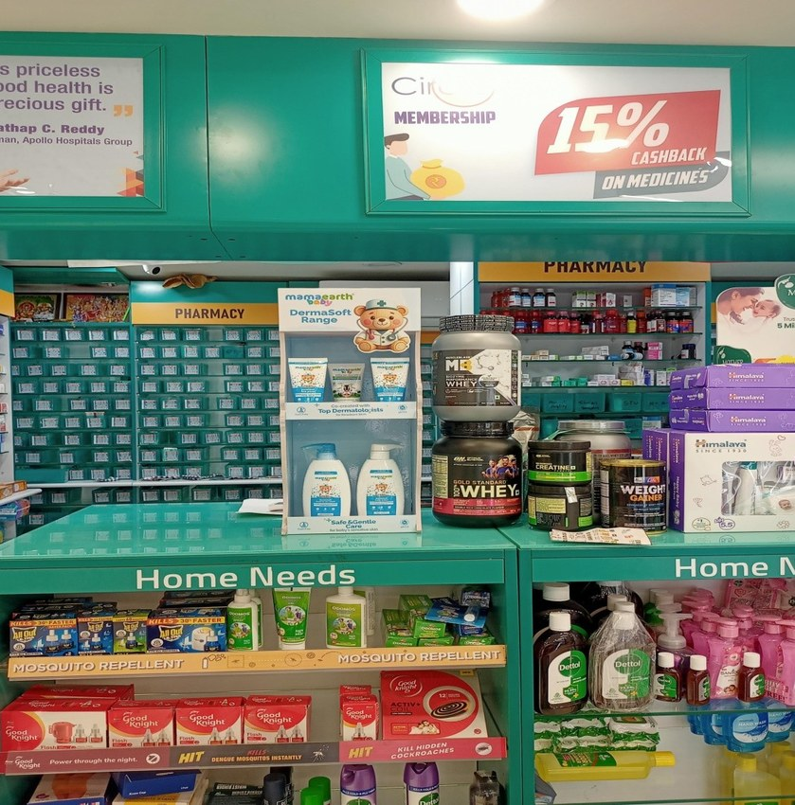
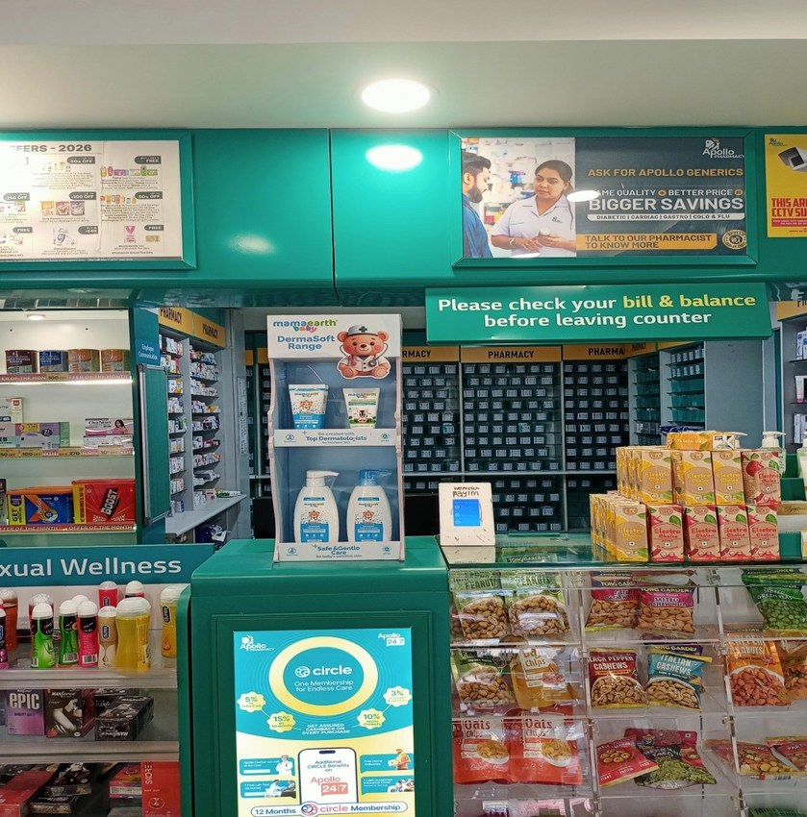
West Bengal & Derma Range – Execution Snapshot
Apollo Pharmacy — Skincare aisle, West Bengal
Mamaearth DermaSoft FSU — Apollo, West Bengal
Mamaearth DermaSoft counter display — West Bengal
25 / 34

Slide 26
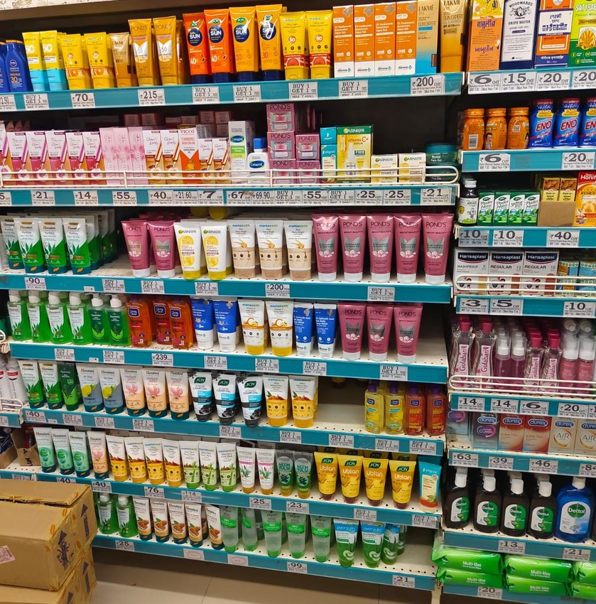
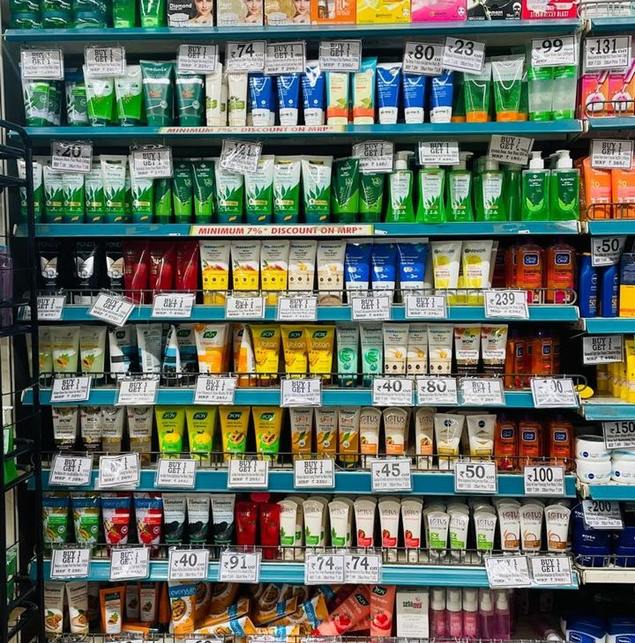
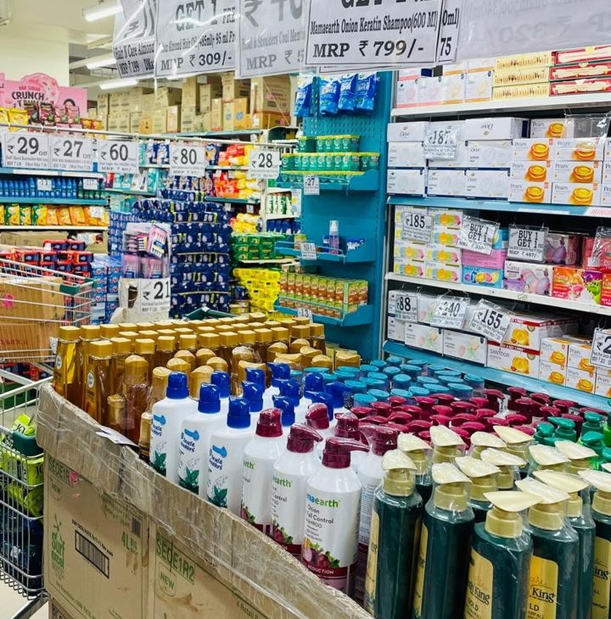
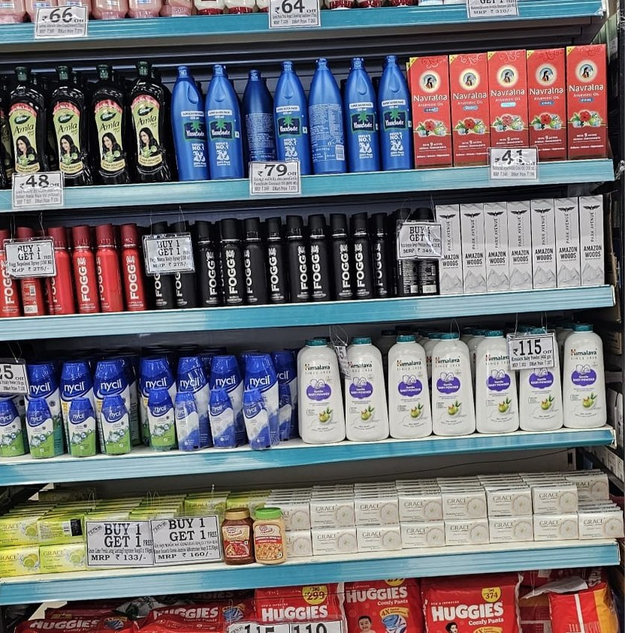
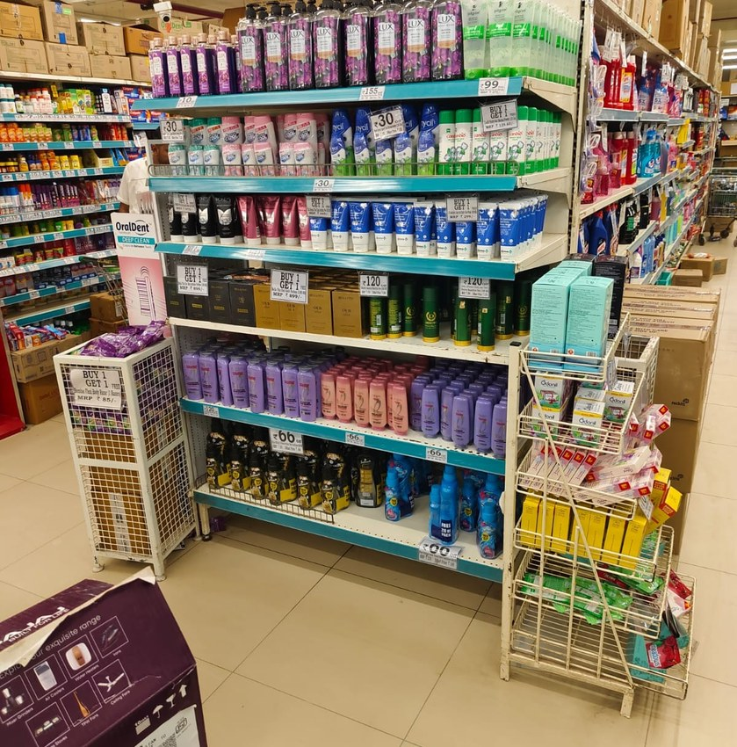
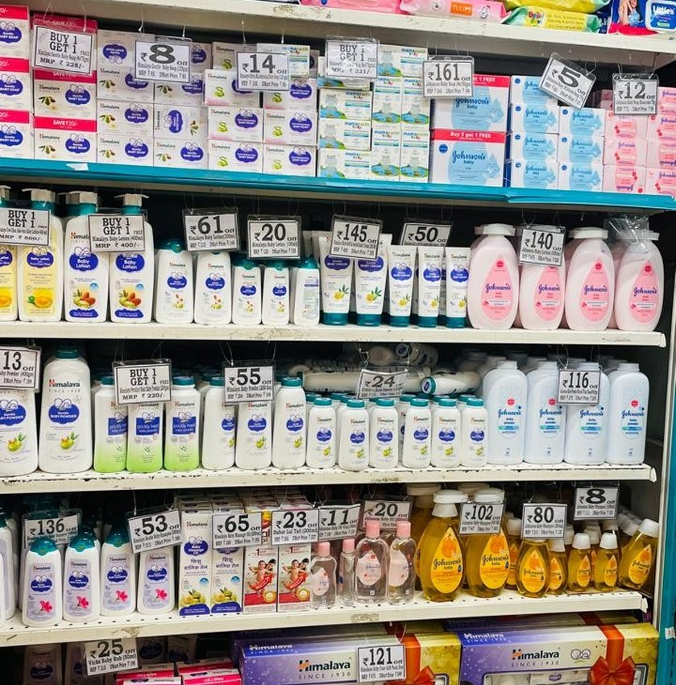
Gujarat Region – Execution Snapshot
Gujarat Region Execution May 26
Ganesh Khengre ROM May-26
Ganesh Khengre ROM May-26
Gujarat Region Execution May 26
Gujarat Region Execution May 26
Ganesh Khengre ROM May-26
26 / 34

Slide 27
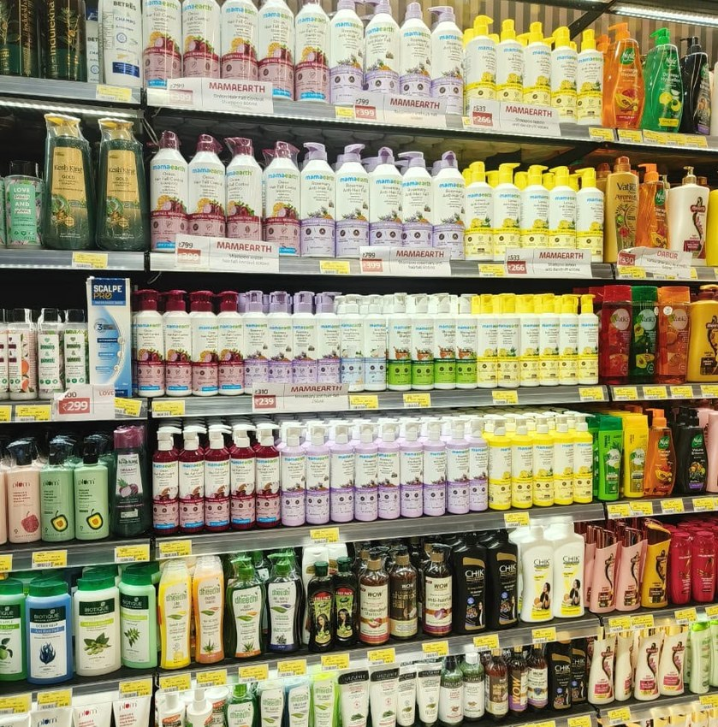
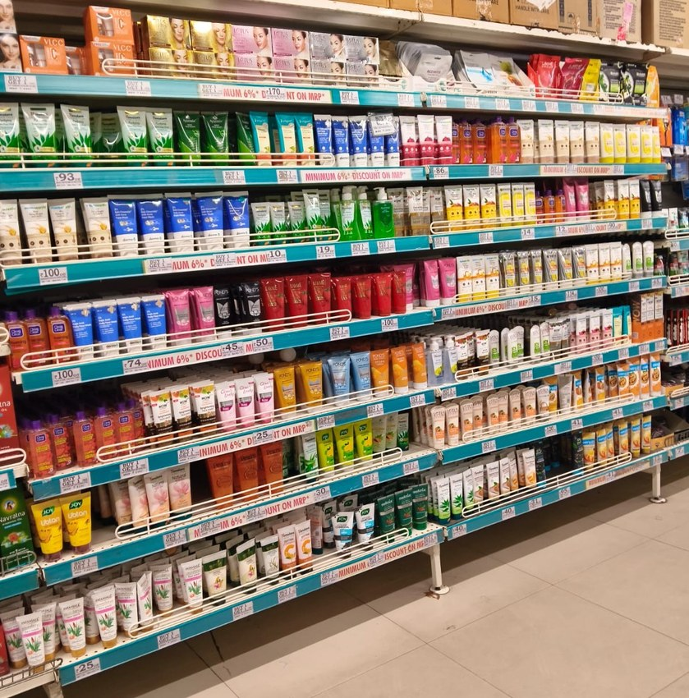
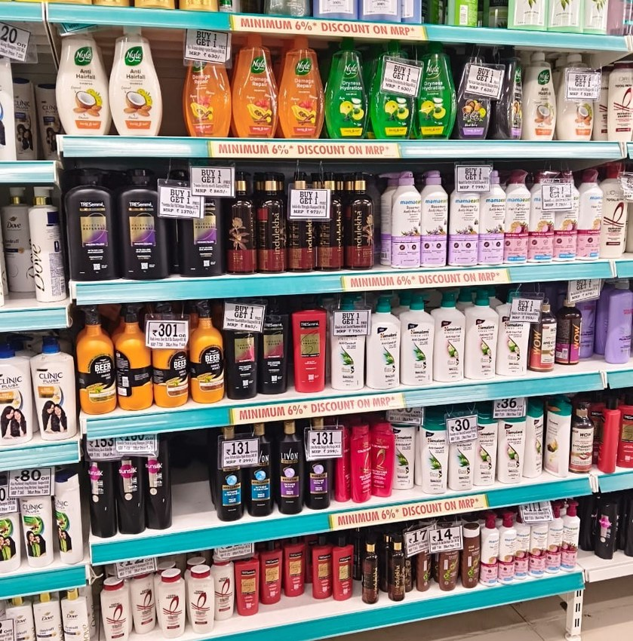
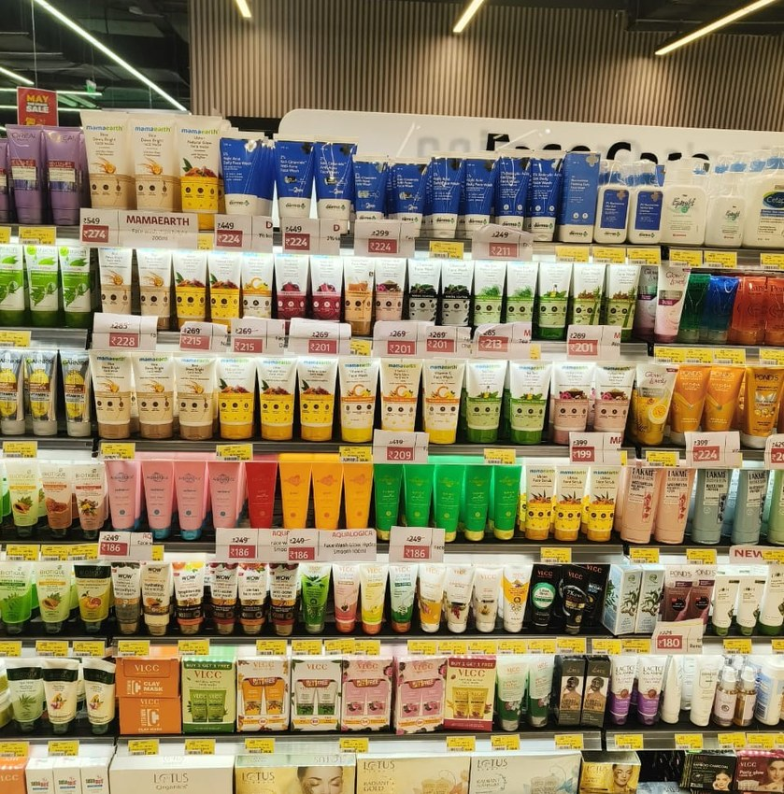
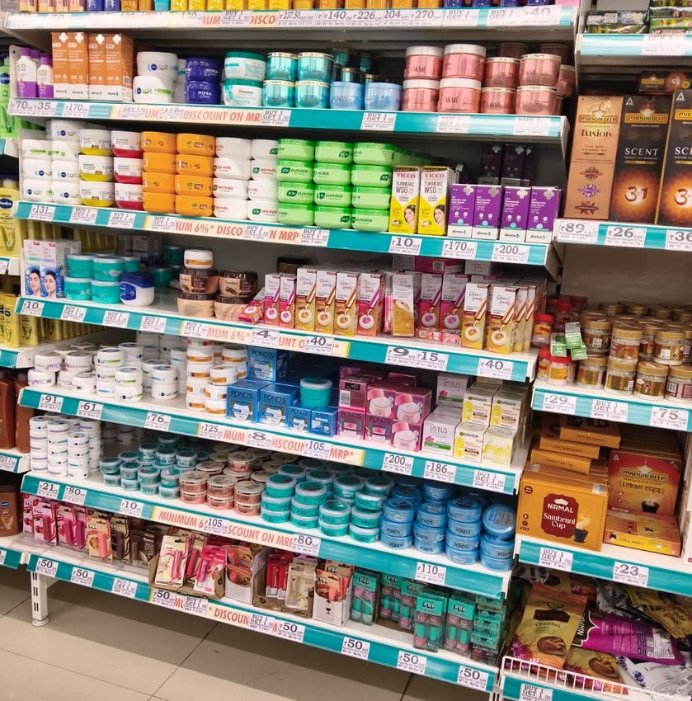
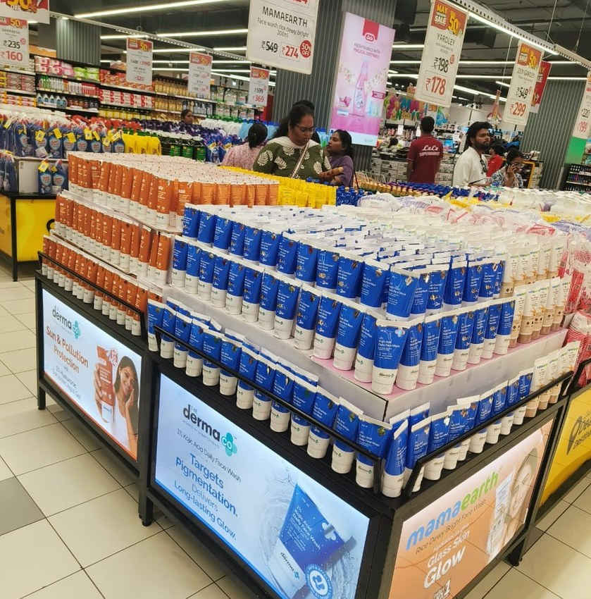
JC Review Markets – Execution Snapshot
JC Meet June 26 Radhika
Review May-26
Review May-26
JC Meet June 26 Radhika
Review May-26
JC Meet June 26 Radhika
27 / 34

Slide 28
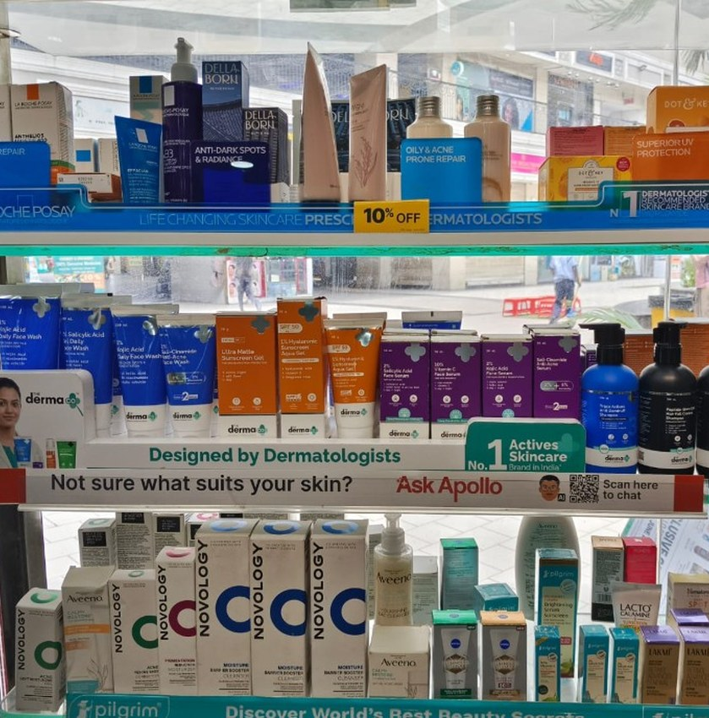
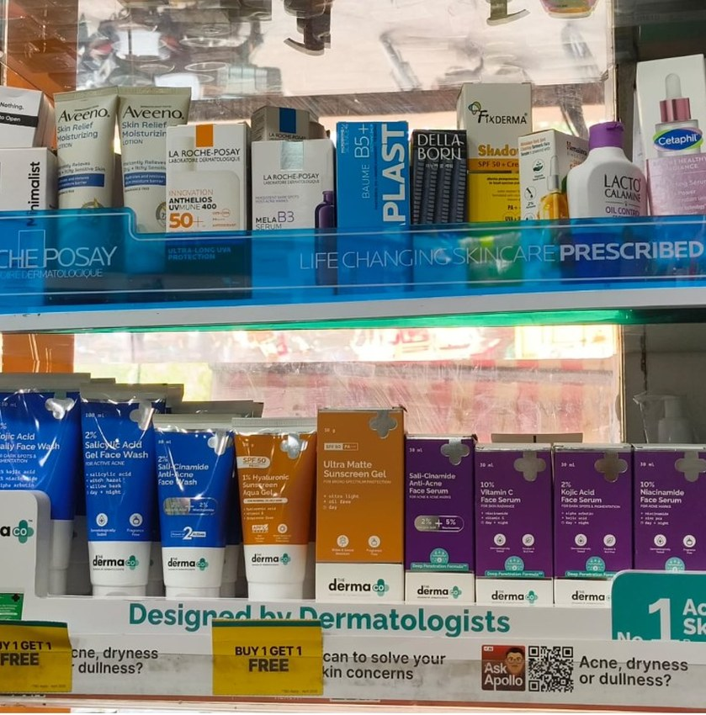
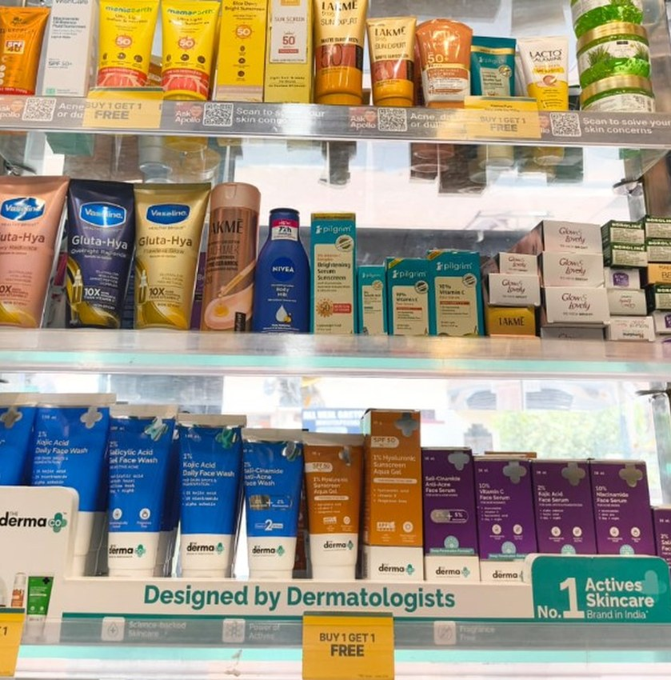
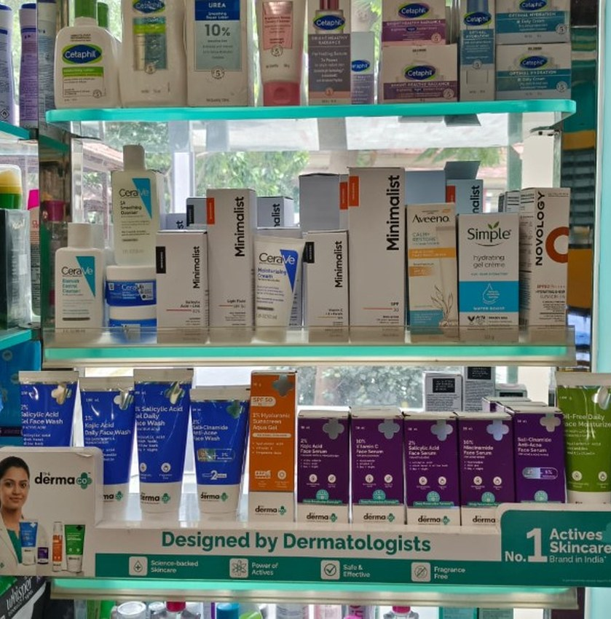
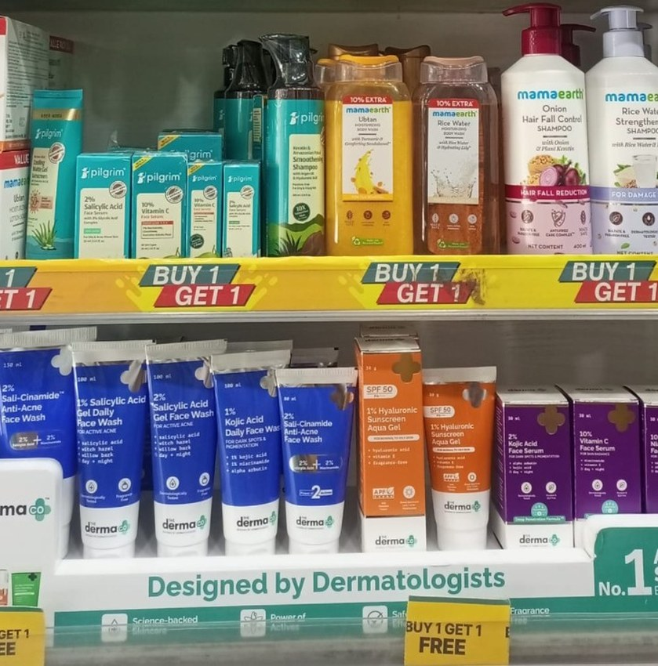
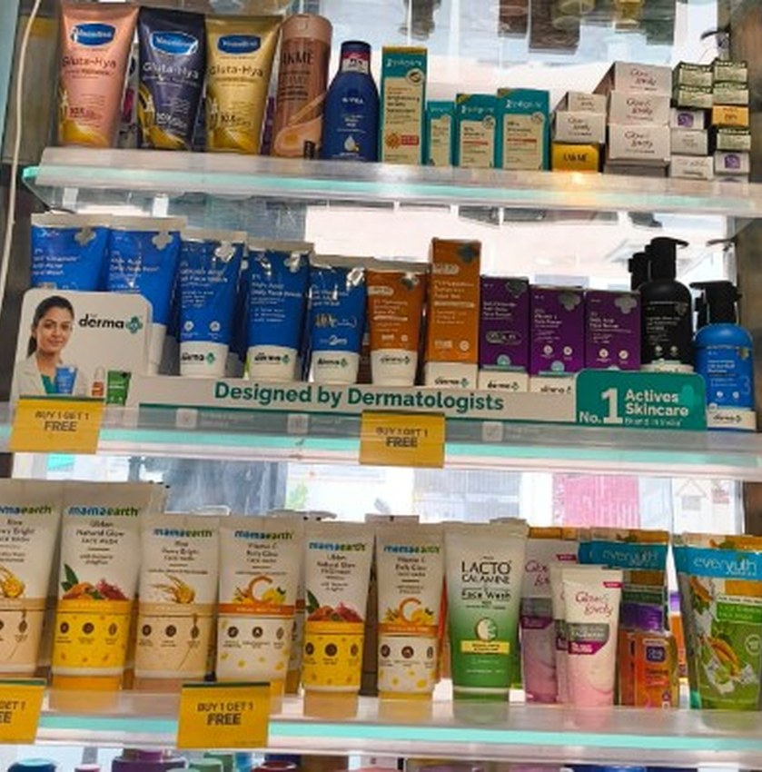
TDC / SIS Delhi NCR – Execution Snapshot
Tdc Sis Delhi Ncr PPT
Tdc Sis Delhi Ncr PPT
Tdc Sis Delhi Ncr PPT
Tdc Sis Delhi Ncr PPT
Tdc Sis Delhi Ncr PPT
Tdc Sis Delhi Ncr PPT
28 / 34

Slide 29
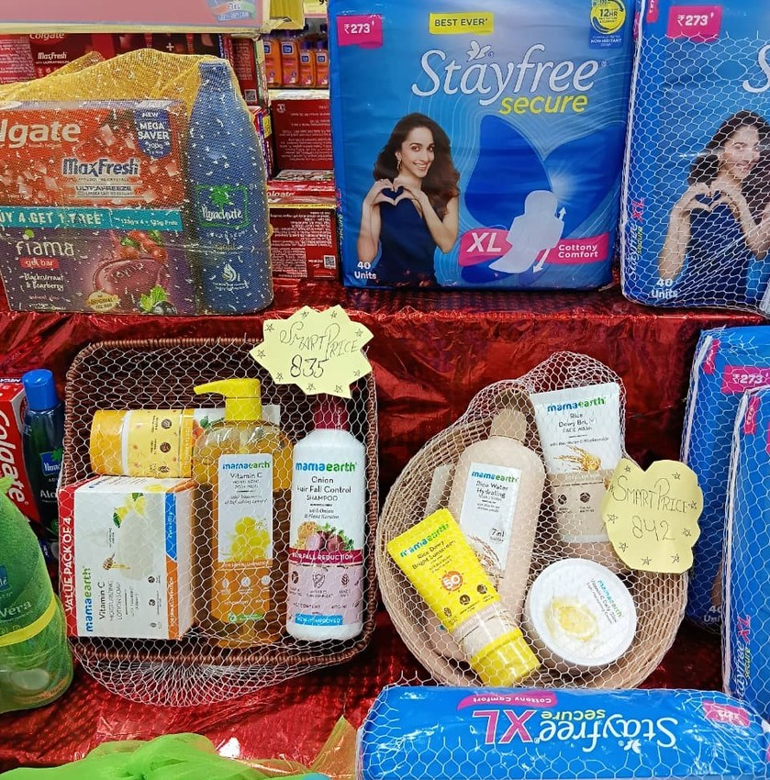
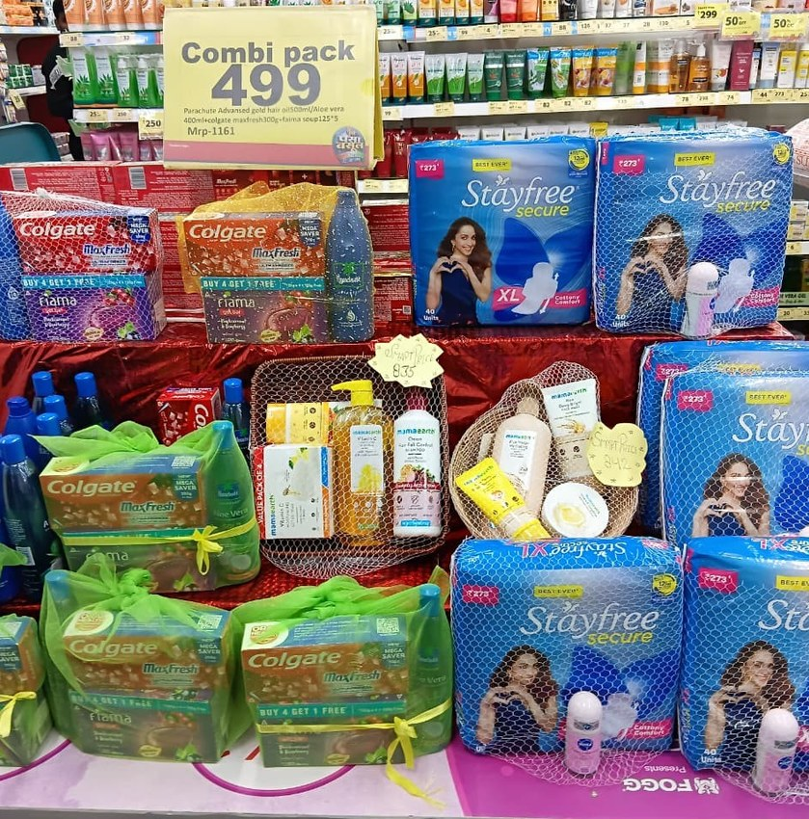
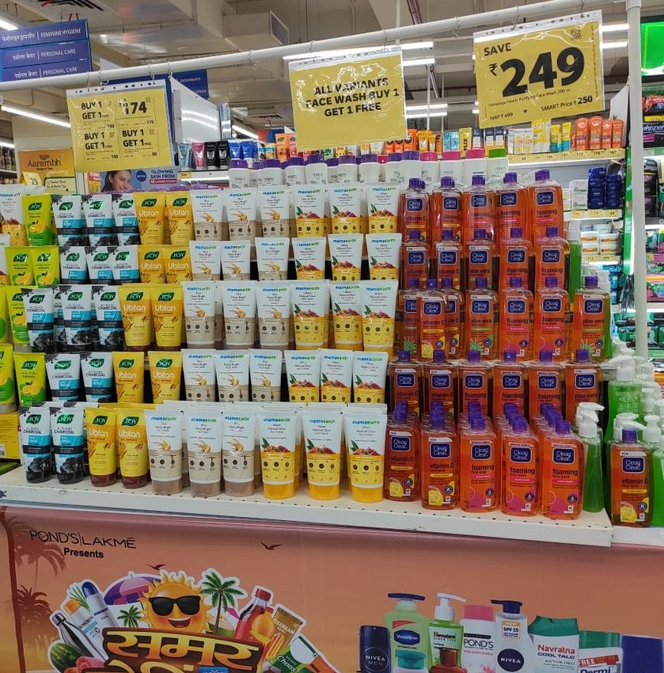
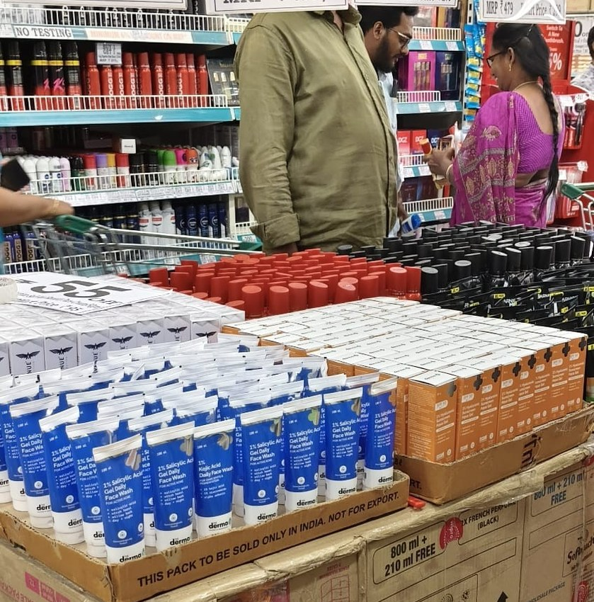
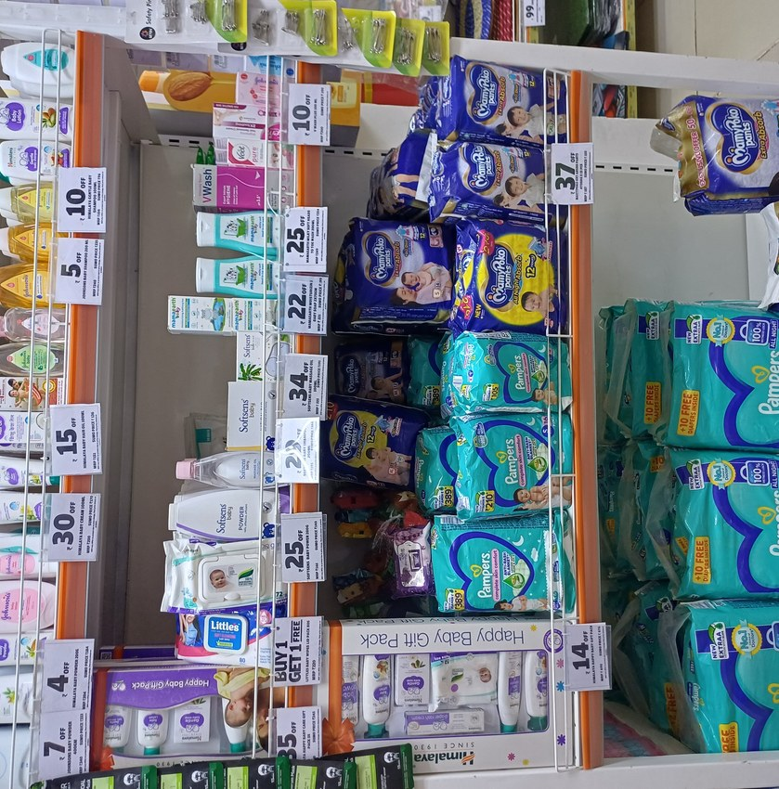
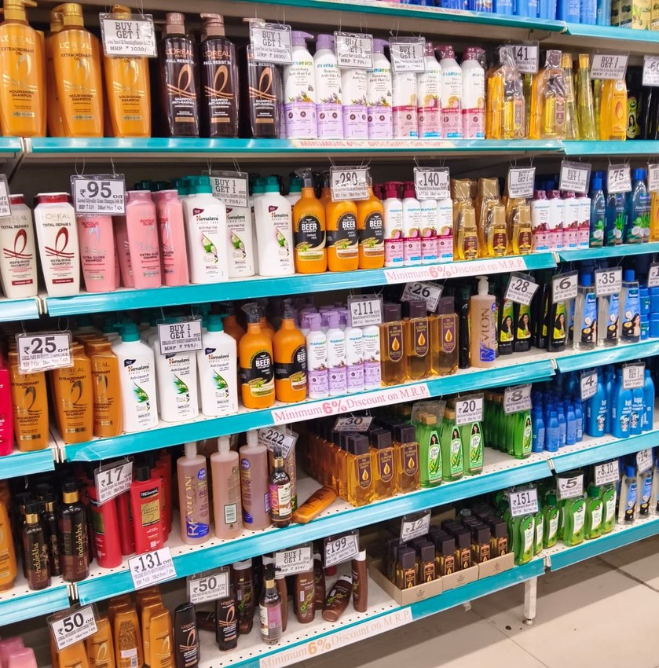
Stock Depth & Article Range Across Outlets
PPT For Reveiw 05.06.2026
PPT For Reveiw 05.06.2026
PPT For Reveiw 05.06.2026
May 26 JC Review PPT Chakri
SUMO SAVE DISPLAY
Review May-26
29 / 34

Slide 30
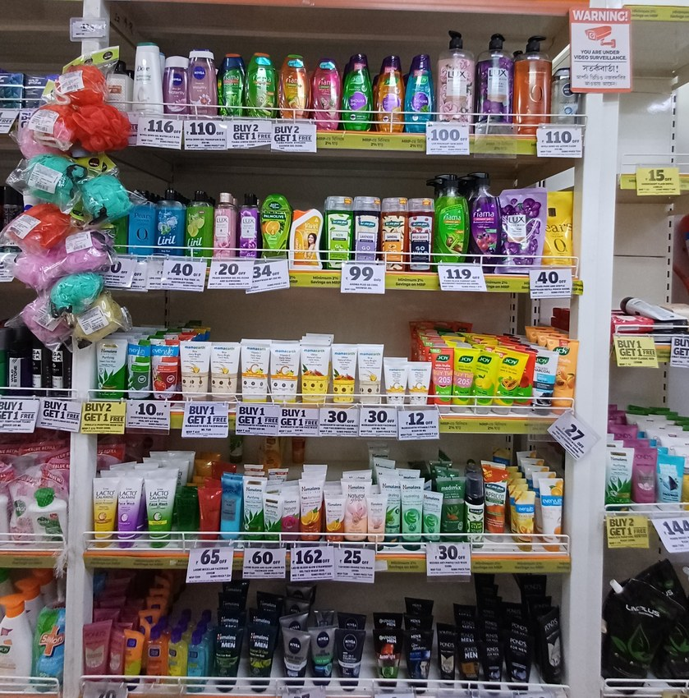
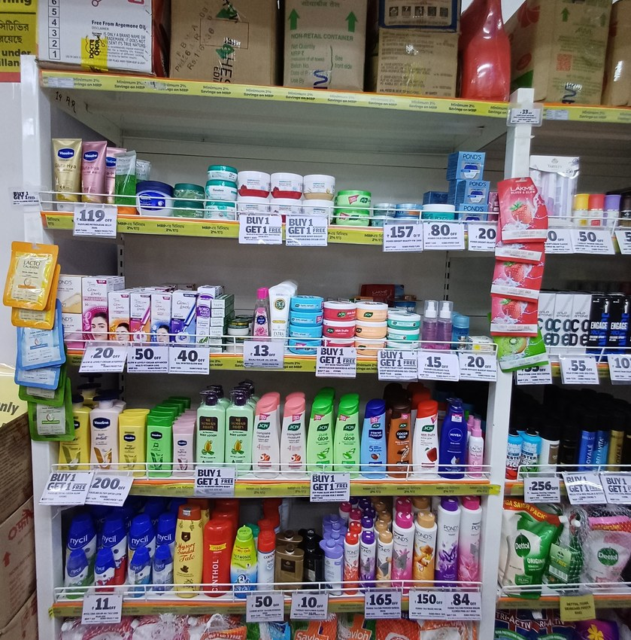
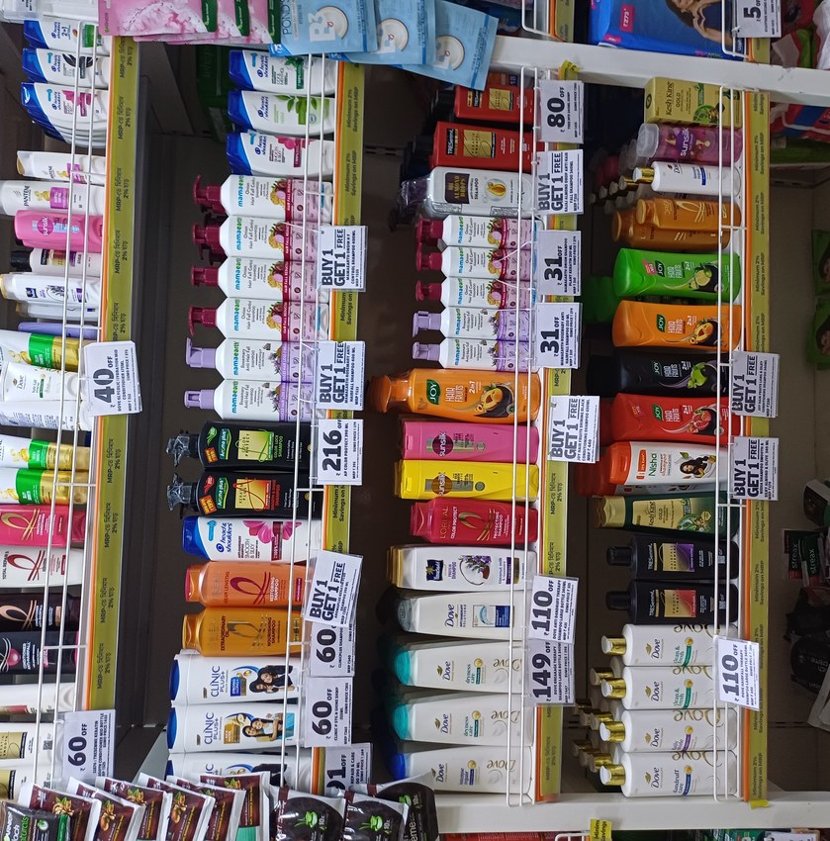
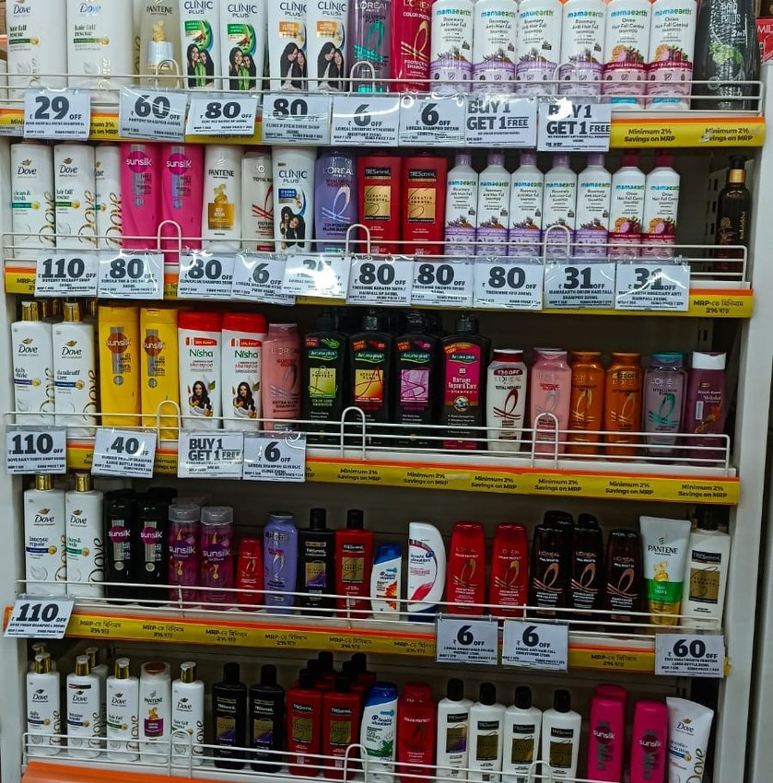
SOS / SOA – Honasa Portfolio Visibility
SUMO SAVE DISPLAY
SUMO SAVE DISPLAY
SUMO SAVE DISPLAY
SUMO SAVE DISPLAY
30 / 34

Slide 31
Visual Proof of Execution — Q1 FY26-27 (placeholder)
Drop best-in-class visibility photos below; label each by State + Retail Chain banner. No live image source connected this cycle.
State: ___________
Chain: ___________
State: ___________
Chain: ___________
State: ___________
Chain: ___________
State: ___________
Chain: ___________
State: ___________
Chain: ___________
State: ___________
Chain: ___________

Slide 32
Portfolio | All Categories | Executive Summary
Primary vs. Offtake Sell-Out — Executive View
Q1 FY26-27 (Apr-Jun'26) consolidated | 26-chain matched universe (Primary & Offtake both report)
Total Primary (Q1 FY27)
Primary vs. Offtake — Sell-Out Tracking
SITUATION
Q1 FY27: Primary Rs13,625L vs Offtake Rs11,436L - Sell-Out 83.9%.
COMPLICATION
Rs2,188L billed but not yet sold-through - trade inventory is building faster than consumer offtake.
RESOLUTION
Slow Q2 primary billing pace vs Q1 to let channel inventory normalize; prioritize sell-out schemes.
Primary (billed-in)
Offtake (sold-out)
Q1 FY27 (Apr-Jun26)
13,625L
Rs 13,625L
84%
26-chain matched universe
11,436L
Total Offtake (Q1 FY27)
Rs 11,436L
Jun'26
4,163L
Same 26-chain universe
92%
Sell-Out %
3,823L
83.9%
Gap: Rs 2,188L billed-not-sold
Sell-Out % = Offtake / Primary Billing x 100. Matched universe = chains present in both Primary and Offtake reporting (see Chain_Mapping sheet).

Slide 33
Portfolio | All Categories | Chain-Level Deep Dive
Primary vs. Offtake Sell-Out — Chain / KAM View
Q1 FY26-27 (Apr-Jun'26) | Key accounts: Dmart, Reliance, Apollo + top format chains
Weakest Sell-Out (Q1)
Primary vs. Offtake — Sell-Out Tracking
SITUATION
Dmart Q1: Primary Rs5,527L, Offtake Rs4,232L - Sell-Out 77%, weakest large KAM.
COMPLICATION
Dmart and Lulu show Primary well ahead of Offtake - stock sitting in DC/store, near-expiry claim risk builds.
RESOLUTION
Freeze incremental Dmart/Lulu primary orders this cycle; secure urgent PO for Metro Cnc (OOS risk).
Primary (billed-in)
Offtake (sold-out)
Dmart
5,527L
77%
Dmart 77%
4,232L
Reliance
3,047L
92%
Primary Rs5,527L vs Offtake Rs4,232L
2,806L
OOS Risk Flag (Q1)
Apollo
2,555L
85%
2,173L
Metro Cnc 152%
Metro Cnc
103L
152%
Offtake exceeds Primary - stock depleting
157L
Healthiest Large KAM
Lulu
505L
66%
333L
Reliance 92%
H&G
239L
84%
Primary Rs3,047L vs Offtake Rs2,806L
201L
Chains matched via Chain_Mapping sheet (confirmed name pairs only). Chains with Q1 Primary <Rs20L excluded as immaterial.

Slide 34
Portfolio | All Categories | Zone-Level Deep Dive
Primary vs. Offtake Sell-Out — Zone View
Q1 FY26-27 (Apr-Jun'26) | 5 common zones (East, North, South-1, South-2, West)
Weakest Zone Sell-Out
Primary vs. Offtake — Sell-Out Tracking
SITUATION
All 5 zones show Primary > Offtake in Q1; South-1 weakest at 75%, North best at 85%.
COMPLICATION
South-1 carries the largest billed-not-sold gap - a broad-based over-stock, not a single-zone issue.
RESOLUTION
RSM to phase South-1 primary orders over 4-6 weeks; redirect push to sell-out activation, not billing.
Primary (billed-in)
Offtake (sold-out)
East
1,532L
77%
South-1 75%
1,173L
Primary Rs3,298L vs Offtake Rs2,489L
North
3,120L
85%
2,641L
Strongest Zone Sell-Out
South-1
3,298L
North 85%
75%
2,489L
Primary Rs3,120L vs Offtake Rs2,641L
South-2
1,979L
80%
All Zones
1,576L
Primary > Offtake
West
3,731L
78%
2,905L
Every zone is over-stocked vs sell-out, none in OOS risk
Pan India/FSN zone excluded - no matching zone dimension in Primary reporting for this channel.

