Slide 1
MT OFFTAKE PERFORMANCE REPORT — JUL'26
SUMMARY & KEY INSIGHTS JUL’26
Jul'26 NSV
Jun'26 NSV
L3M Avg
YoY Growth
₹ 40.67 Cr
₹ 41.97 Cr
₹ 40.53 Cr
—
Highest-ever NSV
MoM ▼ 3.1%
Apr–Jul ▲ 0.5%
YoY n/a
Monthly and Top-3 Chain NSV Sales Trend
May’26 Chain Sales Contribution % & Sales
Jul'26 MT Offtake: ₹40.67 Cr total (₹34.15 Cr MT geographic, excl eB2B+SIS). Reliance drove a ₹1.42 Cr MoM decline; all other chains combined grew. South-1 leads zone ranking at ₹8.21 Cr. TDC at 30% share — portfolio continues widening.
Chain-wise Monthly Performance Snapshot
Chain | May-25 | Jan-26 | Feb-26 | Mar-26 | Apr-26 | May-26 | Cont% | L3M Avg(FMA) | GOLY | MOM
 |  |  |  |  |  |  |  |  | May
Dmart | 897 | 967 | 928 | 1,226 | 1,258 | 1,518 | 38% | 1,137 | ▲ 69% | ▲ 21%
Reliance | 715 | 900 | 757 | 805 | 868 | 990 | 25% | 810 | ▲ 39% | ▲ 14%
Apollo | 272 | 534 | 511 | 570 | 699 | 751 | 19% | 593 | ▲ 176% | ▲ 8%
Fsn | 175 | 164 | 168 | 173 | 229 | 208 | 5% | 190 | ▲ 19% | ▼ 9%
Wellness | 86 | 83 | 86 | 98 | 110 | 102 | 3% | 98 | ▲ 19% | ▼ 7%
H&G | 80 | 80 | 48 | 51 | 62 | 87 | 2% | 54 | ▲ 9% | ▲ 41%
Lulu | 42 | 103 | 70 | 78 | 101 | 116 | 3% | 83 | ▲ 176% | ▲ 15%
Metro | 48 | 53 | 48 | 53 | 48 | 48 | 1% | 50 | ▲ 0% | ▲ 0%
Delhi RMT | 41 | 35 | 28 | 42 | 58 | 46 | 1% | 43 | ▲ 13% | ▼ 20%
More Retail | 25 | 39 | 39 | 45 | 45 | 55 | 1% | 43 | ▲ 117% | ▲ 24%
Walmart | 18 | 17 | 17 | 19 | 26 | 11 | 0% | 20 | ▼ 37% | ▼ 56%
Spencer | 33 | 13 | 14 | 12 | 13 | 12 | 0% | 13 | ▼ 63% | ▼ 4%
Vmm | 13 | 17 | 14 | 25 | 28 | 31 | 1% | 22 | ▲ 138% | ▲ 13%
Others Combined | 22 | 36 | 34 | 39 | 47 | 44 | 1% | 40 | ▲ 97% | ▼ 7%
Total Channel | 2488 | 3075 | 2795 | 3273 | 3589 | 4019 |  | 3195 | ▲ 62% | ▲ 12%
04
1 / 9

Slide 2
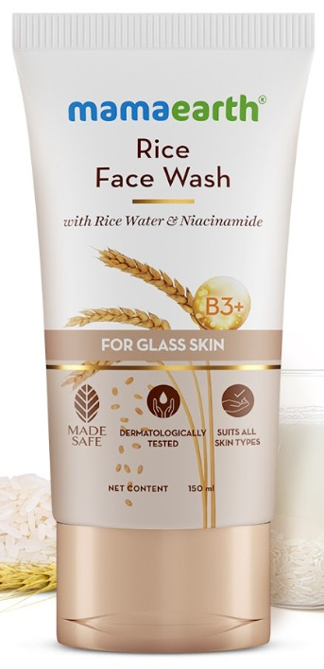

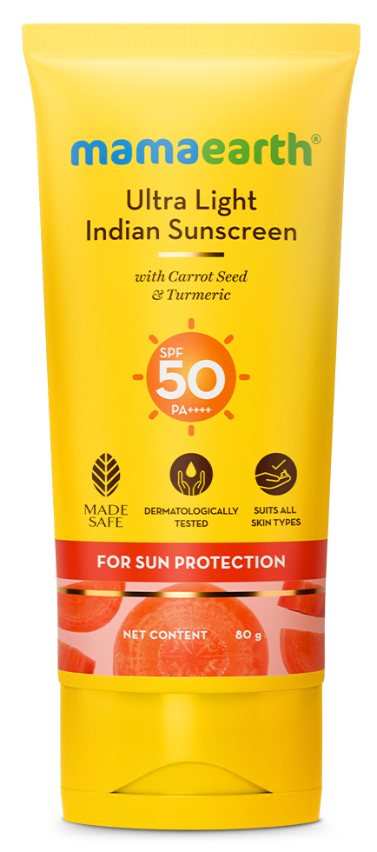
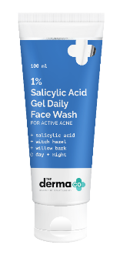
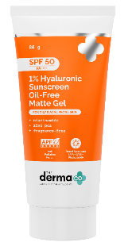
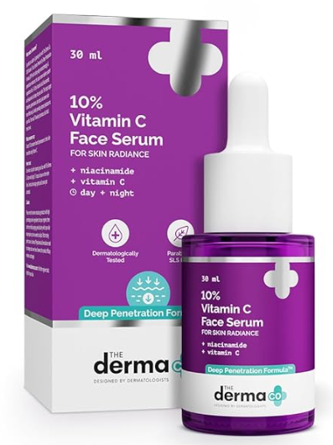
Brand & Category Segment Deep-Dive
Portfolio growth drivers and contribution view
Portfolio growth drivers and contribution view
Brand | May-25 | Jan-26 | Feb-26 | Mar-26 | Apr-26 | May-26 | Cont% | L3M Avg | GO L3M | GOLY May
Mamaearth | 2,168 | 2,438 | 2,188 | 2,477 | 2,653 | 2,836 | 71% | 2,436 | ▲ 16% | ▲ 30%
The Derma Co. | 218 | 543 | 513 | 686 | 856 | 1,100 | 27% | 685 | ▲ 61% | ▲ 405%
Aqualogica | 63 | 46 | 45 | 59 | 66 | 71 | 2% | 57 | ▲ 25% | ▲ 13%
Emerging Brands | 18 | 14 | 17 | 13 | 13 | 12 | 0% | 14 | ▼ 14% | ▼ 33%
Portfolio Total | 2,466 | 3,039 | 2,761 | 3,234 | 3,589 | 4,019 | 100% | 3,195 | ▲ 26% | ▲ 63%
Strategic Brand Portfolio
Mamaearth remains the portfolio Leader at 70.6% share, growing a steady +30% YoY.
The Derma Co. is the fastest scaling brand now 27.4% of NSV vs single digits a Yr ago, on a genuinely low FY25 base.
Aqualogica continues to show positive structural growth, with ▲13% YoY, ▲7% MoM, and ▲25% vs L3M average. However, its current contribution remains relatively small, so it is not yet materially influencing the overall portfolio trajectory.
Overall | Mamaearth — Top 3 Sub-category Monthly Trend (NSV)
FW
GOLY
▲29%
MoM
▲ 11%
Shampoo
GOLY ▲ 53%
MoM
▲ 10%
Sun Care
GOLY
▲ 67%
MoM
▼ 3%
Hero SKU note: Rice Dewy Bright Face Wash variants from Mamaearth lead the Face Wash portfolio with NSV of ₹5.40 Cr.
Onion Shampoo variants from Mamaearth lead the Shampoo portfolio with NSV of ₹4.56 Cr.
Ultra Light Sunscreen from Mamaearth leads the Suncare portfolio with NSV of ₹1.62 Cr. 2
Overall | The Derma Co. — Top 3 Sub-category Monthly Trend (NSV)
FW
GOLY ▲ 1166%
MoM ▲ 38%
Hero SKU note: 1% Salicylic FW follows with NSV of ₹285 Lacs., contribute 6.4% of May’26 NSV within 1 year of launch .
Hyaluronic Acid leads the pack and contributes 96% of total Suncare sales, with NSV of ₹411 Lacs.
55% Niacinamide Serum leads with NSV of ₹28 Lacs, followed by Vitamin C Serum at ₹23 Lacs..
VOLUME VS. VALUE DECOMPOSITION — JUL'26 VS MAY'25
Mamaearth
Sub Cat | Qty May-25 | Qty May-26 | Qty GOLY% | NSV May-25 | NSV May-26 | NSV GOLY% | ASP GOLY%
Face Cleanser | 6,23,925 | 7,85,723 | ▲ 26% | 865 | 1,120 | ▲ 30% | ▲ 3%
Shampoo | 2,75,067 | 3,57,736 | ▲ 30% | 516 | 789 | ▲ 53% | ▲ 18%
Sun Care | 1,12,028 | 1,67,158 | ▲ 49% | 211 | 353 | ▲ 67% | ▲ 12%
The Derma co.
Sub Cat | Qty May-25 | Qty May-26 | Qty GOLY% | NSV May-25 | NSV May-26 | NSV GOLY% | ASP GOLY%
Face Cleanser | 22,592 | 4,28,182 | ▲ 1795% | 44 | 557 | ▲ 1164% | ▼ 33%
Sun Care | 29,103 | 1,62,541 | ▲ 459% | 94 | 429 | ▲ 357% | ▼ 18%
Shampoo | 22,124 | 30,097 | ▲ 36% | 63 | 92 | ▲ 46% | ▲ 7%
2 / 9

Slide 3
Zone Performance Summary
Zone share, May’26 NSV and growth view
Zone May’26 NSV and Share
Zone Summary
Zone | May-25 | Feb-26 | Mar-26 | Apr-26 | May-26 | Zone Share | L3M Avg | GO L3M | GOLY May
East | 266 | 284 | 311 | 370 | 411 | 10% | 322 | ▲ 28% | ▲ 55%
North | 566 | 630 | 764 | 845 | 934 | 23% | 746 | ▲ 25% | ▲ 65%
South-1 | 487 | 591 | 660 | 770 | 894 | 22% | 674 | ▲ 33% | ▲ 84%
South-2 | 320 | 367 | 429 | 468 | 554 | 14% | 421 | ▲ 31% | ▲ 73%
West | 652 | 722 | 896 | 903 | 1,017 | 25% | 840 | ▲ 21% | ▲ 56%
FSN | 175 | 168 | 173 | 229 | 208 | 5% | 190 | ▲ 9% | ▲ 19%
Zone Insights | May’26
West remained the largest zone with NSV of ₹1,017 Lacs, contributing 25.3% to overall MT offtake.
North and South-1 emerged as the next key growth bases, strengthening the national growth mix beyond West.
South-1 delivered the strongest YoY growth at ▲84%, indicating strong scale-up momentum in the region.
Dmart is the #1 chain in 3 out of 5 zones: North, South-2 and West. This confirms Dmart as a national growth engine, not limited to one zone.
Apollo leads South-1 and ranks #2/#3 in three other zones, showing repeatable pharmacy-channel momentum across regions, largely driven by The Derma Co.
Brand & Category Repeats Across Zones
The Derma Co. achieved its highest-ever monthly NSV of ₹1,100 Lacs, contributing 27.4% to the portfolio. The brand grew ▲404% YoY, making it the fastest-scaling growth engine in the portfolio.
Face Cleanser and Sun Care remained the top 2 growth drivers for The Derma Co. in 5 out of 6 zones, making them the clearest scale-up levers. FSN is the only chain growing materially slower than the network (+18.9% YoY).
Mamaearth Face Cleanser and Shampoo ranked as the #1/#2 sub-categories by value across every zone, confirming their role as stable national anchors.
Sun Care emerged as the fastest seasonal mover across zones, supported by strong summer-led demand and visibility execution.
3 / 9

Slide 4
MT OFFTAKE PERFORMANCE REPORT
EAST ZONE PERFORMANCE
May-26 Sales
411
Zone Share
10.3%
L3M Avg
322
GOLY May
▲ 55%
EAST ZONE DEEP DIVE — JUL'26
East Zone Jul'26 NSV: ₹3.55 Cr Mamaearth ₹2.91 Cr — Face Cleanser ₹1.21 Cr (42%), Shampoo ₹0.94 Cr (32%), Sun Care ₹0.17 Cr The Derma Co. ₹0.60 Cr — Face Cleanser ₹0.40 Cr (66%), Sun Care ₹0.11 Cr, Face Serum ₹0.07 Cr Chains: DMart dominates; Reliance ₹8.06 Cr (national, East subset in zone total)
Brand | May-25 | Apr-26 | May-26 | Cont% | L3M | GO L3M | GOLY
Mamaearth | 235 | 322 | 360 | 88% | 283 | ▲ 27% | ▲ 53%
The Derma Co. | 18 | 40 | 44 | 11% | 30 | ▲ 45% | ▲ 144%
Aqualogica | 9 | 7 | 7 | 2% | 7 | ▲ 0% | ▼ 22%
Emerging Brands | 4 | 1 | 1 | 0% | 1
East | Mamaearth — Top 3 Sub-category Monthly Trend (NSV)
FW
GOLY ▲ 43%
MoM
▲ 10%
Shampoo
GOLY ▲ 77%
MoM
▲ 13%
Sun Care
GOLY ▲157%
MoM
▲ 20%
East | The Derma Co. — Top 3 Sub-category Monthly Trend (NSV)
FW
GOLY
▲500%
MoM
▲ 6%
Sun Care
GOLY
▲125%
MoM
▲ 20%
Face Serum
GOLY
▼ 22%
MoM
▲ 0%
East Chain Summary
Chain | May-25 | Apr-26 | May-26 | Cont% | L3M | GO L3M | GOLY
Reliance | 188 | 235 | 264 | 64% | 209 | ▲ 27% | ▲ 40%
Apollo | 30 | 72 | 80 | 20% | 60 | ▲ 33% | ▲ 167%
VMM | 8 | 15 | 16 | 4% | 11 | ▲ 45% | ▲ 108%
More Retail | 5 | 11 | 11 | 3% | 9 | ▲ 18% | ▲ 120%
Frankros | 1 | 4 | 10 | 2% | 3 | ▲ 200% | ▲ 900%
Spencer | 23 | 9 | 8 | 2% | 9 | ▼ 14% | ▼ 65%
Others Combined | 10 | 26 | 21 | 5% | 20 | ▲ 5% | ▲ 103%
CHAIN KEY HIGHLIGHTS
Zone Record: East delivered its highest month at 411, ▲28% vs L3M and ▲55% vs May-25. Chain Highlights: Reliance leads; Apollo is the fastest YoY chain.
Lead Chain
Reliance - 264
Fastest YoY Chain
Apollo - ▲ 33%
Record Chain ines2
Reliance, VMM, Apollo, More Retail,
Zone Record
May-26 - 411
4 / 9

Slide 5
MT OFFTAKE PERFORMANCE REPORT
NORTH ZONE PERFORMANCE
May-26 Sales
934
Zone Share
23.2%
L3M Avg
746
GOLY May
▲ 65%
NORTH ZONE DEEP DIVE — JUL'26
North Zone Jul'26 NSV: ₹6.98 Cr Mamaearth ₹4.73 Cr — Face Cleanser ₹2.01 Cr (42%), Shampoo ₹1.50 Cr (32%), Sun Care ₹0.36 Cr The Derma Co. ₹2.12 Cr — Face Cleanser ₹1.45 Cr (69%), Sun Care ₹0.46 Cr, Face Serum ₹0.13 Cr Reliance North at 44.9% conversion — weakest in national pack
Brand | May-25 | Apr-26 | May-26 | Cont% | L3M | GO L3M | GOLY
Mamaearth | 517 | 649 | 671 | 72% | 586 | ▲ 13% | ▲ 28%
The Derma Co. | 33 | 181 | 243 | 26% | 147 | ▲ 65% | ▲ 635%
Aqualogica | 12 | 14 | 19 | 2% | 12 | ▲ 59% | ▲ 59%
Emerging Brands | 3 | 1 | 1 | 0% | 1
North | Mamaearth — Top 3 Sub-category Monthly Trend (NSV)
FW
GOLY ▲ 29%
MoM
▲ 7%
Jul'26
262
Shampoo
GOLY ▲ 54%
MoM
▲ 7%
Jul'26 188
Sun Care
GOLY ▲ 50%
MoM
▲ 3%
Jul'26
89
North | The Derma Co. — Top 3 Sub-category Monthly Trend (NSV)
FW
GOLY
▲1806%
MoM
▲ 40%
Jul'26 132
Sun Care
GOLY
▲440%
MoM
▲ 37%
May’26
92
Face
Serum
GOLY
▲ 108%
MoM
▼ 1%
Jul'26
16
North Chain Summary
Chain | May-25 | Apr-26 | May-26 | Cont% | L3M | GO L3M | GOLY
Dmart | 187 | 288 | 351 | 38% | 257 | ▲ 37% | ▲ 88%
Reliance | 243 | 293 | 337 | 36% | 264 | ▲ 28% | ▲ 39%
Apollo | 45 | 118 | 125 | 14% | 104 | ▲ 19% | ▲ 175%
Sancus(Rmt) | 41 | 58 | 46 | 5% | 43 | ▲ 8% | ▲ 13%
Lulu | 5 | 17 | 19 | 2% | 15 | ▲ 32% | ▲ 283%
Metro Cnc | 12 | 14 | 13 | 1% | 13 | ▲ 2% | ▲ 14%
Others Combined | 33 | 57 | 42 | 5% | 50 | ▼ 16% | ▲ 28%
CHAIN KEY HIGHLIGHTS
Zone Record: North delivered its highest month at 934, ▲25% vs L3M and ▲65% vs May-25. Chain Highlights: Dmart leads; Lulu is the fastest YoY chain.
Lead Chain
Fastest YoY Chain
Record Chain Lines
Zone Record
Dmart - 351
Lulu - ▲ 283%
Dmart, Reliance, Apollo,
May-26 - 934
5 / 9

Slide 6
MT OFFTAKE PERFORMANCE REPORT
SOUTH-1 ZONE PERFORMANCE
May-26 Sales
894
Zone Share
22.3%
L3M Avg
674
GOLY May
▲ 84%
SOUTH-1 ZONE DEEP DIVE — JUL'26
South-1 Zone Jul'26 NSV: ₹8.21 Cr — largest zone Mamaearth ₹5.25 Cr — Face Cleanser ₹1.67 Cr (32%), Shampoo ₹1.62 Cr (31%), Sun Care ₹0.46 Cr The Derma Co. ₹2.77 Cr — Face Cleanser ₹1.51 Cr (54%), Sun Care ₹0.86 Cr, Face Serum ₹0.28 Cr Apollo South-1 is strongest pipeline with best-in-class fill rates
Brand | May-25 | Apr-26 | May-26 | Cont% | L3M | GO L3M | GOLY
Mamaearth | 398 | 511 | 585 | 66% | 475 | ▲ 23% | ▲ 47%
The Derma Co. | 64 | 236 | 286 | 32% | 178 | ▲ 61% | ▲ 348%
Aqualogica | 19 | 18 | 18 | 2% | 15 | ▲ 21% | ▼ 3%
Emerging Brands | 6 | 4 | 4 | 0% | 5
South-1 | Mamaearth — Top 3 Sub-category Monthly Trend (NSV)
FW
GOLY ▲ 44%
MoM
▲ 17%
Jul'26
189
Shampoo
GOLY ▲ 63%
MoM
▲ 23%
Jul'26 170
Sun Care
GOLY ▲ 122%
MoM
▼ 0%
Jul'26
70
South-1 | The Derma Co. — Top 3 Sub-category Monthly Trend (NSV)
FW
GOLY
▲772%
MoM
▲ 36%
Jul'26 116
Sun Care
GOLY
▲351%
MoM
▲ 14%
Jul'26 131
Face
Serum
GOLY
▲ 94%
MoM
▲ 9%
Jul'26
30
South-1 Chain Summary
Chain | May-25 | Apr-26 | May-26 | Cont% | L3M | GO L3M | GOLY
Apollo | 101 | 272 | 292 | 33% | 220 | ▲ 32% | ▲ 189%
Dmart | 151 | 213 | 267 | 30% | 188 | ▲ 42% | ▲ 77%
Reliance | 117 | 126 | 152 | 17% | 127 | ▲ 19% | ▲ 29%
Lulu | 35 | 76 | 84 | 9% | 61 | ▲ 37% | ▲ 138%
H&G | 53 | 43 | 58 | 7% | 36 | ▲ 64% | ▲ 11%
Metro Cnc | 15 | 15 | 15 | 2% | 16 | ▼ 3% | ▲ 2%
Others Combined | 15 | 23 | 26 | 3% | 26 | ▲ 6% | ▲ 73%
CHAIN KEY HIGHLIGHTS
Zone Record: South-1 delivered its highest month at 894, ▲33% vs L3M and ▲84% vs May-25. Chain Highlights: Apollo leads and is also the fastest YoY chain.
Lead Chain
Fastest YoY Chain
Record Chain Lines
Zone Record
Apollo - 292
Apollo - ▲ 189%
Apollo, Dmart, Reliance,
May-26 - 894
6 / 9

Slide 7
MT OFFTAKE PERFORMANCE REPORT
SOUTH-2 ZONE PERFORMANCE
May-26 Sales
554
Zone Share
13.8%
L3M Avg
421
GOLY May
▲ 73%
SOUTH-2 ZONE DEEP DIVE — JUL'26
South-2 Zone Jul'26 NSV: ₹4.93 Cr Mamaearth ₹3.75 Cr — Face Cleanser ₹1.35 Cr (36%), Shampoo ₹1.18 Cr (32%), Baby Soap ₹0.33 Cr The Derma Co. ₹1.12 Cr — Face Cleanser ₹0.66 Cr (58%), Sun Care ₹0.31 Cr, Face Serum ₹0.11 Cr
Brand | May-25 | Apr-26 | May-26 | Cont% | L3M | GO L3M | GOLY
Mamaearth | 290 | 371 | 413 | 75% | 347 | ▲ 19% | ▲ 42%
The Derma Co. | 20 | 89 | 131 | 24% | 66 | ▲ 97% | ▲ 545%
Aqualogica | 6 | 7 | 8 | 1% | 5 | ▲ 44% | ▲ 18%
Emerging Brands | 2 | 1 | 1 | 0% | 2
South-2 | Mamaearth — Top 3 Sub-category Monthly Trend (NSV)
FW
GOLY ▲ 50%
MoM
▲ 19%
Jul'26
144
Shampoo
GOLY ▲ 55%
MoM
▲ 8%
Jul'26 119
Sun Care
GOLY ▲ 105%
MoM
▲ 6%
Jul'26
40
South-2 | The Derma Co. — Top 3 Sub-category Monthly Trend (NSV)
FW
GOLY
▲137%
MoM
▲ 48%
Jul'26 62
Sun Care
GOLY
▲509%
MoM
▲ 60%
May’26
57
Face
Serum
GOLY
▲ 124%
MoM
▲ 7%
Jul'26
10
South-2 Chain Summary
Chain | May-25 | Apr-26 | May-26 | Cont% | L3M | GO L3M | GOLY
Dmart | 131 | 177 | 218 | 39% | 155 | ▲ 41% | ▲ 66%
Apollo | 69 | 163 | 176 | 32% | 144 | ▲ 22% | ▲ 154%
Reliance | 59 | 75 | 85 | 15% | 72 | ▲ 19% | ▲ 44%
H&G | 22 | 15 | 24 | 4% | 14 | ▲ 64% | ▲ 8%
More Retail | 10 | 15 | 20 | 4% | 14 | ▲ 44% | ▲ 106%
Lulu | 2 | 9 | 13 | 2% | 7 | ▲ 87% | ▲ 608%
Others Combined | 27 | 20 | 19 | 3% | 17 | ▲ 16% | ▼ 31%
CHAIN KEY HIGHLIGHTS
Zone Record: South-2 delivered its highest month at 554, ▲31% vs L3M and ▲73% vs May-25. Chain Highlights: Dmart leads; Lulu is the fastest YoY chain.
Lead Chain
Fastest YoY Chain
Record Chain Lines
Zone Record
Dmart - 218
Lulu - ▲ 608%
Dmart, Apollo, Reliance,
May-26 - 554
11 / 9

Slide 8
MT OFFTAKE PERFORMANCE REPORT
WEST ZONE PERFORMANCE
May-26 Sales
1016
Zone Share
25.3%
L3M Avg
840
GOLY May
▲ 56%
WEST ZONE DEEP DIVE — JUL'26
West Zone Jul'26 NSV: ₹7.81 Cr — #2 zone Mamaearth ₹4.66 Cr — Face Cleanser ₹2.29 Cr (49%), Shampoo ₹1.46 Cr (31%), Sun Care ₹0.20 Cr The Derma Co. ₹3.08 Cr — Face Cleanser ₹2.34 Cr (76%), Sun Care ₹0.49 Cr, Face Serum ₹0.19 Cr TDC highest zone share at 39.5% — West leads TDC penetration
Brand | May-25 | Apr-26 | May-26 | Cont% | L3M | GO L3M | GOLY
Mamaearth | 584 | 623 | 640 | 63% | 599 | ▲ 7% | ▲ 10%
The Derma Co. | 59 | 265 | 359 | 35% | 228 | ▲ 57% | ▲ 510%
Aqualogica | 9 | 13 | 14 | 1% | 11 | ▲ 29% | ▲ 63%
Emerging Brands | 1 | 2 | 2 | 0% | 1
West | Mamaearth — Top 3 Sub-category Monthly Trend (NSV)
FW
GOLY ▲ 6%
MoM
▲ 12%
Jul'26
290
Shampoo
GOLY ▲ 35%
MoM
▲ 3%
Jul'26 175
Sun
Care
GOLY ▲ 36%
MoM
▼ 15%
Jul'26
88
West | The Derma Co. — Top 3 Sub-category Monthly Trend (NSV)
FW
GOLY▲154%
MoM
▲ 42%
Jul'26 215
Sun Care
GOLY
▲438%
MoM
▲ 40%
Jul'26 119
Face
Serum
GOLY
▲ 3%
MoM
▼ 15%
Jul'26
19
West Chain Summary
Chain | May-25 | Apr-26 | May-26 | Cont% | L3M | GO L3M | GOLY
Dmart | 428 | 577 | 680 | 67% | 537 | ▲ 27% | ▲ 59%
Reliance | 107 | 138 | 152 | 15% | 138 | ▲ 11% | ▲ 42%
Wellness Forever | 77 | 99 | 92 | 9% | 88 | ▲ 4% | ▲ 20%
Apollo | 27 | 74 | 79 | 8% | 64 | ▲ 23% | ▲ 190%
Metro Cnc | 7 | 6 | 5 | 1% | 6 | ▼ 10% | ▼ 27%
Trent | 2 | 4 | 4 | 0% | 3 | ▲ 28% | ▲ 135%
Others Combined | 4 | 5 | 3 | 0% | 3 | ▼ 27% | ▼ 33%
CHAIN KEY HIGHLIGHTS
Zone Record: West delivered its highest month at 1,016, ▲21% vs L3M and ▲56% vs May-25. Chain Highlights: Dmart leads; Apollo is the fastest YoY chain.
Lead Chain
Fastest YoY Chain
Record Chain Lines
Zone Record
Dmart - 680
Apollo - ▲ 190%
Dmart, Reliance, Wellness Forever,
May-26 - 1016
12 / 9

Slide 9
MT OFFTAKE PERFORMANCE REPORT
PAN INDIA PERFORMANCE
May-26 Sales
208
Zone Share
5.2%
L3M Avg
190
GOLY May
▲ 19%
FSN (EB2B) ZONE DEEP DIVE — JUL'26
FSN (eB2B) Jul'26 NSV: ₹2.07 Cr — excluded from MT geographic total Reported separately as eB2B channel; not included in zone-level comparisons
Brand | May-25 | Apr-26 | May-26 | Cont% | L3M | GO L3M | GOLY
Mamaearth | 143 | 173 | 164 | 79% | 146 | ▲ 12% | ▲ 15%
The Derma Co. | 24 | 45 | 37 | 18% | 35 | ▲ 6% | ▲ 54%
Aqualogica | 8 | 7 | 5 | 2% | 6 | ▼ 24% | ▼ 38%
Emerging Brands | 1 | 3 | 3 | 1% | 3
FSN | Mamaearth — Top 3 Sub-category Monthly Trend (NSV)
FW
GOLY ▲ 36%
MoM
▲ 3%
Jul'26
96
Shampoo
GOLY ▼ 3%
MoM
▼ 1%
Jul'26 14
Sun
Care
GOLY ▲ 28%
MoM
▼ 23%
Jul'26
29
FSN | The Derma Co. — Top 3 Sub-category Monthly Trend (NSV)
FW
GOLY
▲289%
MoM
▼ 6%
Jul'26 14
Sun Care
GOLY
▲21%
MoM
▼ 25%
May’26
12
Face
Serum
GOLY
▲ 9%
MoM
▼ 26%
Jul'26
10
FSN Chain Summary
Chain | May-25 | Apr-26 | May-26 | Cont% | L3M | GO L3M | GOLY
Fsn | 175 | 229 | 208 | 100% | 190 | ▲ 9% | ▲ 19%
Others Combined | 0 | 0 | 0 | 0% | 0
CHAIN KEY HIGHLIGHTS
Chain Highlights:- FSN delivered its highest month in May-26 at 208. Growth stood at ▲ 9% vs L3M and ▲ 19% vs May-25.
Lead Chain
Fastest YoY Chain
Record Chain Lines
Zone Record
Apr-26 - 229
Fsn - 208
Fsn - ▲ 19%
Fsn
13 / 9

