Slide 1
MT OFFTAKE PERFORMANCE REPORT
SUMMARY & KEY INSIGHTS MAY’26
May'26 NSV
Apr'26 NSV
L3M Avg
YoY Growth
₹ 40.19 Cr
₹ 35.89 Cr
₹ 31.95 Cr
63.0%
Highest-ever NSV
MoM ▲ 12%
GO L3M ▲ 26%
▲ ₹ 15.54 Cr
Monthly and Top-3 Chain NSV Sales Trend
May’26 Chain Sales Contribution % & Sales
May'26 Highest ever NSV offtake & closed at Rs. 40.19 Cr up ▲ 63% YoY and ▲ 25.8% vs L3M Avg, adding +1,554 Lacs YoY.
Growth is broad based 2 Yr CAGR of 46.5% confirms this is not a low base artifact as May'25 itself grew +31.7% YoY.
Dmart, Reliance and Apollo delivered 81.1% of May'26 offtake up from 77% 6 months ago.
The Derma Co. remain the growth engines & Mamaearth holds 70.6% portfolio share.
Chain-wise Monthly Performance Snapshot
Chain | May-25 | Jan-26 | Feb-26 | Mar-26 | Apr-26 | May-26 | Cont% | L3M Avg(FMA) | GOLY | MOM
 |  |  |  |  |  |  |  |  | May
Dmart | 897 | 967 | 928 | 1,226 | 1,258 | 1,518 | 38% | 1,137 | ▲ 69% | ▲ 21%
Reliance | 715 | 900 | 757 | 805 | 868 | 990 | 25% | 810 | ▲ 39% | ▲ 14%
Apollo | 272 | 534 | 511 | 570 | 699 | 751 | 19% | 593 | ▲ 176% | ▲ 8%
Fsn | 175 | 164 | 168 | 173 | 229 | 208 | 5% | 190 | ▲ 19% | ▼ 9%
Wellness | 86 | 83 | 86 | 98 | 110 | 102 | 3% | 98 | ▲ 19% | ▼ 7%
H&G | 80 | 80 | 48 | 51 | 62 | 87 | 2% | 54 | ▲ 9% | ▲ 41%
Lulu | 42 | 103 | 70 | 78 | 101 | 116 | 3% | 83 | ▲ 176% | ▲ 15%
Metro | 48 | 53 | 48 | 53 | 48 | 48 | 1% | 50 | ▲ 0% | ▲ 0%
Delhi RMT | 41 | 35 | 28 | 42 | 58 | 46 | 1% | 43 | ▲ 13% | ▼ 20%
More Retail | 25 | 39 | 39 | 45 | 45 | 55 | 1% | 43 | ▲ 117% | ▲ 24%
Walmart | 18 | 17 | 17 | 19 | 26 | 11 | 0% | 20 | ▼ 37% | ▼ 56%
Spencer | 33 | 13 | 14 | 12 | 13 | 12 | 0% | 13 | ▼ 63% | ▼ 4%
Vmm | 13 | 17 | 14 | 25 | 28 | 31 | 1% | 22 | ▲ 138% | ▲ 13%
Others Combined | 22 | 36 | 34 | 39 | 47 | 44 | 1% | 40 | ▲ 97% | ▼ 7%
Total Channel | 2488 | 3075 | 2795 | 3273 | 3589 | 4019 |  | 3195 | ▲ 62% | ▲ 12%
04
1 / 24

Slide 2
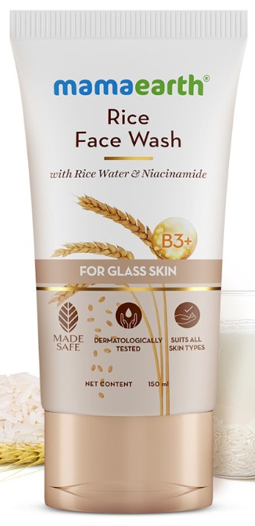
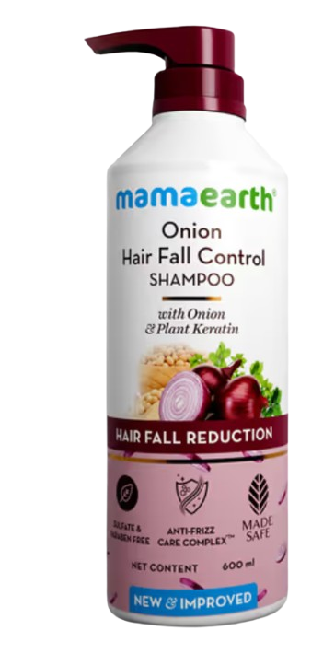
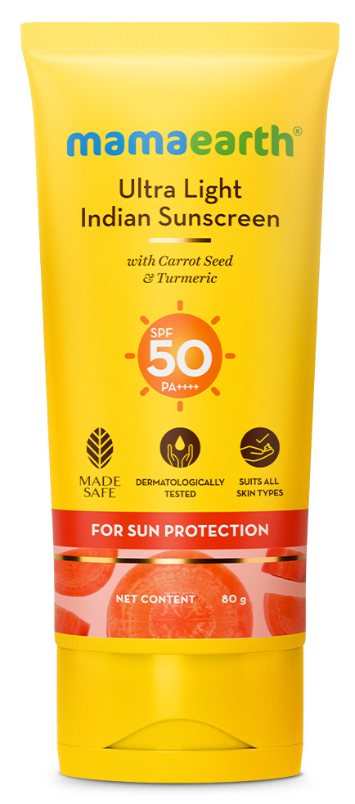
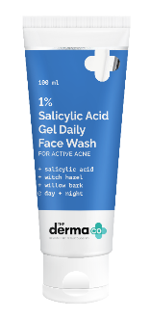
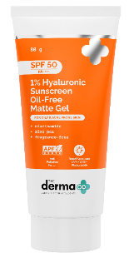
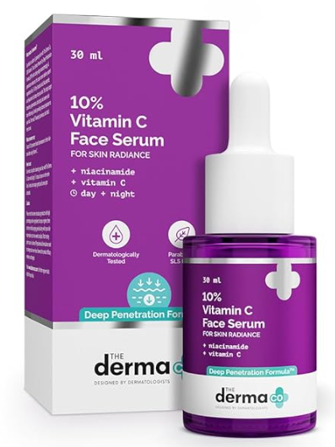
Brand & Category Segment Deep-Dive
Portfolio growth drivers and contribution view
Portfolio growth drivers and contribution view
Brand | May-25 | Jan-26 | Feb-26 | Mar-26 | Apr-26 | May-26 | Cont% | L3M Avg | GO L3M | GOLY May
Mamaearth | 2,168 | 2,438 | 2,188 | 2,477 | 2,653 | 2,836 | 70.60% | 2,436 | ▲ 16% | ▲ 30%
The Derma Co. | 218 | 543 | 513 | 686 | 856 | 1,100 | 27.40% | 685 | ▲ 61% | ▲ 405%
Aqualogica | 63 | 46 | 45 | 59 | 66 | 71 | 1.80% | 57 | ▲ 25% | ▲ 13%
Emerging Brands | 18 | 14 | 17 | 13 | 13 | 12 | 0.30% | 14 | ▼ 14% | ▼ 33%
Portfolio Total | 2,466 | 3,039 | 2,761 | 3,234 | 3,589 | 4,019 | 100.00% | 3,195 | ▲ 26% | ▲ 63%
Strategic Brand Portfolio
Mamaearth remains the portfolio Leader at 70.6% share, growing a steady +30% YoY.
The Derma Co. is the fastest scaling brand now 27.4% of NSV vs single digits a Yr ago, on a genuinely low FY25 base.
Aqualogica continues to show positive structural growth, with ▲13% YoY, ▲7% MoM, and ▲25% vs L3M average. However, its current contribution remains relatively small, so it is not yet materially influencing the overall portfolio trajectory.
Overall | Mamaearth — Top 3 Sub-category Monthly Trend (NSV)
FW
GOLY
▲29%
MoM
▲ 11%
May’26
1,112
Shampoo
GOLY ▲ 53%
MoM
▲ 10%
Sun Care
GOLY
▲ 67%
MoM
▼ 3%
May'26 787
May’26
352
Hero SKU note: Rice Dewy Bright Face Wash variants from Mamaearth lead the Face Wash portfolio with NSV of ₹5.40 Cr.
Onion Shampoo variants from Mamaearth lead the Shampoo portfolio with NSV of ₹4.56 Cr.
Ultra Light Sunscreen from Mamaearth leads the Suncare portfolio with NSV of ₹1.62 Cr. 2
Overall | The Derma Co. — Top 3 Sub-category Monthly Trend (NSV)
FW
GOLY ▲ 1166%
MoM ▲ 38%
May’26
557
Sun Care
GOLY
▲ 356%
MoM ▲ 28%
Face Serum
GOLY
▲ 46%
MoM
▼ 4%
May’26
429
May’26
92
Hero SKU note: 1% Salicylic FW follows with NSV of ₹285 Lacs., contribute 6.4% of May’26 NSV within 1 year of launch .
Hyaluronic Acid leads the pack and contributes 96% of total Suncare sales, with NSV of ₹411 Lacs.
55% Niacinamide Serum leads with NSV of ₹28 Lacs, followed by Vitamin C Serum at ₹23 Lacs..
VOLUME VS. VALUE DECOMPOSITION — MAY'26 VS MAY'25
Mamaearth
Sub Cat | Qty May-25 | Qty May-26 | Qty GOLY% | NSV May-25 | NSV May-26 | NSV GOLY% | ASP GOLY%
Face Cleanser | 6,23,925 | 7,85,723 | ▲ 26% | 865 | 1,120 | ▲ 30% | ▲ 3%
Shampoo | 2,75,067 | 3,57,736 | ▲ 30% | 516 | 789 | ▲ 53% | ▲ 18%
Sun Care | 1,12,028 | 1,67,158 | ▲ 49% | 211 | 353 | ▲ 67% | ▲ 12%
The Derma co.
Sub Cat | Qty May-25 | Qty May-26 | Qty GOLY% | NSV May-25 | NSV May-26 | NSV GOLY% | ASP GOLY%
Face Cleanser | 22,592 | 4,28,182 | ▲ 1795% | 44 | 557 | ▲ 1164% | ▼ 33%
Sun Care | 29,103 | 1,62,541 | ▲ 459% | 94 | 429 | ▲ 357% | ▼ 18%
Shampoo | 22,124 | 30,097 | ▲ 36% | 63 | 92 | ▲ 46% | ▲ 7%
2 / 24

Slide 3
Zone Performance Summary
Zone share, May’26 NSV and growth view
Zone May’26 NSV and Share
Zone Summary
Zone | May-25 | Feb-26 | Mar-26 | Apr-26 | May-26 | Zone Share | L3M Avg | GO L3M | GOLY May
East | 266 | 284 | 311 | 370 | 411 | 10.3% | 322 | ▲ 28% | ▲ 55%
North | 566 | 630 | 764 | 845 | 934 | 23.2% | 746 | ▲ 25% | ▲ 65%
South-1 | 487 | 591 | 660 | 770 | 894 | 22.3% | 674 | ▲ 33% | ▲ 84%
South-2 | 320 | 367 | 429 | 468 | 554 | 13.8% | 421 | ▲ 31% | ▲ 73%
West | 652 | 722 | 896 | 903 | 1,017 | 25.3% | 840 | ▲ 21% | ▲ 56%
FSN | 175 | 168 | 173 | 229 | 208 | 5.2% | 190 | ▲ 9% | ▲ 19%
Zone Insights | May’26
West remained the largest zone with NSV of ₹1,017 Lacs, contributing 25.3% to overall MT offtake.
North and South-1 emerged as the next key growth bases, strengthening the national growth mix beyond West.
South-1 delivered the strongest YoY growth at ▲84%, indicating strong scale-up momentum in the region.
Dmart is the #1 chain in 3 out of 5 zones: North, South-2 and West. This confirms Dmart as a national growth engine, not limited to one zone.
Apollo leads South-1 and ranks #2/#3 in three other zones, showing repeatable pharmacy-channel momentum across regions, largely driven by The Derma Co.
Brand & Category Repeats Across Zones
The Derma Co. achieved its highest-ever monthly NSV of ₹1,100 Lacs, contributing 27.4% to the portfolio. The brand grew ▲404% YoY, making it the fastest-scaling growth engine in the portfolio.
Face Cleanser and Sun Care remained the top 2 growth drivers for The Derma Co. in 5 out of 6 zones, making them the clearest scale-up levers. FSN is the only chain growing materially slower than the network (+18.9% YoY).
Mamaearth Face Cleanser and Shampoo ranked as the #1/#2 sub-categories by value across every zone, confirming their role as stable national anchors.
Sun Care emerged as the fastest seasonal mover across zones, supported by strong summer-led demand and visibility execution.
3 / 24

Slide 4
CHAIN-WISE MARKET SHARE — GROSS SALES BASIS
May'26 Honasa share of category Gross Sales, by chain | NEW — basis differs from NSV elsewhere in this deck
MARKET SHARE SUMMARY — MAY'26 VS APR'26
Chain | Honasa GS (Lacs) | Total Mkt (Lacs) | Mkt Share % | MoM (bps)
MRL | 59.7 | 2,128.7 | 2.80% | ▲ +31
Lulu | 111.5 | 2,848.0 | 3.91% | ▼ -21
Wellness Forever | 137.4 | 977.6 | 14.06% | ▼ -35
Reliance Retail | 2,052.0 | 19,298.6 | 10.63% | ▼ -38
Action Required by Chain
MRL
Lulu
• Mkt Share 2.80% | MoM ▲ +31 bps
• Build — low share, large market; expand assortment & visibility
• Mkt Share 3.91% | MoM ▼ -21 bps
• Fix — review listing gaps in declining sub-categories
Wellness Forever
(Reliance Retail
• Mkt Share 14.06% | MoM ▼ -35 bps
• Protect — stronghold chain; monitor pharmacy-channel pressure
• Mkt Share 10.63% | MoM ▼ -38 bps
• Protect & Accelerate — largest base; review category mix shift
Data Quality Check
FW M/S
• MRL's Honasa share nearly doubled over the period, 8% to 14% — the fastest-improving chain in this view.
• Wellness Forever holds the strongest relative position across all three months (15% to 18%), consistent with the stronghold-chain read on the previous page even though the absolute share level differs.
• Lulu and Reliance are comparatively flat over the period (Lulu 7% to 8%; Reliance 10% to 11%).
Key Takeaway
4 / 24

Slide 5
NIELSEN MARKET SHARE READOUT: FACEWASH & SHAMPOO
Category-level external validation (Nielsen MS Val, Urban) vs chain-wise performance | NEW
Headline
Nielsen confirms the chain-wise growth story: Mamaearth gained share YoY in both categories nationally. Facewash share gains held steady MoM; Shampoo share dipped slightly MoM even as category value grew.
Face Wash Market Share by Zone (%)
Shampoo Market Share by Zone (%)
ZONE-WISE MARKET SHARE — Facewash & SHAMPOO (NIELSEN MS VAL)
Zone | Apr'26 | May'26 | MoM (bps) | Top Brand in Zone
North | 7.36% | 7.03% | ▼ -33 bps | Himalaya (20.1%)
South | 6.22% | 7.13% | ▲ +90 bps | Himalaya (28.3%)
East | 5.00% | 5.37% | ▲ +37 bps | Himalaya (23.0%)
West | 7.26% | 7.23% | ▼ -3 bps | Himalaya (22.1%)
Zone | Apr'26 | May'26 | MoM (bps) | Top Brand in Zone
North | 2.45% | 2.19% | ▼ -26 bps | Dove (15.7%)
South | 3.00% | 3.08% | ▲ +8 bps | Head & Shoulders (12.5%)
East | 2.61% | 2.99% | ▲ +37 bps | Dove (13.7%)
West | 2.11% | 2.16% | ▲ +5 bps | Dove (16.8%)
Facewash — Mamaearth (Nielsen MS Val, Urban India)
Shampoo — Mamaearth (Nielsen MS Val, Urban India)
Metric | May'25 | Apr'26 | May'26 | MoM | YoY
MS % | 5.61% | 6.65% | 6.68% | ▲+2bps | ▲+107bps
Sales (Cr.) | 14.98 | 17.54 | 18.61 | ▲+6.1% | ▲+24.2%
Metric | May'25 | Apr'26 | May'26 | MoM | YoY
MS % | 1.75% | 2.52% | 2.50% | ▼-2bps | ▲+75bps
Sales (Cr.) | 5.49 | 6.94 | 7.75 | ▲+11.5% | ▲+41.1%
Top Category Gainers / Decliners Facewash (Top competitors, MS Val May'26)
Top Category Gainers / Decliners Shampoo (Top competitors, MS Val May'26)
Brand | May'25 | Apr'26 | May'26 | YoY bps
Himalaya | 21.51% | 22.26% | 22.20% | ▲ +69
Garnier | 14.53% | 13.32% | 13.41% | ▼ -112
Pond's | 13.03% | 13.07% | 12.71% | ▼ -32
Mamaearth | 5.61% | 6.65% | 6.68% | ▲ +107
The Derma Co | 0.12% | 0.73% | 0.81% | ▲ +69
Brand | May'25 | Apr'26 | May'26 | YoY bps
Dove | 15.23% | 13.31% | 14.95% | ▼ -28
H & S | 12.19% | 11.74% | 11.12% | ▼ -106
TRESemme | 6.44% | 6.78% | 7.43% | ▲ +99
Mamaearth | 1.75% | 2.52% | 2.50% | ▲ +75
Patanjali | 2.17% | 2.10% | 1.84% | ▼ -34
Business Reason & Action Required
Facewash:
Gain is broad-based (category value ▲24% YoY), consistent with the strong chain-wise Face category growth seen elsewhere in this deck — reads as genuine share gain, not just category tailwind. Protect and continue distribution push.
Shampoo:
YoY gain remains strong (+75 bps) but the marginal MoM dip (-2 bps) against +11.5% category value growth suggests Honasa grew slower than the category this month — flag for next-cycle tracking.
5 / 24

Slide 6
NIELSEN MARKET SHARE READOUT: FACEWASH & SHAMPOO
Category-level external validation (Nielsen MS Val, Urban) vs chain-wise performance | NEW
FACEWASH — TOP CONTRIBUTING STATES
State | Contrib. to Category | May'26 Share | MoM (bps)
Uttar Pradesh * | 14.5% | 6.05% | ▼ -122 bps
Maharashtra * | 13.5% | 6.04% | ▲ +16 bps
West Bengal * | 8.4% | 4.95% | ▲ +28 bps
Delhi | 7.6% | 9.26% | ▼ -42 bps
Haryana | 5.8% | 7.75% | ▲ +148 bps
Madhya Pradesh | 5.5% | 7.26% | ▲ +14 bps
Bihar * | 5.5% | 4.70% | ▼ -15 bps
Gujarat | 5.3% | 10.21% | ▼ -88 bps
* High contribution to category size but share below the national average — under-penetrated opportunity
SHAMPOO — TOP CONTRIBUTING STATES
State | Contrib. to Category | May'26 Share | MoM (bps)
Maharashtra * | 14.8% | 1.48% | ▲ +11 bps
Gujarat | 10.8% | 2.63% | ▼ -61 bps
Uttar Pradesh * | 9.7% | 2.46% | ▼ -67 bps
Delhi * | 7.2% | 1.89% | ▲ +16 bps
Karnataka | 6.3% | 2.72% | ▲ +42 bps
West Bengal | 5.8% | 2.84% | ▲ +53 bps
Haryana * | 5.6% | 2.18% | ▼ -5 bps
Punjab * | 5.5% | 1.41% | ▼ -33 bps
* High contribution to category size but share below the national average — under-penetrated opportunity
High Contribution, Low Share States
Facewash: Uttar Pradesh (14.5% contrib, 6.0% share); Maharashtra (13.5% contrib, 6.0% share); West Bengal (8.4% contrib, 5.0% share); Bihar (5.5% contrib, 4.7% share). Shampoo: Maharashtra (14.8% contrib, 1.5% share); Uttar Pradesh (9.7% contrib, 2.5% share); Delhi (7.2% contrib, 1.9% share); Haryana (5.6% contrib, 2.2% share); Punjab (5.5% contrib, 1.4% share). Uttar Pradesh and Maharashtra are the two largest under-penetrated states across both categories — biggest white-space opportunity for distribution and visibility investment.
CATEGORY, BRAND & PACK-SIZE DRIVING HONASA'S STATE-WISE CHAIN SALES (INTERNAL)
State | May'26 (Lacs) | Top Category | Top Brand | Top Pack
Kerala | 54.9 | Face | Mamaearth | 150 ml/g
Telangana | 32.4 | Face | Mamaearth | 150 ml/g
Karnataka | 32.1 | Face | Mamaearth | 50 ml/g
Uttar Pradesh | 16.3 | Face | Mamaearth | 150 ml/g
Tamil Nadu | 14.4 | Face | Mamaearth | 150 ml/g
West Bengal | 14.1 | Face | Mamaearth | 50 ml/g
Delhi/Ncr | 13.6 | Face | The Derma Co. | 50 ml/g
Andhra Pradesh | 3.4 | Face | Mamaearth | 100 ml/g
Punjab | 2.9 | Face | Mamaearth | 100 ml/g
Basis: MT chain extract (MRL + Lulu + Wellness), Data for=HCL rows only — Honasa's internal sales mix, not a competitive denominator. State names from this source do not map 1:1 to Nielsen's state list above (e.g. Kerala/Andhra Pradesh have no separate Nielsen state cut).
6 / 24

Slide 7
NIELSEN MARKET SHARE READOUT: FACEWASH
Category-level external validation (Nielsen MS Val, Urban — Facewash) | standalone facewash read, not linked to other slides
Mamaearth MS Val
6.65%
MoM ▲ +18 bps YoY ▲ +139 bps
Mamaearth Sales
₹ 17.54 Cr
MoM ▲ +3.7% YoY ▲ +34.1%
Category (Facewash)
₹ 263.6 Cr
MoM ▲ +0.9% YoY ▲ +6.1%
BRAND SHARE — NIELSEN MS VAL % (URBAN, FACEWASH)
Brand | May'25 | Apr'26 | May'26 | YoY bps
Himalaya | 21.8 | 22.5 | 22.3 | ▲ +50
Garnier | 14.1 | 13.7 | 13.3 | ▼ -75
Pond's | 13.2 | 13.0 | 13.1 | ▼ -13
Clean & Clear | 10.4 | 9.2 | 9.3 | ▼ -112
Mamaearth | 5.3 | 6.5 | 6.7 | ▲ +139
Joy | 3.8 | 3.9 | 4.3 | ▲ +47
Glow & Lovely | 3.0 | 2.5 | 2.4 | ▼ -66
Patanjali | 2.7 | 2.4 | 2.2 | ▼ -43
7 / 24

Slide 8
NIELSEN MARKET SHARE READOUT: SHAMPOO
Category-level external validation (Nielsen MS Val, Urban — Bottles) | standalone shampoo read, not linked to other slides
Mamaearth MS Val
2.52%
MoM ▲ +18 bps YoY ▲ +91 bps
Mamaearth Sales
₹ 6.94 Cr
MoM ▲ +4.0% YoY ▲ +52.2%
Category (Bottles)
₹ 276.0 Cr
MoM ▼ -3.3% YoY ▼ -2.8%
BRAND SHARE — NIELSEN MS VAL % (URBAN, BOTTLES)
Brand | May'25 | Apr'26 | May'26 | YoY bps
Dove | 14.5 | 13.1 | 13.3 | ▼ -120
Head & Shoulders | 12.6 | 12.0 | 11.7 | ▼ -89
Clinic Plus | 9.7 | 9.6 | 9.7 | ▼ -3
L'Oreal Paris | 8.1 | 9.4 | 9.3 | ▲ +119
Sunsilk | 8.4 | 7.8 | 7.5 | ▼ -91
Tresemme | 6.1 | 6.6 | 6.8 | ▲ +66
Pantene | 3.9 | 3.6 | 3.5 | ▼ -42
Mamaearth | 1.6 | 2.3 | 2.5 | ▲ +91
8 / 24

Slide 9
PACK SIZE DEEP DIVE
Top contributing pack sizes — Honasa internal sales mix, MT chains
MAY 2026
TOP CONTRIBUTING PACK SIZES (BY MAY'26 SALES)
Pack Size | May'26 (Lacs) | Contribution % | MoM Growth | Status
150 g/ml | 37.2 | 20.2% | ▲ +46.0% | ▲ Gaining Share
50 g/ml | 35.1 | 19.0% | ▲ +11.9% | Needs Promo Support
100 g/ml | 24.7 | 13.4% | ▲ +6.2% | Needs Promo Support
30 g/ml | 14.7 | 8.0% | ▲ +7.8% | Needs Promo Support
200 g/ml | 13.0 | 7.1% | ▲ +27.8% | ▲ Gaining Share
250 g/ml | 11.4 | 6.2% | ▲ +41.2% | ▲ Gaining Share
125 g/ml | 11.4 | 6.2% | ▲ +18.1% | Needs Promo Support
80 g/ml | 9.7 | 5.3% | ▲ +1.7% | Needs Promo Support
CATEGORY & BRAND DRIVING EACH PACK SIZE
Pack Size | Top Category | Cat. Sales (Lacs) | Top Brand | Brand Sales (Lacs)
150 g/ml | Face | 31.0 | The Derma Co. | 19.1
50 g/ml | Face | 32.1 | The Derma Co. | 17.0
100 g/ml | Face | 24.2 | Mamaearth | 16.1
30 g/ml | Face | 14.7 | The Derma Co. | 14.5
200 g/ml | Face | 10.0 | Mamaearth | 12.4
250 g/ml | Hair | 11.0 | Mamaearth | 11.3
125 g/ml | Face | 9.9 | The Derma Co. | 9.6
80 g/ml | Face | 9.7 | Mamaearth | 7.3
PACK-WISE SALES: APR'26 VS MAY'26 (TOP 8 PACKS)
Packs Gaining, Losing & Needing Promo Support
150g/ml and 250g/ml are the fastest-growing packs (+46.0% and +41.2% MoM) and, together with 600g/ml (+34.3%) and 200g/ml (+27.8%), are clear gainers — worth prioritising for visibility and shelf space. 400g/ml is the only top-8 pack in decline (−5.7% MoM) and needs a root-cause check. 50g/ml, 100g/ml, 30g/ml and 125g/ml are flat-to-modest growers (+6% to +19%) despite being large, established packs — these need visibility/promo support to re-accelerate rather than rely on organic pull.
Basis Note
Pack-size (UOM) cuts are from Honasa's internal Realised Sales within the MT chain extract (MRL + Lulu + Wellness); UOM values are the numeric pack size only (unit g or ml depends on product/category) as captured in the source extract.
9 / 24

Slide 10
SHAMPOO DEEP DIVE
Top brands by sales & share — Nielsen MS Val, Urban (Bottles) | May 2026
TOP CONTRIBUTING BRANDS (BY MAY'26 SALES)
Brand | Apr'26 (Cr) | May'26 (Cr) | Contribution % | MoM Growth | Status
Dove | 37.5 | 36.7 | 13.3% | ▼ 2.0% | Needs Promo Support
Head & Shoulders | 34.2 | 32.4 | 11.7% | ▼ 5.4% | Needs Promo Support
Clinic Plus | 27.3 | 26.7 | 9.7% | ▼ 2.1% | Needs Promo Support
L'Oreal Paris | 26.8 | 25.6 | 9.3% | ▼ 4.5% | ▲ Gaining Share
Sunsilk | 22.3 | 20.7 | 7.5% | ▼ 7.4% | Needs Promo Support
Tresemme | 18.7 | 18.7 | 6.8% | ▲ +0.0% | ▲ Gaining Share
Himalaya Baby Care | 9.9 | 10.4 | 3.8% | ▲ +5.0% | ▲ Gaining Share
Mamaearth | 6.7 | 6.9 | 2.5% | ▲ +4.0% | ▲ Gaining Share
BRAND SHARE & GROWTH (NIELSEN MS VAL %)
Brand | May'26 MS % | YoY (bps) | Sales YoY %
Dove | 13.3% | ▼ 120 | ▼ 10.8%
Head & Shoulders | 11.7% | ▼ 89 | ▼ 9.6%
Clinic Plus | 9.7% | ▼ 3 | ▼ 3.1%
L'Oreal Paris | 9.3% | ▲ +119 | ▲ +11.5%
Sunsilk | 7.5% | ▼ 91 | ▼ 13.3%
Tresemme | 6.8% | ▲ +66 | ▲ +7.7%
Himalaya Baby Care | 3.8% | ▲ +41 | ▲ +9.0%
Mamaearth | 2.5% | ▲ +91 | ▲ +52.2%
Why it matters: The shampoo category (Bottles) softened to ₹276 Cr (▼ -3.3% MoM, ▼ -2.8% YoY). Against that, Mamaearth grew sales +52% YoY to ₹6.94 Cr and added +91 bps share — the standout riser, with L’Oreal Paris (▲ +119 bps) and Tresemme (▲ +66 bps) also gaining; Dove (▼ -120) and Head & Shoulders (▼ -89) ceded share.
Action: Keep pressing MT-chain distribution depth and shelf visibility to convert Mamaearth's momentum into a higher rung on the brand ladder.
Source: Nielsen MS Val, Urban, Bottles — Apr’26 vs May’26; YoY vs May’25.
10 / 24

Slide 11
EAST ZONE PERFORMANCE
May-26 Sales
411
Zone Share
10.3%
L3M Avg
322
GOLY May
▲ 55%
Key Performance Highlights
Zone Record: May-26 delivered the highest month for East at 411, contributing 10.3% to total channel sales.
Growth View: May-26 performance was ▲ 28% vs L3M and ▲ 55% vs May-25, confirming Consistent strong month momentum.
Zone Insight: Mamaearth anchors the East mix; The Derma Co. is the fastest-growing brand YoY.
Brand | May-25 | Apr-26 | May-26 | Cont% | L3M | GO L3M | GOLY
Mamaearth | 235 | 322 | 360 | 87.6% | 283 | ▲ 27% | ▲ 53%
The Derma Co. | 18 | 40 | 44 | 10.7% | 30 | ▲ 45% | ▲ 144%
Aqualogica | 9 | 7 | 7 | 1.7% | 7 | ▲ 0% | ▼ 22%
Emerging Brands | 4 | 1 | 1 | 0.2% | 1
East | Mamaearth — Top 3 Sub-category Monthly Trend (NSV)
FW
GOLY ▲ 43%
MoM
▲ 10%
May’26
132
Shampoo
GOLY ▲ 77%
MoM
▲ 13%
May'26 122
Sun Care
GOLY ▲157%
MoM
▲ 20%
May’26
36
East | The Derma Co. — Top 3 Sub-category Monthly Trend (NSV)
FW
GOLY
▲500%
MoM
▲ 6%
May'26 18
Sun Care
GOLY
▲125%
MoM
▲ 20%
May'26 18
Face Serum
GOLY
▼ 22%
MoM
▲ 0%
May’26
7
East Chain Summary
Chain | May-25 | Apr-26 | May-26 | Cont% | L3M | GO L3M | GOLY
Reliance | 188 | 235 | 264 | 64.20% | 209 | ▲ 27% | ▲ 40%
Apollo | 30 | 72 | 80 | 19.50% | 60 | ▲ 33% | ▲ 167%
VMM | 8 | 15 | 16 | 4.00% | 11 | ▲ 45% | ▲ 108%
More Retail | 5 | 11 | 11 | 2.70% | 9 | ▲ 18% | ▲ 120%
Frankros | 1 | 4 | 10 | 2.40% | 3 | ▲ 200% | ▲ 900%
Spencer | 23 | 9 | 8 | 1.90% | 9 | ▼ 14% | ▼ 65%
Others Combined | 10 | 26 | 21 | 5.16% | 20 | ▲ 5% | ▲ 103%
CHAIN KEY HIGHLIGHTS
Zone Record: East delivered its highest month in Apr-26 at 372. Growth stood at ▲ 18% vs L3M and ▲ 68% vs Apr-25.
Chain Highlights Reliance at 264 Lacs; fastest YoY chain: Apollo 80 Lacs Gr▲ 33%.
Lead Chain
Reliance - 264
Fastest YoY Chain
Apollo - ▲ 33%
Record Chain ines2
Reliance, VMM, Apollo, More Retail,
Zone Record
May-26 - 411
11 / 24

Slide 12
NORTH ZONE PERFORMANCE
May-26 Sales
934
Zone Share
23.2%
L3M Avg
746
GOLY May
▲ 65%
Key Performance Highlights
Zone Record: May-26 delivered the highest month for North at 934, contributing 23.2% to total channel sales.
Growth View: May-26 performance was ▲ 25% vs L3M and ▲ 65% vs May-25, confirming Consistent strong month momentum.
Zone Insight: Mamaearth anchors the North mix; The Derma Co. is the fastest-growing brand YoY.
Brand | May-25 | Apr-26 | May-26 | Cont% | L3M | GO L3M | GOLY
Mamaearth | 517 | 649 | 671 | 71.8% | 586 | ▲ 13% | ▲ 28%
The Derma Co. | 33 | 181 | 243 | 26.3% | 147 | ▲ 65% | ▲ 635%
Aqualogica | 12 | 14 | 19 | 2.1% | 12 | ▲ 59% | ▲ 59%
Emerging Brands | 3 | 1 | 1 | 0.1% | 1
North | Mamaearth — Top 3 Sub-category Monthly Trend (NSV)
FW
GOLY ▲ 29%
MoM
▲ 7%
May'26
262
Shampoo
GOLY ▲ 54%
MoM
▲ 7%
May'26 188
Sun Care
GOLY ▲ 50%
MoM
▲ 3%
May'26
89
North | The Derma Co. — Top 3 Sub-category Monthly Trend (NSV)
FW
GOLY
▲1806%
MoM
▲ 40%
May'26 132
Sun Care
GOLY
▲440%
MoM
▲ 37%
May’26
92
Face
Serum
GOLY
▲ 108%
MoM
▼ 1%
May'26
16
North Chain Summary
Chain | May-25 | Apr-26 | May-26 | Cont% | L3M | GO L3M | GOLY
Dmart | 187 | 288 | 351 | 37.6% | 257 | ▲ 37% | ▲ 88%
Reliance | 243 | 293 | 337 | 36.4% | 264 | ▲ 28% | ▲ 39%
Apollo | 45 | 118 | 125 | 13.5% | 104 | ▲ 19% | ▲ 175%
Sancus(Rmt) | 41 | 58 | 46 | 5.0% | 43 | ▲ 8% | ▲ 13%
Lulu | 5 | 17 | 19 | 2.1% | 15 | ▲ 32% | ▲ 283%
Metro Cnc | 12 | 14 | 13 | 1.4% | 13 | ▲ 2% | ▲ 14%
Others Combined | 33 | 57 | 42 | 4.5% | 50 | ▼ 16% | ▲ 28%
CHAIN KEY HIGHLIGHTS
Zone Record: North delivered its highest month in May-26 at 934. Growth stood at ▲ 25% vs L3M and ▲ 65% vs May-25.
Chain Highlights Dmart at 351 Lacs; fastest YoY chain: Lulu 19 Lacs Gr▲ 283%.
Lead Chain
Fastest YoY Chain
Record Chain Lines
Zone Record
Dmart - 351
Lulu - ▲ 283%
Dmart, Reliance, Apollo,
May-26 - 934
12 / 24

Slide 13
SOUTH-1 ZONE PERFORMANCE
May-26 Sales
894
Zone Share
22.3%
L3M Avg
674
GOLY May
▲ 84%
Key Performance Highlights
Zone Record: May-26 delivered the highest month for South-1 at 894, contributing 22.3% to total channel sales.
Growth View: May-26 performance was ▲ 33% vs L3M and ▲ 84% vs May-25, confirming Consistent strong month momentum.
Zone Insight: South-1 covers Karnataka, Tamil Nadu & Kerala; Mamaearth leads, The Derma Co. scaling fast.
Brand | May-25 | Apr-26 | May-26 | Cont% | L3M | GO L3M | GOLY
Mamaearth | 398 | 511 | 585 | 65.5% | 475 | ▲ 23% | ▲ 47%
The Derma Co. | 64 | 236 | 286 | 32.0% | 178 | ▲ 61% | ▲ 348%
Aqualogica | 19 | 18 | 18 | 2.0% | 15 | ▲ 21% | ▼ 3%
Emerging Brands | 6 | 4 | 4 | 0.4% | 5
South-1 | Mamaearth — Top 3 Sub-category Monthly Trend (NSV)
FW
GOLY ▲ 44%
MoM
▲ 17%
May'26
189
Shampoo
GOLY ▲ 63%
MoM
▲ 23%
May'26 170
Sun Care
GOLY ▲ 122%
MoM
▼ 0%
May'26
70
South-1 | The Derma Co. — Top 3 Sub-category Monthly Trend (NSV)
FW
GOLY
▲772%
MoM
▲ 36%
May'26 116
Sun Care
GOLY
▲351%
MoM
▲ 14%
May'26 131
Face
Serum
GOLY
▲ 94%
MoM
▲ 9%
May'26
30
South-1 Chain Summary
Chain | May-25 | Apr-26 | May-26 | Cont% | L3M | GO L3M | GOLY
Apollo | 101 | 272 | 292 | 32.6% | 220 | ▲ 32% | ▲ 189%
Dmart | 151 | 213 | 267 | 29.9% | 188 | ▲ 42% | ▲ 77%
Reliance | 117 | 126 | 152 | 17.0% | 127 | ▲ 19% | ▲ 29%
Lulu | 35 | 76 | 84 | 9.4% | 61 | ▲ 37% | ▲ 138%
H&G | 53 | 43 | 58 | 6.5% | 36 | ▲ 64% | ▲ 11%
Metro Cnc | 15 | 15 | 15 | 1.7% | 16 | ▼ 3% | ▲ 2%
Others Combined | 15 | 23 | 26 | 2.9% | 26 | ▲ 6% | ▲ 73%
CHAIN KEY HIGHLIGHTS
Zone Record: South-1 delivered its highest month in May-26 at 894. Growth stood at ▲ 33% vs L3M and ▲ 84% vs May-25.
Chain Highlights Apollo at 292 Lacs; fastest YoY chain: Apollo 292 Lacs Gr▲ 189%.
Lead Chain
Fastest YoY Chain
Record Chain Lines
Zone Record
Apollo - 292
Apollo - ▲ 189%
Apollo, Dmart, Reliance,
May-26 - 894
13 / 24

Slide 14
SOUTH-2 ZONE PERFORMANCE
May-26 Sales
554
Zone Share
13.8%
L3M Avg
421
GOLY May
▲ 73%
Key Performance Highlights
Zone Record: May-26 delivered the highest month for South-2 at 554, contributing 13.8% to total channel sales.
Growth View: May-26 performance was ▲ 31% vs L3M and ▲ 73% vs May-25, confirming Consistent strong month momentum.
Zone Insight: South-2 covers Andhra Pradesh & Telangana; Mamaearth leads, The Derma Co. scaling fast.
Brand | May-25 | Apr-26 | May-26 | Cont% | L3M | GO L3M | GOLY
Mamaearth | 290 | 371 | 413 | 74.6% | 347 | ▲ 19% | ▲ 42%
The Derma Co. | 20 | 89 | 131 | 23.7% | 66 | ▲ 97% | ▲ 545%
Aqualogica | 6 | 7 | 8 | 1.4% | 5 | ▲ 44% | ▲ 18%
Emerging Brands | 2 | 1 | 1 | 0.4% | 2
South-2 | Mamaearth — Top 3 Sub-category Monthly Trend (NSV)
FW
GOLY ▲ 50%
MoM
▲ 19%
May'26
144
Shampoo
GOLY ▲ 55%
MoM
▲ 8%
May'26 119
Sun Care
GOLY ▲ 105%
MoM
▲ 6%
May'26
40
South-2 | The Derma Co. — Top 3 Sub-category Monthly Trend (NSV)
FW
GOLY
▲137%
MoM
▲ 48%
May'26 62
Sun Care
GOLY
▲509%
MoM
▲ 60%
May’26
57
Face
Serum
GOLY
▲ 124%
MoM
▲ 7%
May'26
10
South-2 Chain Summary
Chain | May-25 | Apr-26 | May-26 | Cont% | L3M | GO L3M | GOLY
Dmart | 131 | 177 | 218 | 39.3% | 155 | ▲ 41% | ▲ 66%
Apollo | 69 | 163 | 176 | 31.7% | 144 | ▲ 22% | ▲ 154%
Reliance | 59 | 75 | 85 | 15.4% | 72 | ▲ 19% | ▲ 44%
H&G | 22 | 15 | 24 | 4.3% | 14 | ▲ 64% | ▲ 8%
More Retail | 10 | 15 | 20 | 3.6% | 14 | ▲ 44% | ▲ 106%
Lulu | 2 | 9 | 13 | 2.3% | 7 | ▲ 87% | ▲ 608%
Others Combined | 27 | 20 | 19 | 3.4% | 17 | ▲ 16% | ▼ 31%
CHAIN KEY HIGHLIGHTS
Zone Record: South-2 delivered its highest month in May-26 at 554. Growth stood at ▲ 31% vs L3M and ▲ 73% vs May-25.
Chain Highlights Dmart at 218 Lacs; fastest YoY chain: Lulu 13 Lacs Gr▲ 608%.
Lead Chain
Fastest YoY Chain
Record Chain Lines
Zone Record
Dmart - 218
Lulu - ▲ 608%
Dmart, Apollo, Reliance,
May-26 - 554
14 / 24

Slide 15
WEST ZONE PERFORMANCE
May-26 Sales
1016
Zone Share
25.3%
L3M Avg
840
GOLY May
▲ 56%
Key Performance Highlights
Zone Record: May-26 delivered the highest month for West at 1016, contributing 25.3% to total channel sales.
Growth View: May-26 performance was ▲ 21% vs L3M and ▲ 56% vs May-25, confirming Consistent strong month momentum.
Zone Insight: Mamaearth anchors the West mix; The Derma Co. is the fastest-growing brand YoY.
Brand | May-25 | Apr-26 | May-26 | Cont% | L3M | GO L3M | GOLY
Mamaearth | 584 | 623 | 640 | 63.1% | 599 | ▲ 7% | ▲ 10%
The Derma Co. | 59 | 265 | 359 | 35.3% | 228 | ▲ 57% | ▲ 510%
Aqualogica | 9 | 13 | 14 | 1.4% | 11 | ▲ 29% | ▲ 63%
Emerging Brands | 1 | 2 | 2 | 0.2% | 1
West | Mamaearth — Top 3 Sub-category Monthly Trend (NSV)
FW
GOLY ▲ 6%
MoM
▲ 12%
May'26
290
Shampoo
GOLY ▲ 35%
MoM
▲ 3%
May'26 175
Sun
Care
GOLY ▲ 36%
MoM
▼ 15%
May'26
88
West | The Derma Co. — Top 3 Sub-category Monthly Trend (NSV)
FW
GOLY▲154%
MoM
▲ 42%
May'26 215
Sun Care
GOLY
▲438%
MoM
▲ 40%
May'26 119
Face
Serum
GOLY
▲ 3%
MoM
▼ 15%
May'26
19
West Chain Summary
Chain | May-25 | Apr-26 | May-26 | Cont% | L3M | GO L3M | GOLY
Dmart | 428 | 577 | 680 | 66.9% | 537 | ▲ 27% | ▲ 59%
Reliance | 107 | 138 | 152 | 15.0% | 138 | ▲ 11% | ▲ 42%
Wellness Forever | 77 | 99 | 92 | 9.1% | 88 | ▲ 4% | ▲ 20%
Apollo | 27 | 74 | 79 | 7.8% | 64 | ▲ 23% | ▲ 190%
Metro Cnc | 7 | 6 | 5 | 0.5% | 6 | ▼ 10% | ▼ 27%
Trent | 2 | 4 | 4 | 0.4% | 3 | ▲ 28% | ▲ 135%
Others Combined | 4 | 5 | 3 | 0.3% | 3 | ▼ 27% | ▼ 33%
CHAIN KEY HIGHLIGHTS
Zone Record: West delivered its highest month in May-26 at 1016. Growth stood at ▲ 21% vs L3M and ▲ 56% vs May-25.
Chain Highlights Dmart at 680 Lacs; fastest YoY chain: Apollo 79 Lacs Gr▲ 190%.
Lead Chain
Fastest YoY Chain
Record Chain Lines
Zone Record
Dmart - 680
Apollo - ▲ 190%
Dmart, Reliance, Wellness Forever,
May-26 - 1016
15 / 24

Slide 16
PAN INDIA PERFORMANCE
May-26 Sales
208
Zone Share
5.2%
L3M Avg
190
GOLY May
▲ 19%
Key Performance Highlights
Zone Record: May-26 delivered the highest month for FSN at 208, contributing 5.2% to total channel sales.
Growth View: May-26 performance was ▲ 9% vs L3M and ▲ 19% vs May-25, confirming Consistent strong month momentum.
Brand | May-25 | Apr-26 | May-26 | Cont% | L3M | GO L3M | GOLY
Mamaearth | 143 | 173 | 164 | 78.9% | 146 | ▲ 12% | ▲ 15%
The Derma Co. | 24 | 45 | 37 | 17.6% | 35 | ▲ 6% | ▲ 54%
Aqualogica | 8 | 7 | 5 | 2.2% | 6 | ▼ 24% | ▼ 38%
Emerging Brands | 1 | 3 | 3 | 1.3% | 3
FSN | Mamaearth — Top 3 Sub-category Monthly Trend (NSV)
FW
GOLY ▲ 36%
MoM
▲ 3%
May'26
96
Shampoo
GOLY ▼ 3%
MoM
▼ 1%
May'26 14
Sun
Care
GOLY ▲ 28%
MoM
▼ 23%
May'26
29
FSN | The Derma Co. — Top 3 Sub-category Monthly Trend (NSV)
FW
GOLY
▲289%
MoM
▼ 6%
May'26 14
Sun Care
GOLY
▲21%
MoM
▼ 25%
May’26
12
Face
Serum
GOLY
▲ 9%
MoM
▼ 26%
May'26
10
FSN Chain Summary
Chain | May-25 | Apr-26 | May-26 | Cont% | L3M | GO L3M | GOLY
Fsn | 175 | 229 | 208 | 100.0% | 190 | ▲ 9% | ▲ 19%
Others Combined | 0 | 0 | 0 | 0.0% | 0
CHAIN KEY HIGHLIGHTS
Chain Highlights:- FSN delivered its highest month in May-26 at 208. Growth stood at ▲ 9% vs L3M and ▲ 19% vs May-25.
Lead Chain
Fastest YoY Chain
Record Chain Lines
Zone Record
Apr-26 - 229
Fsn - 208
Fsn - ▲ 19%
Fsn
16 / 24

Slide 17
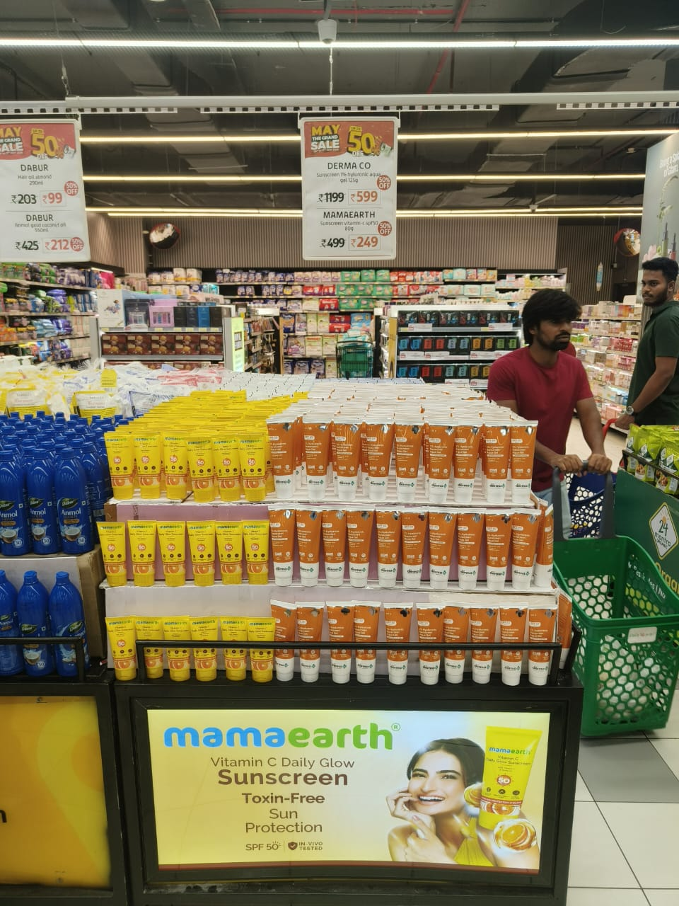
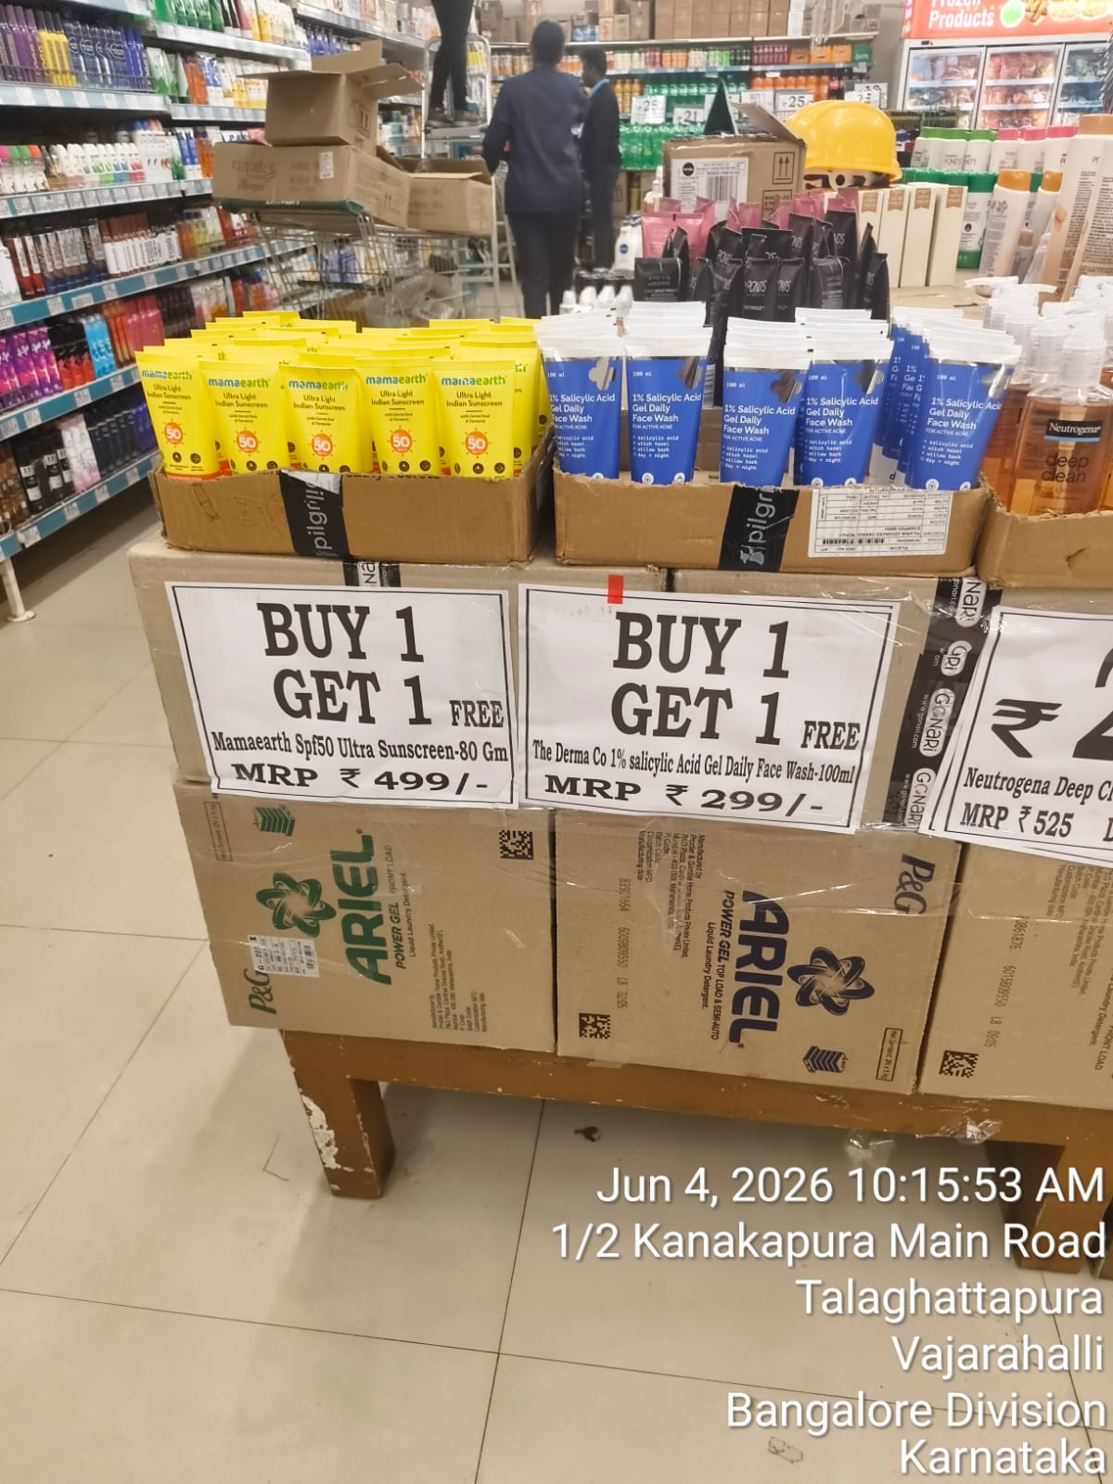
Zone-wise Best Execution Images
Best available field execution proof, by zone — and where the image bank still needs to be built
FIELD CAPTURES
SOUTH-1 — HYDERABAD
SOUTH-2 — KARNATAKA
Lulu | Hyderabad* | South-1 | Endcap / Bin-Tower
D-Mart | Bengaluru** | South-2 | BOGO Bin Display
Derma Co. + Mamaearth pyramid bin with 50% off signage at the chain entrance.
Mamaearth Sunscreen + Derma Co. Face Wash combo crates, geotagged 4-Jun-2026.
MT Offtake Performance Review | May'26 | Honasa Consumer Limited — Internal
17 / 24
21

Slide 18
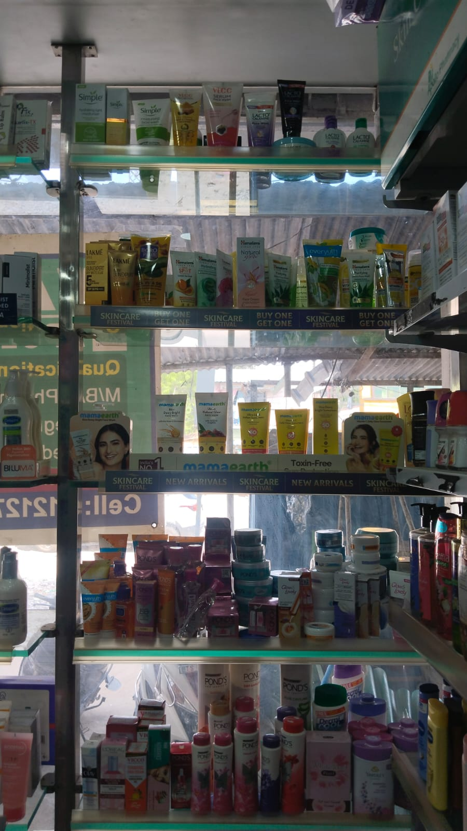
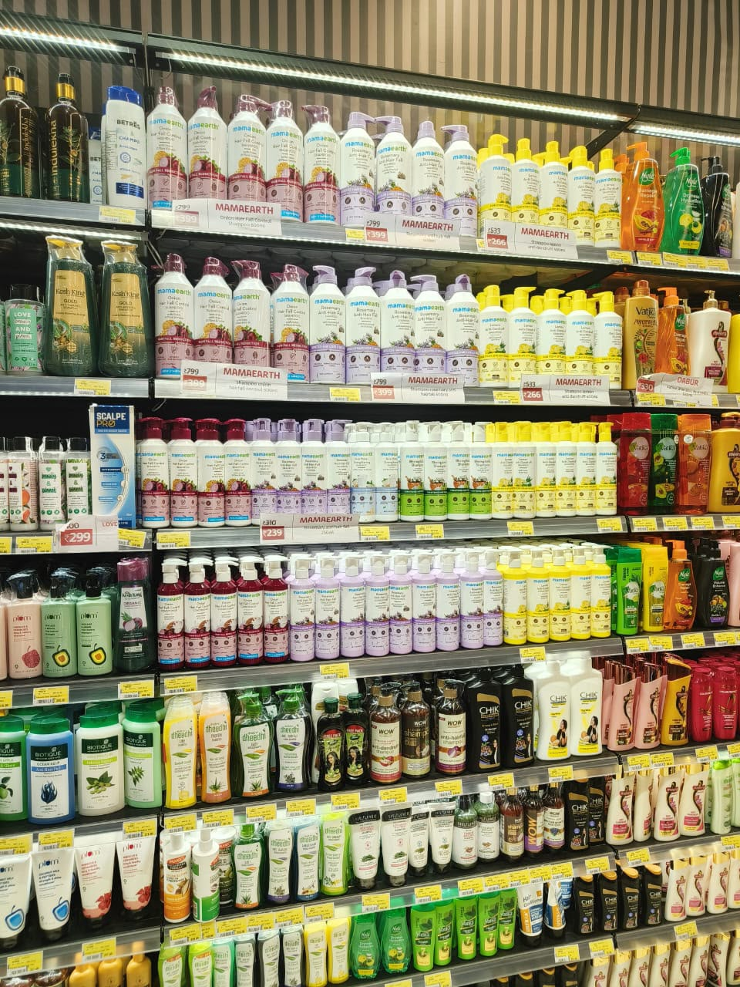
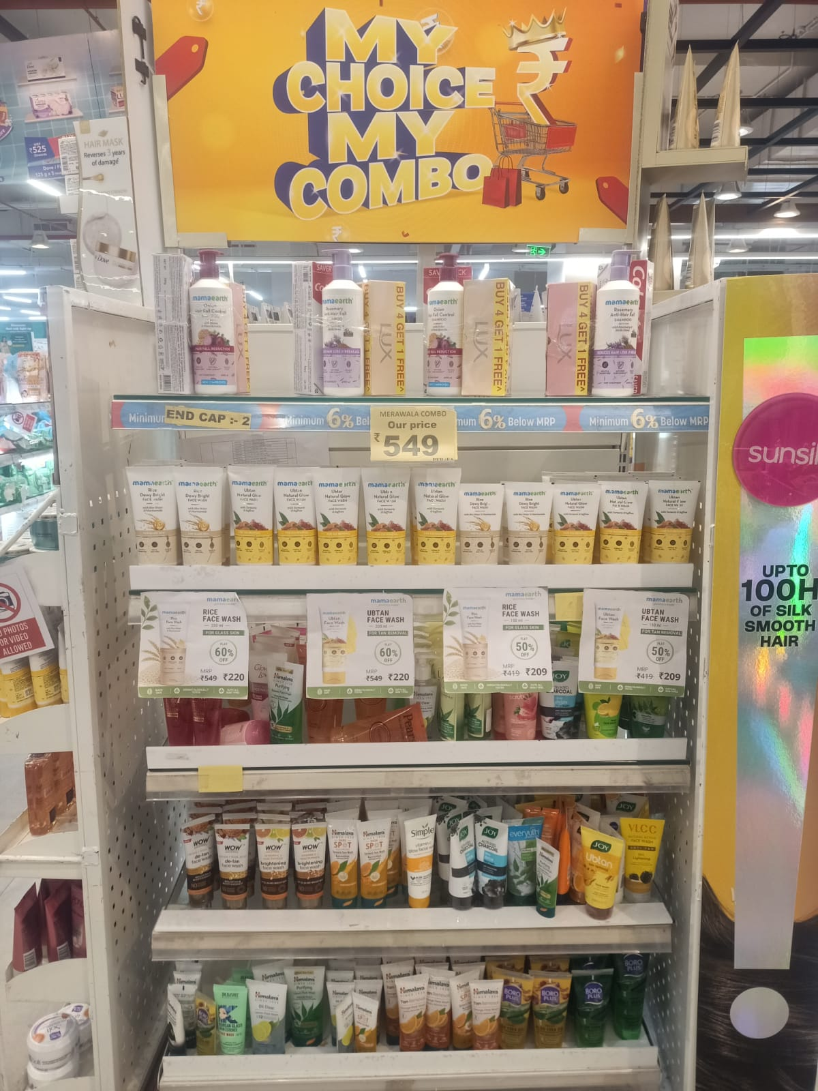
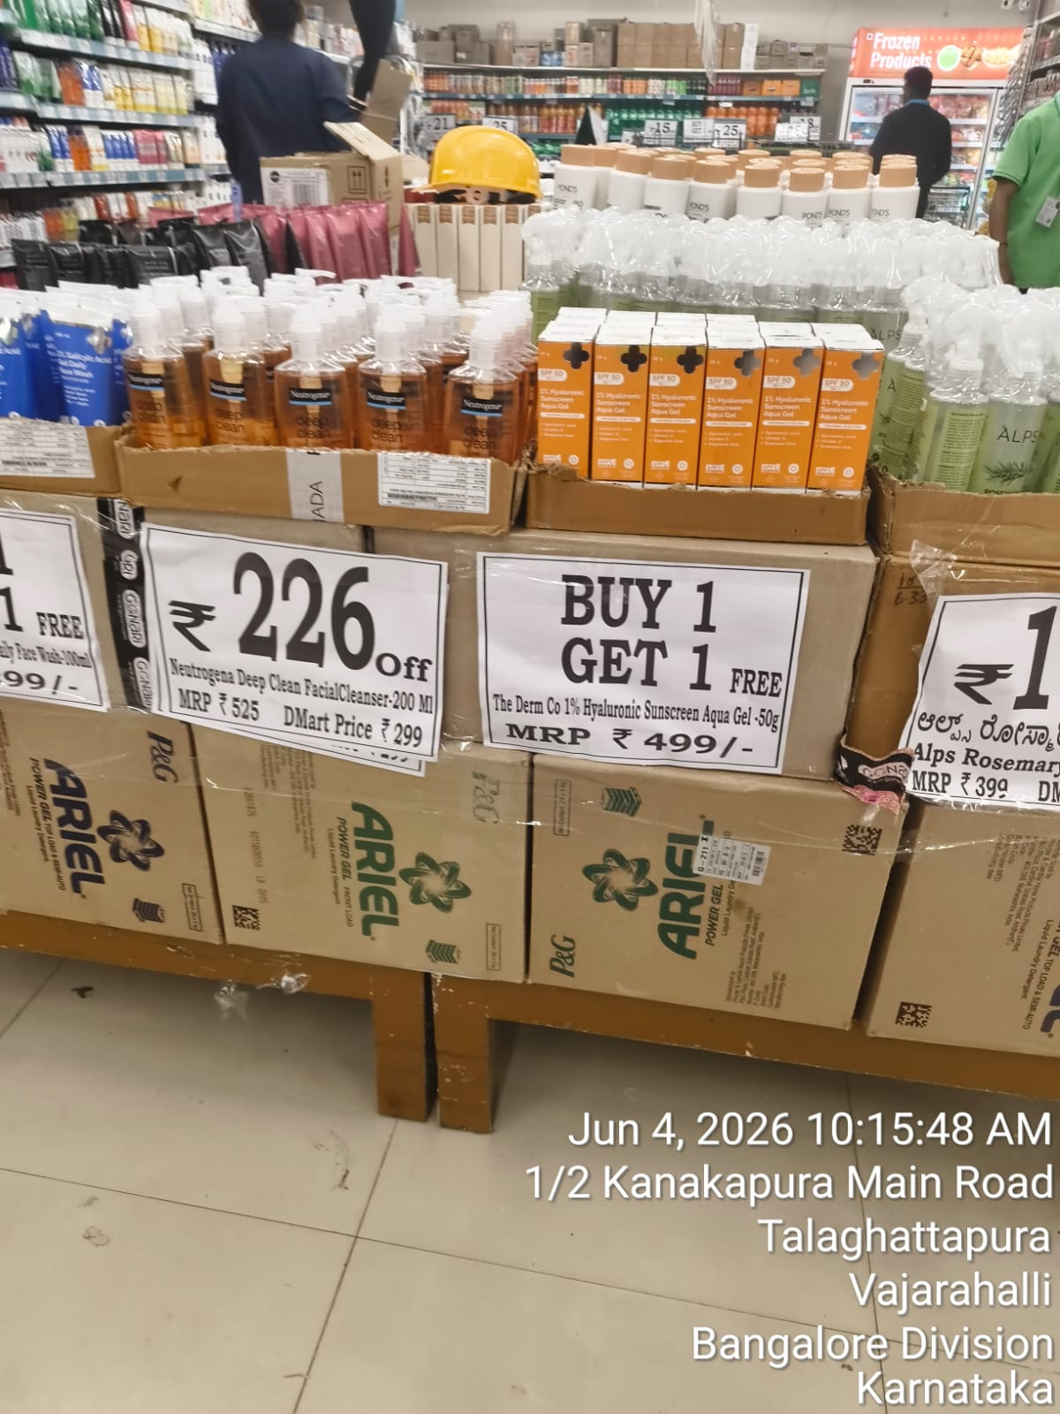
Chain-wise Execution Showcase
One best-in-class execution image per chain — curated to avoid repetition
FIELD CAPTURES
APOLLO — SOUTH-1
LULU — SOUTH-1
Apollo | Hyderabad* | Eye-Level Shelf Block
Lulu | Hyderabad* | Shampoo Aisle Block
Mamaearth Sun Care range fronted with BOGO talkers on a dedicated shelf strip.
Three uninterrupted Mamaearth shampoo shelves at eye level, ahead of competitor sets.
RELIANCE — SOUTH-1
D-MART — SOUTH-2
Reliance | Hyderabad* | Branded Endcap
D-Mart | Bengaluru** | BOGO Bin Display
'Merawala Combo' endcap with Mamaearth Buy-4-Get-1 signage and combo pricing.
Derma Co. Hyaluronic Sunscreen bin (geotagged 4-Jun-2026), paired with a Neutrogena combo crate.
Curation note: each chain above is shown once with its strongest available image. Additional angles for Lulu and D-Mart exist in the master image log and can be swapped in on request.
MT Offtake Performance Review | May'26 | Honasa Consumer Limited — Internal
18 / 24
22

Slide 19
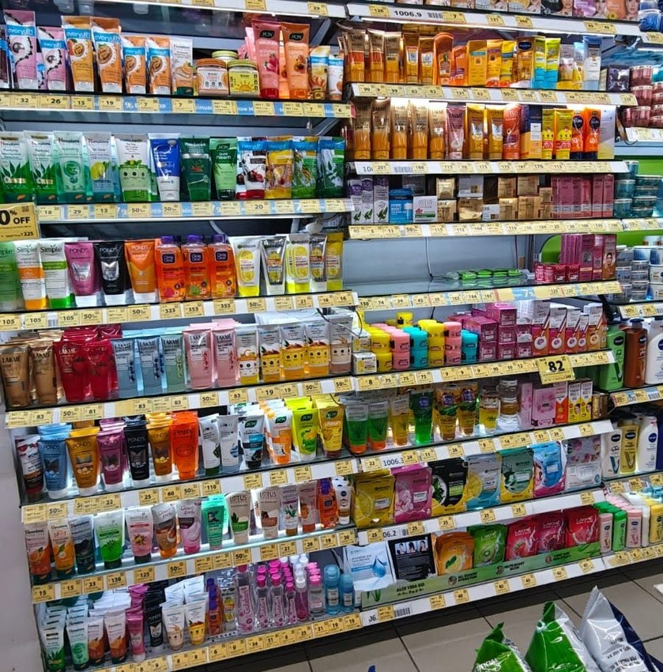
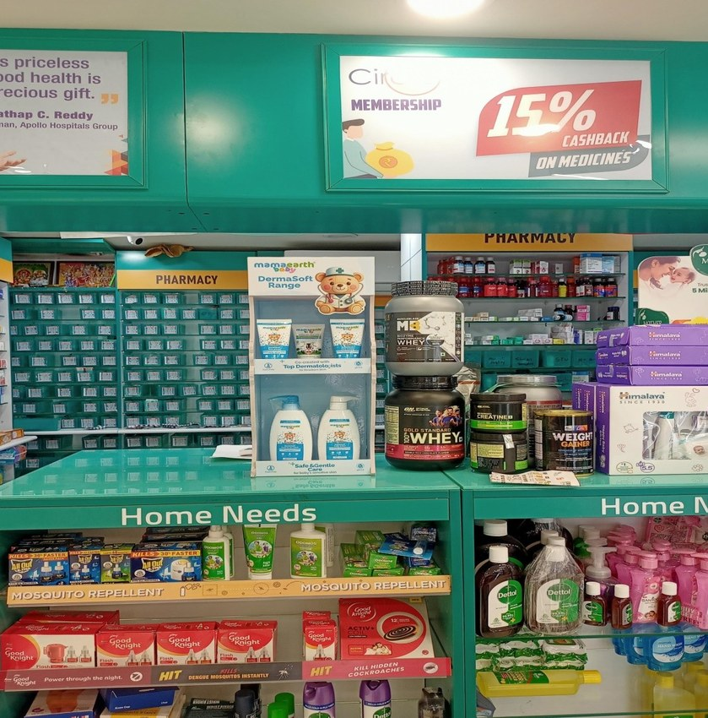
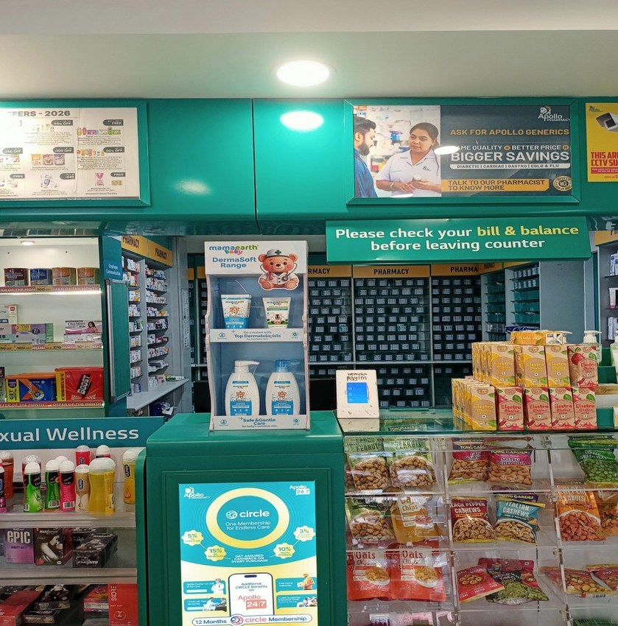
West Bengal & Derma Range – Execution Snapshot
Apollo Pharmacy — Skincare aisle, West Bengal
Mamaearth DermaSoft FSU — Apollo, West Bengal
Mamaearth DermaSoft counter display — West Bengal
19 / 24

Slide 20
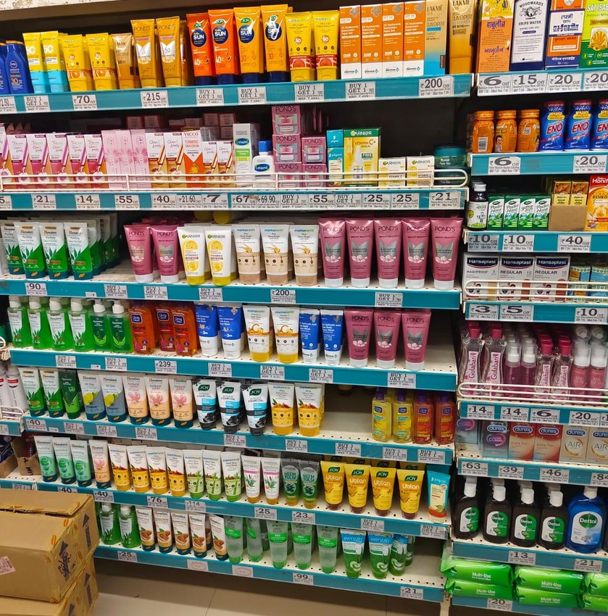
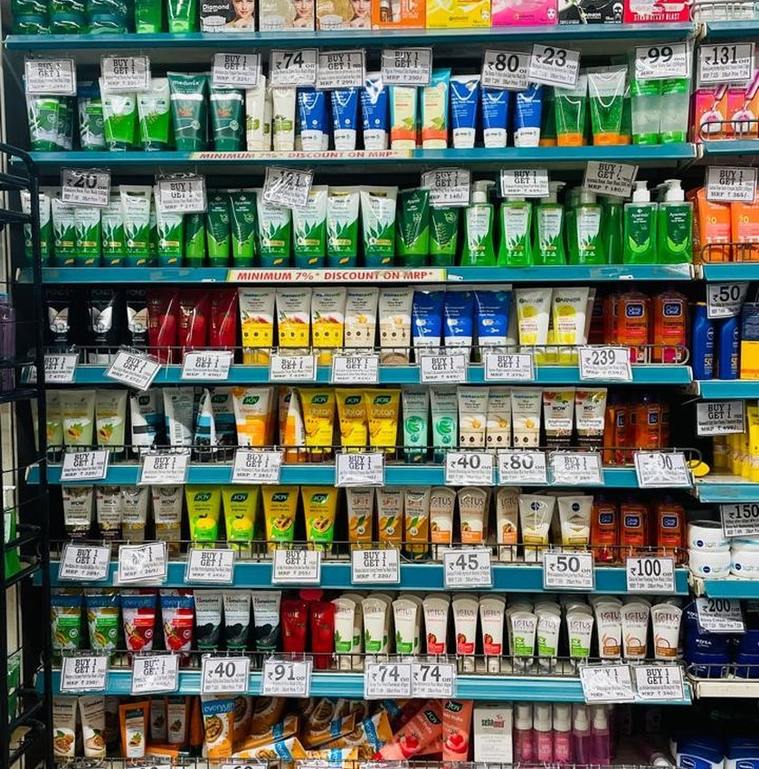
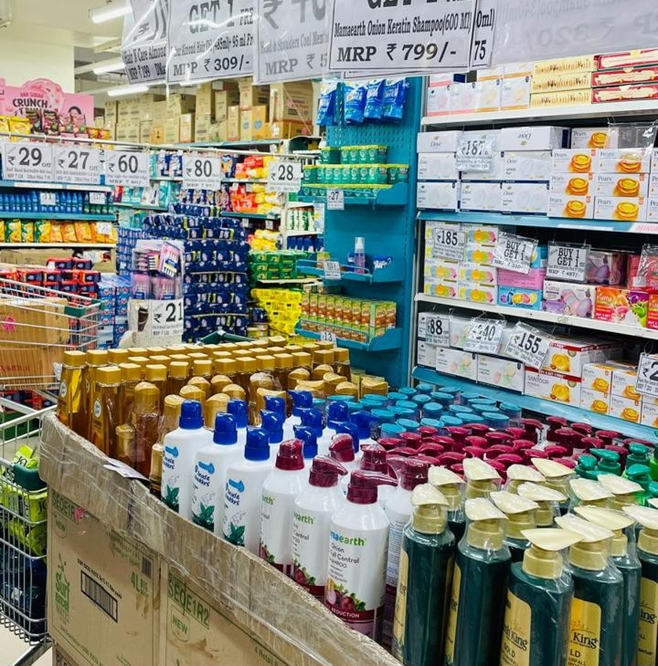
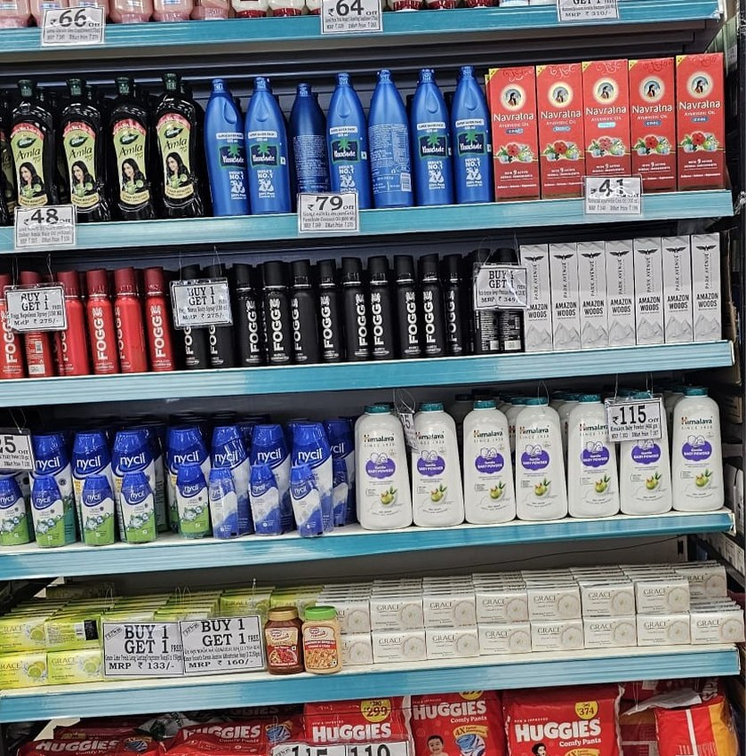
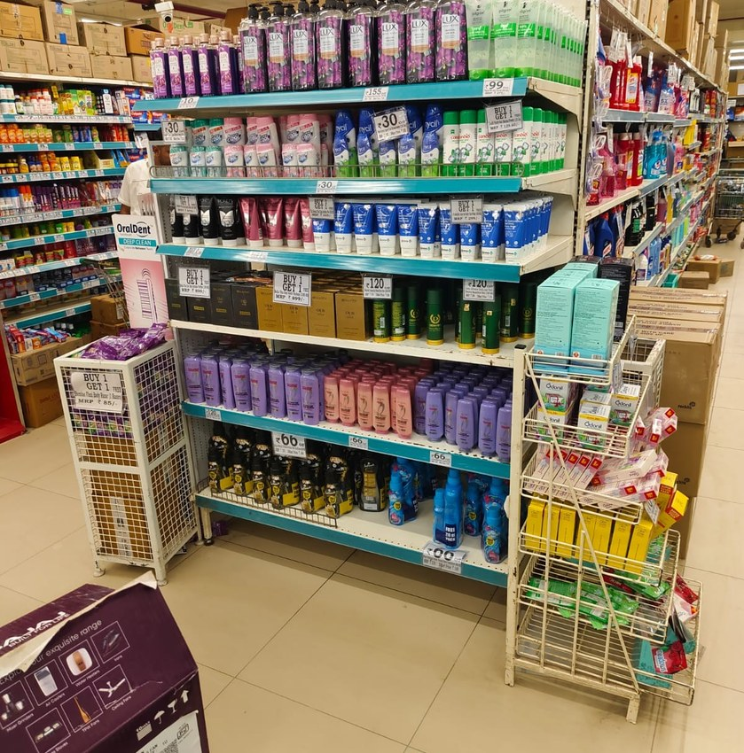
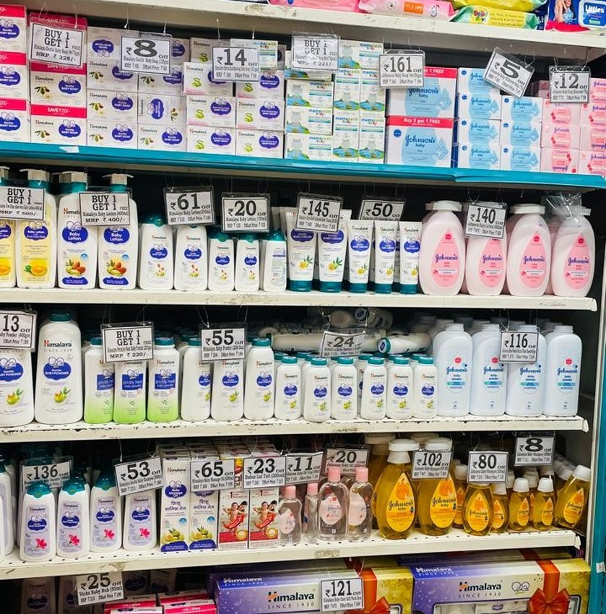
Gujarat Region – Execution Snapshot
Gujarat Region Execution May 26
Ganesh Khengre ROM May-26
Ganesh Khengre ROM May-26
Gujarat Region Execution May 26
Gujarat Region Execution May 26
Ganesh Khengre ROM May-26
20 / 24

Slide 21
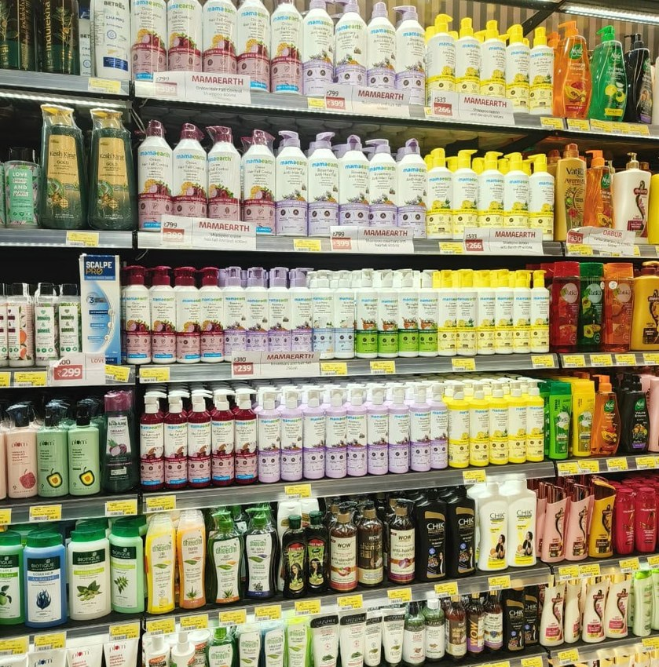
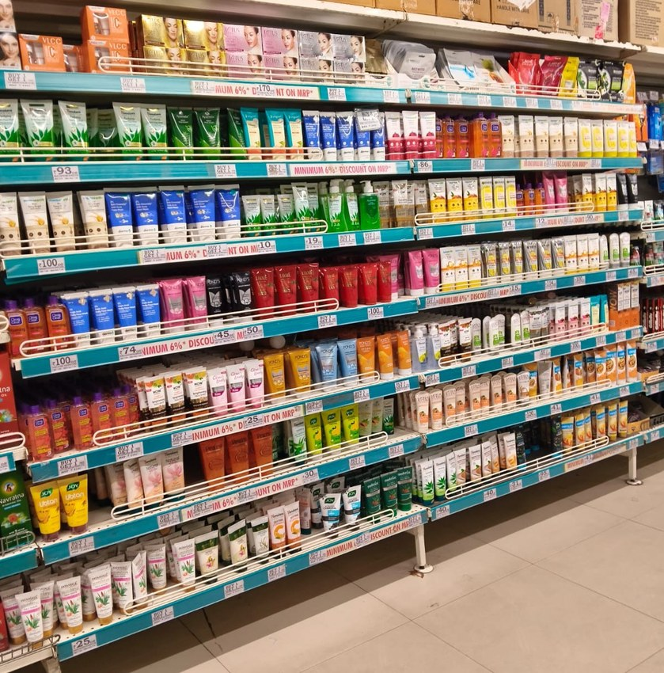
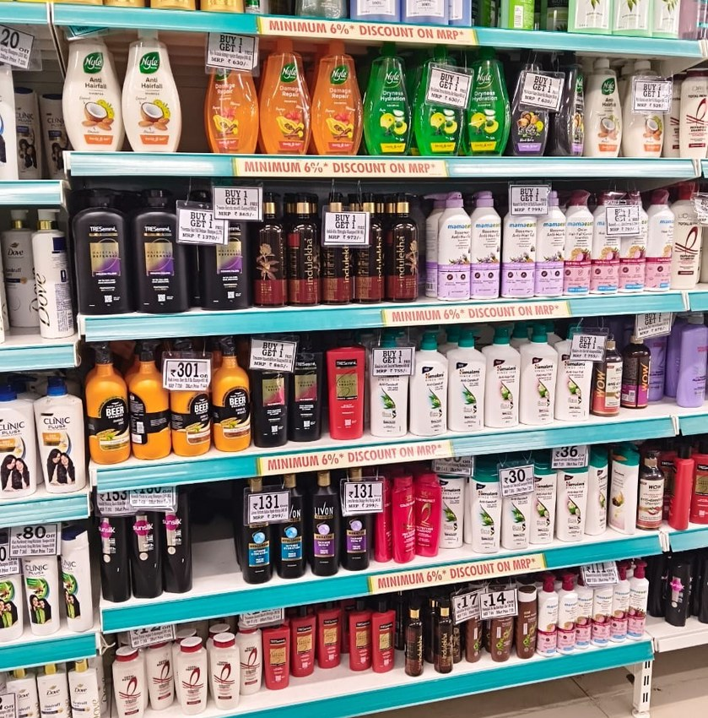
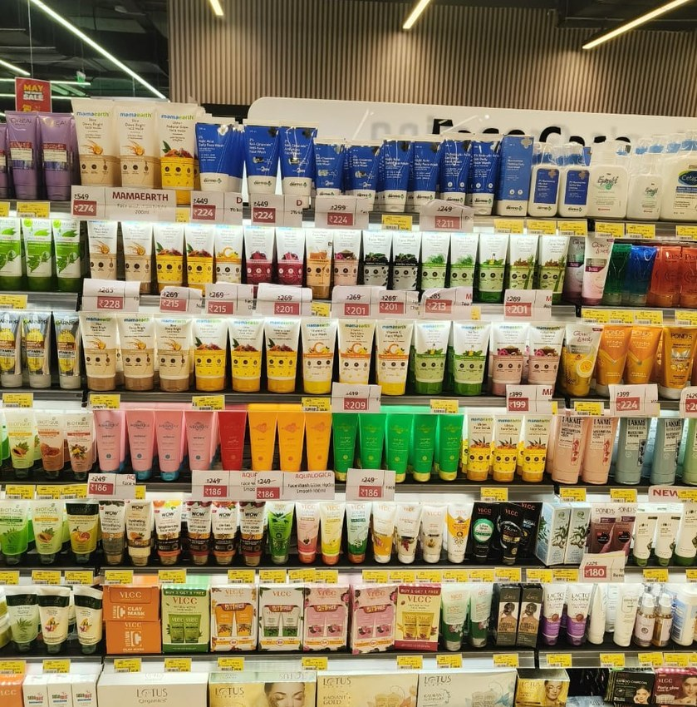
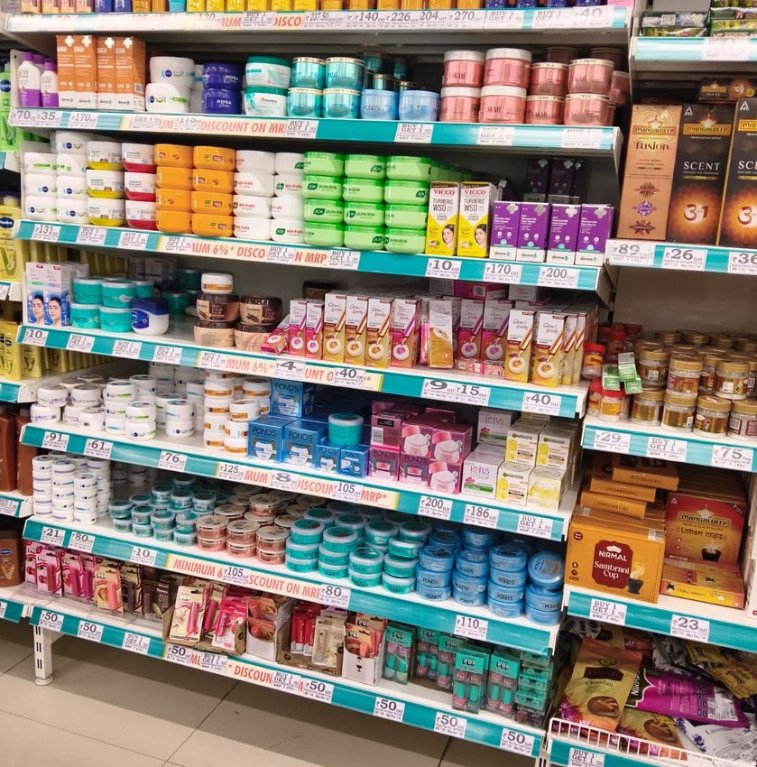
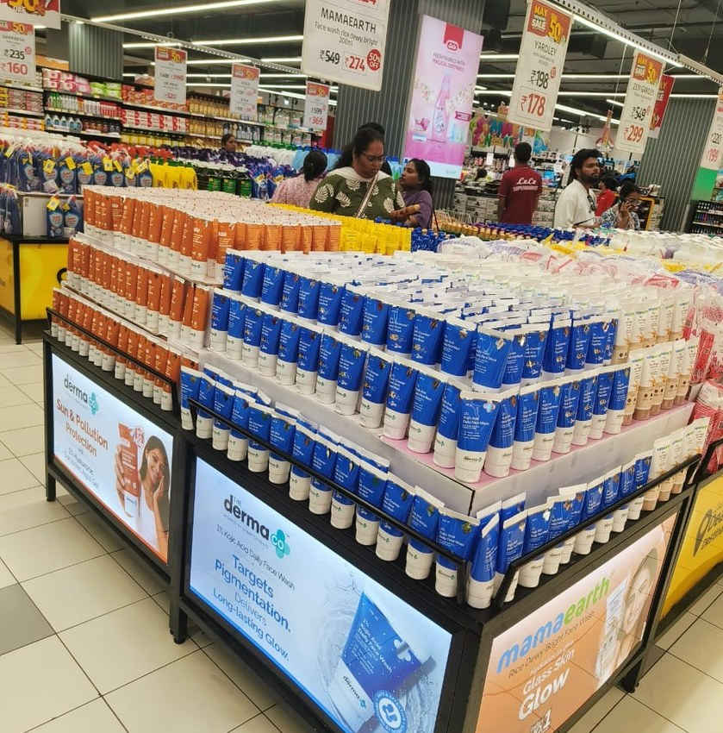
JC Review Markets – Execution Snapshot
JC Meet June 26 Radhika
Review May-26
Review May-26
JC Meet June 26 Radhika
Review May-26
JC Meet June 26 Radhika
21 / 24

Slide 22
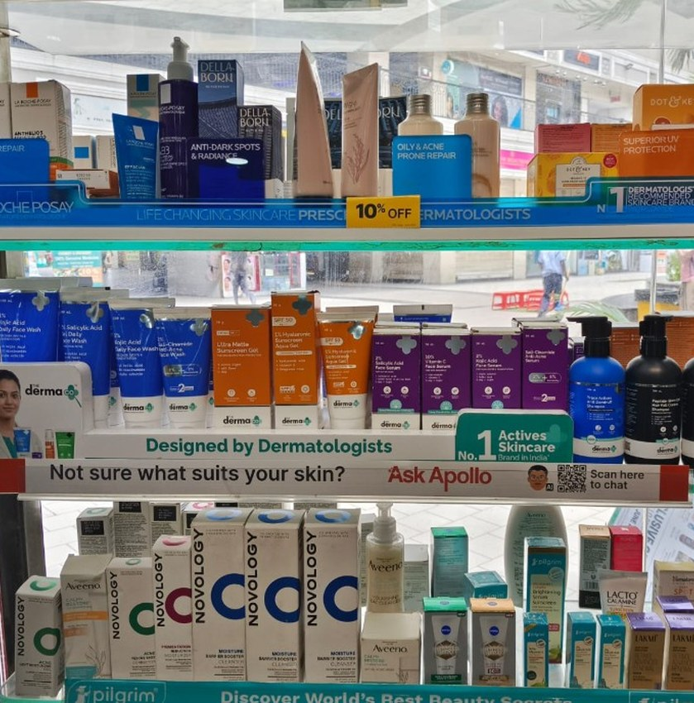
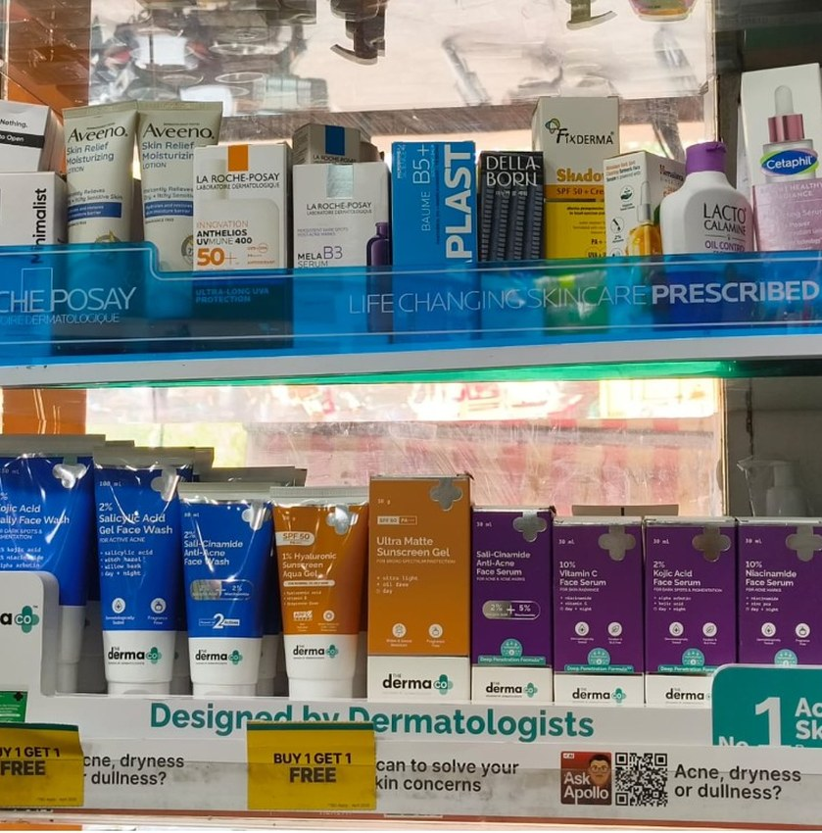
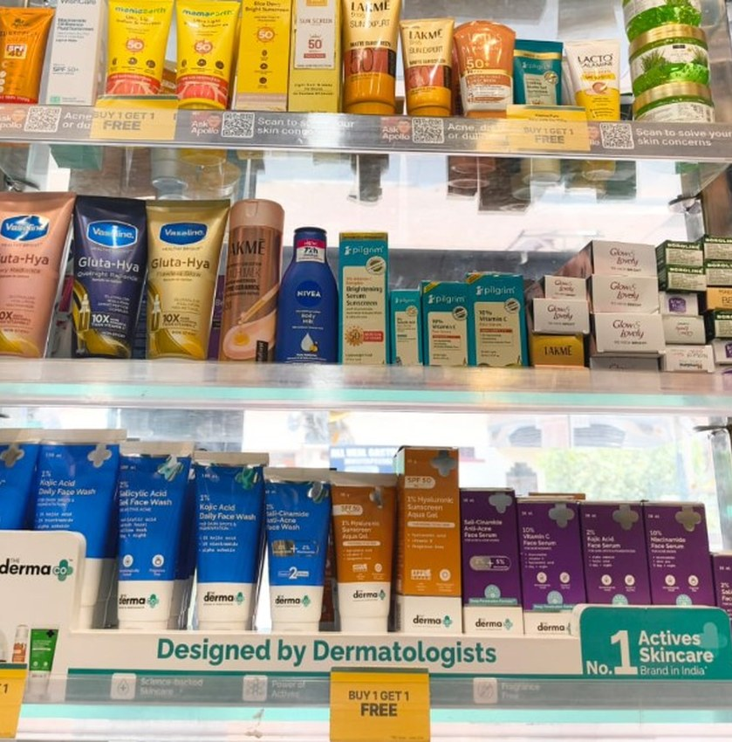
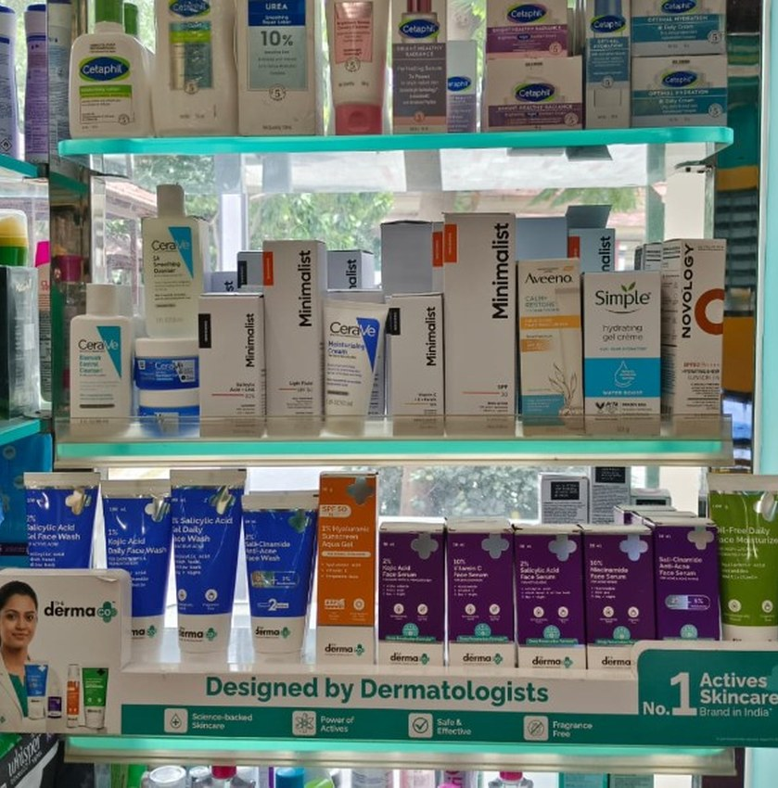
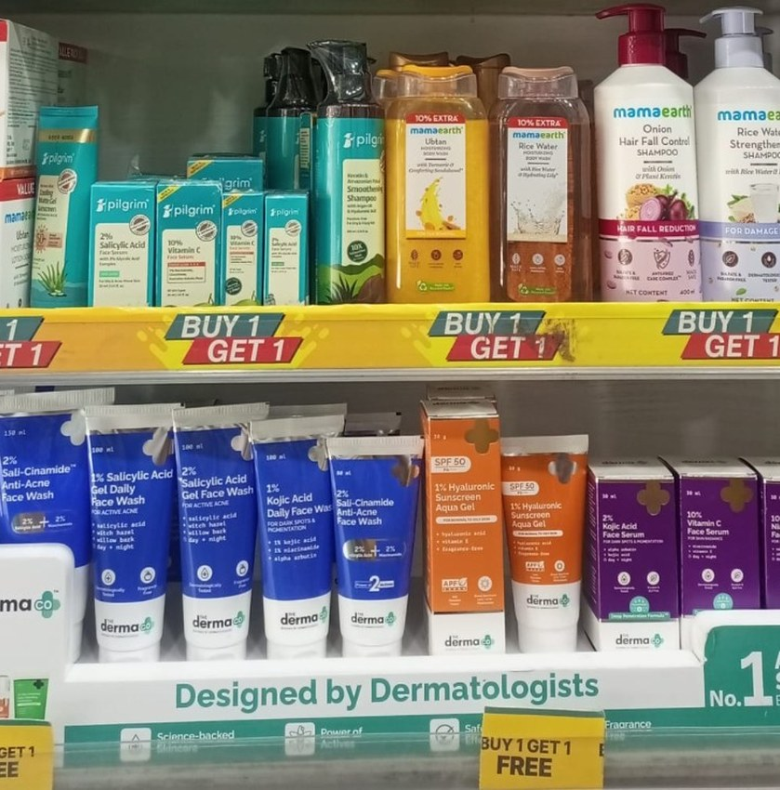
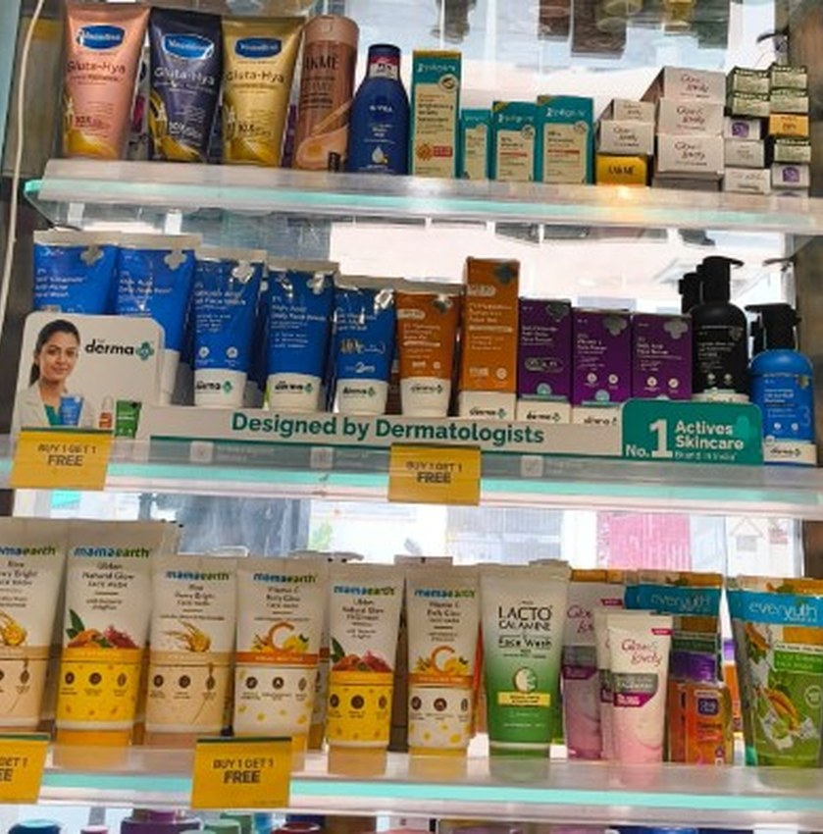
TDC / SIS Delhi NCR – Execution Snapshot
Tdc Sis Delhi Ncr PPT
Tdc Sis Delhi Ncr PPT
Tdc Sis Delhi Ncr PPT
Tdc Sis Delhi Ncr PPT
Tdc Sis Delhi Ncr PPT
Tdc Sis Delhi Ncr PPT
22 / 24

Slide 23
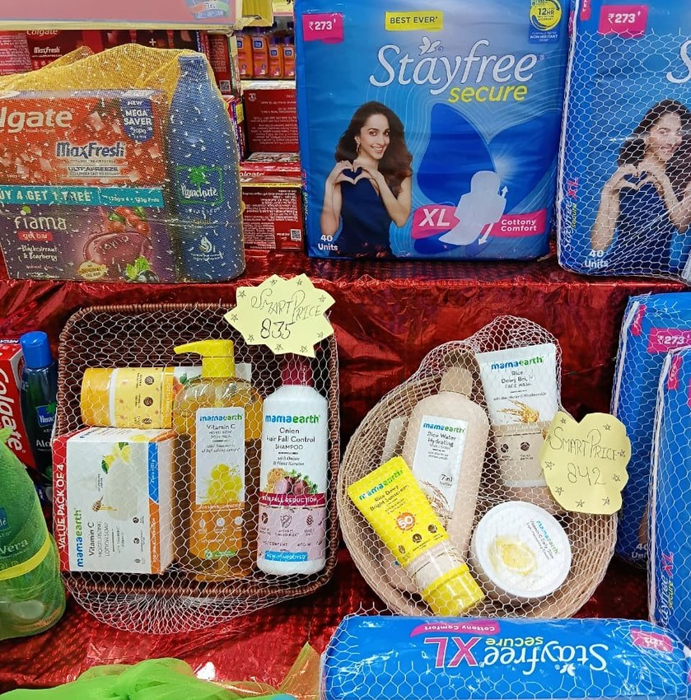
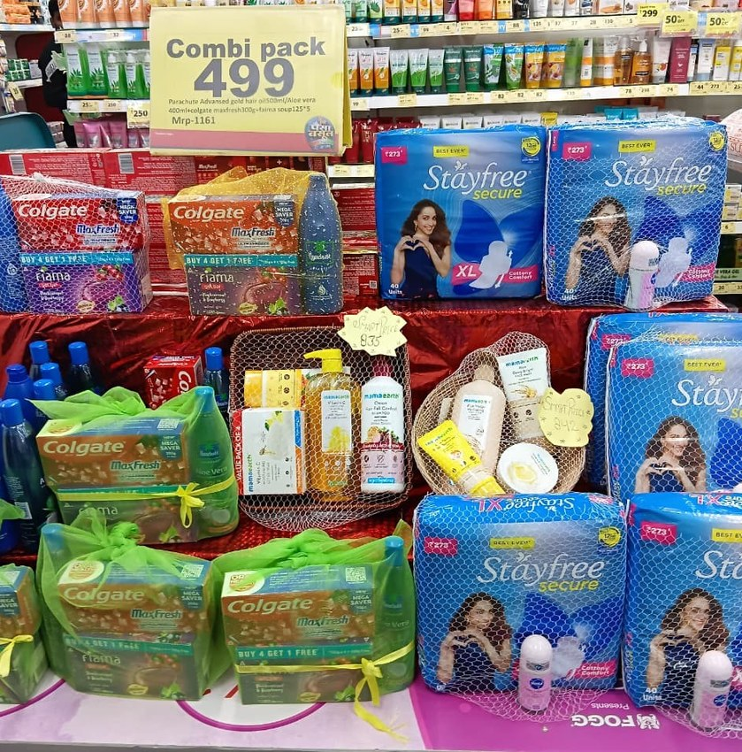
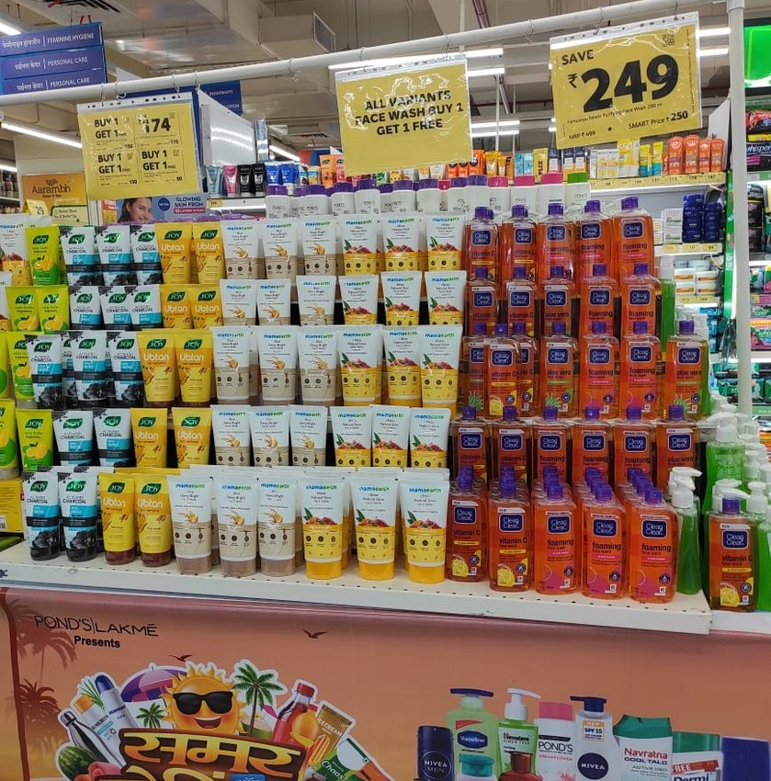
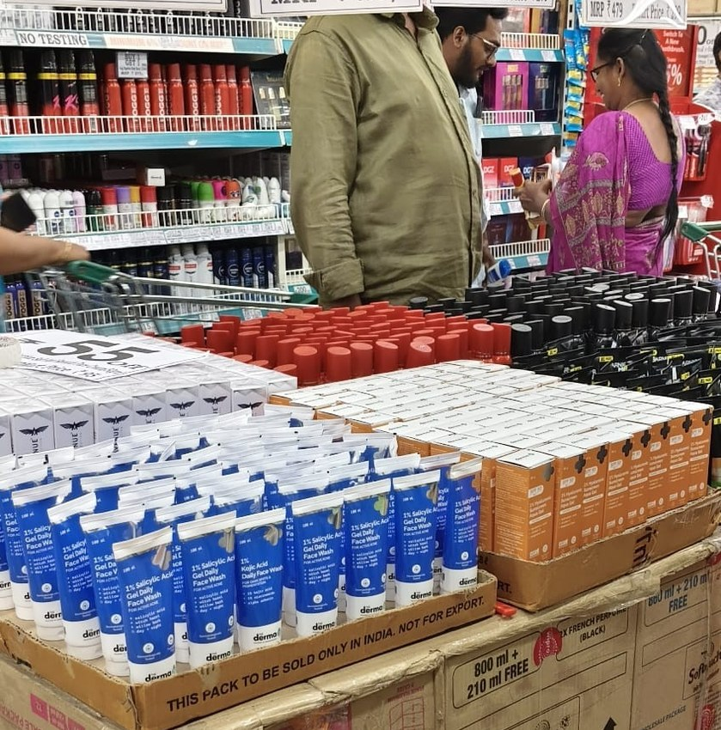
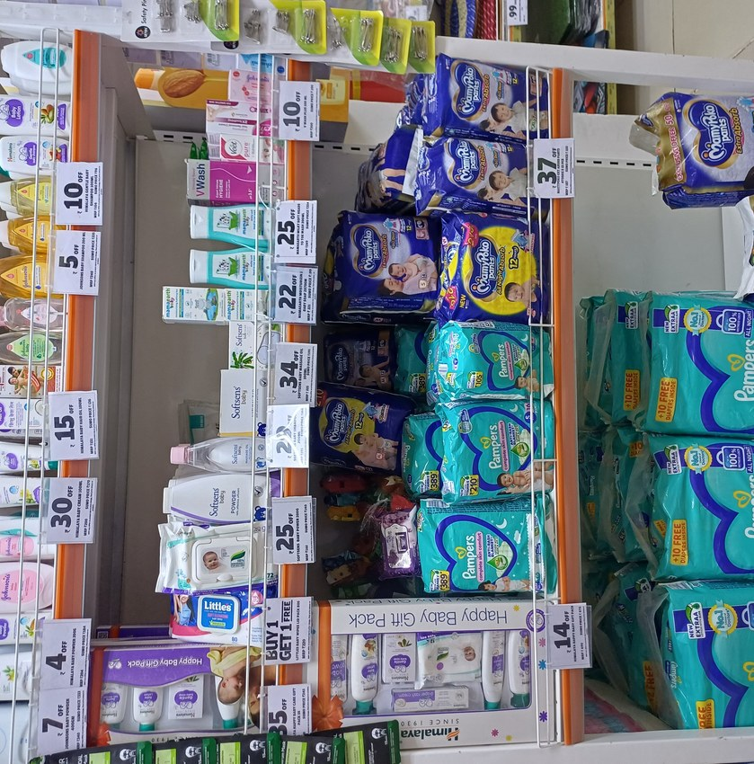
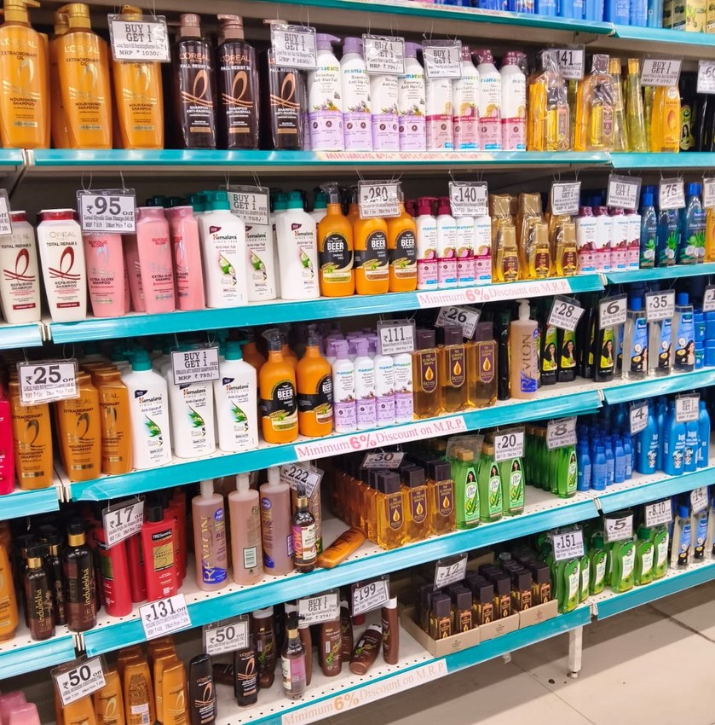
Stock Depth & Article Range Across Outlets
PPT For Reveiw 05.06.2026
PPT For Reveiw 05.06.2026
PPT For Reveiw 05.06.2026
May 26 JC Review PPT Chakri
SUMO SAVE DISPLAY
Review May-26
23 / 24

Slide 24
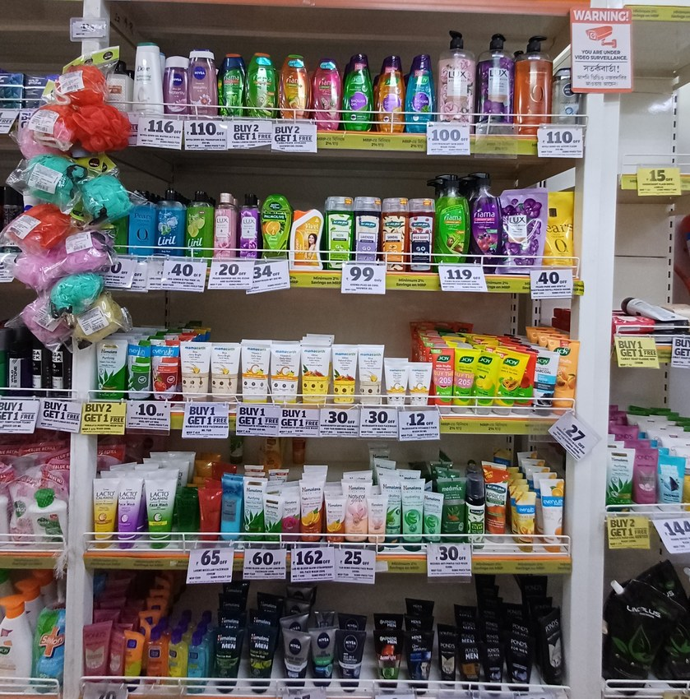
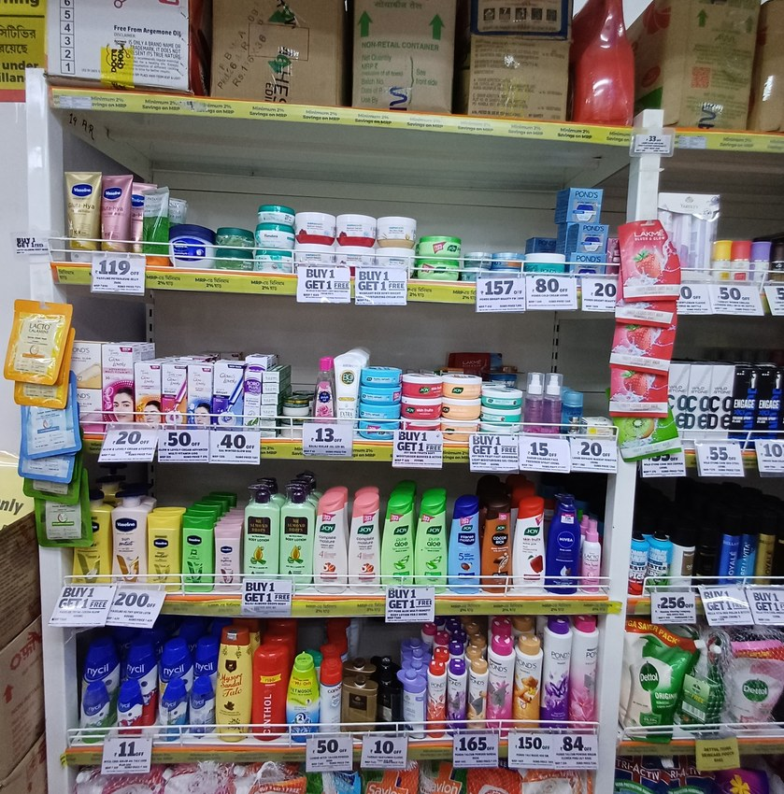
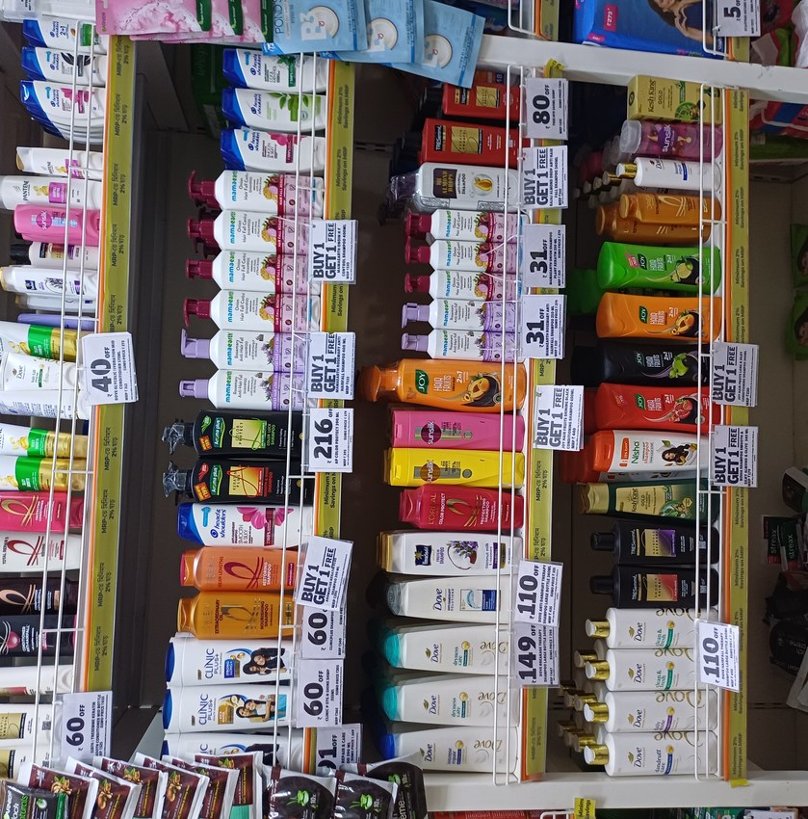
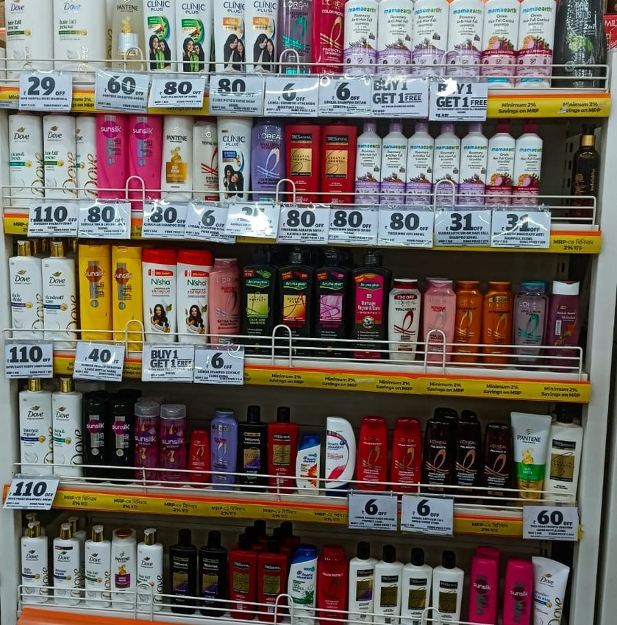
SOS / SOA – Honasa Portfolio Visibility
SUMO SAVE DISPLAY
SUMO SAVE DISPLAY
SUMO SAVE DISPLAY
SUMO SAVE DISPLAY
24 / 24

Slide 25
Zone Performance Matrix
Share trend × Distribution gap analysis by zone
Zone | YoY % | FY27 Value
East | 53.8% | ₹1,173L
North | 62.4% | ₹2,641L
Pan India | 13.0% | ₹653L
South 1 | 56.7% | ₹2,489L
South 2 | 26.9% | ₹1,576L
West | 31.5% | ₹2,905L

Slide 26
City-Tier Distribution Breakdown
Distribution points and market reach by city tier
Tier | Distribution Points | Unique Cities | Share (₹L)
Tier-1 | 1 | 1 | ₹0.0L
Tier-2 | 1 | 1 | ₹0.0L
Tier-3 | 23 | 23 | ₹0.4L
Key Insight: Tier-1 metros drive majority of volume. Tier-2/3 expansion opportunity: identify high-PDO, low-distribution gaps.

