Slide 1
SOLAR BATTERY MANAGEMENT AND
ENERGY MONITORING SYSTEM
Submitted by:
ASWAN AYYAPPAN (UKP25EE023)
AADIL MOHAMED (UKP25EE001)

Slide 2
CONTENTS
Objective & Problem Statement
Block Diagram
Circuit Diagram
Result
Conclusion & Future Scope

Slide 3
OBJECTIVE & PROBLEM STATEMENT
Solar battery health and depth of discharge require continuous automated monitoring.
Fluctuating DC loads cause voltage sag and sudden battery drain.
Inductive DC pump motors draw heavy startup inrush current and risk stall burnout.
Traditional energy meters fail to provide real-time, load-level power insights.
Uncalibrated sensor inputs lead to calculation errors and billing discrepancies.
Automate energy monitoring using ESP32, ACS712 current sensors, and voltage dividers.
Monitor real-time DC power consumption using strict physical formulas (P = V * I).
Classify motor operating states (Normal Run, Startup Surge, Stall Overload) in real time.
Integrate cloud telemetry and Groq AI Copilot for autonomous billing analytics.

Slide 4
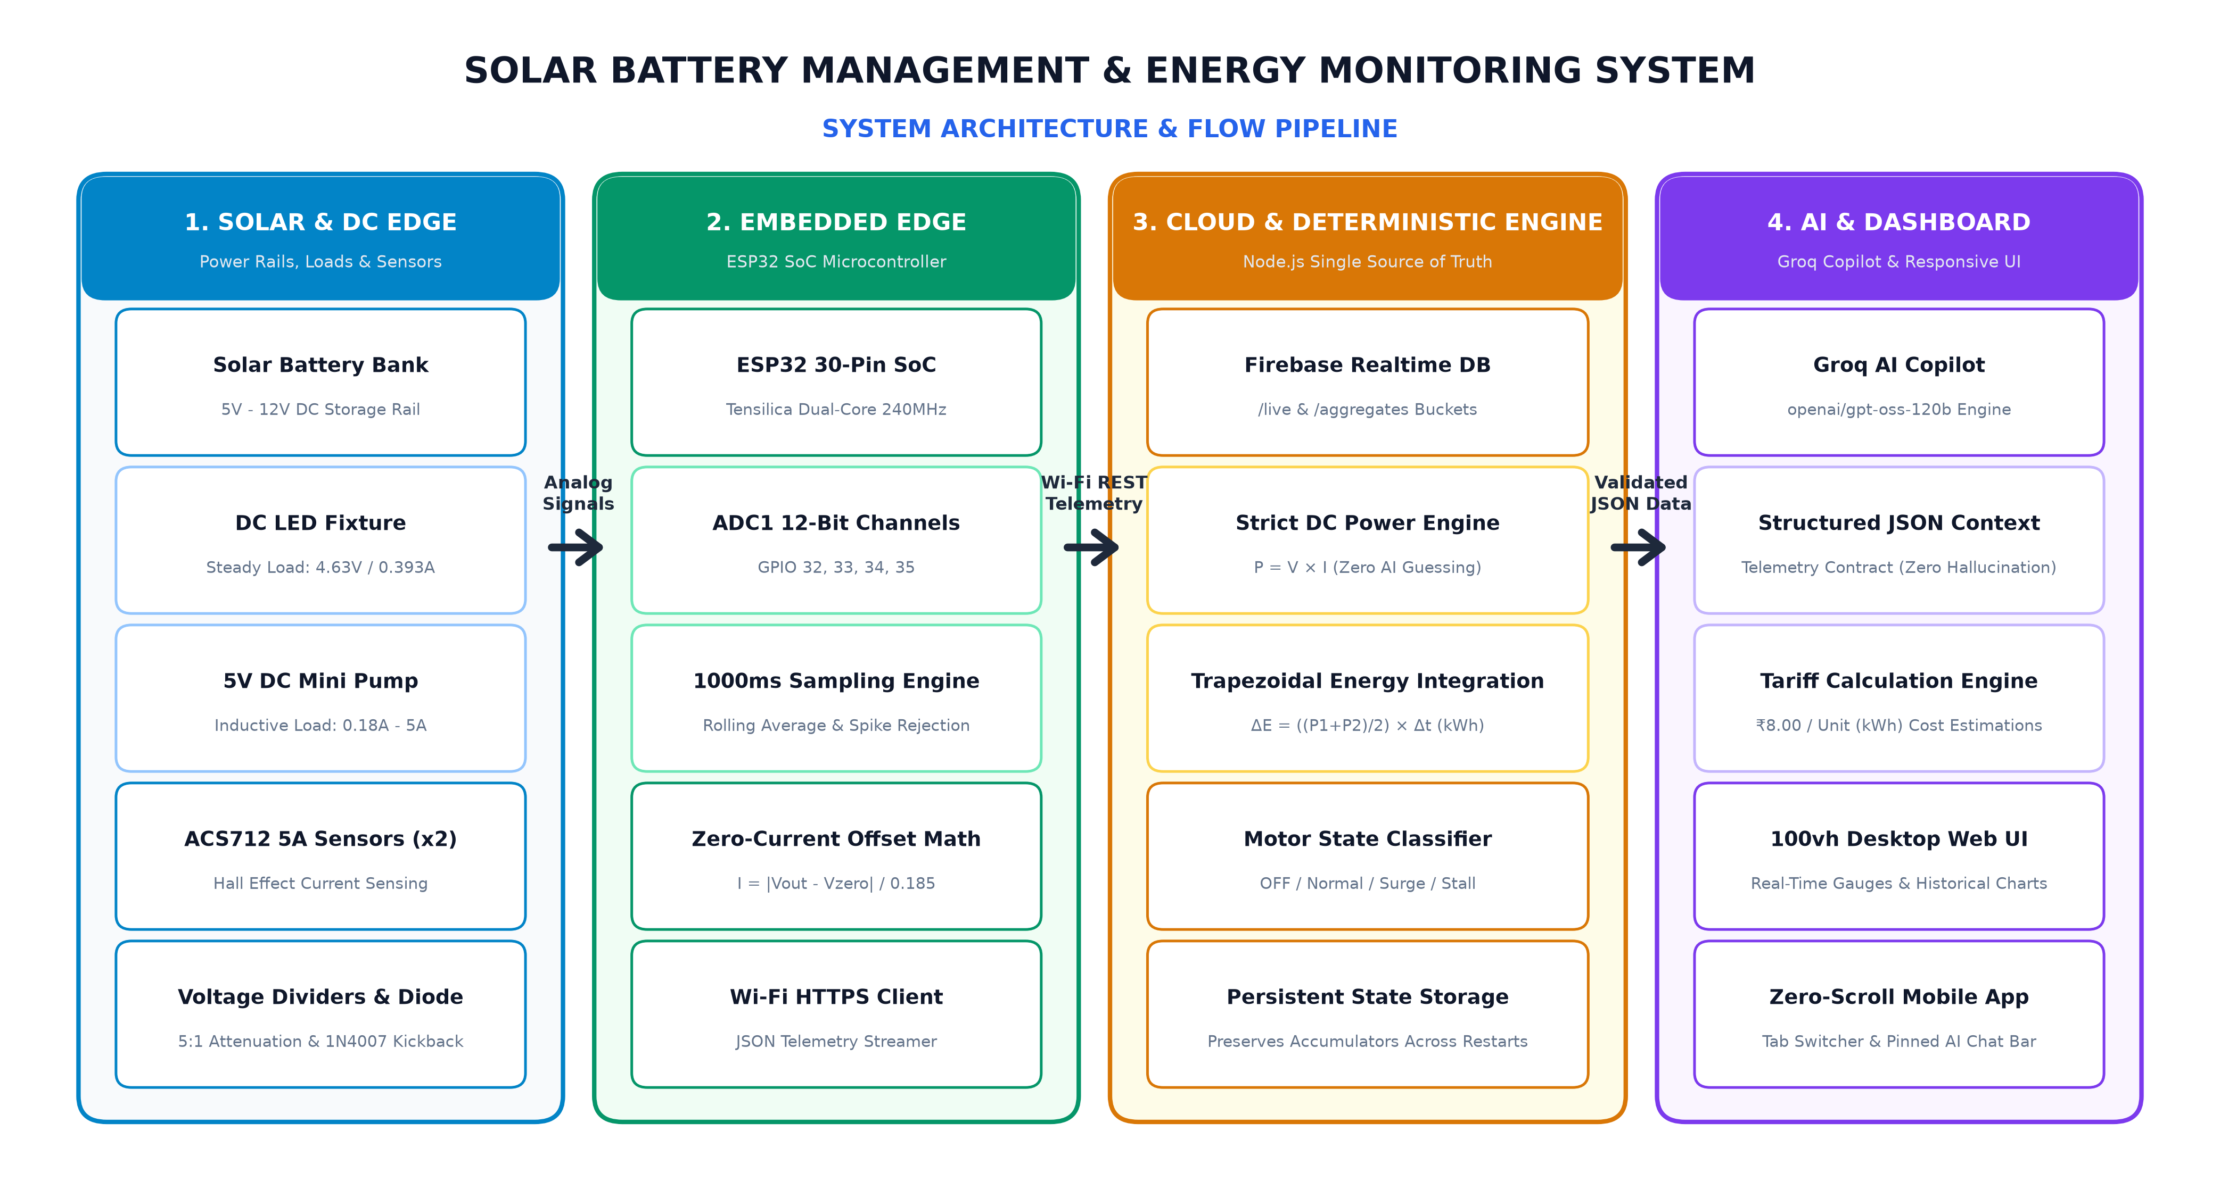
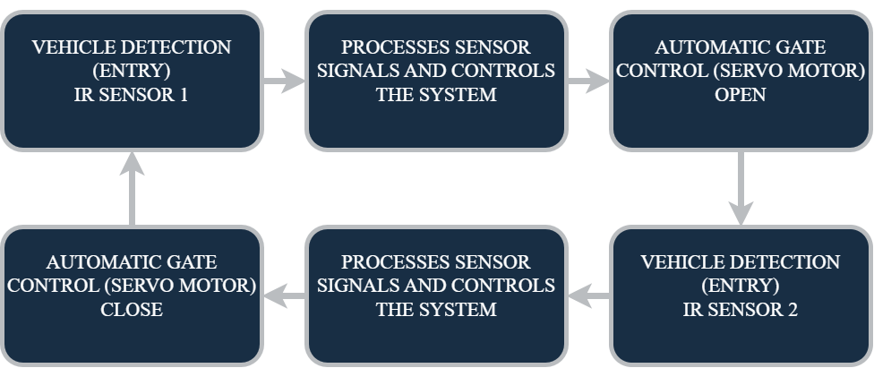
BLOCK DIAGRAM

Slide 5
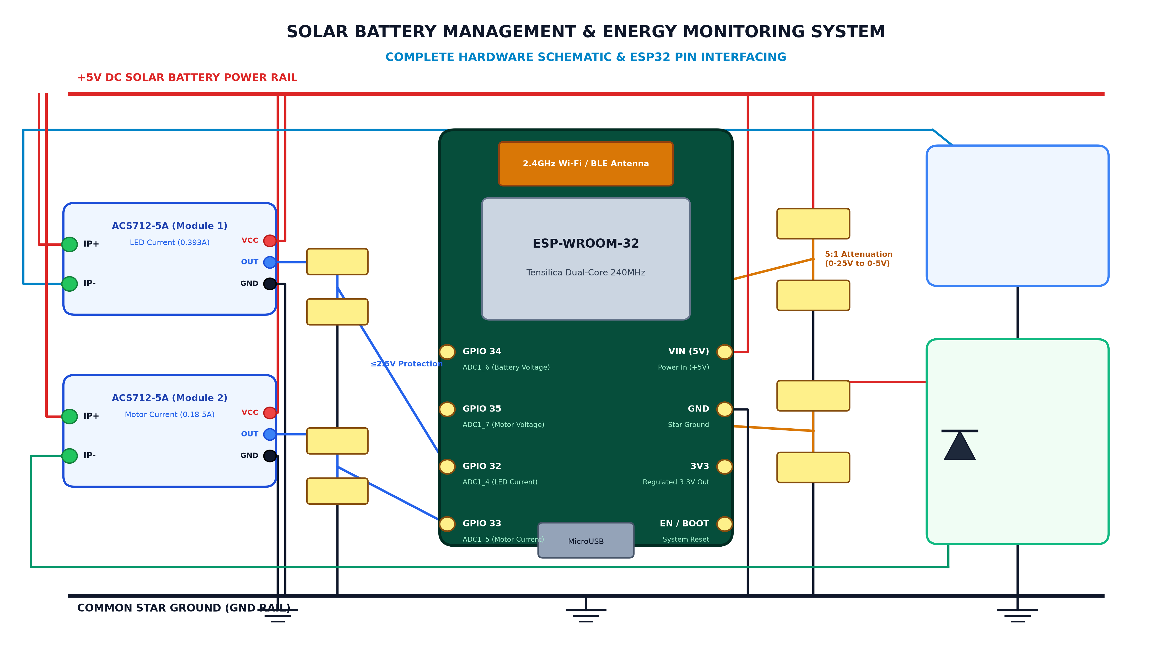
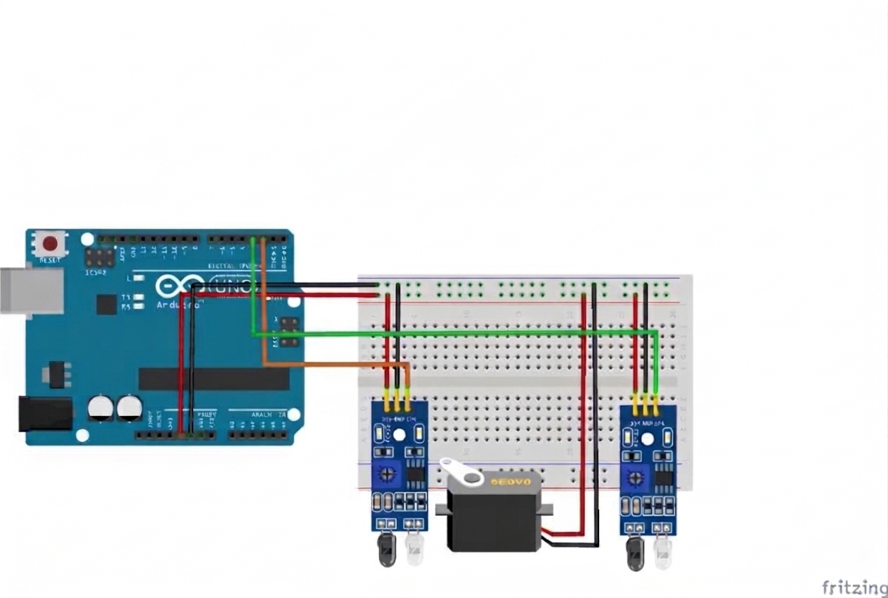
CIRCUIT DIAGRAM

Slide 6
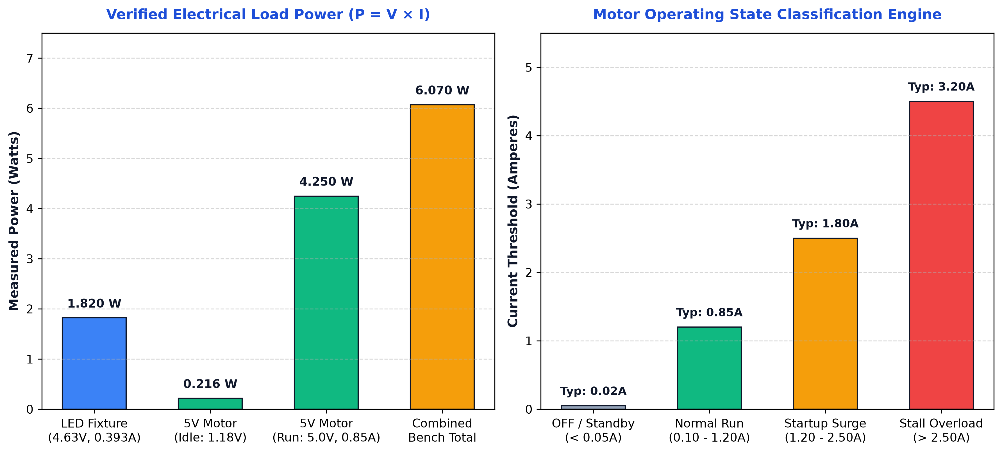
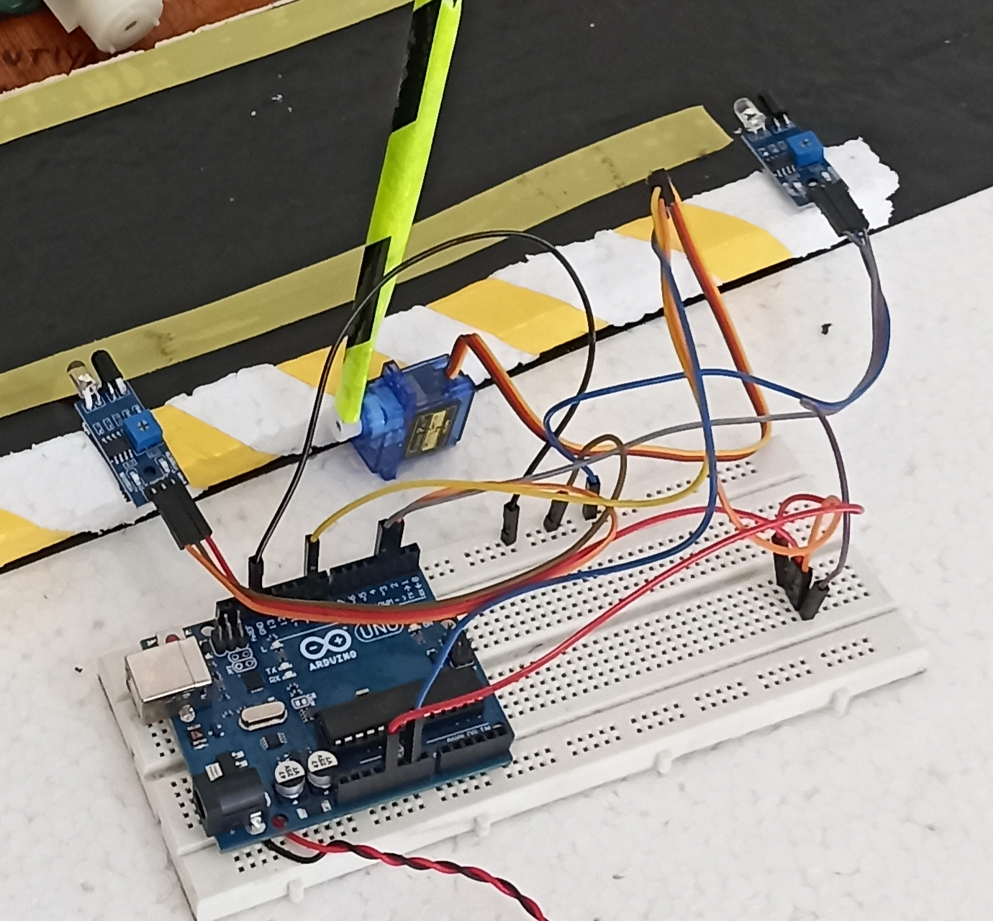
RESULT

Slide 7
CONCLUSION & FUTURE SCOPE
Demonstrates a complete Solar Battery Management and Energy Monitoring System.
Continuously measures voltage, current, and power across LED and 5V pump motor loads.
Eliminates AI math hallucinations via a centralized deterministic calculation engine.
Automates motor operational state classification for equipment protection.
Integrates Groq AI Copilot for autonomous diagnostics and accurate tariff estimations.
Future integration of Maximum Power Point Tracking (MPPT) solar charge controller.
Automated Solid-State Relay (SSR) cut-off protection during persistent motor stall.
Deployment of TinyML on ESP32 for predictive battery State of Health (SoH).

Slide 8
THANK YOU

