Slide 1


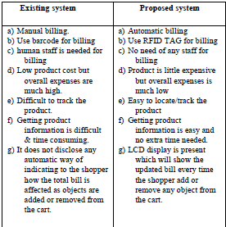
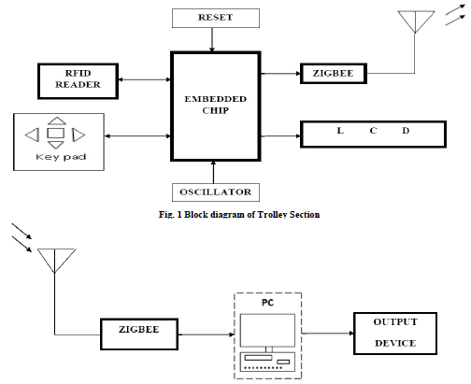
POSTER PRESENTATION
RFID BASED INTELLIGENT TROLLEY USING ZIGBEE
NIKHIL VAZE, KRUTIKA THAKUR, MEETA VADHEL, ANIKET WANI
GUIDED BY:-RUPALI ADVIRKAR
AIM
LITERATURE SURVEY
RESULTS & CONCLUSIONS
TO Develop RFID based INTELLIGENT TROLLEY using ZIGBEE in the world of Automation.
The intended objectives were successfully achieved in the prototype model developed. The developed product is easy to use, economical and does not require any special training. Though the project showcases the proof of concept, there are a few aspects that can be included to make the smart
shopping cart more robust. To begin with, in this project the latency time of the wireless communication with the server may need to be considered. Secondly, the communication is not very secure. Another ZIGBEE module operating at the
same frequency can easily intercept the transmitted data. This issue will have to be resolved specifically with respect to billing to promote consumer confidence. Further, a more sophisticated micro-controller and larger display system can
be used to provide better consumer experience.
OBJECTIVES
To reduce the waste of time in the Mall for undue reasons in shopping formalities.
To make everyday life more efficient convenient and comfortable.
Developing the ways of modularising the life in terms of technology.
Introducing automation in day-to-day life
ABSTRACT
The advent of wireless technology along with other communication techniques has helped in making electronic commerce very popular. A modern forward looking product is the one that aids the comfort, convenience and efficiency in everyday life. This is an innovative concept of RFID Based Smart Shopping and Billing. The key idea here is to assist a person in everyday shopping in terms of reduced time spent while purchasing a product. The developed system comprises of Cart location detection unit (CLDU), Server Communication unit (SCU), User Interface and display unit (UIDU) and Billing and Inventory management unit (BIMU). CLDU is used to smartly locate the position of shopping cart inside the shopping market to help in obtaining relevant product information. SCU will help in establishing and maintaining the connection of the shopping cart with the main server. UIDU will provide the customer with user interface and BIMU deals with the billing and inventory management in collaboration with the SCU. These units are integrated into a smart enclosed system and are tested to satisfy the functionality. The smart shopping cart will help shorten the checkout lines thereby helping the customers at retail stores. The customers will be able to scan the items themselves and the LCD screen on the shopping cart will keep updating the total. This will turn out to be very beneficial as more people will enjoy the shopping experience and come more often to shop.
FUTURE SCOPE
PROPOSED MODEL
The field of Automation is boundless.
The project we are designing is Smart Trolley for Mall Automation. Future scope to this is that the TROLLEY developed for reduction in the billing time can be extended to follow the person automatically. There will be no need to drag the TROLLEY. Besides it will follow us on its own.
The further development can be done in the TROLLEYs used in the secured Libraries, where people are not allowed to enter. In such situations the TROLLEY will Automatically pick up the required books for us.
REFERENCES
[1]J.Suryaprasad, B.O.P. Kumar, D. Roopa and A.K. Arjun, "A Novel Low-Cost Intelligent Shopping Cart”, IEEE 2nd International Conference on Networked Embedded Systems for Enterprise Applications, pp.1-4, 2011.
[2] D.V.S Chandra Babu, “wireless intelligent billing trolley for supermarket”, International Journal of Advanced Research in Technology, vol.3, issue 1, Aug. 2012.
[3] Ankit Anil Aggarwal, “RFID Based Automatic Shopping Cart”, The International Institute for Science, Technology and Education journal on Control Theory and Informatics ,vol.1, no.1, 2011.

