Slide 1
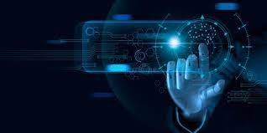

Top 10 Benefits of Future Technology of AI
Art By A.P

Slide 2

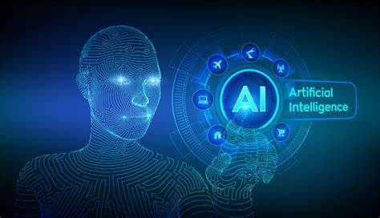
Artificial Intelligence has been around for quite some time now. From quick suggestion on search engines and auto –focus in smartphones to robot greeters at shopping centers and vehicle cruise control, AI is increasingly becoming a part of our day to day lives. By integrating AI solutions into every aspects of the business, organizations can optimize operations, gain a competitive edge and ultimately accelerate growth. The scope for innovation and development in Ai is enormous and it will continue changing the world in diverse ways in the future.
Art By A.P

Slide 3
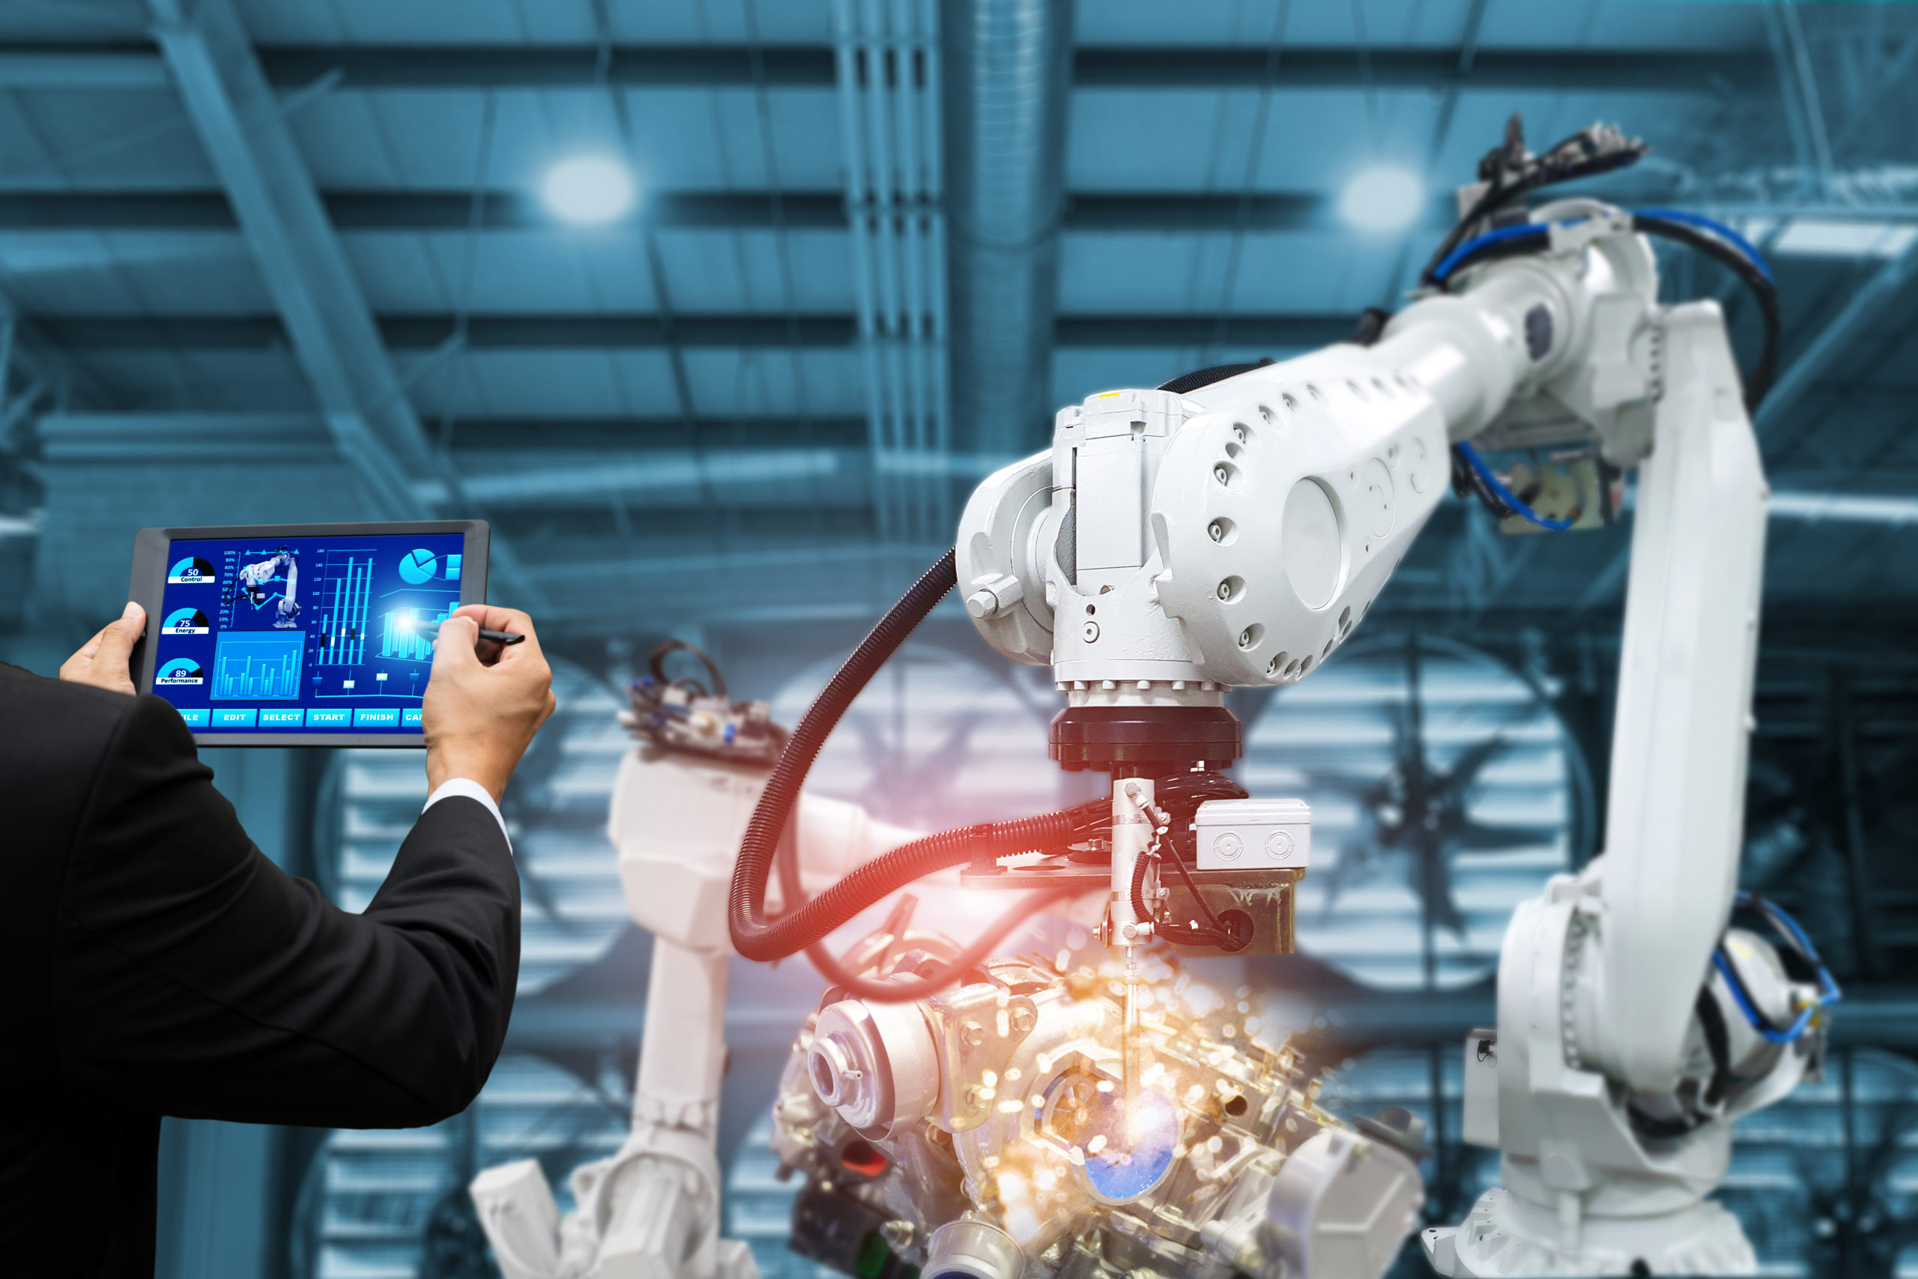
1. Automation -
Automation is one of the most commonly cited benefits of AI technology, and it has significant Impacts on the communications, transportation, consumer products and service industries. Automation not just leads to higher production rates and increased productivity in these sectors but also allows more efficient use of raw materials, improved product quality, reduced lead times, and superior safety. Automation can also help to free resources that can be used for more important things.
Art By A.P

Slide 4
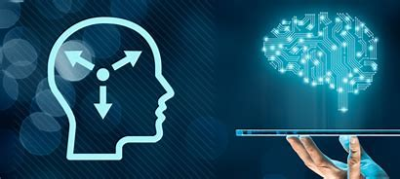
2. Smart Decision Making -
Artificial Intelligence has been always used for making smarter business decisions. AI technology can coordinate data delivery, analyze trends, develop data consistency, provide forecasts and quantify uncertainties to make the best decisions for the company. As log as AI is not programmed to imitate human emotions, it will remain unbiased on the matter at hand and will help to make the right decision to support business efficiency.
Art By A.P

Slide 5
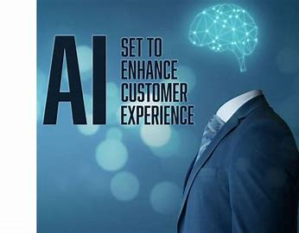
3. Enhanced Customer Experience -
AI – powered solutions can help businesses too respond to customer queries and grievances quickly and address the situations efficiently. The use of chatbots that couple conversational AI with Natural Language Processing technology can generate highly personalized messages for customers, which helps to find the best solution for their needs. AI tools can help too reduce the strain from the customer service staff, which will lead to better productivity.
Art By A.P

Slide 6
4. Medical Advances -
The use of Artificial Intelligence solutions in the health care sector is becoming increasingly popular these days. Remote patient monitoring technology for instance, allows healthcare providers too perform clinical diagnoses and suggest treatments quickly without requiring the patient to visit the hospital in-person. AI can also be beneficial in monitoring the progression of contagious diseases and even predict their future effects and outcomes.
Art By A.P

Slide 7
5. Research and Data Analysis -
AI and Machine Learning technology can be used to analyze data much more efficiently. It can help to create predictive models and algorithms to process data and understand the potential outcomes of different trends and scenarios. Moreover, the advanced computing capabilities of AI can also speed up the processing and analysis of data for research and development, which could have taken too long for humans to review and understand.
Art By A.P

Slide 8
6. Solving Complex Problems -
The developments in AI technologies from basic Machine Learning to advanced Deep Learning models have made it capable to solve complex issues. From fraud detection and personalized customer interaction to weather forecasting and medical diagnosis, AI is helping businesses across industries to find the right solutions to address their challenges more adequately. Greater efficiency in solving complex problems means increased productivity and reduced expenses.
Art By A.P

Slide 9
7. Business Continuity -
Business forecasting using AI technology not only helps companies make critical decisions but also prepares them for any emergency to ensure business continuity. As risk management and analysis today, Ai-powered tools can help organizations to respond to the crisis proactively. AI and Machine Learning can also create scenarios to help business plan for a speedy disaster recover strategy.
Art By A.P

Slide 10
8. Managing Repetitive Tasks -
Performing recurring business tasks is not just time-consuming but it can also be monotonous and reduce the productivity of the employees over time. AI-powered Robotic Process Automation tools can automate interaction between different business systems and make the tiresome work easy for the company. It can imitate the actions of humans within the digital systems in the HR ,IT , Marketing, or sales departments to execute any business process quickly without needing any manual effort.
Art By A.P

Slide 11
9. Minimizing Errors -
Another great benefits of automating regular business tasks using AI tools is that it helps to reduce the chance of manual errors. As Robotic Process Automation tools take care of the data entry and processing jobs, it can make the digital systems more efficient and less likely to run into or create any problems due to data processing mistakes. This can be especially beneficial for business that cannot afford to make even the slightest of errors.
Art By A.P

Slide 12
10. Increased Business Efficiency -
Artificial Intelligence can help to ensure 24-hours service availability and will deliver the same performance and consistency throughout the day. Taking care of repetitive tasks will not make AI tools get tired or bored either. This can help to improve the efficiency of the business and reduce the stress on the employees, who can be re-assigned to perform more complex business tasks that require manual intervention.
Art By A.P

Slide 13
Conclusion -
There are many more benefits of Artificial Intelligence that spam from space exploration to advancement in defense systems and more. The technology is evolving steadily, and it has the potential to be more intelligent than ever. While there is no more intelligent than ever. While there is no surefire way of predicting the future of AI , it will certainly continue benefitting businesses and end-users in their everyday lives.
That’s all for today. I hope you will be enjoying your precious Life
Art By A.P

