Slide 1
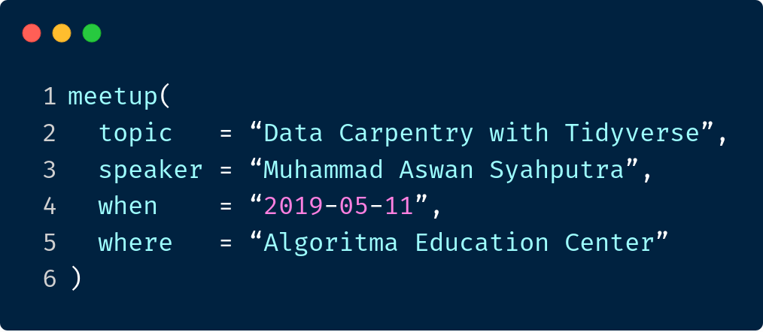

Slide 2



Sensory Scientist @ Sensolution.ID
Trainer @ R-Academy Telkom University and The Datanomics Institute (TDI)
Initiator of Komunitas R Indonesia
Pkgs: sensehubr, nusandata,
bandungjuara, prakiraan, etc
Shinyapps: sensehub, thermostats, aquastats, bcrp, bandungjuara, etc
aswansyahputra
@aswansyahputra_

Slide 3



t.me/GNURIndonesia
indo-r
@r_indonesia_
www.r-indonesia.id
Komunitas
R Indonesia

Slide 4


Slide 5
Know your
neighbour!
Who are you?
What you do with data?
How would you describe your experience with R?

Slide 6

Artwork by @allison_horst

Slide 7
Artwork by @allison_horst

Slide 8
Data
Carpentry?

Slide 9
“
Do not underestimate
DATA PREPROCESSING
”

Slide 10
“
is not a single process
but a thousand of
little skills and techniques
”
- David Minmo

Slide 11

The tidyverse is an opinionated collection of R packages designed for data science. All packages share an underlying design philosophy, grammar, and data structures.
Artwork by @allison_horst

Slide 12
Visualise
Import
Tidy
Transform
Communicate
Model
Understand
Program

Slide 13
Visualise
Import
Tidy
Transform
Communicate
Model
Understand
Program

Slide 14
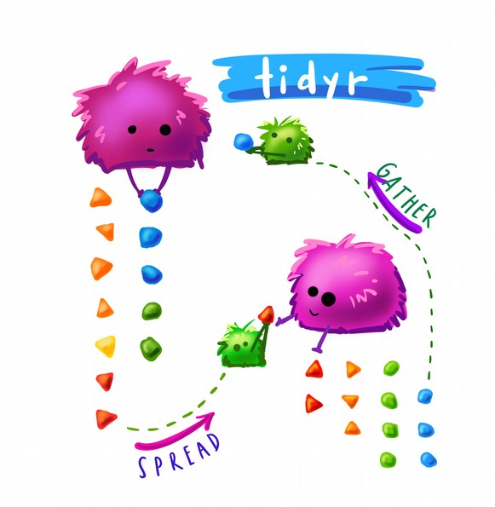

tidyr
Artwork by @allison_horst

Slide 15
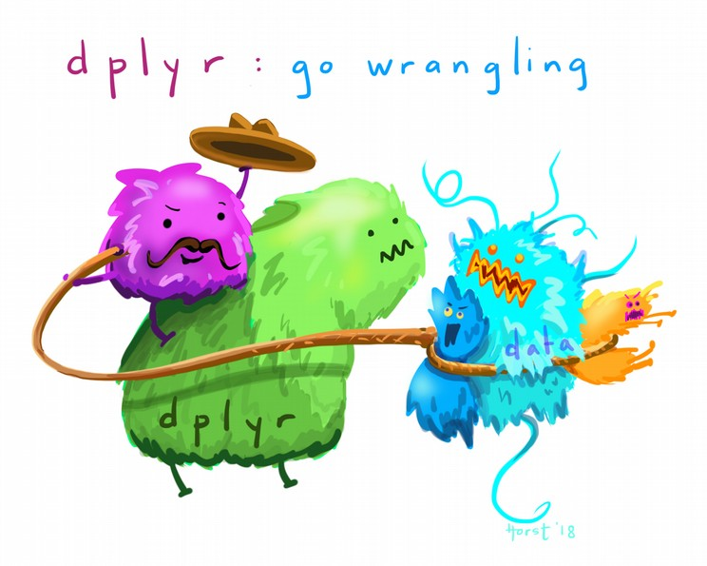

dplyr
Artwork by @allison_horst

Slide 16
dplyr basic functions:
filter() selects rows based on their values
mutate() creates new variables
select() picks columns by name
summarise() calculates summary statistics
arrange() sorts the rows
Operators:
! (not)
I (or)
& (and)
==, !=
<, <=, >, >=
%in%
is.na()
tidyr basic functions:
gather() wide-format >> long-format
spread() long-format >> wide-format
fill() fills value based on previous entry
complete() turns implicit missing values into explicit
Credits to Michael Toth

Slide 17
How can I
chain?

Slide 18


Slide 19
1. diputar
2. dijilat
3. dicelupin
4. dimakan :D

Slide 20
1. putar(apa)
2. jilat(apa, berapa_kali)
3. celup(apa, ke)
4. makan(apa, output)

Slide 21
a
> oreo_putar ← putar(apa = “oreo”)
> oreo_jilat ← jilat(apa = oreo_putar,
berapa_kali = 2)
> oreo_celup ← celup(apa = oreo_jilat,
ke = “susu”)
> makan(apa = oreo_celup,
output = “kenyang.perut”)

Slide 22
a
> oreo_putar ← putar(apa = “oreo”)
> oreo_jilat ← jilat(apa = oreo_putar,
berapa_kali = 2)
> oreo_celup ← celup(apa = oreo_jilat,
ke = “susu”)
> makan(apa = oreo_celup,
output = “kenyang.perut”)

Slide 23
b
> makan(
celup(
jilat(
putar(apa = “oreo”),
berapa_kali = 2
),
ke = “susu”
),
output = “kenyang.perut”
)

Slide 24

function(arg1, arg2, arg3,...)
magrittr
arg1 %>%
function(arg2, arg3,...)
function(arg1, arg2, arg3,...)
arg2 %>%
function(arg1, arg2=.,arg3,...)

Slide 25
c
> putar(apa = “oreo”) %>%
jilat(berapa_kali = 2) %>%
celup(ke = “susu”) %>%
makan(output = “kenyang.perut”)

Slide 26
What to do
today?

Slide 27


Slide 28
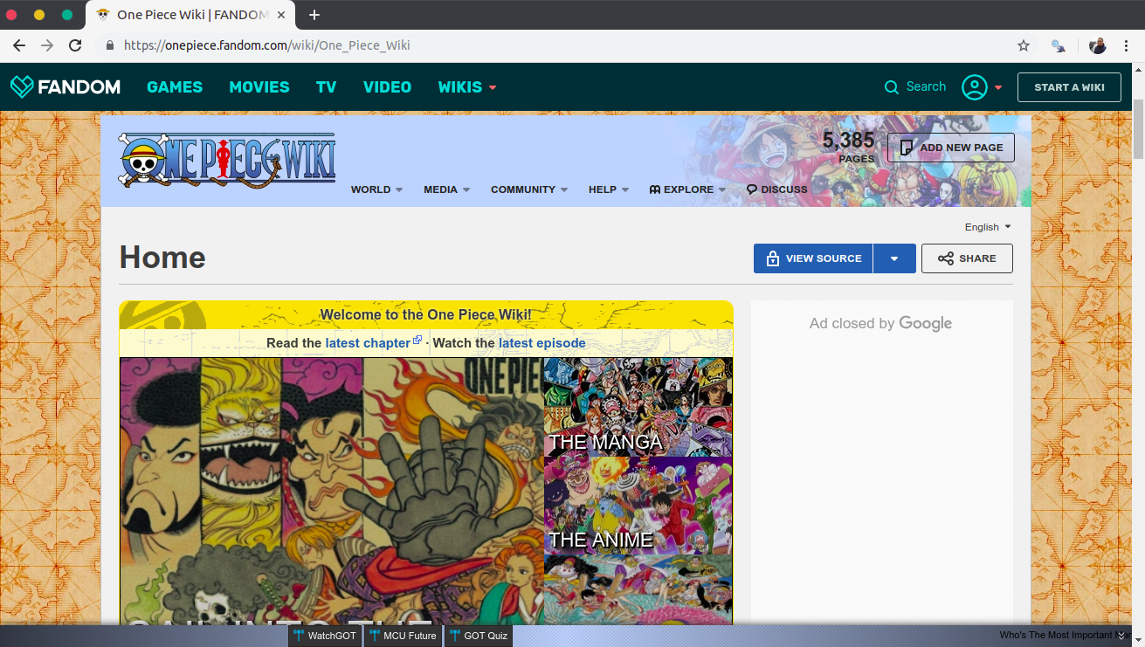
www.onepiece.fandom.com

Slide 29
Let’s write R scripts together!
I will demonstrate and explain the use of each code
Access this presesentation at:
s.id/data-carpentry-tidyverse
Let’s get
started!

Slide 30
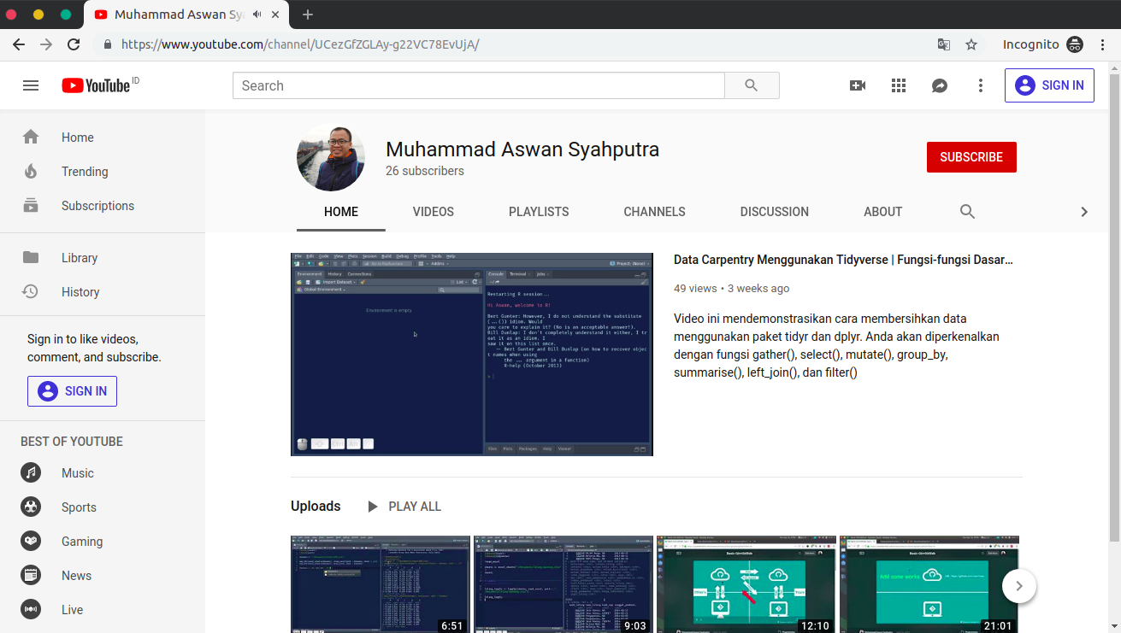
s.id/yt_aswansyahputra

Slide 31
Thanks!
aswansyahputra@sensolution.id
www.aswansyahputra.com
speakerdeck.com/aswansyahputra

