Slide 1
dplyr::glimpse(rplus_4_datascience)
...
Muhammad Aswan Syahputra
@aswansyahputra
www.aswansyahputra.com

Slide 2

Founded by Ross Ihaka & Robert Gentleman
High level language
Interactive & Programming
A swiss army knife for statistical tests and models, out-of-the box!
Download R

Slide 3
“The closer you are to statistics, research, and data science, the more you might prefer R”

Slide 4
But...

Slide 5
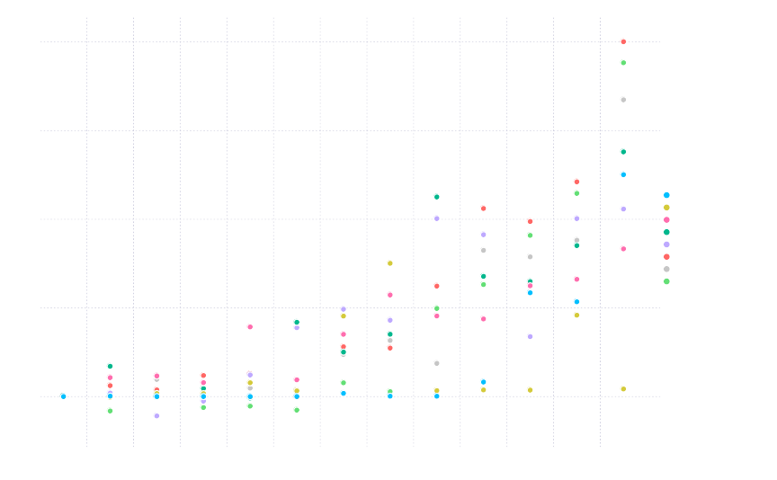
Sumber: https://julialang.org/benchmarks/

Slide 6
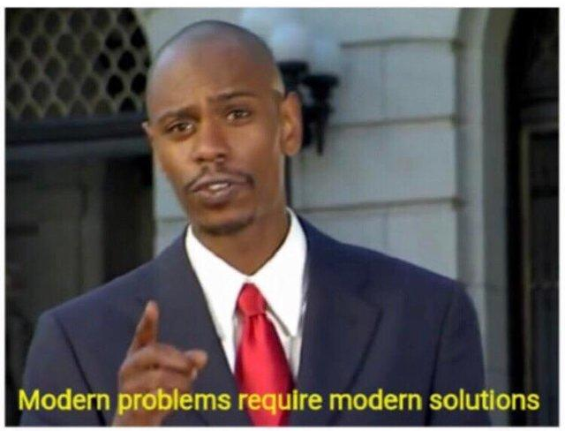
When R possess drawbacks but you can buy more RAM, work in Rstudio, and use Tidyverse approach

Slide 7

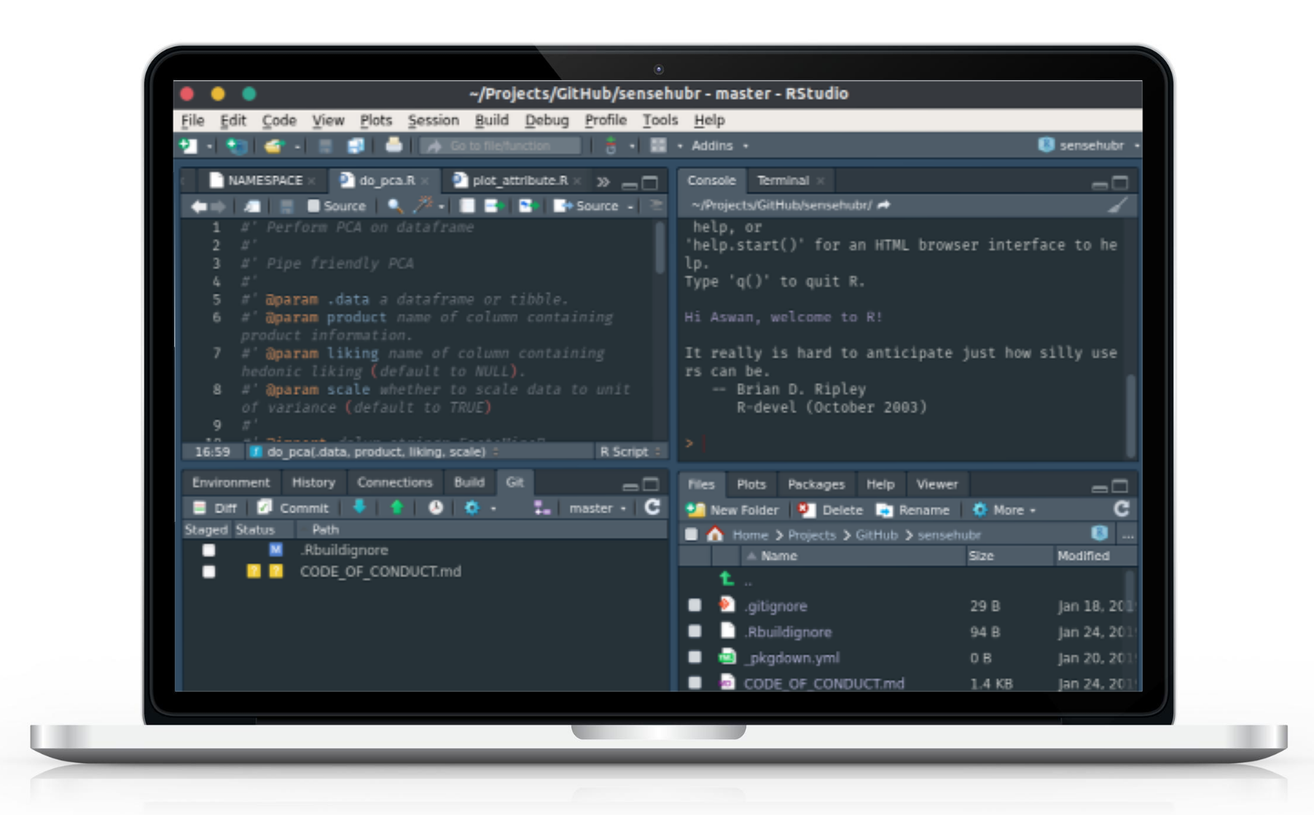
Main features:
Console
Syntax-highlighting editor
Tools for plotting, history, debugging and workspace management
Download RStudio

Slide 8
Tidyverse?

Slide 9

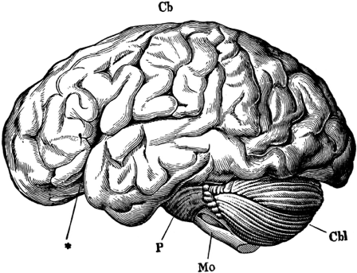

Human thought
Machine Language
Source: https://github.com/rstudio-education/arm-workshop-rsc2019

Slide 10

Human thought
Machine Language
Source: https://github.com/rstudio-education/arm-workshop-rsc2019

Slide 11
The tidyverse is an opinionated collection of R packages designed for data science.
Human thought
Machine Language
Source: https://github.com/rstudio-education/arm-workshop-rsc2019

Slide 12
Data science activity
Visualise
Import
Tidy
Transform
Communicate
Model
Understand
Program

Slide 13
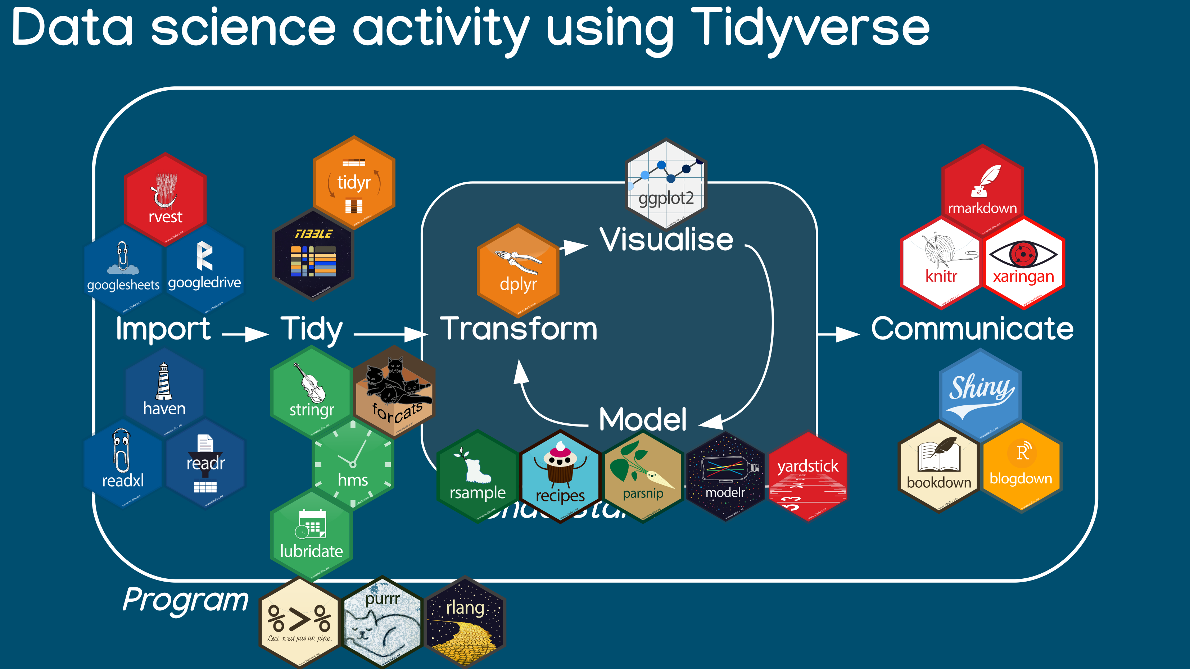

Slide 14
How to install it?
install.packages(“tidyverse”)
https://tidyverse.org/

Slide 15
With great codes,
comes great bugs!
- (not) Uncle Ben

Slide 16


Keep track of your code with Version Control System
+
https://git-scm.com/
https://github.com/

Slide 17
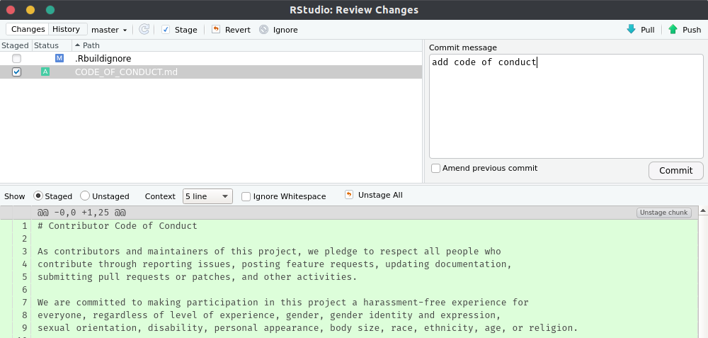
Keep track of your code with Version Control System
It is available in RStudio!

Slide 18
Next? Have fun!

Slide 19
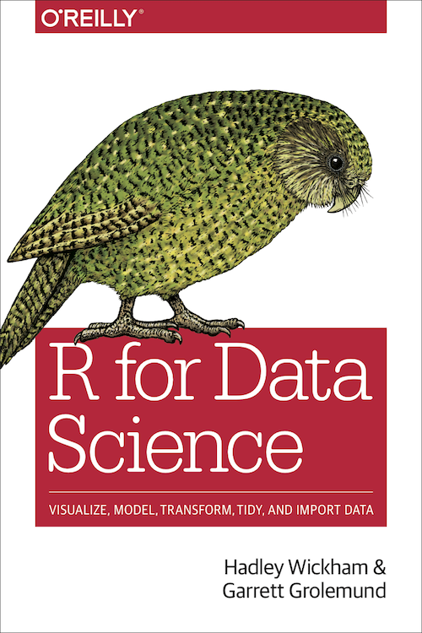
Need help?
R for Data Science
(r4ds.had.co.nz)
Introduction to Statistical Learning
(www-bcf.usc.edu/~gareth/ISL/)
Online books
(bookdown.org)
Online course
(2 m.o access at DataCamp >> my.visualstudio.com)
install.packages(“swirl”)

Slide 20
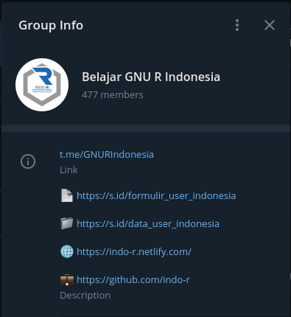
Indonesian R user community
Telegram:
@GNURIndonesia (t.me/GNURIndonesia)
Web:
www.indo-r.netlify.com
GitHub:
www.github.com/indo-r

Slide 21
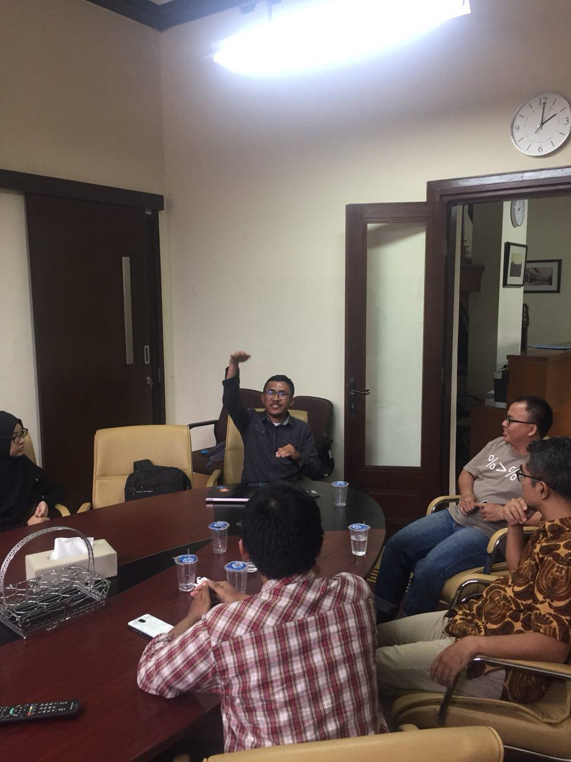
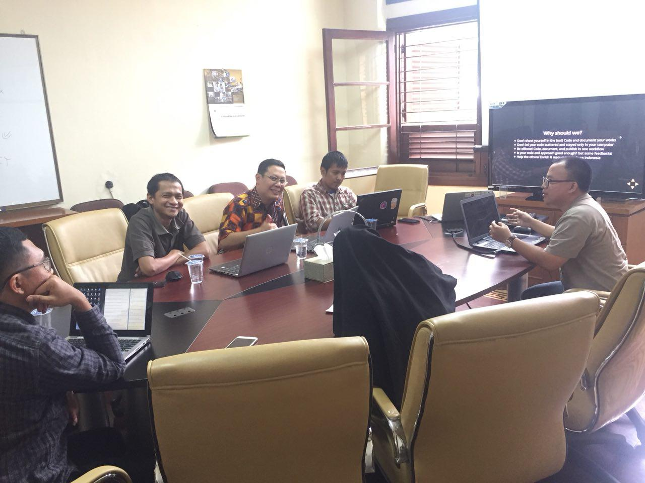
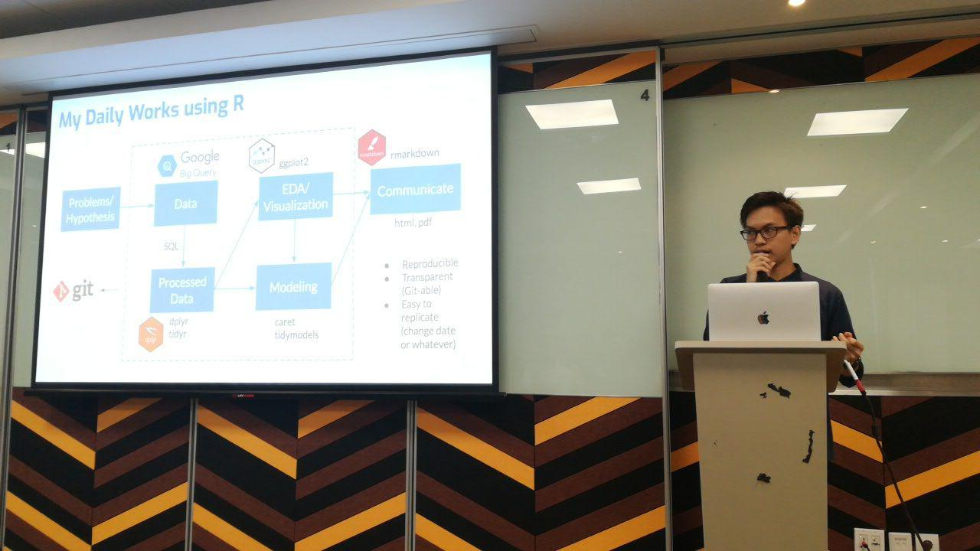
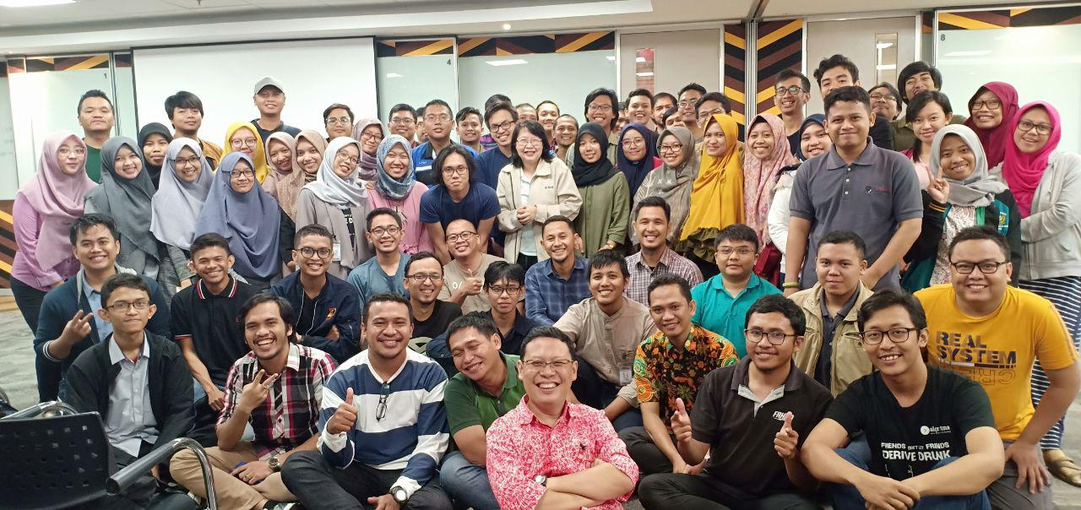
Indonesian R user community
Kopdar useR! Bandung?

Slide 22
Thanks!
aswansyahputra@sensolution.id
Telegram: @aswansyahputra
GitHub: @aswansyahputra
www.aswansyahputra.com

