Slide 1





Let’s build your first RStudio snippets and Addins!
Muhammad Aswan Syahputra
@aswansyahputra

Slide 2




R (+)

Slide 3
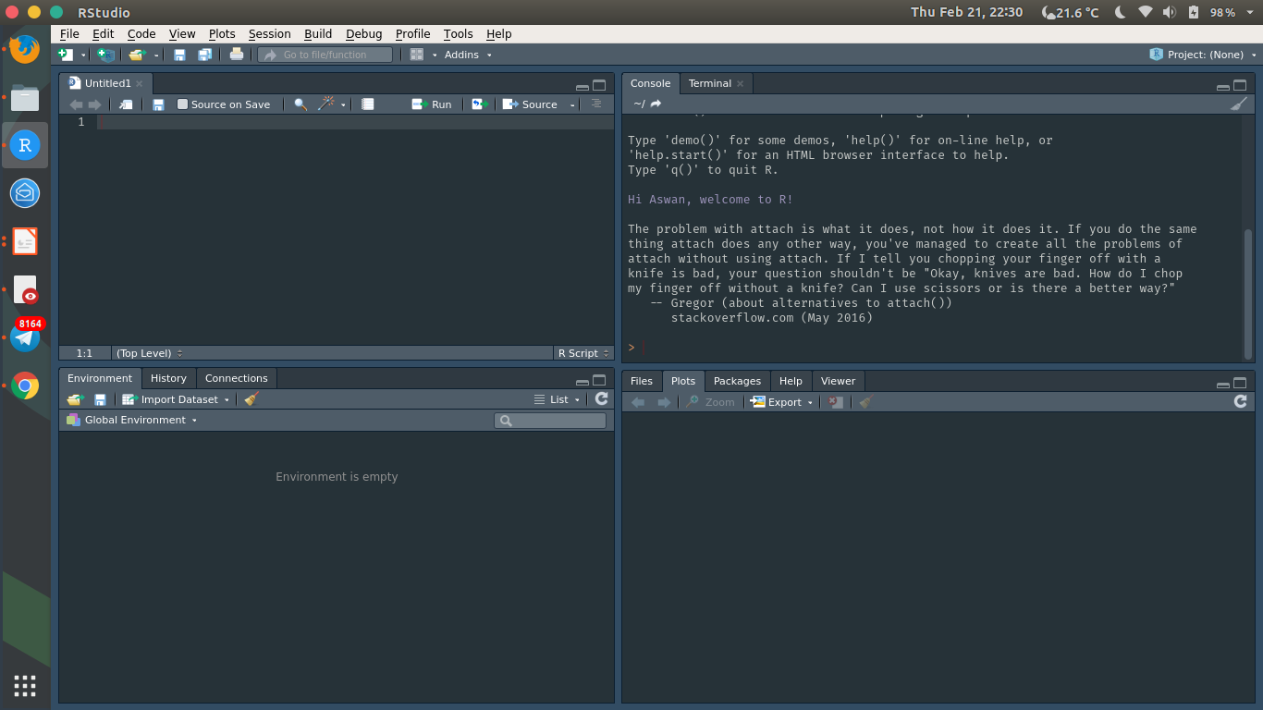
Main features:
Console
Syntax-highlighting editor
Tools for plotting, history, debugging and workspace management

Slide 4
Dig the gems!

Slide 5
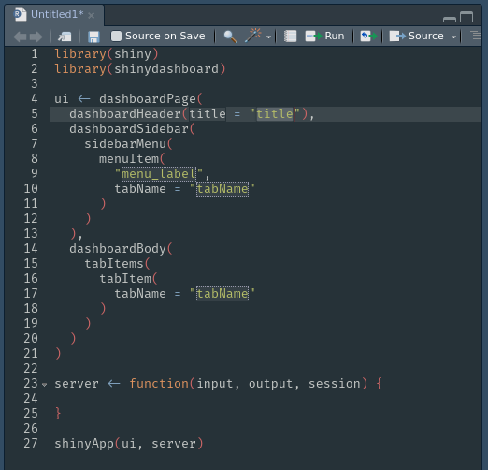
Snippets
Put your codes into reusable template
Less typing
Less error
Less time
Preset available, but a lot of room for customisation!

Slide 6
Snippets
snippet name
put your code here...
Go to Tools – Global Options – Code
Check ‘Enable code snippets’
Click ‘Edit snippets’ for editing
snippet name
fun(arg1 = ${1:arg1}

Slide 7
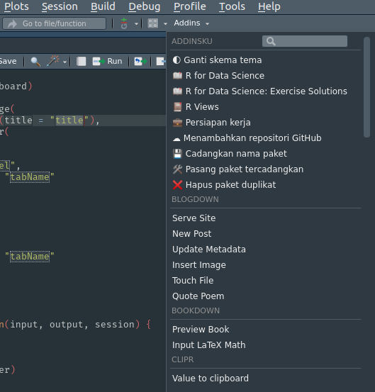
Addins
Gadget for RStudio
Basically are functions
Turn line of codes into GUI
Do magical things!

Slide 8
DESCRIPTION
LICENSE
NAMESPACE
R/
yourfunction.R
inst/
rstudio/
addins.dcf
Addins
Try them out!
datapasta
reprex
styler
colourpicker
regexplain
ggThemeAssist
Name: this_addin
Description: do_that
Binding: yourfunction
Interatice: true/false

Slide 9
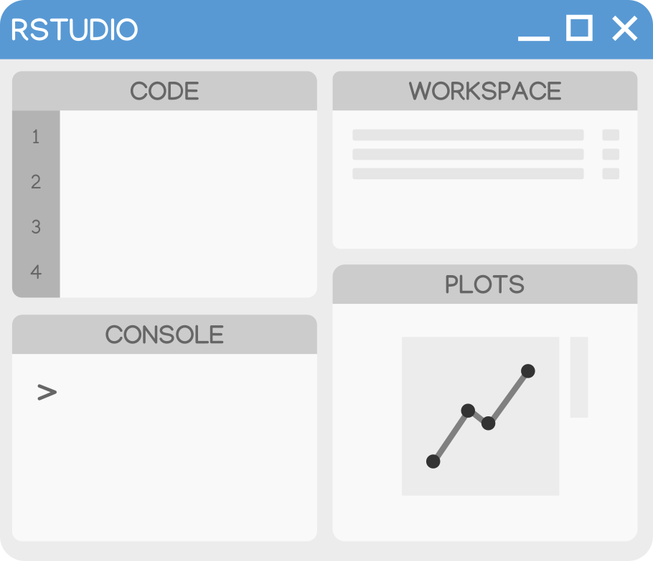
Let’s make them!
s.id/snippetsaddins

Slide 10
Next? Have fun!

Slide 11
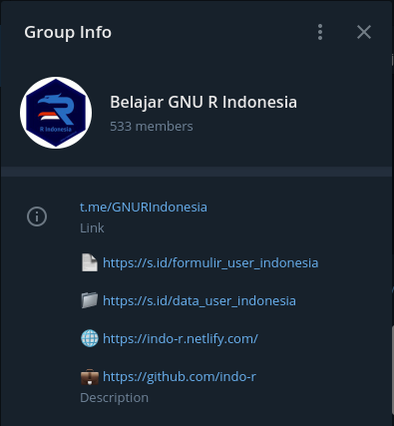
R Indonesia
Telegram:
@GNURIndonesia (t.me/GNURIndonesia)
Web:
www.r-indonesia.id
GitHub:
www.github.com/indo-r

Slide 12
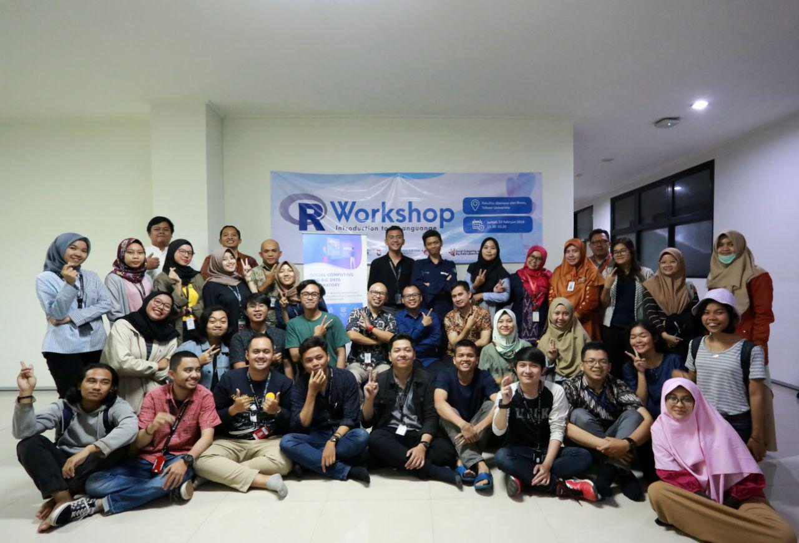
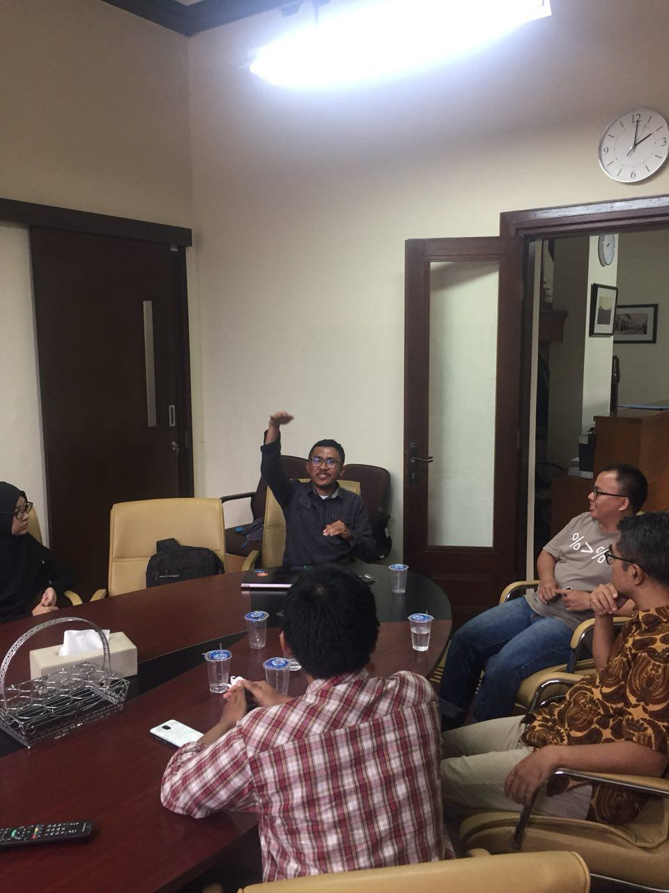
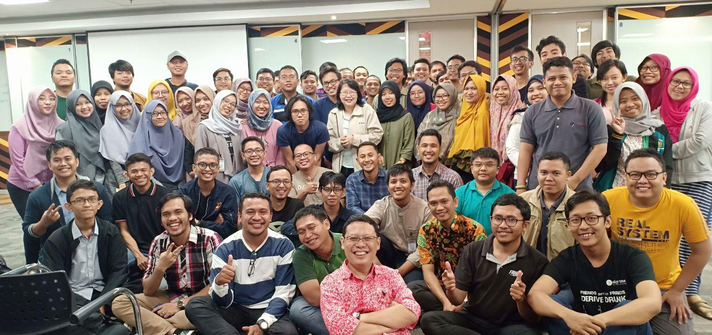
R Indonesia

Slide 13
Thanks!
aswansyahputra@sensolution.id
www.aswansyahputra.com
speakerdeck.com/aswansyahputra

