Slide 1
MatrixLang
IMPLEMENTATION REVIEW // COMPILER DESIGN LAB
1
0
0
0
0
0
0
2^53
A * (B * C)
556
556
556
input(int8)
0x1p+53
11,120
556
556
A dimension-aware compiler that proves which floating-point guarantee every optimization keeps
inf * 0 = NaN
11,120
11,120
556
{{1,0},{0,1}}
print(R);
bit-identical
bound-preserving
relaxed
-0 != +0
fl(x)
Matrix<40x2>
// remember this matrix
SUBMITTED BY
SUPERVISOR
COURSE
A Aswanth Raj
Dr. Ranjithkumar S
Compiler Design Lab
24BAI0044
SCOPE, VIT Vellore
BCSE307P
transpose(A)
(a+b)+c
github.com/aswanth-07/matrixlang
School of Computer Science and Engineering · VIT Vellore
Notes:
About 45 seconds.
Good morning, sir. I am A Aswanth Raj, 24BAI0044, and this is the implementation review of MatrixLang, done under Dr. Ranjithkumar S for the Compiler Design Lab, BCSE307P.
In one sentence: MatrixLang is a complete compiler for a small matrix language, and its optimizer proves, for every floating-point rewrite, which guarantee it keeps: bit-identical, bound-preserving or relaxed. Those three levels are the green, amber and red you will see on every slide.
The matrix on the right is a teaser. It comes back on slide 3 with its meaning.
(Run this in Slide Show: every transition is Morph.)

Slide 2
Nine stages, from source text to certified C
01 // THE COMPILER
0
1
0
0
0
0
0
A * (B * C)
2^53
01
Scanner
matrix.l
02
Parser
matrix.y
03
Shape types
types.c
04
Semantics
semantic.c
05
Input domains
domain.c
06
Three-address code
tac.c
07
Facts and contracts
facts.c
08
Stack VM
vm.c
09
Certified C
emit_c.c
NEW
NEW
NEW
input(int8)
0x1p+53
FRONT END
MIDDLE END
BACK ENDS
source · chain.ml
$ matrixc --explain --certificate chain.ml
print(R);
-0 != +0
matrix A[40,2] = input(int8);
matrix B[2,40] = input(int8);
matrix C[40,2] = input(int8);
matrix R = A * B * C; // 40x2
print(R);
chain order A * B * C -> A * (B * C)
11,120 -> 556 operations, -95.0%
Contract: strict
1. bit-identical print(R)
every intermediate of every bracketing
needs at most 28 of 53 significand bits
fl(x)
Matrix<40x2>
transpose(A)
(a+b)+c
7,700 lines of C11, Flex and Bison · 34 flags expose every stage · a browser workspace shows them side by side · make test passes
MatrixLang
{{1,0},{0,1}}
inf * 0 = NaN
github.com/aswanth-07/matrixlang
Notes:
About 90 seconds.
Everything on this slide is implemented and runs: nine stages, 7,700 lines of C11 with Flex and Bison.
Front end: a Flex scanner; a Bison LALR(1) parser with no conflicts; and a type system in which the type of a matrix is its shape, Matrix<40x2>, so a dimension mismatch is a compile-time error. New since the last review: input domains. A program declares run-time inputs such as input(int8), and every value is checked against its domain when it is loaded.
Middle end: three-address code, then the optimizer: constant folding, common subexpressions, copy propagation, dead code, algebraic identities, and matrix-chain reordering by dynamic programming over a cost model. New: a fact analysis and three numerical contracts decide which value-changing rewrites are legal.
Back ends: a typed stack VM, and, new, a C11 emitter that hands the optimized program to GCC.
Bottom: a real run. The chain A*B*C becomes A*(B*C), 11,120 operations down to 556, and the compiler certifies that print(R) is still bit-identical, because every intermediate of every bracketing needs at most 28 of the 53 significand bits.
34 command-line flags show each stage; the browser workspace shows them side by side. make test passes: 234 acceptance checks, numerical fixtures, front-end agreement, service tests and a GCC check of the emitted C.

Slide 3
One fast-math switch hides three guarantees
02 // THE IDEA
0
0
1
0
0
0
0
A * (B * C)
2^53
Floating-point addition is not associative, so reordering A·B·C can change its bits. Compilers offer one switch, strict IEEE or ‑ffast‑math. A switch says what the compiler may do, never what the result is.
transpose(A)
--fp-strict
--fp-bounded
--fp-algebraic
input(int8)
0x1p+53
input(int8)
556
bit-identical
556
bit-identical
556
bit-identical
THREE GUARANTEES, WEAKEST LAST
input(real(1))
11,120
kept order
556
bound-preserving
556
bound-preserving
bit-identical
Same bits as the unoptimized program, for every input in the declared domains.
-0 != +0
bound-preserving
input(real)
11,120
kept order
11,120
kept order
556
relaxed
fl(x)
Within the source order's worst-case error bound; NaN and Inf unchanged.
relaxed
Equal only over the real numbers.
print(R);
Operations left after optimization, and the certificate of print(R), as matrixc reports them for R = A·B·C with shapes 40×2, 2×40 and 40×2.
(a+b)+c
Matrix<40x2>
{{1,0},{0,1}}
MatrixLang
github.com/aswanth-07/matrixlang
inf * 0 = NaN
Notes:
About 75 seconds.
Reordering a product chain is the biggest saving available, but floating-point addition is not associative, so a reorder can change the bits. Production compilers offer one switch: strict IEEE, or -ffast-math. That switch says what the compiler may do. It never says what the result is.
I separate three guarantees. Bit-identical: the same bits as the unoptimized program for every input in the declared domains. Bound-preserving: within the source order's worst-case error bound, with NaN and infinity unchanged. Relaxed: equal only over the real numbers. A contract names the weakest level the optimizer may use: strict, bounded or algebraic.
This is the matrix from the title slide. One program, R = A*B*C. Rows are the declared input domain; columns are the contract. On int8 data every contract reorders, 556 operations, and the output stays bit-identical. On real(1) data strict refuses and keeps 11,120; bounded reorders and certifies the error bound. On unbounded reals only algebraic reorders, and the output is certified relaxed. The program text never changes; what decides is the values it will see.

Slide 4
Domains in, proofs through, certificates out
03 // THE PROOFS
0
0
0
1
0
0
0
A * (B * C)
2^53
transpose(A)
1 DECLARE
matrix A[40,2] = input(int8);
Checked against its domain at load time, before execution.
THEOREM 1 · CORRECTLY ROUNDED CHAINS
input(int8)
If every proper sub-chain fits in 53 significand bits and the final sums round at most once, every bracketing and every order of summation returns the correctly rounded product.
2 TRACK FACTS
Each entry is a multiple of 2^{g}, at most m in size. For int8:
198 · 35,697³ ≤ 2⁵³ < 198 · 35,698³
g = 0
m = 128
finite
signed
no -0
For int(0,m) chains 100×2 · 2×100 · 100×2, strict reorders up to m* = 35,697. At m* + 1 we build inputs on which the bracketings print different bits: the proved threshold is the true boundary.
3 PROVE
Two theorems give each value-changing rewrite its level:
T1 bit-identical T2 bound-preserving else relaxed
THEOREM 2 · BRACKETING INVARIANCE
All bracketings share one worst-case error bound, so bounded reordering needs only a range check.
4 CERTIFY
Each print gets the weakest level that reaches it. Emitted C licenses exactly the sums the facts free:
#pragma omp simd reduction(+:acc)
print(R);
bit-identical
<
bound-preserving
<
relaxed
(a+b)+c
Matrix<40x2>
fl(x)
-0 != +0
{{1,0},{0,1}}
MatrixLang
github.com/aswanth-07/matrixlang
inf * 0 = NaN
0x1p+53
Notes:
About 90 seconds.
How the compiler proves it, in four steps.
One: inputs declare a domain, and the runtime checks it.
Two: a grid-magnitude analysis keeps five facts per value: every entry is a multiple of 2 to the g, its magnitude is at most m, and whether it is finite, whether it can be negative, and whether it can be minus zero. For int8 data: g = 0 and m = 128.
Three: two theorems. Theorem 1: if every proper sub-chain fits in 53 significand bits and the final sums round at most once, every bracketing and every order of summation returns the correctly rounded product, so the reorder is bit-identical. It is tight. For int(0,m) chains of shape 100x2, 2x100, 100x2 the compiler reorders up to m = 35,697, because 198 times 35,697 cubed is at most 2 to the 53 and 198 times 35,698 cubed is not; at 35,698 we construct inputs on which the two bracketings print different bits.
Theorem 2: the standard componentwise error bound of a chain is the same for every bracketing, so the bounded contract needs only a range check that rules out overflow.
Four: every print gets a certificate, the weakest level among the rewrites that reach it. The C backend turns certificates into code: only the sums the facts prove order-free get an OpenMP reduction clause, which licenses GCC to vectorise exactly those.

Slide 5
The optimizer now proves what it keeps
04 // SINCE THE LAST REVIEW
0
0
0
0
1
0
0
A * (B * C)
2^53
transpose(A)
7,700
lines of C11, Flex and Bison
was 4,779
3
numerical contracts, proved per rewrite
was one global switch
2
theorems behind the optimizer
was none
234
acceptance checks, plus four verifiers
was 157
AT THE LAST REVIEW
NOW
Floating-point rewrites
reorder with no guarantee, or never
three contracts; every rewrite proves its level
Program values
literals only, no run-time inputs
10 declared input domains, checked at load
Code generation
stack VM
stack VM, and C11 with OpenMP reduction clauses
Evidence
modeled operation counts
6 research questions, GCC runtimes, 57,600 runs
print(R);
Paper
9-page teaching-compiler study
10-page research paper with two theorems
Matrix<40x2>
input(int8)
-0 != +0
{{1,0},{0,1}}
0x1p+53
MatrixLang
(a+b)+c
github.com/aswanth-07/matrixlang
inf * 0 = NaN
fl(x)
Notes:
About 60 seconds.
Since the last review the code grew from 4,779 to 7,700 lines. The last review had one switch: reorder with no guarantee at all, or never reorder. Now there are three contracts, and every rewrite proves which one it satisfies. Two theorems stand behind the optimizer. The checks went from 157 to 234 acceptance checks, plus four independent verifiers: numerical fixtures, front-end agreement, the workspace service tests, and a GCC check of the emitted C.
Row by row: programs now take run-time inputs with declared domains; the back end emits C with OpenMP reduction clauses; the evidence is no longer modeled operation counts alone but six research questions with real GCC runtimes; and the nine-page teaching-compiler study became a ten-page research paper.

Slide 6
Faster than ‑ffast‑math, and with a guarantee
05 // THE EVIDENCE
0
0
0
0
0
1
0
‑ffast‑math (GCC)
no proofs (last review)
strict + proofs
bounded + proofs
data: results/contracts
transpose(A)
SPEEDUP OVER THE PROGRAM AS WRITTEN
ARITHMETIC REMOVED
four kernels, GCC 15.2 -O3, median of 50 runs
15,000 generated programs, by input domain
print(R);
0 of 57,600
outputs certified bit-identical that changed
m* + 1
first breaking input on 3 of 4 chain families
24 vs 0
proof-built vs random tests that kill the 54-bit mutant
p = 4.6×10⁻¹¹
the cheaper bracketing is also more accurate
Matrix<40x2>
input(int8)
-0 != +0
{{1,0},{0,1}}
0x1p+53
fl(x)
inf * 0 = NaN
MatrixLang
2^53
A * (B * C)
github.com/aswanth-07/matrixlang
(a+b)+c
Notes:
About 90 seconds. Two baselines, every number regenerated from raw data by make contracts.
Left: runtime against GCC's own baseline, -ffast-math, on four kernels compiled by GCC 15.2. The red bars are -ffast-math, so short you can barely see them: at most 1.13x, because GCC reassociates scalar sums but never reorders a matrix chain. Green is the strict contract: walk counts on a graph, 278x faster with identical bits, because the proof says every bracketing gives the same answer. It refuses the real-valued kernels, which is correct: there the bits would change. Amber is the bounded contract: it takes those too, 469x and 277x, within the source order's worst-case error bound.
Right: the other baseline is my own optimizer from the last review, which had no proofs. Grey: it could remove almost nothing safely, 0.5% of the arithmetic on int8 programs. With proofs, strict removes 16.5% with identical bits, and bounded removes all of the available saving on every bounded domain.
Bottom: 0 of 57,600 outputs certified bit-identical ever changed; the threshold is tight: the first breaking input is at m* + 1 on three chain families, and at m* + 2 on the four-operand chain, where a parity argument rules out m* + 1; a mutant that allows 54 bits is killed by 24 proof-built tests and by no random test at all; and in a preregistered study of 2,700 chains the cheaper bracketing is also more accurate, p = 4.6e-11.

Slide 7

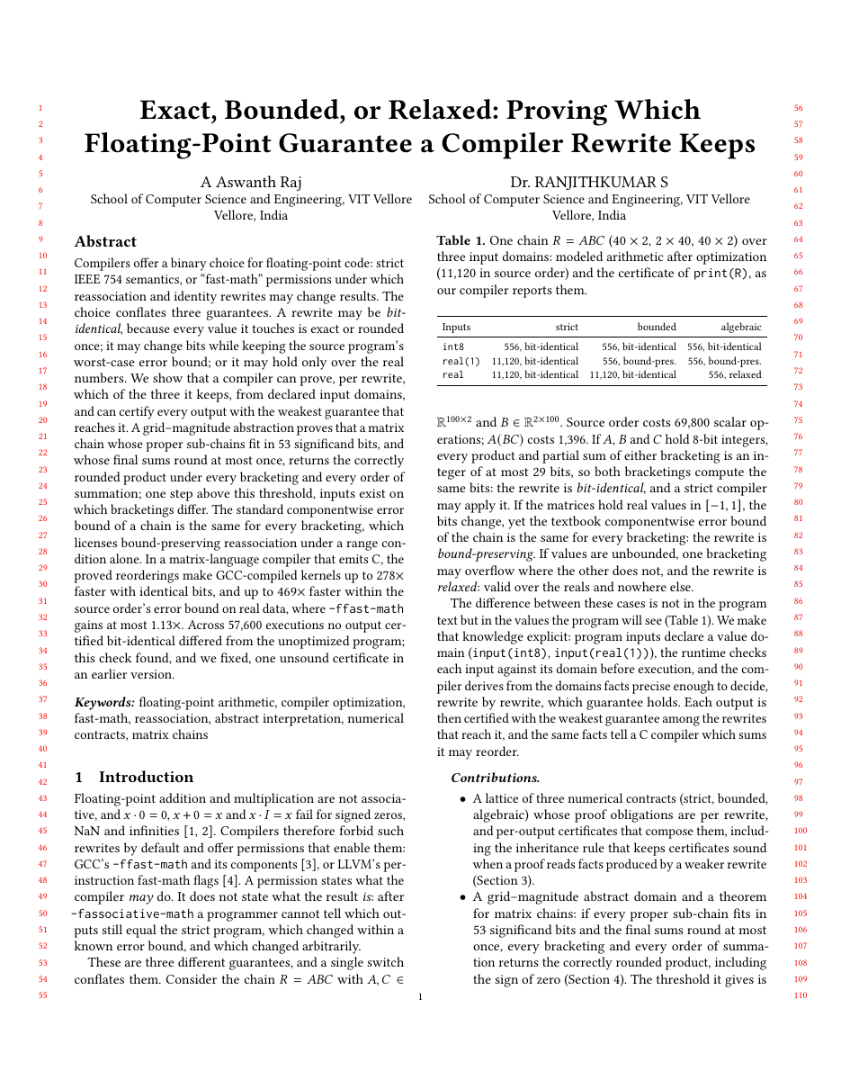
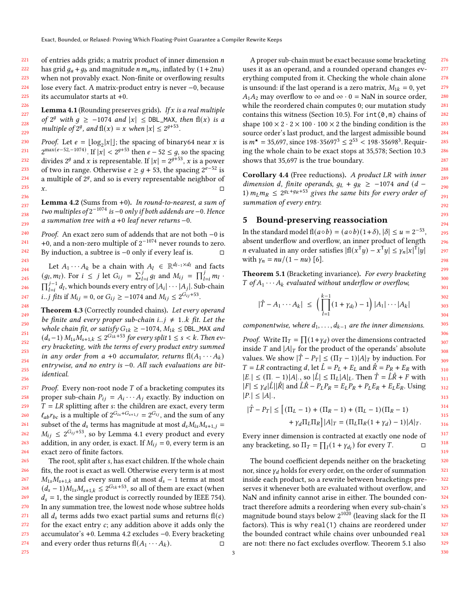
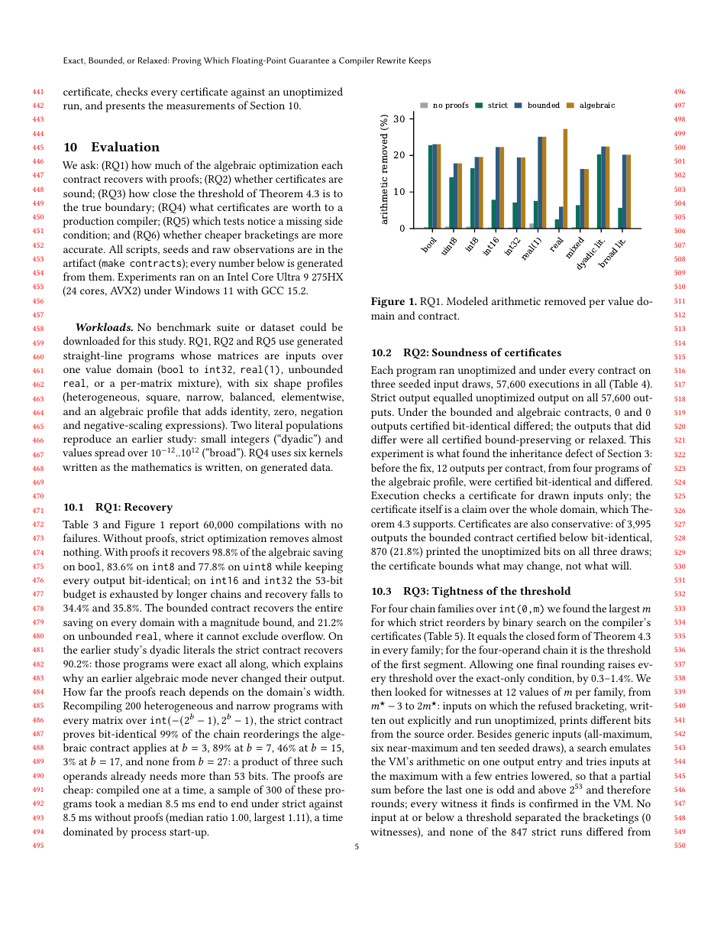
Thank you
$ matrixc --certificate implementation_review.ml
0
0
0
0
0
0
1
transpose(A)
bit-identical
print(thank_you)
bound-preserving
print(questions)
relaxed
print(feedback)
github.com/aswanth-07/matrixlang
code · paper · raw data · workspace
THE PAPER
Exact, Bounded, or Relaxed
Proving Which Floating-Point Guarantee
a Compiler Rewrite Keeps
2^53
{{1,0},{0,1}}
A Aswanth Raj · Dr. Ranjithkumar S
print(R);
ACM SIGPLAN format · 10 pages · target CC 2027
0x1p+53
input(int8)
Matrix<40x2>
MatrixLang
A Aswanth Raj · 24BAI0044 Supervisor Dr. Ranjithkumar S BCSE307P · Compiler Design Lab
-0 != +0
A * (B * C)
fl(x)
(a+b)+c
inf * 0 = NaN
Notes:
Thank you. The QR code opens the repository: code, paper, raw data and the browser workspace.
The paper: "Exact, Bounded, or Relaxed: Proving Which Floating-Point Guarantee a Compiler Rewrite Keeps", ten pages in ACM SIGPLAN format, with you as co-author, sir, pending your review. Two theorems, an implementation, and six research questions. The target is CC 2027, ACM SIGPLAN Compiler Construction; its call is expected in November, following earlier years.
Likely questions:
Why not just use -ffast-math? It is a permission, not a guarantee: nobody can tell which outputs changed. And here it gains at most 1.13x, because GCC does not reorder matrix chains.
How do you know the certificates are sound? Theorem 1, plus 57,600 executions per contract with no violation. That check found, and I fixed, one real defect: the inheritance rule.
Is the threshold tight? Yes. A witness exists at m* + 1 on three chain families, and at m* + 2 on the four-operand chain, where a parity argument rules out m* + 1.
Limits? Straight-line, statically shaped programs. Bit-identity proofs cover integer and dyadic data. The bounded contract excludes gradual underflow. Runtimes come from one machine and one compiler.
What next? An LLVM prototype of the per-reduction license, loops through a fixed point over the same lattice, kernels from real applications, and submission to CC 2027.

