Slide 1



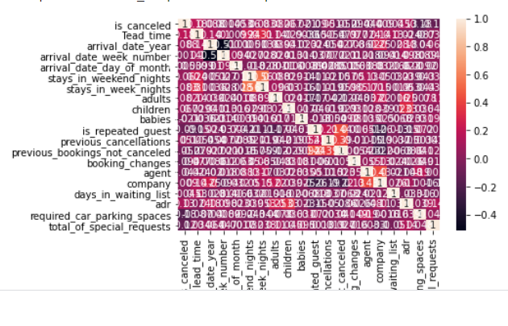
Project Name
Project Short Summary
This project analyzes room booking data using IBM Cloud and Watson Studio, aiming to uncover booking patterns, customer preferences, and cancellation factors. The analysis includes data preprocessing, exploratory data analysis, and machine learning model building to predict cancellations and optimize room allocation. Key insights reveal trends in booking behavior and factors influencing cancellations, aiding in improved service offerings.
Program Feedback
internship and teaching also is very well , easy to understand all course but IBM CLOUD and Email problem is delay to solve , my cloud is not working I fill the form and ask admin but don’t response so I project doing on other platform in feature days please change this one…….thank you lot for giving opportunity
ASWANTH E
aswanth0218@gmail.com
Sri Venkateshwara Institute of Science and Technology
#skillsbuild

