Slide 1

AI reinvention made real
Accenture Innovation Challenge 2026

Slide 2
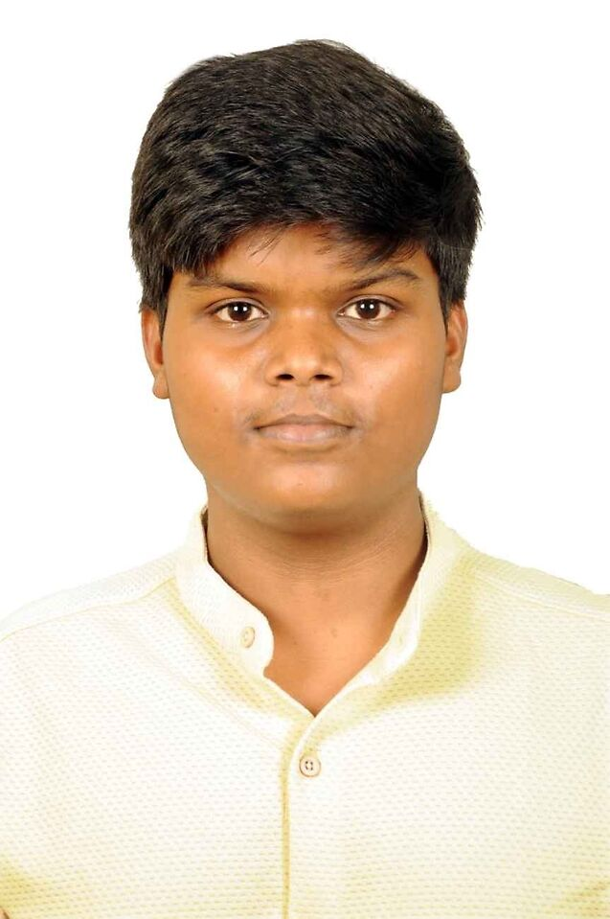

Team details
TEAM NAME: Aswanth (individual participant)
Aswanth
College: Indian Institute of Technology Madras
Stream: Civil Engineering (B.Tech)
Year of graduation: 2028
All fields are mandatory

Slide 3
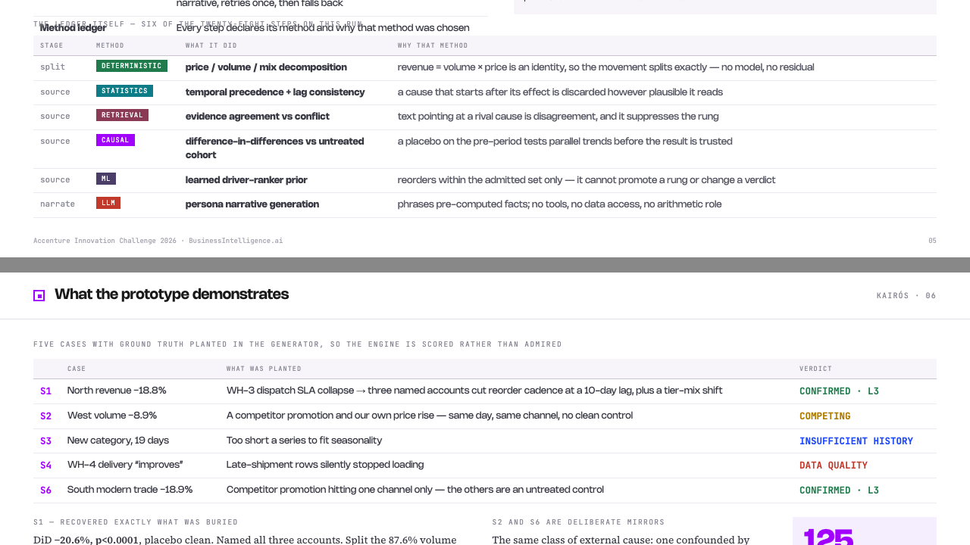

Slide 4
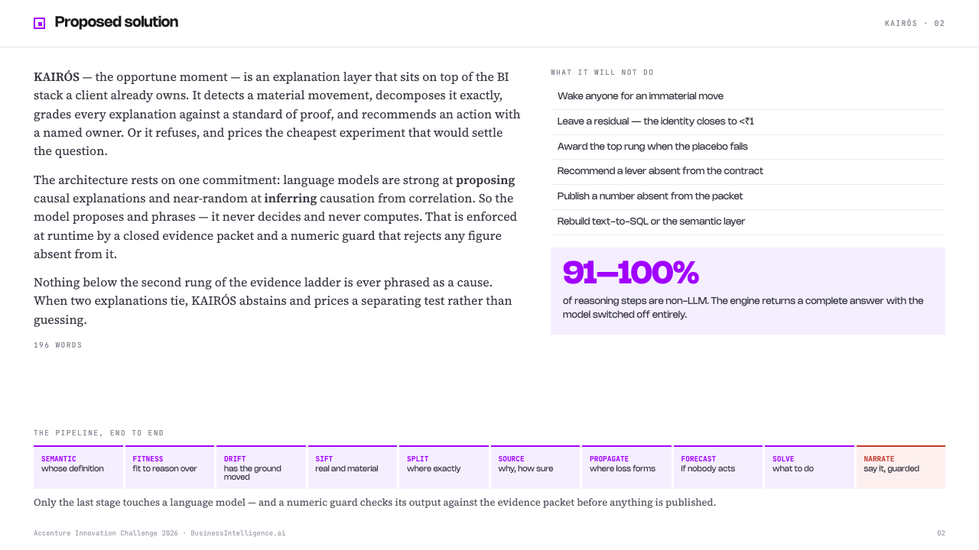

Slide 5
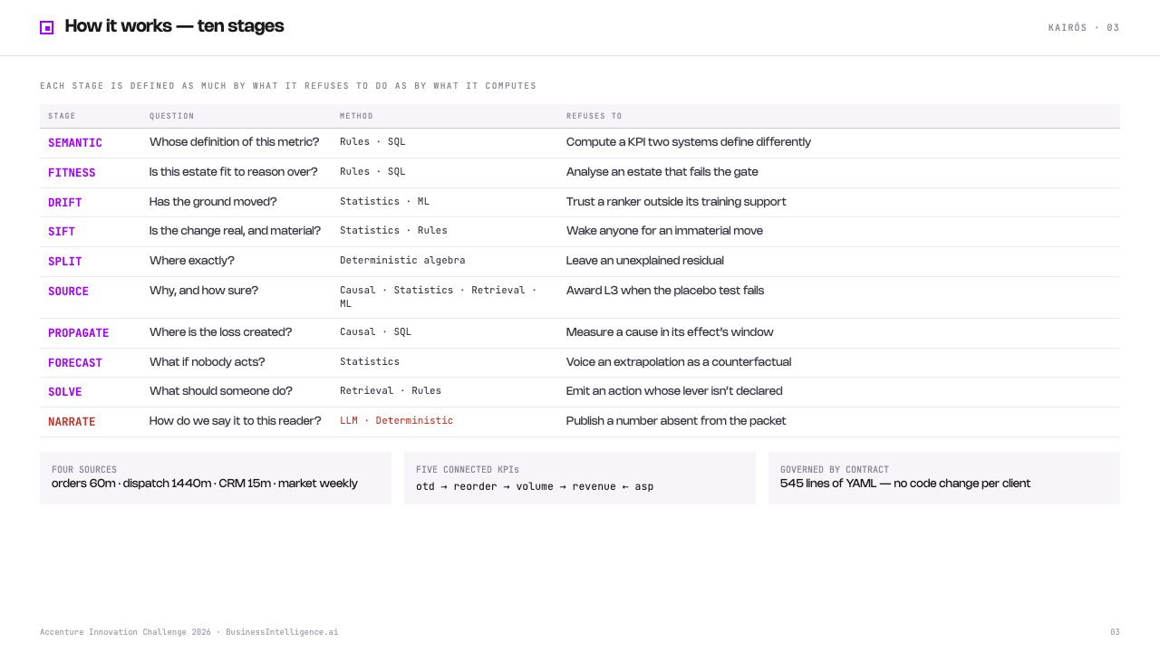

Slide 6
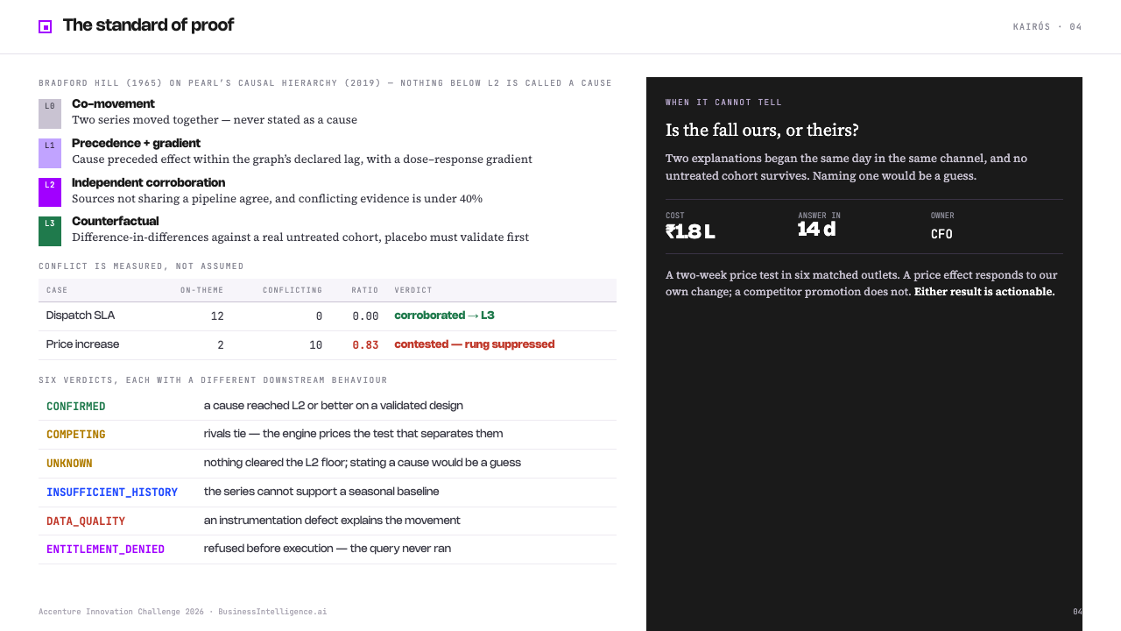

Slide 7
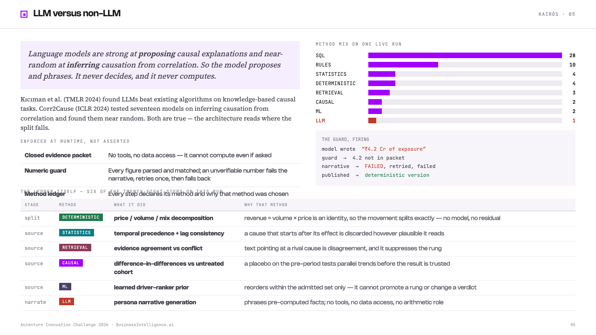

Slide 8
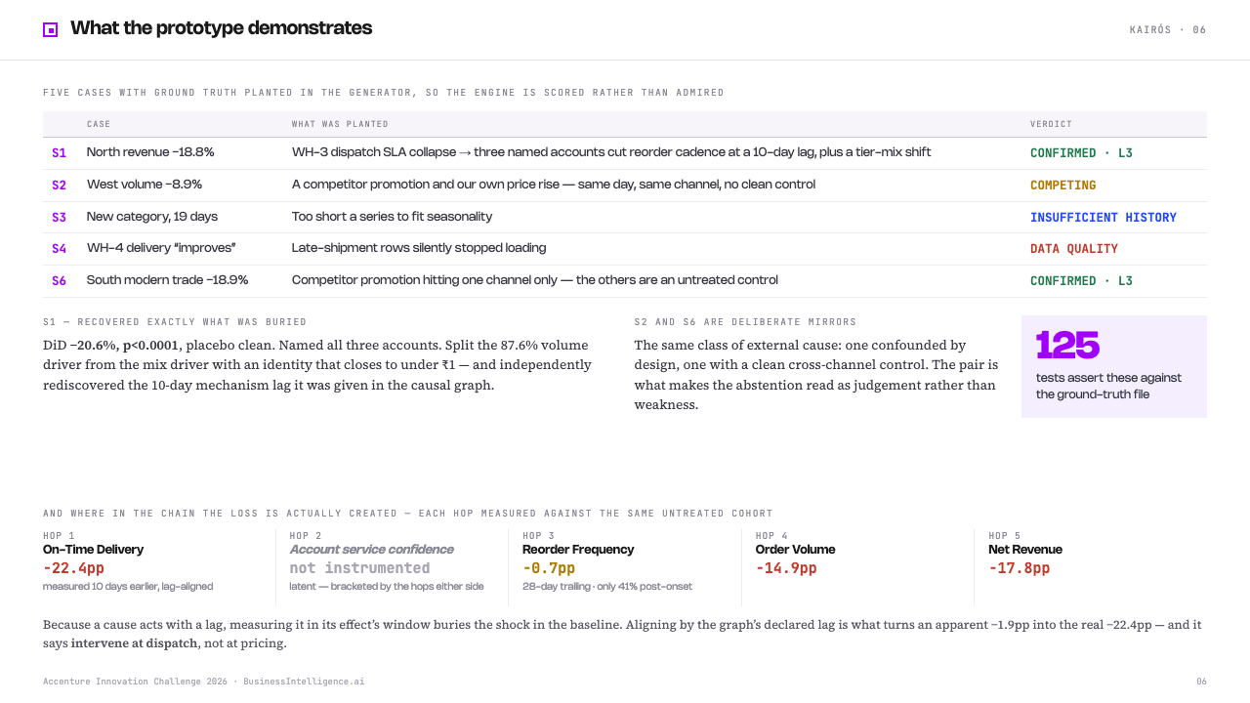

Slide 9
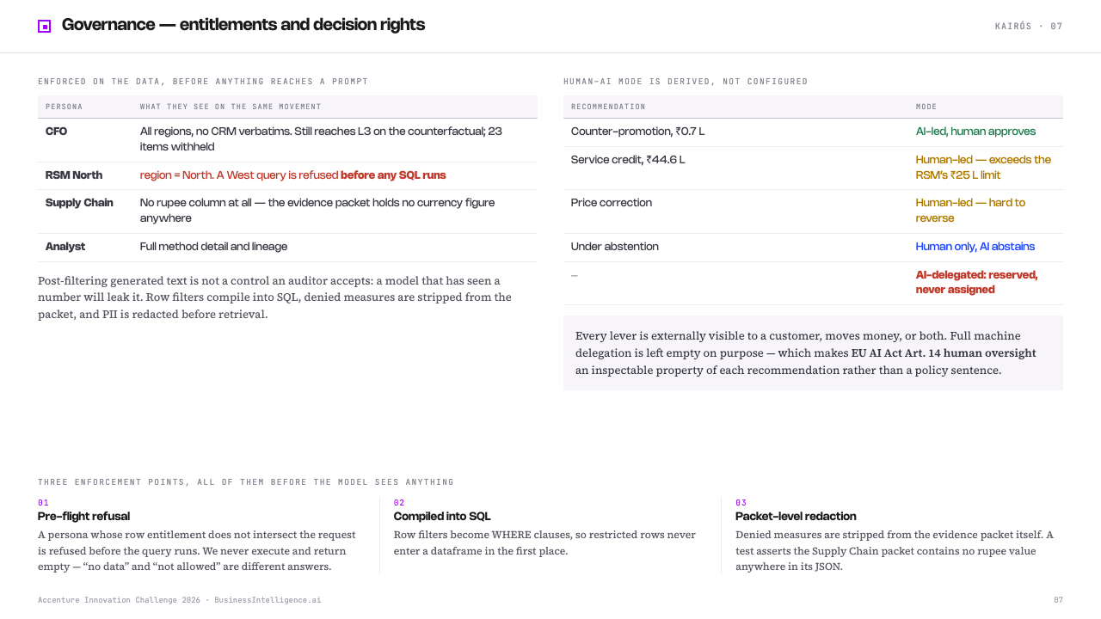

Slide 10
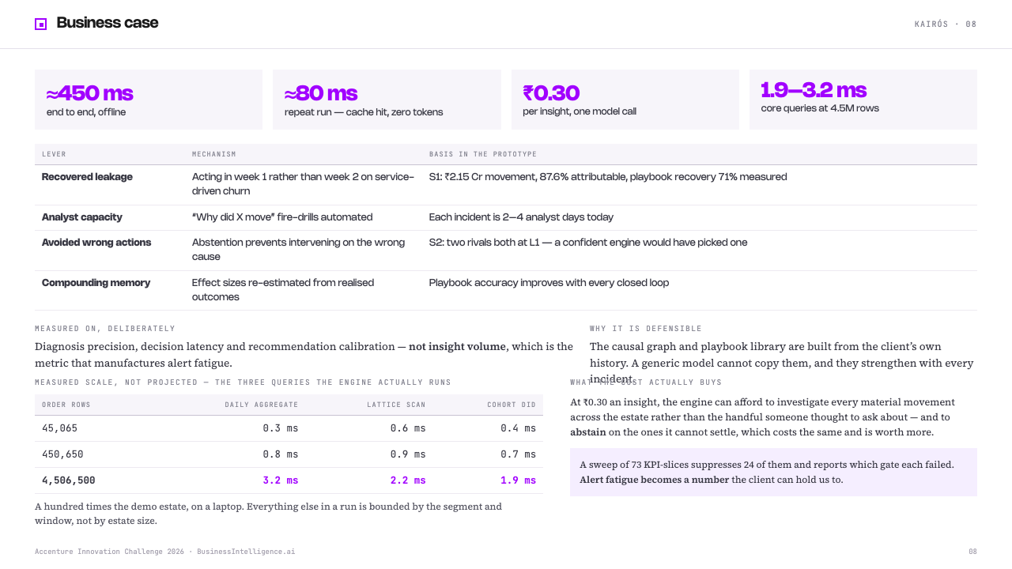

Slide 11
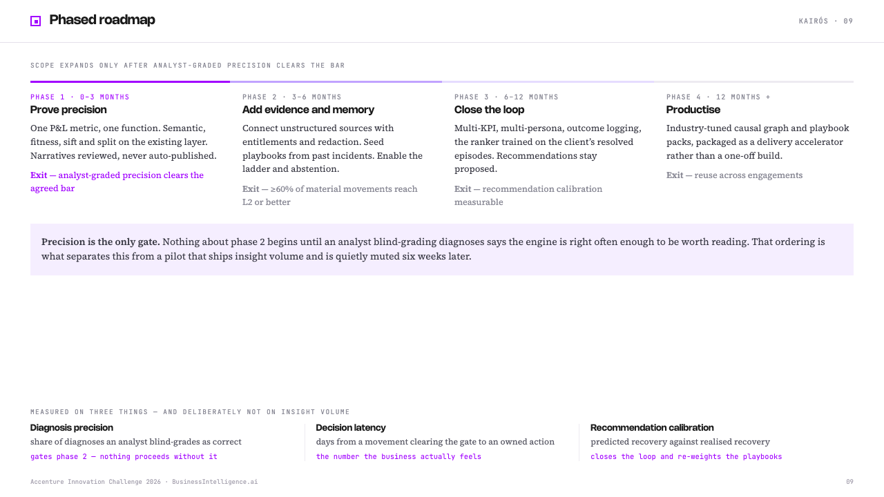

Slide 12
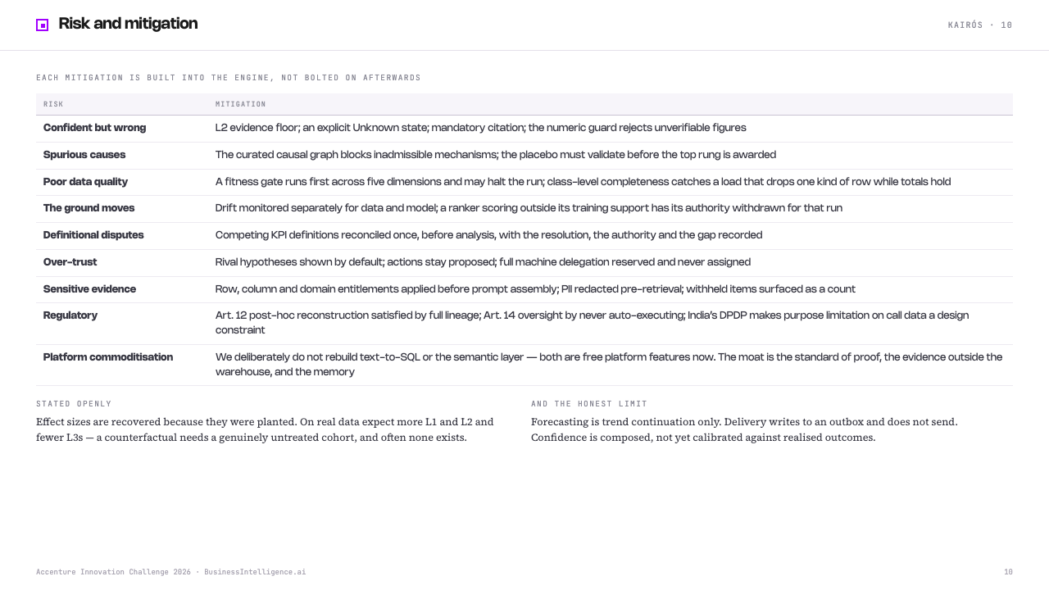

Slide 13
Video

Slide 14
Thank you

