Slide 1
Network Security Architecture

Slide 2
Reading Material
Computer Security chapter 26.
“Firewalls and Internet Security: Repelling the Wily Hacker”, Cheswick, Bellovin, and Rubin.
  New second edition
“Firewall and Internet Security, the Second Hundred (Internet) Years” http://www.cisco.com/warp/public/759/ipj_2-2/ipj_2-2_fis1.html
  A firewall overview article from 1999

Slide 3
Overview
Network Security Architecture
  Segmentation
  Wireless
  Security Domains
  VPN
Firewall Technology
  Address Translation
  Denial of Service attacks
Intrusion Detection
Both firewalls and IDS are introductions.
  Both are covered in more detail in the Security Lab class.
  IDS is covered in more detail in 463 – Computer Security.

Slide 4
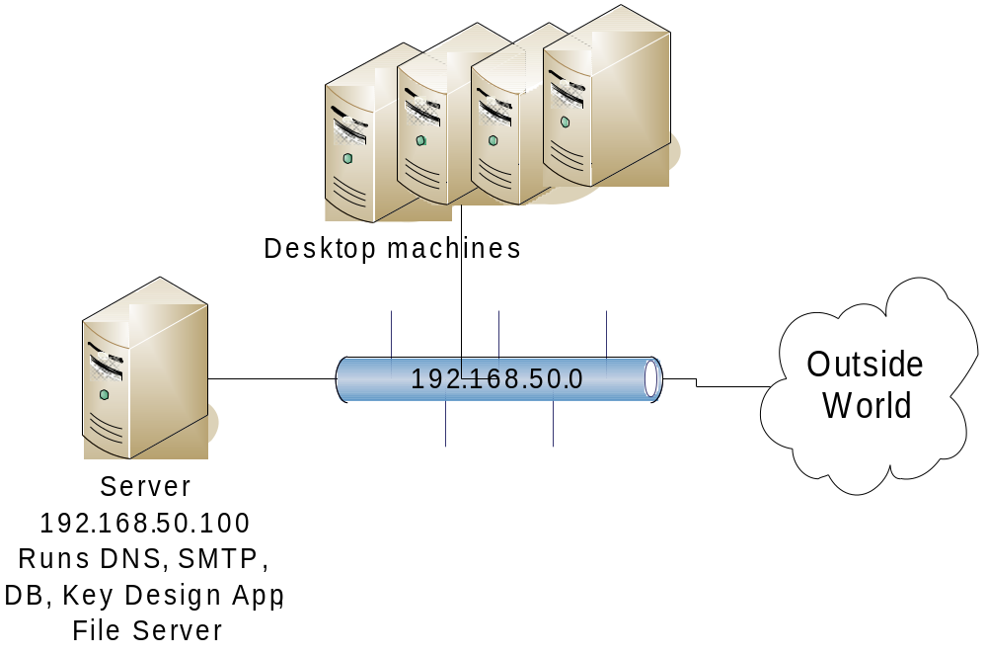
Segment
Separate Functionality
  Limit infection vectors

Slide 5
802.11 or Wi-Fi
IEEE standard for wireless communication
  Operates at the physical/data link layer
  Operates at the 2.4 or 5 GHz radio bands
Wireless Access Point is the radio base station
  The access point acts as a gateway to a wired network e.g., ethernet
  Can advertise Service Set Identifier (SSID) or not
    Doesn't really matter, watcher will learn active SSIDs
Laptop with wireless card uses 802.11 to communicate with the Access Point

Slide 6
Security Mechanisms
MAC restrictions at the access point
  Protects servers from unexpected clients
  Unacceptable in a dynamic environment
  No identity integrity. You can reprogram your card to pose as an “accepted” MAC.
IPSec
  To access point or some IPSec gateway beyond
  Protects clients from wireless sniffers
  Used by UIUC wireless networks
802.11i
  Authentication and integrity integral to the 802.11 framework
  WEP, WPA, WPA2

Slide 7
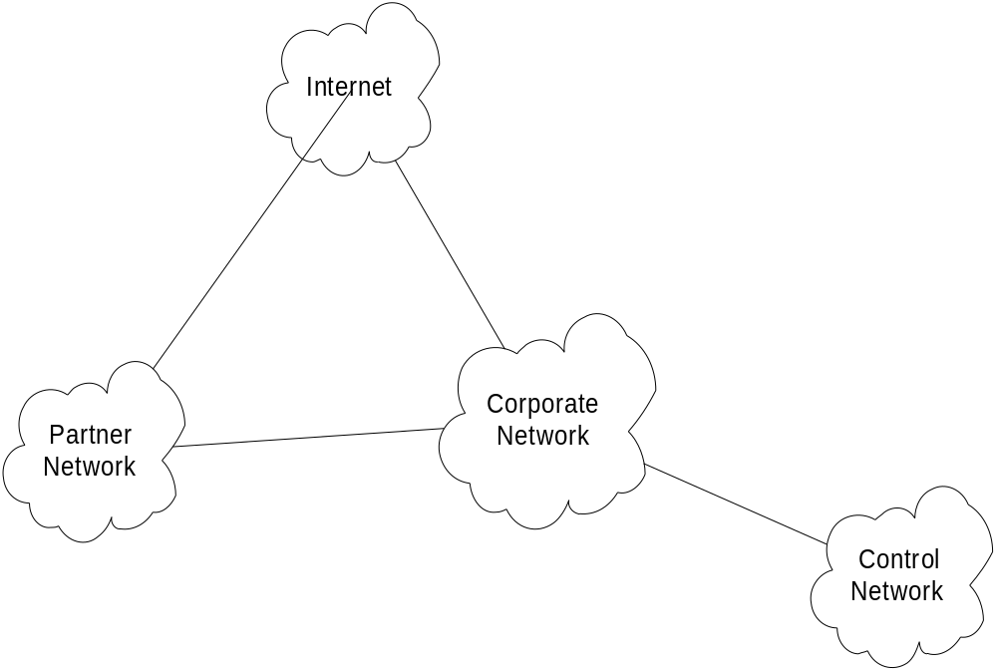
Security Domains

Slide 8
Perimeter Defense
Is it adequate?
  Locating and securing all perimeter points is quite difficult
    Less effective for large border
  Inspecting/ensuring that remote connections are adequately protected is difficult
  Insiders attack is often the most damaging

Slide 9
Virtual Private Networks
A private network that is configured within a public network
A VPN “appears” to be dedicated network to customer
The customer is actually “sharing” trunks and other physical infrastructure with other customers
Security?
  Depends on implementing protocol

Slide 10
Multiple VPN Technologies
SSL
    Confidentiality? Yes
    Data integrity? Yes
    User authentication? Yes
    Network access control? No
    In addition, limited traffic
  IPSec
    Confidentiality? Yes
    Data Integrity? Yes
    User Authentication? Yes
    Network access control? Yes
    Client configuration required.
  VLAN – Layer 2 tunnelling technology
    Confidentiality? No
    Data Integrity? No
    User authentication? Yes
    Network access control? Yes
    Not viable over non-VLAN internetworks

Slide 11
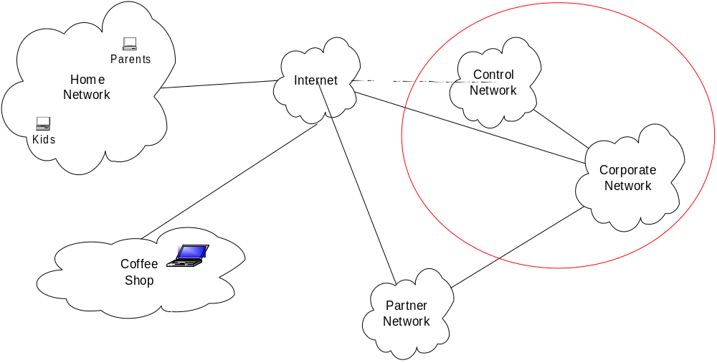
Security Domains with VPNs

Slide 12
“Typical” corporate network
Firewall
Intranet
Demilitarized
Zone (DMZ)
Mail forwarding
DNS (DMZ)
File Server
Web Server
Web Server
Mail server
DNS (internal)
Firewall
User machines
User machines
User machines
Internet

Slide 13
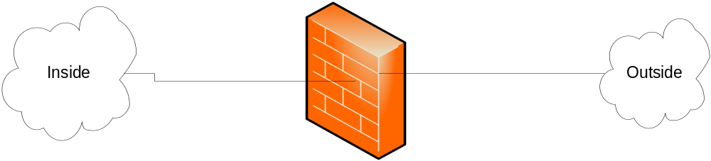
Firewall Goal
Insert after the fact security by wrapping or interposing a filter on network traffic

Slide 14
Application Proxy Firewall
Firewall software runs in application space on the firewall
The traffic source must be aware of the proxy and add an additional header
Leverage basic network stack functionality to sanitize application level traffic
  Block java or active X
  Filter out “bad” URLs
  Ensure well formed protocols or block suspect aspects of protocol

Slide 15
Packet Filter Firewall
Operates at Layer 3 in router or HW firewall
Has access to the Layer 3 header and Layer 4 header
Can block traffic based on source and destination address, ports, and protocol
Does not reconstruct Layer 4 payload, so cannot do reliable analysis of layer 4 or higher content

Slide 16
Stateful Packet Filters
Evolved as packet filters aimed for proxy functionality
In addition to Layer 3 reassembly, it can reconstruct layer 4 traffic
Some application layer analysis exists, e.g., for HTTP, FTP, H.323
  Called context-based access control (CBAC) on IOS
  Configured by fixup command on PIX
Some of this analysis is necessary to enable address translation and dynamic access for negotiated data channels
Reconstruction and analysis can be expensive.
  Must be configured on specified traffic streams
  At a minimum the user must tell the Firewall what kind of traffic to expect on a port
  Degree of reconstruction varies per platform, e.g. IOS does not do IP reassembly

Slide 17
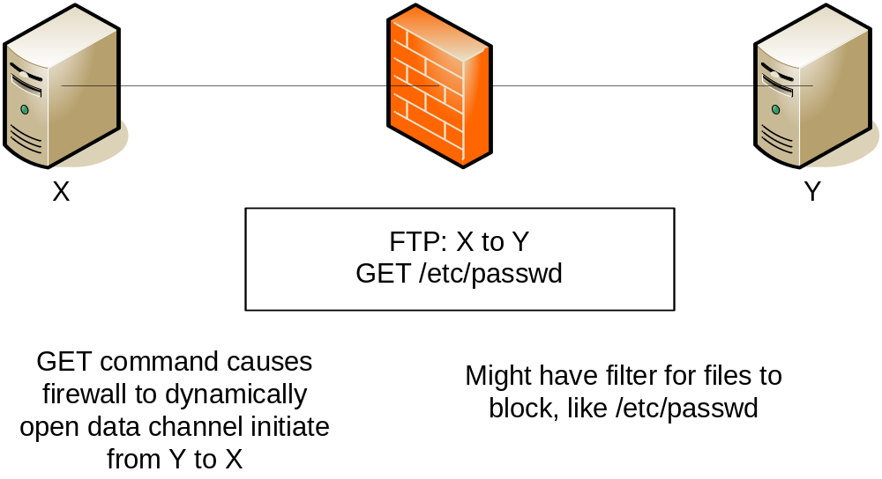
Traffic reconstruction

Slide 18
Access Control Lists (ACLs)
Used to define traffic streams
  Bind ACL’s to interface and action
Access Control Entry (ACE) contains
  Source address
  Destination Address
  Protocol, e.g., IP, TCP, UDP, ICMP, GRE
  Source Port
  Destination Port
ACL runtime lookup
  Linear
  N-dimensional tree lookup (PIX Turbo ACL)
  Object Groups
  HW classification assists

Slide 19
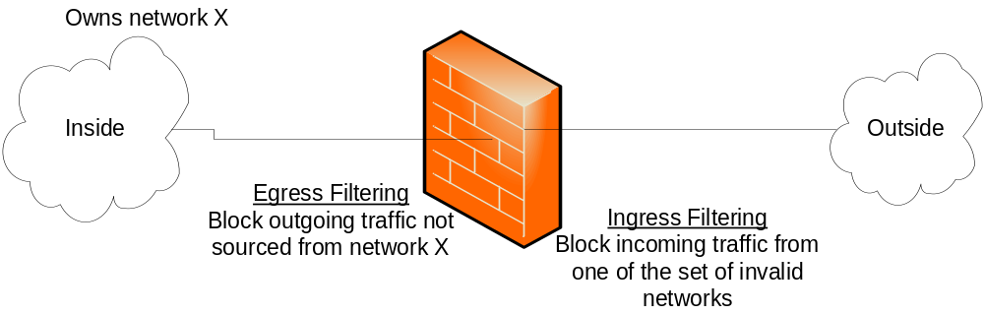
Ingress and Egress Filtering
Ingress filtering
  Filter out packets from invalid addresses before entering your network
Egress filtering
  Filter out packets from invalid addresses before leaving your network

Slide 20
Denial of Service
Example attacks
  Smurf Attack
  TCP SYN Attack
  Teardrop
DoS general exploits resource limitations
  Denial by Consumption
  Denial by Disruption
  Denial by Reservation

Slide 21
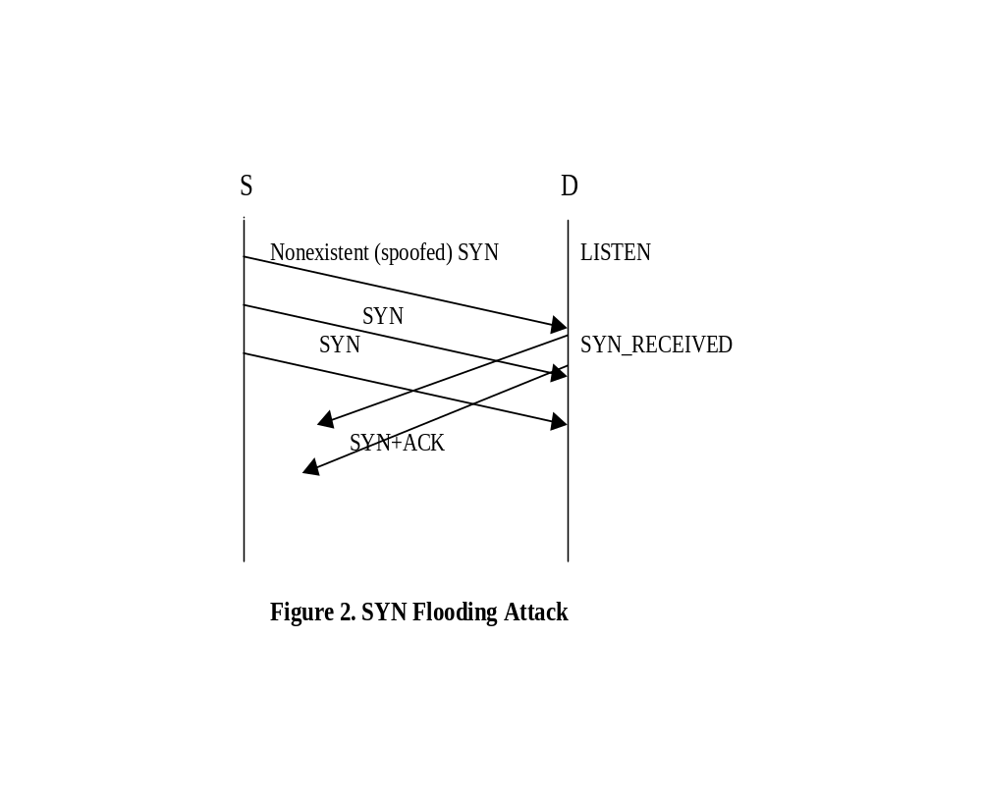
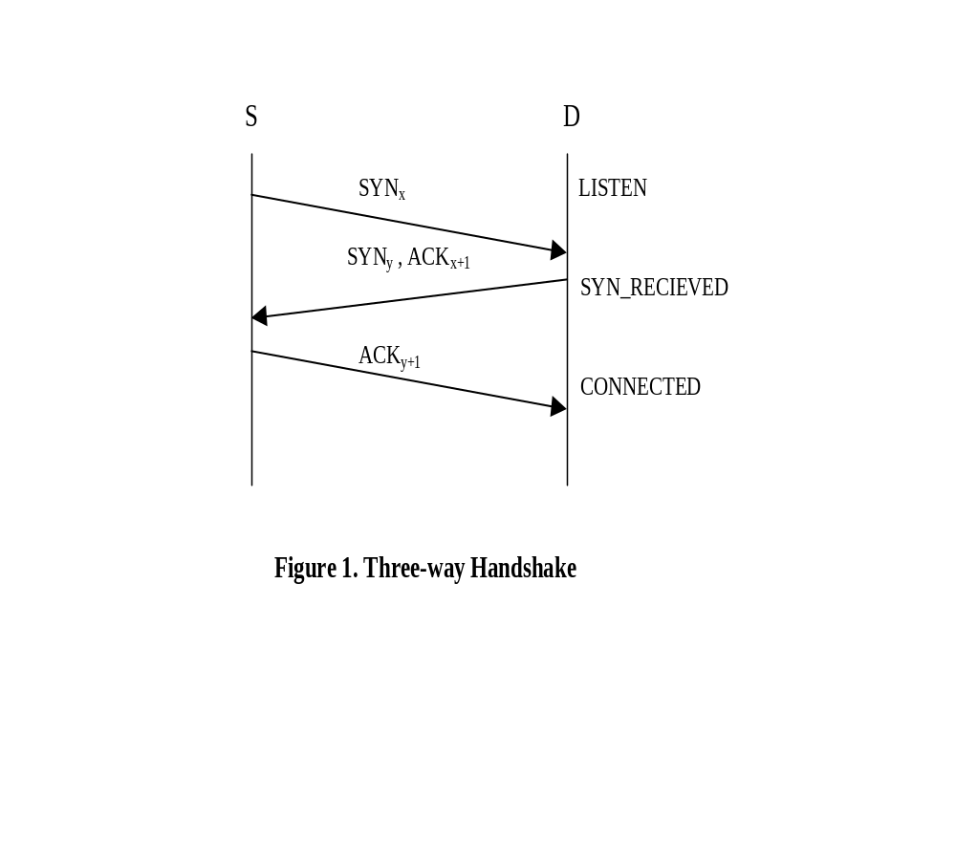
TCP SYN Attack
Exploits the three-way handshake

Slide 22
TCP SYN Attack Solutions
Intermediate Firewall/Router
  Limit number of half open connections
Ingress and egress filtering to reduce spoofed addresses
  Does not help against DDoS bot networks
Reactively block attacking addresses
  Generally expensive to acquire technology to do fast enough
Fix Protocol - IPv6

Slide 23
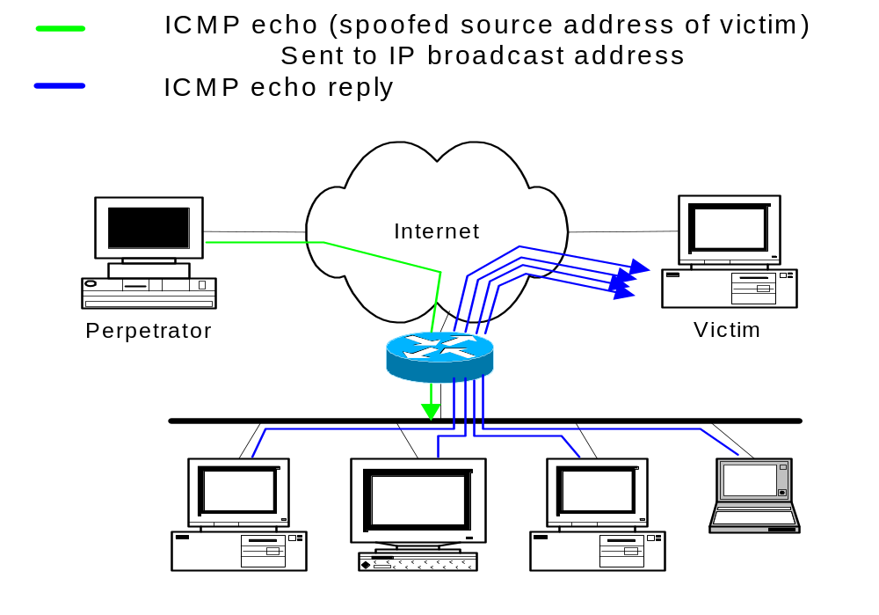
“Smurf”
Notes:
This is a diagram of a “Smurf” or “Fraggle” attack.
The single stream from the perpetrator to the broadcast LANrepresents the flow of information from the perpetrator to the broadcast LAN, usually several packets per second of ICMP echo (“Smurf”) or UDP echo (“Fraggle”) traffic spoofed to look like it is coming from the victim’s system.
If the router at the edge of the LAN forwards the broadcast ping to the LAN, each device on the LAN will respond with an echo-reply (ICMP) or will bounce the traffic (UDP), creating a multiplication of the original traffic flow. The traffic is then directed to the victim.
There are usually several bounce sites involved, used to increase the factor by which traffic is multiplied.
This attack is characterized by many ICMP echo reply packets at the victim’s site or many UDP packets involving the diagnostic “echo” port.

Slide 24
Smurf Issues
Amplification attack
  Small effort on attacker results in big impact on victim
Victim fails unexpectedly under high load
  May just stop responding
  May stop performing normal security checks
Exploiting protocol failure
  Fixed in IPv6
Old attack
  Blocked by most firewalls

Slide 25
Teardrop Attack
Send series of fragments that don't fit together
  Poor stack implementations would crash
  Early windows stacks
Offset 0, len 60
Offset 30, len 90
Offset 41, len 173

Slide 26
Address Translation
Traditional NAT RFC 3022 Reference RFC
Map real address to alias address
  Real address associated with physical device, generally an unroutable address
  Alias address generally a routeable associated with the translation device
Originally motivated by limited access to publicly routable IP addresses
  Folks didn’t want to pay for addresses and/or hassle with getting official addresses
Later folks said this also added security
  By hiding structure of internal network
  Obscuring access to internal machines
Adds complexity to firewall technology
  Must dig around in data stream to rewrite references to IP addresses and ports
  Limits how quickly new protocols can be firewalled

Slide 27
Address Hiding (NAPT)
Many to few dynamic mapping
  Packets from a large pool of private addresses are mapped to a small pool of public addresses at runtime
Port remapping makes this sharing more scalable
  Two real addresses can be rewritten to the same alias address
  Rewrite the source port to differentiate the streams
Traffic must be initiated from the real side

Slide 28
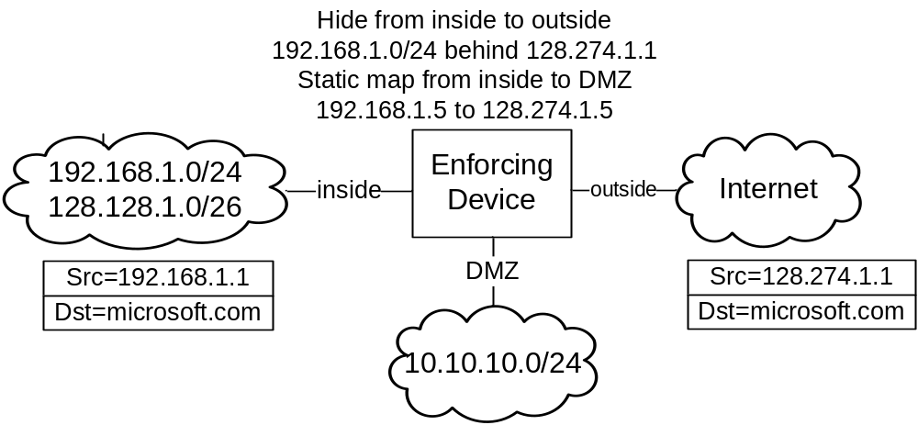
NAT example

Slide 29
Static Mapping
One-to-one fixed mapping
  One real address is mapped to one alias address at configuration time
  Traffic can be initiated from either side
Used to statically map out small set of servers from a network that is otherwise hidden
Static port remapping is also available

Slide 30
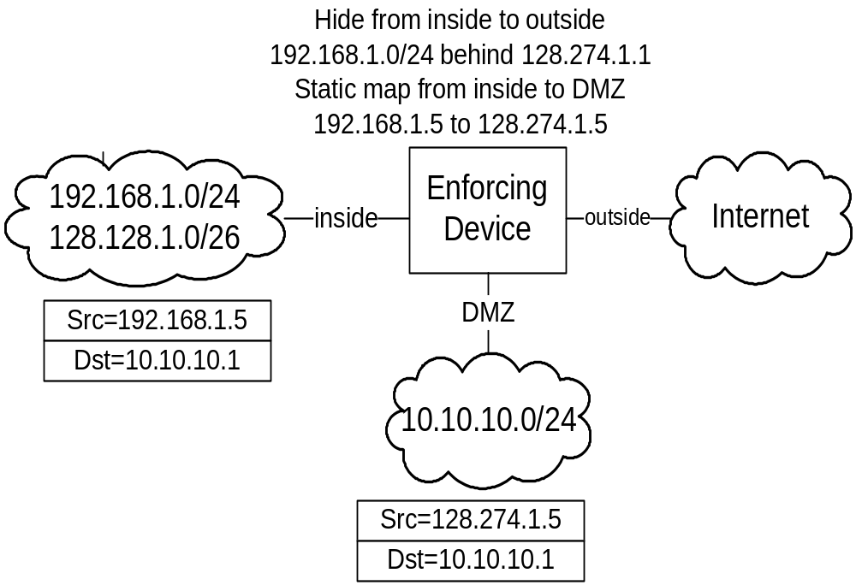
NAT example

Slide 31
FW Runtime Characteristics
Firewalls track streams of traffic
  TCP streams are obvious
  Creates pseudo UDP streams for UCP packets between the same addresses and ports that arrive near enough to each other
Processing first packet in stream is more expensive
  Must evaluate ACLs and calculate address translations
  Subsequent packets get session data from a table

Slide 32
Multi-legged Firewalls
Historically firewalls have protected inside from outside
  Still true for the most part with personal and home firewalls
  No longer sufficient for larger enterprises
PIX security level solution
  Outbound = traffic from low security level interface to high security level interface
  Inbound = traffic from high security level interface to low security level interface
  Different requirements for inbound and outbound traffic
IOS divides interfaces into inside and outside groups
  Address translation can only be defined between inside and outside groups
Routing conflicts with address translation
  Address translation specifies both interfaces
  Must be evaluated before the routing, better be consistent

Slide 33
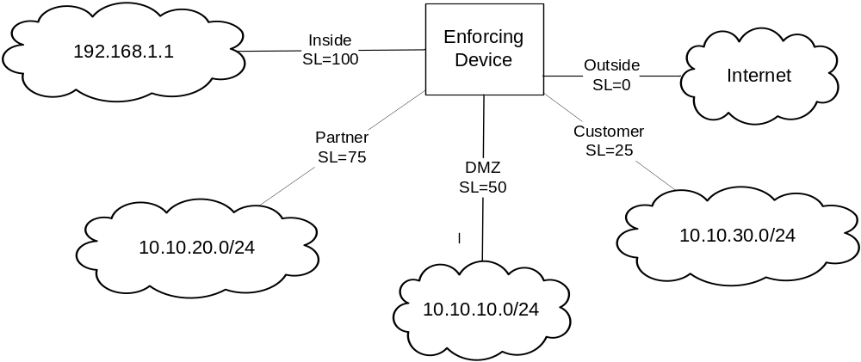
Four Legged FW
Static translation from DMZ to Customer
  10.10.10.10.1 to 128.1.1.1
But routing table wants to route 128.1.1.1 from DMZ to outside interface
  Static translation interface selection will win

Slide 34
Identity Aware Firewall
Use TACACS+ or Radius to authenticate, authorize, account for user with respect to FW
  For administration of FW
  For traffic passing through FW
    PIX cut-through proxy allows authentication on one protocol to cover other protocols from same source
Authorization for executing commands on the device
Download or enable ACL’s
XAuth to integrate AAA with VPN authentication and other security mechanisms

Slide 35
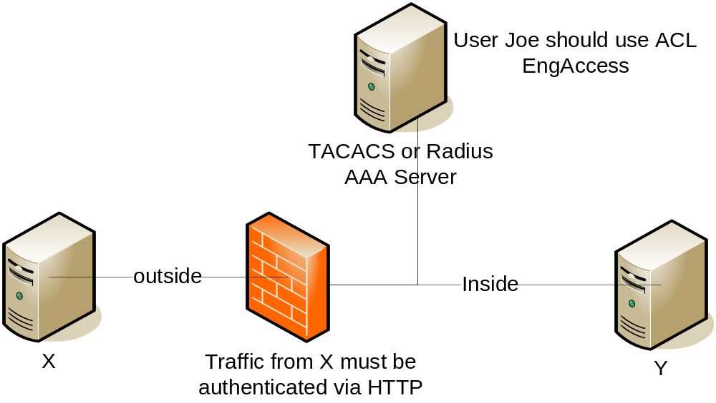
AAA Scenario

Slide 36
Is the Firewall Dead?
End-to-end security (encryption) renders firewalls useless
  Tunnels hide information that firewalls would filter or sanitize
  With IPSec decrypting and re-encrypting is viable
Blurring security domain perimeters
  Who are you protecting from whom
  Dynamic entities due to DHCP and laptops
  More dynamic business arrangements, short term partnerships, outsourcing
Total Cost of Ownership (TCO) is too high
  Managing firewalls for a large network is expensive
Perhaps personal or distributed firewalls are the answer?
  “Implementing a Distributed Firewall” http://www1.cs.columbia.edu/~angelos/Papers/df.pdf

Slide 37
Intrusion Detection
Holy Grail: Detect and correct “bad” system behavior
Detection can be viewed in two parts
  Anomaly detection: Use statistical techniques to determine unusual behavior
  Mis-use detection: Use signatures to determine occurrence of known attacks
Detection can be performed on host data (HIDS), network data (NIDS), or a hybrid of both

Slide 38
Intrusion Handling
Preparation for attack
Identification of the attack
Containment of the attack
  Gather information about the attacker
  Honeypots
Eradication
  Broadly quarantine the system so it can do no more harm
  BGP blackholing
  Tighten firewalls
  Cleanse the corrupted system
Followup phase
  Gather evidence and take action against the attacker

Slide 39
Honey Pots
Reconnaissance for the good guys
Deploy a fake system
  Observe it being attacked
Resource management
  Cannot be completely passive
    Must provide enough information to keep attacker interested
  Must ensure that bait does not run away
Scale
  Host, network, dark address space

Slide 40
IDS Architecture
Agents run at the lowest level gathering data. Perform some basic processing.
Agents send data to a Director that performs more significant processing of the data. Potentially there is a hierarchy of agents and directors
  Director has information from multiple sources and can perform a time-based correlation to derive more significant actions
Directors invoke Notifiers to perform some action in response to a detected attack
  Popup a window on a screen
  Send an email or a page
  Send a new syslog message elsewhere.
  Adjust a firewall or some other policy to block future action from the attacker

Slide 41
Data Sources
Direct data
  Network packets
  System calls
Indirect data
  Syslog data, Windows event logs
  Events from other intrusion detection systems
  Netflow information generated by routers about network traffic

Slide 42
Mis-use/Signature Detection
Fixed signatures are used in most deployed IDS products
  E.g., Cisco, ISS, Snort
Like virus scanners, part of the value of the product is the team of people producing new signatures for newly observed malevolent behavior
The static signature mechanism has obvious problems in that a dedicated attacker can adjust his behaviour to avoid matching the signature.
The volume of signatures can result in many false positives
  Must tune the IDS to match the characteristics of your network
  E.g., what might be unusual in a network of Unix systems might be normal in a network of Windows Systems (or visa versa)
  Can result in IDS tuned too low to miss real events
  Can hide real attacks in the mass of false positives

Slide 43
Example Signature
Signature for port sweep
  A set of TCP packets attempting to connect to a sequence of ports on the same device in a fixed amount of time
In some environments, the admin might run nmap periodically to get an inventory of what is on the network
  You would not want to activate this signature in that case

Slide 44
Anomaly/statistical detection
Seems like using statistics will result in a more adaptable and self-tuning system
  Statistics, neural networks, data mining, etc.
How do you characterize normal?
  Create training data from observing “good” runs
    E.g., Forrest’s program system call analysis
  Use visualization to rely on your eyes
How do you adjust to real changes in behaviour?
  Gradual changes can be easily addressed. Gradually adjust expected changes over time
  Rapid changes can occur. E.g., different behaviour after work hours or changing to a work on the next project

Slide 45
Host Based IDS
Tripwire – Very basic detection of changes to installed binaries
More recent HIDS. Look at patterns of actions of system calls, file activity, etc. to permit, deny, or query operations
  Cisco Security Agent
  Symantec
  McAfee Entercept

Slide 46
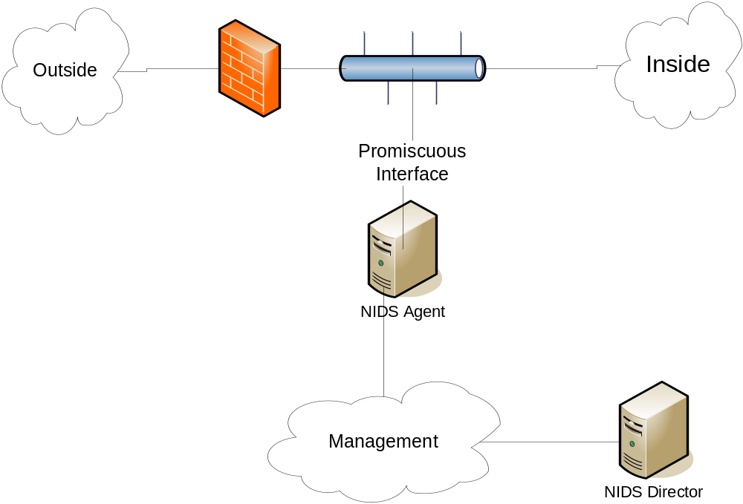
Classical NIDS deployment

Slide 47
NIDS Remediation Options
Log the event
Drop the connection
Reset the connection
Change the configuration of a nearby router or firewall to block future connections

Slide 48
Intrusion Protection Systems (IPS)
Another name for inline NIDS
Latest buzz among the current NIDS vendors
Requires very fast signature handling
  Slow signature handling will not only miss attacks but it will also cause the delay of valid traffic
  Specialized hardware required for high volume gateways
When IDS is inline, the intrusion detector can take direct steps to remediate.
If you move IDS into the network processing path, how is this different from really clever firewalling?

Slide 49
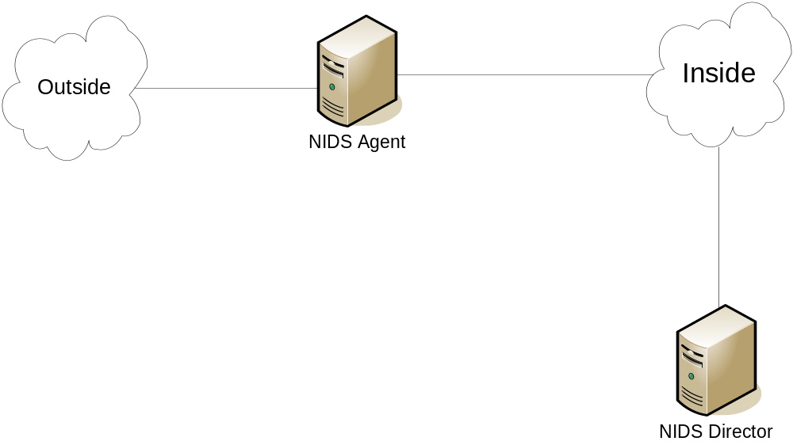
Network IPS scenario

Slide 50
Summary
Identification of security domains basis of perimeter security control
  Firewall is the main enforcer
Intrusion detection introduces deeper analysis and potential for more dynamic enforcement
Intermediate enforcement can handle some Denial of Service attacks

