Slide 1
Mobile Business Intelligence
A Short Course organized at
AG DS & OR (University of Paderborn-Germany)
By
Prof. Dr. O.P.Vyas
DAAD Fellow (Germany), AOTS Fellow (Japan)
Indian Institute of Information Technology Allahabad (India)
Email: dropvyas@gmail.com
Notes:
Ranjana vyas

Slide 2
Mobile BI
Session #6
The Ability predict in the Business helps enormously in preparing startegies for efficient operations and advantage over competitors but developing Business Intelligence would require understanding of Business context as well.

Slide 3
B.I & Analytics
Data Analytics
Descriptive
Predictive
Association
Rule Mining
Classification mining analyzes a set of training data (i.e. a set of objects whose class labels are known) and constructs a model for each class based on the features in the data.
A set of classification rules are generated by the classification process, and these can be used to classify future data, as well as develop a better understanding of each class in the database.
Associative
Classification
Application
domain

Slide 4
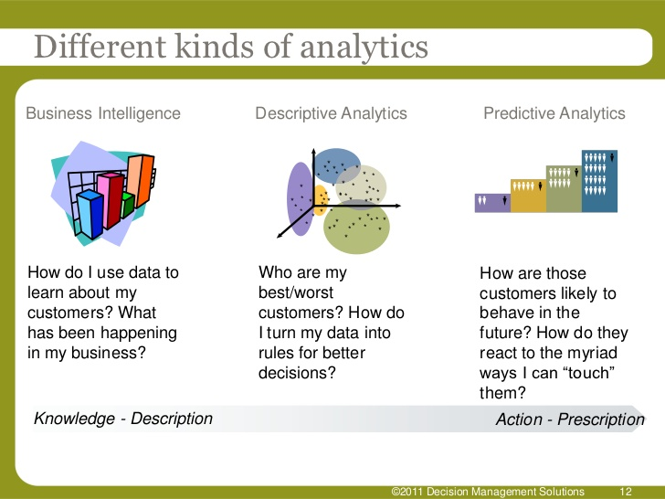
B.I. & Analytics…

Slide 5
Predictive Analytics
  Predictive Analytics in Businesses depends upon effective model with appropriate dataset .
  Predictive modeling: Predict data values or construct generalized linear models based on the database data.
One can only predict value ranges or category distributions
Method outline:
  Classification & Regression Analysis
Determine the major factors which influence the prediction
  Data relevance analysis: uncertainty measurement, entropy analysis, expert judgement, etc.

Slide 6
Predictive Approaches works on the principle of Learning from past Data and generating pattern for future happening !!
Past data or historical data is termed as Training Data ….and alongwith appropriate model it is used for Learning..

Slide 7
Evolution of Analytics
Complexity
Real-time streaming analytics:
Deep learning, A.I.
Past looking
Predictive Analytics:
Modeling, Experimental verification
BI (data driven):
Visualizations, KPI’s, OLAP, Dashboards
Seat of the pants:
Intuition, domain knowledge
Future looking
Insight

Slide 8
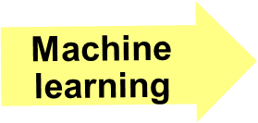
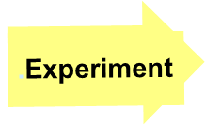
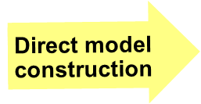
Predictive Analytics Process
Pre-existing data
Theoretical Model
Treatments + Controls + Error = Response
Model Verification
Domain knowledge,
1st principles, experience
Notes:
Significance Testing

Slide 9
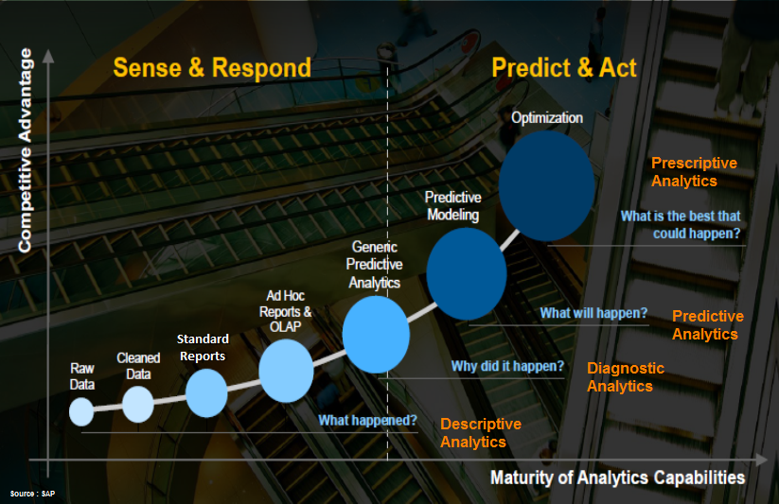
Predictive to Prescriptive Analytics

Slide 10
Machine Learning also similar thing…?
Machine learning is one of the most popular approach to build Theory from the field data.

Slide 11
Machine Learning
The fundamental idea behind these approaches is to learn the theory automatically from the data, through a process of inference, model fitting, or learning from examples.
  An unprecedented wealth of data is being generated by various systems--Business or Scientific systems both.
The demands and opportunities for interpreting these data are expanding more than ever.
Machine learning approaches (e.g. Neural networks, Hidden Markov Models and Belief Networks) are ideally suited for areas in which there is a lot of data but little theory.
The goal in machine learning is to extract useful information from a body of data by building good probabilistic models and to automate the process as much as possible.

Slide 12
Machine Learning & Data Mining…
Machine learning approaches
        Bayesian Belief networks
        Neural networks,
        Hidden Markov Models
        Vector Support machines
are best suited for domains characterized by the presence of large amounts of data, “noisy” patterns and the absence of general theories.
Thus they form a viable complementary approach to conventional methods.
Machine Learning and Data Mining are often referred in place of each other…but with only some small differences…

Slide 13
Supervised vs. Unsupervised Learning
Learning: Training data are analyzed by a classification algorithm.
  Supervised learning (classification) Learning of the model is supervised in that it is told to which class each training sample belongs
    Supervision: The training data (observations, measurements, etc.) are accompanied by labels indicating the class of the observations
    New data is classified based on the training set
  Unsupervised learning (clustering)
    The class labels of training data is unknown
    Given a set of measurements, observations, etc. with the aim of establishing the existence of classes or clusters in the data

Slide 14
Data Classification — A Two-Step Process
Model construction: describing a set of predetermined classes
[ Learning ]
  Each tuple / sample is assumed to belong to a predefined class, as determined by the class label attribute.
  The set of tuples used for model construction: training set (given data).
  The model is represented as classification rules, decision trees, or mathematical formulae.
Model usage: for classifying future or unknown objects
[ Classification ]
  Estimate accuracy of the model
    The known label of test sample is compared with the classified result from the model
    Accuracy rate is the percentage of test set samples that are correctly classified by the model
    Test set is independent of training set, otherwise over-fitting will occur

Slide 15



Classification Process (1): Model Construction ( Learning)
Classification
Algorithms
Training
Data
Classifier
(Model)
Classification rules
IF rank = ‘professor’
OR years > 6
THEN tenured = ‘yes’

Slide 16




Classification Process (2): Use the Model in Prediction
( classification)
Classifier
Test
Data
Unseen Data
(Jeff, Professor, 4)
Tenured?

Slide 17




Examples of Classification Task
Classifying whether the new credit card applicant
will be of High, Medium or Low credit risk.
Classifying credit card transactions
as legitimate or fraudulent.
Categorizing news stories as finance,
weather, entertainment, sports, etc
Predicting tumor cells as benign or malignant
Classifying secondary structures of protein
as alpha-helix, beta-sheet, or random
coil

Slide 18
Classification and Prediction
What is classification? What is prediction?
Issues regarding classification and prediction
Classification by decision tree induction
Bayesian Classification
Rule-based classification
Classification by back propagation (ANN)
Support Vector Machines (SVM)
Associative Classification
Lazy learners (or learning from your neighbors)
Other Classification methods
  Rough Set Approach
  Fuzzy Set approach
  Genetic Algorithm
Ensemble methods
Prediction
Accuracy and error measures
Model selection
Summary
Data Mining: Concepts and Techniques

Slide 19

Decision Tree Classification Task
Decision Tree

Slide 20

Decision Tree Induction
A decision tree is a flow chart like tree structure, where each internal node denoted a test on an attribute, each branch represents an outcome of the test, and leaf nodes represent classes or class distribution.
categorical
categorical
continuous
class
Splitting Attributes
Refund
Yes
No
NO
MarSt
Single, Divorced
Married
TaxInc
NO
< 80K
> 80K
NO
YES
Training Data
Model: Decision Tree

Slide 21
Another Example of Decision Tree
categorical
categorical
continuous
class
MarSt
Single, Divorced
Married
NO
Refund
Yes
No
NO
TaxInc
< 80K
> 80K
NO
YES
There could be more than one tree that fits the same data!

Slide 22
Algorithm for Decision Tree Induction
Basic algorithm (a greedy algorithm)
  Tree is constructed in a top-down recursive divide-and-conquer manner
  At start, all the training examples are at the root
  Attributes are categorical (if continuous-valued, they are discretized in advance)
  Examples are partitioned recursively based on selected attributes
  Test attributes are selected on the basis of a heuristic or statistical measure (e.g., information gain)
Conditions for stopping partitioning
  All samples for a given node belong to the same class
  There are no remaining attributes for further partitioning – majority voting is employed for classifying the leaf
  There are no samples left

Slide 23
DTC
The algorithms that are used for constructing decision trees work by choosing a variable at each step that is the next best variable to use in splitting the set of items.
"Best" is defined by how well the variable splits the set into subsets that have the same value of the target variable. Different algorithms use different formulae for measuring "best".
The recursion is completed when the when splitting no longer adds value to the predictions or when subset at a node all has the same value of the target variable.
In data mining, trees can be described also as the combination of mathematical and computational techniques to aid the description, categorisation and generalisation of a given set of data.

Slide 24
DTC
During the late 1970s and 1980s J. Ross Quinlan developed a decision tree algorithm known as ID3 ( Iterative Dichotomiser).
Quinlan later improved the ID3 algorithm to give C4.5 which became a benchmark to which newer supervised learning algorithms are often compared.
In 1984 CART ( Classification and Regression Trees) was developed using similar approach.
ID3,C4.5,CART are greedy Algorithms for the induction of decision trees.
Each algorithm uses an attribute selection measure to select the attribute tested for each non Leaf node in the tree.
These approaches Select the attribute with the highest information gain.
.

Slide 25
C4.5 & C5.0
C4.5 made a number of improvements to ID3. Some of these are:
  Handling both continuous and discrete attributes.
  Handling training data with missing attribute values.
  Handling attributes with differing costs.
  Pruning trees after creation - C4.5 goes back through the tree once it's been created and attempts to remove branches that do not help.
Improvements in C5.0/See5 algorithm
Quinlan went on to create C5.0. Some of these are:
  Speed - C5.0 is significantly faster than C4.5 (several orders of magnitude).
  Memory usage - C5.0 is more memory efficient than C4.5.
  Smaller decision trees - C5.0 gets similar results to C4.5 with considerably smaller decision trees.
  Support for boosting - Boosting improves the trees and gives them more accuracy.
Boosting is a machine learning meta-algorithm for performing supervised learning.

Slide 26
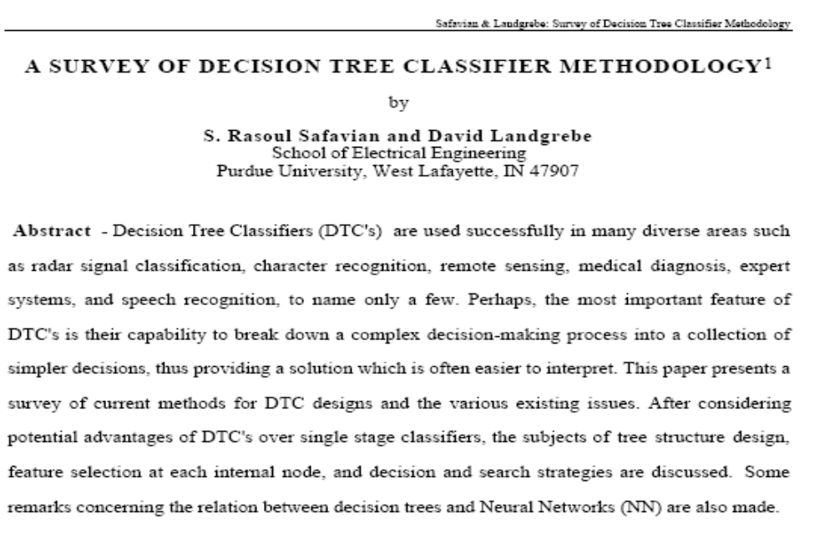
Decision Tree Classifiers : Survey paper

Slide 27
Classification in Large Databases
Classification—a classical problem extensively studied by statisticians and machine learning researchers
Scalability: Classifying data sets with millions of examples and hundreds of attributes with reasonable speed
Why decision tree induction in data mining?
  relatively faster learning speed (than other classification methods)
  convertible to simple and easy to understand classification rules
  can use SQL queries for accessing databases
  comparable classification accuracy with other methods
Data Mining: Concepts and Techniques

Slide 28
Constructing Classifier for B.I.
The leading Credit Card Company Visa International and Computer Company Acer Inc. has agreed to market the newly launched Laptop Computer.
For targeted marketing campaign, both the companies would like to use the existing database of Visa Credit card holders, to find out most likely buyers of their Computer.
For a given Database, your job will be to construct a Classifier.
This Classifier should take an input as the customer-details like
  Age,
  Income
  Student or Professional
  Credit_Card Ratings
And based on above inputs, the Classifier would Predict, whether the person is likely buyer of the Laptop Computer or not.

Slide 29
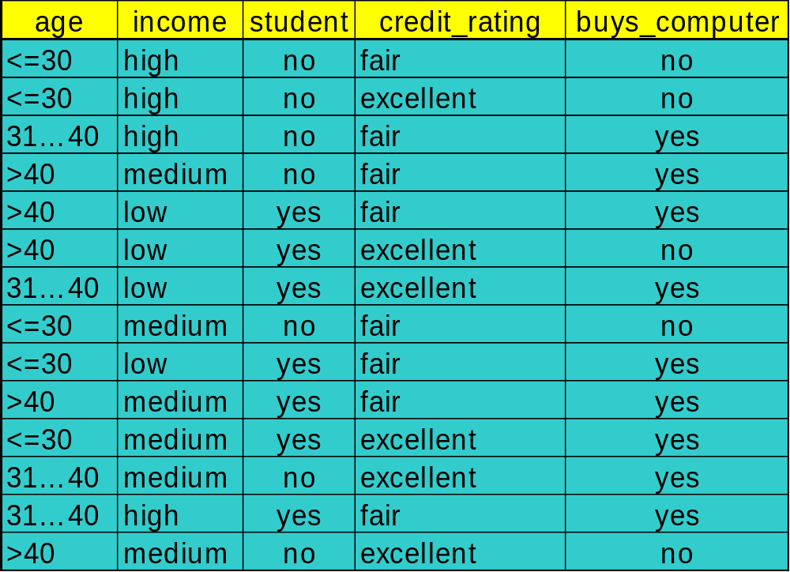
To construct Classifier from a given training data

Slide 30
Constructing Classifier
Data Domain Analysis
  Small Dataset with 04 discrete valued attributes.
  The Class label attributes are Boolean in nature!
    Class Labels:
      C1:buys_computer = ‘yes’
      C2:buys_computer = ‘no’
Predictive mechanism needed !
Business application with transactional database: no missing values !
Implementation details
  Execution of Java program with dataset.
  Constructing IF…. THEN… ELSE Rules.

Slide 31
DT induction: Issues
There are 04 attributes in the table, which attribute to start with at Root ?
  Attribute Selection measure or measure of goodness of split
    Select the attribute with the highest information gain
    Calculate information gain of each of 04 attributes by calculating;
      Expected information (entropy)
      Information needed
      Information Gained= (a)-(b)
    Find out the maximum I.G. out of attributes age, income, student, credit_rating

Slide 32




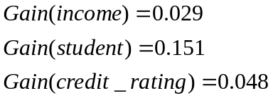
Attribute Selection: Information Gain
Class P: buys_computer = “yes”
Class N: buys_computer = “no”
means “age <=30” has 5 out of 14 samples, with 2 yes’es and 3 no’s. Hence
Similarly, Looking at other Gains, we can see the Gain(age) is max.
Data Mining: Concepts and Techniques

Slide 33

Gain Ratio for Attribute Selection (C4.5)
Information gain measure is biased towards attributes with a large number of values
C4.5 (a successor of ID3) uses gain ratio to overcome the problem (normalization to information gain)
  GainRatio(A) = Gain(A)/SplitInfo(A)
Ex.
  gain_ratio(income) = 0.029/0.926 = 0.031
The attribute with the maximum gain ratio is selected as the splitting attribute

Slide 34
Output: A Decision Tree for
“Buys_Computer”
age?
<=30
overcast
>40
31..40
Income | Student | Credit_rating | Class
High | No | Fair | no
High | No | excellent | no
medium | No | Fair | no
Income | Student | Credit_rating | Class
medium | No | Fair | yes
Income | Student | Credit_rating | Class
High | No | Fair | yes
Data Mining: Concepts and Techniques

Slide 35
Output: A Decision Tree for “buys_computer”
age?
<=30
overcast
>40
31..40
student?
yes
credit rating?
no
yes
excellent
fair
no
yes
no
yes
Data Mining: Concepts and Techniques

Slide 36
Issues: Evaluating Classification Methods
Accuracy
  classifier accuracy: predicting class label
  predictor accuracy: guessing value of predicted attributes
Speed
  time to construct the model (training time)
  time to use the model (classification/prediction time)
Robustness: handling noise and missing values
Scalability: efficiency in disk-resident databases
Interpretability
  understanding and insight provided by the model
Other measures, e.g., goodness of rules, such as decision tree size or compactness of classification rules
Data Mining: Concepts and Techniques

Slide 37
Constructing Classifier for B.I.
The leading Credit Card Company Visa International and Computer Company Acer Inc. has agreed to market the newly launched Laptop Computer.
For targeted marketing campaign, both the companies would like to use the existing database of Visa Credit card holders, to find out most likely buyers of their Computer.
For a given Database, your job will be to construct a Classifier.
This Classifier should take an input as the customer-details like
  Age,
  Income
  Student or Professional
  Credit_Card Ratings
And based on above inputs, the Classifier would Predict, whether the person is likely buyer of the Laptop Computer or not.
DTC was proposed as one of the alternative, but it showed some limitations.

Slide 38
Credit Card Database & BI application
As the Visa International has accumulated huge record of its Credit card holders for last 05 years amounting to terabytes of data.
Though larger the data better the training of the Classifiers ( some popularly used DTC algorithms C4.5 uses as much as 2/3 of the data for training the Classifiers).
In Case of our BI application, the problem starts with calculating Information Gain
    Every attributes involves all transactions for IG
    disk resident training data is not fitting into our memory for training activity.
    Scalability Problem!

Slide 39
DTC
Speed was not good enough !
  Because of swapping of training data in and out of memory the time to construct the model (training time) !
  time to use the model (prediction time) was although reasonable !
The B.I. Solution for Customer having Age age <=30, Income = medium, Student = yes and Credit_rating = Fair) falling into either of the category with level of certainty was not specifically available.

Slide 40

Training Dataset
Class Labels:
C1:buys_computer = ‘yes’
C2:buys_computer = ‘no’
Data sample:
X = (age <=30, Income = medium, Student = yes
Credit_rating = Fair)
Belongs to which Class?

Slide 41
To get a better Predictive Mechanism….
Explore other classifiers…

Slide 42
Classification : Which one & Why ?
What is classification? What is prediction?
Issues regarding classification and prediction
Classification by decision tree induction
Bayesian classification
Bayesian Belief Network
Soft Computing techniques
  Classification by back propagation
Support Vector Machines (SVM)
Associative classification
Lazy learners (or learning from your neighbors)
Other classification methods
Prediction
Accuracy and error measures
Ensemble methods
Model selection
Summary
Data Mining: Concepts and Techniques

Slide 43
Scalable Decision Tree Induction Methods
SLIQ (EDBT’96 — Mehta et al.)
  Builds an index for each attribute and only class list and the current attribute list reside in memory
SPRINT (VLDB’96 — J. Shafer et al.)
  Constructs an attribute list data structure
PUBLIC (VLDB’98 — Rastogi & Shim)
  Integrates tree splitting and tree pruning: stop growing the tree earlier
RainForest (VLDB’98 — Gehrke, Ramakrishnan & Ganti)
  Builds an AVC-list (attribute, value, class label)
BOAT (PODS’99 — Gehrke, Ganti, Ramakrishnan & Loh)
  Uses bootstrapping to create several small samples
Data Mining: Concepts and Techniques

Slide 44
Decision Tree Classifiers : Survey paper

Slide 45
Domain Analysis for Credit Card Database
Predictive mechanism needed ..
No missing values.../ What if Missing Values..?
Attributes may or may not depend on each other
Database is huge !
Attributes are NOT many !!
Class Labels are Boolean !!!
  Which Classifier? And please Why?

Slide 46
Using Bayesian Classification for B.I.
Bayesian classifiers are statistical classifiers which predict class membership probabilities such as the probability that a given sample belongs to a particular class.
Bayesian classification is based on the Bayes theorem and it is observed that a simple Bayesian Classifier known as the naïve Bayesian classifier to be comparable in performance with decision tree and Neural network classifiers.
Naïve Bayesian classifier assume that the effect of an attribute value on a given class is independent of the values of the other attributes. (conditional independence).
.

Slide 47
Bayesian Theorem: Basics
Let X be a data sample (“evidence”): class label is unknown
Let H be a hypothesis that X belongs to class C
Classification is to determine P(H|X), the probability that the hypothesis holds given the observed data sample X
P(H) (prior probability), the initial probability
  E.g., X will buy computer, regardless of age, income, …
P(X): probability that sample data is observed
2) P(X|H) (posteriori probability), the probability of observing the sample X, given that the hypothesis holds ( X belongs to Class C)
  E.g., Given that X will buy computer, the prob. that X is 31..40, medium income
Data Mining: Concepts and Techniques

Slide 48
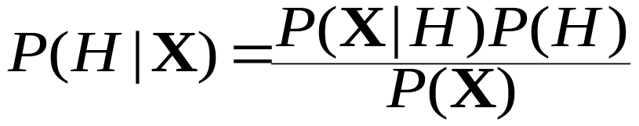
Bayesian Theorem
Given training data X, posteriori probability of a hypothesis H, P(H|X), follows the Bayes theorem
Informally, this can be written as
  posteriori = likelihood x prior/evidence
Predicts X belongs to C₂ iff the probability P(C_{i}|X) is the highest among all the P(C_{k}|X) for all the k classes
Practical difficulty: require initial knowledge of many probabilities, significant computational cost
Data Mining: Concepts and Techniques

Slide 49
Naïve Bayesian Classifier: Comments
Advantages
  Easy to implement
  Good results obtained in most of the cases
Disadvantages
  Assumption: class conditional independence, therefore loss of accuracy
  Practically, dependencies exist among variables
    E.g., hospitals: patients: Profile: age, family history, etc.
    Symptoms: fever, cough etc., Disease: lung cancer, diabetes, etc.
    Dependencies among these cannot be modeled by Naïve Bayesian Classifier
Data Mining: Concepts and Techniques

Slide 50
Conditional Dependence
How to deal with these dependencies?
  Can we incorporate dependencies into Bayesian classification ?
  Bayesian Belief Networks can incorporate dependence.
  Bayesian belief network allows a subset of the variables conditionally independent
  Immensely useful in bio-informatics domain as these data attributes involves high dependence !

Slide 51
Bayesian Belief Networks
A graphical model of causal relationships
  Represents dependency among the variables
  Gives a specification of joint probability distribution
Nodes: random variables
Links: dependency
X and Y are the parents of Z, and Y is the parent of P
No dependency between Z and P
Has no loops or cycles
X
Y
Z
P
Data Mining: Concepts and Techniques

Slide 52
Classification and Prediction
What is classification? What is prediction?
Issues regarding classification and prediction
Classification by decision tree induction
Bayesian classification
  BBN: When and how?
Soft Computing Approaches
Classification by back propagation
Associative classification
Lazy learners (or learning from your neighbors)
Other classification methods
Prediction
Accuracy and error measures
Ensemble methods
Model selection
Summary
Data Mining: Concepts and Techniques

Slide 53
Soft Computing in Data Mining

Slide 54
Soft Computing in Data Mining
Data Mining Techniques
  Association techniques
  Classification techniques
  Classifiers
    Bayesian classifier ( Naïve, Belief network)
  Clustering
    Clustering techniques
  Data mining Process:
    Data Mining Query Language (DMQL)
Soft Computing approach
  Artificial Systems Vs Biological Systems
  Soft Computing:Concepts
    Neural Network.
    Genetic Algorithm
    Rough set
  Application domain
    Biological data
    Anomaly detection
    Financial application
  Issues and Challenges
Notes:
Ranjana vyas

Slide 55
Artificial systems Vs. Biological systems
Designers of artificial systems – both hardware and software, whether engineering systems, computer systems, or business systems-can only marvel at the robustness, the efficiency, and the flexibility of biological systems.
The central theme of research on many Soft Computing approaches like ANN & GAs has been robustness for survival in many different environments. The implications of robustness for artificial systems are manifold. If artificial systems can be made more robust, costly redesigns can be reduced or eliminated.
Feature for self-repair, self-guidance, and re-production are the rule in biological systems, whereas they barely exist in the most sophisticated systems.
Notes:
Ranjana vyas

Slide 56
Soft Computing approach
Soft computing is a consortium of methodologies that
works synergistically and provides, in one form or another,
flexible information processing capability for handling real-life
ambiguous situations .
Its aim is to exploit the tolerance for imprecision, uncertainty, approximate reasoning, and partial truth in order to achieve tractability, robustness, and low-cost solutions.
The guiding principle is to devise methods of computation that lead to an acceptable solution at low cost by seeking for an approximate solution to an imprecisely/precisely formulated problem.

Slide 57
Soft Computing approach
Soft computing methodologies (involving fuzzy sets, neural networks, genetic algorithms, and rough sets) are most widely applied in the data mining step of the overall KDD process.
Fuzzy sets provide a natural framework for the process in dealing with uncertainty.
Neural networks and rough sets are widely used for classification and rule generation.
Genetic algorithms (GAs) are involved in various optimization and search processes, like query optimization and template selection.
Other data mining approaches like case based reasoning and decision trees are also widely used along with Soft Computing to solve problems.

Slide 58
Soft Computing & Data Mining
Current research in data mining mainly focuses on the
discovery algorithm and visualization techniques.
There is a growing awareness that, in practice, it is easy to discover a huge
number of patterns in a database where most of these patterns
are actually obvious, redundant, and useless or uninteresting
to the user.
To prevent the user from being overwhelmed by a large number of uninteresting patterns, techniques are needed to identify only the useful/interesting patterns and present them to the user.
Soft computing methodologies, involving fuzzy sets, neural networks, genetic algorithms, rough sets, and their hybridizations, have recently been used to solve data mining problems.
These methodologies strive to provide approximate solutions at low cost,
thereby speeding up the process.

Slide 59
Soft Computing and Data mining
Neural networks are suitable in data-rich environments and
are typically used for extracting embedded knowledge in the
form of rules, quantitative evaluation of these rules. ANN has shown significant applicability in Classification Rule Mining.
Back propagation has been considered as effective mechanism in field of classification. The back propagation algorithm was presented by Rumelhart, Hinton, and Williams [ RHW86]. One of the most popularly used back propagation technique is a neural network learning algorithm.
ANN is also very useful in clustering, as unsupervised learning mechanism and its characteristic of self-organization proves to be specially useful for imprecise and noisy input situations.
Fuzzy sets, which constitute the oldest component of soft computing are suitable for handling the issues related to understandability of patterns, incomplete/noisy data, mixed media information and human interaction, and can provide approximate solutions faster.
They have been mainly used in clustering, discovering
association rules, summarization, time series analysis, web applications, and image retrieval.

Slide 60
Soft Computing & Data Mining
Neuro-fuzzy hybridization exploits the characteristics of both
neural networks and fuzzy sets in generating natural/linguistic
rules, handling imprecise and mixed mode data, and modeling
highly nonlinear decision boundaries. Domain knowledge, in
natural form, can be encoded in the network for improved performance.
Genetic algorithms provide efficient search algorithms to select
a model, from mixed media data, based on some preference
criterion/objective function. They have been employed in
regression and in discovering association rules. Rough sets are
suitable for handling different types of uncertainty in data and
have been mainly utilized for extracting knowledge in the form
of rules.

Slide 61
Soft Computing
Other hybridizations typically enjoy the generic and application- specific merits of the individual soft computing tools that they integrate. Data mining functions modeled by such systems include rule extraction, data summarization, clustering, incorporation of domain knowledge, and partitioning. It is to be noted that the notion of partitioning, i.e., the modular approach, provides an effective direction for scaling up algorithms and speeding up convergence.
Case-based reasoning (CBR), a novel AI problem solving paradigm, has recently drawn the attention of both soft computing and data mining communities. A profile of potential applications is available in literature.
Recently, several commercial data mining tools have been developed based on soft computing methodologies. These include Data Mining Suite, using fuzzy logic; Braincell, Cognos, 4Thought and IBM Intelligent Miners for Data, using neural networks; and Nuggets, using GAs.

Slide 62
Classification by Backpropopagation
Backpropagation has been considered as effective mechanism in field of classification. The backpropagation algorithm was presented by Rumelhart, Hinton, and Williams [ RHW86]. One of the most popularly used backpropagation technique is a neural network learning algorithm.
In Freud’s theory of psychodynamics, the human brain (~10 ^ 11) was described as a neural network, and recent investigations have corroborated this view.
This analogy therefore offers an interesting model for the creation of more complex learning machines, and has led the creation of ANN.
Neural network, with their remarkable ability to derive meaning from complicated or imprecise data, can be used to extract patterns and detect trends that are too complex to be noticed by either humans or other computer techniques.
A trained neural network can be thought of as an "expert" in the category of information it has been given to analyze. This expert can then be used to provide projections given new situations of interest and answer "what if" questions.
Notes:
Ranjana vyas

