Slide 1
Data Mining & Warehousing
By
Prof. Dr. O.P.Vyas
DAAD Fellow (Germany), AOTS Fellow(Japan)
Indian Institute of Information Technology, Allahabad

Slide 2
“ We are pouring in data but starving in Knowledge ”
Jiawei Han

Slide 3
DMW
DM Functionalities: ARM-Apriori Algorithm
  Learning: Supervised & Unsupervised
  Classification: Overview
    Working mechanism of Classifier
    Associative Classification
  Clustering Analysis
  Web Mining: Case Study of Google
    Searching Authoritative pages
    PageRank Algorithm

Slide 4
Classification
Classification
  Application of Classification task
    Business Intelligence, Bio Informatics
  Classification: Overview of Technique
    Model Construction & Model Usage
  Issues in Classification
  Classification through DTC
  Various Classifiers: Bayesian Classifiers, Bayesian Belief Network
  Ongoing research efforts in DM

Slide 5
Classification and Prediction
What is Classification?
Issues regarding classification and prediction
Classification by decision tree induction
Bayesian Classification
Rule-based classification
Classification by back propagation (ANN)
Support Vector Machines (SVM)
Associative Classification
Lazy learners (or learning from your neighbors)
Other Classification methods
  Rough Set Approach
  Fuzzy Set approach
  Genetic Algorithm
Ensemble methods
Prediction
Accuracy and error measures
Model selection
Summary
Data Mining: Concepts and Techniques

Slide 6
Classification vs. Prediction
Classification:
  Classifies data (constructs a model) based on the training set and the values (class labels) in a classifying attribute and uses it in classifying new data.
  Predicts categorical class labels.
Prediction: - Prediction can be viewed as the construction and use of a model to assess the class of an unlabeled sample, or to assess the value or value ranges of an attribute that a given sample is likely to have.
Classifiers: Working Mechanism
  Learning & Classification
  Supervised Vs Unsupervised Learning

Slide 7
Predictive Modeling in Databases
Predictive modeling: Predict data values or construct generalized linear models based on the database data.
One can only predict value ranges or category distributions
Method outline:
  Minimal generalization
  Attribute relevance analysis
  Generalized linear model construction
  Prediction
Determine the major factors which influence the prediction
  Data relevance analysis: uncertainty measurement, entropy analysis, expert judgement, etc.
Multi-level prediction: drill-down and roll-up analysis.
www.sas.com www.spss.com www.mathsoft.com

Slide 8
Supervised vs. Unsupervised Learning
Learning: training data are analyzed by a classification algorithm.
  Supervised learning (classification) Learning of the model is supervised in that it is told to which class each training sample belongs
    Supervision: The training data (observations, measurements, etc.) are accompanied by labels indicating the class of the observations
    New data is classified based on the training set
  Unsupervised learning (clustering)
    The class labels of training data is unknown
    Given a set of measurements, observations, etc. with the aim of establishing the existence of classes or clusters in the data

Slide 9
Data Classification — A Two-Step Process
Model construction: describing a set of predetermined classes
[ Learning ]
  Each tuple / sample is assumed to belong to a predefined class, as determined by the class label attribute.
  The set of tuples used for model construction: training set (given data).
  The model is represented as classification rules, decision trees, or mathematical formulae.
Model usage: for classifying future or unknown objects
[ Classification ]
  Estimate accuracy of the model
    The known label of test sample is compared with the classified result from the model
    Accuracy rate is the percentage of test set samples that are correctly classified by the model
    Test set is independent of training set, otherwise over-fitting will occur

Slide 10



Classification Process (1): Model Construction ( Learning)
Classification
Algorithms
Training
Data
Classifier
(Model)
Classification rules
IF rank = ‘professor’
OR years > 6
THEN tenured = ‘yes’

Slide 11




Classification Process (2): Use the Model in Prediction
( classification)
Classifier
Test
Data
Unseen Data
(Jeff, Professor, 4)
Tenured?

Slide 12




Examples of Classification Task
Classifying whether the new credit card applicant
will be of High, Medium or Low credit risk.
Classifying credit card transactions
as legitimate or fraudulent.
Categorizing news stories as finance,
weather, entertainment, sports, etc
Predicting tumor cells as benign or malignant
Classifying secondary structures of protein
as alpha-helix, beta-sheet, or random
coil

Slide 13
Classification and Prediction
What is classification? What is prediction?
Issues regarding classification and prediction
Classification by decision tree induction
Bayesian Classification
Rule-based classification
Classification by back propagation (ANN)
Support Vector Machines (SVM)
Associative Classification
Lazy learners (or learning from your neighbors)
Other Classification methods
  Rough Set Approach
  Fuzzy Set approach
  Genetic Algorithm
Ensemble methods
Prediction
Accuracy and error measures
Model selection
Summary
Data Mining: Concepts and Techniques

Slide 14

Decision Tree Classification Task
Decision Tree

Slide 15

Decision Tree Induction
A decision tree is a flow chart like tree structure, where each internal node denoted a test on an attribute, each branch represents an outcome of the test, and leaf nodes represent classes or class distribution.
categorical
categorical
continuous
class
Splitting Attributes
Refund
Yes
No
NO
MarSt
Single, Divorced
Married
TaxInc
NO
< 80K
> 80K
NO
YES
Training Data
Model: Decision Tree

Slide 16
Another Example of Decision Tree
categorical
categorical
continuous
class
MarSt
Single, Divorced
Married
NO
Refund
Yes
No
NO
TaxInc
< 80K
> 80K
NO
YES
There could be more than one tree that fits the same data!

Slide 17
Algorithm for Decision Tree Induction
Basic algorithm (a greedy algorithm)
  Tree is constructed in a top-down recursive divide-and-conquer manner
  At start, all the training examples are at the root
  Attributes are categorical (if continuous-valued, they are discretized in advance)
  Examples are partitioned recursively based on selected attributes
  Test attributes are selected on the basis of a heuristic or statistical measure (e.g., information gain)
Conditions for stopping partitioning
  All samples for a given node belong to the same class
  There are no remaining attributes for further partitioning – majority voting is employed for classifying the leaf
  There are no samples left

Slide 18
DTC
The algorithms that are used for constructing decision trees work by choosing a variable at each step that is the next best variable to use in splitting the set of items.
"Best" is defined by how well the variable splits the set into subsets that have the same value of the target variable. Different algorithms use different formulae for measuring "best".
The recursion is completed when the when splitting no longer adds value to the predictions or when subset at a node all has the same value of the target variable.
In data mining, trees can be described also as the combination of mathematical and computational techniques to aid the description, categorisation and generalisation of a given set of data.

Slide 19
DTC
During the late 1970s and 1980s J. Ross Quinlan developed a decision tree algorithm known as ID3 ( Iterative Dichotomiser).
Quinlan later improved the ID3 algorithm to give C4.5 which became a benchmark to which newer supervised learning algorithms are often compared.
In 1984 CART ( Classification and Regression Trees) was developed using similar approach.
ID3,C4.5,CART are greedy Algorithms for the induction of decision trees.
Each algorithm uses an attribute selection measure to select the attribute tested for each non Leaf node in the tree.
These approaches Select the attribute with the highest information gain.
.

Slide 20
C4.5 & C5.0
C4.5 made a number of improvements to ID3. Some of these are:
  Handling both continuous and discrete attributes.
  Handling training data with missing attribute values.
  Handling attributes with differing costs.
  Pruning trees after creation - C4.5 goes back through the tree once it's been created and attempts to remove branches that do not help.
Improvements in C5.0/See5 algorithm
Quinlan went on to create C5.0. Some of these are:
  Speed - C5.0 is significantly faster than C4.5 (several orders of magnitude).
  Memory usage - C5.0 is more memory efficient than C4.5.
  Smaller decision trees - C5.0 gets similar results to C4.5 with considerably smaller decision trees.
  Support for boosting - Boosting improves the trees and gives them more accuracy.
Boosting is a machine learning meta-algorithm for performing supervised learning.

Slide 21
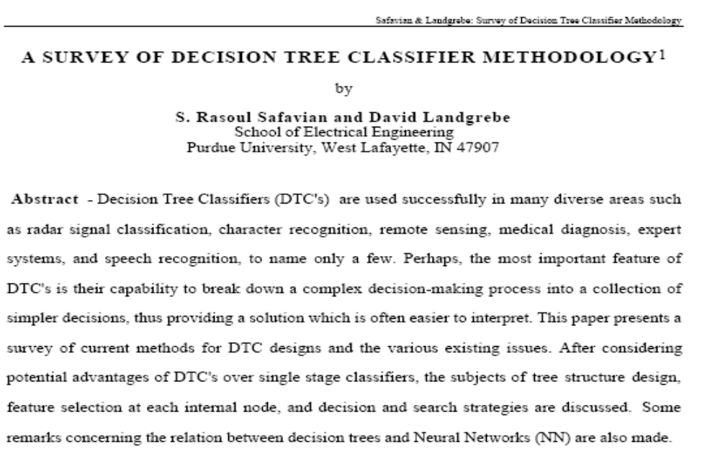
Decision Tree Classifiers : Survey paper

Slide 22
Classification in Large Databases
Classification—a classical problem extensively studied by statisticians and machine learning researchers
Scalability: Classifying data sets with millions of examples and hundreds of attributes with reasonable speed
Why decision tree induction in data mining?
  relatively faster learning speed (than other classification methods)
  convertible to simple and easy to understand classification rules
  can use SQL queries for accessing databases
  comparable classification accuracy with other methods
Data Mining: Concepts and Techniques

Slide 23
Constructing Classifier for B.I.
The leading Credit Card Company Visa International and Computer Company Acer Inc. has agreed to market the newly launched Laptop Computer.
For targeted marketing campaign, both the companies would like to use the existing database of Visa Credit card holders, to find out most likely buyers of their Computer.
For a given Database, your job will be to construct a Classifier.
This Classifier should take an input as the customer-details like
  Age,
  Income
  Student or Professional
  Credit_Card Ratings
And based on above inputs, the Classifier would Predict, whether the person is likely buyer of the Laptop Computer or not.

Slide 24
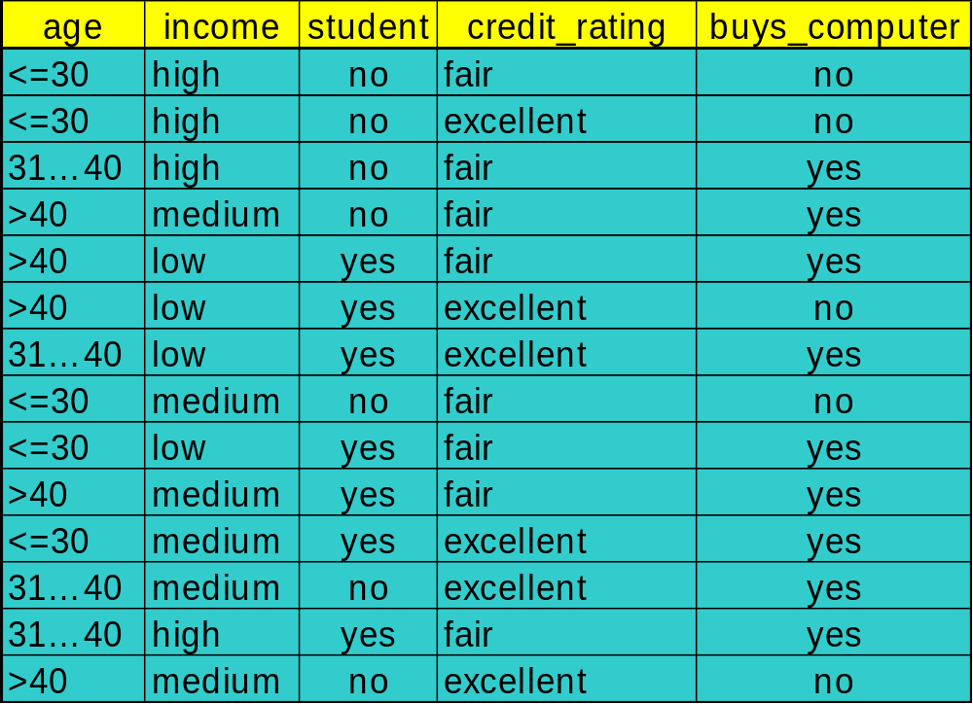
To construct Classifier from a given training data

Slide 25
Constructing Classifier
Data Domain Analysis
  Small Dataset with 04 discrete valued attributes.
  The Class label attributes are Boolean in nature!
    Class Labels:
      C1:buys_computer = ‘yes’
      C2:buys_computer = ‘no’
Predictive mechanism needed !
Business application with transactional database: no missing values !
Implementation details
  Execution of Java program with dataset.
  Constructing IF…. THEN… ELSE Rules.

Slide 26
DT induction: Issues
There are 04 attributes in the table, which attribute to start with at Root ?
  Attribute Selection measure or measure of goodness of split
    Select the attribute with the highest information gain
    Calculate information gain of each of 04 attributes by calculating;
      Expected information (entropy)
      Information needed
      Information Gained= (a)-(b)
    Find out the maximum I.G. out of attributes age, income, student, credit_rating

Slide 27




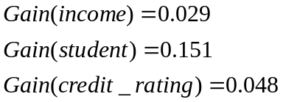
Attribute Selection: Information Gain
Class P: buys_computer = “yes”
Class N: buys_computer = “no”
means “age <=30” has 5 out of 14 samples, with 2 yes’es and 3 no’s. Hence
Similarly, Looking at other Gains, we can see the Gain(age) is max.
Data Mining: Concepts and Techniques

Slide 28

Gain Ratio for Attribute Selection (C4.5)
Information gain measure is biased towards attributes with a large number of values
C4.5 (a successor of ID3) uses gain ratio to overcome the problem (normalization to information gain)
  GainRatio(A) = Gain(A)/SplitInfo(A)
Ex.
  gain_ratio(income) = 0.029/0.926 = 0.031
The attribute with the maximum gain ratio is selected as the splitting attribute

Slide 29
Output: A Decision Tree for
“Buys_Computer”
age?
<=30
overcast
>40
31..40
Income | Student | Credit_rating | Class
High | No | Fair | no
High | No | excellent | no
medium | No | Fair | no
Income | Student | Credit_rating | Class
medium | No | Fair | yes
Income | Student | Credit_rating | Class
High | No | Fair | yes
Data Mining: Concepts and Techniques

Slide 30
Output: A Decision Tree for “buys_computer”
age?
<=30
overcast
>40
31..40
student?
yes
credit rating?
no
yes
excellent
fair
no
yes
no
yes
Data Mining: Concepts and Techniques

Slide 31
Issues: Evaluating Classification Methods
Accuracy
  classifier accuracy: predicting class label
  predictor accuracy: guessing value of predicted attributes
Speed
  time to construct the model (training time)
  time to use the model (classification/prediction time)
Robustness: handling noise and missing values
Scalability: efficiency in disk-resident databases
Interpretability
  understanding and insight provided by the model
Other measures, e.g., goodness of rules, such as decision tree size or compactness of classification rules
Data Mining: Concepts and Techniques

Slide 32
Constructing Classifier for B.I.
The leading Credit Card Company Visa International and Computer Company Acer Inc. has agreed to market the newly launched Laptop Computer.
For targeted marketing campaign, both the companies would like to use the existing database of Visa Credit card holders, to find out most likely buyers of their Computer.
For a given Database, your job will be to construct a Classifier.
This Classifier should take an input as the customer-details like
  Age,
  Income
  Student or Professional
  Credit_Card Ratings
And based on above inputs, the Classifier would Predict, whether the person is likely buyer of the Laptop Computer or not.
DTC was proposed as one of the alternative, but it showed some limitations.

Slide 33
Credit Card Database & BI application
As the Visa International has accumulated huge record of its Credit card holders for last 05 years amounting to terabytes of data.
Though larger the data better the training of the Classifiers ( some popularly used DTC algorithms C4.5 uses as much as 2/3 of the data for training the Classifiers).
In Case of our BI application, the problem starts with calculating Information Gain
    Every attributes involves all transactions for IG
    disk resident training data is not fitting into our memory for training activity.
    Scalability Problem!

Slide 34
Trees grows to Forests
Random Forests Approach
Ensemble learning

Slide 35
Random forests or Random decision forests are a method for classification, regression and other tasks that operates by constructing a multitude of decision trees at training time and outputting the class that is the mode of the classes (classification) or mean prediction (regression) of the individual trees.
Random decision forests correct for decision trees' habit of overfitting to their training set

Slide 36
Random Forests
There are two keywords here — random and forests.
Random forest is a collection of many decision trees.
Instead of relying on a single decision tree, you build many decision trees say 100 of them.
And we know what a collection of trees is called — a forest. So that’s why is it called a forest.
Why is it called Random then?
Adding randomness to the DTC is central to this idea.

Slide 37
Randomness in Tree..
Say our dataset has 1,000 rows and 30 columns.
There are two levels of randomness in this algorithm:
At row level: Each of these decision trees gets a random sample of the training data (say 10%) i.e. each of these trees will be trained independently on 100 randomly chosen rows out of 1,000 rows of data. Keep in mind that each of these decision trees is getting trained on 100 randomly chosen rows from the dataset i.e they are different from each other in terms of predictions.
At column level: The second level of randomness is introduced at the column level. Not all the columns are passed into training each of the decision trees. Say we want only 10% of columns to be sent to each tree. This means a randomly selected 3 column will be sent to each tree. So for the first decision tree, maybe column C1, C2, and C4 were chosen. The next DT will have C4, C5, C10 as chosen columns and so on.

Slide 38
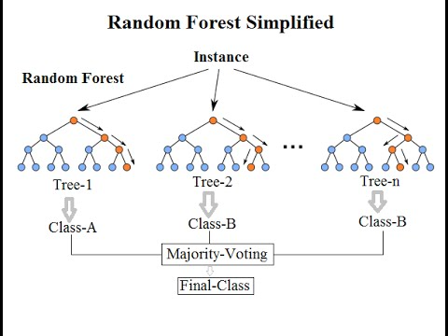
The Random Forests belong to Ensemble Learning approach, as multiple learners operate in the process.

Slide 39
When is Random forest a poor choice
Random forests don’t train well on smaller datasets as it fails to pick on the pattern. To simplify, say we know that 1 pen costs INR 1, 2 pens cost INR 2, 3 pens cost INR 6. In this case, linear regression will easily estimate the cost of 4 pens but random forests will fail to come up with a good estimate.
There is a problem of interpretability with random forest.You can’t see or understand the relationship between the response and the independent variables. Understand that a random forest is a predictive tool and not a descriptive tool. You get variable importance but this may not suffice in many analysis of interests where the objective might be to see the relationship between response and the independent features.
The time taken to train random forestsmay sometimes be too huge as you train multiple decision trees. Also, in the case of a categorical variable, the time complexity increases exponentially. For a categorical column with n levels, RF tries split at 2^n -1 points to find the maximal splitting point.

Slide 40
Random Forests as Ensemble learner
The Random Forests belong to Ensemble Learning approach, as multiple learners operate in the process.
First algorithm for random decision forests was created by Tin Kam Ho using the random subspace method which, in Ho's formulation, is a way to implement the "stochastic discrimination" approach to classification proposed by Eugene Kleinberg
An extension of the algorithm was developed by Leo Breima and Adele Cutler, who registered "Random Forests" as a trademark (as of 2019, owned by Minitab, Inc. ⁾
The extension combines Breiman's "bagging" idea and random selection of features, introduced first by Ho and later independently by Amit and Geman in order to construct a collection of decision trees with controlled variance.

Slide 41
Trees grows to Forests
But limitations of Approach remains…

Slide 42
Tree based and Regression
In case of a regression problem, the range of values response variable can take is determined by the values already available in the training dataset. Unlike linear regression, decision trees and hence random forest can’t take values outside the training data.
What are the advantages of using random forest?
Since we are using multiple decision trees, the bias remains the same as that of a single decision tree. However, the variance decreases and thus we decrease the chances of overfitting.
When all you care about is the predictions and want a quick and dirty way-out, random forest comes to the rescue. You don’t have to worry much about the assumptions of the model or linearity in the dataset.

Slide 43
DTC
Speed was not good enough !
The B.I. Solution for Customer having Age age <=30, Income = medium, Student = yes and Credit_rating = Fair) falling into either of the category with level of certainty was not specifically available.

Slide 44

Training Dataset
Class Labels:
C1:buys_computer = ‘yes’
C2:buys_computer = ‘no’
Data sample:
X = (age <=30, Income = medium, Student = yes
Credit_rating = Fair)
Belongs to which Class?

Slide 45
Classification : Which one & Why ?
What is classification? What is prediction?
Issues regarding classification and prediction
Classification by decision tree induction
Bayesian classification
Bayesian Belief Network
Soft Computing techniques
  Classification by back propagation
Support Vector Machines (SVM)
Associative classification
Lazy learners (or learning from your neighbors)
Other classification methods
Prediction
Accuracy and error measures
Ensemble methods
Model selection
Summary
Data Mining: Concepts and Techniques

Slide 46
Using Bayesian Classification for B.I.
Bayesian classifiers are statistical classifiers which predict class membership probabilities such as the probability that a given sample belongs to a particular class.
  Bayesian classification is based on the Bayes theorem and it is observed that a simple Bayesian Classifier known as the naïve Bayesian classifier to be comparable in performance with decision tree and Neural network classifiers.
Naïve Bayesian classifier assume that the effect of an attribute value on a given class is independent of the values of the other attributes. (conditional independence).
.

Slide 47
Bayesian Theorem: Basics
Let X be a data sample (“evidence”): class label is unknown
Let H be a hypothesis that X belongs to class C
Classification is to determine P(H|X), the probability that the hypothesis holds given the observed data sample X
P(H) (prior probability), the initial probability
  E.g., X will buy computer, regardless of age, income, …
P(X): probability that sample data is observed
2) P(X|H) (posteriori probability), the probability of observing the sample X, given that the hypothesis holds ( X belongs to Class C)
  E.g., Given that X will buy computer, the prob. that X is 31..40, medium income
Data Mining: Concepts and Techniques

Slide 48
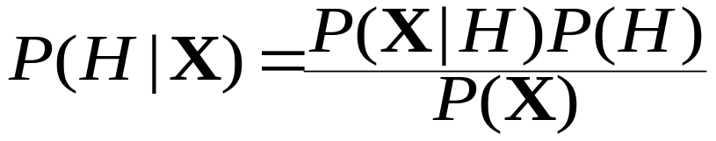
Bayesian Theorem
Given training data X, posteriori probability of a hypothesis H, P(H|X), follows the Bayes theorem
Informally, this can be written as
  posteriori = likelihood x prior/evidence
Predicts X belongs to C₂ iff the probability P(C_{i}|X) is the highest among all the P(C_{k}|X) for all the k classes
Practical difficulty: require initial knowledge of many probabilities, significant computational cost
Data Mining: Concepts and Techniques

Slide 49


Towards Naïve Bayesian Classifier
Let D be a training set of tuples and their associated class labels, and each tuple is represented by an n-D attribute vector X = (x₁, x₂, …, x_{n})
Suppose there are m classes C₁, C₂, …, C_{m}.we have C₁,C₂
Classification is to derive the maximum posteriori, i.e., the maximal P(C_{i}|X)
This can be derived from Bayes’ theorem
Since P(X) is constant for all classes, only
  needs to be maximized

Slide 50
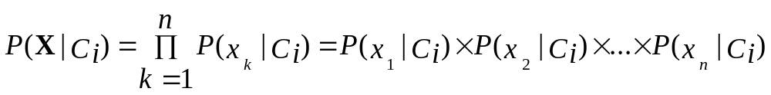
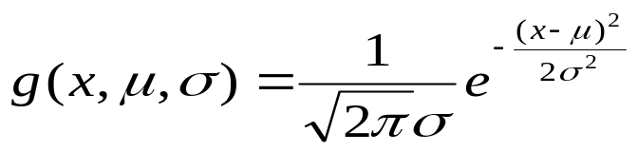

Derivation of Naïve Bayes Classifier
A simplified assumption: attributes are conditionally independent
This greatly reduces the computation cost: Only counts the class distribution
If A_{k} is categorical, P(x_{k}|C_{i}) is the # of tuples in C_{i} having value x_{k} for A_{k} divided by |C_{i, D}| (# of tuples of C_{i} in D)
If A_{k} is continous-valued, P(x_{k}|C_{i}) is usually computed based on Gaussian distribution with a mean μ and standard deviation σ
  and P(x_{k}|C_{i}) is

Slide 51
Naïve Bayesian Classifier: Training Dataset
Class Labels:
C1:buys_computer = ‘yes’
C2:buys_computer = ‘no’
Data sample
X = (age <=30, Income = medium, Student = yes
Credit_rating = Fair)
Data Mining: Concepts and Techniques

Slide 52
Naïve Bayesian Classifier: An Example
Let C₁ corresponds to the class buys_computer = “yes” and C₂ buys_computer = “no”.
P(C_{i}): P(buys_computer = “yes”) = 9/14 = 0.643
P(buys_computer = “no”) = 5/14= 0.357
Compute P(X|C_{i}) for each class
P(age = “<=30” | buys_computer = “yes”) = 2/9 = 0.222
P(age = “<= 30” | buys_computer = “no”) = 3/5 = 0.6
P(income = “medium” | buys_computer = “yes”) = 4/9 = 0.444
P(income = “medium” | buys_computer = “no”) = 2/5 = 0.4
P(student = “yes” | buys_computer = “yes) = 6/9 = 0.667
P(student = “yes” | buys_computer = “no”) = 1/5 = 0.2
P(credit_rating = “fair” | buys_computer = “yes”) = 6/9 = 0.667
P(credit_rating = “fair” | buys_computer = “no”) = 2/5 = 0.4
X = (age <= 30 , income = medium, student = yes, credit_rating = fair)
P(X|C_{i}) : P(X|buys_computer = “yes”) = 0.222 x 0.444 x 0.667 x 0.667 = 0.044
P(X|buys_computer = “no”) = 0.6 x 0.4 x 0.2 x 0.4 = 0.019
P(X|C_{i})*P(C_{i}) : P(X|buys_computer = “yes”) * P(buys_computer = “yes”) = 0.028
P(X|buys_computer = “no”) * P(buys_computer = “no”) = 0.007
Therefore, X belongs to class (“buys_computer = yes”)
Data Mining: Concepts and Techniques

Slide 53
Customer Prediction with Bayes Theorem: Problems
There may be field data having some records in which probability of buying a computer by a Low income may come out to be Zero for all other attributes !
The Bayes Theorem assumes that the attribute-values like age, income,credit_ratings etc are conditionally independent !
Above assumption may not hold true if the additional attributes are added in due course of time, some of which have inter-dependencies / associations.

Slide 54
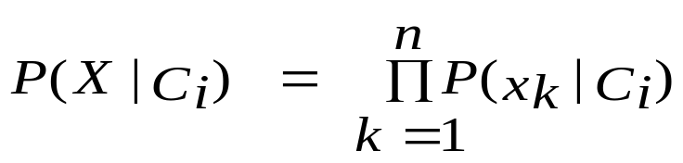
Avoiding the 0-Probability Problem
Suppose a dataset with 1000 tuples, income=low (0), income= medium (990), and income = high (10),
Naïve Bayesian prediction requires each conditional prob. be non-zero. Otherwise, the predicted prob. will be zero
How to avoid this 0-Probability Problem !!

Slide 55
Laplacian Probability
Use Laplacian correction (or Laplacian estimator)
  Adding 1 to each case
    Prob(income = low) = 1/1003
    Prob(income = medium) = 991/1003
    Prob(income = high) = 11/1003
  This incorrect/manipulated data may incur in erroneous result , but still will be usable !
  The “corrected” prob. estimates are close to their “uncorrected” counterparts

Slide 56
Naïve Bayesian Classifier: Comments
Advantages
  Easy to implement
  Good results obtained in most of the cases
Disadvantages
  Assumption: class conditional independence, therefore loss of accuracy
  Practically, dependencies exist among variables
    E.g., hospitals: patients: Profile: age, family history, etc.
    Symptoms: fever, cough etc., Disease: lung cancer, diabetes, etc.
    Dependencies among these cannot be modeled by Naïve Bayesian Classifier
Data Mining: Concepts and Techniques

Slide 57
Conditional Dependence
How to deal with these dependencies?
  Can we incorporate dependencies into Bayesian classification ?
  Bayesian Belief Networks can incorporate dependence.
  Bayesian belief network allows a subset of the variables conditionally independent
  Immensely useful in bio-informatics domain as these data attributes involves high dependence !

Slide 58
Classification and Prediction
What is classification? What is prediction?
Issues regarding classification and prediction
Classification by decision tree induction
Bayesian classification
  BBN: When and how?
Support Vector Machines (SVM)
Rule-based classification
Classification by back propagation
Associative classification
Lazy learners (or learning from your neighbors)
Other classification methods
Prediction
Accuracy and error measures
Ensemble methods
Model selection
Summary
Data Mining: Concepts and Techniques

Slide 59
Bayesian Classification
Bayesian classifiers are statistical classifiers which predict class membership probabilities such as the probability that a given sample belongs to a particular class.
Bayesian classification is based on the Bayes theorem and it is observed that a simple Bayesian Classifier known as the naïve Bayesian classifier to be comparable in performance with decision tree and Neural network classifiers.
Naïve Bayesian classifier assume that the effect of an attribute value on a given class is independent of the values of the other attributes. (conditional independence).
Bayesian belief networks are graphical models, which unlike naïve bayesian classifiers allow the representation of dependencies among subsets of attributes. Can be Used for classification.

Slide 60
Bayesian Belief Networks (II)
Bayesian belief network allows a subset of the variables conditionally independent
A graphical model of causal relationships
Several cases of learning Bayesian belief networks
  Given both network structure and all the variables: easy
  Given network structure but only some variables
  When the network structure is not known in advance

Slide 61
Bayesian Belief Networks
Bayesian belief network allows a subset of the variables conditionally independent
A graphical model of causal relationships
  Represents dependency among the variables
  Gives a specification of joint probability distribution
Nodes: random variables
Links: dependency
X and Y are the parents of Z, and Y is the parent of P
No dependency between Z and P
Has no loops or cycles
X
Y
Z
P
Data Mining: Concepts and Techniques

Slide 62
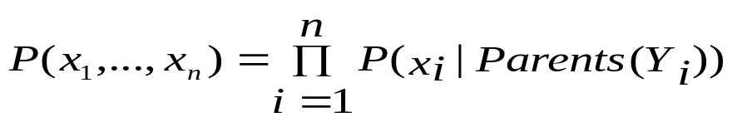
Bayesian Belief Network: An Example
Family
History
Smoker
The conditional probability table (CPT) for variable LungCancer:
(FH, S)
(FH, ~S)
(~FH, S)
(~FH, ~S)
LC
0.8
0.5
0.7
0.1
LungCancer
Emphysema
~LC
0.2
0.5
0.3
0.9
CPT shows the conditional probability for each possible combination of its parents
PositiveXRay
Dyspnea
Derivation of the probability of a particular combination of values of X, from CPT:
Bayesian Belief Networks
Data Mining: Concepts and Techniques

Slide 63
Training Bayesian Networks
Several scenarios:
  Given both the network structure and all variables observable: learn only the CPTs
  Network structure known, some hidden variables: gradient descent (greedy hill-climbing) method, analogous to neural network learning
  Network structure unknown, all variables observable: search through the model space to reconstruct network topology
  Unknown structure, all hidden variables: No good algorithms known for this purpose
Ref. D. Heckerman: Bayesian networks for data mining
Data Mining: Concepts and Techniques

Slide 64
Classification and Prediction
Types/ tools of classification and prediction
Classification by decision tree induction
Bayesian Classification
Classification by backpropagation
S.V.M.
Classification based on concepts from association rule mining
Other Classification Methods
  Rough set
  Fuzzy approach
Prediction
Classification accuracy
Summary

Slide 65
Classification and Prediction
What is classification? What is prediction?
Issues regarding classification and prediction
Classification by decision tree induction
Bayesian Classification
Classification:
  Categories of Classification : Linear Classifiers
  Generative models vs. discriminative models
  ANN Vs SVM
Other Classification Methods
Prediction
Classification accuracy
Summary

Slide 66
Linear Classification
In the field of machine learning, the goal of classification is to use an object's characteristics to identify which class (or group) it belongs to.
Binary Classification problem
x
x
The data above the orange line belongs to class ‘x’
The data below orange line belongs to class ‘o’
Examples: SVM, Perceptron, Probabilistic Classifiers
x
x
x
x
x
x
o
x
o
x
o
o
o
o
o
o
o
o
o
o
o

Slide 67

Linear classifier
A linear classifier achieves this by making a classification decision based on the value of a linear combination of the characteristics.
An object's characteristics are also known as feature values and are typically presented to the machine in a vector called a feature vector.
If the input feature vector to the classifier is a real vector x , then the output score is
where w is a real vector of weights and f is a function that converts the dot product of the two vectors into the desired output. (In other words, w is a one-form or linear functional mapping x onto R.)
The weight vector w is learned from a set of labeled training samples. Often f is a simple function that maps all values above a certain threshold to the first class and all other values to the second class.

Slide 68
Generative models vs. discriminative models
There are two broad classes of methods for determining the parameters of a linear classifier .
Methods of the first class model conditional density functions . Examples of such algorithms include:
  Linear Discriminant Analysis (or Fisher's linear discriminant) (LDA)—assumes Gaussian conditional density models
  Naive Bayes classifier—assumes independent binomial conditional density models.
The second set of methods includes discriminative models, which attempt to maximize the quality of the output on a training set. Additional terms in the training cost function can easily perform regularization of the final model. Examples of discriminative training of linear classifiers include
Logistic regression—maximum likelihood estimation of assuming that the observed training set was generated by a binomial model that depends on the output of the classifier.
Perceptron—an algorithm that attempts to fix all errors encountered in the training set
Support vector machine—an algorithm that maximizes the margin between the decision hyperplane and the examples in the training set.

Slide 69
Discriminative Classifiers
Advantages
  prediction accuracy is generally high
    As compared to Bayesian methods – in general
  robust, works when training examples contain errors
  fast evaluation of the learned target function
    Bayesian networks are normally slow
Criticism
  long training time
  difficult to understand the learned function (weights)
    Bayesian networks can be used easily for pattern discovery
  not easy to incorporate domain knowledge
    Easy in the form of priors on the data or distributions
Data Mining: Concepts and Techniques

Slide 70
Artificial systems Vs. Biological systems
Designers of artificial systems – both hardware and software, whether engineering systems, computer systems, or business systems-can only marvel at the robustness, the efficiency, and the flexibility of biological systems.
The central theme of research on many Soft Computing approaches like ANN & GAs has been robustness for survival in many different environments. The implications of robustness for artificial systems are manifold. If artificial systems can be made more robust, costly redesigns can be reduced or eliminated.
Feature for self-repair, self-guidance, and re-production are the rule in biological systems, whereas they barely exist in the most sophisticated systems.
Notes:
Ranjana vyas

Slide 71
Classification by Backpropopagation
Backpropagation has been considered as effective mechanism in field of classification. The backpropagation algorithm was presented by Rumelhart, Hinton, and Williams [ RHW86]. One of the most popularly used backpropagation technique is a neural network learning algorithm.
In Freud’s theory of psychodynamics, the human brain (~10 ^ 11) was described as a neural network, and recent investigations have corroborated this view.
This analogy therefore offers an interesting model for the creation of more complex learning machines, and has led the creation of ANN.
Neural network, with their remarkable ability to derive meaning from complicated or imprecise data, can be used to extract patterns and detect trends that are too complex to be noticed by either humans or other computer techniques.
A trained neural network can be thought of as an "expert" in the category of information it has been given to analyze. This expert can then be used to provide projections given new situations of interest and answer "what if" questions.
Notes:
Ranjana vyas

Slide 72
Neural Networks
An Artificial Neural Network (ANN) is an information processing paradigm that is inspired by the way biological nervous systems, such as the brain, process information.
The key element of this paradigm is the novel structure of the information processing system.
It is composed of a large number of highly interconnected processing elements (neurones) working in unison to solve specific problems. ANNs, like people, learn by example.
An ANN is configured for a specific application, such as pattern recognition or data classification, through a learning process.
Learning in biological systems involves adjustments to the synaptic connections that exist between the neurones. This is true of ANNs as well.
Notes:
Ranjana vyas

Slide 73
ANN Advantages
Adaptive learning: An ability to learn how to do tasks based on the data given for training or initial experience.
Self-Organisation: An ANN can create its own organization or representation of the information it receives during learning time.
Real Time Operation: ANN computations may be carried out in parallel, and special hardware devices are being designed and manufactured which take advantage of this capability.
Fault Tolerance via Redundant Information Coding: Partial destruction of a network leads to the corresponding degradation of performance. However, some network capabilities may be retained even with major network damage.

Slide 74
Issues: Data Preparation
Data cleaning
  Preprocess data in order to reduce noise and handle missing values
Relevance analysis (feature selection)
  Remove the irrelevant or redundant attributes
Data transformation
  Generalize and/or normalize data
Data Mining: Concepts and Techniques

Slide 75
CLS 1966]
Bayesian classifier [Cheessman-1988]
Neural Network [Bishop-1995]
Tree Structure Classifier [CART Hunt-1884]
Genetic Algorithm
[Goldberg-1989]
ID3 [Quinlan-1986]
MDL [Quinlan-1989]
C4.5[Quinlan-1993]
MDL- Decision tree
[Mehta-1995]
SLIQ [Mehta-1996]
Muliple Interval
[Fayyad-1993]
Optimal pruning of decision tree [Hassein 1996]
SPIRIT[Mehta-1996]
E . D. tree [ Fekuda-1996]
Rainsforest [Gehrke-1998]
PUBLIC [Rastogi-1998]
Auto D-tree[Murthy -1998]
BOAT [Gehrke-1999]
Constraint [Rastogi-2000]
Building Constraints [Rastogi-2003]

Slide 76
Issues: Evaluating Classification Methods
Accuracy
  classifier accuracy: predicting class label
  predictor accuracy: guessing value of predicted attributes
Speed
  time to construct the model (training time)
  time to use the model (classification/prediction time)
Robustness: handling noise and missing values
Scalability: efficiency in disk-resident databases
Interpretability
  understanding and insight provided by the model
Other measures, e.g., goodness of rules, such as decision tree size or compactness of classification rules
Data Mining: Concepts and Techniques

Slide 77
Mining the WWW
Begun with the idea of Clustering of Web documents
Given the rapidly increasing data on Internet, Web is apt candidate for Data Mining and Knowledge discovery approaches
Web Mining Taxonomy
Finding Authoritative Web pages: HITS & Search Engines
Using Web data for Mining
Text Mining in Web

Slide 78
Web Mining Taxonomy
Web Mining
Web Content
Mining
Web Structure
Mining
Web Usage
Mining
Web Page
Content Mining
Search Result
Mining
General Access
Pattern Tracking
Customized
Usage Tracking
Dr. O.P. Vyas - IIIT-Allahabad

Slide 79
Mining the World-Wide Web
Web Mining
Web Content
Mining
Web Structure
Mining
Web Usage
Mining
Web Page Content Mining
Web Page Summarization
WebLog (Lakshmanan et.al. 1996), WebOQL(Mendelzon et.al. 1998) …:
Web Structuring query languages;
Can identify information within given web pages
Ahoy! (Etzioni et.al. 1997):Uses heuristics to distinguish personal home pages from other web pages
ShopBot (Etzioni et.al. 1997): Looks for product prices within web pages
Search Result
Mining
General Access
Pattern Tracking
Customized
Usage Tracking
Dr. O.P. Vyas - IIIT-Allahabad

Slide 80
Mining the World-Wide Web
Web Mining
Web Content
Mining
Web Structure
Mining
Web Usage
Mining
Web Page
Content Mining
Search Result Mining
Search Engine Result Summarization
Clustering Search Result (Leouski and Croft, 1996, Zamir and Etzioni, 1997):
Categorizes documents using phrases in titles and snippets
General Access
Pattern Tracking
Customized
Usage Tracking
Dr. O.P. Vyas - IIIT-Allahabad

Slide 81
Mining the World-Wide Web
Web Mining
Web Content
Mining
Web Usage
Mining
Web Structure Mining
Using Links
PageRank (Brin et al., 1998)
CLEVER (Chakrabarti et al., 1998)
Use interconnections between web pages to give weight to pages.
Using Generalization
MLDB (1994), VWV (1998)
Uses a multi-level database representation of the Web. Counters (popularity) and link lists are used for capturing structure.
Search Result
Mining
General Access
Pattern Tracking
Web Page
Content Mining
Customized
Usage Tracking
Dr. O.P. Vyas - IIIT-Allahabad

Slide 82
Mining the World-Wide Web
Web Mining
Web Content
Mining
Web Structure
Mining
Web Usage
Mining
Web Page
Content Mining
General Access Pattern Tracking
Web Log Mining (Zaïane, Xin and Han, 1998)
Uses KDD techniques to understand general access patterns and trends.
Can shed light on better structure and grouping of resource providers.
Customized
Usage Tracking
Search Result
Mining
Dr. O.P. Vyas - IIIT-Allahabad

Slide 83
Mining the World-Wide Web
Web Mining
Web Content
Mining
Web Structure
Mining
Web Usage
Mining
Web Page
Content Mining
General Access
Pattern Tracking
Customized Usage Tracking
Adaptive Sites (Perkowitz and Etzioni, 1997)
Analyzes access patterns of each user at a time.
Web site restructures itself automatically by learning from user access patterns.
Search Result
Mining
Dr. O.P. Vyas - IIIT-Allahabad

Slide 84
Mining the World-Wide Web
The WWW is huge, widely distributed, global information service center for
  Information services: news, advertisements, consumer information, financial management, education, government, e-commerce, etc.
  Hyper-link information
  Access and usage information
WWW provides rich sources for data mining
Challenges
  Too huge for effective data warehousing and data mining ( ~ hundreds of Terabytes)
  Too complex and heterogeneous: no standards and structure
  The Web is a highly dynamic information source.
Dr. O.P. Vyas - IIIT-Allahabad

Slide 85
Web Mining
Clustering of Web docs, Search Engines
Finding Authoritative Web pages
Using Web data for Mining
Text Mining in Web

Slide 86
Mining the Web's Link Structures
Finding authoritative Web pages
  Retrieving pages that are not only relevant, but also of high quality, or authoritative on the topic.
  The secrecy of authority is hiding in Web page linkages.
Hyperlinks can infer the notion of authority
  The Web consists not only of pages, but also of hyperlinks pointing from one page to another
  These hyperlinks contain an enormous amount of latent human annotation
  A hyperlink pointing to another Web page, this can be considered as the author's endorsement of the other page.
  The collectively endorsement of a given page by different authors on the Web may indicate the importance of the page and may naturally lead to the discovery of authoritative Web pages.
Dr. O.P. Vyas - IIIT-Allahabad

Slide 87
Mining the Web's Link Structures
Problems with the Web linkage structure
  Not every hyperlink represents an endorsement
    Other purposes are for navigation or for paid advertisements
    If the majority of hyperlinks are for endorsement, the collective opinion will still dominate
  One authority will seldom have its Web page point to its rival authorities in the same field (Will Coke give pointer to Pepsi ?)
  Authoritative pages are seldom particularly descriptive. ( Yahoo! main Web page will not contain the self-description “Web search engine” ).
Hub
  Set of Web pages that provides collections of links to authorities. Such pages could be lists of recommended reference sites on individual home pages, such as recommended reference sites from a course home page.
Dr. O.P. Vyas - IIIT-Allahabad

Slide 88
HITS (Hyperlink-Induced Topic Search)
Explore interactions between hubs and authoritative pages
Use an index-based search engine to form the root set
( HITS uses the query terms to collect a starting set of say, 200 pages from search engine, these pages form root set.)
  Many of these pages are presumably relevant to the search topic
  Some of them should contain links to most of the prominent authorities
Expand the root set into a base set
  Include all of the pages that the root-set pages link to, and all of the pages that link to a page in the root set, up to a designated size cutoff
  ( such as 1000 to 5000 pages to be included in the base set)
Apply weight-propagation
  An iterative process that determines numerical estimates of hub and authority weights. Notice that since the links between two pages with the same Web domain( i.e. sharing the same first level in their URLs) often serve as a navigation function and thus do not confer authority, such links are excluded from the weight-propagation analysis.
Dr. O.P. Vyas - IIIT-Allahabad

Slide 89
HITS….
First associate a nonnegative authority weight ap
and a nonnegative hub weight hp with each page p in the base set p , and initialize all a and h values to a uniform constant. The weights are normalized and an invariant is maintained that the squares of all weights sum to 1. The authority and hub weights are updated based on the following equations;
ap = S hq q such that q → p ……..( I)
hp = S aq q such that q ← p ………(II)
Equation (I) implies that if a page is pointed to by many good hubs, its authority weight should increase ( i.e. it is the sum of the current hub weights of all of the pages pointing to it).
Equation (II) implies that if a page is pointing to many good authorities, its hub weight should increase ( i.e. it is the sum of the current authority weights of all of the pages it points to)
Dr. O.P. Vyas - IIIT-Allahabad

Slide 90
Systems Based on HITS
  Output a short list of the pages with large hub weights, and the pages with large authority weights for the given search topic
Systems based on the HITS algorithm
  Clever, Google: achieve better quality search results than those generated by term-index engines such as AltaVista and those such as Yahoo!
Difficulties from ignoring textual contexts
  Drifting: when hubs contain multiple topics
  Topic hijacking: when many pages from a single Web site point to the same single popular site
Dr. O.P. Vyas - IIIT-Allahabad

Slide 91
Automatic Classification of Web Documents
Assign a class label to each document from a set of predefined topic categories
Based on a set of examples of preclassified documents
Example
  Use Yahoo!'s taxonomy and its associated documents as training and test sets
  Derive a Web document classification scheme
  Use the scheme classify new Web documents by assigning categories from the same taxonomy
Keyword-based document classification methods
Statistical models
Dr. O.P. Vyas - IIIT-Allahabad

Slide 92
Multilayered Web Information Base
Layer₀: the Web itself
Layer₁: the Web page descriptor layer
  Contains descriptive information for pages on the Web
  An abstraction of Layer₀: substantially smaller but still rich enough to preserve most of the interesting, general information
  Organized into dozens of semistructured classes
    document, person, organization, ads, directory, sales, software, game, stocks, library_catalog, geographic_data, scientific_data, etc.
Layer₂ and up: various Web directory services constructed on top of Layer₁
  provide multidimensional, application-specific services
Dr. O.P. Vyas - IIIT-Allahabad

Slide 93







Multiple Layered Web Architecture
More Generalized Descriptions
Layer_{n}
...
Generalized Descriptions
Layer₁
Layer₀
Dr. O.P. Vyas - IIIT-Allahabad

Slide 94
Mining the World-Wide Web
Layer-0: Primitive data
Layer-1: dozen database relations representing types of objects (metadata)
document, organization, person, software, game, map, image,…
document(file_addr, authors, title, publication, publication_date, abstract, language, table_of_contents, category_description, keywords, index, multimedia_attached, num_pages, format, first_paragraphs, size_doc, timestamp, access_frequency, links_out,...)
person(last_name, first_name, home_page_addr, position, picture_attached, phone, e-mail, office_address, education, research_interests, publications, size_of_home_page, timestamp, access_frequency, ...)
image(image_addr, author, title, publication_date, category_description, keywords, size, width, height, duration, format, parent_pages, colour_histogram, Colour_layout, Texture_layout, Movement_vector, localisation_vector, timestamp, access_frequency, ...)
Dr. O.P. Vyas - IIIT-Allahabad

Slide 95
Mining the World-Wide Web
Layer-2: simplification of layer-1
doc_brief(file_addr, authors, title, publication, publication_date, abstract, language, category_description, key_words, major_index, num_pages, format, size_doc, access_frequency, links_out)
person_brief (last_name, first_name, publications,affiliation, e-mail, research_interests, size_home_page, access_frequency)
Layer-3: generalization of layer-2
cs_doc(file_addr, authors, title, publication, publication_date, abstract, language, category_description, keywords, num_pages, form, size_doc, links_out)
doc_summary(affiliation, field, publication_year, count, first_author_list, file_addr_list)
doc_author_brief(file_addr, authors, affiliation, title, publication, pub_date, category_description, keywords, num_pages, format, size_doc, links_out)
person_summary(affiliation, research_interest, year, num_publications, count)
Dr. O.P. Vyas - IIIT-Allahabad

Slide 96




Mining Text Data: Social Network
Data Mining / Knowledge Discovery
Structured Data Multimedia Free Text Hypertext
HomeLoan (
Loanee: Frank Rizzo
Lender: MWF
Agency: Lake View
Amount: $200,000
Term: 15 years
)
Frank Rizzo bought
his home from Lake
View Real Estate in
1992.
He paid $200,000
under a15-year loan
from MW Financial.
<a href>Frank Rizzo
</a> Bought
<a hef>this home</a>
from <a href> Lake
View Real Estate</a>
In <b>1992</b>.
<p>...
Loans($200K,[map],...)
Data Mining: Principles and Algorithms
Notes:
Throughout this course we have been discussing Data Mining over a variety of data types.
Two former types we covered were Structured Data (relational) and multimedia data.
Today and in the last class we have been discussing Data Mining over free text,
and our next section will cover hypertext, such as web pages.
Text mining is well motivated, due to the fact that much of the world’s data can be
found in free text form (newspaper articles, emails, literature, etc.). There is a
lot of information available to mine.
While mining free text has the same goals as data mining in general
(extracting useful knowledge/stats/trends), text mining must overcome
a major difficulty – there is no explicit structure.
Machines can reason will relational data well since schemas are explicitly available.
Free text, however, encodes all semantic information within natural language. Our
text mining algorithms, then, must make some sense out of this natural language
representation. Humans are great at doing this, but this has proved to be a problem for machines.

Slide 97
Bag-of-Tokens Approaches
Documents
Token Sets
Four score and seven years ago our fathers brought forth on this continent, a new nation, conceived in Liberty, and dedicated to the proposition that all men are created equal.
Now we are engaged in a great civil war, testing whether that nation, or …
nation – 5
civil - 1
war – 2
men – 2
died – 4
people – 5
Liberty – 1
God – 1
…
Feature
Extraction
Loses all order-specific information!
Severely limits context!
Data Mining: Principles and Algorithms
Notes:
The previous text mining presentations “made sense” out of free text by
viewing text as a bag-of-tokens (words, n-grams). This is the same approach as IR.
Under that model we can already summarize, classify, cluster, and compute co-occurrence stats over free text.
These are quite useful for mining and managing large volumes of free text.
However, there is a potential to do much more. The BOT approach loses a LOT of information
contained in text, such as word order, sentence structure, and context. These are precisely the
features that humans use to interpret text.
Thus the natural question is can we do better?

Slide 98

Natural Language Processing
A dog is chasing a boy on the playground
Lexical
analysis
(part-of-speech
tagging)
Det
Noun
Aux
Verb
Det
Noun
Prep
Det
Noun
Noun Phrase
Noun Phrase
Complex Verb
Noun Phrase
Prep Phrase
Semantic analysis
Verb Phrase
Syntactic analysis
(Parsing)
Dog(d1).
Boy(b1).
Playground(p1).
Chasing(d1,b1,p1).
Verb Phrase
+
Sentence
Scared(x) if Chasing(_,x,_).
A person saying this may
be reminding another person to
get the dog back…
Scared(b1)
Inference
Pragmatic analysis
(speech act)
Data Mining: Principles and Algorithms
(Taken from ChengXiang Zhai, CS 397cxz – Fall 2003)
Notes:
NLP, or Computational Linguistics, is an entire field dedicated to the study
of automatically understanding free text. This field has been active since the 50’s.
General NLP attempts to understand document completely (at the level of a human reader).
There are several steps involved in NLP.
…Blah…

