Slide 1
Error Detection / Correction
Hamming code

Slide 2
Error Detection / Correction
Why might we need Error detection/correction?
Even & Odd Parity
  Error detection
Hamming code
  Used for error detection & error correction

Slide 3
Parity bits
ASCII – 7 bit code (hex 00 to 7F)
Could use “8th” bit for parity bit:
X1011010
    Even parity: make total number of “1” bits is even
    01011010
    Odd parity: make total number of “1” bits odd
    11011010
If a parity bit is added to a bit stream, then there is a basis to check for bit(s) being corrupted.

Slide 4
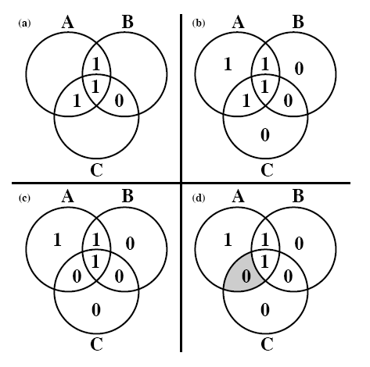
Error detecting Code Example
Error Detection/correction coding:
Word:
With even parity:
With Error:
Identifying error:

Slide 5
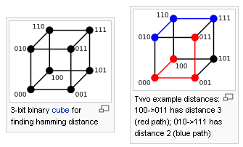
Hamming Distance
The Hamming distance is the number of bits that have to be changed to get from one bit pattern to another.
Example: 10010101 & 10011001 have a hamming distance of 2
For any coding whose members have a Hamming distance of two, any one bit error can be detected. Why?

Slide 6
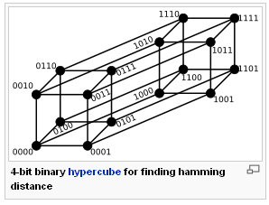
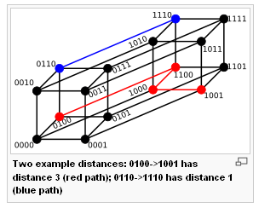
Hamming Distance
For any coding whose members have a Hamming distance of three, any one bit error can be detected and corrected. Why?
And any two bit error can be detected. Why?

Slide 7
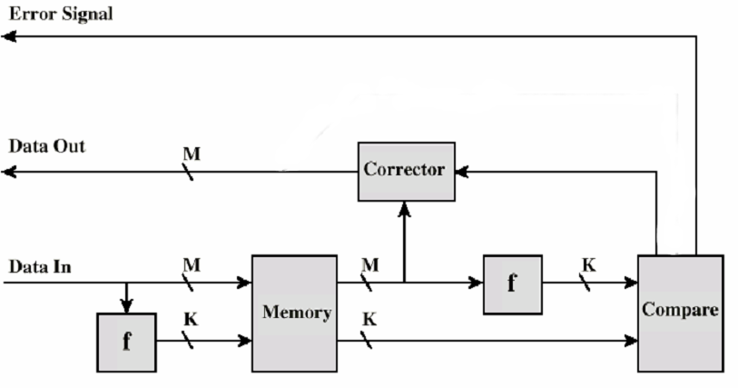
Error Correcting Code Function
Syndrome
Data
Code
The output of the “Compare” to the “Corrector” is termed the “syndrome”, and is K bits long

Slide 8
Hamming Code Syndrome
If we compare the read K bits compared with the write K bits, using an EXOR function, the result is called the “syndrome”.
If the syndrome is all zeros, there were no errors.
If there is a 1 bit somewhere, we know it represents an error.

Slide 9
Hamming Code Design – determining K
To store an M bit word with detection/correction takes M+K bit words
If K =1, we can detect single bit errors but not correct them
If 2^{K} - 1 >= M + K , we can detect, identify, and correct all single bit errors, i.e. the syndrome contains the information to correct any single bit error
Example: For M = 8:
and K = 3: 2³ – 1 = 7 < 8 + 3 (doesn’t work)
and K = 4: 2⁴ – 1 = 15 > 8 + 4 (works!)
Therefore, we must choose K =4,
i.e., the minimum size of the syndrome is 4

Slide 10
Hamming Code Syndrome
If we compare the read K bits with the write K bits,
using an exclusive or function, the result is called
the “syndrome”.
- If the syndrome is all zeros, there were no errors,
i.e. the bits were exactly alike
- If there is a 1 bit somewhere, we know that 1
represents an error.

Slide 11
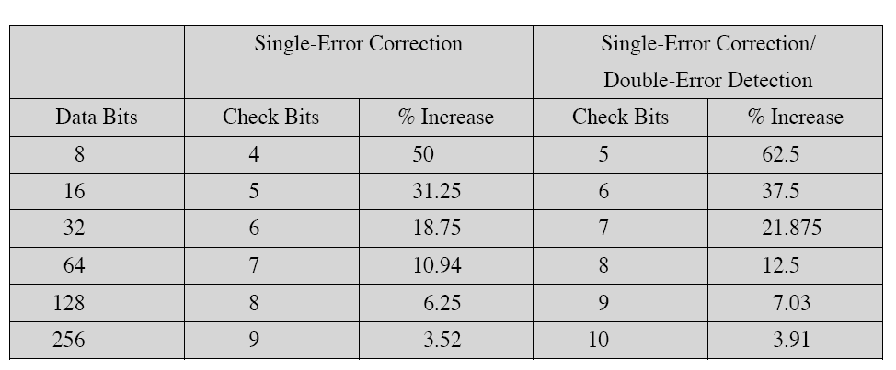
Increased word length for error correcting

Slide 12
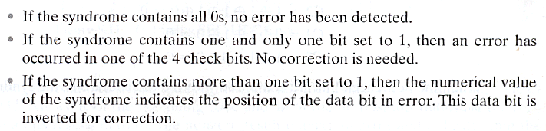
Hamming Code Syndrome Design Criteria

Slide 13
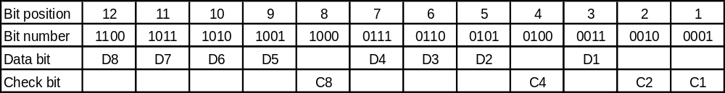
A Layout of Data and Check Bits that Achieves Our Design Criteria:
C1 is a parity check on every data bit whose position is xxx1
C1 = D1 exor D2 exor D4 exor D5 exor D7
C2 is a parity check on every data bit whose position is xx1x
C2 = D1 exor D3 exor D4 exor D6 exor D7
C4 is a parity check on every data bit whose position is x1xx
C4 = D2 exor D3 exor D4 exor D8
C8 is a parity check on every data bit whose position is 1xxx
C8 = D5 exor D6 exor D7 exor D8
Why this ordering? Because we want the syndrome, the Hamming test word, to yield the address of the error.

Slide 14
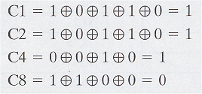
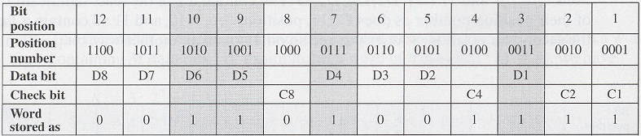
Example:
Data stored = 00111001
Check bits:
Putting it together:

Slide 15
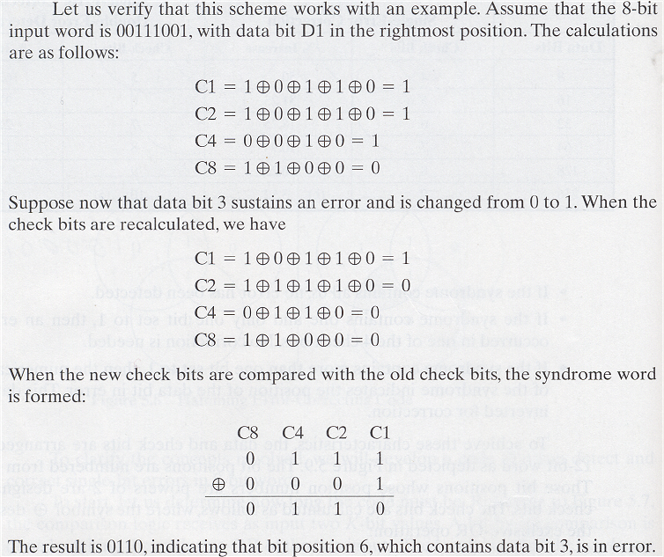
Example:

Slide 16
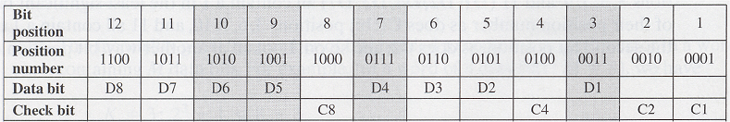
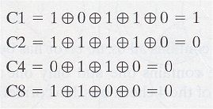
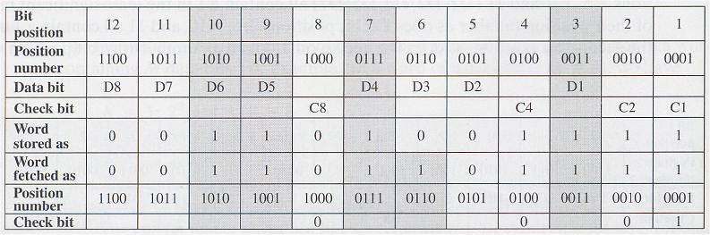
Example:
Word fetched:
Check Bits:
Comparing:
C8 C4 C2 C1
0 1 1 1 Orig Check Bits
0 0 0 1 New Check Bits
0 1 1 0 Syndrome
0110 = 6 ➔ bit position 6 is wrong, i.e. bit D3 is wrong
Putting it all together:

Slide 17
Increased word length for error correcting

Slide 18
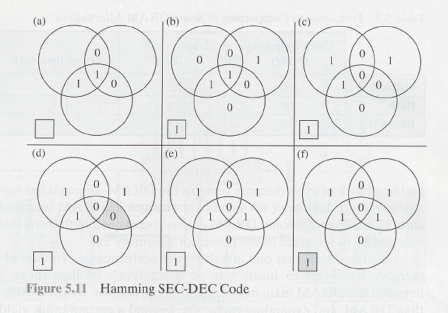
SEC-DEC Example
Requires One Extra Check Bit
Single Error Correction:
Single Error Correction, Double Error Detection:
Word With Even Parity Word With Even Parity With Two Errors
With Errors Identifying Error SEC Attempt IS SEC Correct? Extra Bit Confirms DE

Slide 19
Increased word length for error correcting

