Slide 1

Class Timetable Generator
Go, change the world
RV College of
Engineering
Experiential Learning
Phase 1: Presentation
CYCLE | CHEMISTRY
BRANCH | COMPUTER SCIENCE AND ENGINEERING

Slide 2

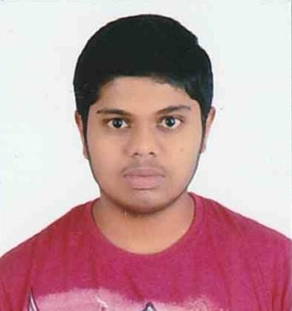
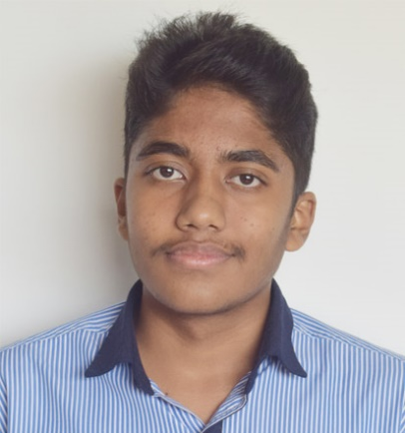
TEAM INTRODUCTION
PHOTO MEMBER-1 | PHOTO MEMBER-2 | PHOTO MEMBER-3 | PHOTO MEMBER-4
Roll No. | Admission No. | Name | Email Id
12 | RVCE21BCS012 | Aditya Veer Singh | adityaveers.cs21@rvce.edu.in
17 | RVCE21BCS017 | Parakh Agrawal | parakhagrawal.cs21@rvce.edu.in
38 | RVCE21BCS039 | M Aswartha Reddy | maswarthar.cs21@rvce.edu.in
43 | RVCE21BCS044 | Shishira M Iyar | shishiramiyar.cs21@rvce.edu.in
15 | RVCE21BCS014 | Saksham Prasad | sakshamprasad.cs21@rvce.edu.in

Slide 3
Introduction
This EL project deals with the generation of a website to appealingly display the timetable of professors
We are attempting to create a user-friendly, easily accessible interface which can be accessed by both professors and students
It also shows the workload and the free hours of the professors

Slide 4
Introduction
We have used JAM stack to make the website
The data is stored in json format
We used python to make data entry more user-friendly
We also used git for version control and collaboration

Slide 5
Data Format
The given excel format is not ideal for reading by code
Therefore we have decided to convert the data into a suitable json format
We use our own unit of time which is minutes since 9am since its more convenient.
We store the start time and duration of each class in minutes

Slide 6
Data Entry
We use python for data entry
The python code takes the teachers’ names, class names and the start and end times of classes as input. It is then converted to the appropriate json format automatically
Sentinel control is used to enter subject names
It is also fool proof and catches all the possible errors.

Slide 7
Future Scope
Administrator view to look at which teacher is free at a given time
Bar colour and background colour can be adjusted depending on client requirements
Department-wise teacher selection
Database can be expanded

Slide 8

THANK YOU

