Slide 1


SALES PREDICTION Using ML
Aswathaman R
Cohort- Seattle

Slide 2
ABOUT ROSSMANN
Rossmann, is one of the largest drug store chains in Europe with around 56,200 employees and more than 4000 stores.
The company was founded in 1972 by Dirk Rossmann with its headquarters in Burgwedel in Germany..
The product range includes up to 21,700 items and can vary depending on the size of the shop and the location.
In 2021, sales increased by 8.1 percent to 11.1 billion euros. There are a total of 4,361 Rossmann branches, 2,231 of which are in Germany

Slide 3
PROBLEM STATEMENT
PROBLEM DESCRIPTION,
Currently, Rossmann store managers are tasked with predicting their daily sales for up to six weeks in advance.
Store sales are influenced by many factors, including promotions, competition, school and state holidays, seasonality, and locality.
With thousands of individual managers predicting sales based on their unique circumstances, the accuracy of results can be quite varied.

Slide 4
SALES PREDICTION
PROBLEM STATEMENT
As a data scientist , we were provided with historical sales data for 1,115 Rossmann stores. The task is to forecast the "Sales" column for the test set.
PROJECT OBJECTIVE
Enhancing the Rossmann store chain through Linear Regression in Machine Learning

Slide 5
CONTENTS
Visualization Analysis
Preprocessing the Data
ML-Regression Models
ML-Evaluation Metrics
conclusion

Slide 6
STEPS INVOLVED
Importing the Dataset
Dataset Inspection
Handling Missing values
Feature Extraction
Exploratory Data Analysis
Pre-processing the Data
ML Regression Model
ML Model Evaluation

Slide 7
DATA SUMMARY
Name of the Dataset | Rossmann Store
Number of variables | 17
Number of observations | 1017209
Duplicate rows | 0
Total size in memory | 150 MB
Missing Data (Columns) | CompetitionDistance | 2642
 | CompetitionOpenSinceMonth | 323348
 | CompetitionOpenSinceYear | 323348
 | Promo2SinceWeek | 508031

Slide 8
VARIABLE DATA TYPE
Date Type | Column
Numeric - int64 | 0 Store 1 DayOfWeek 3 Sales 4 Customers 5 Open 6 Promo 8 SchoolHoliday 14 Promo2
Numeric – float64 | 11 CompetitionDistance 12 CompetitionOpenSinceMonth 13 CompetitionOpenSinceYear 15 Promo2SinceWeek 16 Promo2SinceYear
String - object | 2 Date 7 StateHoliday 10 Assortment 17 Promo Interval

Slide 9
DATASET INSPECTION
Rossman clearly stated that they were undergoing refurbishments in some of the stores , In the Dataset , found that nearly 150000 stores has been closed ,so to reduce bias , I have conducted the study only for the stores which are open.
The final dataset size was (844392, 21)

Slide 10
FEATURE EXTRACTION
We will extract some useful features from our dataset
Sales per Customer - To determine how many sales per customer
Competition Dist Cat - To group the competition store by 10 bins
Promo 2 Open - To determine since how many months promo-2 exist
Competition Open - To determine since how many months Competition exist
is Promo Month - To determine whether the sale is happened in promo month.

Slide 11
1. VISUALIZATION ANALYSIS
STORE TYPE vs STORE TYPE COUNT/SALES/CUSTOMERS
DAY OF WEEK vs SALES/CUSTOMERS
DAY OF WEEK vs SALES (Considering Promo)
STORE TYPE vs ASSORTMENT TYPE
PROMO 1 AND PROMO 2 vs SALES
HOLIDAY vs SALES
STORE COMPETITION DISTANCE vs SALES

Slide 12
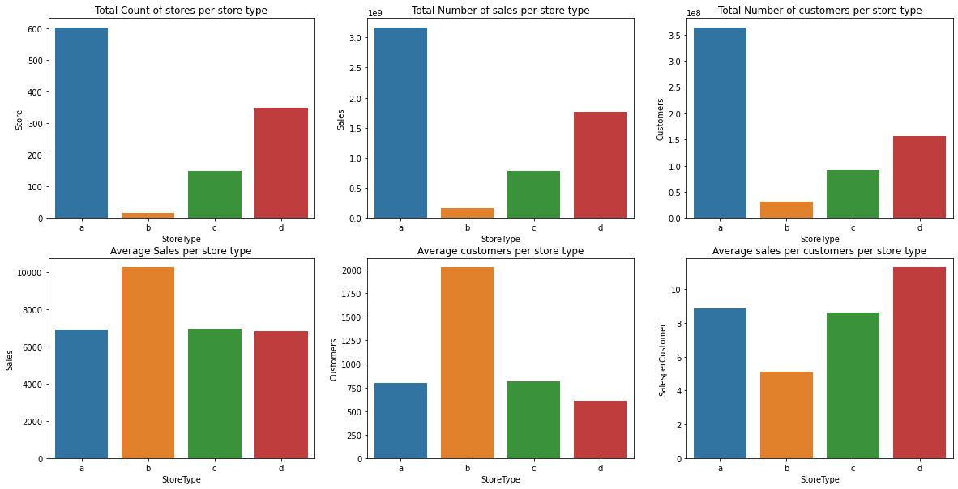
VISUALIZATION ANALYSIS
STORE TYPE vs STORE TYPE COUNT/SALES/CUSTOMERS
The Store Type A has the most stores, sales and customers. Whereas B has the highest average sales
similar patterns with the customers column and the Sales column, if the customer increases ,Sales increases

Slide 13
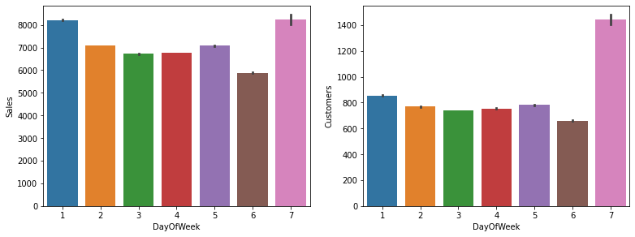
VISUALIZATION ANALYSIS
DAY OF WEEK vs SALES/CUSTOMERS
Average Sales on Sunday is higher because only few number of stores open on Monday
Highest sales are recorded on Mondays and lowest sales are recorded on Sundays.
This may be because most of the shops are closed on Sundays and this leads to higher demand on the next day, which is Monday.

Slide 14
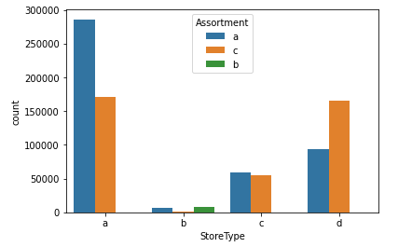
VISUALIZATION ANALYSIS
STORE TYPE vs ASSORTMENT TYPE
Assortment – Type – A
High in Store type A
Low in store type B
Assortment – Type –B
High in Store type A
Low in store type B
Assortment – Type –C
Available only in store type B

Slide 15
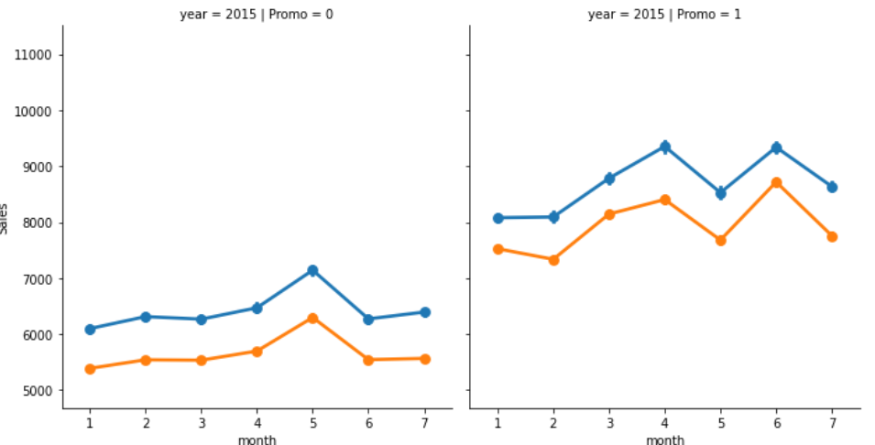
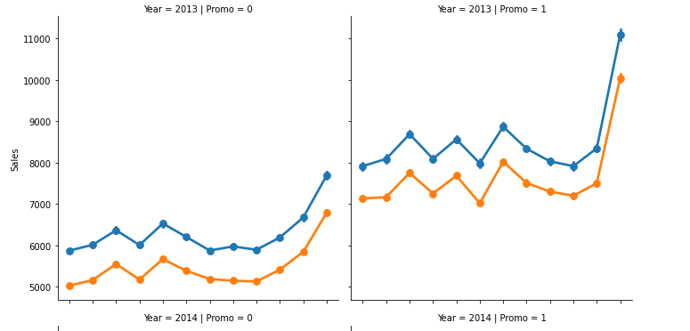
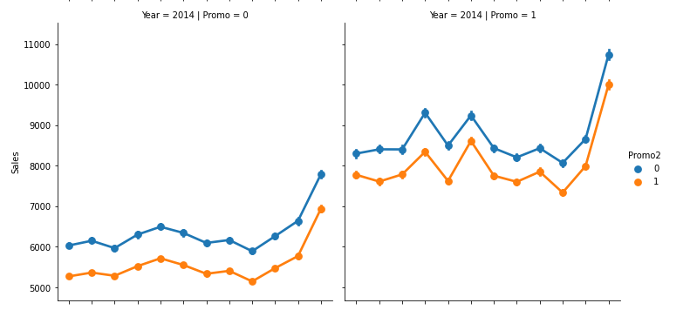
VISUALIZATION ANALYSIS
PROMO 1 AND PROMO 2 vs SALES
In 2013 and 2014 when there is no promotion, sales increased but not in a high amount. When there is a promotion we can see high difference in the sales.
In 2015 -when there is no promotion sales was less. When compared with the promotion. In 2015 , in non promo chart we can see that in the month of may has the more sales, but in promo chart may has low sales

Slide 16
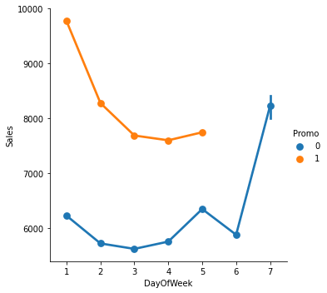
VISUALIZATION ANALYSIS
DAY OF WEEK vs SALES(Considering Promo)
From the graph we can infer that there is no promo on weekends
Promo - Monday has very high sales with promo may be due to holiday for most of the stores on Sunday.
Non Promo – Huge dip in sales on weekdays, steep rise in sales on Sundays can be seen may be it is due to only few stores are available.

Slide 17
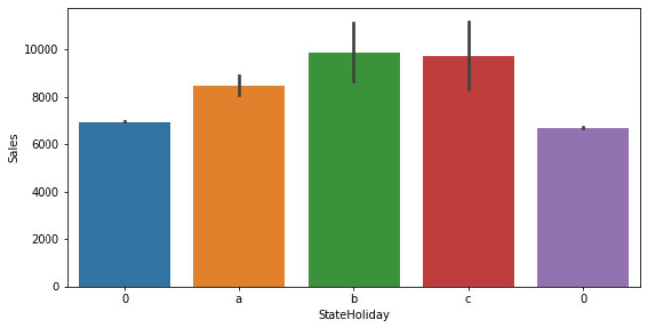
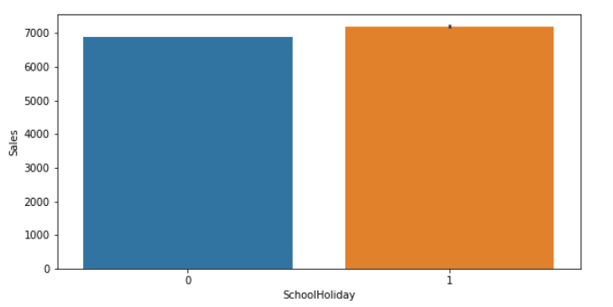
VISUALIZATION ANALYSIS
HOLIDAY VS SALES
State holiday
Average sales has been higher on Easter Holiday
School Holiday
Average sales on school holiday is similar to sales of week days. It may be due to only very few stores are open during school holiday

Slide 18
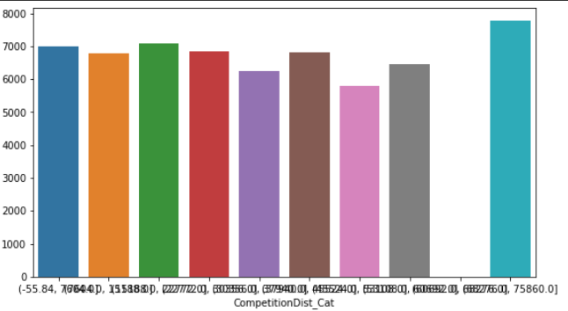
VISUALIZATION ANALYSIS
STORE COMPETITION DISTANCE vs SALES
Store Competition distance is grouped into 10 bins. From these we can observe that more number of stores are at more distance between the stores

Slide 19
VISUALIZATION ANALYSIS
SUMMARY ON VISUALIZATION ANALYSIS
At this stage, we got a solid understanding of the distributions, the statistical properties and the relationships of our variables. Some of the key understandings are
Customers and sales are also highly correlated because an increase in customers means that there must be an increase in sales too
we can see that Storetype A has the highest number of branches,sales and customers from the 4 different storetypes. But this doesn't mean it's the best performing Storetype.
Surprisingly it is StoreType D who has the highest average spending per Customer, this is probably explained by an average competition distance higher than ther rest which means each customer will buy more since he knows there isn't a lot of similair shops around.
After attempting to look at Sales behaviour in a week over the Years and over the months, i concluded that the pattern doesn't change, which means all the time there is a peak on Mondays with promotions, a tiny peak on Friday before the weekend and a big peak on Sunday because of closed stores.

Slide 20
1. PRE PROCESSING THE DATA
ENCODING
DISTRIBUTION ANALYSIS
CORRELATION ANALYSIS
FEATURE SELECTION

Slide 21
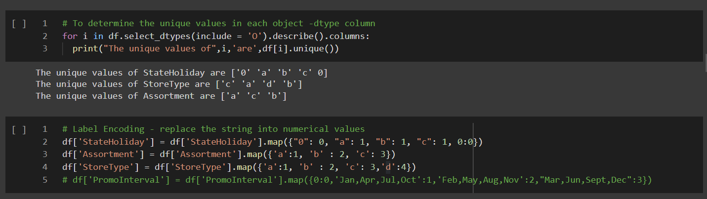
PRE PROCESSING THE DATA
ENCODING
LABEL ENCODING
Label Encoding refers to converting the labels into a numeric form so as to convert them into the machine-readable form.

Slide 22
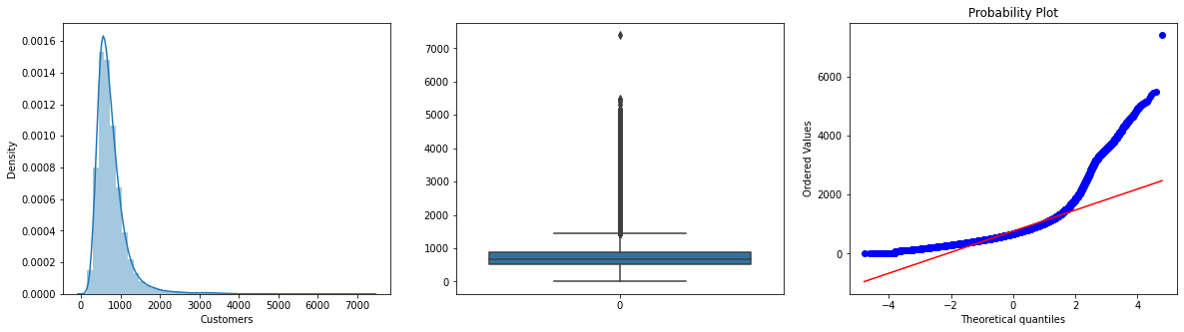
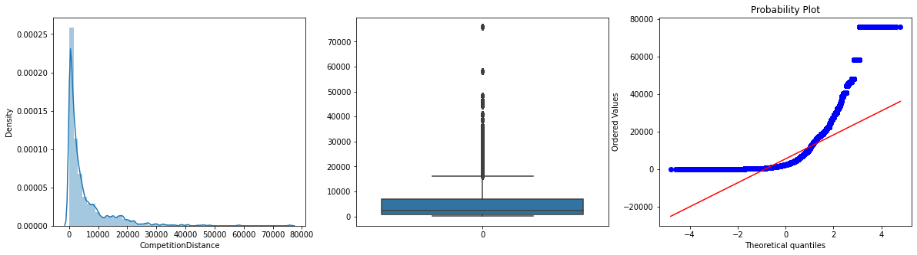
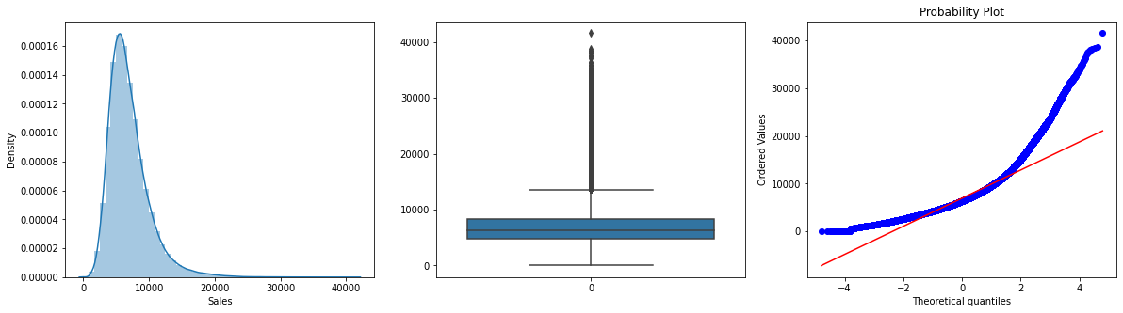
PRE PROCESSING THE DATA
DISTRIBUTION ANALYSIS
Customers –
Right skew
More number of outliers
Competition Distance –
Right skew
More number of outliers
Sales –
Right skew
More number of outliers

Slide 23
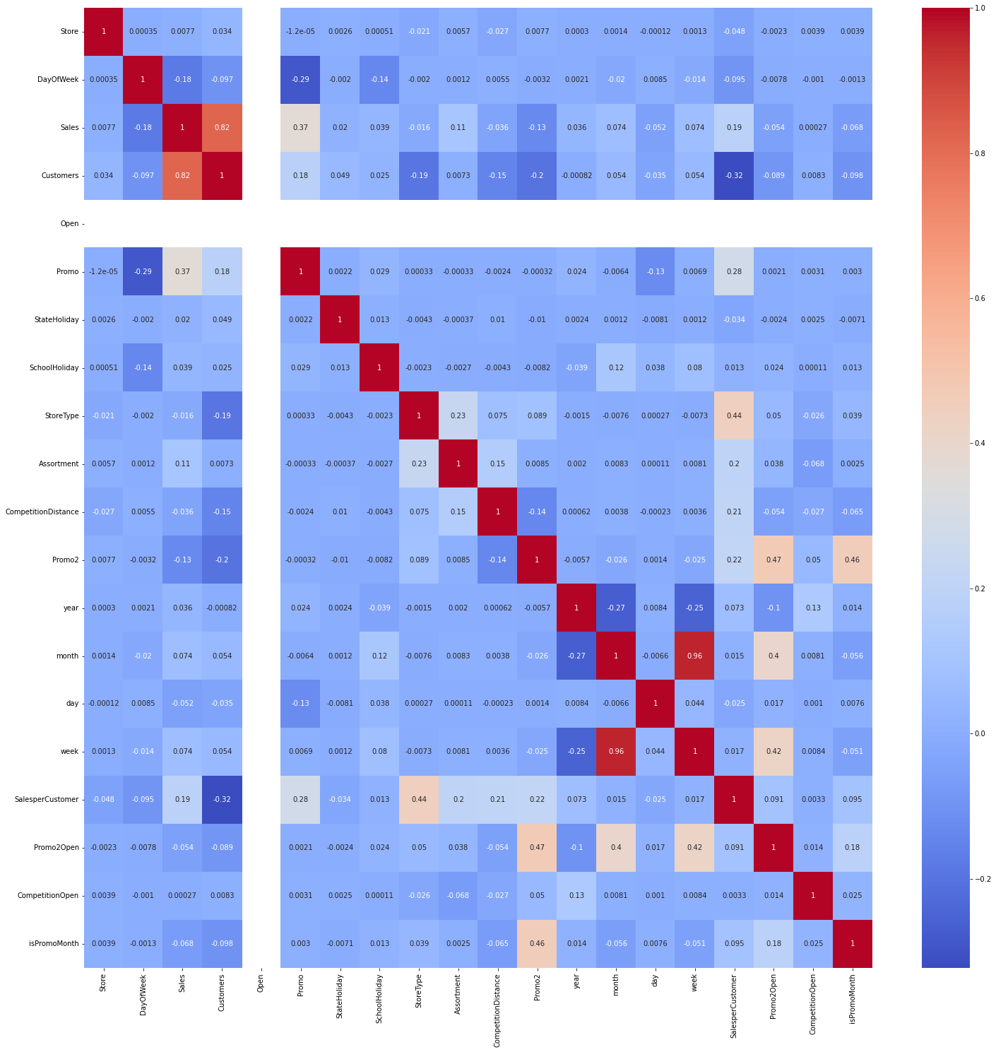
PRE PROCESSING THE DATA
CORRELATION ANALYSIS
It's interesting to see that Sales per Customer and Promo (0.28) actually correlate positively, since running a promotion increases that number .
Sales per Customer also correlates with Competition Distance(0.2), in a positive manner

Slide 24
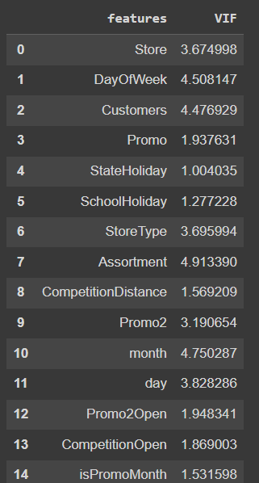
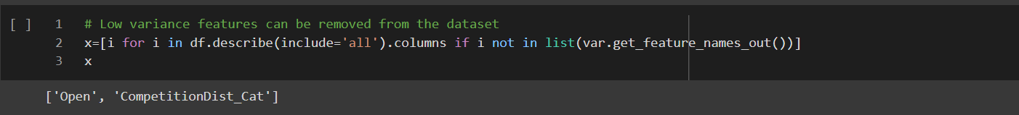
PRE PROCESSING THE DATA
CORRELATION ANALYSIS
VARIANCE
If the variance is low or close to zero, then a feature is approximately constant and will not improve the performance of the model. In that case, it should be removed.
VARIANCE INFLATION FACTOR
A variance inflation factor (VIF) provides a measure of multicollinearity among the independent variables in a multiple regression model.

Slide 25
PRE PROCESSING THE DATA
FEATURE SELECTION
FEATURE SELECTION
The features considered for creating the model are
['Store', 'DayOfWeek', 'Sales', 'Customers', 'Promo', 'StateHoliday', 'SchoolHoliday', 'StoreType', 'Assortment', 'CompetitionDistance', 'Promo2', 'year', 'month', 'day', 'Promo2Open', 'CompetitionOpen', 'isPromoMonth']

Slide 26
ML MODEL
Machine Learning Model for Sales prediction
Rossmann Sales data contain 10L rows, which will consume more computational time for training the model. So to overcome this , by mean of random sampling the size of the dataset has been reduced to 3L
For Train –Test data split up , I have considered 0.3 as threshold, So that train data will be around 2L rows to train the model.
To predict the sales, following Regression models are created
Linear Regression
Decision Tree Regressor
Random Forest Regressor
Extreme Gradient Boosting
Lasso Regression
Ridge Regression
ElastoNet Regression

Slide 27
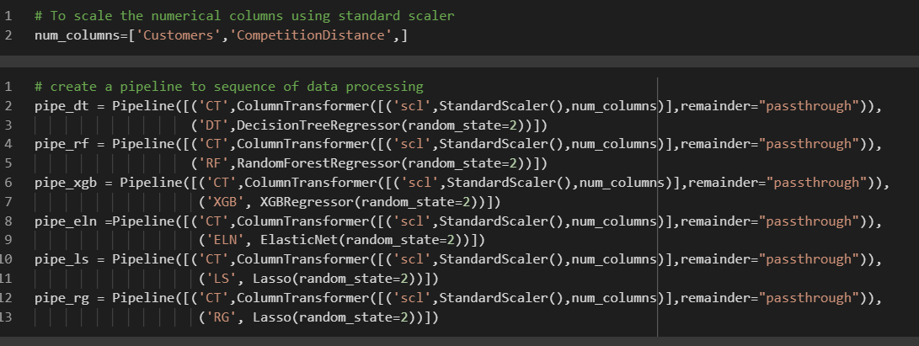
MODEL PIPELINE
Model Pipeline is created , so that scaling of data and model assignment will take place in sequence

Slide 28
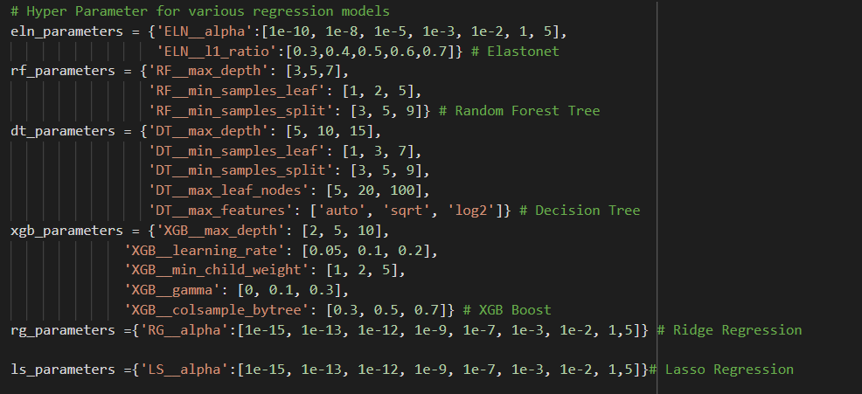
HYPERPARAMETER TUNING
Hyperparameter tuning consists of finding a set of optimal hyperparameter values for a learning algorithm while applying this optimized algorithm to any data set.
That combination of hyperparameters maximizes the model's performance, minimizing a predefined loss function to produce better results with fewer errors.

Slide 29
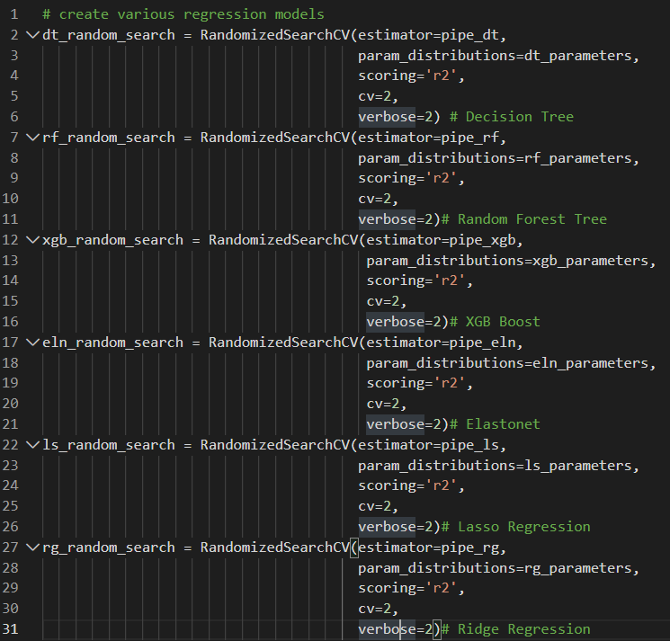
HYPERPARAMETER TUNING
RandomSearch CV, which uses random hyperparameter values to pick the best hyperparameters.
It's way faster than GridSearchCV.

Slide 30
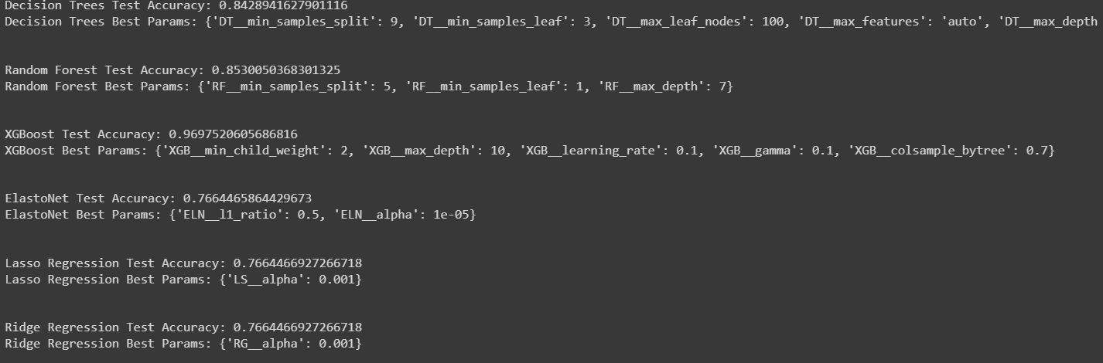
HYPERPARAMETER TUNING
The best parameters for each model is shown below

Slide 31
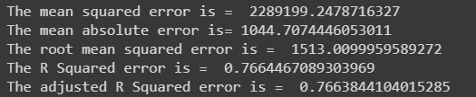
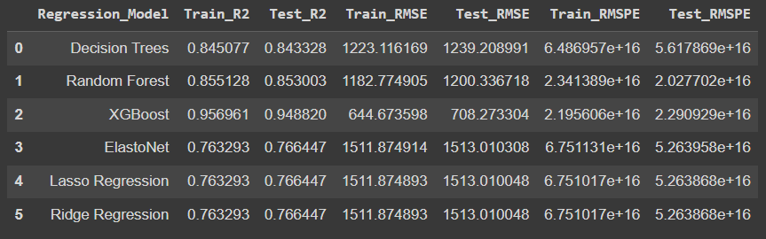
ML MODEL EVALUATION
Linear Regression
Regression Model Comparison

Slide 32
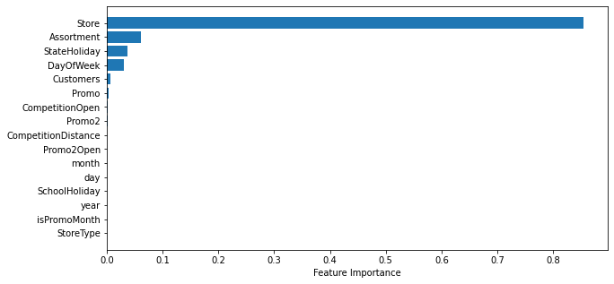
ML MODEL EVALUATION
FEATURE IMPORTANCE
In our ML – Random Forest model , Store Id has high feature importance, Next to it is Assortment.

Slide 33
CONCLUSION
Conclusion
Among all the regression models , XGBoost produces high r2 score, but there is tendency for a model to over fit because of high r2 score.
Random Forest gives 85% as r2 which pretty good.it may be because of more categorical features.
ElastoNet, Lasso, Ridge Regression models produces same output. compared to linear regression, regularized regression algorithm produces good result
If model interpretability is more important than accuracy, model built using decision tree algorithm should be chosen over the one using random forest algorithm. Since the difference between accuracy of these two models is less than 1%, there won't be a large difference in the result.

