Slide 1


Traffic Jam: Predicting People's Movement into Nairobi

Slide 2
PROBLEM STATEMENT
PROBLEM DESCRIPTION,
This challenge asks you to build a model that predicts the number of seats that Mobiticket can expect to sell for each ride, i.e. for a specific route on a specific date and time. There are 14 routes in this dataset.
All of the routes end in Nairobi and originate in towns to the North-West of Nairobi towards Lake Victoria.
The routes from these 14 origins to the first stop in the outskirts of Nairobi takes approximately 8 to 9 hours from time of departure.

Slide 3
PROBLEM STATEMENT
From the first stop in the outskirts of Nairobi into the main bus terminal, where most passengers get off, in Central Business District, takes another 2 to 3 hours depending on traffic.
The three stops that all these routes make in Nairobi (in order) are:
    Kawangware: the first stop in the outskirts of Nairobi
    Westlands
    Afya Centre: the main bus terminal where most passengers disembark
Passengers of these bus (or shuttle) rides are affected by Nairobi traffic not only during their ride into the city, but from there they must continue their journey to their final destination in Nairobi wherever that may be.

Slide 4
PROBLEM STATEMENT
Traffic can act as a deterrent for those who have the option to avoid buses that arrive in Nairobi during peak traffic hours. On the other hand, traffic may be an indication for people’s movement patterns, reflecting business hours, cultural events, political events, and holidays.

Slide 5
DATA DESCRIPTION
Nairobi Transport Data.csv (zipped) is the dataset of tickets purchased from Mobiticket for the 14 routes from “up country” into Nairobi between 17 October 2017 and 20 April 2018.
This dataset includes the variables: ride_id, seat_number, payment_method, payment_receipt, travel_date, travel_time, travel_from, travel_to, car_type, max_capacity.
Uber Movement provided historic hourly travel time between any two points in Nairobi.

Slide 6
DATA DESCRIPTION
Variables description:
ride_id: unique ID of a vehicle on a specific route on a specific day and time.
seat_number: seat assigned to ticket
payment_method: method used by customer to purchase ticket from Mobiticket (cash or Mpesa)
payment_receipt: unique id number for ticket purchased from Mobiticket
travel_date: date of ride departure. (MM/DD/YYYY)
travel_time: scheduled departure time of ride. Rides generally depart on time. (hh:mm)
travel_from: town from which ride originated
travel_to: destination of ride. All rides are to Nairobi.
car_type: vehicle type (shuttle or bus)
max_capacity: number of seats on the vehicle

Slide 7
CONTENTS
Visualization Analysis
Preprocessing the Data
ML-Regression Models
ML-Evaluation Metrics
conclusion

Slide 8
STEPS INVOLVED
Importing the Dataset
Dataset Inspection
Handling Missing values
Exploratory Data Analysis
Feature Extraction
FEATURE ENGINEERING
ML Regression Model
ML Model Evaluation

Slide 9
DATA SUMMARY
Name of the Dataset | Train_revised
Number of variables | 10
Number of observations | 51645
Duplicate rows | 0
Total size in memory | 5 MB
Missing Data (Columns) | 0

Slide 10
VARIABLE DATA TYPE
Date Type | Column
Numeric - int64 | 0 ride_id 9 max_capacity
String - object | 1 seat_number 2 payment_method 3 payment_receipt 4 travel_date 5 travel_time 6 travel_from 7 travel_to 8 car_type

Slide 11
DATASET INSPECTION
There are total 61 unique seats in this dataset.
Travelers have used 2 types of payment method and most of the people have used Mpesa to pay for their ticket.
The record of 149 days out of 2 year is present in this dataset.
There are 2 different types of car and most of them are bus.

Slide 12
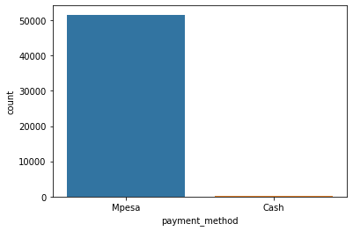
EXPLORATORY DATA ANALYSIS (EDA)
PAYMENT METHODS
There are two type of payment methods people have used to buy the tickets.

Slide 13
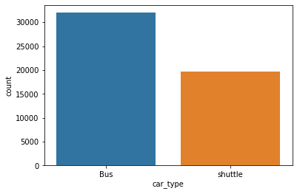
EXPLORATORY DATA ANALYSIS (EDA)
CAR TYPE
There are two type of cars Bus and shuttle.

Slide 14
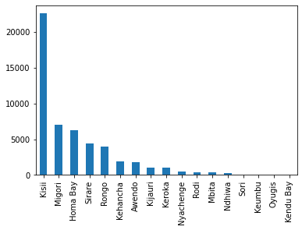
EXPLORATORY DATA ANALYSIS (EDA)
TRAVEL DETAILS – ORIGIN PLACE
From the above bar graph, we can say most of the travelers traveling from Kisii to Nairobi.

Slide 15
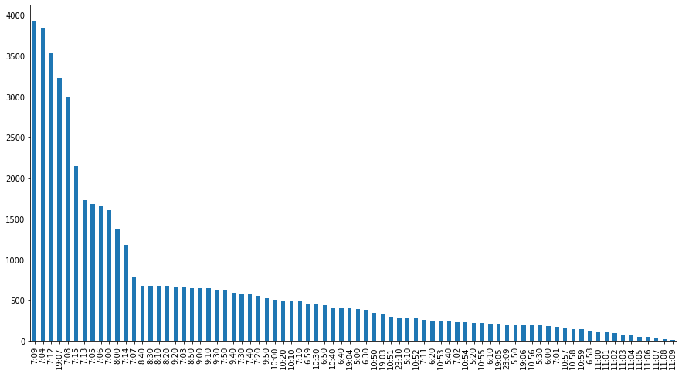
EXPLORATORY DATA ANALYSIS (EDA)
TRAVEL DETAILS -TIME
From the above bar graph, we can say most of the travelers travel at 7:09 from the origin.

Slide 16
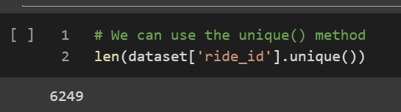
EXPLORATORY DATA ANALYSIS (EDA)
RIDE ID
We see there are 6249 unique ride_id.

Slide 17
FEATURE EXTRACTION
TARGET VARIABLE
Since we are not given the target variable so we need to find target variable first.
There might be many ways of finding the target variable but here I am using one way that is I will find the count of each ride_id and that will be the number_of_ticket as our target variable.

Slide 18
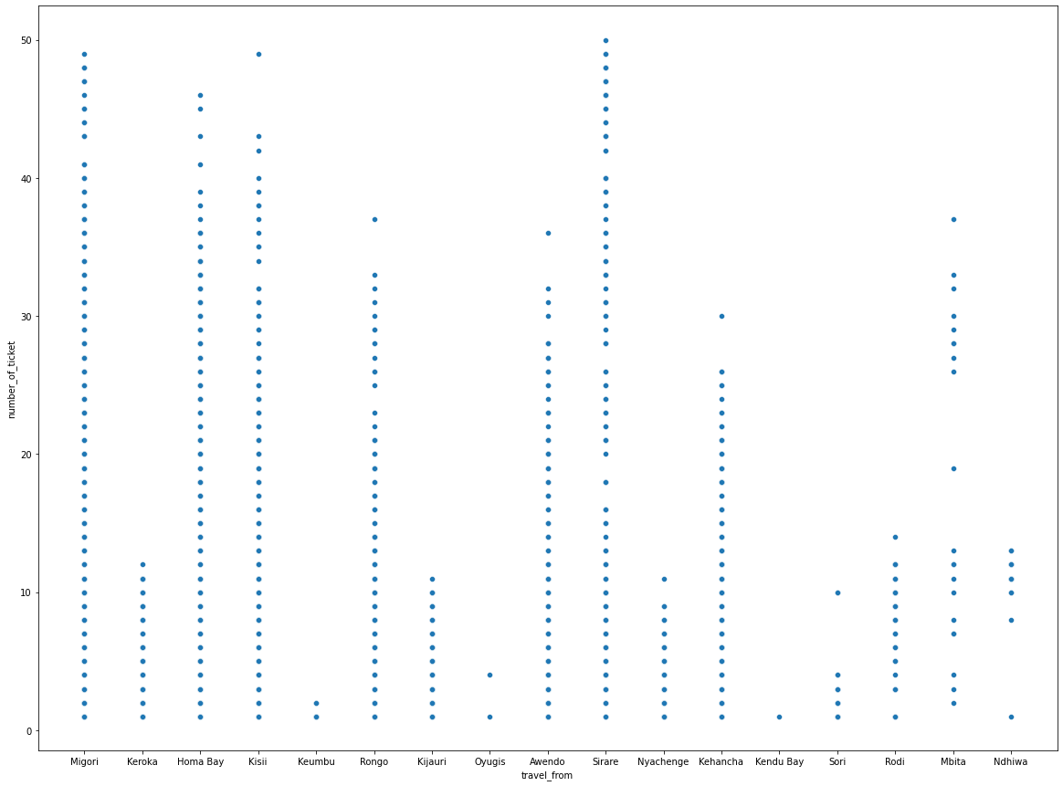
FEATURE EXTRACTION
NUMBER OF TICKETS BOOKED FROM ORIGIN CITY
From the graph, peoples from Migori, Sirare has booked most number of tickets.

Slide 19
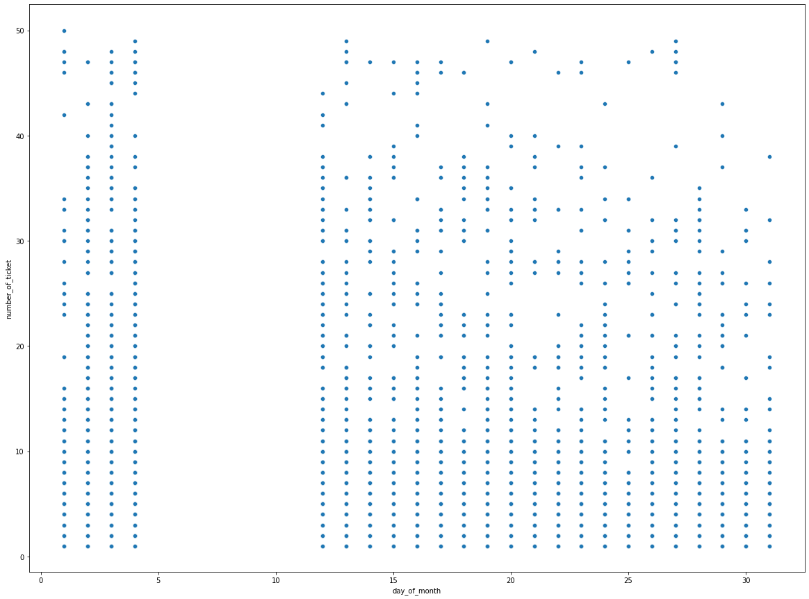
FEATURE EXTRACTION
TRAVEL DETAILS BASED ON THE DAY OF THE MONTH
We can see that there is the gap between 5 to 11 in the day of the month. We can assume that there is official holiday of public transport between these days. we can also say that the number of tickets in all the days of month are same

Slide 20
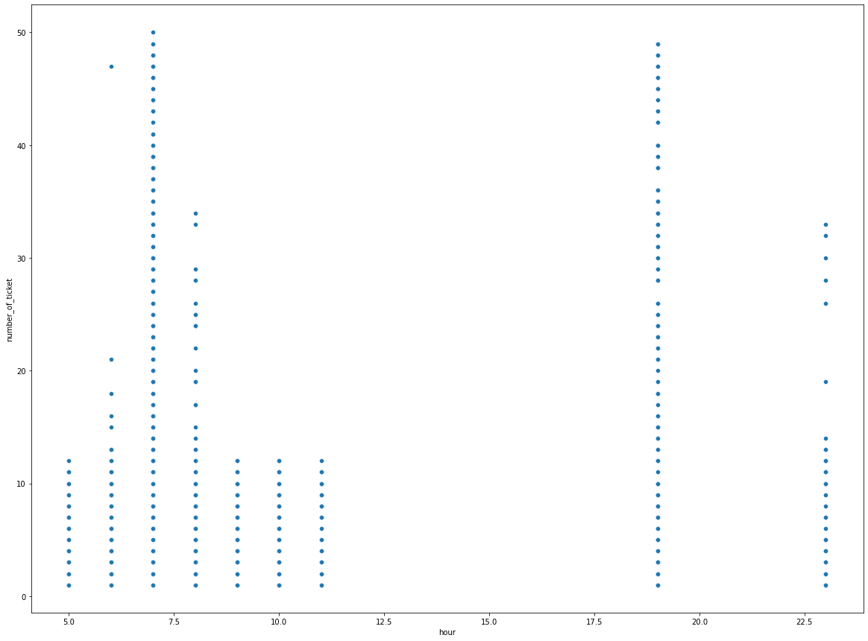
FEATURE EXTRACTION
TRAVEL DETAILS BASED ON THE HOUR OF THE DAY
We can see that most of the tickets were sold at 7 AM and 8 PM. And that seems true because in the morning most of the people go to the work and office.
From the above we can say that there is not ride between 12pm to 5.30Pm.

Slide 21
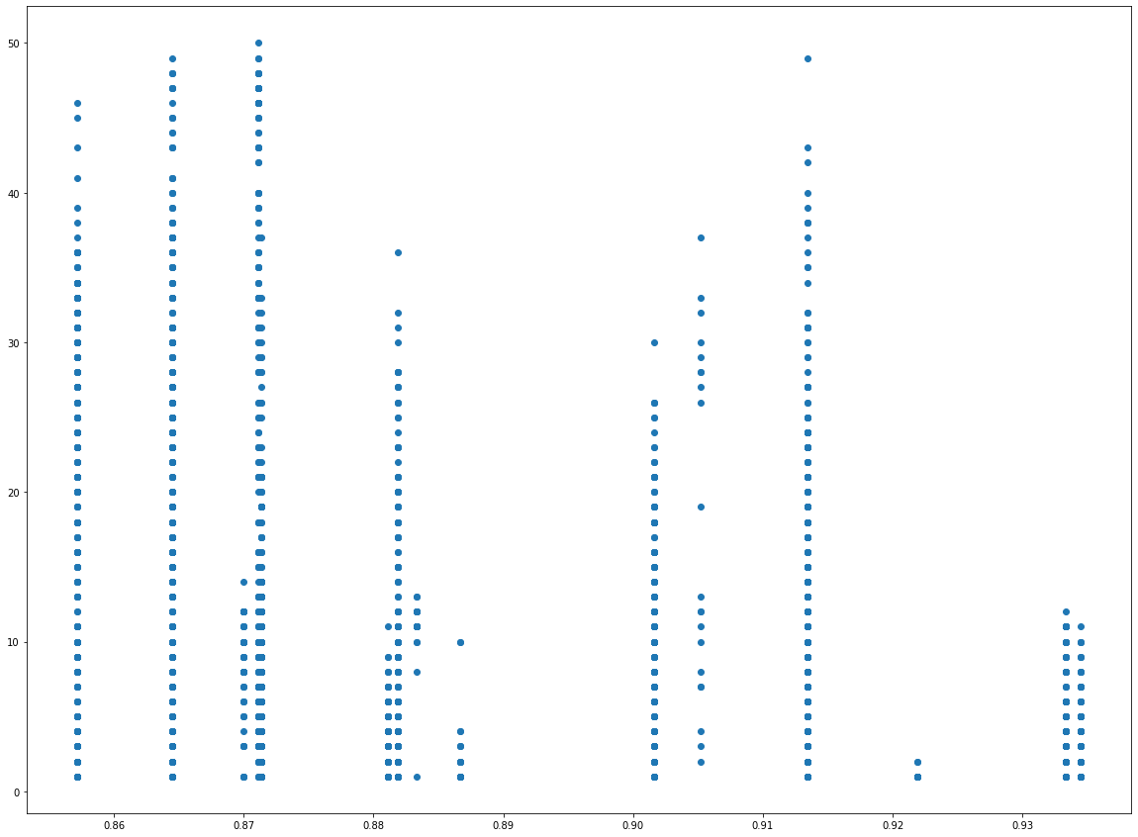
FEATURE EXTRACTION
SPEED TO REACH THE DESTINATION
Scatter plot shows the speed of the vehicle and Number of tickets booked.
Higher the speed , lesser number of tickets booked.

Slide 22
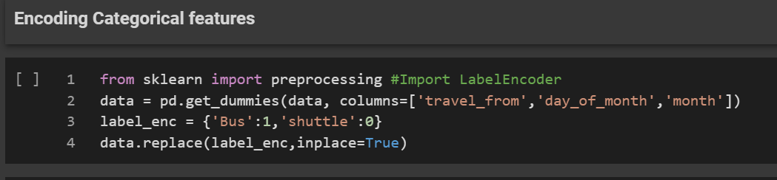
FEATURE ENGINEERING
ENCODING CATEGORICAL FEATURES
Encoding for categorical features are done by using get_dummies method.
The shape of the final data set is (6042,52)

Slide 23
FEATURE ENGINEERING
The features considered to create ML- Regression are
{'car_type', 'day_of_week', 'day_of_year', 'hour', 'minute', 'is_weekend', 'year', 'quarter', 'hourly_travelers', 'daily_travelers', 'Time_gap_btw_0_1_next_bus', 'Time_gap_btw_0_1_previous_bus', 'Time_gap_btw_0_2_next_bus', 'Time_gap_btw_0_2_previous_bus', 'Time_gap_btw_0_3_next_bus', 'Time_gap_btw_0_3_previous_bus', 'Time_gap_btw_next_previous_bus', 'travel_from_distance', 'travel_from_time', 'Speed', 'hod_arrived_date', 'minute_arrived_date', 'is_rush_hour', 'travel_from_Awendo', 'travel_from_Homa Bay', 'travel_from_Kehancha', 'travel_from_Keroka', 'travel_from_Keumbu', 'travel_from_Kijauri', 'travel_from_Kisii', 'travel_from_Mbita', 'travel_from_Migori', 'travel_from_Ndhiwa', 'travel_from_Nyachenge', 'travel_from_Rodi', 'travel_from_Rongo', 'travel_from_Sirare', 'travel_from_Sori', 'day_of_month_1', 'day_of_month_2', 'day_of_month_3', 'month_1', 'month_2', 'month_3’}

Slide 24
ML MODEL
For Train –Test data split up , we have considered 0.33 as threshold, So that train data will be around 4000 rows to train the model.
To predict the number of tickets will be booked , following Regression models are created
  Linear Regression
  Random Forest Regressor
  Extreme Gradient Boosting
  Lasso Regression
  Gradient Boosting Regressor

Slide 25
ML - REGRESSION MODEL
S.No | Regression Model | MSE | RMSE | RMSPE | MAE | MAPE
1 | Linear Regression | 48.5 | 6.96 | 346.44 | 4.75 | 165.80
2 | Lasso Regression | 56.12 | 7.49 | 341.44 | 5.437 | 185.59
3 | Gradient Boosting Regressor | 29.38 | 5.42 | 240 | 3.53 | 113.30
4 | XGboost | 24.9 | 4.99 | 206.98 | 3.16 | 96.5
In Random Forest, Model seems to be over fitted because of
Train score: 0.951206584831083 Test score: 0.6480112690449429

Slide 26
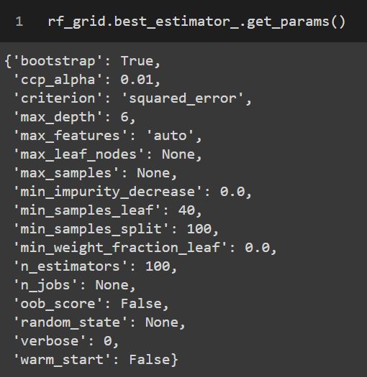
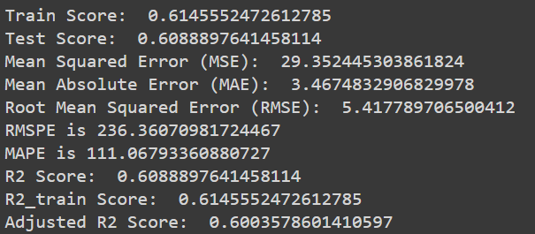
HYPERPARAMETER TUNING
GRID SEARCH CV ON RANDOM FOREST
The best parameters for random forest are
The Evaluation metrics for random forest are

Slide 27
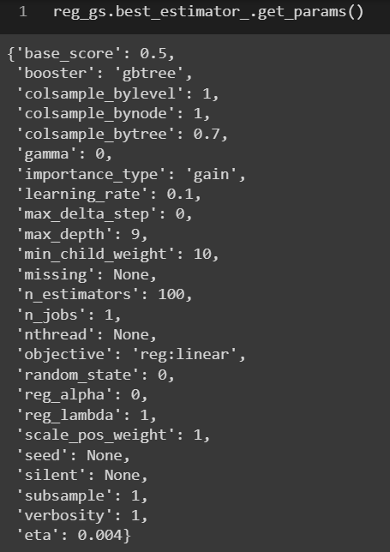
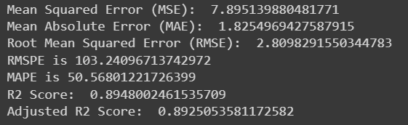
HYPERPARAMETER TUNING
GRID SEARCH CV ON XGBOOST ALGORITHM
The best parameters for XGBOOST are
The Evaluation metrics for XGBOOST are

Slide 28
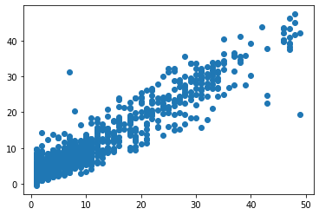
CONCLUSION
RESIDUAL ANALYSIS
Residual analysis is used to assess the appropriateness of a linear regression model by defining residuals and examining the residual plot graphs.
Residual ( e) refers to the difference between observed value ( y) vs predicted value ( y ^ ). Every data point have one residual

Slide 29
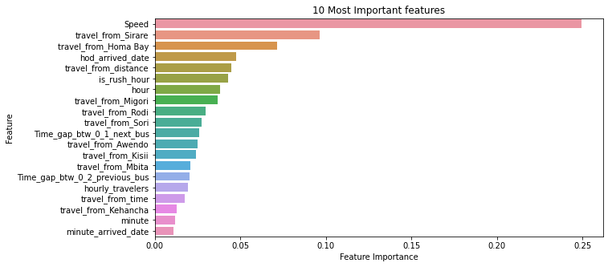
CONCLUSION
FEATURE IMPORTANCE
From the graph, Speed is the most important feature of our data set.

Slide 30
CONCLUSION
CONCLUSION
We used different type of regression algorithms to train our model like, Linear Regression, Regularized linear regression (Lasso), GBM, Random Forest Regressor, XGboost regressor. and Also we tuned the parameters of Random forest regressor and XGboost regressor and also found the important features for training the model. Out of them XGboost with tuned hyperparameters gave the best result.

