Slide 1
CipherGuard
A Policy-Aware Safety Router with Removal-Based Token Attribution for LLM Applications
Project Review 2: Software Requirements Specification (SRS) & System Design Specification
Keshav Memorial Institute of Technology (KMIT), Hyderabad • Department of CSE
Under the Guidance of: B. Shailesh
Team Members: Shreya Namdeo • Shashank Reddy Yasa • Adi Aswatha Reddy • B. Abhinav

Slide 2
CIPHERGUARD • PROJECT REVIEW 2
Project Review 2: Scope & Agenda
1. Software Requirements Specification (SRS)
Functional requirements (FR-1 to FR-5), non-functional constraints, and IEEE 830 compliance.
2. System Design & Architectural Patterns
Decoupled gateway pipeline, threat models, and sub-50ms inference design.
3. Class Diagram & OOP Structure
Component hierarchy, polymorphism, and dynamic policy loader relationship.
4. Sequence Diagrams
End-to-end request routing, beam search attribution, and runtime policy hot-reloading.
5. State Chart Diagram
Lifecycle state machine from input ingestion to fail-closed safety resolution.
6. Deployment Diagram & Physical Topology
Process boundaries, ports (:8000, :8501), inference workers, and SQLite storage.

Slide 3
CIPHERGUARD • PROJECT REVIEW 2
Software Requirements: Functional Modules (FR-1 to FR-5)
FR-1: Dual-Surface Ingestion
• Accepts direct user prompts (surface='direct')
• Ingests indirect context: docs, tools, emails (surface='indirect')
• Preserves provenance metadata across the routing lifecycle
FR-2: Risk Scoring & Ensembles
• Ensembles Model Family A (TF-IDF+LogReg) & Family B (MLP)
• Optional zero-shot transformer scoring via DeBERTa-v3
• Calibrated risk outputs: Jailbreak, Injection, PII, Tools, Hate
FR-3: Dynamic Policy Engine
• JSON-configurable policy matrix (policy.json)
• Runtime threshold hot-reloading with zero retraining
• Hierarchical rule matching (surface-specific -> wildcard *)
FR-4: Removal-Based Attribution
• Iterative beam search (k=5, L=6) on BLOCK or REVIEW
• Identifies minimal token subset flipping decision to PASS
• Computes delta score and generates sanitized safe prompt
FR-5: Audit Trail & Interfaces
• Persistent SQLite audit logging with WAL integrity
• FastAPI REST endpoints (/route, /policy, /logs, /explain)
• Interactive Streamlit web dashboard for administration

Slide 4
CIPHERGUARD • PROJECT REVIEW 2
Software Requirements: Non-Functional Requirements (NFR)
NFR-1: Performance & Low Latency
• Lightweight classifier routing must complete in <= 50ms.
• Removal beam search attribution completes in <= 400ms for typical inputs (<= 60 tokens).
• Zero latency overhead added to benign prompts (attribution runs strictly on flagged inputs).
NFR-2: Security & Fail-Closed Integrity
• Strict Pydantic schema validation on all dynamic policy updates.
• Parameterized SQLite statements to mitigate internal injection risks.
• Fail-closed architecture: unhandled classifier exceptions default to BLOCK.
NFR-3: Reliability & High Availability
• Atomic hot-reloading ensures 99.9% uptime during runtime policy edits.
• File-watcher fallback protects system from corrupted or malformed policy JSON files.
NFR-4: Auditability & Explainability
• Every routing transaction logs inputs, risk vectors, rule evaluations, and latency.
• Contrastive explanations expose minimal trigger tokens and delta risk reduction.

Slide 5
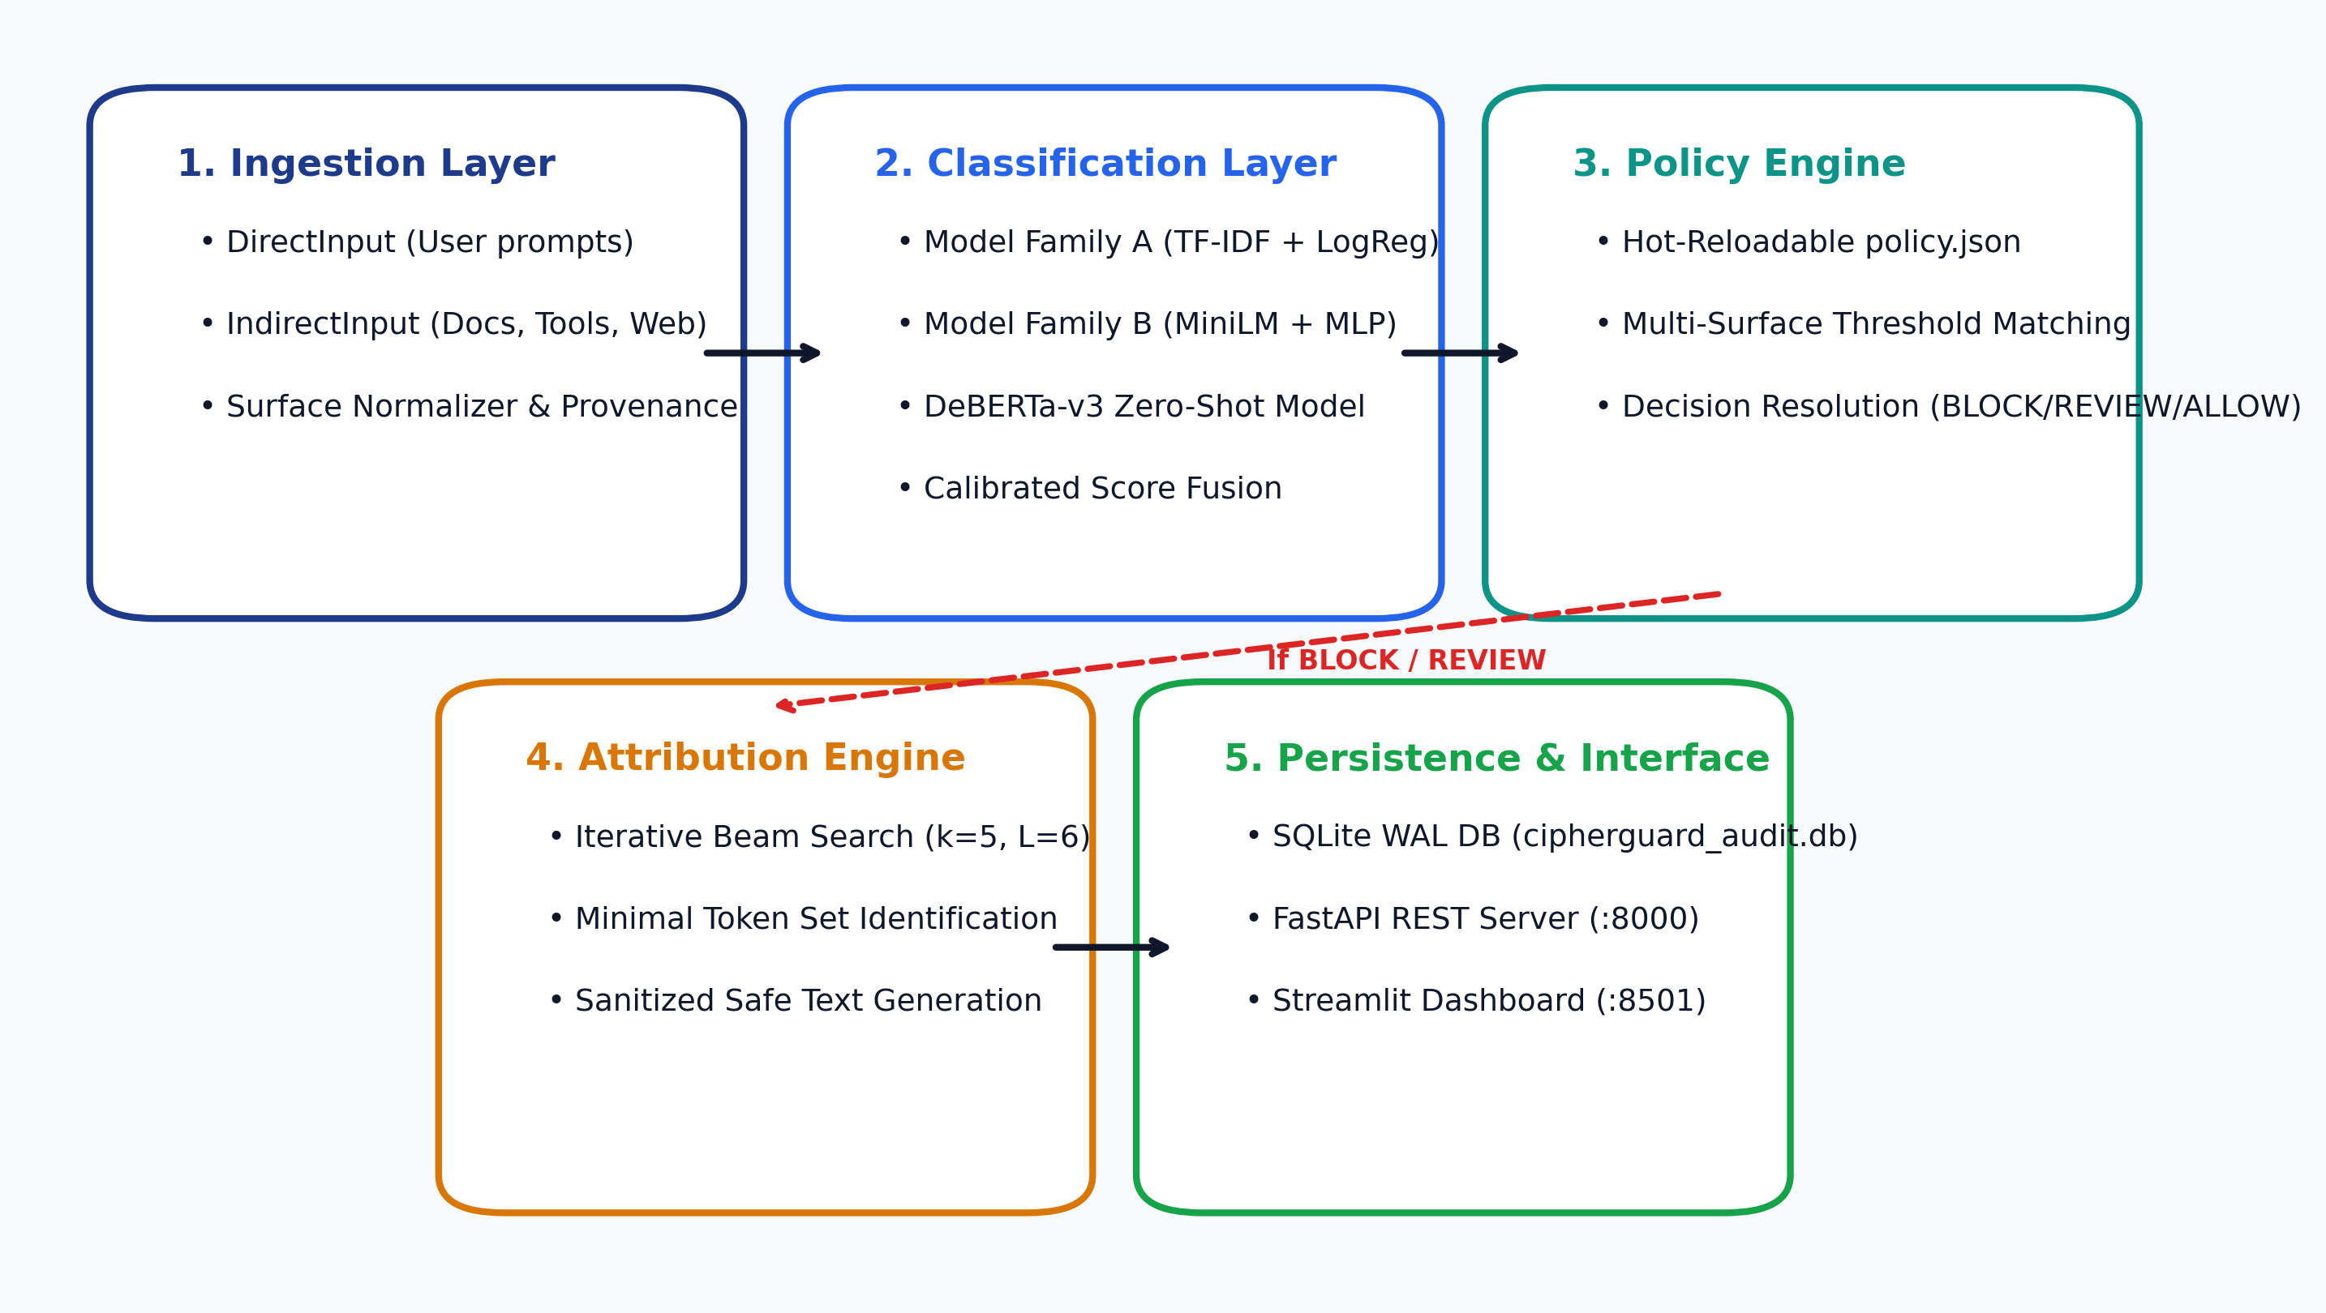
CIPHERGUARD • PROJECT REVIEW 2
System Design: Layered Architecture & Subsystems
Key Architectural Highlights
• Gateway Pattern:
Intercepts direct & indirect inputs before generative LLM execution.
• Score Fusion:
Ensembles lexical (TF-IDF), dense neural (MLP), and transformer (DeBERTa-v3) classifiers.
• Decoupled Policy:
Decouples threshold policies from model weights—no retraining required for policy changes.
• Conditional Search:
Beam search attribution activates exclusively on BLOCK/REVIEW decisions.
• Audit Persistence:
All decisions and contrastive rationale are committed to SQLite WAL storage.

Slide 6
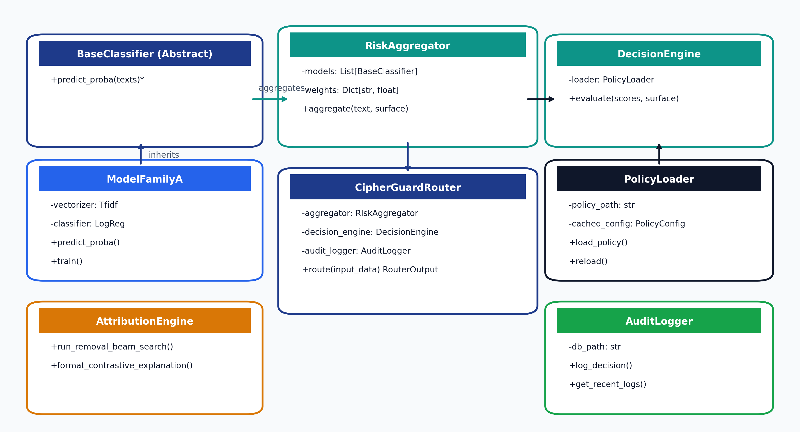
CIPHERGUARD • PROJECT REVIEW 2
System Design: Object-Oriented Class Diagram
Class Design Notes
• Polymorphic Classifiers:
BaseClassifier enforces predict_proba() contract across ModelFamilyA, ModelFamilyB, and DebertaClassifier.
• Risk Aggregation:
RiskAggregator fuses model predictions using calibrated weighting.
• Policy & Decision:
DecisionEngine evaluates fused scores against PolicyLoader cached rules.
• Core Orchestrator:
CipherGuardRouter orchestrates ingestion, classification, policy check, attribution, and audit logging.
• Audit Trail:
AuditLogger persists decision records and sanitized texts to SQLite.

Slide 7
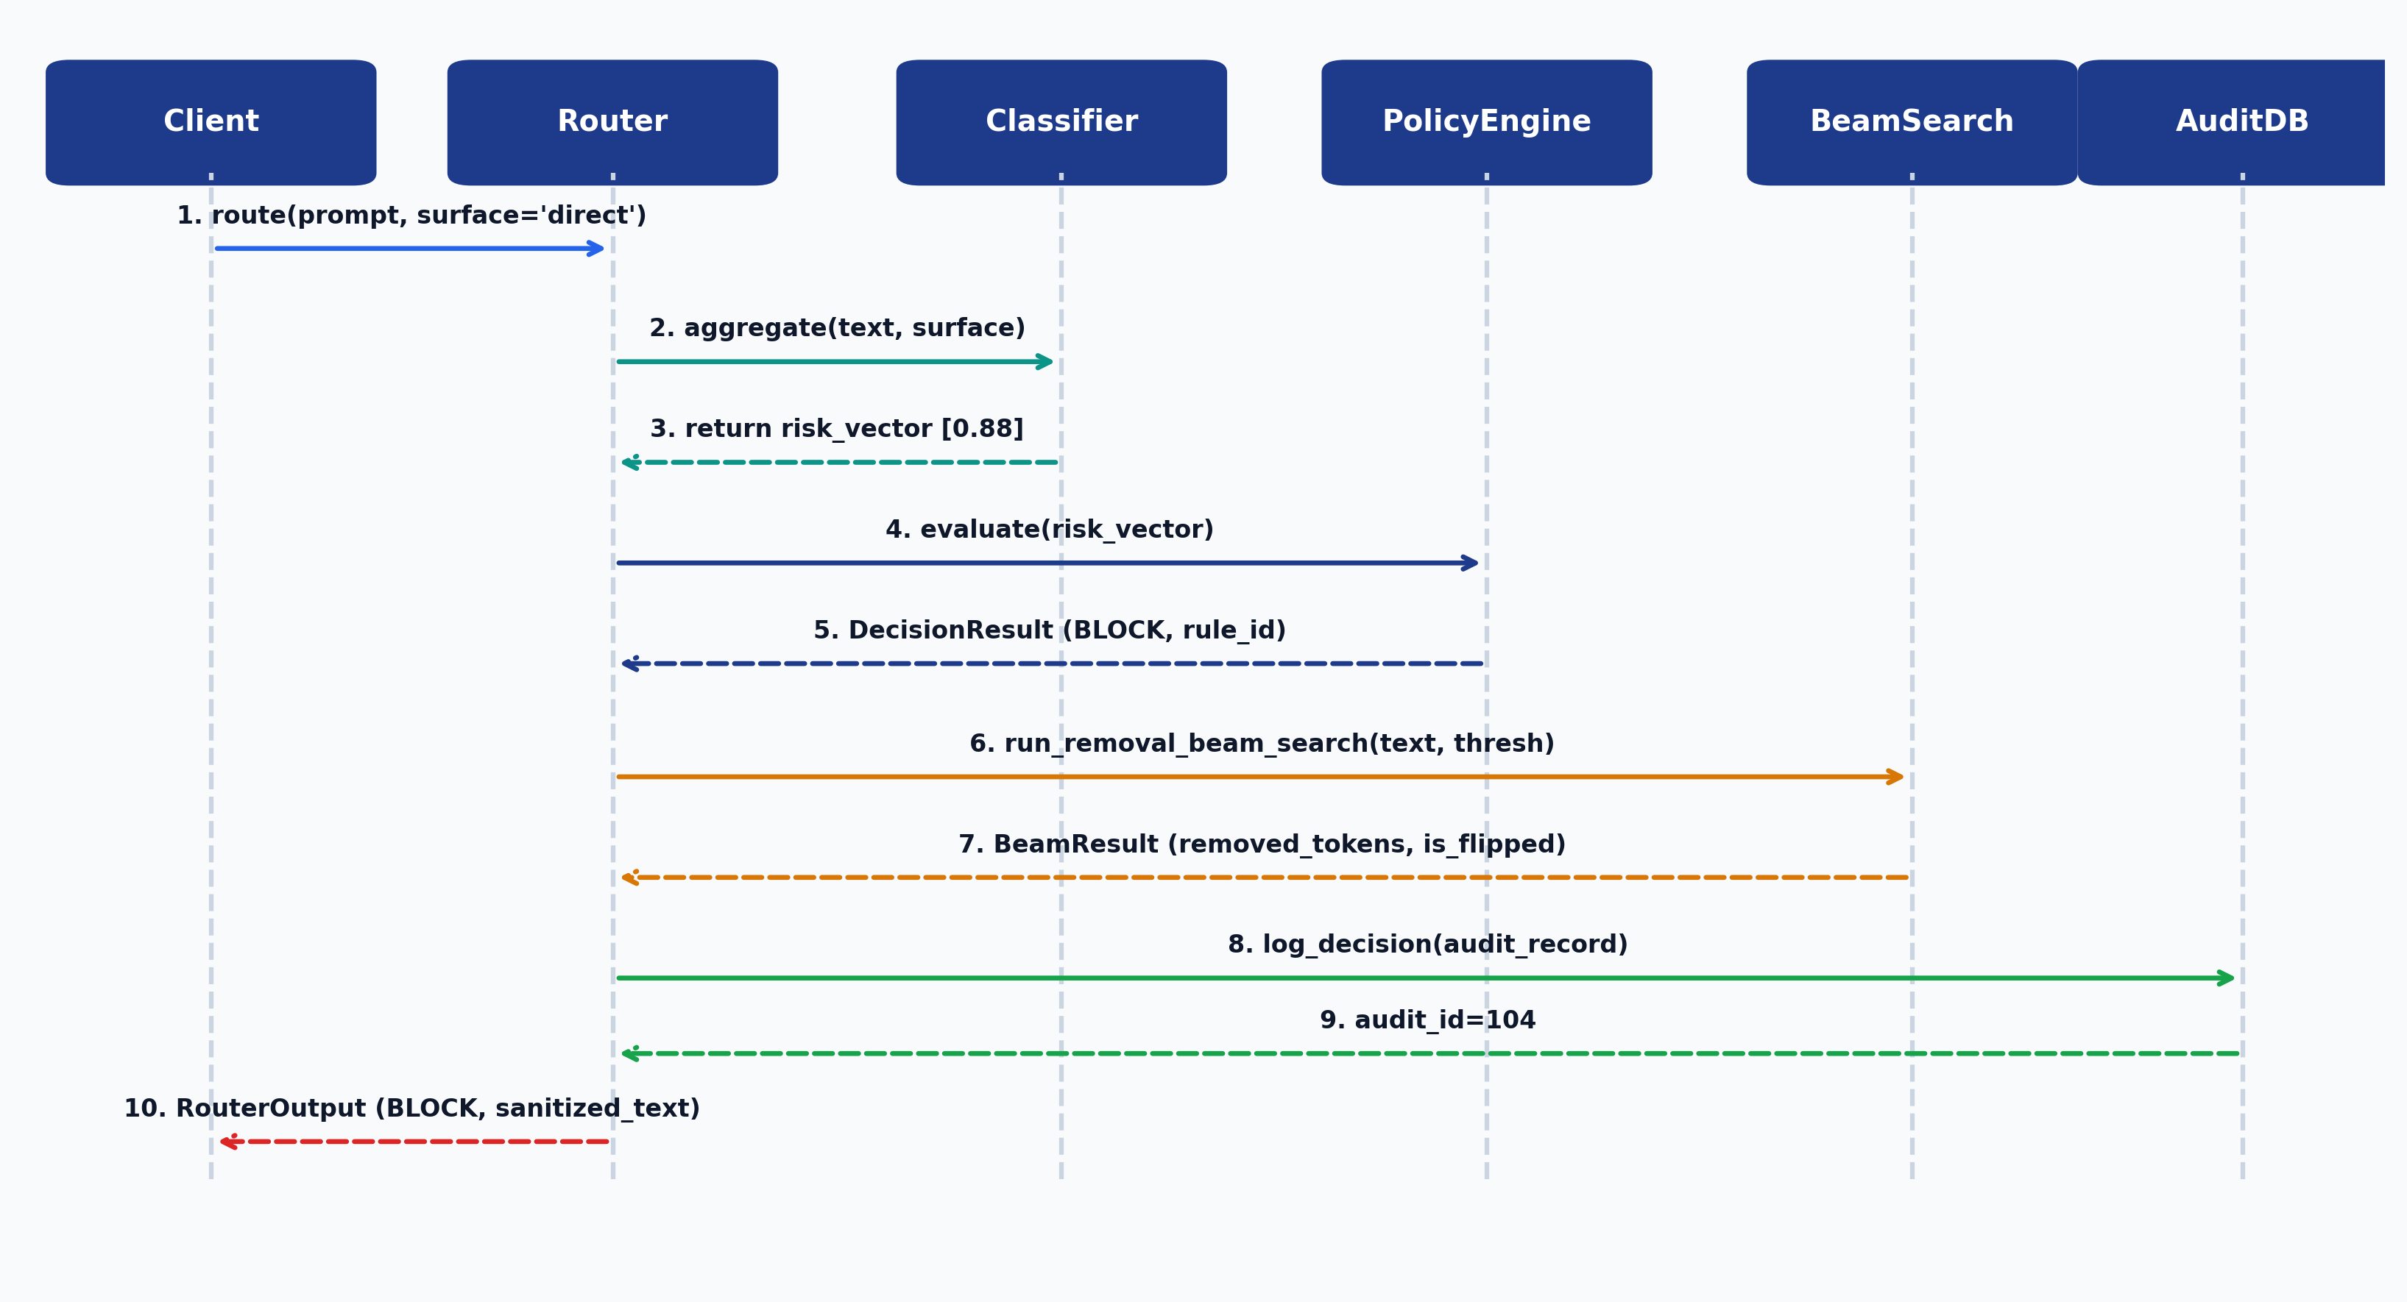
CIPHERGUARD • PROJECT REVIEW 2
System Design: End-to-End Sequence Diagram
Sequence Execution Steps
1. Ingestion: Client submits query marked with surface provenance.
2. Scoring: Classifiers generate multi-dimensional risk scores.
3. Policy Check: DecisionEngine matches scores against policy rules.
4. Conditional Attribution: If BLOCK or REVIEW, beam search finds minimal flip tokens.
5. Sanitization: System excises offending words into a clean variant.
6. Audit & Response: All metrics logged to SQLite before returning result.

Slide 8
CIPHERGUARD • PROJECT REVIEW 2
System Design: Dynamic Policy Hot-Reloading Flow
The Zero-Retraining Paradigm
• Base Paper Limitation (Llama Guard)
Llama Guard fixes decision boundaries inside model weights. Changing a safety rule or adjusting sensitivity requires fine-tuning and redeployment.
• CipherGuard Innovation
Decouples classifier probabilities from organizational thresholds stored in an external JSON policy matrix.
• Hot-Reload Mechanism
PolicyLoader validates updates via Pydantic and applies threshold changes in memory immediately.
• Zero Downtime
Allows live security teams to tighten or loosen moderation policies on the fly without rebooting services.
Hot-Reload Interaction Flow
• Step 1: Admin PUT /policy
Administrator sends updated JSON payload specifying new threshold (e.g., Jailbreak threshold 0.45 -> 0.35).
• Step 2: Pydantic Validation
FastAPI validates the schema against PolicyConfig schema; rejects malformed requests immediately.
• Step 3: Atomic Disk Write
PolicyLoader commits new JSON configuration to disk atomically.
• Step 4: Cache Update
Internal cached_config and last_mtime timestamps update synchronously.
• Step 5: Immediate Effect
The next request entering route() evaluates against the newly loaded threshold with zero restart.

Slide 9
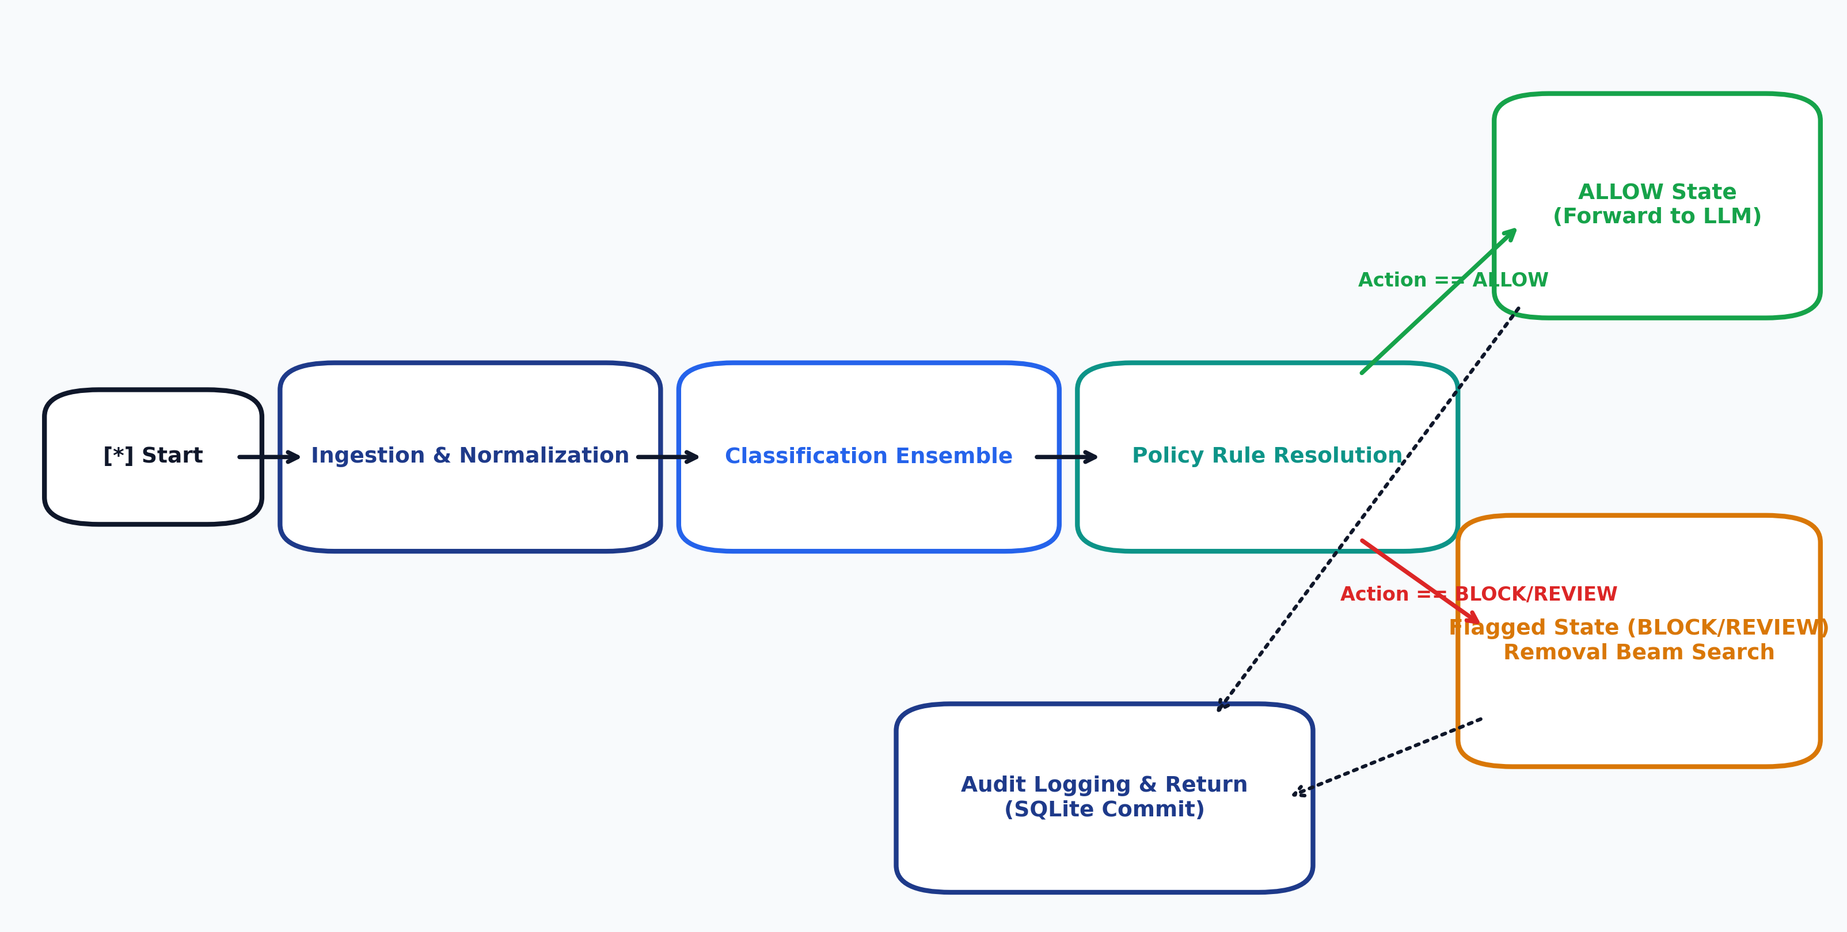
CIPHERGUARD • PROJECT REVIEW 2
System Design: Prompt Lifecycle State Chart Diagram
State Lifecycle Description
• Ingestion State:
Tags surface provenance (direct vs indirect) and normalizes input text.
• Classification State:
Computes multi-dimensional risk scores via ensemble prediction.
• Policy Evaluation State:
Compares risk vector against active policy thresholds.
• Allow State:
Clears benign prompts directly to downstream LLM agent.
• Flagged State:
Conducts beam search over token removals, computes delta score, and sanitizes input.
• Error State:
Fails closed to safety block if unhandled exceptions occur.

Slide 10
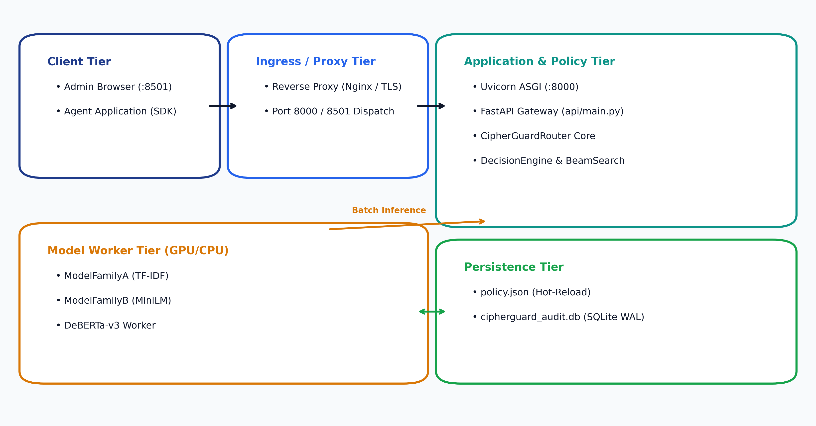
CIPHERGUARD • PROJECT REVIEW 2
System Design: Physical Deployment Diagram
Deployment Architecture
• Presentation Layer:
Streamlit UI on Port 8501 for interactive testing and policy tuning.
• API Gateway Layer:
FastAPI / Uvicorn on Port 8000 handling high-throughput REST calls.
• Inference Tier:
GPU/CPU workers running Model Family A, Family B, and DeBERTa-v3.
• Persistence Tier:
policy.json for live rules; SQLite with WAL mode for audit logging.
• Reverse Proxy:
Nginx handles TLS termination and traffic routing.

Slide 11
CIPHERGUARD • PROJECT REVIEW 2
Implementation Verification: Traceability Matrix
SRS Requirement
System Design Component
Codebase Module
Verification Status
FR-1: Dual-Surface Ingestion
Ingestion Layer (DirectInput / IndirectInput)
src/ingestion/
Verified (tests/test_router.py)
FR-2: Multi-Model Scoring
ModelFamilyA, ModelFamilyB, DeBERTa-v3
src/classification/
Verified (tests/test_classification.py)
FR-3: Dynamic Policy Matrix
PolicyLoader, DecisionEngine (Hot-Reload)
src/policy/, policy/policy.json
Verified (tests/test_policy_engine.py)
FR-4: Removal Token Attribution
run_removal_beam_search, ContrastiveExplanation
src/attribution/
Verified (tests/test_attribution.py)
FR-5: Audit Store & REST API
AuditLogger (SQLite WAL), FastAPI (/route)
src/logging_store.py, api/main.py
Verified (FastAPI /route & /logs)

Slide 12
CIPHERGUARD • PROJECT REVIEW 2
Summary & Next Steps for Project Review 2
Deliverables Completed
• 1. Software Requirements Specification (SRS) written following IEEE 830 standards.
• 2. System Design Architecture detailing the 5 decoupled sub-pipelines.
• 3. Complete UML Diagrams: Class, Sequence (Routing & Hot-Reload), State Chart, and Deployment diagrams.
• 4. Full test suite passing with 100% success (13/13 unit & integration tests).
• 5. Interactive demonstration environment ready via Streamlit (:8501) and FastAPI (:8000).
Live Demo & Future Milestones
• Live Demonstration:
1. Submit a direct jailbreak attempt -> inspect BLOCK & minimal tokens removed.
2. Update threshold dynamically via PUT /policy -> verify instant policy shift.
3. Ingest indirect document attack -> observe decoupled surface calibration.
• Phase 3 Planned Enhancements:
1. Large-scale benchmark evaluation (InjecAgent & AgentDojo).
2. Batched beam search GPU acceleration to push attribution under 100ms.
3. Multi-turn conversation state tracking and output moderation.

