Slide 1
Market Basket Analysis
CS5661 Spring 2018
Manikandan Eswaran
Vivek Agarwal
Harminder Singh

Slide 2
Objective
Using standard scikit-learn algorithms and predict if a particular item (product) has the possibility to be re-ordered.
Apply Apriori association rule data mining techniques to find the combination of product items that has a possibility of being ordered together with a given confidence level.

Slide 3
Dataset
The dataset for this project was taken from kaggle. The data set contains transactions data set that contains a set of orders and the list of products in each order with a flag specifying if a particular item in that order was a re-order or the first order.

Slide 4
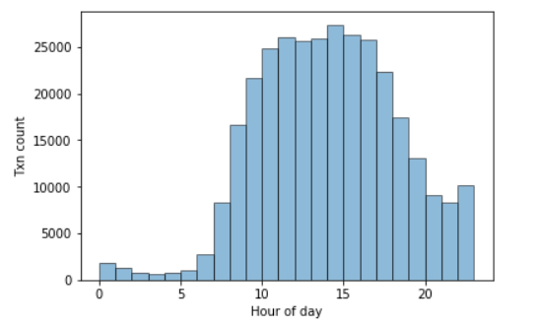
Understanding the dataset Distribution of transactions over the day

Slide 5
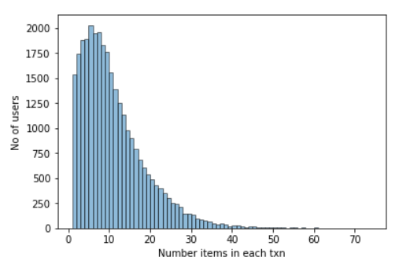
Understanding the dataset Number of products purchased Vs number of users

Slide 6
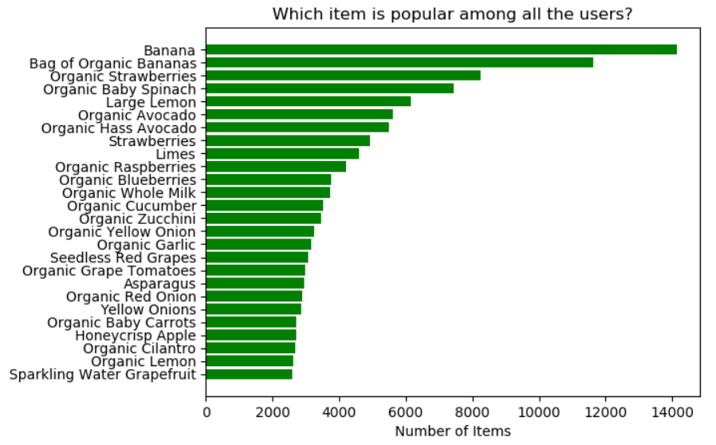
Understanding the dataset Most purchased products by users

Slide 7
Data preprocessing
User id and product id values one-hot encoded. This resulted in 26k+ features.
Applied PCA to reduce features to 50

Slide 8
Predicting Re-order flag
Algorithm | Parameters | Accuracy Score (%)
DecisionTreeClassifier | - | 59.63
RandomForestClassifier | n_estimators=25 | 68.21
MLPClassifier | hidden_layer_sizes=(3,3) activation= 'logistic' solver='adam' alpha=1e-5, learning_rate_init = 0.01 | 63.81
GridSearchCV/ MLPClassifier | {'hidden_layer_sizes': (5, 5)} | 63.56
Deep NN | Dense(10/relu)->Dense(5/relu)->Dense(1/softmax) | 60.45

Slide 9
Apriori data mining to find association rules
Transaction Id | Products
1 | {milk, egg, bread}
2 | {milk, egg, coffee, bread}
3 | {sugar, coffee, toothbrush}
4 | {milk, bread, coffee}
5 | {sugar, egg, vinegar}
Product(s) | No of txns containing product(s)
{milk} | 3
{bread} | 3
{egg} | 3
{sugar} | 2
{toothbrush} | 1
{milk, bread} | 3
{egg, bread} | 2
{sugar, toothbrush} | 1

Slide 10
Apriori rules
Rule | Support | Confidence
{milk}->{bread} | S({milk, bread})/N = 3/5 = 0.6 | S({milk, bread})/S({milk}) = 3/3 = 1.0
{egg}->{bread} | S({egg, bread})/N = 2/5 = 0.4 | S({egg, bread})/S({egg}) = 2/3 = 0.67
{sugar}->{toothbrush} | S({sugar, toothbrush})/N = 1/5 = 0.2 | S({sugar, toothbrush})/S({sugar}) = 1/2 = 0.5

Slide 11

Support and Confidence
Support – Support for rule {X}->{Y} is the ratio of number of transactions where a product group {X U Y} is part of, to the total number of transactions.
$support\left(X→Y\right)= \frac{σ(X∪Y)}{N}$
Confidence – Confidence of a rule {X}->{Y} is the ratio of support of the given product group {X U Y} to the support of the product group {X}.
$confidence\left(X→Y\right)= \frac{σ(X∪Y)}{σ(X)}$

Slide 12
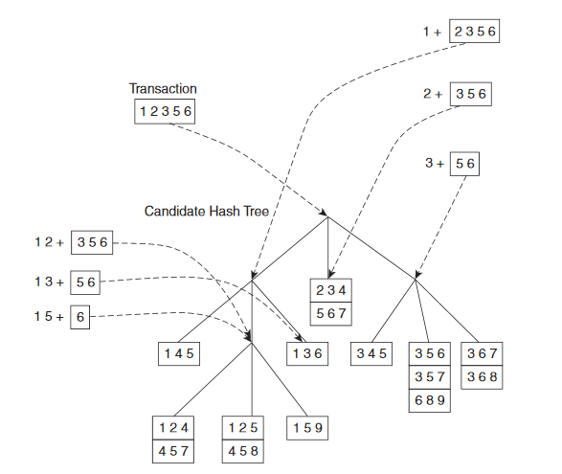
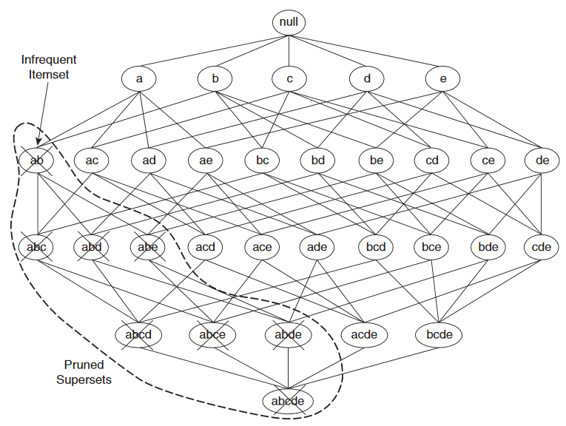
Apriori Optimizations
Candidate set generation
Frequent item set generation

Slide 13
Apriori Results (50k Records)
Rule | Confidence
{Limes,Bunched Cilantro} -> {Large Lemon} | 0.50
{Organic Red Bell Pepper,Banana} -> {Organic Avocado} | 0.58
{Broccoli Crown,Organic Strawberries} -> {Banana} | 0.55
{Seedless Red Grapes,Organic Baby Spinach} -> {Banana} | 0.50
{Limes,Asparagus} -> {Large Lemon} | 0.54
{Seedless Red Grapes,Limes} -> {Large Lemon} | 0.77

Slide 14
Conclusion
This project helped us learn the application of few data science techniques to the product sales data to
(1) predict the product items that might possibly be reordered in future, using standard algorithms in scikit-learn and keras and
(2) mine association rules that help discover relation among product items that have the higher probability of being ordered together.
Challenges in processing big data using ANN and Apriori.

