Slide 1

DEPARTMENT OF ARTIFICIAL INTELLIGENCE AND DATA SCIENCE ACADEMIC YEAR 2025 - 2026 SEMESTER III ARTIFICIAL INTELLIGENCE LABORATORY MINI PROJECT REVIEW ROCK, PAPER, SCISSOR GAME USING MONTE CARLO SEARCH
REGISTER NUMBER | 2117240070029
NAME | Aswathaanalina A S
YEAR | II
SECTION | A
FACULTY IN-CHARGE | Mrs. M. Divya

Slide 2
PROBLEM STATEMENT
The primary challenge is to create a computer opponent that is both engaging and challenging to play against. A randomly-playing AI would provide no real competition. Therefore, the AI must be capable of:
Evaluating the current state of the game board to determine which player has an advantage.
"Looking ahead" to predict potential future moves and their outcomes.
Making strategic decisions that maximize its own chances of winning while simultaneously minimizing the human player's chances.
Operating within a reasonable time frame, so the human player is not left waiting for the AI's turn.

Slide 3
THEORETICAL BACKGROUND
Artificial Intelligence and Game Playing
AI in the context of board games like Connect 4 is a form of "narrow AI," designed to solve a specific problem. These games are perfect environments for AI because they are:
Deterministic: The outcome of every move is fixed.
Perfect Information: Both players can see the entire game state at all times.
Zero-Sum: One player's gain is the other player's loss.
The AI's task is to search through a "game tree" of all possible future moves to find the path that leads to the best possible outcome for itself.

Slide 4
IMPLEMENTATION AND CODE
Link to code in Git-hub Repository
List | Git-hub Repository Links
Implementation of Code Link | https://github.com/aswathaanalina-19/connect-4-ai
Word Document Report Link | https://github.com/aswathaanalina-19/connect-4-ai/blob/main/Connect_4_with_AI-Aswa.docx
PPT Link | https://github.com/aswathaanalina-19/connect-4-ai/blob/main/connect-4-with-AI(ppt)-ASWA.pptx

Slide 5
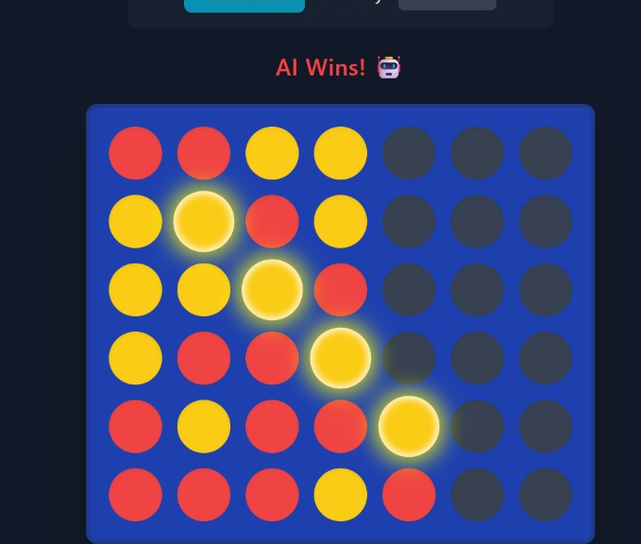
OUTPUT AND RESULTS

Slide 6
OUTPUT AND RESULTS
RESULTS
The developed Connect 4 with AI system successfully simulates a strategic board game where a human player competes against an intelligent computer opponent.
The AI player makes optimal moves using the Minimax Algorithm with Alpha-Beta Pruning, effectively reducing unnecessary computations.
The AI can analyze multiple future moves ahead, making the gameplay challenging and realistic.
The adjustable difficulty level (depth of search) allows players to set different levels of challenge.
The system provides instant feedback, error-free move validation, and accurate win detection (horizontal, vertical, and diagonal).
The experiment shows that as the search depth increases, the AI’s performance improves, producing more strategic decisions.
Overall Result: The project demonstrates that implementing Minimax with Alpha-Beta Pruning in Connect 4 results in an efficient and competitive AI opponent capable of providing engaging gameplay.

Slide 7
REFERENCES
Russell, S. & Norvig, P. (2021). Artificial Intelligence: A Modern Approach (4th Edition). Pearson.
GeeksforGeeks. “Minimax Algorithm in Game Theory | Set 1 (Introduction)” — https://www.geeksforgeeks.org/minimax-algorithm-in-game-theory-set-1-introduction/
Stack Overflow Discussions – “Connect 4 AI using Minimax Algorithm”
TutorialsPoint. “Alpha-Beta Pruning in Artificial Intelligence.”
GitHub repositories on Connect 4 AI Minimax implementations for reference to logic optimization and performance tuning .

