Slide 1
DISTRICT 04 · AI-NATIVE EMR
AXIOM
An evidence-grounded clinical intelligence layer for electronic medical records
"A clinical AI that always answers is unsafe. Ours refuses when the evidence does not support an answer - and we measure how often that happens."

Slide 2
THE PROBLEM
Most clinical AI answers everything.
In a hospital, that is how patients get hurt.
Every model here will hallucinate. That is not a defect — it is what they do.
Nothing separates what the record supports from what the model inferred.
A confident wrong answer is indistinguishable from a correct one at the point of care.
Absence of documentation gets read as absence of disease. It is not.
The failure is not that the AI is wrong.
It is that you cannot tell when it is.

Slide 3
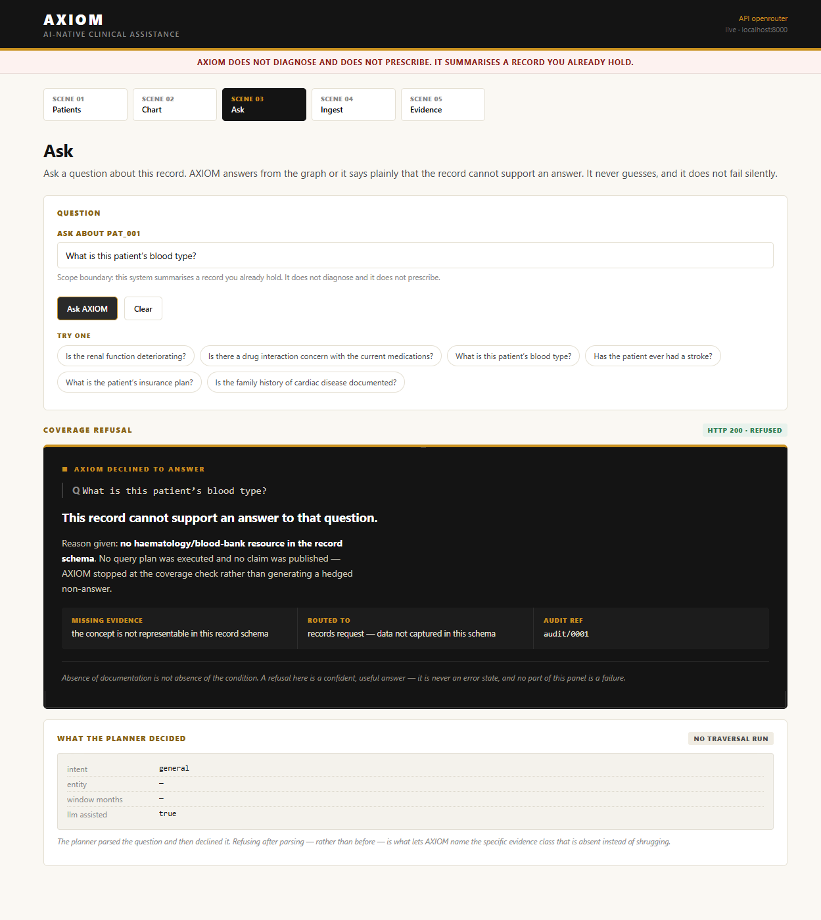
WHAT OURS DOES INSTEAD
THE TURN
WHAT OTHER AIs DO
WHAT AXIOM DOES
"No documented evidence of DVT."
REFUSED.
Technically quoted. Clinically read as
"No blood clot."
Measured, not assumed - our own chunk-RAG
baseline returns this verbatim.
HTTP 200. Names the missing evidence:
no thromboembolism (I63/I81) documented.
"Absence of documentation is not absence of
the condition."
Routed to chart review. Audited.

Slide 4
HOW
Refusal is the feature, not the fallback.
DOCUMENT
->
EXTRACT
->
GRAPH
->
VERIFY
->
REFUSE
Lab reports, discharge summaries,
prescription printouts
Deterministic parsers for tables;
the LLM for prose only
Time-stamped nodes, typed edges,
provenance to source
An independent entailment check sees
only the claim and its evidence
What fails is suppressed. What the
record cannot support is declined.
Suppressed means absent - not greyed out, not footnoted. A refusal returns HTTP 200 with its reason, the missing evidence, and an audit reference.

Slide 5
ARCHITECTURE
The model is load-bearing in exactly one place.
Parsing a lab table is not an LLM problem. A regex reads 'Potassium 5.20 mmol/L 3.50-5.10 H' perfectly. Models do prose; parsers do structure.
Query compilation is the LLM's job. Turning 'is his kidney function actually worsening, or is one bad day skewing it?' into a scoped traversal. Thirty tokens of JSON - a small model does this reliably.
Verification and refusal are deterministic. Nothing in that path can fail open.
Why it matters here:
We run on a free, rate-limited tier. Rather than hide that, we let it push the architecture toward determinism - so a 429 degrades the demo instead of killing it.

Slide 6
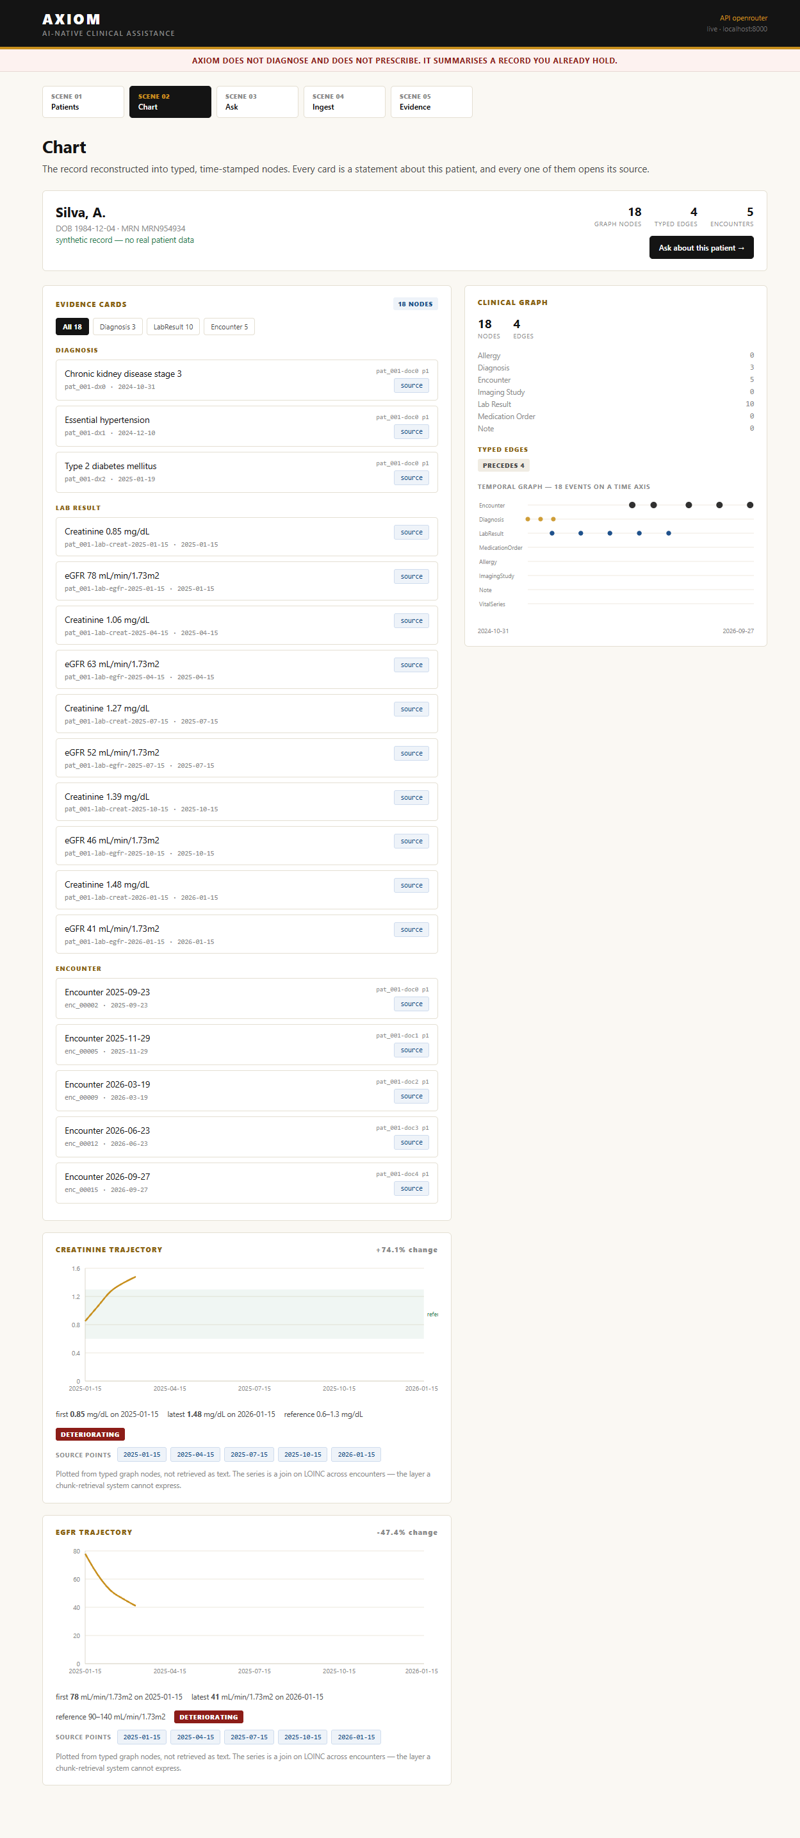
THE MOAT
Four questions flat retrieval cannot answer.
"What changed since the last visit?" - temporal join across encounters
"Was this already known?" - supersession reasoning
"What is the creatinine trajectory over 18 months?" - series over one analyte
"Which diagnoses have no follow-up?" - an anti-join in time
Document chunks have no time in them.
A time-stamped clinical graph does.
We ship a chunk-RAG strawman alongside it - unrigged, TF-IDF, no hedging in the prompt - so the comparison is honest rather than asserted.

Slide 7
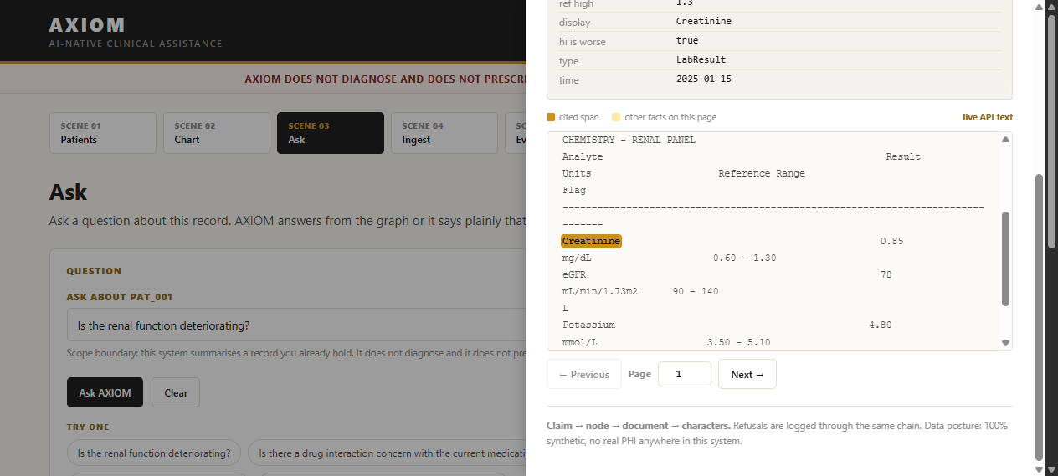
PROVENANCE
Every claim resolves to a region of a document.
Every extracted fact keeps its source document, page, and character span.
Click any sentence; the original PDF opens, scrolled to the line.
Two clicks, every time. A claim without a reachable source is a bug.

Slide 8
RESULTS
Measured, with the sweep that matters.
detection rate
#################################.
97.1%
102/105 planted findings
unsupported claim rate
..................................
0.0%
0 of 270 claims
citation validity
##################################
100.0%
every claim resolves
false positive rate
..................................
0.0%
29 clean patients, 0 spurious
abstention recall
##################################
100.0%
6/6 unanswerable refused
negation accuracy
##################################
100.0%
120 sentences
entity resolution F1
##################################
100.0%
180 negative pairs

Slide 9
ROBUSTNESS
Present this curve, not the headline number.
Detection rate under injected noise. Degradation is graceful, not cliff-edged - this is the only figure that predicts real-world behaviour.
noise 0.00
########################################
1.000
noise 0.25
######################################..
0.950
noise 0.50
######################################..
0.950
noise 0.75
#####################################...
0.925
noise 1.00
###################################.....
0.875

Slide 10
LIMITATIONS
Where this breaks.
The verifier is rule-based, not a model. An LLM verifier would score materially lower. We say so first.
All clinical data is synthetic, generated from Synthea's physiological model. Real disease trajectories, no real patients.
Ingestion is fully automatic. Nothing is clinician-confirmed. A mislabelled value becomes a permanent node.
We do not touch real PHI. MIMIC-IV on PhysioNet is the legitimate route; scraping is not.
Entity-resolution margin is thin (0.015). Real data would need calibration and human review.
Publishing these is the point.
A team that volunteers the number it missed is demonstrating more engineering maturity than one that reports only wins - and it is the only way the rest of the numbers are believable.

Slide 11
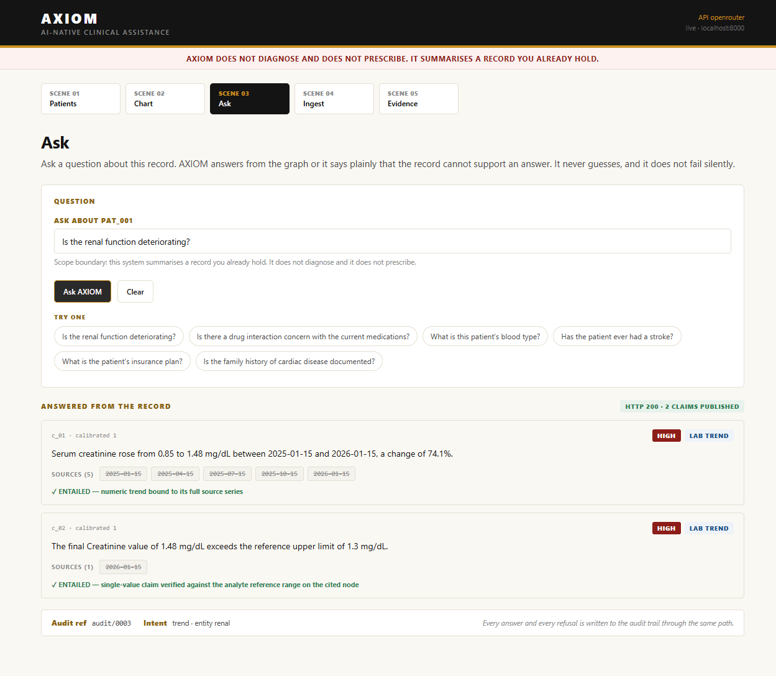
IN ONE LINE
Every AI on this floor will hallucinate.
We built the one that catches itself - and we can prove it live, on demand.
AXIOM does not diagnose and does not prescribe.
It surfaces evidence and reasoning to a licensed clinician who decides. That boundary is permanent chrome in the product, not a dismissible banner.

