Slide 1

UNIVERSITY COLLEGE OF ENGINEERING,
BIT CAMPUS,TIRUCHIRAPPALLI
AI BASED FAKE CERTIFICATE DETECTION
PRESENTED BY
SWATHI A - 810022205068
BANUPRIYA M - 810022205085
GUIDED BY
Mrs.C.Kanimozhi.,M.TECH(Ph.D)
Assistant Professor

Slide 2
PROBLEM STATEMENT
Academic marksheets and degree certificates can be easily altered using image editing tools without visibly changing their overall structure and format.
Existing verification systems mainly analyze textual content and fail to detect subtle background texture changes caused by document tampering.

Slide 3
OBJECTIVES
To analyze document image textures for forgery detection.
To use GAN for extracting deep texture features from document images.
To train a deep learning model for real vs fake classification.
To build a simple web interface for document upload and analysis.

Slide 4
ABSTRACT
This project develops a texture-based fake certificate detection system that analyzes document images using CNN and GAN models. The system learns deep texture features from marksheets and certificates to identify inconsistencies caused by editing or digital manipulation. Based on these learned patterns, the model classifies the document as real or fake.

Slide 5
LITERATURE SURVEY
s. no | Title | Year/Publisher | Authors name | Methodology | limitation | Future Work | Achievements
1. | Deepfake Generation and Detection: Case Study and Challenges | 2023 / IEEE Access | Yogesh Patel et al. | Used GAN, CNN, Autoencoders for deepfake generation & detection; spatial and texture inconsistencies analyzed. | Requires large datasets; struggles with highly realistic GAN images | Improve dataset quality and multimodal detection | Provided comprehensive survey of GAN-based detection and techniques
2. | Image Forgery Detection Techniques: Latest Trends and Key Challenges. | 2024 / IEEE Access | Poulomi Deb et al. | Active (watermarking) & Passive (copy-move, splicing); texture + statistical features + ML models | Watermarking not always available; passive methods less robust for complex forgery | Integration of deep learning with traditional methods | Compared multiple forgery detection techniques with strengths & weaknesses
3. | CNN-Based Image Forgery Detection. | 2020 /IEEE | Various Authors | Deep CNN for feature extraction and classification of forged images | Requires high computational power; overfitting risk | Lightweight CNN models and real-time detection | High accuracy in image forgery classification
4. | Copy-Move Forgery Detection using DCT & PCA | 2024/IEEE | Various Authors. | Block-based method using DCT, PCA for detecting duplicated regions | Cannot detect complex transformations | Use deep learning for robust detection. | Efficient for simple forgery detection
5. | GAN-Based Image Forgery Detection | 2021/IEEE | Aryan et al. | Used GAN discriminator features + CNN classifier | Difficult to detect advanced GAN-generated images | Improve adversarial training techniques | Improved detection of synthetic images
6. | Hybrid CNN + Texture Features for Document Authentication | 2022 /Springer | Research Community | Combined CNN + GLCM + LBP for feature fusion | Increased model complexity | Optimization and feature selection techniques | Higher accuracy than single-method approaches

Slide 6
EXISTING APP
DigiLocker
EduChecker
Meon Marksheet Verification API

Slide 7
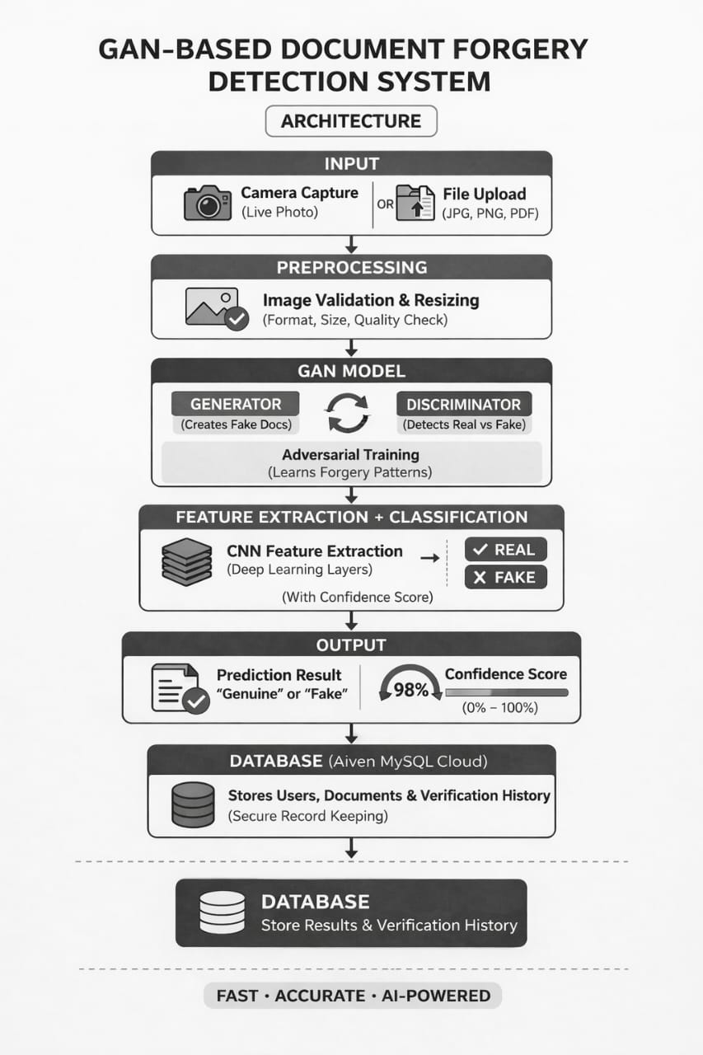
ARCHITECTURE

Slide 8


DFD DIAGRAM
FAKE DOCUMENT DETECTION
UPLOAD DOCUMENT
ANALYZE DOCUMENT
GENERATE NOTIFICATION
User
Admin
DOCUMENT DATABASE
DETECTION RESULT DATABASE
STORE & RETREIVE DATA
DOCUMENT
NOTIFICATIONS
DOCUMENT DATABASE
NOTIFICATIONS & RESULTS

Slide 9
ER DIAGRAM
USERS
ADMINS
User_id
Username
email
uploads
reviews
admin_id
username
email
DOCUMENT
Doc_id
DETECTION
detection_id
user_id
file_name
DETECTION
detection_id
document_id
result
DOCUMENT
Analyzes
DATABASE

Slide 10
USECASE DIAGRAM
UPLOAD DOCUMENT
REVIEW RESULT
FAKE DOCUMENT DETECTION SYSTEM
RECEIVE NOTIFICATIONS
User
Admin
VIEW ANALYSIS RESULTS
MANAGE USERS

Slide 11
ALGORITHM USED
GAN Training Algorithm
CNN based classification Algorithm
Image processing Algorithm

Slide 12
TECHNIQUE USED
Image Preprocessing - O(N)
Edge Detection - O(N)
CNN-Based Classification - O(n2⋅d)

Slide 13
IMPLEMENTATION
DocVerify AI — Complete Backend
================================
Full Flask app with:
- SQLite database (users + scan history)
- User auth (register / login / logout)
- CNN model inference (real vs fake)
- File upload + camera capture
- Profile management
- Scan history with pagination
- All routes connected to frontend templates
import os
import json
import secrets
import base64
import re
import numpy as np
from datetime import datetime
from functools import wraps
from flask import (
Flask, render_template, request,
redirect, url_for, session, flash, jsonify
)
from flask_sqlalchemy import SQLAlchemy
from flask_bcrypt import Bcrypt
from werkzeug.utils import secure_filename
# ── Optional .env support
try:
from dotenv import load_dotenv
load_dotenv()
except ImportError:
pass
# APP SETUP
app = Flask(__name__)
app.secret_key = os.environ.get("SECRET_KEY", secrets.token_hex(32))
app.config["SQLALCHEMY_DATABASE_URI"] = "sqlite:///docverify.db"

Slide 14
app.config["SQLALCHEMY_TRACK_MODIFICATIONS"] = False
app.config["UPLOAD_FOLDER"] = os.path.join(os.path.dirname(__file__), "uploads")
app.config["MAX_CONTENT_LENGTH"] = 16 * 1024 * 1024 # 16 MB
ALLOWED_EXTENSIONS = {"png", "jpg", "jpeg", "bmp", "tiff", "webp"}
db = SQLAlchemy(app)
bcrypt = Bcrypt(app)
# ── Create required folders
os.makedirs(app.config["UPLOAD_FOLDER"], exist_ok=True)
os.makedirs(os.path.join("static", "images"), exist_ok=True)
# LOAD CNN MODEL
model = None
try:
from tensorflow.keras.models import load_model as _load_model
_model_path = os.path.join(os.path.dirname(__file__), "model.keras")
if os.path.exists(_model_path):
model = _load_model(_model_path)
print("✅ model.keras loaded successfully")
else:
print("⚠️ model.keras not found — running in DEMO mode (random results)")
except Exception as e:
print(f"⚠️ TensorFlow not available: {e}\n Running in DEMO mode.")
# ── Load class threshold config ──────────────────────────────────────────────────
_FAKE_CLASS_IS_0 = True
_class_info_path = os.path.join(os.path.dirname(__file__), "class_info.json")
if os.path.exists(_class_info_path):
with open(_class_info_path) as _f:
_ci = json.load(_f)
_FAKE_CLASS_IS_0 = _ci.get("fake_class_is_0", True)
print(f"✅ class_info.json loaded — {_ci.get('threshold_note', '')}")
else:
print("⚠️ class_info.json not found — using default: output < 0.5 = FAKE")

Slide 15
# ────────────────────────────────────────────────────────────────────────────────
# DATABASE MODELS
# ────────────────────────────────────────────────────────────────────────────────
class User(db.Model):
__tablename__ = "user"
id = db.Column(db.Integer, primary_key=True)
username = db.Column(db.String(100), unique=True, nullable=False)
email = db.Column(db.String(150), unique=True, nullable=False)
password = db.Column(db.String(200), nullable=False)
profile_pic = db.Column(db.String(200), default="default.png")
created_at = db.Column(db.DateTime, default=datetime.utcnow)
scans = db.relationship("ScanHistory", backref="user", lazy=True,
cascade="all, delete-orphan")
def __repr__(self):
return f"<User {self.username}>"
class ScanHistory(db.Model):
__tablename__ = "scan_history"
id = db.Column(db.Integer, primary_key=True)
user_id = db.Column(db.Integer, db.ForeignKey("user.id"), nullable=False)
filename = db.Column(db.String(300), nullable=False)
result = db.Column(db.String(50), nullable=False) # "Fake Document" | "Original Document"
confidence = db.Column(db.Float, nullable=False)
scanned_at = db.Column(db.DateTime, default=datetime.utcnow)
def __repr__(self):
return f"<Scan {self.filename} → {self.result}>"
@property
def is_fake(self):
return self.result == "Fake Document"
@property
def result_class(self):
return "fake" if self.is_fake else "original"
# Create all tables
with app.app_context():
db.create_all()
print("✅ Database tables ready (docverify.db)")

Slide 16
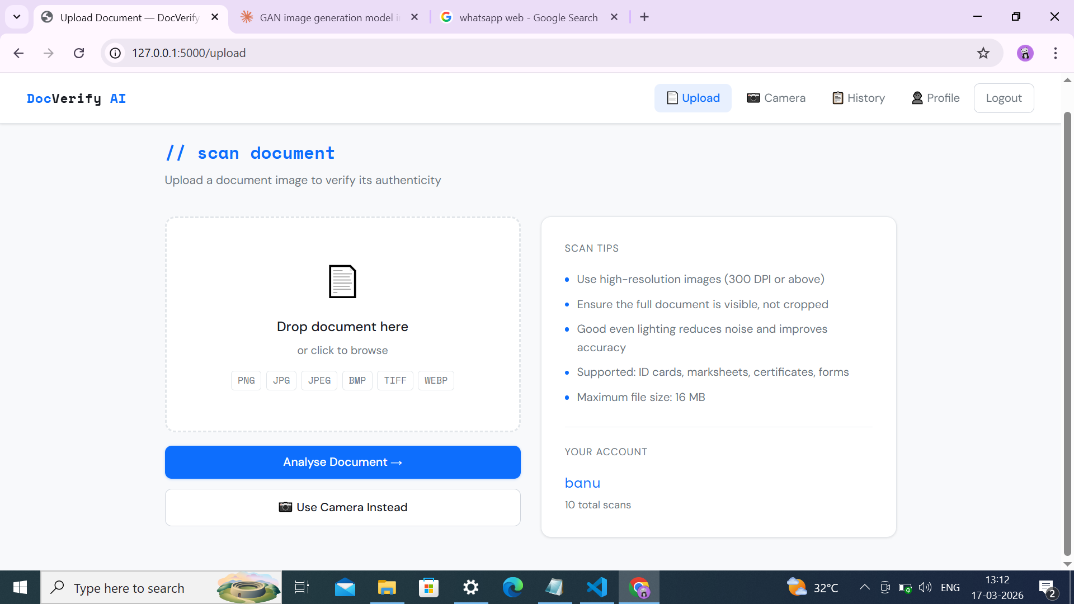
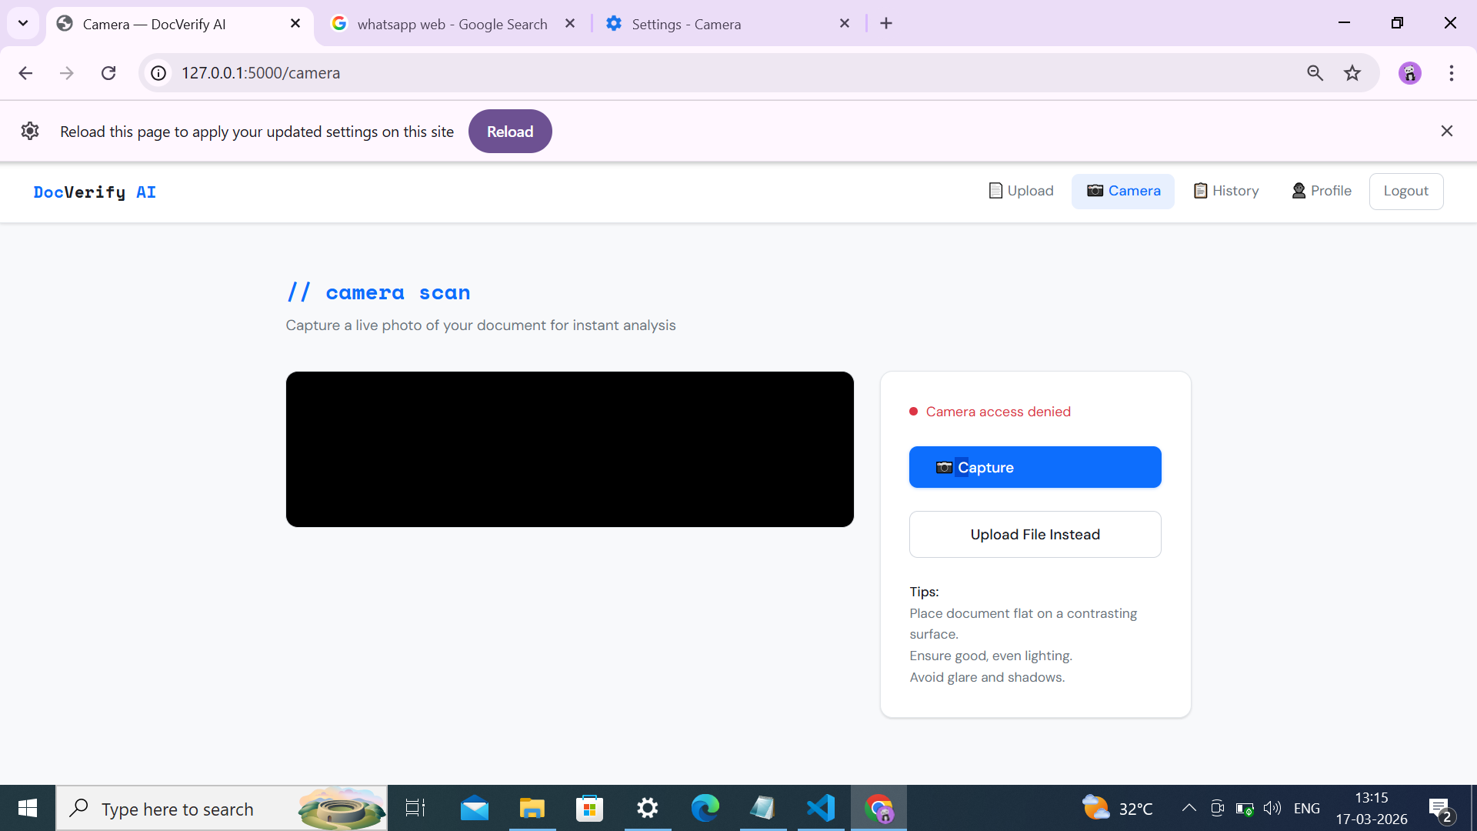
OUTPUT

Slide 17
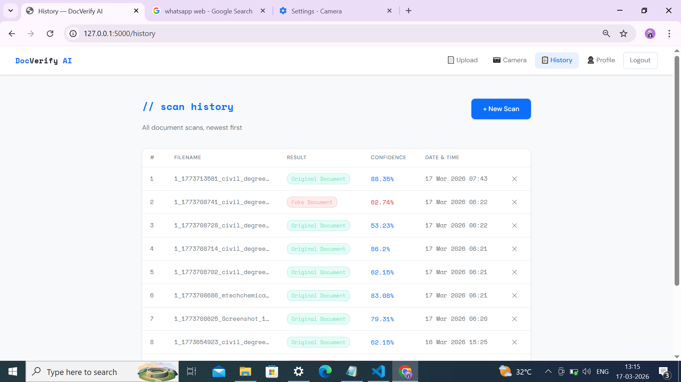
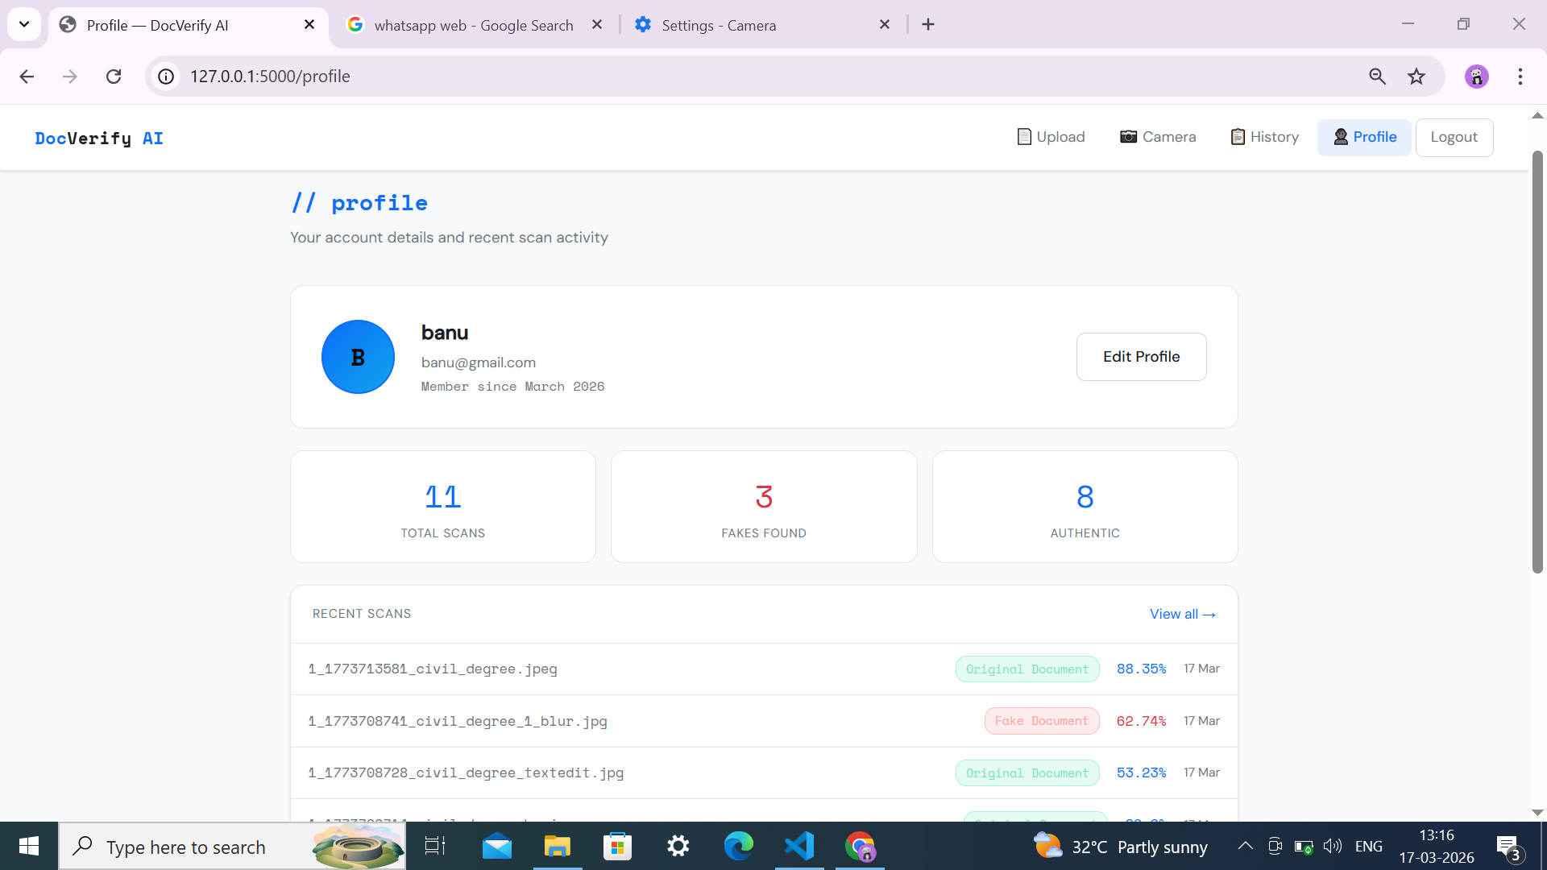

Slide 18
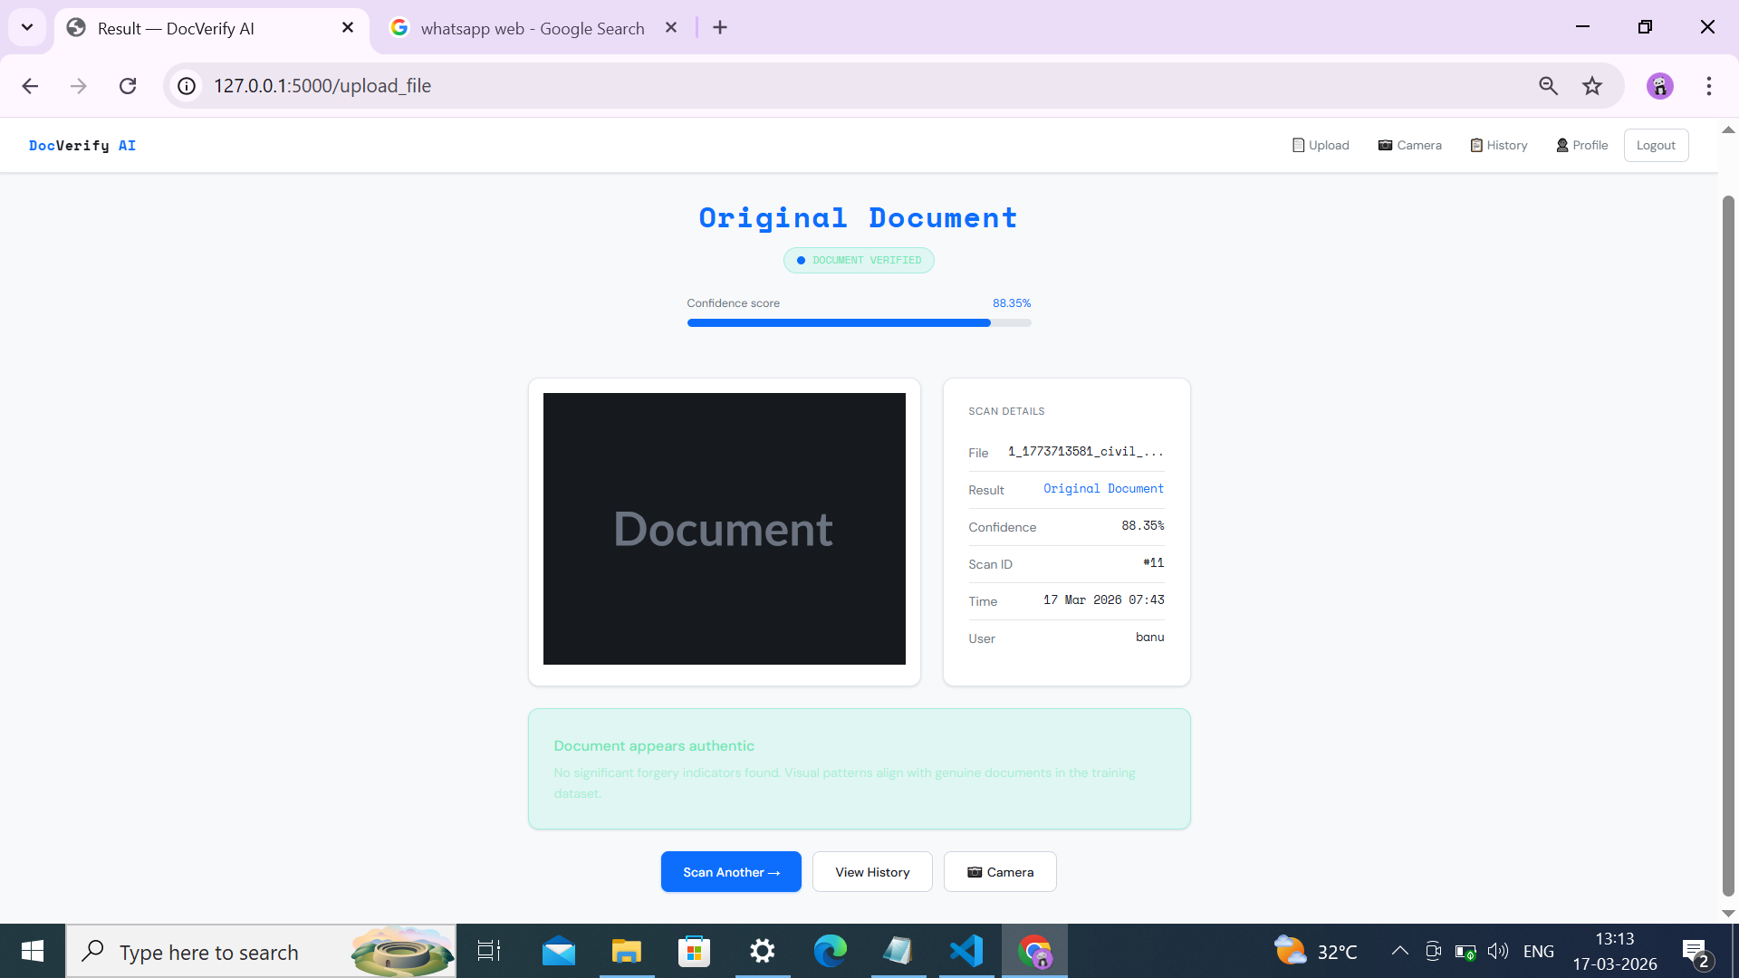

Slide 19
REFERENCES
X. Nie, X. Liu, J. Guo, L. Wang, and Y. Yin, “Supervised discrete multiplelength hashing for image retrieval,” IEEE Trans. Big Data, vol. 9, no. 1, pp. 312–327, Feb. 2023
L. Zhao, C. Chen, and J. Huang, “Deep learning-based forgery attack on document images,” IEEE Trans. Image Process., vol. 30, pp. 7964–7979,2021
L. Wu et al., “Editing text in the wild,” in Proc. 27th ACM Int. Conf.Multimedia, 2019, pp. 1500–1508
C. Liu, Y. Liu, L. Jin, S. Zhang, C. Luo, and Y. Wang, “EraseNet: Endto-end text removal in the wild,” IEEE Trans. Image Process., vol. 29,pp. 8760–8775, 2020.

