Slide 1

.crash course
Christina Protopapadaki, Filip Jorissen & Bram van der Heijde
Christina.Protopapadaki@bwk.kuleuven.be Filip.Jorissen@mech.kuleuven.be,
Bram.vanderHeijde@kuleuven.be
October 19, 2017

Slide 2
Modelica crash course
What is Modelica ?
Syntax, language concepts and model structuring
Modelica tools
Use of IDEAS library
Getting started (tutorials, reference docs, libraries, software implementations, ...)
➔ To get you started with Modelica!

Slide 3
 | Agenda
13:00 - 13:30 | What is modelica? How does it work?
13:30 - 13:45 | What is Dymola and how does it work? Where to find information?
13:45 – 14:00 | Break & Licence activation
14:00 – 14:30 | What is IDEAS?
14:30 - 15:30 | IDEAS: SimpleHouse Hands-on
15:30 - 16:30 | Advanced topics
16:30 - 17:30 | Demo IDEAS Building model (optional)

Slide 4
What is Modelica?

Slide 5
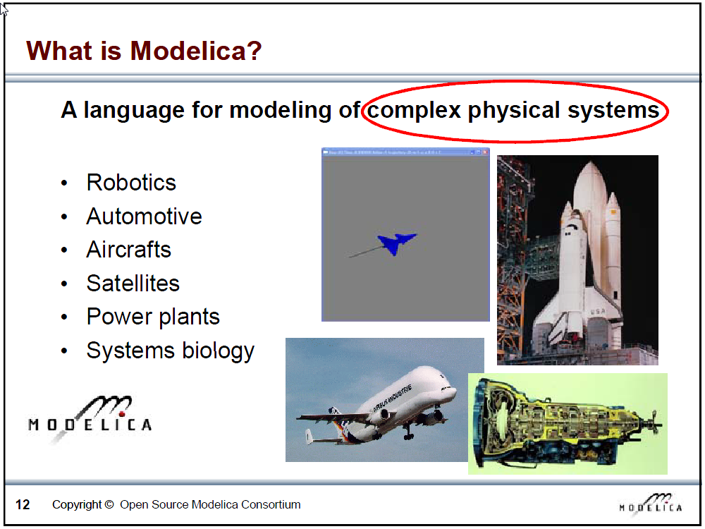
Slide from Peter Fritzson, Introduction to Object-Oriented Modeling, Simulation and Control with Modelica, Tutorial for Modelica Conference 2011, Dresden

Slide 6
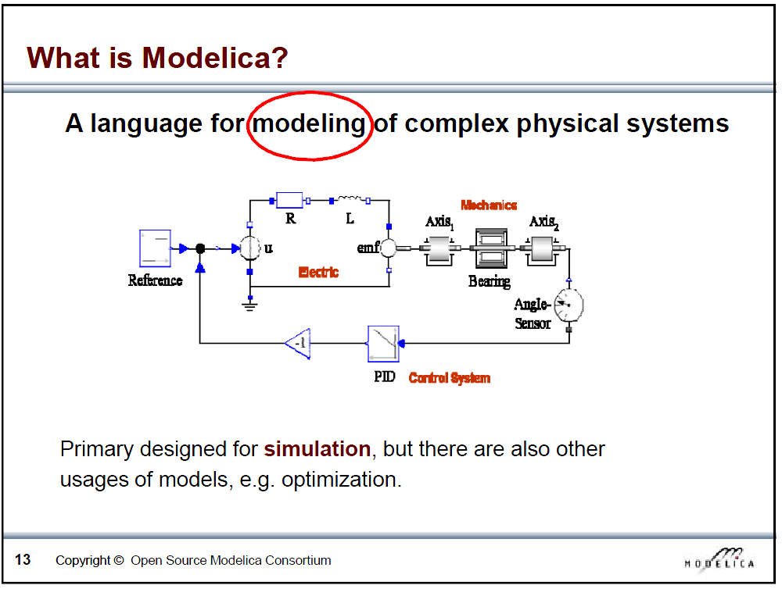
Slide from Peter Fritzson, Introduction to Object-Oriented Modeling, Simulation and Control with Modelica, Tutorial for Modelica Conference 2011, Dresden

Slide 7
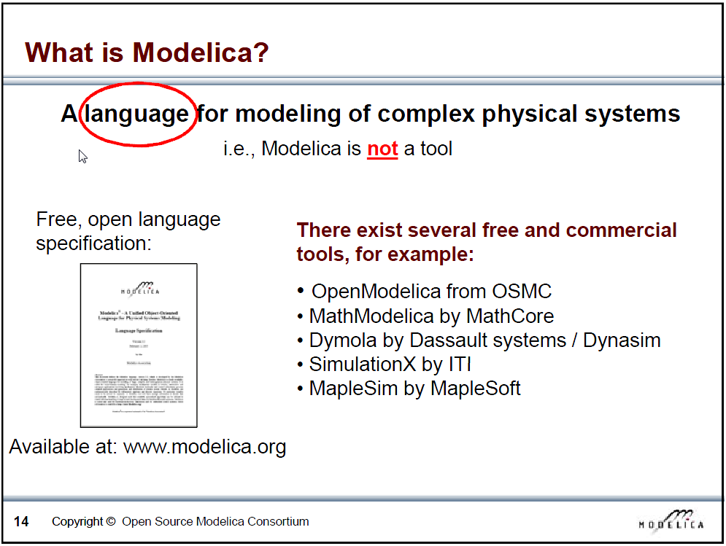
Slide from Peter Fritzson, Introduction to Object-Oriented Modeling, Simulation and Control with Modelica, Tutorial for Modelica Conference 2011, Dresden

Slide 8
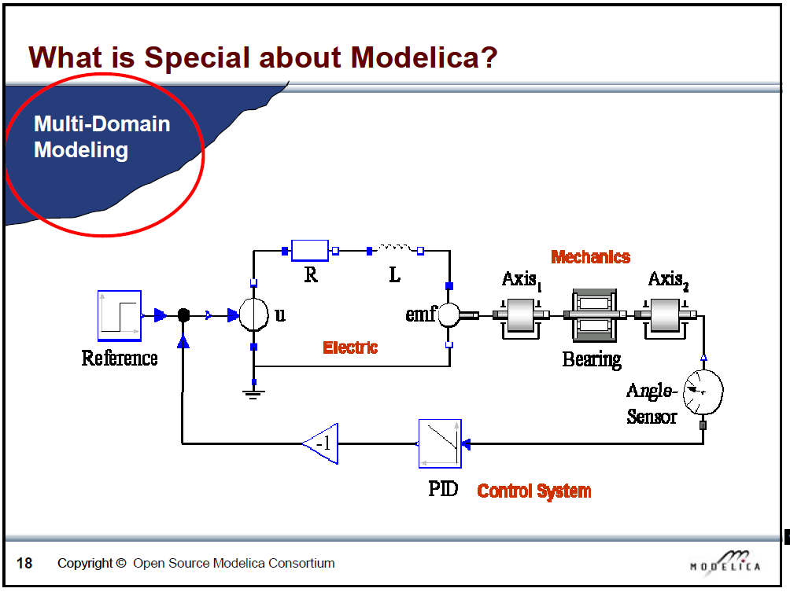
Slide from Peter Fritzson, Introduction to Object-Oriented Modeling, Simulation and Control with Modelica, Tutorial for Modelica Conference 2011, Dresden

Slide 9
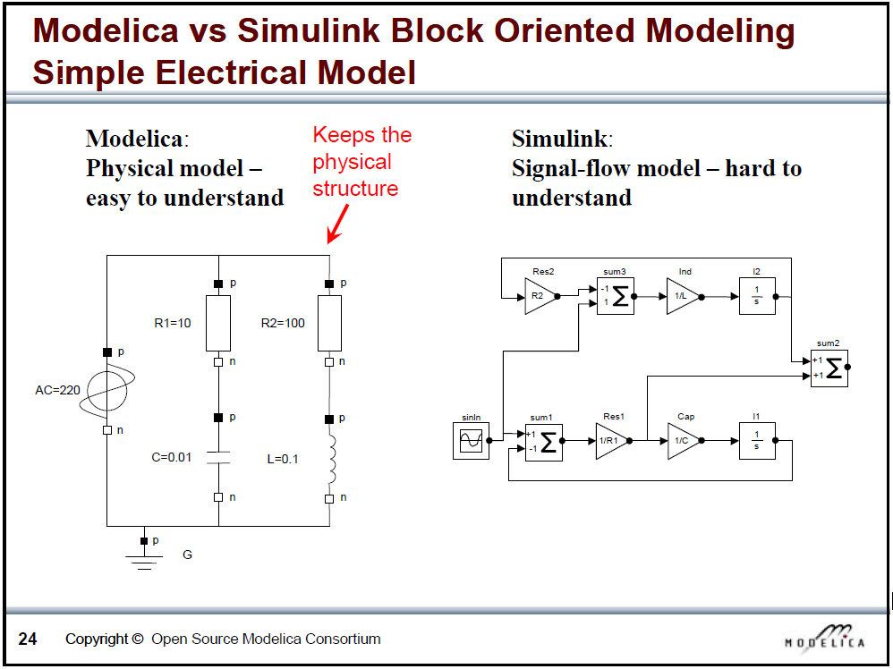
Slide from Peter Fritzson, Introduction to Object-Oriented Modeling, Simulation and Control with Modelica, Tutorial for Modelica Conference 2011, Dresden

Slide 10

What is Modelica
Modelica is a language for modeling of physical systems
open source
object oriented
Acausal modeling (equation based)
multi-domain
primarily for simulation, but usable for optimization
small and large models (> 100 000 equations)
many model libraries (free and commercial)
textual and graphical modeling

Slide 11
How does Dymola work?

Slide 12
Modelica environments
Commercial software tools
Dymola (Dassault Systèmes, Sweden)
MathModelica (MathCore, Sweden)
SimulationX (ITI, Germany)
MapleSim (Maplesoft, Canada)
Free and open source tools
OpenModelica (Open Source Modelica Consortium, Sweden and other countries)
JModelica (Modelon, Sweden)

Slide 13
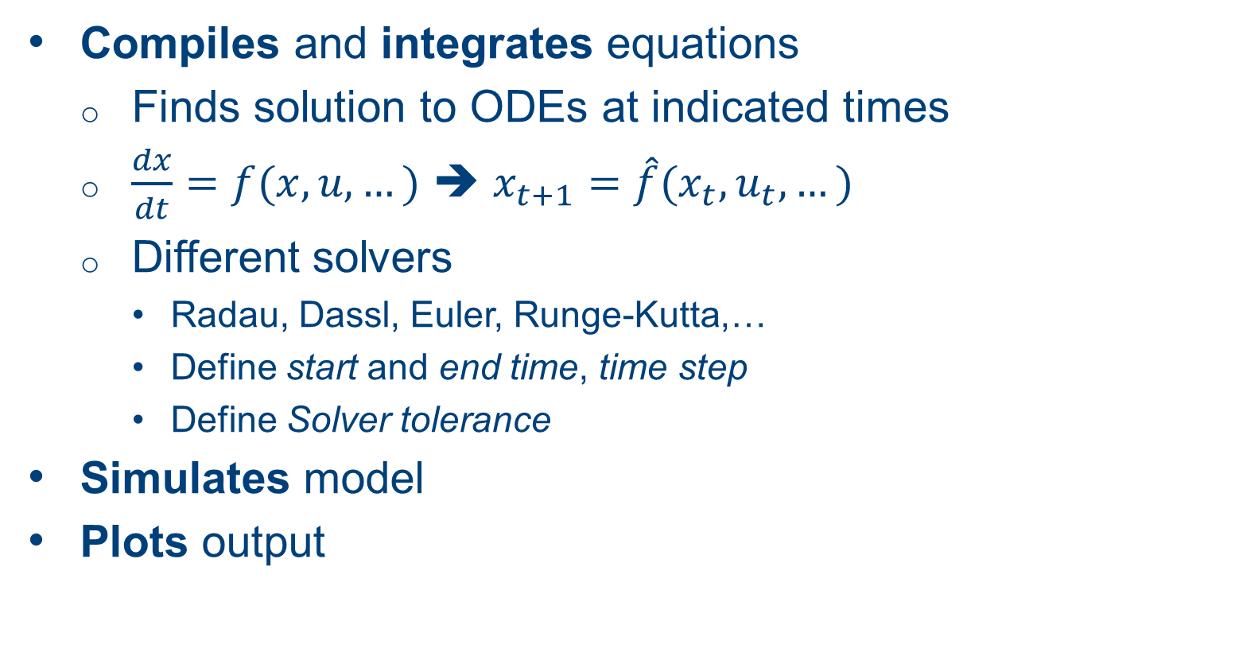
What does Dymola do?
Compiles and integrates equations
Finds solution to ODEs at indicated times
$\frac{dx}{dt}=f(x,u,…)$ ➔ $x_{t+1}=\hat{f}(x_{t},u_{t},…)$
Different solvers
Radau, Dassl, Euler, Runge-Kutta,…
Define start and end time, time step
Define Solver tolerance
Simulates model
Plots output

Slide 14
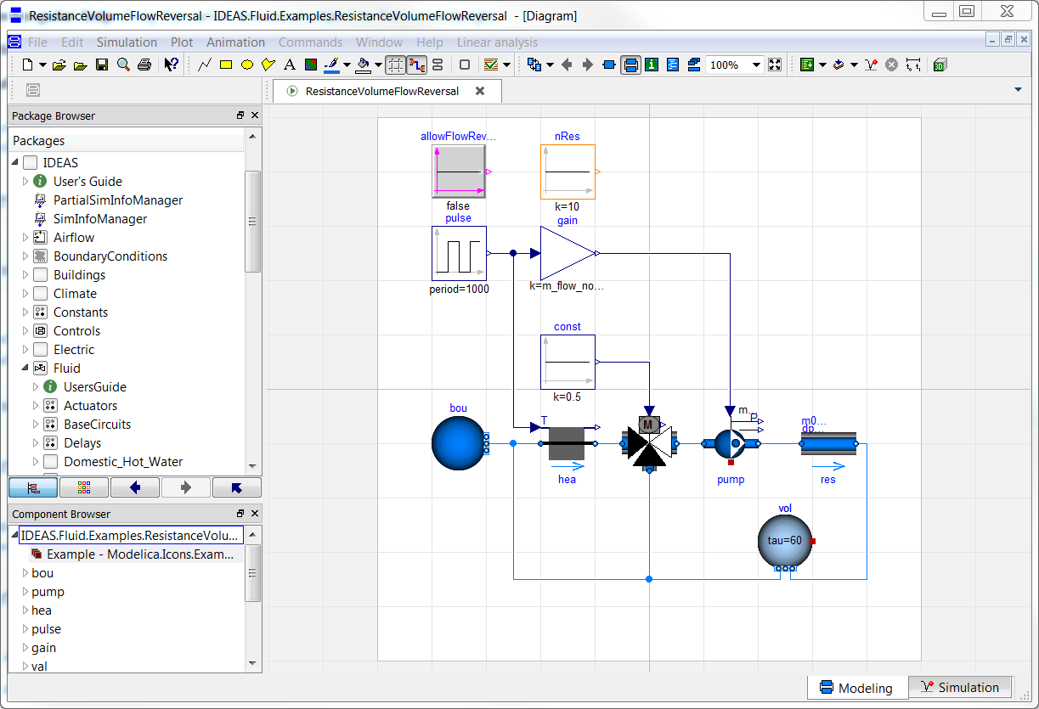
Graphical user interface

Slide 15
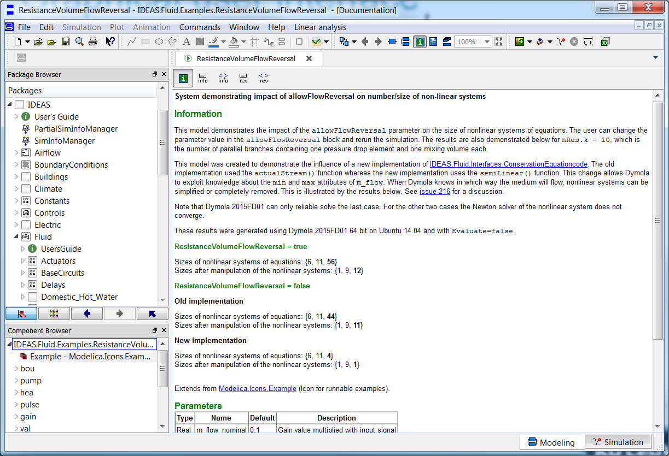
Graphical user interface

Slide 16
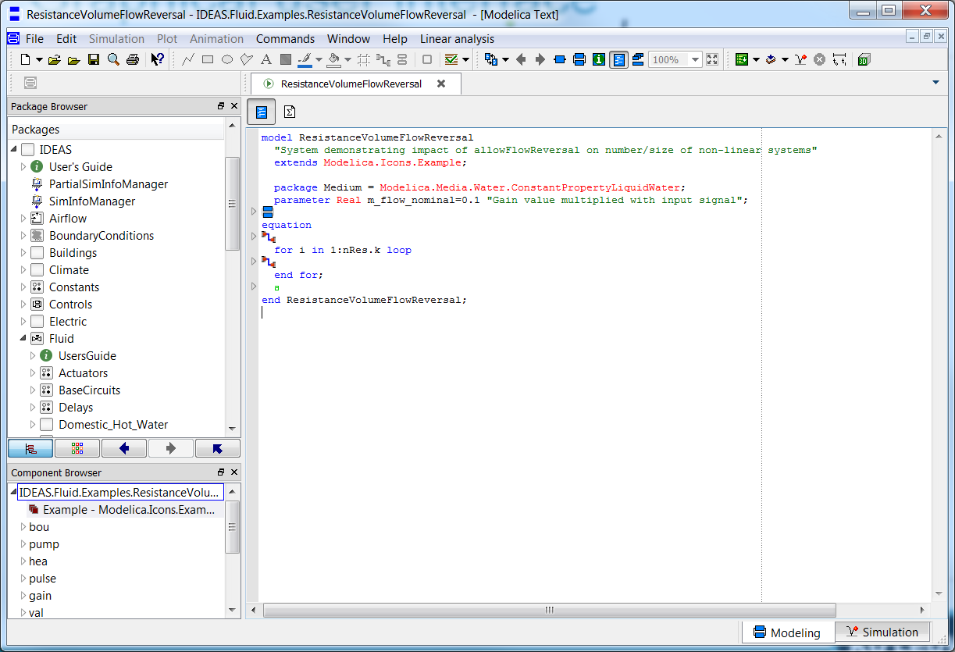
Graphical user interface

Slide 17
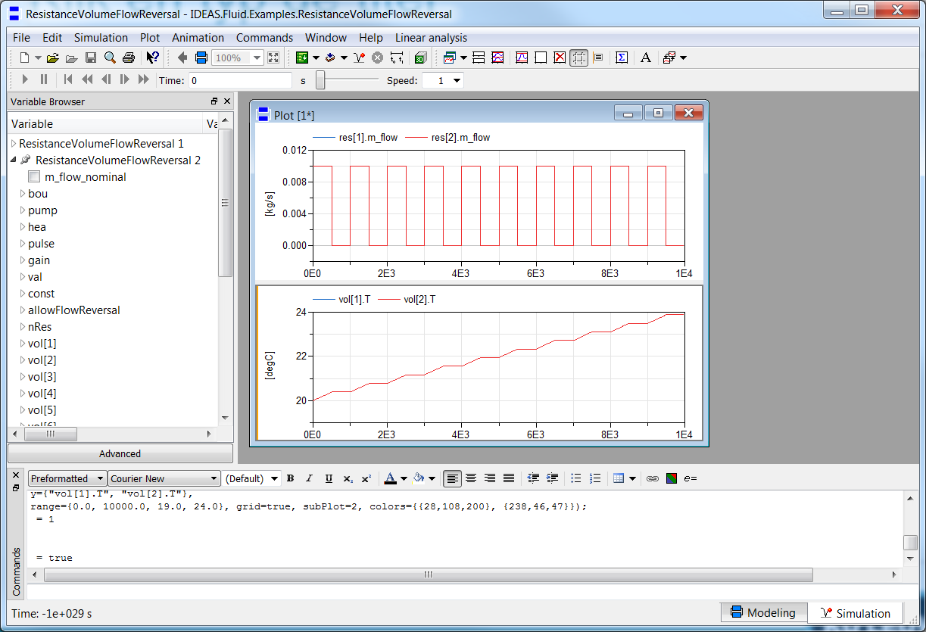
Graphical user interface

Slide 18
Break
Time to activate and borrow your license!

Slide 19
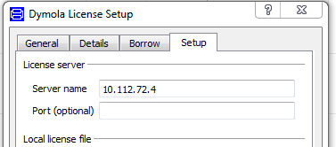
Use of Dymola with KULeuven license
Access to a floating licence (on the building physics server).
Connected physically (cable) to the building physics or mech network
Open Dymola and go to help>licence..
Enter 10.112.72.4 and follow instructions
More information on Modelicans (google groups)

Slide 20
How does Modelica work?

Slide 21
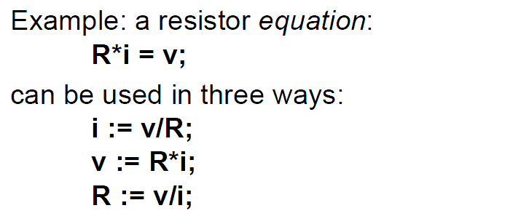
Equations
Arithmetic operators
*, /, +, -, ^ (use . for element-wise)
Derivatives
der(x) = x ~
Slide from Peter Fritzson, Introduction to Object-Oriented Modeling, Simulation and Control with Modelica, Tutorial for Modelica Conference 2011, Dresden
Notes:
Modelica is a programming language. Overview of the most important parts of the syntax

Slide 22
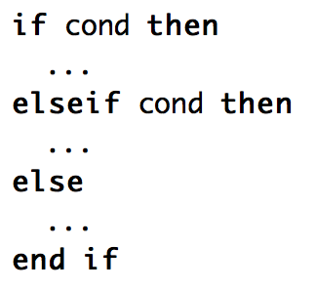

Logical operators, control flow
Logical
and, or, not
Conditional
if, elseif, else
Loops
for
Comparing numbers
>, <, <>, >=,…

Slide 23
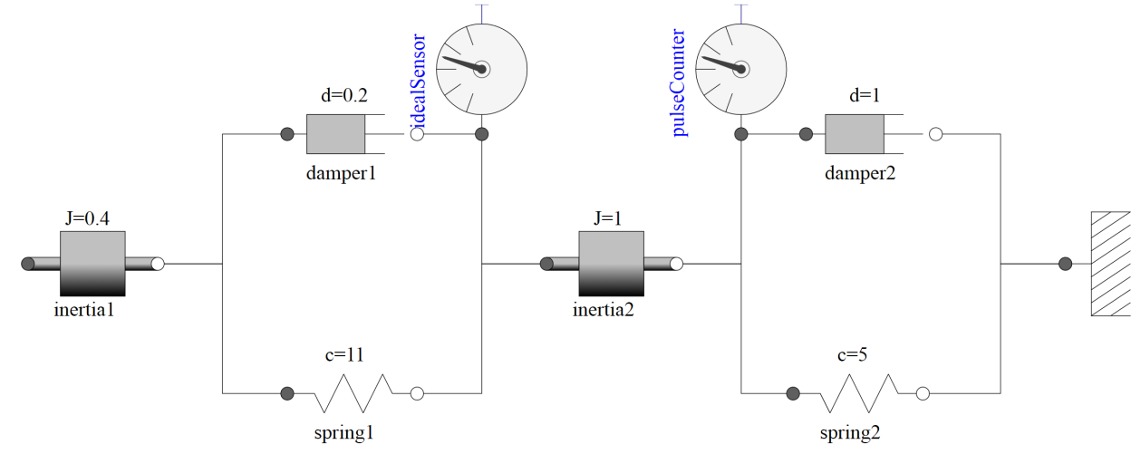
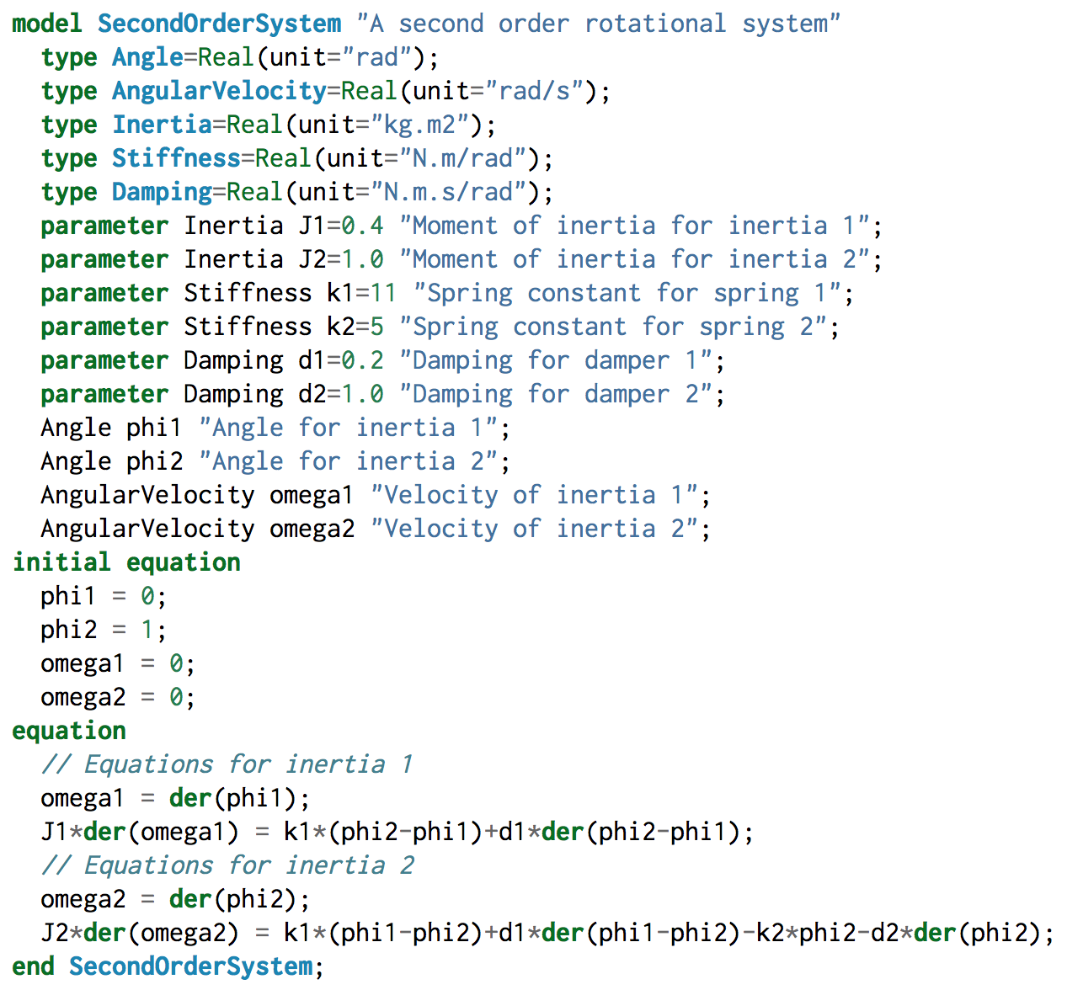
Models
# variables = # equations!
Balanced
Close line with ;
From M. Tiller, Modelica by Example, http://book.xogeny.com

Slide 24
Comments
Very important!
Comments regarding components, parameters, variables
“this is a comment”
Can show up in graphical interface
Line comments
// This is a comment on one line
/* This is a comment over multiple lines */

Slide 25
Slide from Peter Fritzson, Introduction to Object-Oriented Modeling, Simulation and Control with Modelica, Tutorial for Modelica Conference 2011, Dresden

Slide 26
Connectors
Usually
Signal in out
Fluid flow (mass flow rate, pressure, enthalpy)
Heat flow (heat flow rate, temperature)

Slide 27
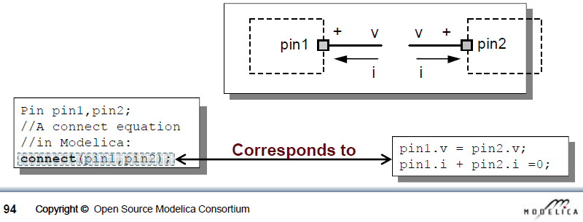
Connectors
flow variable, potential variable
Potential: voltage, pressure, temperature…
Flow: current, mass/volume flow, heat flow…
Example: Electrical model
Slide from Peter Fritzson, Introduction to Object-Oriented Modeling, Simulation and Control with Modelica, Tutorial for Modelica Conference 2011, Dresden

Slide 28
Components
Instances of a model
model name usually Capitalized, instance not
Wall innerWall(res = 200, A = 10);
public variables and parameters can be accessed with dot notation, e.g.:
heatPort.Qflow
wall.res
Protected variables/params cannot be accessed
Don’t show up in simulation results

Slide 29
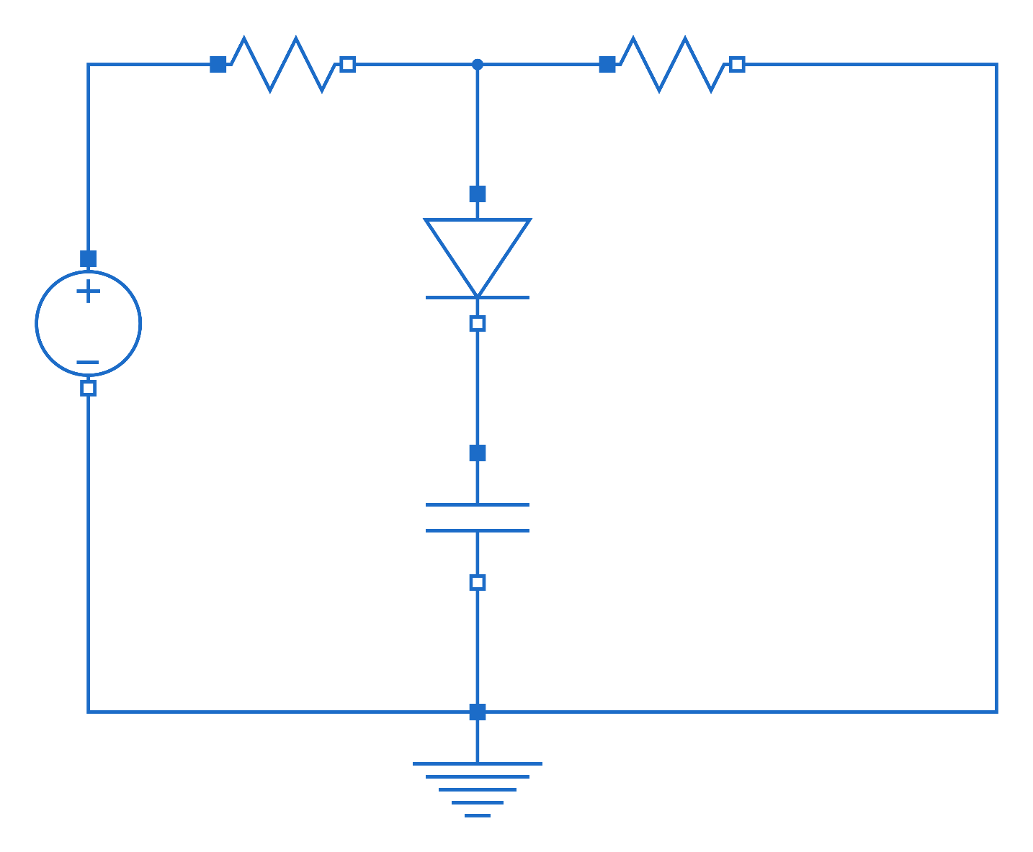
Homework exercise

Slide 30
ToDo BRAM: add slides on homework example and link to inheritance

Slide 31
Inheritance
Model inherits from other model
Variables, parameters, equations
partial model
Code can be managed more easily
Example

Slide 32
Interface with other programs
Scripting
Parameter variation
Parallel simulations
Optimal control
Python scripts
Nice for plotting
BuildingsPy (http://simulationresearch.lbl.gov/modelica/buildingspy/)
Built-in interface
MATLAB
Built-in with Dymola

Slide 33
Websites
General
www.modelica.org
www.openmodelica.org
www.jmodelica.org
http://www.claytex.com/tech-blog/
Modelica language
http://modref.xogeny.com/ !!!
http://book.xogeny.com/ !!!
KUL modeling conventions
https://docs.google.com/document/d/1MaNKTdLz-YPpEEH3Eg12ECzG0ErK-rIK9IHd6gsBp7Q/edit?usp=sharing
Libraries:
https://github.com/open-ideas --> IDEAS + Crash Course
https://simulationresearch.lbl.gov/modelica --> look at Buildings.Examples.Tutorial
IBPSA Project 1: https://github.com/ibpsa/modelica-ibpsa
Dymola user guide
Volume 1 & 2: C:\Program Files (x86)\Dymola 2017\Documentation\Dymola User Manual Volume 1 or via Dymola > help.

Slide 34
Fora
http://www.openmodelica.org/index.php/forum
http://www.jmodelica.org/forum
www.stackoverflow.com (tag Modelica)
And last but not least: https://groups.google.com/d/forum/modelicans

