Slide 1
Digital Image Processing
Sampling and Quantization

Slide 2
key stages in digital image processing
Sampling : related to coordinates values
(Nyquist frequency)
Quantization : related to intensity values

Slide 3

y (intensity values)
a | b
c | d
Generating a digital image. (a) Continuous image. (b) A scaling line from A to B in the continuous image, used to illustrate the concepts of sampling and quantization. (c) sampling and quantization. (d) Digital scan line.
© 2002 R. C. Gonzalez & R. E. Woods

Slide 4

a | b
(a) Continuous image projected onto a sensor array. (b) Result of image sampling and quantization.
© 2002 R. C. Gonzalez & R. E. Woods

Slide 5

0 | 0 | 0 | 75 | 75 | 75 | 128 | 128 | 128 | 128
0 | 75 | 75 | 75 | 128 | 128 | 128 | 255 | 255 | 255
75 | 75 | 75 | 200 | 200 | 200 | 255 | 255 | 255 | 200
128 | 128 | 128 | 200 | 200 | 255 | 255 | 200 | 200 | 200
128 | 128 | 128 | 255 | 255 | 200 | 200 | 200 | 75 | 75
175 | 175 | 175 | 225 | 225 | 225 | 75 | 75 | 75 | 100
175 | 175 | 100 | 100 | 100 | 225 | 225 | 75 | 75 | 100
75 | 75 | 75 | 35 | 35 | 35 | 0 | 0 | 0 | 35
35 | 35 | 35 | 0 | 0 | 0 | 35 | 35 | 35 | 75
75 | 75 | 75 | 100 | 100 | 100 | 200 | 200 | 200 | 200

Slide 6
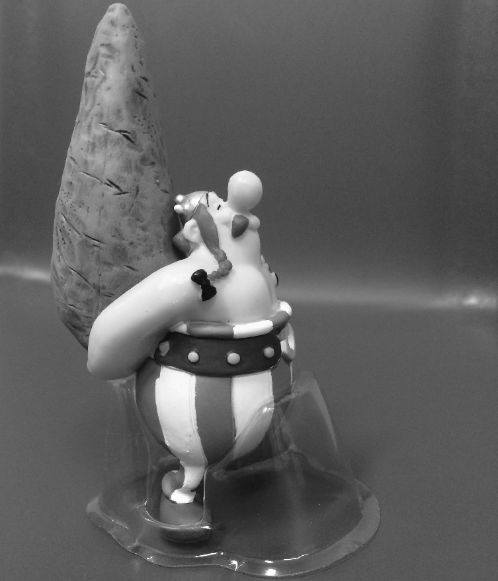
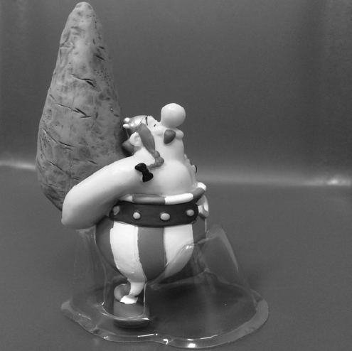

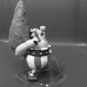

Sampling
32
64
128
256
512
1024

Slide 7
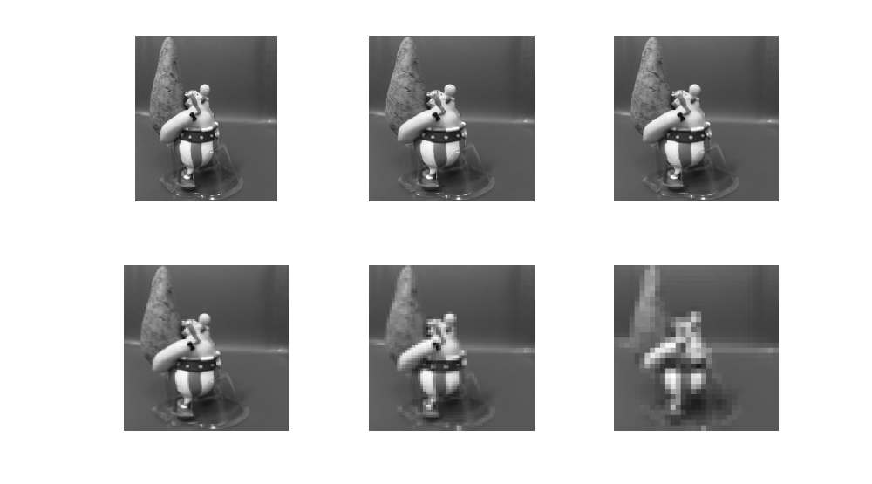
Sampling
1024
512
256
128
64
32

Slide 8
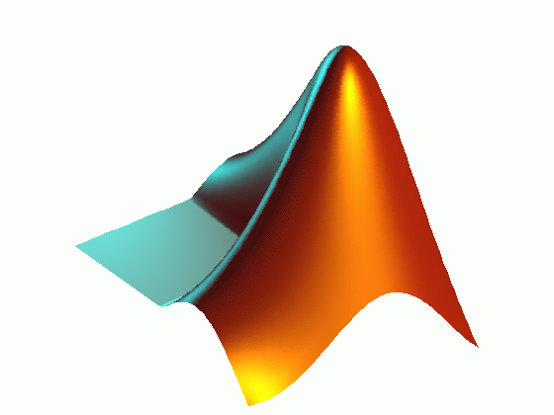
imread() – reading an image with different postfixes
imresize() – resizing an image to any given size
figure – opening a new graphical window
subplot(#of row, # of col, location) – showing different plots/images in one graphical window
imshow() – displaying an image

Slide 9
generating figures of slide 6
im=imread('obelix.jpg');
im=rgb2gray(imread('obelix.jpg'));
im1=imresize(im, [1024 1024]);
im2=imresize(im1, [1024 1024]/2);
im3=imresize(im1, [1024 1024]/4);
im4=imresize(im1, [1024 1024]/8);
im5=imresize(im1, [1024 1024]/16);
im6=imresize(im1, [1024 1024]/32);
figure;imshow(im1)
figure;imshow(im2)
figure;imshow(im3)
figure;imshow(im4)
figure;imshow(im5)

Slide 10
generating figure of slide 7
figure;
subplot(2,3,1);imshow(im1);subplot(2,3,2);imshow(im2)
subplot(2,3,3);imshow(im3);subplot(2,3,4);imshow(im4)
subplot(2,3,5);imshow(im5);subplot(2,3,6);imshow(im6)

Slide 11
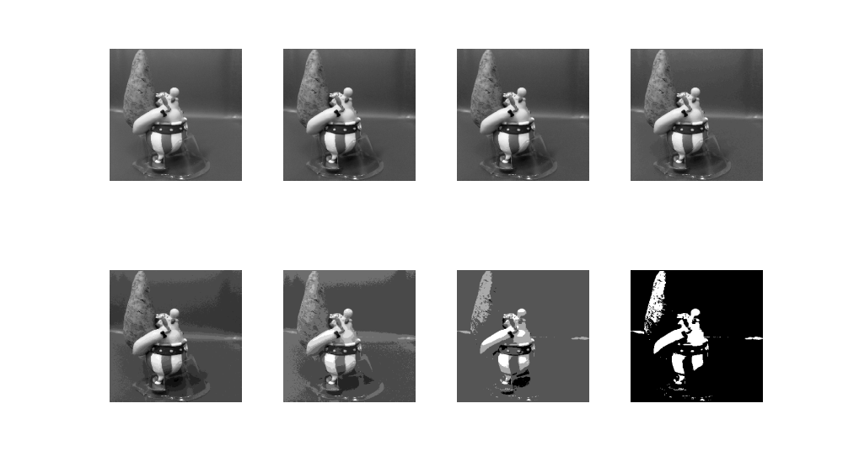
Quantization
8-bit
7-bit
6-bit
5-bit
4-bit
3-bit
2-bit
1-bit

Slide 12
generating figure of slide 11
im=imread('obelix.jpg');
im=rgb2gray(imread('obelix.jpg'));
im1=imresize(im, [1024 1024]);
im2= gray2ind(im1,2^7);
im3= gray2ind(im1,2^6);
im4= gray2ind(im1,2^5);
im5= gray2ind(im1,2^4);
im6= gray2ind(im1,2^3);
im7= gray2ind(im1,2^2);
im8= gray2ind(im1,2^1);

Slide 13
figure;
subplot(2,4,1);imshow(im1,[]);subplot(2,4,2);imshow(im2,[])
subplot(2,4,3);imshow(im3,[]);subplot(2,4,4);imshow(im4,[])
subplot(2,4,5);imshow(im5,[]);subplot(2,4,6);imshow(im6,[])
subplot(2,4,7);imshow(im7,[]);subplot(2,4,8);imshow(im8,[])

Slide 14
Summary
We have looked at:
  What is sampling?
  What is spatial resolution?
  What is quantization?
  What is grey-level resolution?
Next time we will start to see zooming
and interpolation

