Slide 1
Executive Financial Dashboard | Power BI
Elevate Labs Data Analyst Internship Assignment
Desinged By
Aswathy Sadanappan

Slide 2
Project Overview
High-level Executive Financial Overview for five companies (2021–2025)
Forecasting included up to 2030
Built using Power BI

Slide 3
Objectives
Develop modern, insightful Power BI dashboard
Apply clean UI/UX principles
Demonstrate interactive features: slicers, tooltips, bookmarks, drillthrough

Slide 4
Key Features – KPIs
Total Revenue
Net Income
ROE %
Net Margin
Total Net Income by Company

Slide 5
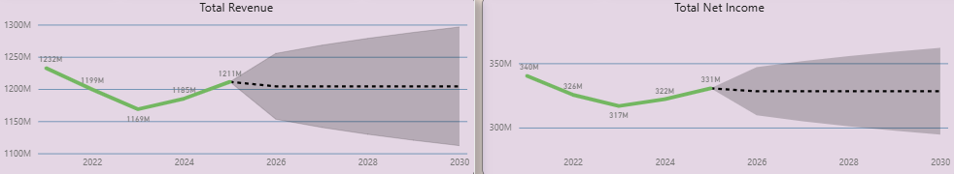
Key Features – Forecast Visuals
Visuals with shaded confidence ranges for future predictions (2026–2030)

Slide 6
Key Features – Company Comparisons
Company-wise Net Income Comparison – Compare net income across the five companies from 2021–2025.
Gross Margin Analysis – Compare gross margins across companies for the same period.
Insights for Decision-Making – Identify which companies are performing better in terms of profitability and margins.

Slide 7
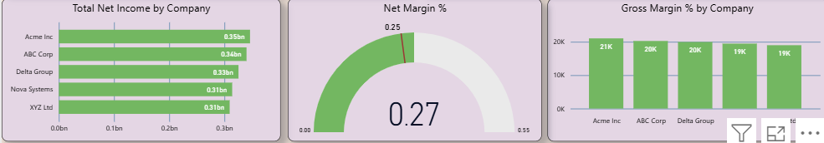
Key Features – Company Comparisons

Slide 8
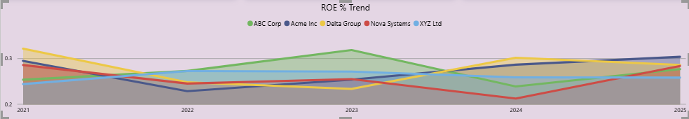
Key Features – Trend Analysis
Net Margin Gauge
ROE % Trend Analysis

Slide 9

Interactive Features
Slicers: Year and Company
Bookmarks: Key Insights toggle panel
Drill through: Company deep dive (optional)

Slide 10
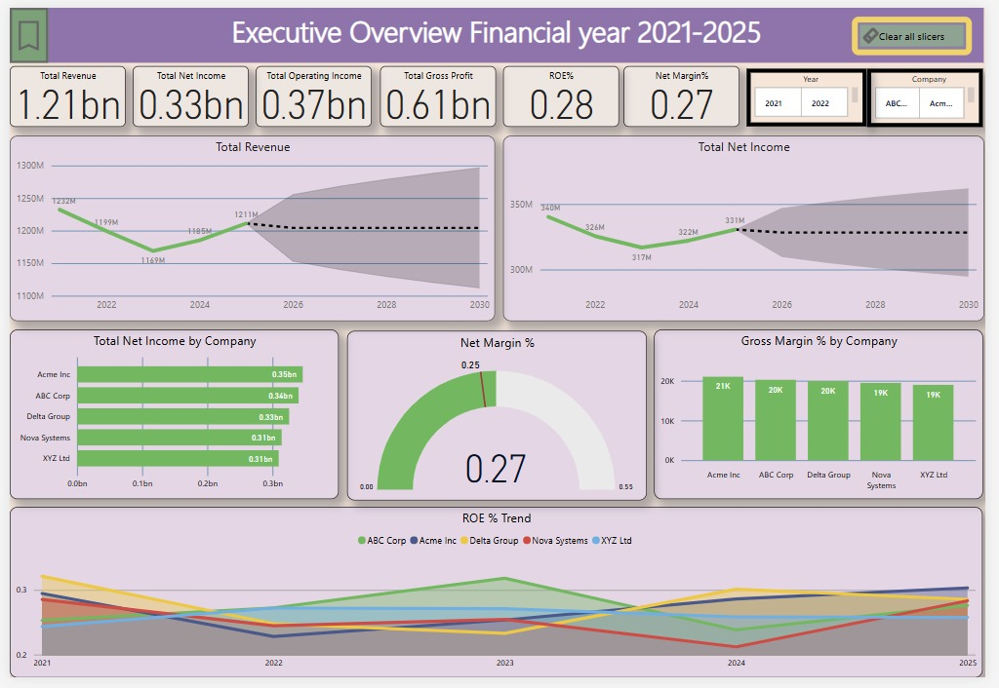
Files Included
Executive_Dashboard.pbix – Power BI report file

Slide 11
Conclusion
Dashboard provides actionable executive insights
Supports forecasting, comparisons, and decision-making
Modern UX/UI and interactive features

Slide 12


