Slide 1
Attendance Management System
Aswathy Dinesh

Slide 2
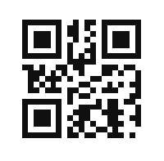
Face recognition
OR code

Slide 3

Idea
Student ID card+Orcode
Scan ID
Update Database
If matches
Track Qrcode &
Stud Face
Comapare
Image in Database
else
Error Message

Slide 4
Current Work
Face Tracking

