Slide 1

23CSE498- DESIGN PATTERNS (DP)
June 2026 – November 2026
Faculty Names : Dr. Aswathy Mohan (CSE , AIE, AIDS, EAC)
aswathymohan@am.amrita.edu
School of Computing, Amrita Vishwa Vidyapeetham, Amritapuri Campus

Slide 2
Syllabus
Unit 1:
Introduction to Design Patterns:
Significance – Software Design and patterns – Model – View - Controller. Describing Design Patterns, The Catalogue of Design Patterns, Organizing The Cato log, How Design Patterns solve Design Problems, How to Select a Design pattern, How to Use a Design Pattern.
Unit 2:
Observer Pattern - Decorator Pattern - Factory Pattern - Singleton Pattern - Command Pattern - Adapter and Facade Patterns - Template Method Pattern - Iterator and Composite Patterns – The State Pattern – The Proxy Pattern – Compound Patterns.
Unit 3:
GRASP Patterns and Anti-patterns, Overview of concurrency patterns. Case Study: Use of patterns in the Design of a Modern Web Framework, Design patterns in agile and iterative development

Slide 3
Textbook & References
Textbook(s)
Erich Gamma, Richard Helm, Ralph Johnson and John M. Vlissides, “Design Patterns: Elements of Reusable Object Oriented Software”, Second Edition, Addison Wesley, 2000
Reference(s)
James W. Cooper, Java Design Patterns: A Tutorial, Second Edition, Pearson Education, 2003.
Erich Freeman, Elisabeth Robson, Bert Bates and Kathy Sierra, Head First Design Patterns, O’Reilly Media Inc., October 2004.
Mark Grand, Patterns in Java – A Catalog of Reusable Patterns Illustrated with UML, Wiley – Dreamtech India, 2002.

Slide 4
Evaluation Policy
Sl. No | Assessment Component | Sub-Component Details | Marks | Weightage (%) | Tentative Evaluation Time
1 | Mid Term Examination | Units 1 and 2 | 50 | 20% | Mid-Semester
2 | Continuous Assessment Theory (CAT1) | Quiz 1 – Design Pattern Concepts/ Interim exam | 10 | 10% | Week 8
3 | Continuous Assessment Lab (CAL) | Case Study: Part 1 - AI Assisted Design Patterns in Modern Web Frameworks | 10 | 40% | Week 5
 |  | Case Study: Part 2 - AI Assisted Design Patterns in Agile and Iterative Development | 10 |  | Week 7
 |  | Case Study: Part 3 - Cross-Language Pattern Analysis using LLM | 10 |  | Week 9
 |  | Case Study Viva Voce | 10 |  | Week 11
4 | End Semester Examination | Complete Syllabus | 50 | 30% | End of Semester
 | Total |  |  | 100%

Slide 5
file:///C:/Users/aswat/OneDrive%20-%20Amrita%20university/Aswathy/23CSE455_DP/Journey_of_an_S7_CSE_AIE_AIDS_Student.html

Slide 6
Is this course for you?
Understand OOP & SOLID Principles
Analyse Design Problems
Learn GoF Patterns
Apply Reusable Designs
Build Scalable Software
Improve Architecture Skills
Develop Enterprise Applications

Slide 7
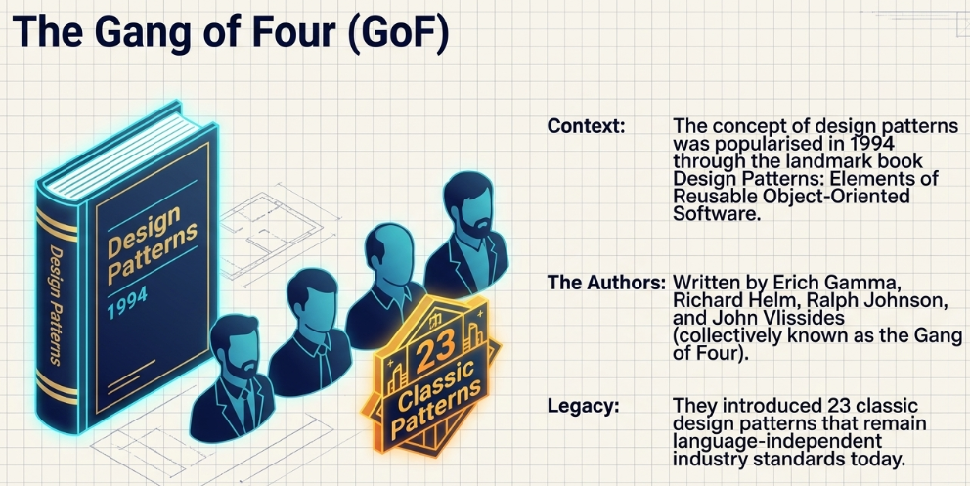
Design Patterns
Typical solutions to common problems in software design.
  Reusable solutions for recurrent problems.
Gang-of-Four design patterns
  23 common software design patterns introduced in the book Design Patterns: Elements of Reusable Object-Oriented Software
7

Slide 8
Categories of Design Patterns
Structural
Behavioral
Creational
Adapter pattern
Bridge pattern
Composite pattern
Decorator pattern
Façade pattern
Flyweight pattern
Proxy pattern
Chain of Responsibility
Command pattern
Iterator pattern
Interpreter pattern
Mediator pattern
Memento pattern
Observer pattern
State pattern
Strategy pattern
Template Method pattern
Visitor pattern
Factory Method pattern
Abstract Factory pattern
Prototype pattern
Singleton pattern
Builder pattern
Relates to object creation and instantiation (relates to both static and dynamic aspects)
Relates to class structure and composition
(static aspect)
Relates to inter-object interactions (dynamic aspect)
8

Slide 9
Design Patterns- Example (Encryption)
A typical implementation
Strategy pattern example
³ Liskov’s substitution principle
⁴ Interface segregation principle
class Encryptor {
String text;
String encrypt(algo) {
switch (algo) {
case “AES” :
// AES logic
case “RSA” :
// RSA logic
…..
}
}
}
class Encryptor {
Encryption strategy;
String text;
String encrypt() {
strategy.algo(text);
}
}
interface Encryption {
void algo(text);
}
⁵ Dependency inversion principle
class AES
implements Encryption
{
String algo(text) {
// AES logic
}
}
class RSA
implements Encryption
{
String algo(text) {
// RSA logic
}
}
² Open Closed principle
¹ Single responsibility principle
9

Slide 10
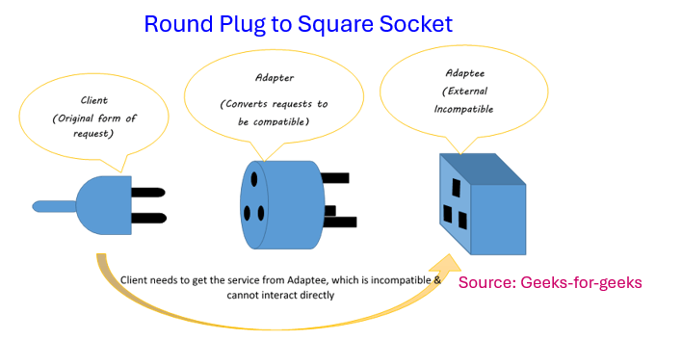
Structural - Design Patterns
Structural
Adapter pattern
Bridge pattern
Composite pattern
Decorator pattern
Façade pattern
Flyweight pattern
Proxy pattern
Relates to class structure and composition
(static aspect)
JSON Parser
XML to JSON converter
XML file
JSON file
10

Slide 11
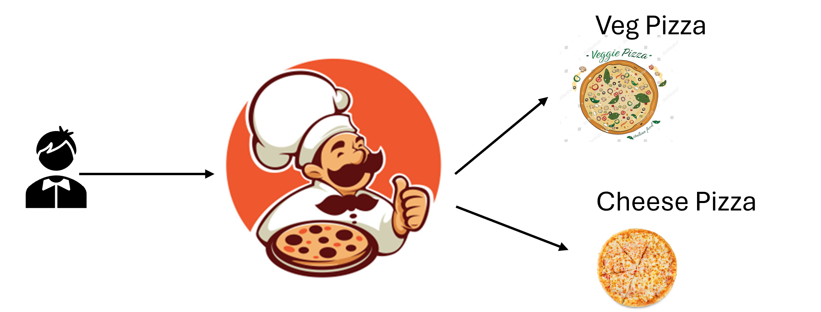
Creational - Design Patterns
Creational
Differing choice of products
Factory Method pattern
Abstract Factory pattern
Prototype pattern
Singleton pattern
Builder pattern
Relates to object creation and instantiation (relates to both static and dynamic aspects)
Grenade
Game
Player
Gun
Fire
11

Slide 12
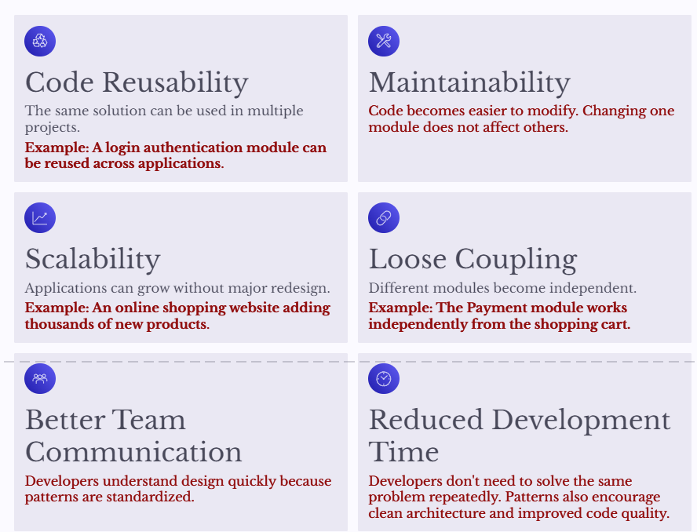
Design Patterns- Significances

Slide 13
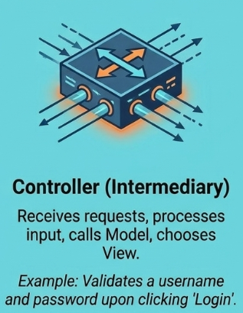
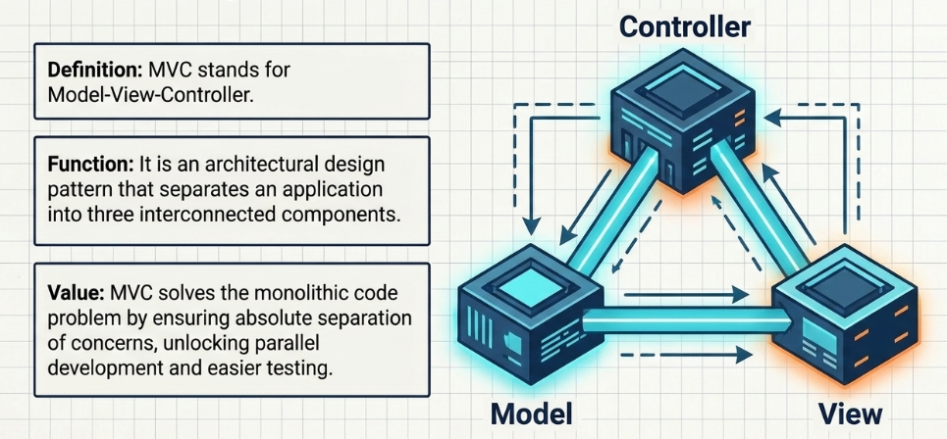
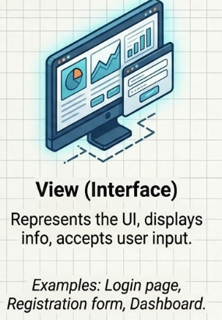
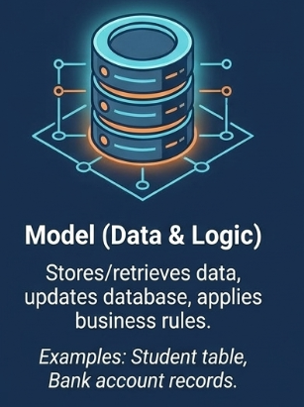
Introducing MVC Architecture
One type of Architecture Design patterns

Slide 14
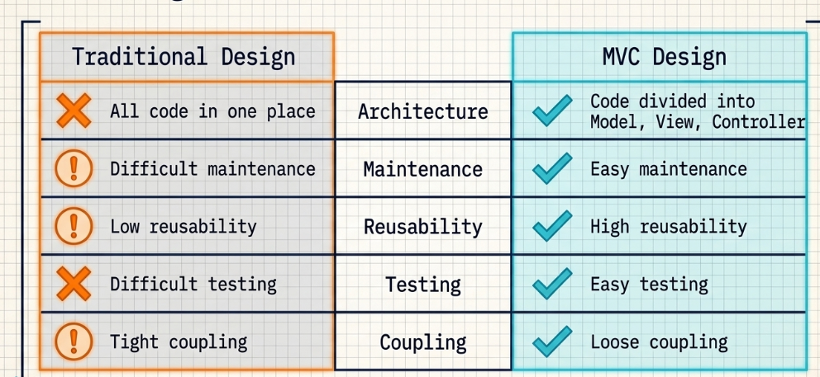
Monolithic vs. MVC

Slide 15
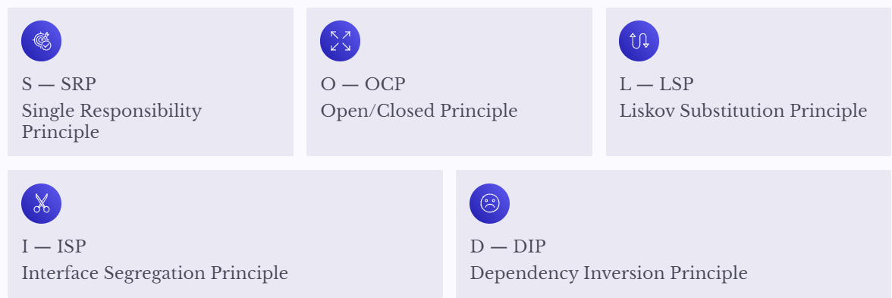
SOLID Programming Principles
A foundational guide to writing maintainable, extensible, and robust object-oriented code
The essential prerequisite to understanding Design Patterns.
SOLID is a set of five object-oriented design principles introduced by Robert C. Martin.

Slide 16
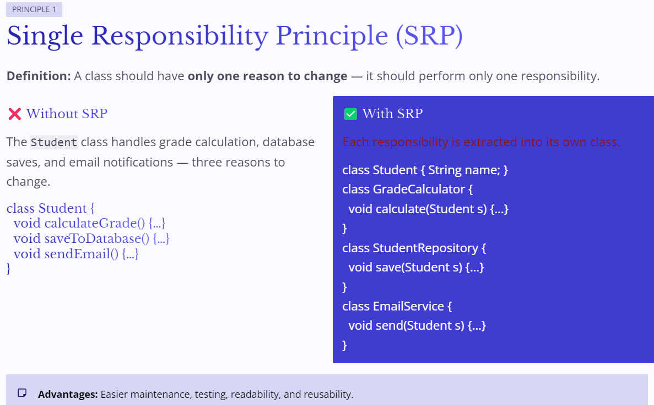
SOLID - SRP

Slide 17
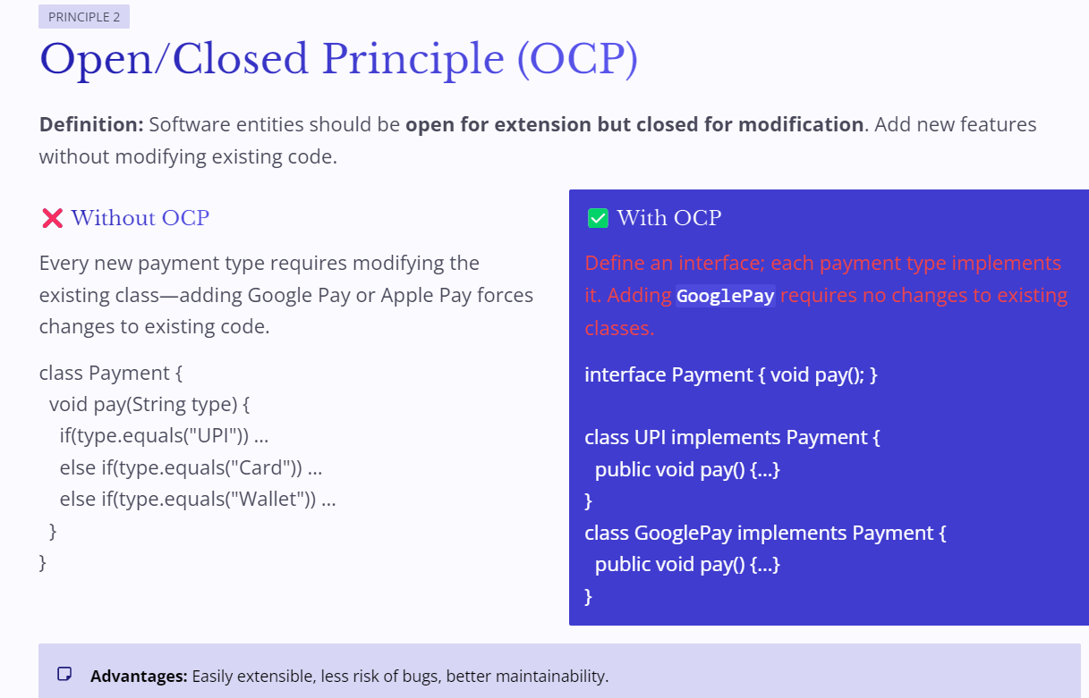
SOLID - OCP

Slide 18
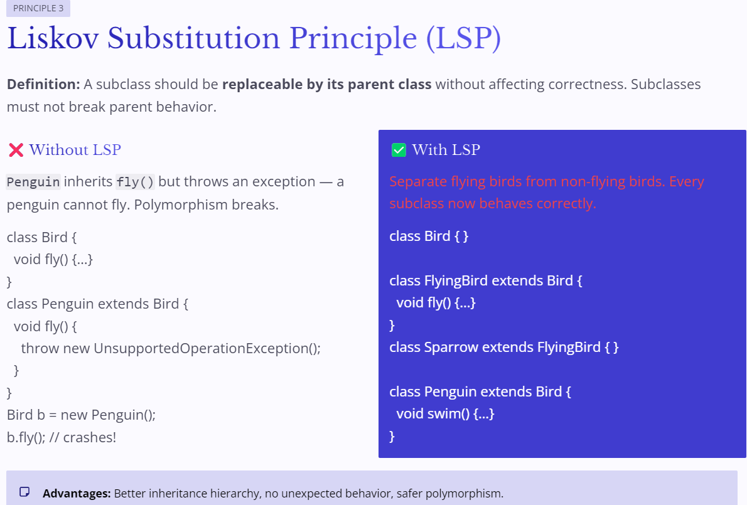
SOLID - LSP

Slide 19
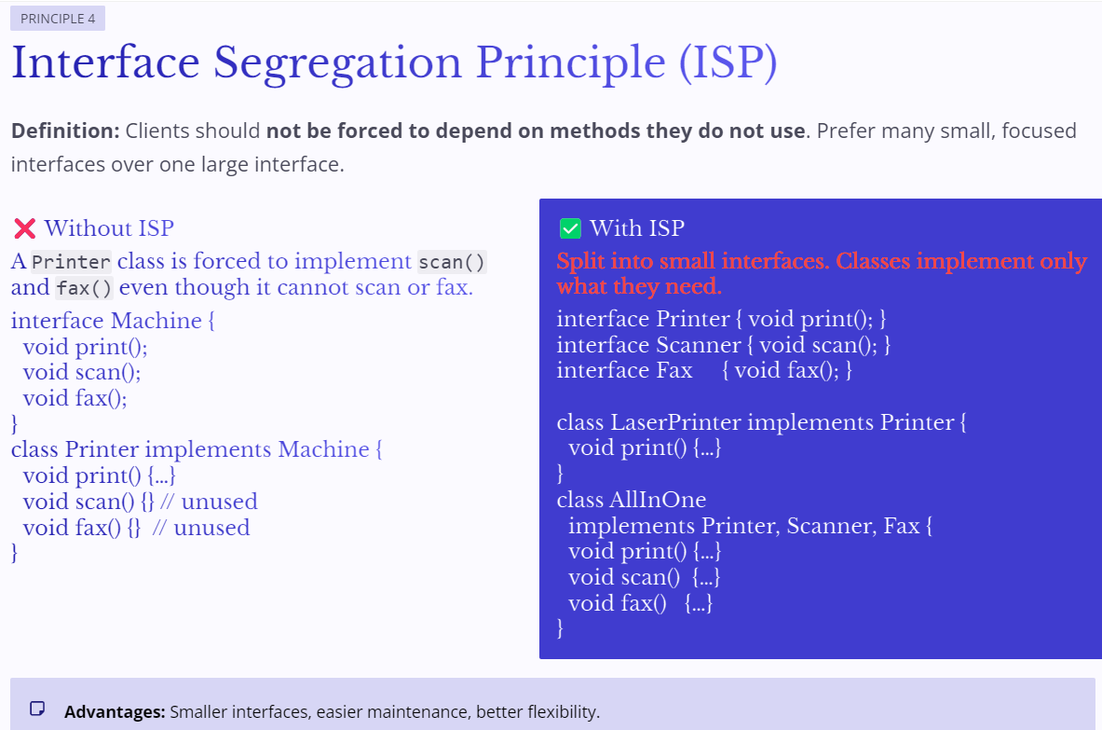
SOLID - ISP

Slide 20
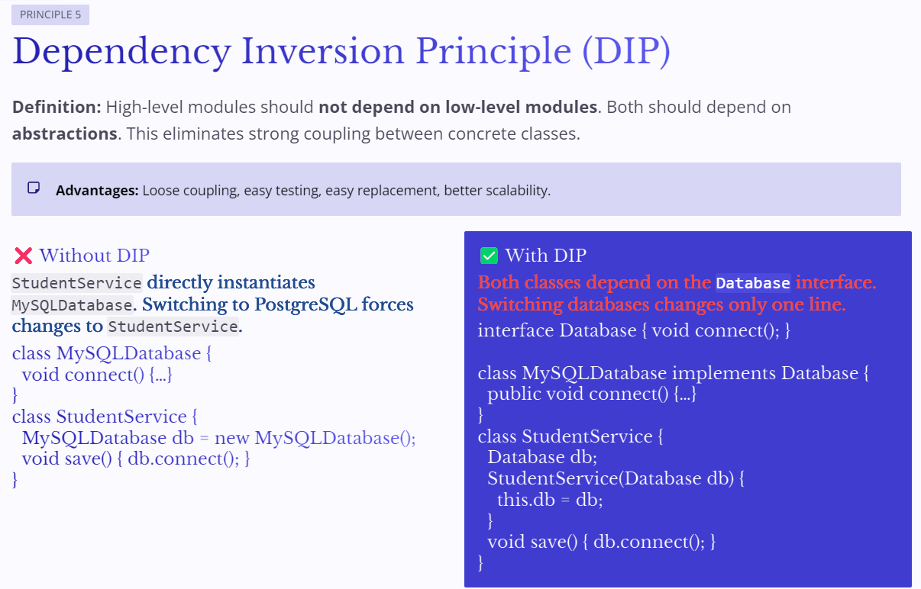
SOLID - DIP

Slide 21
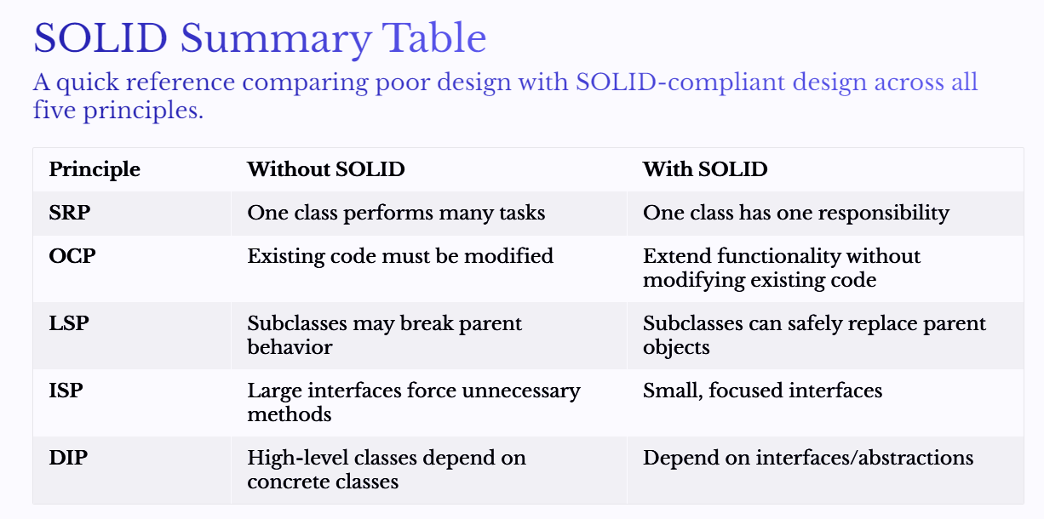
SOLID - Summary

Slide 22
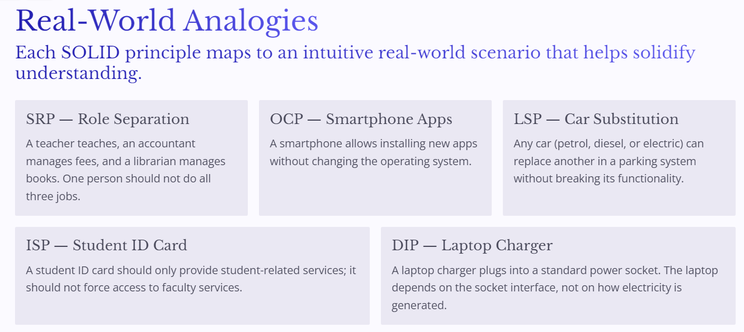
SOLID - Summary

Slide 24
Do not edit
How to change the design
Why did you choose this elective?
The Slido app must be installed on every computer you’re presenting from

Slide 25
Do not edit
How to change the design
What comes to mind when you think of 'design patterns'?
The Slido app must be installed on every computer you’re presenting from

Slide 26
How comfortable are you with Java/OOP?
Rate yourself.
Do not edit
How to change the design
The Slido app must be installed on every computer you’re presenting from

Slide 27
Which of these are Object-Oriented Programming concepts?
Do not edit
How to change the design
The Slido app must be installed on every computer you’re presenting from

Slide 28
Suppose every class creates its own database connection.
What problem might occur?
Do not edit
How to change the design
The Slido app must be installed on every computer you’re presenting from

Slide 29
Do not edit
How to change the design
True or False
Copying code from one class to another is a good software design practice.
The Slido app must be installed on every computer you’re presenting from

Slide 30
Do not edit
How to change the design
Which design is more flexible for future database changes?
1. Student -> Database
2. Student -> Interface -> Database
The Slido app must be installed on every computer you’re presenting from

Slide 31
Spot the Problem
Imagine you are building a Food Delivery App. Every payment option is written inside one class.
Payment, Credit Card, UPI, PayPal, Wallet, Net Banking
Question:
What happens when a new payment method is introduced?
Do not edit
How to change the design
The Slido app must be installed on every computer you’re presenting from

Slide 32
Do not edit
How to change the design
Mini Puzzle
How many objects should exist for a Printer Spooler?
The Slido app must be installed on every computer you’re presenting from

Slide 33
Which software do you use daily?
Do not edit
How to change the design
The Slido app must be installed on every computer you’re presenting from

