Slide 1

23CSE498- DESIGN PATTERNS (DP)
June 2026 – November 2026
Faculty Names : Dr. Aswathy Mohan (CSE , AIE, AIDS, EAC)
aswathymohan@am.amrita.edu
School of Computing, Amrita Vishwa Vidyapeetham, Amritapuri Campus

Slide 2
Syllabus
Unit 1:
Introduction to Design Patterns:
Significance – Software Design and patterns – Model – View - Controller. Describing Design Patterns, The Catalogue of Design Patterns, Organizing The Cato log, How Design Patterns solve Design Problems, How to Select a Design pattern, How to Use a Design Pattern.
Unit 2:
Observer Pattern - Decorator Pattern - Factory Pattern - Singleton Pattern - Command Pattern - Adapter and Facade Patterns - Template Method Pattern - Iterator and Composite Patterns – The State Pattern – The Proxy Pattern – Compound Patterns.
Unit 3:
GRASP Patterns and Anti-patterns, Overview of concurrency patterns. Case Study: Use of patterns in the Design of a Modern Web Framework, Design patterns in agile and iterative development

Slide 3
Textbook & References
Textbook(s)
Erich Gamma, Richard Helm, Ralph Johnson and John M. Vlissides, “Design Patterns: Elements of Reusable Object Oriented Software”, Second Edition, Addison Wesley, 2000
Reference(s)
James W. Cooper, Java Design Patterns: A Tutorial, Second Edition, Pearson Education, 2003.
Erich Freeman, Elisabeth Robson, Bert Bates and Kathy Sierra, Head First Design Patterns, O’Reilly Media Inc., October 2004.
Mark Grand, Patterns in Java – A Catalog of Reusable Patterns Illustrated with UML, Wiley – Dreamtech India, 2002.

Slide 4
Evaluation Policy
Sl. No | Assessment Component | Sub-Component Details | Marks | Weightage (%) | Tentative Evaluation Time
1 | Mid Term Examination | Units 1 and 2 | 50 | 20% | Mid-Semester
2 | Continuous Assessment Theory (CAT1) | Quiz 1 – Design Pattern Concepts/ Interim exam | 10 | 10% | Week 8
3 | Continuous Assessment Lab (CAL) | Case Study: Part 1 - AI Assisted Design Patterns in Modern Web Frameworks | 10 | 40% | Week 5
 |  | Case Study: Part 2 - AI Assisted Design Patterns in Agile and Iterative Development | 10 |  | Week 7
 |  | Case Study: Part 3 - Cross-Language Pattern Analysis using LLM | 10 |  | Week 9
 |  | Case Study Viva Voce | 10 |  | Week 11
4 | End Semester Examination | Complete Syllabus | 50 | 30% | End of Semester
 | Total |  |  | 100%

Slide 5
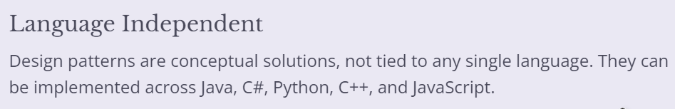
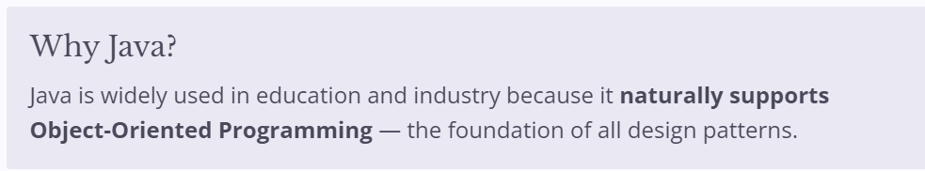
Bridge Course: Java Fundamentals for Design Patterns
Why Java for Design Patterns?

Slide 6
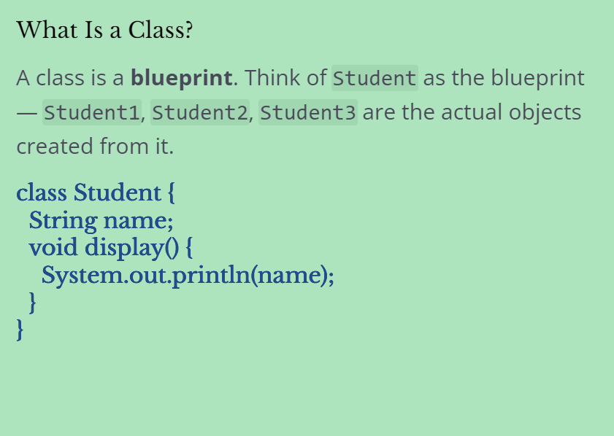
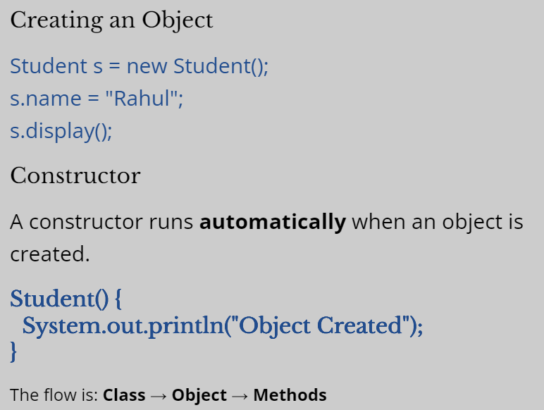
Classes, Objects & Constructors

Slide 7
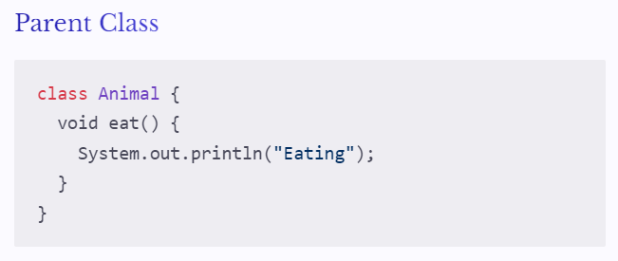
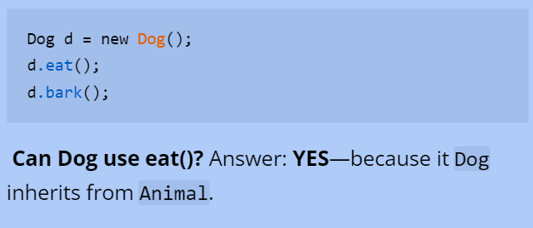
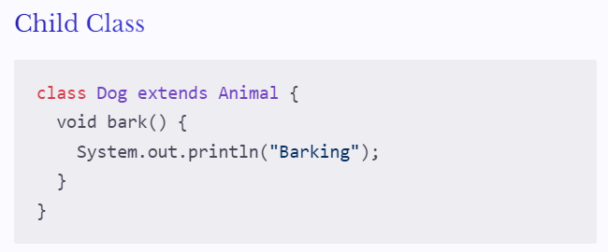
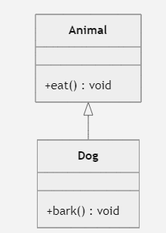
Inheritance

Slide 8
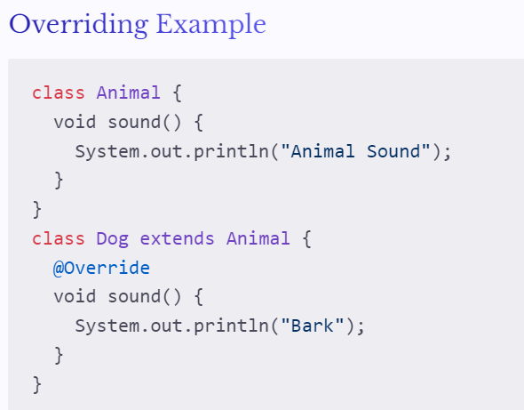
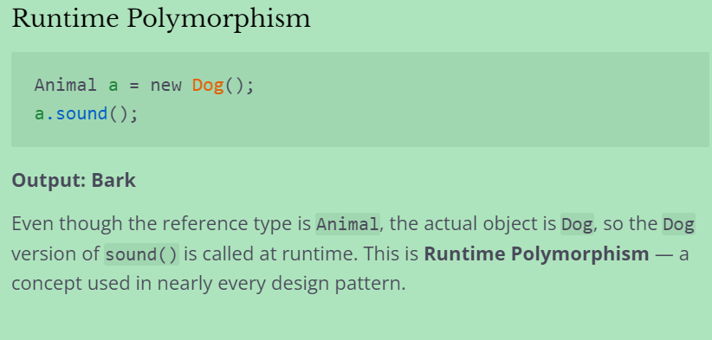
Method Overriding & Runtime Polymorphism
When a subclass redefines a parent method, it's called method overriding. The @Override annotation marks this explicitly.

Slide 9
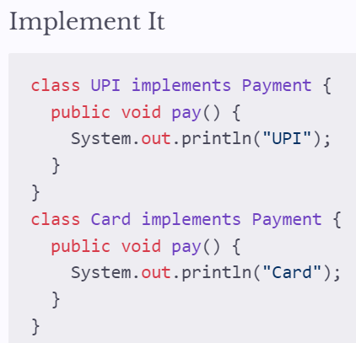
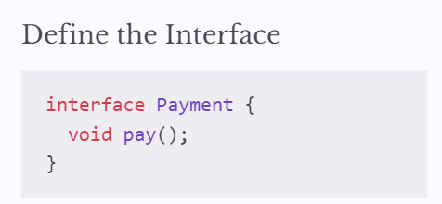
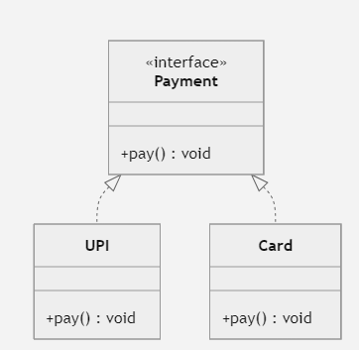
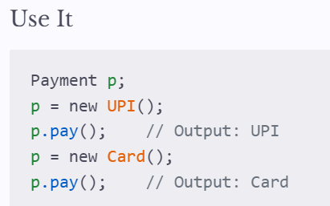
Interfaces
Real-world analogy: all mobile phones depend on the USB interface, not a specific charger implementation. In Java, interfaces define a contract that classes must fulfil.

Slide 10
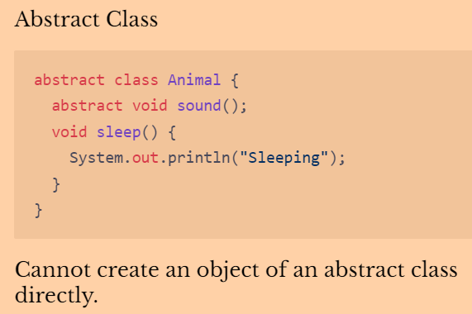
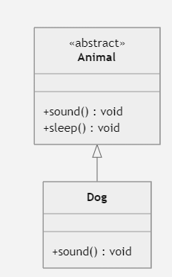
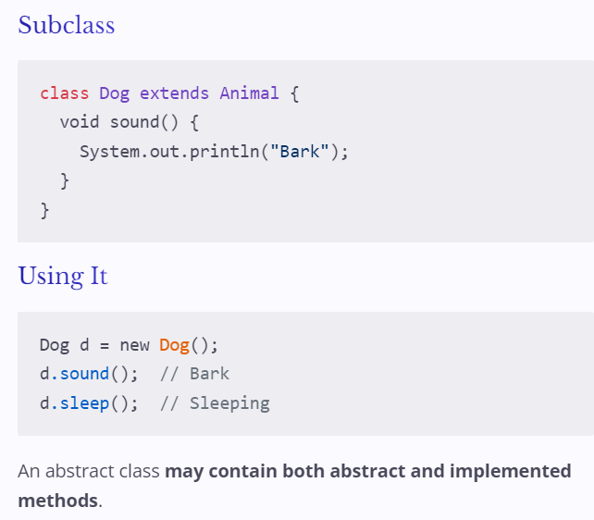
Abstract Classes
Can an Animal make a sound?
It depends on the animal. This is exactly what an abstract class expresses — a shared structure with some methods left undefined.

Slide 11
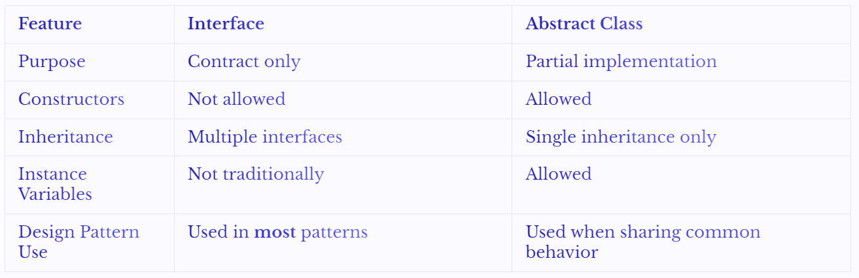
Interface vs. Abstract Class
Both define contracts, but they serve different purposes. Understanding when to use each is essential for design patterns.

Slide 12
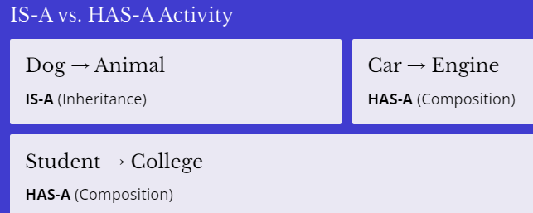
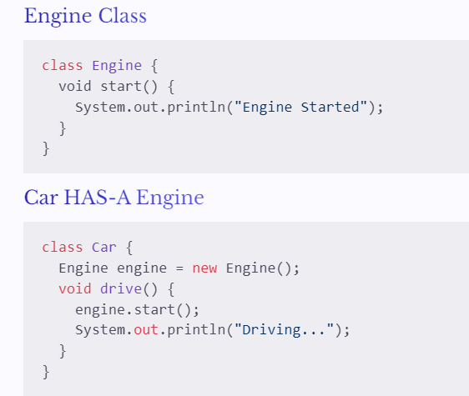
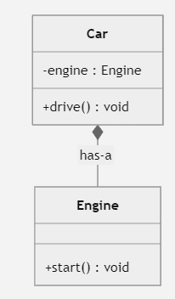
Composition
Composition means a class has an object of another class as a member -- a HAS-A relationship, not IS-A.
Design patterns prefer composition over inheritance for flexibility.

Slide 13
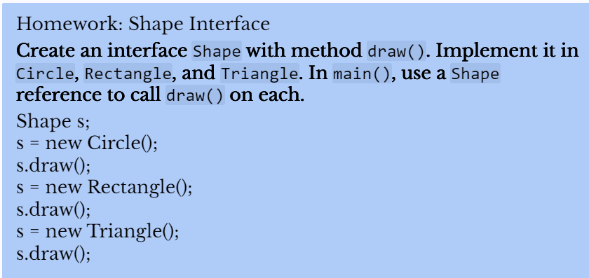
Homework

Slide 14
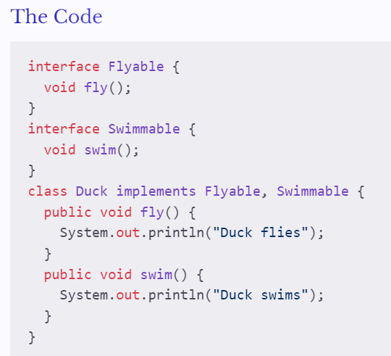
When Does Multiple Interfaces Make Sense?
A class should implement multiple interfaces only when it truly has multiple distinct capabilities. The classic example: a Duck.
Why This Works
A duck genuinely has two independent capabilities — it can fly and it can swim. Both behaviours are intrinsic to what a duck is.

Slide 15
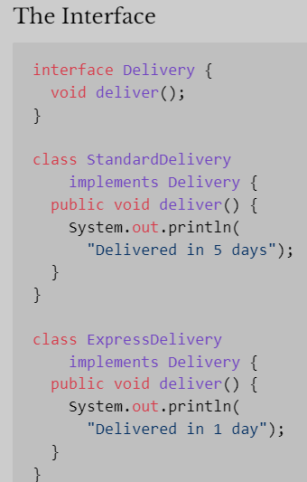
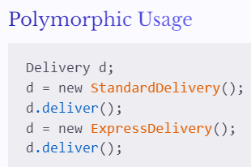
When Does Multiple Interfaces Make Sense?
Instead of sharing implementation, interfaces define only the contract — what a class must do, not how.
Classes implement the interface independently.
Any class can implement Delivery regardless of its place in the class hierarchy.
This gives you flexibility and interchangeable implementations without a rigid inheritance tree.

Slide 16
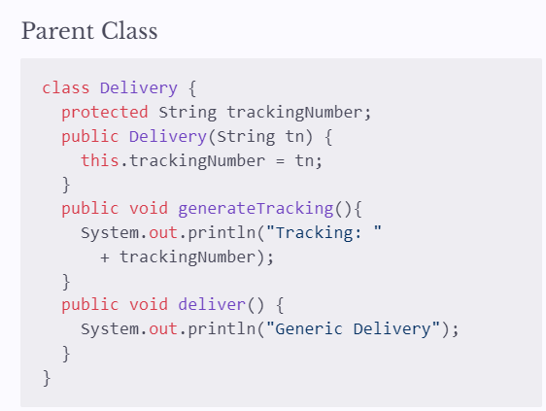
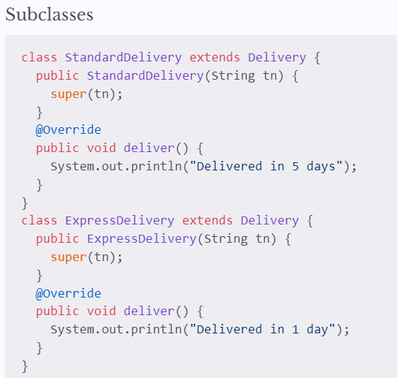
When Does Inheritance Make Sense?
Use inheritance when subclasses are a specialized form of the parent and share common data and behaviour.
Example: all delivery types share a tracking number
Advantage
Both subclasses automatically inherit trackingNumber and generateTracking() — written once, reused everywhere. Without inheritance, this code would be duplicated in every class.

Slide 17
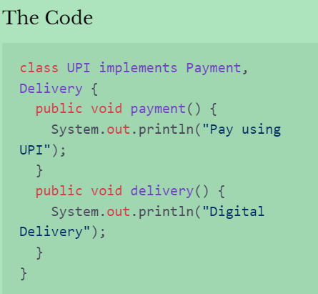
Inheritance Over Interfaces and use Composition
Forcing UPI to implement Delivery violates the Single Responsibility Principle
A payment method does not inherently deliver anything.
The responsibilities are unrelated

Slide 18
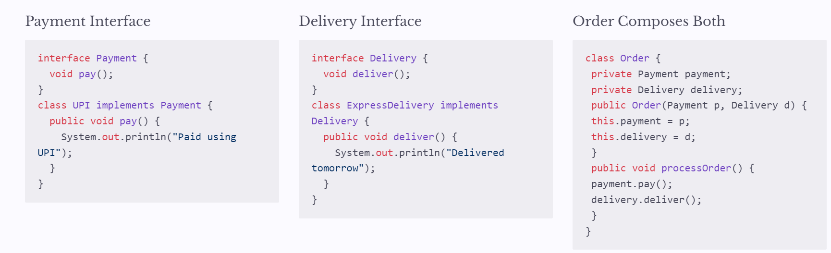
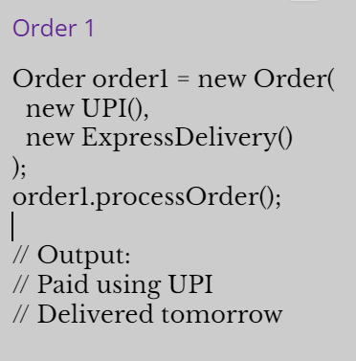
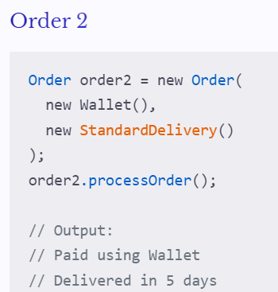
Better Design : Use Composition
Instead of forcing one class to do everything, compose an Order from separate Payment and Delivery objects. Each interface has a single, clear responsibility.
With composition, any Payment can be paired with any Delivery — without modifying the Order class. This is the Open/Closed Principle in action

