Slide 1

23CSE498- DESIGN PATTERNS (DP)
June 2026 – November 2026
Faculty Names : Dr. Aswathy Mohan (CSE , AIE, AIDS, EAC)
aswathymohan@am.amrita.edu
School of Computing, Amrita Vishwa Vidyapeetham, Amritapuri Campus

Slide 2
Syllabus
Unit 1:
Introduction to Design Patterns:
Significance – Software Design and patterns – Model – View - Controller. Describing Design Patterns, The Catalogue of Design Patterns, Organizing The Cato log, How Design Patterns solve Design Problems, How to Select a Design pattern, How to Use a Design Pattern.
Unit 2:
Observer Pattern - Decorator Pattern - Factory Pattern - Singleton Pattern - Command Pattern - Adapter and Facade Patterns - Template Method Pattern - Iterator and Composite Patterns – The State Pattern – The Proxy Pattern – Compound Patterns.
Unit 3:
GRASP Patterns and Anti-patterns, Overview of concurrency patterns. Case Study: Use of patterns in the Design of a Modern Web Framework, Design patterns in agile and iterative development

Slide 3
Textbook & References
Textbook(s)
Erich Gamma, Richard Helm, Ralph Johnson and John M. Vlissides, “Design Patterns: Elements of Reusable Object Oriented Software”, Second Edition, Addison Wesley, 2000
Reference(s)
James W. Cooper, Java Design Patterns: A Tutorial, Second Edition, Pearson Education, 2003.
Erich Freeman, Elisabeth Robson, Bert Bates and Kathy Sierra, Head First Design Patterns, O’Reilly Media Inc., October 2004.
Mark Grand, Patterns in Java – A Catalog of Reusable Patterns Illustrated with UML, Wiley – Dreamtech India, 2002.

Slide 4
Evaluation Policy
Sl. No | Assessment Component | Sub-Component Details | Marks | Weightage (%) | Tentative Evaluation Time
1 | Mid Term Examination | Units 1 and 2 | 50 | 20% | Mid-Semester
2 | Continuous Assessment Theory (CAT1) | Quiz 1 – Design Pattern Concepts/ Interim exam | 10 | 10% | Week 8
3 | Continuous Assessment Lab (CAL) | Case Study: Part 1 - AI Assisted Design Patterns in Modern Web Frameworks | 10 | 40% | Week 5
 |  | Case Study: Part 2 - AI Assisted Design Patterns in Agile and Iterative Development | 10 |  | Week 7
 |  | Case Study: Part 3 - Cross-Language Pattern Analysis using LLM | 10 |  | Week 9
 |  | Case Study Viva Voce | 10 |  | Week 11
4 | End Semester Examination | Complete Syllabus | 50 | 30% | End of Semester
 | Total |  |  | 100%

Slide 5
Unit 2

Slide 6
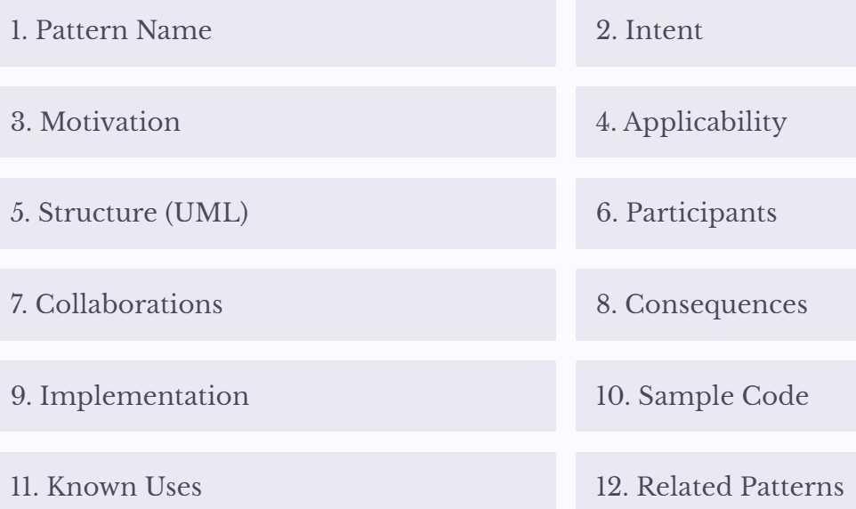
Observer Pattern
How does YouTube notify millions of subscribers when a creator uploads a new video?
The GoF Documentation Template
Every design pattern in this course uses the same 12-part structure

Slide 7
Motivation: The Real-World Problem
Does YouTube call every user manually?
How does WhatsApp notify everyone in a group?
How do stock market apps update prices automatically
Core question: If 10 million subscribers exist, how can a channel notify all of them without knowing their internal implementation

Slide 8
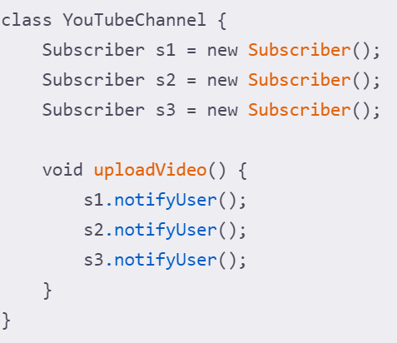
Why the Existing Design Fails
A naive implementation hardcodes every subscribers:
Hardcoded Subscribers
Every subscriber must be declared explicitly — cannot add new ones dynamically.
Tight Coupling
One class knows too much about another class.
Difficult Maintenance
Changes ripple through the entire system.

Slide 9
The Observer Pattern
GoF Intent: Define a one-to-many dependency between objects so that when one object changes state, all its dependents are notified and updated automatically.
Simplified: One object changes → Many objects automatically receive updates
Pattern Name
Observer
Intent
Automatically notify dependent objects
Motivation
YouTube notifications
Applicability
Many objects depend on one; automatic updates needed; loose coupling desired

Slide 10
The Observer Pattern- Structure & Participants
GoF Intent: Define a one-to-many dependency between objects so that when one object changes state, all its dependents are notified and updated automatically.
Simplified: One object changes → Many objects automatically receive updates
Participant | Responsibility
Subject | Maintains subscriber list
Observer | Receives updates
ConcreteSubject | YouTube Channel
ConcreteObserver | Subscriber
Subject
Observer
Client
registerob();
removeob()
operation();
notify();
update();
Concrete
Subject
Concrete
Observer A
Concrete
Observer B
Participants
Observer ob;
registerob(){ …}
removeob(){ ... }
operation(){..notify();}
notify(){….}
update(){ … }
update(){ … }

Slide 11
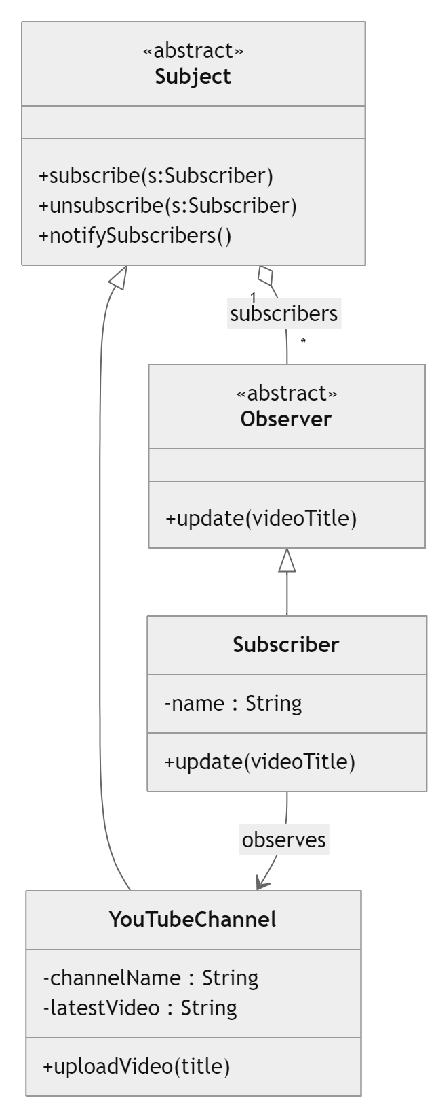
The Observer Pattern- Variant 1
UML Structure
Variant 1
This version is closest to the original Design Patterns book (Gamma et al., 1994).
Both Subject and Observer are modelled as abstract classes.
Concrete classes inherit shared behaviour, maximizing code reuse — common in early OO languages.
✓ Advantages
Maximum code reuse through inheritance; shared implementation of notification logic in the abstract Subject.
✗ Disadvantages
Java cannot extend another class simultaneously; less flexible for multiple inheritance scenarios.

Slide 12
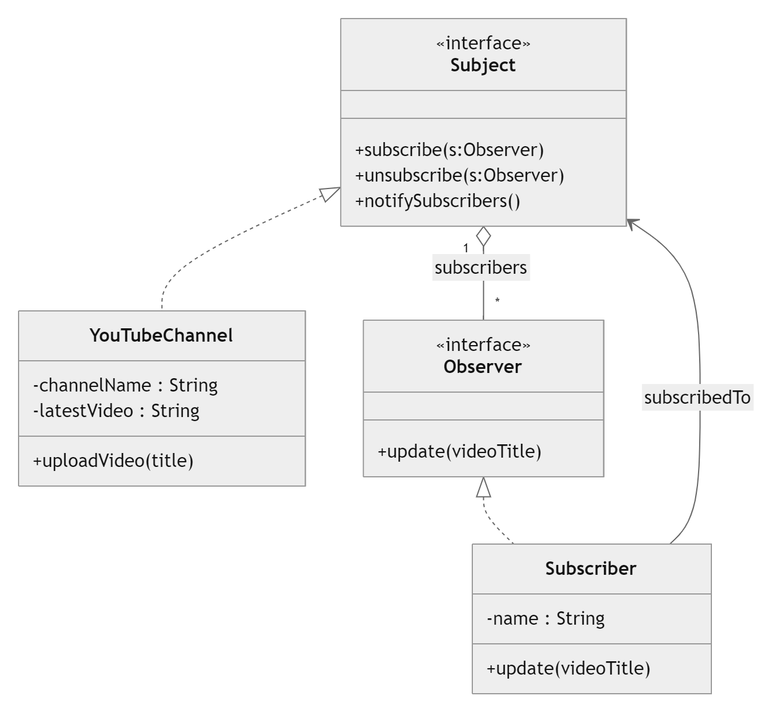
The Observer Pattern- Variant 2
Variant 2
Modern Java/C# developers typically model both Subject and Observer as interfaces.
This maximizes flexibility and supports multiple inheritance of interfaces, making it ideal for dependency injection frameworks.
✓ Advantages
Loose coupling; supports multiple inheritance of interfaces; easy to test with mocks.
✗ Disadvantages
Every concrete subject must duplicate attach(), detach(), and notify() — no shared implementation.
UML Structure

Slide 13
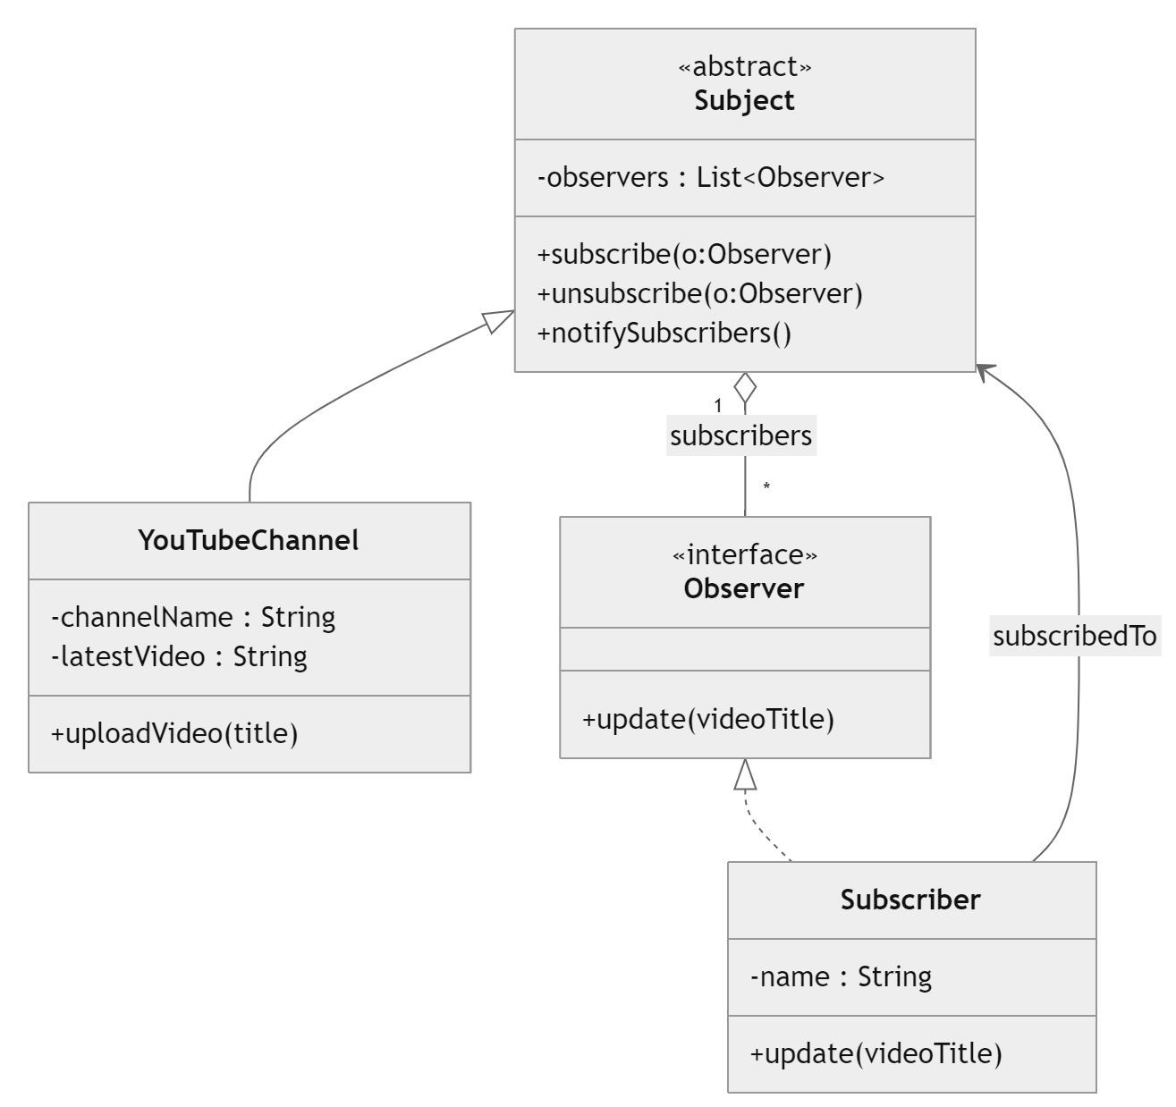
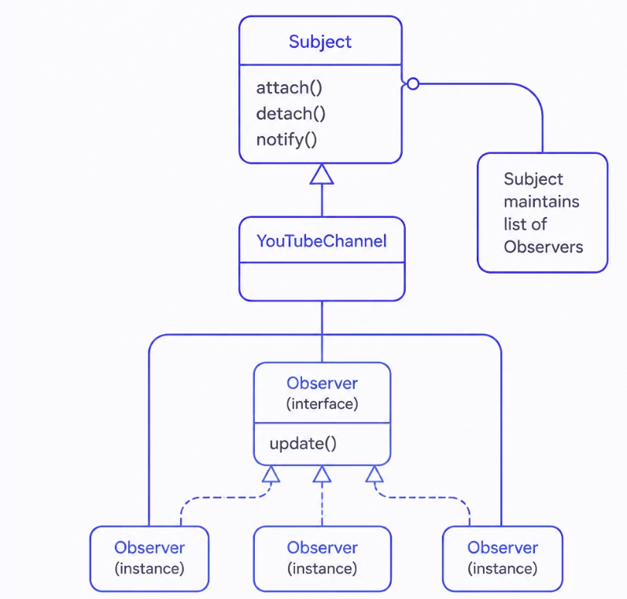
The Observer Pattern-Variant 3
Most Common in Practice
UML Structure
Variant 3
This is the version most frequently used in real-world software.
Subject is an abstract class (storing the observer list and implementing notification logic), while Observer is an interface — balancing code reuse and flexibility. Found in Spring Framework, Java Swing, Android, and JavaFX.

Slide 14
The Observer Pattern- Most Common in Practice
Variant 3
This is the version most frequently used in real-world software.
Subject is an abstract class (storing the observer list and implementing notification logic), while Observer is an interface — balancing code reuse and flexibility.
UML Structure
✓ Loose Coupling
Observer interface allows independent implementations.
✓ Maximum Code Reuse
Notification logic stays in abstract Subject.
✓ Enterprise Ready
Used in Spring, Android, JavaFX, Java Swing.

Slide 15
The Observer Pattern- Comparative Analysis of Three Variant
Each variant has distinct trade-offs in code reuse, flexibility, and real-world applicability.
The Hybrid approach (Variant 3) is the recommended choice for modern Java/C# enterprise applications.
Feature | Variant 1 (GoF) | Variant 2 (Interfaces) | Variant 3 (Hybrid) ✓
Subject | Abstract Class | Interface | Abstract Class
Observer | Abstract Class | Interface | Interface
Code Reuse | High | Low | High
Loose Coupling | Medium | High | High
Multiple Inheritance | No | Yes | Yes
Enterprise Usage | Low | Medium | Very High
GoF Similarity | ★★★★★ | ★★★ | ★★★★★
Recommended | No | Sometimes | ✓ Yes

Slide 16
Mapping Observer Generic Pattern to YouTube Example
The generic Observer participants map directly to a YouTube channel– subscriber system.
Generic Pattern | YouTube Example
Subject | YouTubeChannel
ConcreteSubject | TechChannel
Observer | Subscriber
ConcreteObserver | UserSubscriber
attach() | subscribe()
detach() | unsubscribe()
notify() | notifySubscribers()
update() | receiveNotification()
subjectState | uploadedVideo

Slide 17
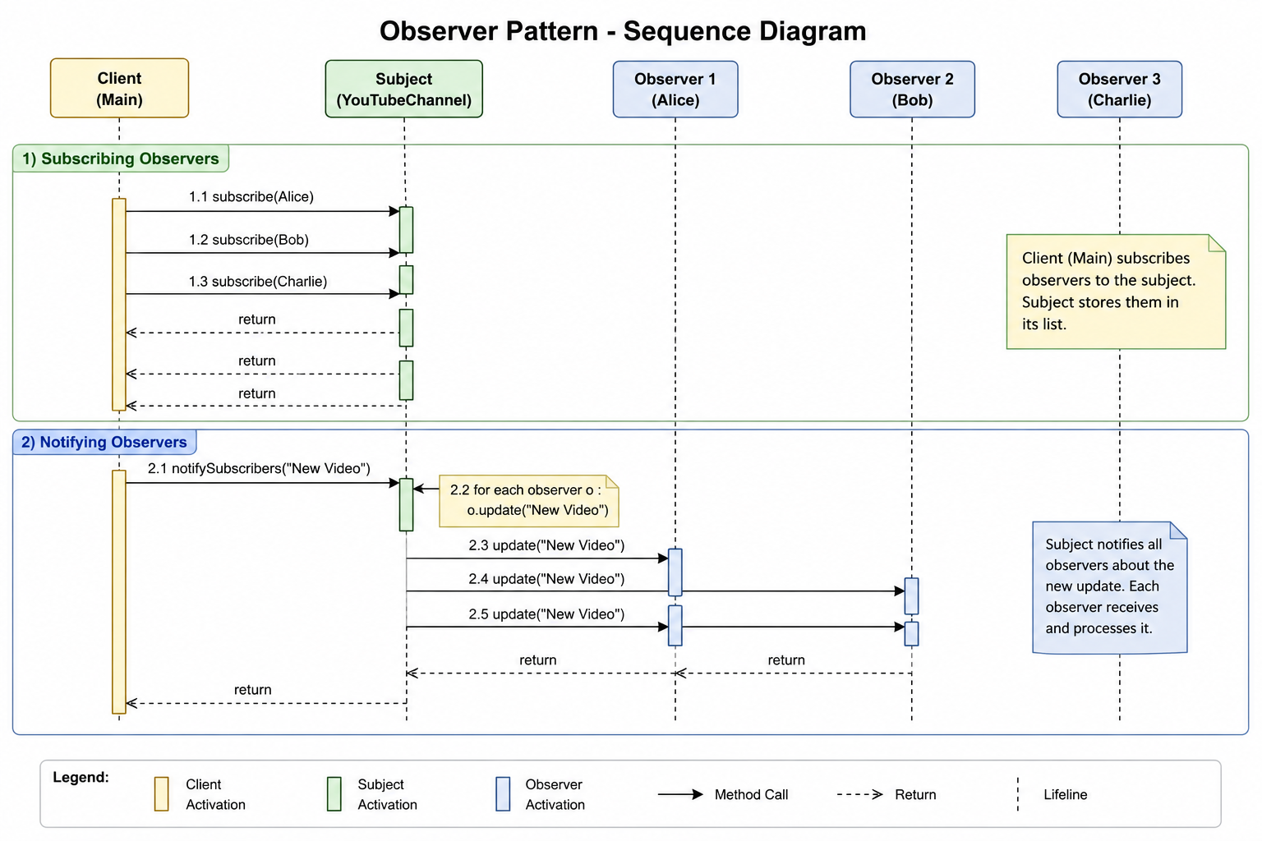
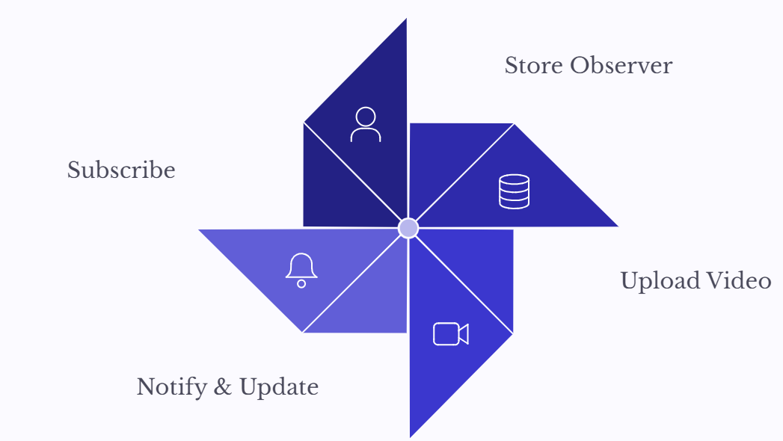
Observer Pattern - Collaborations
The sequence of interactions when a new video is uploaded
Subscriber subscribes
2. Subject stores observer
3. New video uploaded
4. Subject calls notify()
5. Every observer executes update().

Slide 18
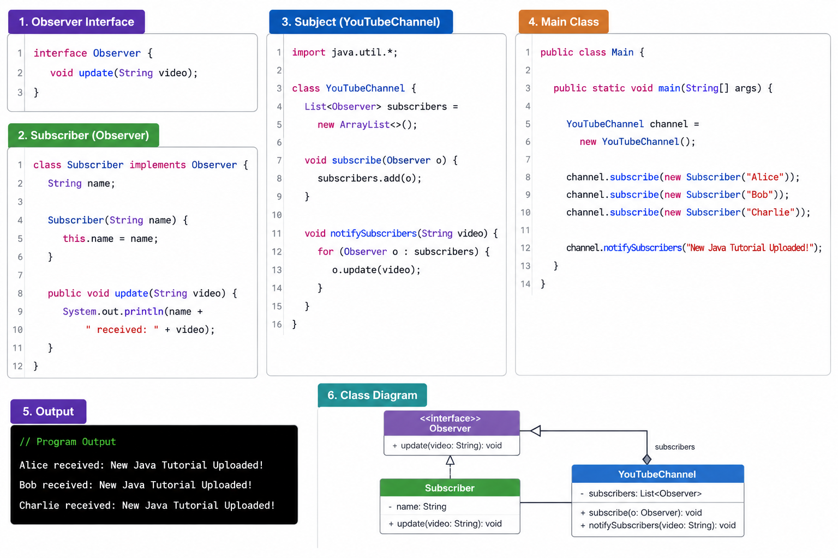
Observer Pattern – Java Implementation

Slide 19
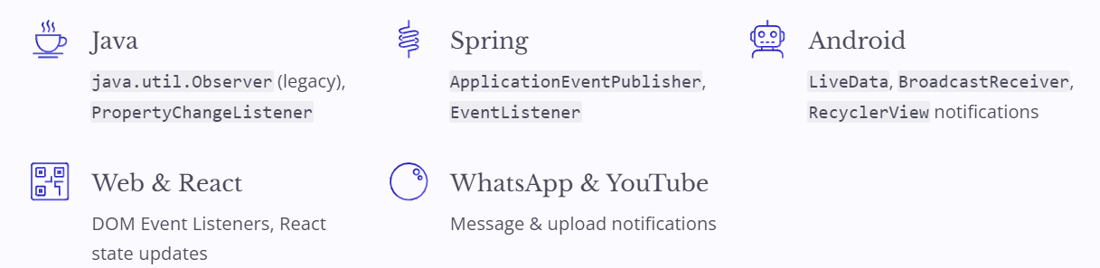
Observer Pattern – Consequences
✅ Advantages
Loose coupling · Easy to add observers · Dynamic relationships · Reusable · Event-driven
⚠️ Disadvantages
Notification overhead · Difficult debugging · Unexpected update chains · Performance issues with many observers
🌐 Industry Examples

Slide 20
Observer Pattern – Related Pattern
Observer | Automatic notification
Mediator | Centralized communication
Command | Encapsulates requests
State | Changes behaviour by state
🌱 Coding Exercise : Build a Weather Station — Observer interface, three observers (Mobile App, LED Display, Email Alert), and a WeatherStation Subject. When temperature changes, all observers receive the updated value (e.g., 35°C).

