Slide 1
Unit 2

Slide 2
State Design Pattern
According to the Gang of Four (GoF)
Allow an object to alter its behaviour when its internal state changes. The object will appear to change its class."
Simple Definition
The State Pattern allows an object to behave differently depending on its current state.
Pattern Name
State
Intent
Allow an object to alter its behaviour when its internal state changes.
Motivation
Same Object → Different States → Different Behaviour. The State Pattern models exactly this.
Traffic Signal
RED → Stop ·
GREEN → Move ·
YELLOW → Wait.
Same object, different behaviour per state.
ATM Machine
No Card → Card Inserted → PIN Verified → Cash Withdrawn. Each state gates the next operation.
Mobile Phone
Locked → No apps ·
Silent → No ringtone ·
Airplane → Calls disabled.

Slide 3
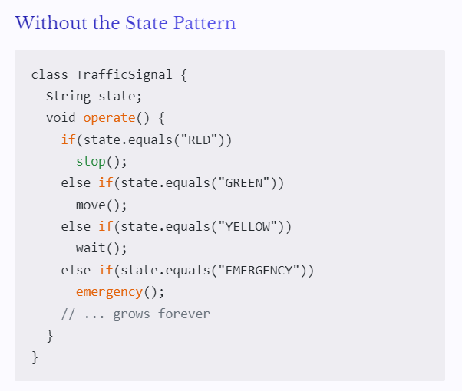
Why the Existing Design Fails
A naive implementation A Traffic Signal Controller
Problems
Too many if-else statements
Every new state modifies the existing class (suppose municipality adds Emergency Mode, Flashing Yellow, Smart AI Mode, and more — the code spirals.)
Violates the Open-Closed Principle
Code becomes hard to read, debug, and maintain
Multiple developers cause merge conflicts
High Coupling, Low Cohesion, Poor Scalability.

Slide 4
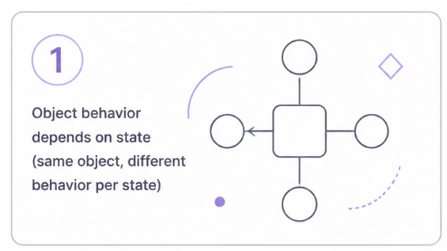
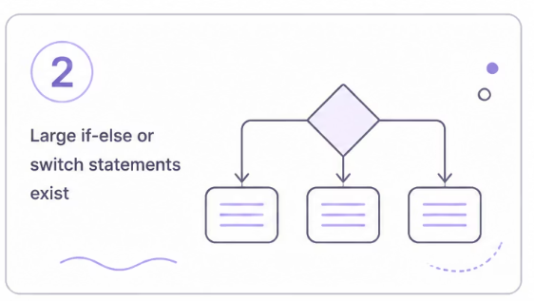
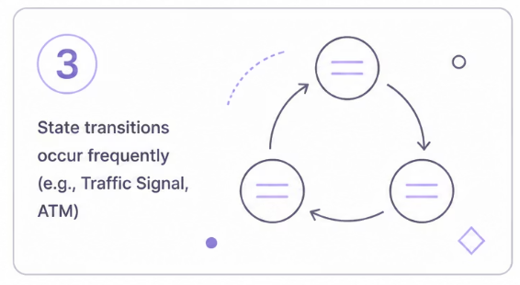
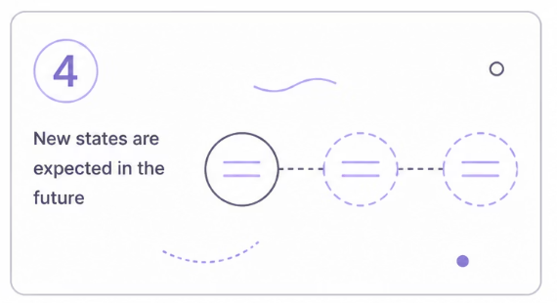
Applicability
Use the State Pattern when an object's behaviour depends on its current state, states change frequently, and new states may be added.
Do NOT use it for one or two static states or when simple if-else suffices.

Slide 5
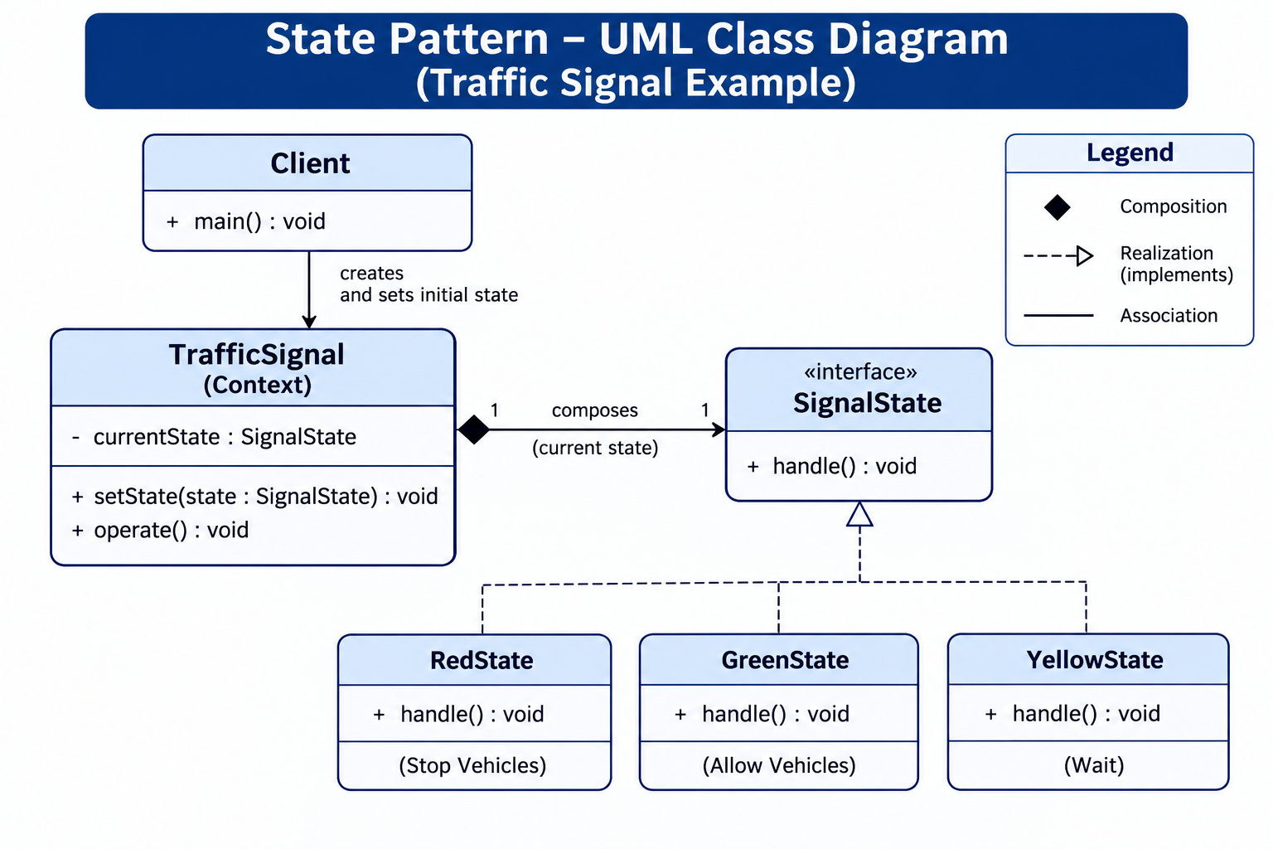
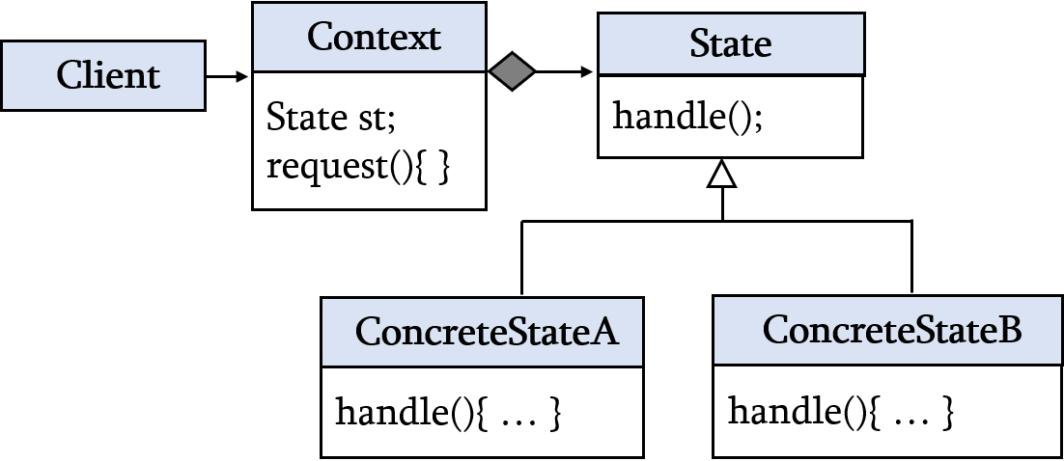
The State Pattern- Structure & Participants
Participant Responsibilities
Context
Maintains current state, delegates requests, changes state. Example: TrafficSignal
State (Interface)
Defines the common handle() method that all states must implement.
Concrete State
Implements behaviour for one state.
Example: RedState → Stop Vehicles
Client
Creates Context, sets initial state, and starts execution.
The Context does NOT know how a state works — it simply delegates via currentState.handle().This is Delegation.

Slide 6
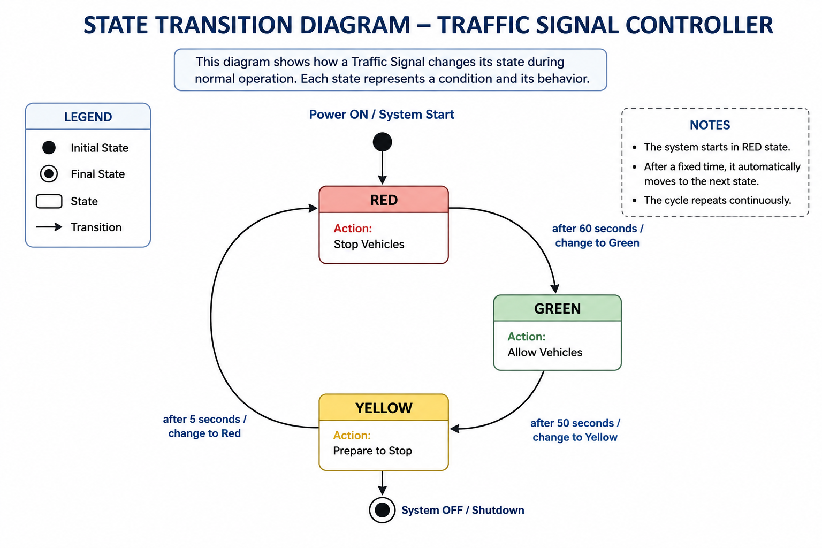
The State Pattern- Collaborations & State Transition Diagram
State Transition Diagram
Unlike a UML Class Diagram (shows classes and relationships), a State Transition Diagram visualizes possible state changes before writing code:
Traffic Signal: RED → GREEN → YELLOW → RED
ATM: No Card → Card Inserted → PIN Verified → Eject Card
Media Player: Stopped → Playing → Paused → Stopped

Slide 7
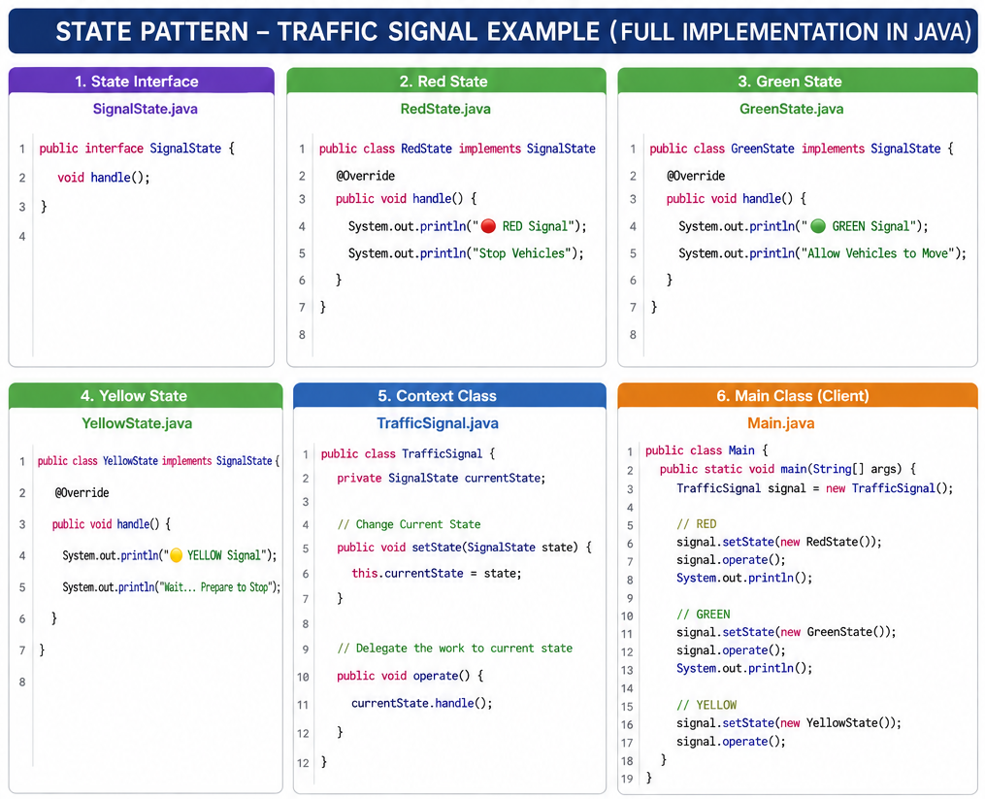
State Pattern – Java Implementation

Slide 8
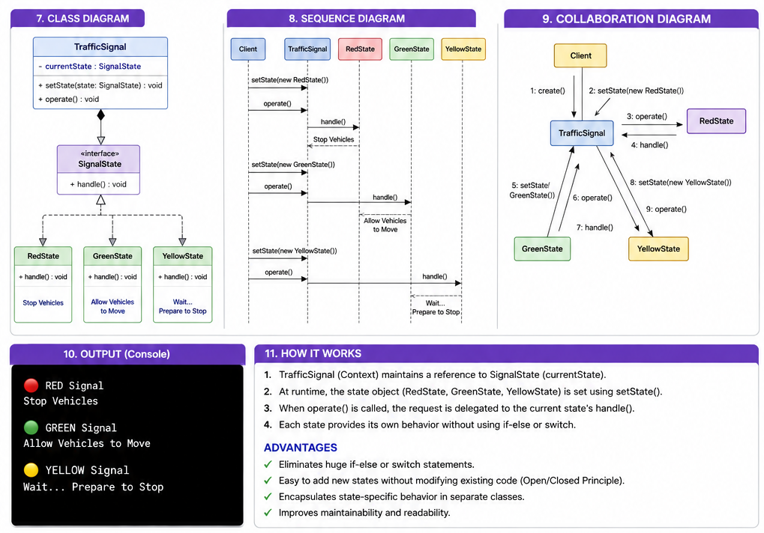
State Pattern – Java Implementation

Slide 9
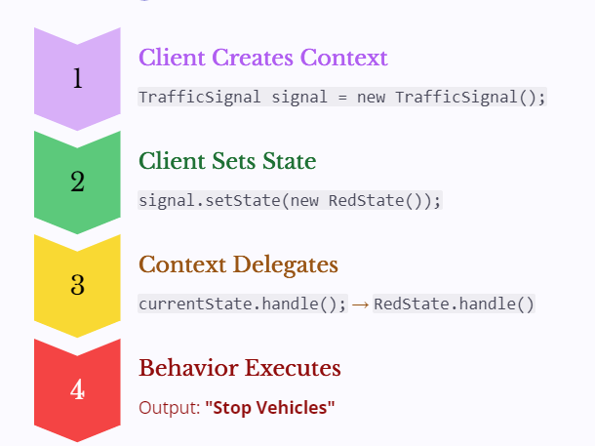
State Pattern – Execution Flow & Design Principles
Runtime Polymorphism
Same variable SignalState state holds RedState, then GreenState — different objects, different behaviour.
Programming to Interface
Context depends on SignalState (abstraction), not concrete classes — enabling loose coupling and easy extension.
Open-Closed Principle
Add EmergencyState by creating a new class. TrafficSignal remains unchanged

Slide 10
State Pattern – Consequences
✓ Advantages
Eliminates if-else — cleaner code via delegation
Open-Closed Principle — extend with new states, no modification
Loose Coupling — Context depends only on SignalState interface
High Cohesion — each state contains only its own behavior
Easy Testing — each state tested independently
Runtime Flexibility — behavior changes dynamically without recompilation
✗ Disadvantages
More Classes — one class per state increases file count
Higher Initial Complexity — small programs may not benefit
Memory Overhead — each state is a separate object
Transition Logic — someone must decide when states change
Learning Curve — beginners confuse State with Strategy (similar UML)
Use State Pattern when: behaviour depends on state, many states exist, states change frequently, future states may be added.
Avoid when: only one or two states, simple conditional logic suffices, states never change.

Slide 11
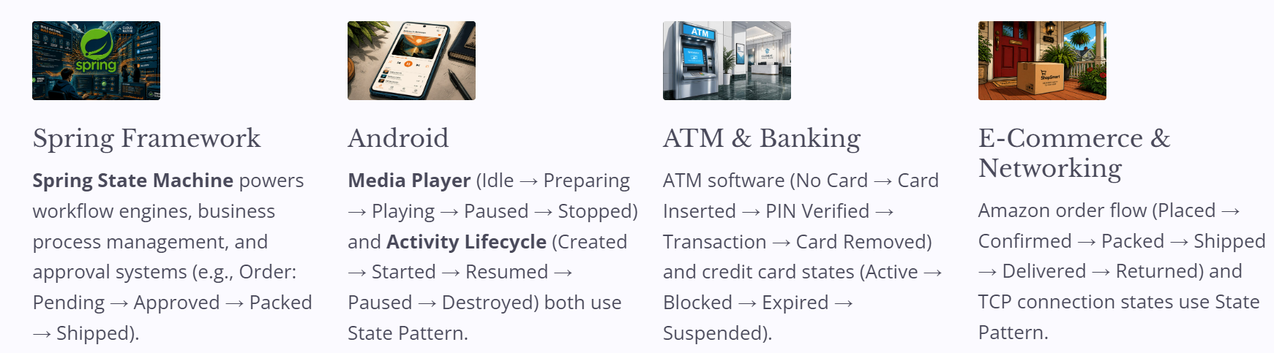
State Pattern – Known Uses in Real Software
The State Pattern is widely used across industries and frameworks. Here are notable examples:

Slide 12
State Pattern Vs Strategy Pattern
Both patterns share identical UML structure (composition + delegation), but their intent is completely different. Never identify a pattern by UML alone.
Feature | State Pattern | Strategy Pattern
Intent | Change behavior when internal state changes | Select one algorithm among interchangeable options
Decision Maker | Context / State (automatic) | Client (manual selection)
State Transition | Yes — states transition automatically | No — strategies are independent
Object Behavior | Changes — object appears to become another | Remains same — only algorithm changes
Real Example | Traffic Signal, ATM, Media Player | Payment Gateway, Google Maps routes, Sorting
Memory Trick | "How should I behave now?" | "Which algorithm should I use?"
If behaviour changes due to current condition → State.
If behaviour changes because user chooses an algorithm → Strategy.
Both use composition, but purpose differs entirely.

