Slide 1
COMMAND DESIGN PATTERN
According to the Gang of Four (GoF)
Encapsulate a request as an object so it can be parameterized, queued, logged, or undone.
CLIENT
COMMAND
INVOKER
RECEIVER
Memory trick: “What operation should I execute?” → Command
Unit 2 | Design Patterns

Slide 2
Command Design Pattern
• Capture a request and turn it into an object
Intent
Encapsulate a request as an object, allowing the request to be stored, passed around, parameterized, queued, logged, or undone.
Motivation
Real Scenario
• Client creates a command object.
• Invoker stores and triggers the command.
• Command calls the Receiver’s real operation.
• Client and Invoker stay independent of device details.
Smart Home Remote
Press “ON” → Remote does not know how a light works.
It only asks the stored Command to execute().
Command separates the object that asks for work from the object that performs the work.
Unit 2 | Command Design Pattern

Slide 3
Why the Existing Design Fails
• A remote full of device-specific if/else logic becomes tightly coupled
Naive Remote
Command Solution
Problem Code
Remote only knows:
class RemoteControl {
void press(int slot) {
if (slot == 1) light.on();
else if (slot == 2) fan.high();
else if (slot == 3) stereo.on();
else if (slot == 4) garage.up();
}
}
Command → execute()
Each ConcreteCommand knows which Receiver action to perform.
• Remote knows concrete receiver classes.
• Every new device adds another condition.
• Changing a device can force remote changes.
• Testing becomes harder as branches grow.
Add a new command — not another branch in the remote.
Unit 2 | Command Design Pattern

Slide 4
Applicability
✔ Use Command when
✘ Avoid Command when
• Different requests should share a common execute() interface.
• Operations must be queued or scheduled.
• Undo / redo is required.
• Requests need to be logged or replayed.
• Macro operations should combine several commands.
• The Invoker should not depend on Receiver classes.
• The operation is tiny and will never vary.
• No decoupling, queueing, logging, or undo is needed.
• Adding command classes would be more complexity than value.
• A direct method call is already clear and maintainable.
Typical scenarios
Smart home • GUI actions • Job queues • Transactions • Remote APIs
Unit 2 | Command Design Pattern

Slide 5
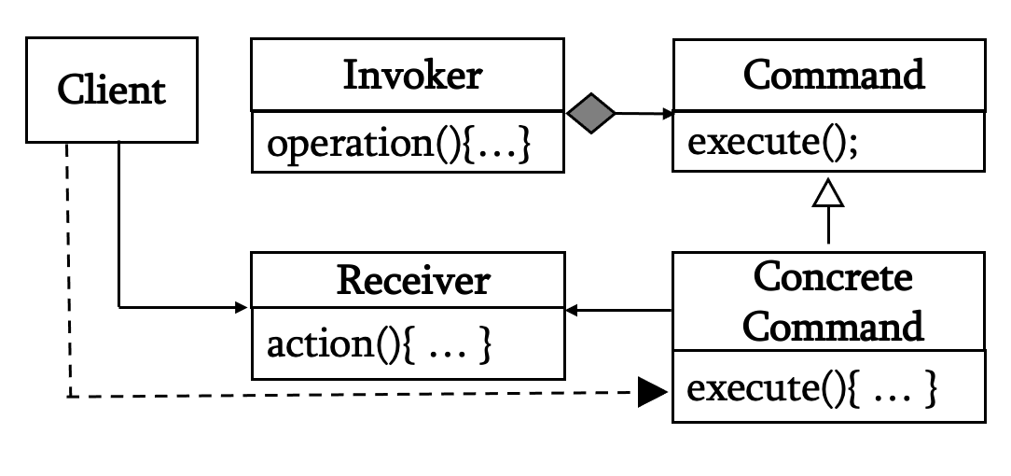
The Command Pattern – Structure & Participants
• Each participant has one clear responsibility
Client
Invoker
Command
Receiver
Creates ConcreteCommand
and supplies Receiver
Stores command
and calls execute()
Common interface
execute() / undo()
Performs the actual
business/device action
The Invoker does not need to know whether it is controlling a Light, Fan, Stereo, Garage Door, or another Receiver.
Unit 2 | Command Design Pattern

Slide 6
The Command Pattern – Collaborations & Request Flow
• The sequence of interactions when a smart-home button is pressed
1. Configure
2. Store
3. Press
4. Execute
Client creates
ConcreteCommand
Invoker stores
Command
Client asks
Invoker
Command calls
Receiver
Example: “Turn the living-room light ON”
Client
RemoteControl
Command
Light (Receiver)
new LightOnCommand(light)
setCommand(0, lightOn)
execute()
on()
Key idea: the request travels through a Command object before reaching the Receiver.
Unit 2 | Command Design Pattern

Slide 7
Command Pattern – Java Implementation
• Smart Home Remote Control: Light ON / OFF
1. Command Interface
2. ConcreteCommand
3. Receiver
4. Invoker
interface Command {
void execute();
void undo();
}
class LightOnCommand implements Command {
private Light light;
LightOnCommand(Light light) {
this.light = light;
}
public void execute() {
light.on();
}
public void undo() {
light.off();
}
}
class Light {
private String location;
Light(String location) {
this.location = location;
}
void on() {
System.out.println(location + " light ON");
}
void off() {
System.out.println(location + " light OFF");
}
}
class RemoteControl {
private Command command;
void setCommand(Command c) {
command = c;
}
void press() {
command.execute();
}
void undo() {
command.undo();
}
}
5. Client / Main
Output
Light livingRoom = new Light("Living Room");
RemoteControl remote = new RemoteControl();
Command on = new LightOnCommand(livingRoom);
remote.setCommand(on);
remote.press();
remote.undo();
Living Room light ON
Living Room light OFF
The same RemoteControl can now accept a different Command without changing its own code.
Unit 2 | Command Design Pattern

Slide 8
Command Pattern – Full Smart-Home Scenario
• One remote controls different devices through interchangeable commands
1. Commands
3. Client Wiring
class FanHighCommand implements Command {
Fan fan;
FanHighCommand(Fan fan) {
this.fan = fan;
}
public void execute() {
fan.high();
}
public void undo() {
fan.off();
}
}
class GarageOpenCommand implements Command {
Garage garage;
GarageOpenCommand(Garage g) {
garage = g;
}
public void execute() {
garage.up();
}
public void undo() {
garage.down();
}
}
2. Remote
Light living = new Light("Living Room");
Fan fan = new Fan("Bedroom");
Garage garage = new Garage("Garage");
remote.setCommand(0,
new LightOnCommand(living));
remote.setCommand(1,
new FanHighCommand(fan));
remote.setCommand(2,
new GarageOpenCommand(garage));
remote.onButtonWasPushed(0);
remote.onButtonWasPushed(1);
remote.onButtonWasPushed(2);
class RemoteControl {
Command[] onCommands =
new Command[7];
void setCommand(int slot, Command c) {
onCommands[slot] = c;
}
void onButtonWasPushed(int slot) {
onCommands[slot].execute();
}
}
Design Pattern Role | Your Example | Why?
Receiver | Light, Fan, Garage | These classes actually perform the work
Command | Command interface | Defines execute() and undo()
Concrete Command | LightOnCommand, FanHighCommand, GarageOpenCommand | Connects a request to a specific Receiver
Invoker | RemoteControl | Stores commands and triggers them
Client | Main | Creates Receivers, Commands, and connects them to the Invoker
Slot 0
Slot 1
Slot 2
Slot 3
Light → on()
Fan → high()
Garage → up()
Stereo → on()
Same Invoker • different Commands • different Receivers
Unit 2 | Command Design Pattern

Slide 9
Command Pattern – Collaborations
• The sequence of interactions when a remote-control button is pressed
Client
(Main)
Invoker
(Remote)
Command
(LightOn)
Receiver
(Light)
1) Configure
1.1 setCommand()
Invoker
knows only
Command
1.2 store command
2) Execute
2.1 buttonWasPushed()
2.2 execute()
2.3 light.on()
return
Client → Invoker → Command → Receiver
Unit 2 | Command Design Pattern

Slide 10
Command Pattern – Execution Flow & Design Principles
• The pattern is mainly about separation of responsibilities
Execution Flow
Design Principles
1
Client creates Command
Encapsulation
Request details live inside the Command object.
2
Invoker stores Command
Separation of Responsibilities
3
User triggers Invoker
Invoker triggers; Command maps request to Receiver.
4
Invoker calls execute()
Open for Extension
Add a new ConcreteCommand without changing the Invoker.
5
Command calls Receiver
Invoker → Command → Receiver
Unit 2 | Command Design Pattern

Slide 11
Command Pattern – Consequences
• What you gain — and what you pay for
✓ Advantages
✗ Disadvantages
• Decouples Invoker from Receiver.
• Supports undo / redo.
• Supports queueing and scheduling.
• Supports logging and replay.
• Makes macro operations easy.
• Commands can be tested independently.
• More classes and objects.
• Simple operations may feel over-engineered.
• Undo may require saving previous Receiver state.
• Large command histories can consume memory.
• Macro / queue management can add complexity.
Use when flexibility is worth the extra structure.
Unit 2 | Command Design Pattern

Slide 12
Command Pattern – Known Uses & Quick Comparison
• Recognize the pattern by its intent, not just by its class diagram
Known Uses
Command vs Memento
GUI buttons
Click action becomes a command
Feature
Command
Memento
Smart home
Remote triggers device commands
Intent
Encapsulate request
Capture state
Job queues
Requests wait for worker threads
Main use
Execute / queue / log
Restore / rollback
Transactions
Operations can be queued / rolled back
Stores
Action + parameters
Snapshot of state
Logging
Commands can be stored and replayed
Memory trick
What should I execute?
What was my state?
Macro actions
Many commands execute as one
Command = operation object
Memento = state snapshot
Unit 2 | Command Design Pattern

