Slide 1
Unit 2
Composite Design Pattern
Structural pattern for part-whole hierarchies

Slide 2
Composite Design Pattern
According to the Gang of Four (GoF)
Compose objects into tree structures to represent part-whole hierarchies. Composite lets clients treat individual objects and compositions of objects uniformly.
Simple Definition:
The Composite Pattern gives leaf objects and groups a common interface, so a client can call the same operation on either.
Intent
Represent part-whole trees and treat individual objects and groups through one interface.
Pattern Name
Composite
Motivation
Nested objects → Common interface → Recursive operation → Uniform client code
Real-Life Examples
File system: files and folders
Graphics editor: shapes and groups
Organization chart: employees and teams
Menu system: items and submenus
Document: text blocks and sections

Slide 3
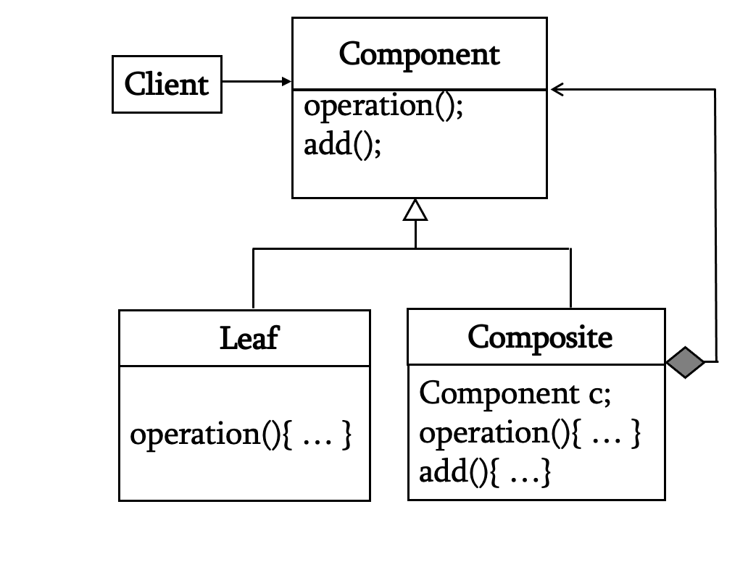
The Composite Pattern - Structure & Participants
A client calls the same operation on a single object or a group. The group forwards that call to its children.
Component
common operation
Leaf
no children
Composite
contains children
The tree can nest composites at any depth.

Slide 4
Three roles in the pattern
COMPOSITE PATTERN
Component
Defines an operation every node supports. The client keeps a Component reference.
Leaf
Composite
Performs the operation directly. It has no child collection.
Stores Component children and usually delegates the operation to each child.
Client code depends on Component, so it can receive either a Leaf or a Composite.
Folder example: identify the roles
FileSystemNode
File = Leaf
Folder = Composite
Common methods: display(indent), getSize(), and getName(). The client holds this type.
Stores a name and byte count. It displays itself and returns its own size.
Stores List<FileSystemNode>. It displays children and sums their sizes.
A folder can contain files and other folders because both implement FileSystemNode.

Slide 5
A folder is a recursive tree
COMPOSITE PATTERN
Projects/
README.md
2 KB
src/
assets/
notes.txt
1 KB
App.java
4 KB
logo.png
3 KB
getSize(Projects) = 2 + 4 + 3 + 1 = 10 KB

Slide 6
Why the Existing Design Fails
A naive implementation of a file explorer
Without Composite Pattern
if (node instanceof File) {
displayFile((File) node);
} else if (node instanceof Folder) {
for (Node child : ((Folder) node).children) {
display(child);
}
}
Each new element type adds another branch.
Problems
Separate code paths for files and folders
Nested structures require repeated type checks
Adding a new element changes client code
Operations become difficult to extend
Recursive handling spreads across the application
Clients depend on concrete element classes

Slide 7
Folder implementation: component and file
COMPOSITE PATTERN
public interface FileSystemNode {
String getName();
long getSize();
void display(String indent);
}
public final class FileNode implements FileSystemNode {
private final String name;
private final long size;
public FileNode(String name, long size) {
this.name = name; this.size = size;
}
public String getName() { return name; }
public long getSize() { return size; }
public void display(String indent) {
System.out.println(indent + name);
}
}

Slide 8
Folder implementation: composite
COMPOSITE PATTERN
public final class Folder implements FileSystemNode {
private final String name;
private final List<FileSystemNode> children = new ArrayList<>();
public Folder(String name) { this.name = name; }
public String getName() { return name; }
public void add(FileSystemNode child) { children.add(child); }
public void remove(FileSystemNode child) { children.remove(child); }
public long getSize() {
long total = 0;
for (FileSystemNode child : children) total += child.getSize();
return total;
}
public void display(String indent) {
System.out.println(indent + name + "/");
for (FileSystemNode child : children) child.display(indent + " ");
}
}

Slide 9
Folder client: one call traverses the tree
COMPOSITE PATTERN
Folder root = new Folder("Projects");
root.add(new FileNode("README.md", 2_000));
Folder src = new Folder("src");
src.add(new FileNode("App.java", 4_000));
root.add(src);
root.display("");
System.out.println(root.getSize());
Expected result
Projects/
README.md
src/
App.java
6000 bytes
The client calls display() and getSize() on the root. Folder recursion reaches every child.

Slide 10
GoF example: a drawing editor
COMPOSITE PATTERN
Graphic
draw()
Line
Rectangle
Picture
Text
Leaf
Leaf
Composite
Picture.draw() calls draw() on each child, including a nested Picture.

Slide 11
UI example: a screen is also a tree
COMPOSITE PATTERN
UIComponent
Leaf widgets
Container
render() is the shared operation. The client can render any UIComponent.
Button, Label, and TextField render their own content.
Panel, Form, or Dialog stores UIComponent children and renders them.
A Panel can contain another Panel, so a complete screen can start from one root component.

Slide 12
UI tree: screen, panels, and widgets
COMPOSITE PATTERN
Settings screen
Panel
Header Panel
Form Panel
Label
Settings
Button
Save
TextField
Username
Button
Cancel
screen.render() delegates through panels to widgets.

Slide 13
UI implementation: interface and container
COMPOSITE PATTERN
interface UIComponent {
void render();
}
final class Button implements UIComponent {
private final String label;
Button(String label) { this.label = label; }
public void render() {
System.out.println("Button: " + label);
}
}
final class Panel implements UIComponent {
private final List<UIComponent> children =
new ArrayList<>();
void add(UIComponent child) {
children.add(child);
}
public void render() {
for (UIComponent child : children)
child.render();
}
}
The real render method would draw widgets; console output keeps the recursion visible.

Slide 14
UI client: build once, render from the root
COMPOSITE PATTERN
Panel screen = new Panel();
Panel form = new Panel();
form.add(new TextField("Username"));
form.add(new Button("Save"));
screen.add(new Label("Settings"));
screen.add(form);
UIComponent view = screen;
view.render();
Call sequence
screen.render()
Label.render()
form.render()
TextField.render()
Button.render()
Adding a new widget changes the tree, while the client still calls render() once.

Slide 15
Composite Pattern - Consequences
Benefits
Limits
One client API for leaves and groups.
Nested structures grow naturally.
New leaf types fit without changing traversal code.
Recursion can be deep or expensive.
Rules about allowed children need explicit checks.
Parent links and caching complicate updates.
Use Composite when the domain really forms a part–whole tree.

Slide 16
Applicability
When should we use the Composite Pattern?
✔ Objects form a tree or part-whole hierarchy.
✔ Clients should treat leaves and groups uniformly.
✔ Operations should work recursively on nested groups.
✔ New element types should fit the same interface.
When NOT to Use Composite Pattern
✘ The data has no meaningful hierarchy.
✘ Leaves and groups need unrelated operations.
✘ Strict type safety for child operations matters most.
✘ A simple flat collection is sufficient.

