Slide 1
Decorator Design Pattern
Add responsibilities to an object dynamically
Unit 2
GoF structural pattern

Slide 2
Decorator Design Pattern
Gang of Four intent
Attach additional responsibilities to an object dynamically. Decorators provide a flexible alternative to subclassing for extending functionality.
Simple definition
Everyday examples
A decorator wraps another object with the same interface. It adds behavior before or after forwarding a call to that object.
• Coffee plus milk or syrup
• Text view plus scroll bar or border
• Input stream plus buffering
Core object → wrapper → another wrapper → client uses one interface
02

Slide 3
Why Direct Subclassing Becomes Difficult
Class explosion
Decorator approach
If every combination needs a subclass, even a small menu grows quickly.
Start with an Espresso object and wrap it only with the add-ons selected for this order.
• Espresso
• EspressoWithMilk
• EspressoWithSyrup
• EspressoWithMilkAndSyrup
• EspressoWithDoubleMilk
Beverage drink = new Syrup(
new Milk(new Espresso()));
Composition creates combinations at runtime.
03

Slide 4
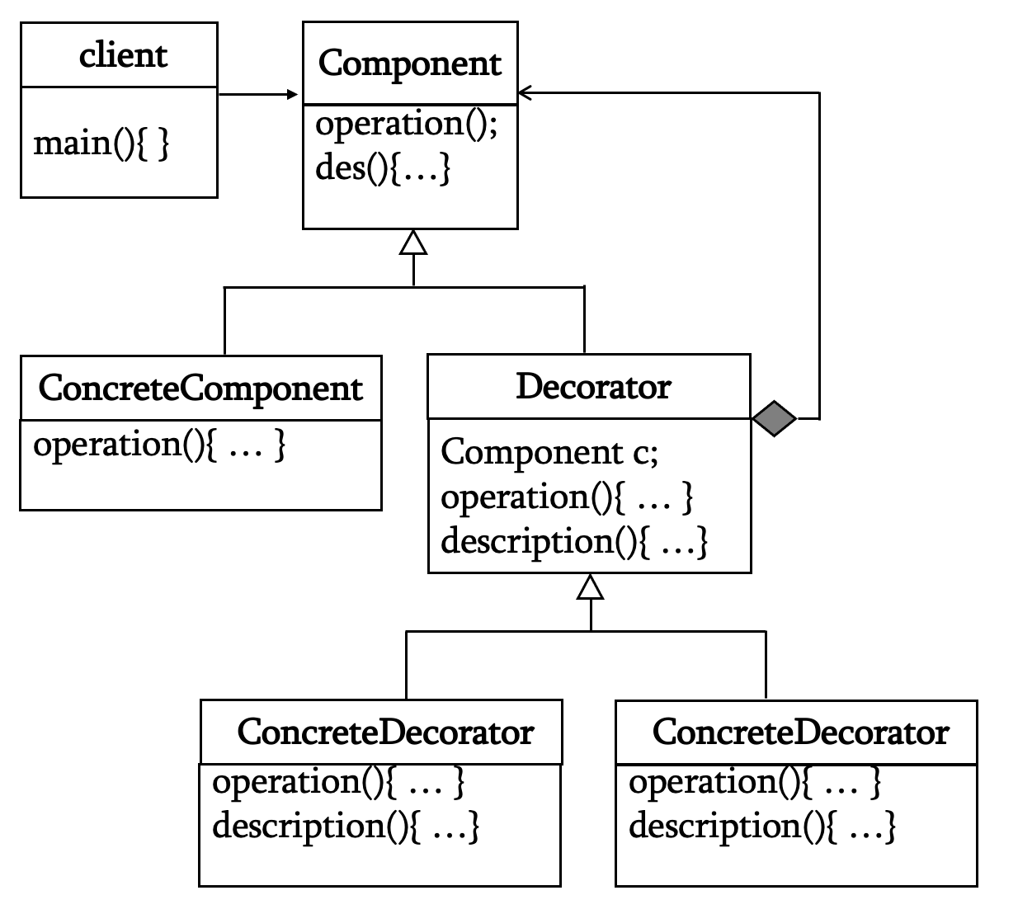
Structure and Participants
Responsibilities
Component defines the shared operation.
A Concrete Component performs the base work.
A Decorator stores a Component reference and delegates while adding its own behavior.
Concrete Component
base behavior
Component
common operation
Client
uses Component
Decorator
holds Component

Slide 5
Java: Component and Concrete Component
DECORATOR PATTERN
interface Beverage {
String description();
double cost();
}
final class Espresso implements Beverage {
public String description() {
return "Espresso";
}
public double cost() {
return 2.00;
}
}
The shared contract
Every beverage responds to description() and cost().
The base object
Espresso implements the contract directly. It does not need to know which decorators may wrap it later.
06

Slide 6
Java: Abstract Decorator and Add-ons
DECORATOR PATTERN
abstract class BeverageDecorator implements Beverage {
protected final Beverage inner;
BeverageDecorator(Beverage inner) { this.inner = inner; }
}
final class Milk extends BeverageDecorator {
Milk(Beverage inner) { super(inner); }
public String description() { return inner.description() + ", milk"; }
public double cost() { return inner.cost() + 0.50; }
}
final class Syrup extends BeverageDecorator {
Syrup(Beverage inner) { super(inner); }
public String description() { return inner.description() + ", syrup"; }
public double cost() { return inner.cost() + 0.75; }
}
Each add-on forwards the request, then extends the result.
07

Slide 7
Java: Build and Use the Decorated Object
DECORATOR PATTERN
Beverage drink = new Syrup(
new Milk(
new Espresso()));
System.out.println(drink.description());
System.out.printf("$%.2f%n", drink.cost());
Output
Espresso, milk, syrup
$3.25
The client uses Beverage. It can add, remove, or reorder wrappers without creating a new beverage subclass.
Wrapper order matters when behavior is order-sensitive, such as filtering, logging, or formatting.
08

Slide 8
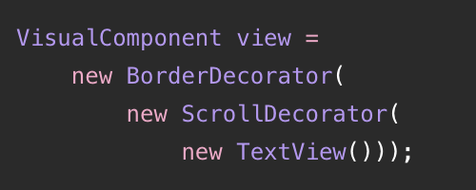
UI Example: A Text View with Extras
DECORATOR PATTERN
TextView
base display
ScrollDecorator
adds scrolling
BorderDecorator
adds border
The same interface
TextView draws the text.
ScrollDecorator wraps it and adds scrolling.
BorderDecorator wraps that and adds a border.
The client draws the outermost wrapper once.
09

Slide 9
Java I/O: A Familiar Decorator Chain
DECORATOR PATTERN
InputStream input = new BufferedInputStream(
new FileInputStream("data.txt"));
int nextByte = input.read();
FileInputStream
BufferedInputStream
Reads bytes from a file. It is the base stream.
Wraps another InputStream and adds buffering while retaining the read() interface.
The client still calls read() through InputStream.
10

Slide 10
Decorator Compared with Related Patterns
DECORATOR PATTERN
Pattern
Main purpose
Relationship to interface
Decorator
Adds behavior to one object
Keeps the component interface
Adapter
Makes an interface usable elsewhere
Converts the interface
Facade
Simplifies a subsystem
Offers a new task-level interface
Composite
Treats leaves and groups uniformly
Shares a component interface
Decorator focuses on one object whose behavior needs optional layers.
11

Slide 11
Applicability and Consequences
DECORATOR PATTERN
Use Decorator when
Benefits and limits
• Features are optional or combinable
• Behavior may change at runtime
• Subclass combinations would multiply
• Client should keep one common interface
• Flexible extension without changing core
• Small focused wrapper classes
• More objects to understand and debug
• Wrapper order may affect results
Key lesson
A decorator has the same interface as the object it wraps. It forwards calls and adds behavior, so the client can treat the whole chain as one Component.
12

