Slide 1
Facade Design Pattern
A simple interface to a complex subsystem
Unit 2
GoF structural pattern

Slide 2
Facade Design Pattern
According to the Gang of Four (GoF)
Provide a unified interface to a set of interfaces in a subsystem. A facade defines a higher-level interface that makes the subsystem easier to use.
Simple definition
Real-life examples
The client makes one meaningful request. The facade coordinates the subsystem objects and their call order.
• Home theater: watchMovie()
• Compiler: compile()
• Checkout: placeOrder()
Motivation
Many classes and repeated setup steps → one common task method → simpler client code
02

Slide 3
Structure and Participants
FACADE PATTERN
Client
Facade
common task method
Subsystem classes
independent services
Responsibilities
Client
Calls the facade for common tasks.
Facade
Creates or holds subsystem objects and coordinates them.
Subsystem
Performs the actual low-level work. Advanced clients may call it directly.
04

Slide 4
Why the Existing Design Fails
FACADE PATTERN
Problems without Facade
Home theater without Facade
• Clients know too many subsystem classes
• Every client repeats the setup sequence
• Call order is easy to get wrong
• Subsystem changes affect many clients
• Testing the workflow becomes harder
popper.on(); popper.pop();
lights.dim(10); screen.down();
projector.on();
projector.wideScreenMode();
amp.on(); amp.setDvd(dvd);
amp.setSurroundSound();
amp.setVolume(5);
dvd.on(); dvd.play(movie);
The same sequence would appear in every client that starts a movie.
03

Slide 5
Home Theater: One Call, Many Steps
FACADE PATTERN
Client view
Facade workflow
1 Start popper and pop corn
2 Dim lights and lower screen
3 Start projector and choose mode
4 Configure amplifier and DVD player
5 Play the requested movie
homeTheater.watchMovie("The Avengers");
The client chooses the movie and asks to watch it. The facade owns the setup sequence.
One client call triggers a coordinated sequence.
05

Slide 6
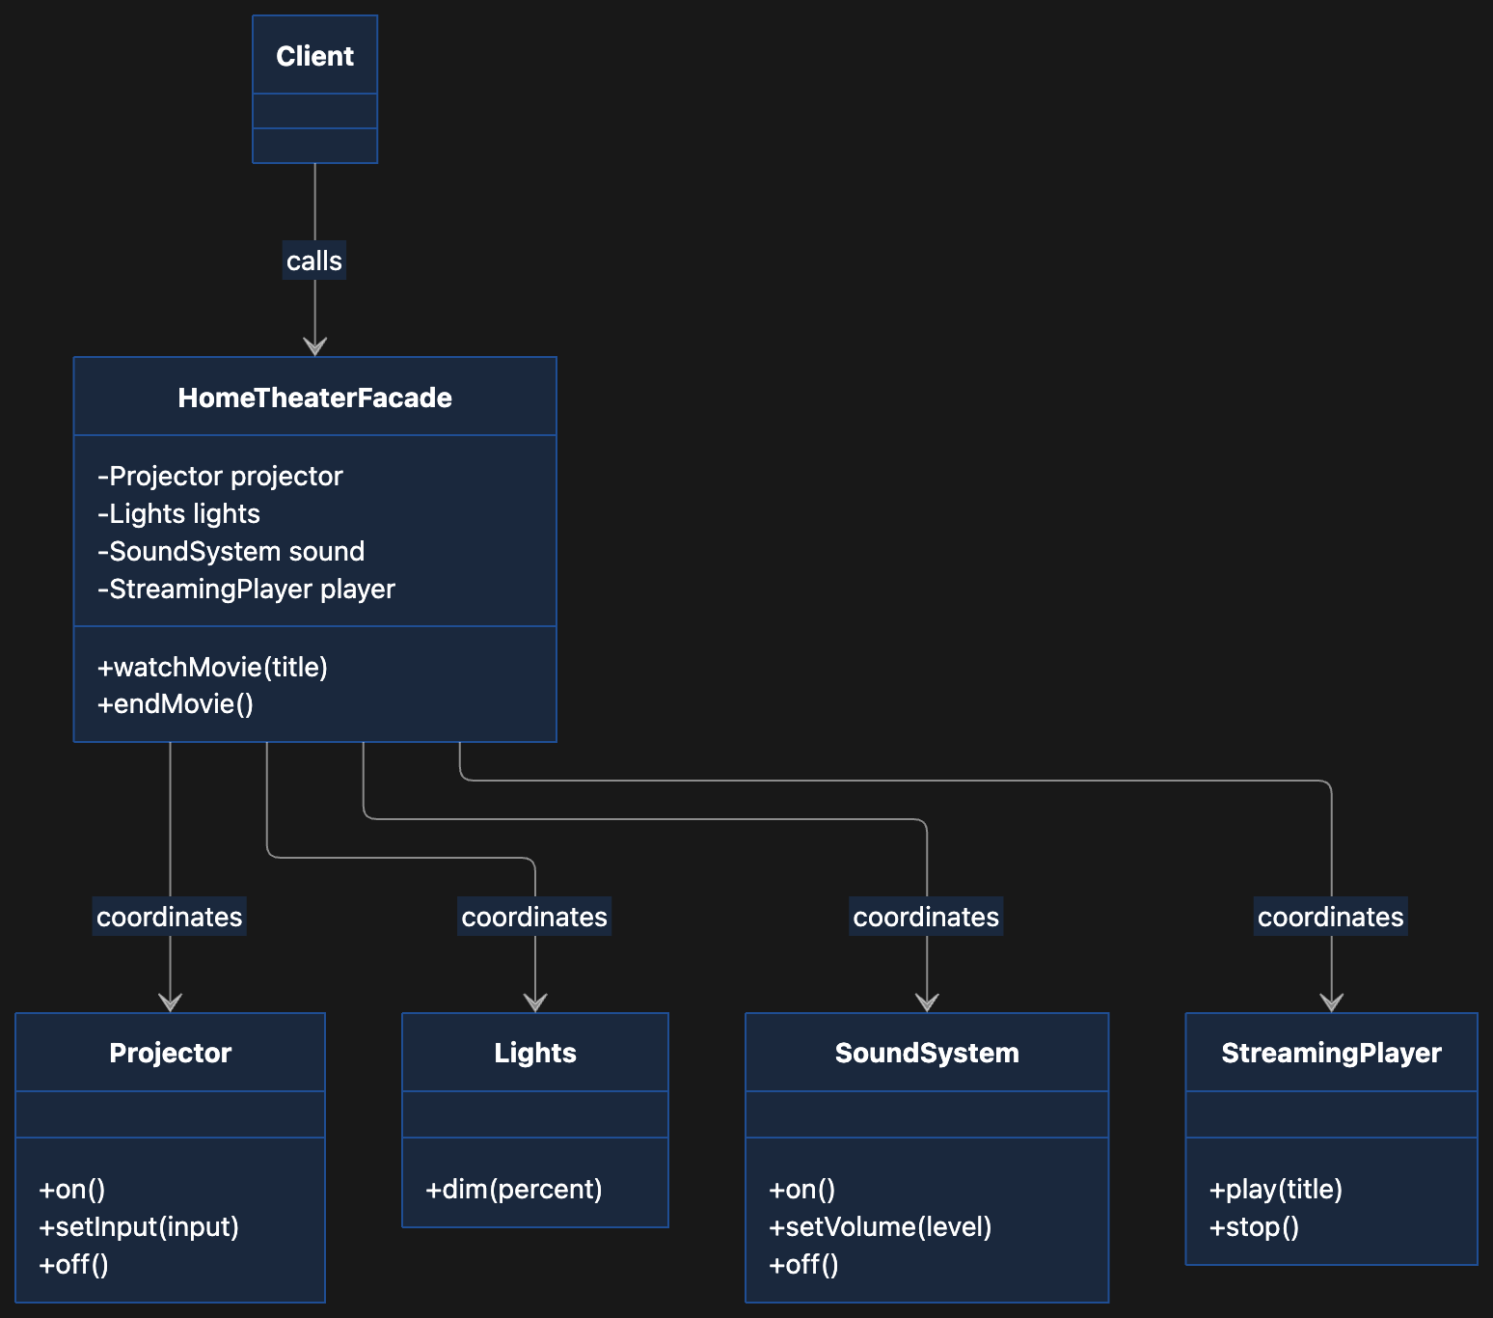
Home Theater: Class Diagram

Slide 7
Home Theater: Facade Implementation
FACADE PATTERN
class HomeTheaterFacade {
private final Amplifier amp;
private final DvdPlayer dvd;
private final Projector projector;
private final TheaterLights lights;
private final Screen screen;
private final PopcornPopper popper;
HomeTheaterFacade(Amplifier a, DvdPlayer d,
Projector p, TheaterLights l, Screen s, PopcornPopper c) {
amp = a; dvd = d; projector = p;
lights = l; screen = s; popper = c;
}
}
void watchMovie(String movie) {
popper.on(); popper.pop();
lights.dim(10); screen.down();
projector.on();
projector.wideScreenMode();
amp.on(); amp.setDvd(dvd);
amp.setSurroundSound();
amp.setVolume(5);
dvd.on(); dvd.play(movie);
}
void endMovie() {
dvd.stop(); amp.off(); projector.off();
screen.up(); lights.on(); popper.off();
}
The facade stores subsystem references and expresses a task as an ordered method.
06

Slide 8
Home Theater: Client and Access
FACADE PATTERN
HomeTheaterFacade theater = new HomeTheaterFacade(
amp, dvd, projector, lights, screen, popper);
theater.watchMovie("Raiders of the Lost Ark");
theater.endMovie();
Common clients
Specialized clients
• Use watchMovie() and endMovie()
• Depend mainly on the facade
• Do not remember setup order
• Can still call projector or amplifier directly
• Keep access to advanced subsystem controls
• Facade does not replace the subsystem
A facade simplifies the default path while preserving specialized access.
07

Slide 9
GoF Compiler Example
FACADE PATTERN
Compiler subsystem
Scanner reads tokens
Parser builds syntax
NodeBuilder creates program nodes
ProgramNode represents the parse tree
CodeGenerator emits target code
Application
client
Compiler
compile()
Without the facade
Each client must create the objects, know their dependencies, and call them in the correct order.
Most clients call compile() once. The compiler facade handles the workflow.
08

Slide 10
Compiler Facade: Workflow
FACADE PATTERN
class Compiler {
void compile(InputStream input, BytecodeStream output) {
Scanner scanner = new Scanner(input);
ProgramNodeBuilder builder = new ProgramNodeBuilder();
Parser parser = new Parser();
parser.parse(scanner, builder);
ProgramNode tree = builder.getRootNode();
CodeGenerator generator = new RISCCodeGenerator(output);
tree.traverse(generator);
}
}
Flow: source → tokens → parse tree → generated code
09

Slide 11
Online Order: A Facade for Checkout
FACADE PATTERN
Client request
CheckoutFacade.placeOrder()
checkout.placeOrder(order);
inventory.reserve(order.items());
payment.charge(order.customer(), order.total());
shipping.createShipment(order);
notification.sendReceipt(order.customer());
The client supplies an order. The facade coordinates services in a defined sequence.
For a real checkout, define failure handling and compensation.
10

Slide 12
Facade, Adapter, Decorator, Composite
FACADE PATTERN
Pattern
Purpose
Typical interface
Facade
Simplifies a subsystem
New task-level interface
Adapter
Connects incompatible interfaces
Converts one interface to another
Decorator
Adds responsibilities
Keeps the wrapped interface
Composite
Treats parts and groups uniformly
Common component interface
Choose by intent: Facade makes a common subsystem task easier for a client.
11

Slide 13
Applicability and Consequences
FACADE PATTERN
When to use Facade
Limits and design choices
• Clients repeat a multi-step workflow
• Subsystem has many classes or dependencies
• You want a clear entry point between layers
• You want clients less coupled to internals
• Do not hide options clients truly need
• Avoid one facade for every possible task
• Define failure behavior across multiple steps
• Keep direct subsystem access when useful
Principle of Least Knowledge
A client talks to the facade. The facade talks to the subsystem objects it owns. This places workflow knowledge in one class and reduces client coupling.
12

