Slide 1
Factory Method Design Pattern
Let subclasses choose the product used by a shared workflow
Unit 2
GoF creational pattern
Notes:
GoF classification and intent: Gamma, Helm, Johnson and Vlissides, Design Patterns (1994). Teaching examples are illustrative. Factory Method structure: https://www.cs.up.ac.za/cs/lmarshall/TDP/Notes/_Chapter4_FactoryMethod.pdf

Slide 2
Factory Method Design Pattern
Gang of Four intent
Define an interface for creating an object, but let subclasses decide which class to instantiate.
Simple definition
Everyday analogy
A creator calls an overridable factory method. Concrete creators supply different products through the same product interface.
A delivery company follows one dispatch process. A road branch supplies a truck, while a sea branch supplies a ship.
Shared workflow calls a factory method, then uses the product
02
Notes:
GoF classification and intent: Gamma, Helm, Johnson and Vlissides, Design Patterns (1994). Teaching examples are illustrative. Factory Method structure: https://www.cs.up.ac.za/cs/lmarshall/TDP/Notes/_Chapter4_FactoryMethod.pdf

Slide 3
Why Factory Method Is Needed
FACTORY METHOD PATTERN
WITHOUT Factory Method
WITH Factory Method
planDelivery() creates Truck directly.
For sea delivery, change the creation line inside this method.
createTransport() is the FACTORY METHOD.
A subclass decides whether to create a Truck or Ship.
class Logistics {
void planDelivery() {
Transport t = new Truck();
t.deliver();
}
}
abstract class Logistics {
// FACTORY METHOD
abstract Transport createTransport();
void planDelivery() {
Transport t = createTransport();
t.deliver();
}
}
class SeaLogistics extends Logistics {
@Override
Transport createTransport() {
return new Ship();
}
}
To support sea delivery, edit the workflow:
Transport t = new Ship();
RoadLogistics returns a Truck. SeaLogistics returns a Ship.
Both reuse the SAME planDelivery() method.
Logistics service =
new SeaLogistics();
service.planDelivery();
03
Notes:
createTransport() is the factory method. planDelivery() is the shared workflow. In the direct construction version, the workflow names the concrete product class. In the Factory Method version, subclasses override createTransport(). Client example: Logistics service = new SeaLogistics(); service.planDelivery(); This calls SeaLogistics.createTransport(), gets a Ship, and calls deliver(). Transport, Truck and Ship are defined on slide 6. GoF intent and structure: https://www.cs.up.ac.za/cs/lmarshall/TDP/Notes/_Chapter4_FactoryMethod.pdf

Slide 4
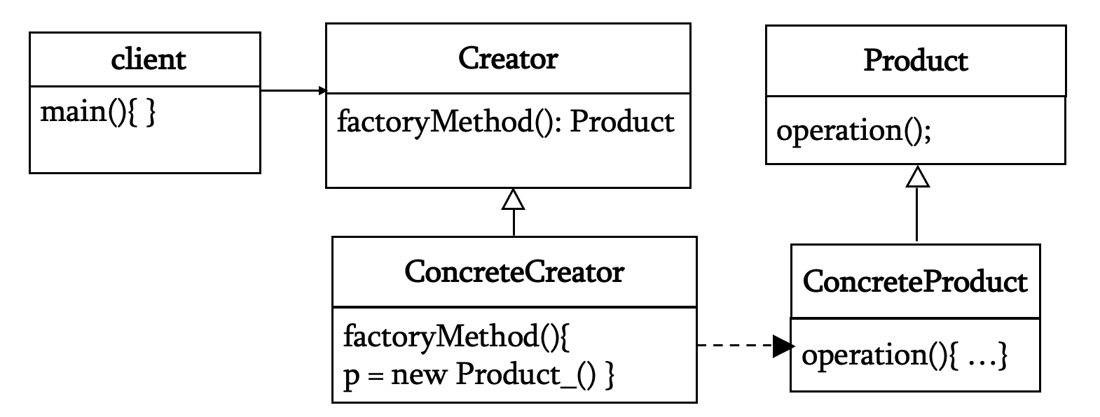
Structure and Participants
FACTORY METHOD PATTERN
Responsibilities
Creator declares the factory method and uses the product interface.
Concrete Creator overrides the method to supply a Concrete Product.
Product defines the operation all concrete products support.
The client chooses a concrete creator.

Slide 5
Structure and Participants
Abstract Factory Pattern
client
Creator
Product
Product
main(){ }
factoryMethodA(): Product
factoryMethodB(): Product
operation();
operation();
ConcreteCreator1
ConcreteCreator2
ConcreteProductA
ConcreteProductB
factoryMethodA(){..}
factoryMethodB(){..}
factoryMethodA(){..}
factoryMethodB(){..}
operation(){ …}
operation(){ …}
Abstract Factory pattern is a creational software design pattern that provides an interface for creating families of related or dependent objects without specifying their concrete classes.

Slide 6
Factory Method: Creation and Use
FACTORY METHOD PATTERN (Based on example)
One delivery request
Client
planDelivery()
RoadLogistics
createTransport()
Truck
deliver()
Creation step
Shared workflow
RoadLogistics overrides createTransport() and returns a Truck as a Transport. SeaLogistics returns a Ship.
Logistics.planDelivery() calls the factory method, then invokes deliver() on the product.
The workflow stays the same.
05
Notes:
GoF classification and intent: Gamma, Helm, Johnson and Vlissides, Design Patterns (1994). Teaching examples are illustrative. Factory Method structure: https://www.cs.up.ac.za/cs/lmarshall/TDP/Notes/_Chapter4_FactoryMethod.pdf

Slide 7
Java: Product Interface and Products
FACTORY METHOD PATTERN
interface Transport {
void deliver();
}
class Truck implements Transport {
public void deliver() {
System.out.println("By road");
}
}
class Ship implements Transport {
public void deliver() {
System.out.println("By sea");
}
}
Product
Transport defines deliver(), the common operation the delivery workflow needs.
Concrete products
Truck and Ship implement Transport. Each product supplies its own delivery behavior.
06
Notes:
GoF classification and intent: Gamma, Helm, Johnson and Vlissides, Design Patterns (1994). Teaching examples are illustrative. Factory Method structure: https://www.cs.up.ac.za/cs/lmarshall/TDP/Notes/_Chapter4_FactoryMethod.pdf

Slide 8
Java: Creator and Concrete Creators
FACTORY METHOD PATTERN
abstract class Logistics {
abstract Transport createTransport();
void planDelivery() {
Transport t = createTransport();
t.deliver();
}
}
class RoadLogistics extends Logistics {
Transport createTransport() { return new Truck(); }
}
class SeaLogistics extends Logistics {
Transport createTransport() { return new Ship(); }
}
The inherited workflow calls the overridden creation method and uses the returned Transport.
07
Notes:
GoF classification and intent: Gamma, Helm, Johnson and Vlissides, Design Patterns (1994). Teaching examples are illustrative. Factory Method structure: https://www.cs.up.ac.za/cs/lmarshall/TDP/Notes/_Chapter4_FactoryMethod.pdf

Slide 9
Java: Client Code and Output
FACTORY METHOD PATTERN
Logistics road = new RoadLogistics();
Logistics sea = new SeaLogistics();
road.planDelivery();
sea.planDelivery();
Output
What the client knows
The setup chooses concrete creators. Code that runs delivery needs only Logistics.planDelivery().
By road
By sea
A new creator can supply a new Transport without changing the shared workflow.
08
Notes:
GoF classification and intent: Gamma, Helm, Johnson and Vlissides, Design Patterns (1994). Teaching examples are illustrative. Factory Method structure: https://www.cs.up.ac.za/cs/lmarshall/TDP/Notes/_Chapter4_FactoryMethod.pdf

Slide 10
Another Example: Document Export
FACTORY METHOD PATTERN (Based on example)
Export workflow
createDocument()
PDF exporter
supplies PDFDocument
Document
render()
Creation within an export workflow
An abstract exporter defines export() and calls createDocument().
PDFExporter returns a PDFDocument, while HTMLExporter returns an HTMLDocument. The export workflow calls Document.render().
The concrete exporter determines the format. The shared workflow uses the document interface.
09
Notes:
GoF classification and intent: Gamma, Helm, Johnson and Vlissides, Design Patterns (1994). Teaching examples are illustrative. Factory Method structure: https://www.cs.up.ac.za/cs/lmarshall/TDP/Notes/_Chapter4_FactoryMethod.pdf

Slide 11
Factory Method and Simple Factory
FACTORY METHOD PATTERN
Factory Method
Simple Factory
• Subclasses override a creation method
• Uses a creator hierarchy
• Shared workflow calls the method
• New creators supply new products
• A helper selects a concrete class
• Often uses a switch or if statement
• Needs no creator hierarchy
• Adding a case changes the helper
Both encapsulate object creation. The GoF Factory Method relies on subclass overrides.
10
Notes:
GoF classification and intent: Gamma, Helm, Johnson and Vlissides, Design Patterns (1994). Teaching examples are illustrative. Factory Method structure: https://www.cs.up.ac.za/cs/lmarshall/TDP/Notes/_Chapter4_FactoryMethod.pdf

Slide 12
Factory Method Compared with Related Patterns
FACTORY METHOD PATTERN
Pattern | Main purpose | Creation mechanism
Factory Method | Vary a workflow’s product | Subclass overrides a creation method
Abstract Factory | Create a related product family | Factory object exposes creation operations
Factory Method focuses on the product supplied by a creator subclass.
11
Notes:
GoF classification and intent: Gamma, Helm, Johnson and Vlissides, Design Patterns (1994). Teaching examples are illustrative. Factory Method structure: https://www.cs.up.ac.za/cs/lmarshall/TDP/Notes/_Chapter4_FactoryMethod.pdf

Slide 13
Applicability and Consequences
FACTORY METHOD PATTERN
Use Factory Method when
Benefits and limits
• A workflow needs different products
• Subclasses should control creation
• Products share a stable interface
• New variants should extend the design
• Separates creation from product use
• Reuses the common workflow
• Supports new creators and products
• Adds classes and inheritance complexity
Key lesson
The creator controls the workflow, while its subclasses control the product it uses. When one fixed product is enough, a constructor may be simpler.
12
Notes:
GoF classification and intent: Gamma, Helm, Johnson and Vlissides, Design Patterns (1994). Teaching examples are illustrative. Factory Method structure: https://www.cs.up.ac.za/cs/lmarshall/TDP/Notes/_Chapter4_FactoryMethod.pdf

