Slide 1
Unit 2

Slide 2
Memento Design Pattern
According to the Gang of Four (GoF)
Capture and externalize an object's internal state so that the object can be restored to that state later.
Pattern Name
Memento
Intent
Capture an object's state without exposing its internal representation, and restore it later.
Motivation
Originator creates a snapshot → Caretaker stores it → Originator restores from the snapshot.
Text Editor
• Edit → Save Snapshot → More Edits
• Undo → Restore Earlier Snapshot
Video Game
• Reach a checkpoint
• Later restore the saved game state
Drawing Application
• Save canvas snapshot
• Undo unwanted changes safely

Slide 3
Why the Existing Design Fails
A naive implementation — Text Editor
class Editor {
String text;
int cursor;
String save() {
return text + "," + cursor; //expose state
}
void restore(String data) {
// parse and rebuild internal state
}
}
Problems
• Object exposes internal fields to the save/restore manager
• Caretaker becomes tightly coupled to implementation details
• Every state change may require changes in save/restore code
• Encapsulation is weakened
• Harder to maintain and evolve
High Coupling, Weak Encapsulation, Poor
Maintainability.

Slide 4
Applicability
Use the Memento Pattern when an object's state must be saved and restored, while the object's internal representation should remain encapsulated.
✔ Use Memento when
• Undo / redo is required
• Checkpoints or snapshots are needed
• Previous versions must be restored
• State details should stay private
✘ Avoid Memento when
• State is tiny and trivial to copy
• No restoration/history is needed
• Snapshot storage would be excessive
• Simple assignment is enough
Typical Scenarios
• Text editors
• Game checkpoints
• Transaction rollback
Key Benefit
• Preserves encapsulation
• Separates history management from the Originator

Slide 5
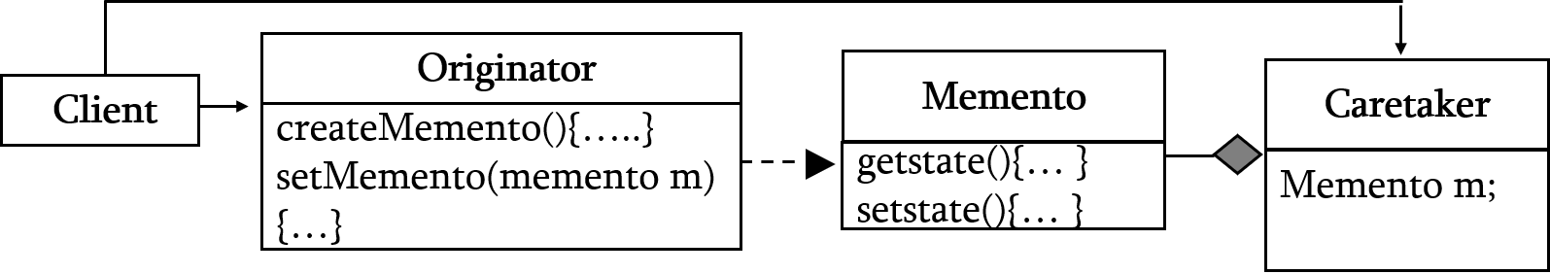
The Memento Pattern – Structure & Participants
Originator
Editor
Memento
Snapshot
Caretaker
History
Client
User / App
Originator = Who owns the state? → Editor
Memento = What is saved? → Snapshot
Caretaker = Who keeps the snapshots? → History
Participant Responsibilities
Originator
• Creates a Memento containing its state
• Restores its state from a Memento
Caretaker
• Stores Mementos
• Does not inspect their internal state
Memento
• Holds a snapshot of Originator state
• Protects the snapshot from arbitrary modification
Client
• Requests snapshots and asks for restoration
• Uses the Caretaker for history
The Caretaker does NOT need to know how the state is represented. It simply stores and returns snapshots. This preserves encapsulation.

Slide 6
The Memento Pattern – Collaborations & Snapshot Flow
1. Edit
Originator
changes state
2. Save
Originator
creates Memento
3. Store
Caretaker
keeps snapshot
4. Restore
Originator
gets old state back
Snapshot history example
Undo → restore M2
Current text becomes "AB"
M1
text = "A"
M2
text = "AB"
M3
text = "ABC"
Snapshot Flow
1. Originator changes its state.
2. Originator creates a Memento.
3. Caretaker stores the Memento.
4. Later, Caretaker returns a snapshot.
5. Originator restores itself from that snapshot.
Key idea:
The Caretaker manages history, but the Originator alone understands what the snapshot means.

Slide 7
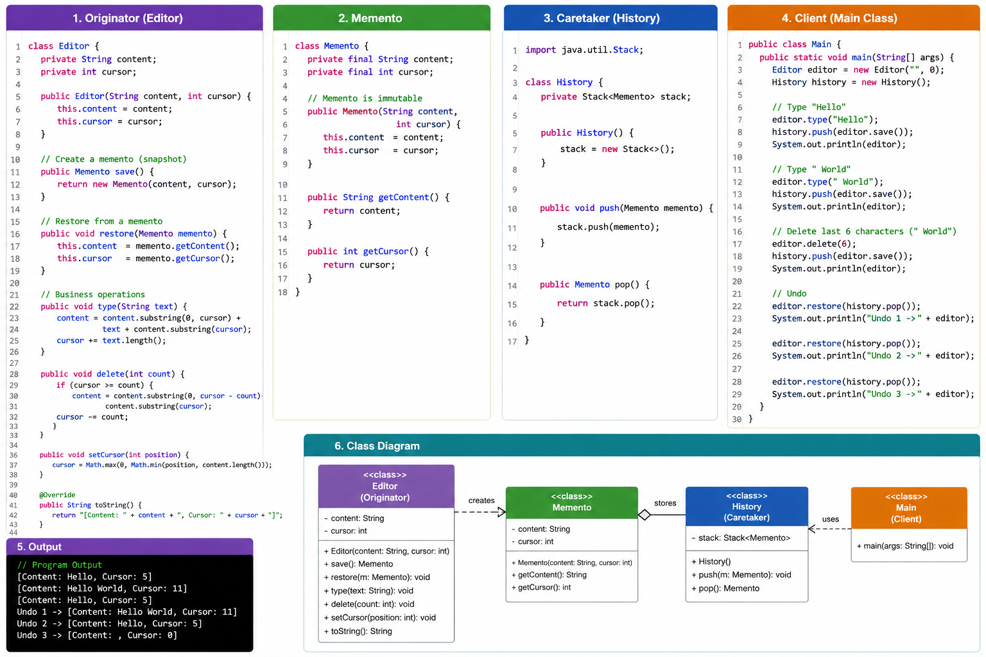
Memento Pattern – Java Implementation

Slide 8
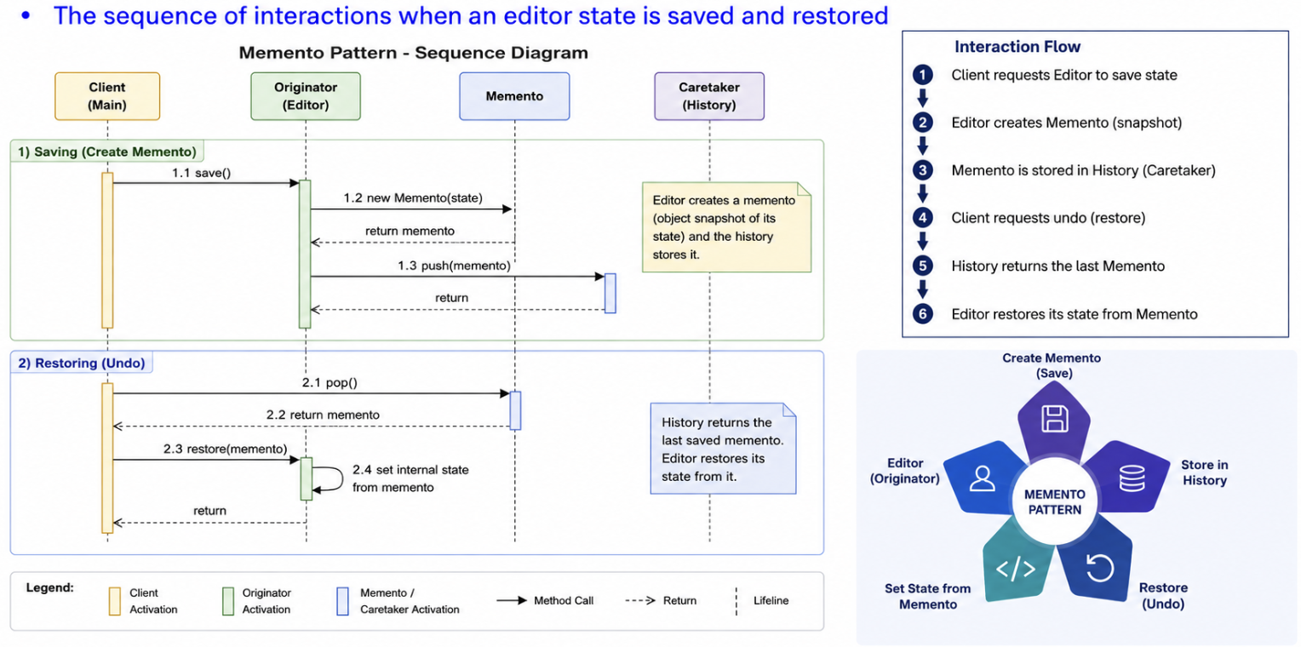
Memento Pattern – Collaborations

Slide 9
Memento Pattern – Execution Flow & Design Principles
Editor
Current State
createMemento()
History
stores snapshot
restore(memento)
Encapsulation
Memento hides the Originator's internal representation. Caretaker treats snapshots as history objects rather than editing their contents.
Separation of Responsibilities
Originator owns state. Caretaker owns history. Memento carries the snapshot.
Single Responsibility
Undo/history management is separated from the main object's business logic.

Slide 10
Memento Pattern – Consequences
✓ Advantages
• Preserves encapsulation
• Supports undo, rollback and checkpoints
• Separates state storage from business logic
• Easy to maintain snapshot history
• Can support multiple restore points
✗ Disadvantages
• Memory cost when many snapshots are stored
• Snapshot creation may be expensive for large objects
• History management can become complex
• Serialization/versioning may be needed for persistent snapshots
Use Memento when: restoration/history is important and state must remain encapsulated.
Avoid when: state is trivial, snapshots are very large, or no rollback requirement exists.

Slide 11
Memento Pattern – Known Uses in Real Software
The Memento Pattern appears wherever software needs safe snapshots, undo, checkpoints, or rollback.
Text & IDE Editors
• Undo / redo
• Restore an earlier document state
Games
• Save points
• Restore a previous game state
Transactions
• Rollback before commit
• Recover from a failed operation
Graphics / Design Tools
• Canvas snapshots
• Undo changes to complex models
Workflow Systems
• Checkpoint long-running processes
Form / Configuration Editors
• Restore previously saved configurations

Slide 12
Memento Pattern Vs Command Pattern
Both can participate in undo/rollback designs, but their intent is different. Do not identify a pattern from structure alone.
Feature | Memento | Command
Intent | Capture and restore object state | Encapsulate a request as an object
Main Purpose | Undo / rollback by restoring snapshots | Queue, log, parameterize or undo requests
State | Stores a snapshot of internal state | Stores the action/request and its parameters
Decision Maker | Originator creates/restores snapshots | Client chooses or invokes commands
Typical Example | Text editor history, game checkpoints | Undo action, remote command queue
Memory Trick | "What was my previous state?" | "What operation should I execute?"
If you need to restore a previous object state → Memento.
If you need to represent and execute an operation as an object → Command.
They can also be combined: Command performs an action, while Memento stores the state needed for undo.

