Slide 1
Proxy Design Pattern
Control access to a real object through a substitute
Unit 2
GoF structural pattern
Notes:
GoF intent: Gamma, Helm, Johnson and Vlissides, Design Patterns (1994), Proxy. https://patterns.univ-nantes.io/proxy.html . Image code is an original teaching example. Console output simulates file loading. It demonstrates single-threaded lazy initialization.

Slide 2
Proxy Design Pattern
Gang of Four intent
Provide a surrogate or placeholder for another object to control access to it.
Simple definition
Everyday analogy
A proxy implements the same interface as the real object. The client calls the proxy, which controls when or how it forwards the request.
A receptionist receives requests before passing them to a manager. The receptionist controls access to the manager.
The client calls the proxy. The proxy decides how to reach the real object.
02
Notes:
GoF intent: Gamma, Helm, Johnson and Vlissides, Design Patterns (1994), Proxy. https://patterns.univ-nantes.io/proxy.html . Image code is an original teaching example. Console output simulates file loading. It demonstrates single-threaded lazy initialization.

Slide 3
Without and With a Virtual Proxy
PROXY PATTERN
Without Proxy
With Proxy
Creating RealImage immediately performs its loading work. The application pays that cost even if it never displays the image.
Creating ProxyImage only stores the filename. It creates RealImage when display() is first called.
Image image =
new RealImage("photo.jpg");
// Loads immediately
Image image =
new ProxyImage("photo.jpg");
// Loading waits for display()
In this example, the proxy controls WHEN the real image object is created.
03
Notes:
GoF intent: Gamma, Helm, Johnson and Vlissides, Design Patterns (1994), Proxy. https://patterns.univ-nantes.io/proxy.html . Image code is an original teaching example. Console output simulates file loading. It demonstrates single-threaded lazy initialization.

Slide 4
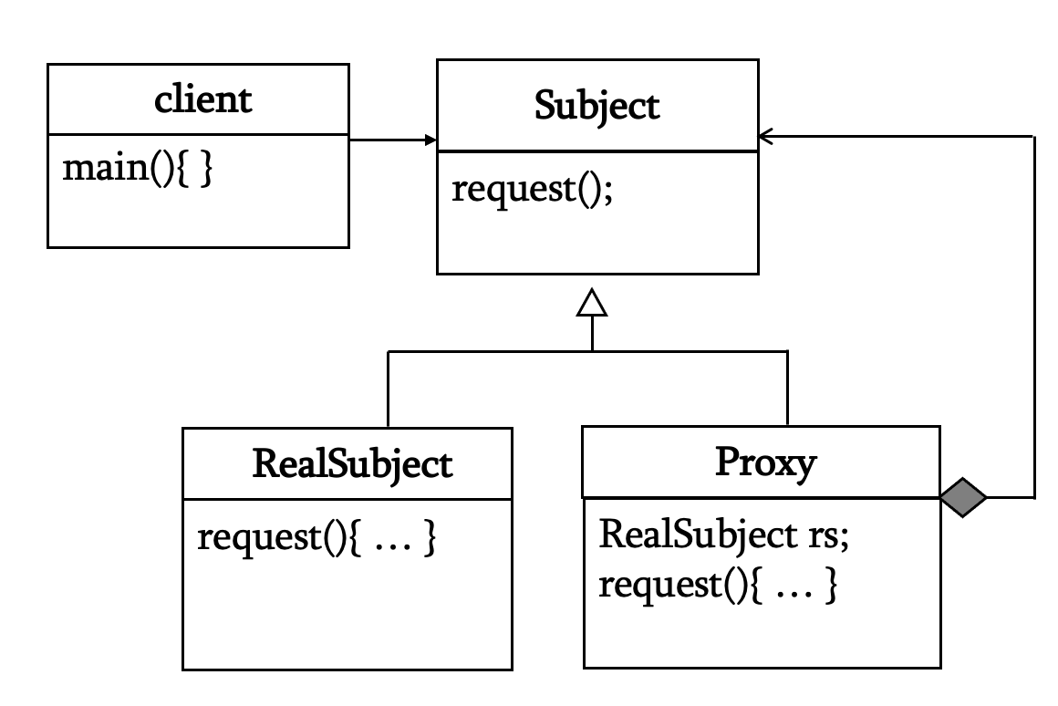
Structure and Participants
PROXY PATTERN
Client
calls display()
Subject
Image interface
Proxy
ProxyI mage
Real Subject
RealImage
Responsibilities
Image defines display(). RealImage performs loading and display work. ProxyImage also implements Image, holds a reference to RealImage, and controls access to it. Client code uses the Image interface and can call either implementation.
04
Notes:
GoF intent: Gamma, Helm, Johnson and Vlissides, Design Patterns (1994), Proxy. https://patterns.univ-nantes.io/proxy.html . Image code is an original teaching example. Console output simulates file loading. It demonstrates single-threaded lazy initialization.

Slide 5
How the Virtual Proxy Works
PROXY PATTERN
The first call to image.display()
Client
display()
ProxyImage
checks real == null
RealImage
load and display
First display call
Later display calls
The proxy creates RealImage because no real object exists yet. The constructor performs loading work, then the proxy calls real.display().
The proxy reuses its stored RealImage and calls display() again. It avoids repeating initialization for that proxy instance.
05
Notes:
GoF intent: Gamma, Helm, Johnson and Vlissides, Design Patterns (1994), Proxy. https://patterns.univ-nantes.io/proxy.html . Image code is an original teaching example. Console output simulates file loading. It demonstrates single-threaded lazy initialization.

Slide 6
Java: Subject and Real Subject
PROXY PATTERN
interface Image {
void display();
}
class RealImage implements Image {
private final String filename;
RealImage(String filename) {
this.filename = filename;
System.out.println(
"Loading " + filename);
}
public void display() {
System.out.println(
"Displaying " + filename);
}
}
Subject: Image
Both the real object and its proxy implement Image. The client uses the same display() operation.
Real Subject: RealImage
Its constructor represents expensive loading. The print statement simulates loading for this example.
06
Notes:
GoF intent: Gamma, Helm, Johnson and Vlissides, Design Patterns (1994), Proxy. https://patterns.univ-nantes.io/proxy.html . Image code is an original teaching example. Console output simulates file loading. It demonstrates single-threaded lazy initialization.

Slide 7
Java: The Virtual Proxy
PROXY PATTERN
class ProxyImage implements Image {
private final String filename;
private RealImage real;
ProxyImage(String filename) {
this.filename = filename;
}
@Override
public void display() {
if (real == null) {
real = new RealImage(filename);
}
real.display();
}
}
ProxyImage is the PROXY. It creates the REAL SUBJECT on first use, then forwards display().
07
Notes:
GoF intent: Gamma, Helm, Johnson and Vlissides, Design Patterns (1994), Proxy. https://patterns.univ-nantes.io/proxy.html . Image code is an original teaching example. Console output simulates file loading. It demonstrates single-threaded lazy initialization.

Slide 8
Java: Client Code and Output
PROXY PATTERN
Image image = new ProxyImage("photo.jpg");
// No loading message yet
image.display(); // First use loads the image
image.display(); // Second use reuses it
Output
What the client knows
The client calls Image.display(). It does not need to know whether the object is RealImage or ProxyImage.
Loading photo.jpg
Displaying photo.jpg
Displaying photo.jpg
Loading appears only once. Displaying appears twice because the client calls display() twice.
08
Notes:
GoF intent: Gamma, Helm, Johnson and Vlissides, Design Patterns (1994), Proxy. https://patterns.univ-nantes.io/proxy.html . Image code is an original teaching example. Console output simulates file loading. It demonstrates single-threaded lazy initialization.

Slide 9
Common Proxy Variants
PROXY PATTERN
Virtual Proxy
delays creation
Protection Proxy
checks access rights
Remote Proxy
represents distant object
Different reasons to control access
A virtual proxy delays expensive initialization. A protection proxy checks whether a caller may access a service. A remote proxy represents an object in another process or machine. A smart reference can perform housekeeping when an object is accessed.
Choose the proxy behavior according to the access-control or lifecycle requirement.
09
Notes:
GoF intent: Gamma, Helm, Johnson and Vlissides, Design Patterns (1994), Proxy. https://patterns.univ-nantes.io/proxy.html . Image code is an original teaching example. Console output simulates file loading. It demonstrates single-threaded lazy initialization.

Slide 10
Proxy and Decorator
PROXY PATTERN
Proxy
Decorator
• Controls access to a real object
• Can delay creating the real object
• May check permissions or handle distance
• Acts as a substitute for the subject
• Adds responsibilities to a component
• Wraps a supplied component
• Can combine optional behaviors
• Supports layers of decoration
Both can share an interface and forward requests. Their design intent is different.
10
Notes:
GoF intent: Gamma, Helm, Johnson and Vlissides, Design Patterns (1994), Proxy. https://patterns.univ-nantes.io/proxy.html . Image code is an original teaching example. Console output simulates file loading. It demonstrates single-threaded lazy initialization.

Slide 11
Proxy Compared with Related Patterns
PROXY PATTERN
Pattern
Main purpose
Relationship to the interface
Proxy
Control access to a real object
Uses the subject interface
Decorator
Add responsibilities to an object
Uses the component interface
Adapter
Make incompatible interfaces work
Converts to the client’s expected interface
Facade
Simplify access to a subsystem
Offers a simpler task-level interface
Identify the pattern by its purpose, even when several patterns use a wrapper.
11
Notes:
GoF intent: Gamma, Helm, Johnson and Vlissides, Design Patterns (1994), Proxy. https://patterns.univ-nantes.io/proxy.html . Image code is an original teaching example. Console output simulates file loading. It demonstrates single-threaded lazy initialization.

Slide 12
Applicability and Consequences
PROXY PATTERN
Use Proxy when
Benefits and limits
• Expensive creation should wait until use
• Access needs permission checks
• A remote object needs a local representative
• Access requires extra coordination
• Keeps access logic outside the real subject
• Can avoid unnecessary initialization
• Adds a layer of indirection
• Can introduce latency or lifecycle complexity
12
Notes:
GoF intent: Gamma, Helm, Johnson and Vlissides, Design Patterns (1994), Proxy. https://patterns.univ-nantes.io/proxy.html . Image code is an original teaching example. Console output simulates file loading. It demonstrates single-threaded lazy initialization.

