Slide 1
Singleton Design Pattern
One shared instance with controlled creation and access
Unit 2
GoF creational pattern
Notes:
GoF Singleton intent. Java scope and implementation caveats: https://www.oracle.com/technical-resources/articles/java/singleton.html . AppConfig is an illustrative teaching example. Eager and lazy implementations are alternatives.

Slide 2
Singleton Design Pattern
Gang of Four intent
Ensure a class only has one instance, and provide a global point of access to it.
Simple definition
Everyday analogy
The class controls construction. Every ordinary call to getInstance() returns the same shared object.
An office uses one reception desk. Different visitors contact the same desk instead of creating a new desk for every visit.
getInstance() returns the SAME object to each client.
02
Notes:
GoF Singleton intent. Java scope and implementation caveats: https://www.oracle.com/technical-resources/articles/java/singleton.html . AppConfig is an illustrative teaching example. Eager and lazy implementations are alternatives.

Slide 3
Without and With Singleton
SINGLETON PATTERN
Without Singleton
With Singleton
Separate AppConfig objects hold separate settings. Changing one object does not update the other.
A private constructor restricts creation. getInstance() returns the same AppConfig to both callers.
AppConfig a = new AppConfig();
AppConfig b = new AppConfig();
AppConfig a =
AppConfig.getInstance();
AppConfig b =
AppConfig.getInstance();
Both clients share one object identity and read the same configuration state.
03
Notes:
GoF Singleton intent. Java scope and implementation caveats: https://www.oracle.com/technical-resources/articles/java/singleton.html . AppConfig is an illustrative teaching example. Eager and lazy implementations are alternatives.

Slide 4
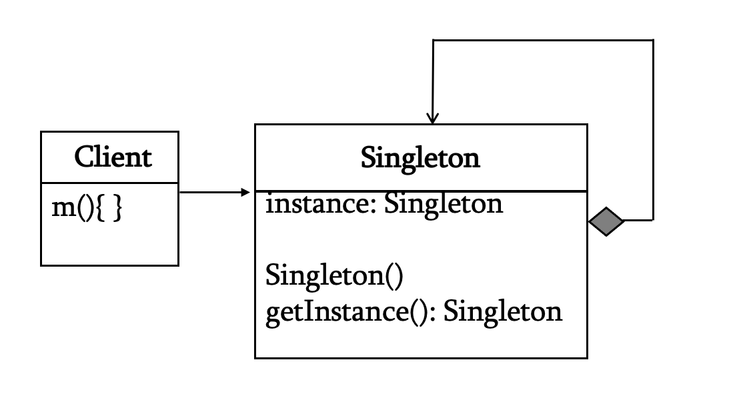
Structure and Participants
SINGLETON PATTERN
Client A
getInstance()
AppConfig
− AppConfig()
+ static getInstance()
+ setTheme(value)
+ getTheme()
Client B
getInstance()
Participant Responsibilities
Both clients receive
the same object reference
Singleton Class
Owns a private constructor.
Stores a private static instance.
Exposes a static access method.
Provides service operations.
Example: AppConfig.
Client
Calls AppConfig.getInstance().
Uses the returned shared object.
Cannot call the private constructor.
getInstance()
returns the shared reference. Safe instance creation does not automatically make mutable service methods thread-safe.
04
Notes:
GoF Singleton intent. Java scope and implementation caveats: https://www.oracle.com/technical-resources/articles/java/singleton.html . AppConfig is an illustrative teaching example. Eager and lazy implementations are alternatives.

Slide 5
Structure and Participants
SINGLETON PATTERN (Based on Example)
Private Constructor
AppConfig()
Access Method
getInstance()
Singleton Class
AppConfig
Shared Object
INSTANCE
Responsibilities
AppConfig controls construction and stores its instance. The private constructor blocks ordinary direct creation. getInstance() provides access to the shared object. Clients use its service methods. In Java, scope is per loaded class within a class loader.
04
Notes:
GoF Singleton intent. Java scope and implementation caveats: https://www.oracle.com/technical-resources/articles/java/singleton.html . AppConfig is an illustrative teaching example. Eager and lazy implementations are alternatives.

Slide 6
How Clients Share the Instance
SINGLETON PATTERN
Both clients obtain the same AppConfig
Client A
getInstance()
AppConfig
shared instance
Client B
getInstance()
Shared state
Thread safety
Client A sets the theme to Dark. Client B reads Dark because both references point to the same object.
Safe instance initialization does not make all service methods safe. Synchronization protects mutable theme access in this example.
05
Notes:
GoF Singleton intent. Java scope and implementation caveats: https://www.oracle.com/technical-resources/articles/java/singleton.html . AppConfig is an illustrative teaching example. Eager and lazy implementations are alternatives.

Slide 7
Java: An Eager Singleton
SINGLETON PATTERN
public final class AppConfig {
private static final AppConfig
INSTANCE = new AppConfig();
private String theme = "Light";
private AppConfig() {}
public static AppConfig getInstance() {
return INSTANCE;
}
public synchronized void setTheme(
String value) { theme = value; }
public synchronized String getTheme() {
return theme;
}
}
Private constructor
Only the class creates its ordinary instance. Client code obtains it through getInstance().
Eager initialization
The static field creates the object when Java initializes AppConfig. Synchronized methods protect the mutable theme.
06
Notes:
GoF Singleton intent. Java scope and implementation caveats: https://www.oracle.com/technical-resources/articles/java/singleton.html . AppConfig is an illustrative teaching example. Eager and lazy implementations are alternatives.

Slide 8
Java: A Lazy Holder Singleton
Basic lazy initialization is not thread-safe.
Two threads could both see instance == null and create separate objects.
SINGLETON PATTERN
public static Singleton getInstance() {
if (instance == null) {
instance = new Singleton();
}
return instance;
}
public final class AppConfig {
private String theme = "Light";
private AppConfig() {}
private static class Holder {
static final AppConfig INSTANCE = new AppConfig();
}
public static AppConfig getInstance() {
return Holder.INSTANCE;
}
public synchronized void setTheme(String value) {
theme = value;
}
public synchronized String getTheme() { return theme; }
}
To make lazy initialization thread-safe, use the static holder Class
Use this class instead of the eager version. The holder creates the instance on first access.
07
Notes:
GoF Singleton intent. Java scope and implementation caveats: https://www.oracle.com/technical-resources/articles/java/singleton.html . AppConfig is an illustrative teaching example. Eager and lazy implementations are alternatives.

Slide 9
Java: Client Code and Output
SINGLETON PATTERN
AppConfig a = AppConfig.getInstance();
AppConfig b = AppConfig.getInstance();
a.setTheme("Dark");
System.out.println(a == b);
System.out.println(b.getTheme());
Output
What the output means
true means a and b refer to the same object. Dark confirms that Client B sees the setting Client A changed.
true
Dark
The same client code works with either the eager singleton or the lazy holder implementation.
08
Notes:
GoF Singleton intent. Java scope and implementation caveats: https://www.oracle.com/technical-resources/articles/java/singleton.html . AppConfig is an illustrative teaching example. Eager and lazy implementations are alternatives.

Slide 10
Example: A Shared Service Coordinator
SINGLETON PATTERN
Module A
requests service
Coordinator
shared object
Module B
requests service
When one service identity is required
A shared configuration registry or logging coordinator may serve several modules. Use Singleton only when one controlled instance is required within the application’s chosen scope.
A dependency injection container can also manage one shared service instance.
09
Notes:
GoF Singleton intent. Java scope and implementation caveats: https://www.oracle.com/technical-resources/articles/java/singleton.html . AppConfig is an illustrative teaching example. Eager and lazy implementations are alternatives.

Slide 11
Eager Initialization and Lazy Holder
SINGLETON PATTERN
Eager initialization
Lazy holder
• Static field stores the instance
• Creation occurs at class initialization
• Implementation is straightforward
• Setup may precede the first use
• Nested class stores the instance
• First access initializes the holder
• Java safely publishes the instance
• Delays setup until the service is used
Both rely on Java class initialization. Mutable shared state still needs concurrency protection.
10
Notes:
GoF Singleton intent. Java scope and implementation caveats: https://www.oracle.com/technical-resources/articles/java/singleton.html . AppConfig is an illustrative teaching example. Eager and lazy implementations are alternatives.

Slide 12
Applicability and Consequences
SINGLETON PATTERN
Use Singleton when
Benefits and limits
• One shared instance is required
• Clients need the same service identity
• The instance scope is clearly defined
• The class must control construction
• Provides a common service reference
• Avoids duplicate service setup
• Shared state complicates isolated tests
• Reflection and serialization need care
Key lesson
getInstance() returns a shared reference. Singleton controls ordinary creation within a defined scope. It does not guarantee one instance across separate class loaders or processes.
12

