Slide 1
Template Method Design Pattern
Keep the process order fixed and let subclasses customize steps
Unit 2
GoF behavioral pattern
Notes:
GoF intent and pattern structure: https://people.csail.mit.edu/addy/pattern/pat5j.htm . Beverage example is an illustrative Java implementation. prepare() is the template method. brew() is the variable primitive step. The optional afterPour() hook on slide 9 is an extension to the main example.

Slide 2
Template Method Design Pattern
Gang of Four Definition
Define the skeleton of an algorithm in an operation, deferring some steps to subclasses. Template Method lets subclasses redefine certain steps of an algorithm without changing the algorithm's structure.
Simple definition
Everyday analogy
A concrete method calls several steps in order. Subclasses override the variable steps, while the superclass keeps the shared process.
Tea and coffee share a preparation process: boil water, brew, then pour. Brewing differs, but the overall order stays the same.
prepare() is the TEMPLATE METHOD. brew() is a customizable step.
02
Notes:
GoF intent and pattern structure: https://people.csail.mit.edu/addy/pattern/pat5j.htm . Beverage example is an illustrative Java implementation. prepare() is the template method. brew() is the variable primitive step. The optional afterPour() hook on slide 9 is an extension to the main example.

Slide 3
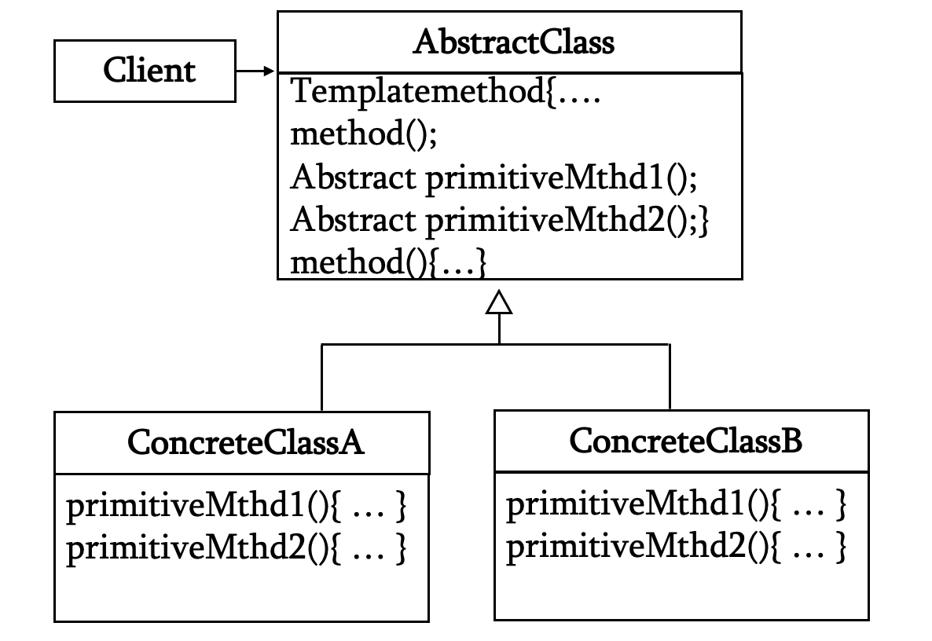
Structure and Participants
TEMPLATE METHOD PATTERN

Slide 4
Without and With Template Method
TEMPLATE METHOD PATTERN
Without Template Method
With Template Method
Tea and Coffee each repeat the preparation sequence. Updating the shared process means editing both classes.
Beverage defines prepare() once. Tea and Coffee inherit it and implement brew() differently.
// In both classes
boilWater();
brew();
pour();
// In superclass Beverage
final void prepare() {
boilWater(); brew(); pour();
}
The template method fixes the order. Subclasses provide the variable step implementations.
03
Notes:
GoF intent and pattern structure: https://people.csail.mit.edu/addy/pattern/pat5j.htm . Beverage example is an illustrative Java implementation. prepare() is the template method. brew() is the variable primitive step. The optional afterPour() hook on slide 9 is an extension to the main example.

Slide 5
Structure and Participants
TEMPLATE METHOD PATTERN ( based on Example)
Template Method
prepare()
Primitive Step
brew()
Abstract Class
Beverage
Concrete Class
Tea or Coffee
Responsibilities
Beverage declares brew() and implements prepare(). The concrete prepare() method calls boilWater(), brew(), then pour(). Tea and Coffee implement brew(). The client calls prepare() on a selected beverage.
04
Notes:
GoF intent and pattern structure: https://people.csail.mit.edu/addy/pattern/pat5j.htm . Beverage example is an illustrative Java implementation. prepare() is the template method. brew() is the variable primitive step. The optional afterPour() hook on slide 9 is an extension to the main example.

Slide 6
How the Template Method Runs
TEMPLATE METHOD PATTERN
A client calls new Tea().prepare()
Step 1
boilWater()
Step 2
Tea.brew()
Step 3
pour()
Shared steps
Variable step
Beverage supplies boilWater() and pour(). Every beverage reuses these common operations.
The call to brew() runs the selected subclass’s implementation. Tea brews tea leaves. Coffee brews ground coffee.
05
Notes:
GoF intent and pattern structure: https://people.csail.mit.edu/addy/pattern/pat5j.htm . Beverage example is an illustrative Java implementation. prepare() is the template method. brew() is the variable primitive step. The optional afterPour() hook on slide 9 is an extension to the main example.

Slide 7
Java: The Abstract Class
TEMPLATE METHOD PATTERN
abstract class Beverage {
// TEMPLATE METHOD
public final void prepare() {
boilWater();
brew();
pour();
}
private void boilWater() {
System.out.println("Boil water");
}
protected abstract void brew();
private void pour() {
System.out.println("Pour into cup");
}
}
Template method: prepare()
prepare() contains the process sequence. final prevents subclasses from replacing that sequence.
Variable step: brew()
brew() is abstract, so each concrete subclass must implement it. The private common methods keep their shared implementation.
06
Notes:
GoF intent and pattern structure: https://people.csail.mit.edu/addy/pattern/pat5j.htm . Beverage example is an illustrative Java implementation. prepare() is the template method. brew() is the variable primitive step. The optional afterPour() hook on slide 9 is an extension to the main example.

Slide 8
Java: Concrete Subclasses
TEMPLATE METHOD PATTERN
class Tea extends Beverage {
@Override
protected void brew() {
System.out.println("Brew tea leaves");
}
}
class Coffee extends Beverage {
@Override
protected void brew() {
System.out.println("Brew ground coffee");
}
}
Tea and Coffee override brew(). Both inherit the SAME prepare() template method.
07
Notes:
GoF intent and pattern structure: https://people.csail.mit.edu/addy/pattern/pat5j.htm . Beverage example is an illustrative Java implementation. prepare() is the template method. brew() is the variable primitive step. The optional afterPour() hook on slide 9 is an extension to the main example.

Slide 9
Java: Client Code and Output
TEMPLATE METHOD PATTERN
Beverage drink = new Tea();
drink.prepare();
// To make coffee instead:
// Beverage drink = new Coffee();
Output
What the client calls
The client calls prepare(). The superclass runs the sequence and calls Tea.brew() for the variable step.
Boil water
Brew tea leaves
Pour into cup
08
Notes:
GoF intent and pattern structure: https://people.csail.mit.edu/addy/pattern/pat5j.htm . Beverage example is an illustrative Java implementation. prepare() is the template method. brew() is the variable primitive step. The optional afterPour() hook on slide 9 is an extension to the main example.

Slide 10
Template Method Compared with Related Patterns
Pattern
Main purpose
Variation mechanism
Template Method
Reuse an algorithm’s fixed sequence
Subclasses implement selected steps
Strategy
Choose an interchangeable algorithm
Context delegates to a strategy object
Factory Method
Let subclasses choose a product
Override an object creation method
Decorator
Add behavior around an object
Wrap and delegate to a component
A template method can call a factory method when one step must create a product.
11
Notes:
GoF intent and pattern structure: https://people.csail.mit.edu/addy/pattern/pat5j.htm . Beverage example is an illustrative Java implementation. prepare() is the template method. brew() is the variable primitive step. The optional afterPour() hook on slide 9 is an extension to the main example.

Slide 11
Applicability and Consequences
TEMPLATE METHOD PATTERN
Use Template Method when
Benefits and limits
• Algorithms share the same sequence
• Only selected steps differ
• Common steps should stay consistent
• Inheritance fits the design
• Removes repeated process code
• Keeps the process order consistent
• Supports controlled extension points
• Couples subclasses to the superclass
12
Notes:
GoF intent and pattern structure: https://people.csail.mit.edu/addy/pattern/pat5j.htm . Beverage example is an illustrative Java implementation. prepare() is the template method. brew() is the variable primitive step. The optional afterPour() hook on slide 9 is an extension to the main example.

