Slide 1


AI-DRIVEN MAINTENANCE
Anomaly Detection & Fatigue Intelligence for Aerospace
and Rail Assets
A LangGraph multi-agent digital twin where physics and ML negotiate,
a Gemini Judge investigate with multiple tools, and every decision leaves an audit trail.
PREDICTIVE MAINTENANCE · AI ANOMALY DETECTION SYSTEM
01

Slide 2



THE CHALLENGE
Fleet failures are
expensive and mostly unavoidable
INDUSTRY BENCHMARK
Unplanned maintenance costs the aerospace industry billions annually - and a single grounded aircraft can idle a fleet's economics for days.
Aircraft and rail operators still rely on fixed inspection intervals and manual thresholds. By the time a gauge trips, damage has often already accumulated - turning a routine swap into an unscheduled grounding.
3–5x
cost of reactive vs. planned repair
Reactive, not predictive
Threshold alarms fire only after a fault is already underway.
6–9 mo
Unplanned downtime
typical AI-maintenance rollout
Emergency repairs cost 3-5x more than scheduled maintenance.
3–5x
Fragmented data
projected first-year ROI
Sensor CSVs, material specs, and fatigue models live in silos.
PREDICTIVE MAINTENANCE · AI ANOMALY DETECTION SYSTEM
02

Slide 3




ASSET COVERAGE
Seven components, purpose-built sensor profiles
Each profile defines normal / warning / critical bands per sensor, tuned separately for aircraft and rail duty cycles.
Engine
Wing
Fuselage
Landing Gear
Vibration · Temp · Oil Pressure · Oil Temp
Vibration · Load Factor · Temperature
Vibration · Temperature · Load Factor
Vibration · Load Factor · Pressure
INCONEL718
AL7075-T6
AL7075-T6
STEEL4340
Component profiles auto-map to CSV columns by name pattern no manual schema wiring required.
Brake
Bogie
Wheel
Temperature · Pressure · Acoustic Emission
Vibration · Load Factor · Temperature
Vibration · Temperature · Pressure
STEEL4340
CASTIRON
STEEL4340
PREDICTIVE MAINTENANCE · AI ANOMALY DETECTION SYSTEM
04

Slide 4
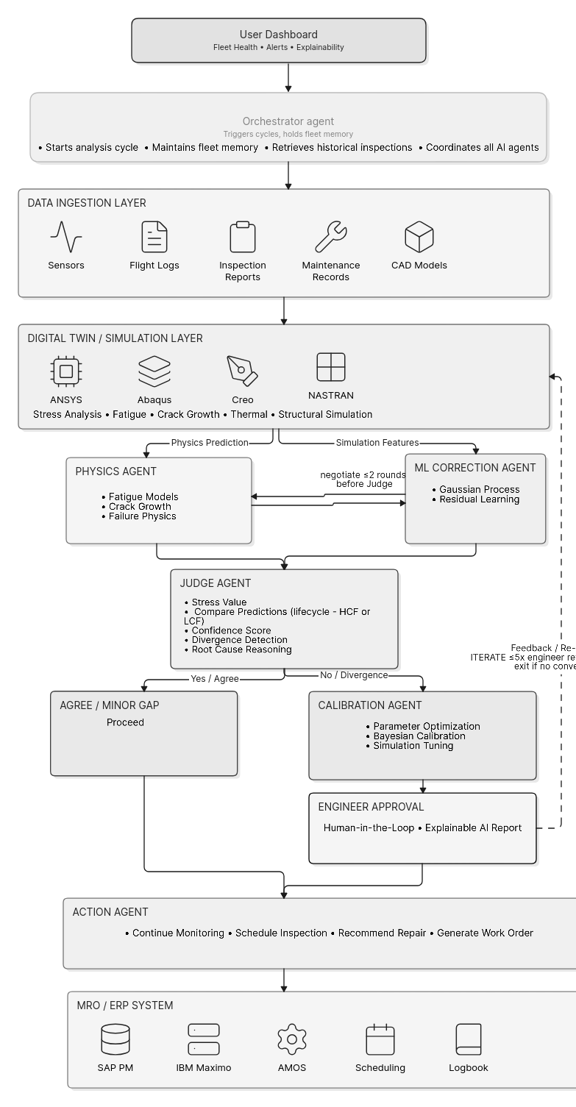

SYSTEM ARCHITECTURE
Two engines, one fleet-health pipeline
A lightweight CSV-threshold detector for rapid field triage, feeding into a deeper AI + physics engine for lifecycle-grade decisions.
Sensor CSV Ingestion
01
Anomaly Detection
02
Stress Generation
03
Auto-scans a directory, matches files to components by name pattern (engine, wing, brake)
Predicts the Anomaly by taking the Sensors data
Converts flight loads and sensor data into stress and strain fields per component.
Physics-Based Fatigue
05
04
RUL & Recommendations
Basquin, Paris Law & NASGRO models translate stress into remaining-life estimates + Gaussian models score each reading
Remaining Useful Life estimation plus material/supplier upgrade guidance.
PREDICTIVE MAINTENANCE · AI ANOMALY DETECTION SYSTEM
03

Slide 5
DEPLOYMENT ROADMAP
From data pipeline to fleet-wide rollout
A phased integration path connects the model directly into existing MRO and asset-management workflows.
01
02
03
04
Data Integration
Model Deployment
Dashboard Integration
Optimization & Scaling
2–3 mo
2–4 mo
1–2 mo
Ongoing
Sensor pipelines, ingestion, quality checks
Anomaly detection + RUL estimation live
MRO connection, work orders, alerts
Model refinement, fleet expansion
TIMELINE
INVESTMENT
PROJECTED ROI
6–9 months
$250K–$500K
3–5x, Year 1
PREDICTIVE MAINTENANCE · AI ANOMALY DETECTION SYSTEM
09

Slide 6

MATERIAL INTELLIGENCE
Every anomaly ends in a decision, not just a flag
The material database cross-references current alloys against a curated upgrade map — surfacing supplier, cost, and confidence in one pass.
Current | Recommended | Key Gain | Risk | Conf.
Inconel718 | Inconel718Plus | +25% fatigue life | Low | 82%
Steel4340 | Steel300M | +20% fatigue life | Medium | 78%
Al7075-T6 | Al7050-T7451 | +15% toughness | Low | 80%
CastIron | DuctileCastIron | +25% fatigue life | Low | 83%
Recommendations bundle estimated cost, supplier lead time, and projected savings — so engineering and procurement work from the same number.
PREDICTIVE MAINTENANCE · AI ANOMALY DETECTION SYSTEM
08

Slide 7
Turn every sensor reading
into a maintenance decision
Maintenance System · Anomaly Detection & Fatigue Intelligence Engine
Questions & next steps welcome.
PREDICTIVE MAINTENANCE · AI ANOMALY DETECTION SYSTEM
10

