Slide 1
A Dope Document
Testing for text divided into columns

Slide 2
Slide 2

Slide 3
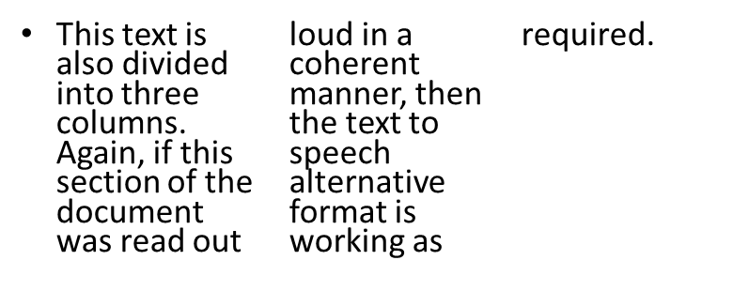
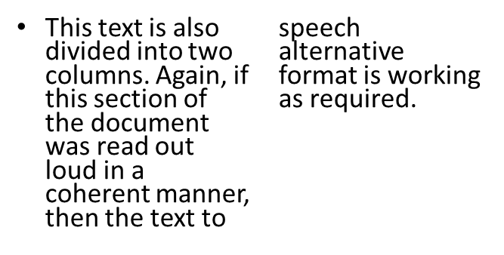


Slide 3
This paragraph is also divided into 3 columns, with the caveat that this text has images inserted in it. The image however should not prevent the text from being read out loud in a coherent manner. If that is the case, then the text to speech feature is working as required

Slide 4
Slide 4
Column 1 row 1 This has added text to see if it’s read properly | Column 2 row 1 | Column 3 row 1 | Column 4 row 1
Column 1 row 2 | Column 2 row 2 This has added text to see if it’s read properly | Column 3 row 2 | Column 4 row 2
Column 1 row 3 | Column 2 row 3 | Column 3 row 3 This has added text to see if it’s read properly | Column 4 row 3
Column 1 row 4 | Column 2 row 4 | Column 3 row 4 | Column 4 row 4 This has added text to see if it’s read properly

