Slide 1

CLOUD NATIVE DEVOPS CAPSTONE
Aegis Health Platform
— Azure AKS Track
Github Actions Certified - GH200

Slide 2
PROJECT OVERVIEW
What is Aegis?
A production-grade, AI-powered health management platform built as a microservices application deployed on Azure Kubernetes Service with full DevOps automation.
DOMAINS COVERED
Medication tracking
Medical imaging
Health records
Multi-agent AI diagnostics
Real-time caregiver alerts

Slide 3
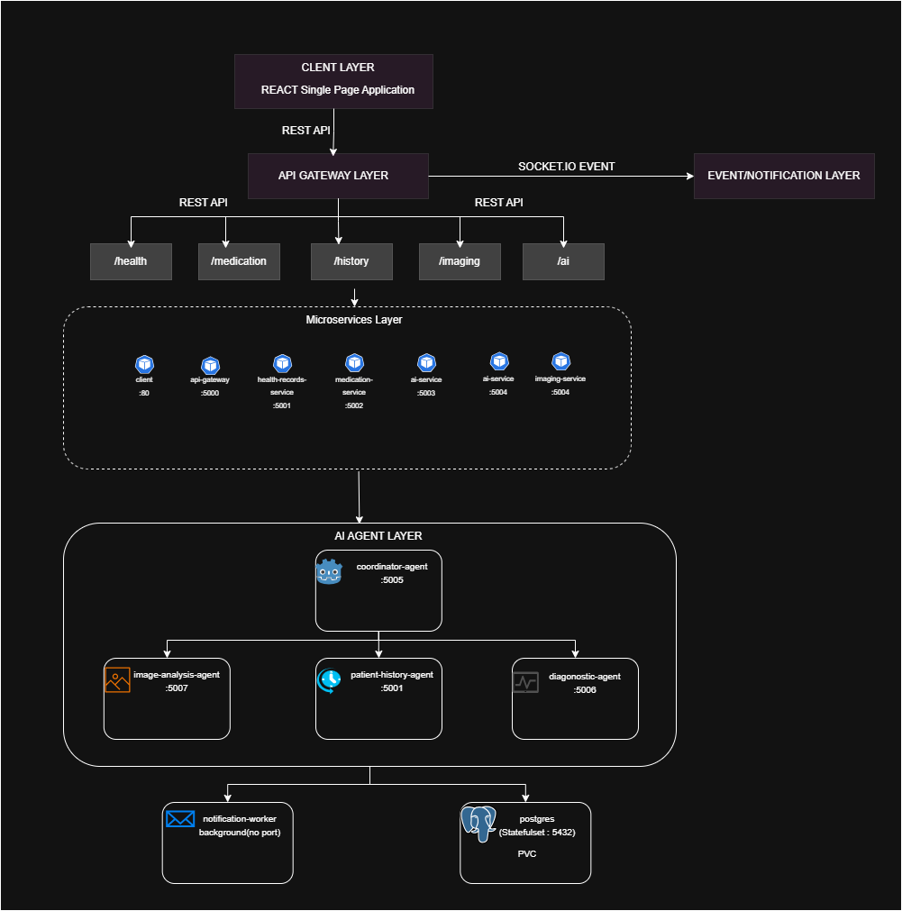

Slide 4

CONTAINERIZATION
Dockerization
Multi-Stage Docker Builds
KEY PRACTICES
# Stage 1 — Builder
FROM node:20-alpine AS builder
COPY package*.json ./
RUN npm ci
RUN npm run build
# Stage 2 — Runtime
FROM node:20-alpine AS runtime
RUN addgroup -S appgroup && \
adduser -S appuser -G appgroup
COPY --from=builder /app/dist ./dist
USER appuser # non-root
EXPOSE 5000
CMD ["node", "dist/index.js"]
Non-root user (UID 1000) in every container
Alpine base images — minimal attack surface
.dockerignore excludes node_modules, .env, test files
Build artifacts only — no source code in runtime image
Images pushed to Azure Container Registry (ACR)
REGISTRY
aegistestacr.azurecr.io

Slide 5
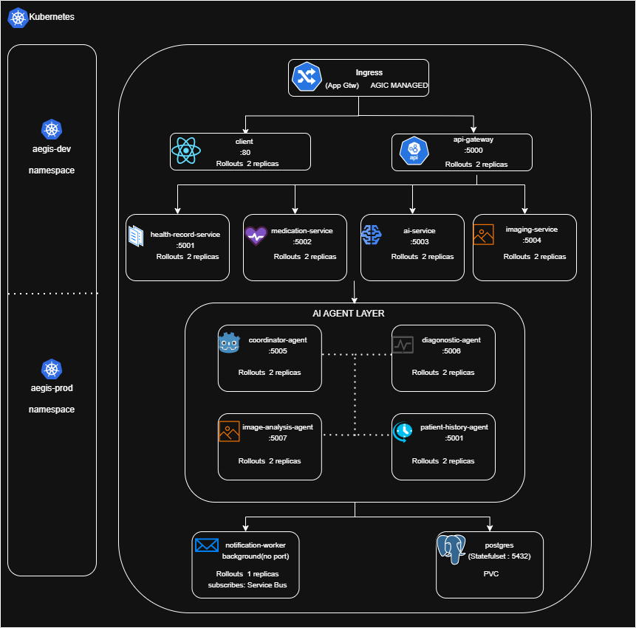

Slide 6
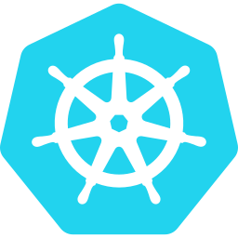
KUBERNETES
Kubernetes Architecture
FEATURE | aegis-dev | aegis-prod
Replicas | 1 per service | 2+ for critical services
Image tags | sha-* (every push) | v*.*.* (semver release only)
HPA | Disabled | Enabled on all services
Resources | Minimal limits | Production spec
ADDITIONAL FEATURES
SecretProviderClass — Key Vault via CSI driver
ServiceAccount — annotated with Workload Identity
ConfigMap — non-sensitive config
StatefulSet — PostgreSQL (managed-csi PVC)
KUBERNETES FEATURES IN USE
Argo Rollouts — Canary (20% → 30s → 50% → 30s → 100%)
HPA — CPU 70-75%, Mem 80%; min 2 / max 5 replicas
Ingress via AGIC (App Gateway Ingress Controller)
NetworkPolicies — default deny-all; explicit allow
Health Probes
/healthz + /ready on all HTTP services
Resource Limits
CPU 100m–500m · Mem 128Mi–512Mi

Slide 7
KUBERNETES DEEP DIVE
Zero-Downtime Deployments & Traffic Control
How traffic reaches pods and how new versions roll out safely
INTERNET
ARGO ROLLOUTS — CANARY STRATEGY
20%
pods → new version
Azure Application Gateway
WAF-enabled · AGIC manages routing rules
wait 30s → monitor
50%
pods → new version
/api
/
wait 30s → monitor
api-gateway
client
100%
pods → new version
old pods terminated
Every workload uses argoproj.io/v1alpha1 Rollout — not standard Deployment
Canary allows catching regressions before full rollout
AGIC automatically updates App Gateway backend pools as rollout progresses
Manual promotion supported if auto-analysis is added later

Slide 8

KUBERNETES DEEP DIVE
Reliability & Auto-Scaling
The platform keeps itself healthy and scales under load
HEALTH PROBES — ON EVERY HTTP SERVICE
HORIZONTAL POD AUTOSCALER (PROD ONLY)
PROBE | PATH | WHAT IT CHECKS
Liveness | /healthz | Is the process alive? Restart if not
Readiness | /ready | Is the service ready? Remove from LB if not
SERVICE | MIN | MAX | CPU | MEM
api-gateway | 2 | 5 | 70% | 80%
client | 2 | 6 | 60% | —
health-records | 2 | 5 | 70% | 80%
medication-service | 2 | 4 | 70% | 80%
AI agents | 1 | 3 | 75% | 80%
readiness FAILS removed from Service endpoints — no traffic during cold start
readiness PASSES added to Service, traffic flows
HPA targets Argo Rollout objects (not Deployments) — scales the active canary replica set
liveness FAILS kubelet restarts container
RESOURCE LIMITS — ENFORCED ON EVERY CONTAINER
CPU: ≥ 100m → ≤ 500m Memory: ≥ 128Mi → ≤ 512Mi

Slide 9


KUBERNETES DEEP DIVE
Security & Identity
Zero static credentials, zero implicit trust
NETWORKPOLICY — DEFAULT DENY-ALL
SERVICEACCOUNT + WORKLOAD IDENTITY
Every namespace has a baseline deny-all ingress policy. Each service then gets its own explicit allow rule:
1
Pod spec references ServiceAccount
client ← App Gateway subnet ONLY
api-gateway ← App Gateway + internal ns
health-records ← api-gateway pods only
medication-svc ← api-gateway pods only
AI agents ← api-gateway + coordinator
notification-wkr ← egress only (no inbound)
2
SA annotated with client-id: "2ae07dc6-..."
3
AKS webhook injects federated token at runtime
4
Azure SDK uses DefaultAzureCredential — no password, no key
5
Pod accesses: Key Vault, Service Bus, Blob, CosmosDB
SecretProviderClass 11 secrets mounted via CSI driver at pod startup — never touches the codebase or image

Slide 10
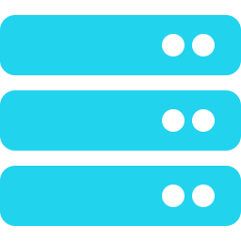
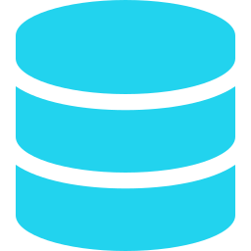
KUBERNETES DEEP DIVE
Configuration & Persistent State
Config stays outside code; state survives pod restarts
CONFIGMAP — AEGIS-CONFIG (NON-SENSITIVE)
STATEFULSET — POSTGRESQL
PORT: "5000"
NODE_ENV: "production"
LOG_LEVEL: "info"
CORS_ORIGIN: "*"
ACS_SENDER_ADDRESS: "DoNotReply@..."
HEALTH_RECORDS_SERVICE_URL:
"http://health-records-service:5001"
MEDICATION_SERVICE_URL:
"http://medication-service:5002"
COORDINATOR_AGENT_URL:
"http://coordinator-agent:8000"
postgres StatefulSet
• Stable pod name: postgres-0 (never random)
• Stable DNS: postgres-0.postgres.aegis-prod.svc
PersistentVolumeClaim
managed-csi · prod: 20Gi · dev: 5Gi
Rule: URL, port, or flag → ConfigMap. Password, key, or token → Key Vault.
Pod deleted → PVC stays → new pod remounts same data
StatefulSet chosen over Deployment: PostgreSQL requires stable identity and durable storage. All application data persists across pod and node restarts.

Slide 11
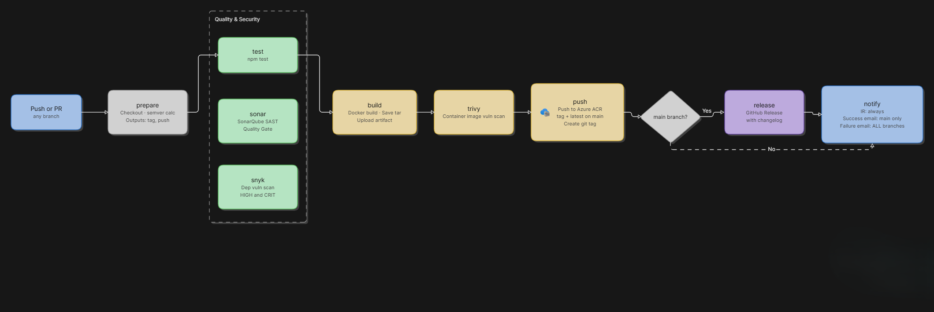
CI/CD
CI Pipeline (Continuous Integration)

Slide 12
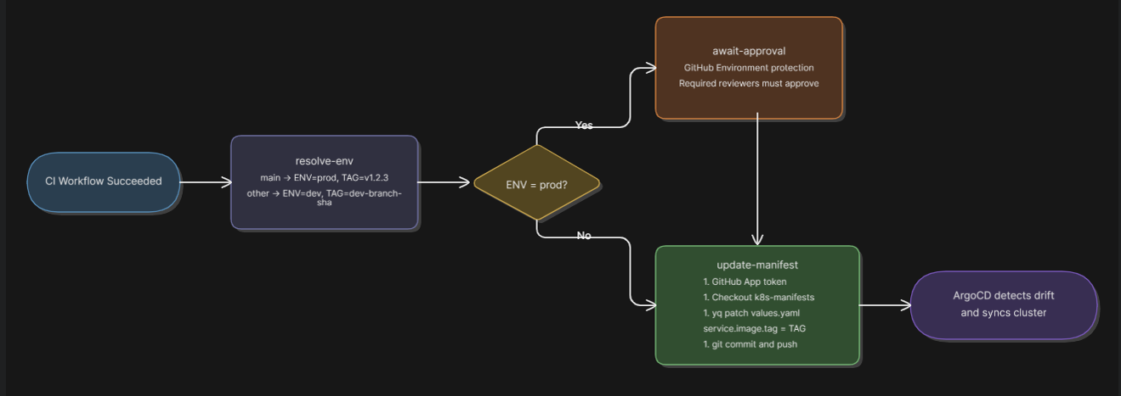
CI/CD
CD Pipeline (GitOps Approach)

Slide 13
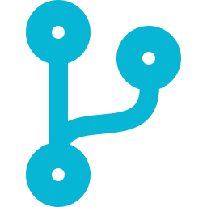
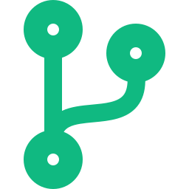

Branch Strategy
Environment-per-branch GitOps model
develop
main
-> dev namespace
-> prod namespace
Feature development & integration
QA and integration testing
Non-production traffic only
Auto deploy on PR merge
Production-ready code only
Protected branch - PR required
Full scan gates before merge
Monitored & audited deployments
Build Once, Deploy to Multiple Environments using the same Docker image tag

Slide 14
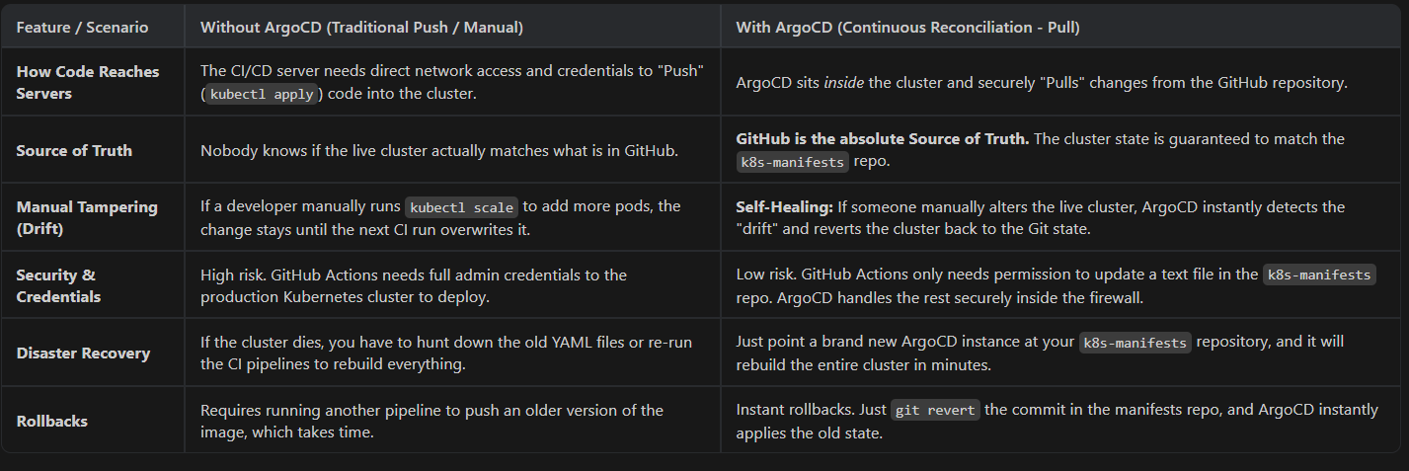
Deployment Strategy: Without ArgoCD vs. With ArgoCD

Slide 15
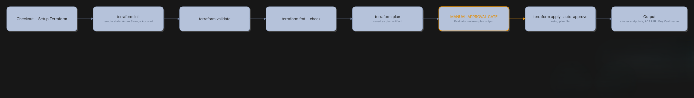

CI/CD
CI/CD: Infrastructure Pipeline
terraform-apply.yml — triggered on changes to terraform/ folder
REMOTE STATE
aegis-tf-state
Storage Account · tfstate container
State locking via Azure Blob lease
GITHUB SECRETS USED
No credentials in code
AZURE_CLIENT_ID
AZURE_TENANT_ID
AZURE_SUBSCRIPTION_ID
AZURE_CLIENT_SECRET

Slide 16

INFRASTRUCTURE AS CODE
Infrastructure as Code (Terraform)
Modular Terraform structure
terraform/
├── main.tf ← root orchestrator
├── variables.tf
├── terraform.tfvars ← all config values
├── outputs.tf ← endpoints, ACR, KV
└── modules/
├── networking/ ← VNet, subnets, NSGs
├── aks/ ← AKS cluster, node pools
├── acr/ ← Azure Container Registry
├── key-vault/ ← Key Vault + policies
├── storage/ ← Blob Storage for records
├── identity/ ← UAMI, federated creds
├── app-gateway/ ← WAF-enabled App Gateway
├── service-bus/ ← aegis-test-bus + queue
├── cosmos-db/ ← MongoDB-compatible DB
└── monitoring/ ← App Insights, Log Analytics
STANDARDS MET
All resources tagged: Environment = test, Owner = aegis-team
No hardcoded values — all via terraform.tfvars
terraform validate and terraform fmt pass clean
.gitignore excludes *.tfstate, .env, *.tfvars
Outputs document all endpoints and resource names
10 modules · fully composable · single root orchestrator

Slide 17
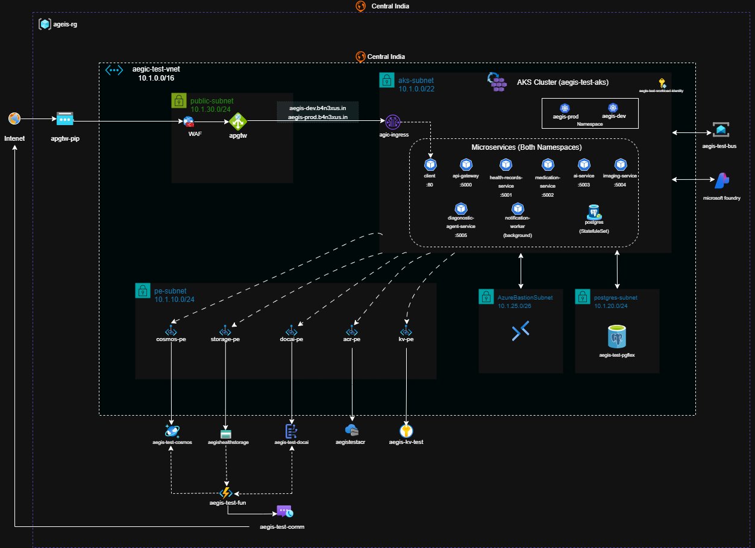

Slide 18
CLOUD INTEGRATION
Cloud Integration & Workload Identity
Zero static credentials — all pod-to-cloud via Workload Identity
UAMI: aegis-test-workload-identity
Pod starts
ServiceAccount annotated with UAMI client-id
Federated credentials configured for both aegis-dev and aegis-prod namespaces
MANAGED CLOUD SERVICES CONNECTED FROM PODS
AKS Workload Identity webhook injects federated token
SERVICE | USED FOR
Azure Key Vault | 11 secrets mounted via CSI driver
Azure CosmosDB (MongoDB) | All application data
Azure Blob Storage | Medical image / document storage
Azure Service Bus | Async missed-dose event queue
Azure Communication Services | Caregiver email alerts
Application Insights | Distributed telemetry & logging
Azure SDK auto-authenticates via DefaultAzureCredential
Accesses: Key Vault, Blob, Service Bus, CosmosDB, App Insights

Slide 19
Event-Driven Architecture
Azure Service Bus — async missed-dose notification pipeline
Patient misses medication threshold
DUPLICATE GUARD
api-gateway (publisher)
@azure/service-bus SDK · ServiceBusSender.sendMessages()
caregiverAlerted flag in SystemStatus document prevents repeat sends
aegis-test-bus / notifications queue
Standard tier, Azure Service Bus
notification-worker (consumer)
peekLock mode → processMessage()
BACKGROUND POLLING PATH
Azure Communication Services
EmailClient.beginSend()
Every 20s, an independent check detects schedule breaches and feeds the same notification queue
Caregiver inbox
HTML alert email

Slide 20




AI Integration
Three AI integrations across the platform
1
2
3
Google Gemini API
Azure AI
Azure Document Intelligence
ai-service
diagnostic-agent-service + image-analysis-agent
imaging-service + Function App
Conversational AI health assistant
Personalized medication & lifestyle recommendations
Chat history persisted in CosmosDB
Clinical symptom analysis
Medical image anomaly detection
Structured diagnostic report generation
OCR on uploaded medical documents and scans
Extracts structured data from PDFs and images
Triggers automatically via Blob Storage event
Multi-agent orchestration: coordinator-agent dispatches tasks to image-analysis-agent, patient-history-agent, and diagnostic-agent-service in parallel, then merges results into a unified report

Slide 21




SECURITY
DevSecOps
Security baked into every layer
Code Level
Container Level
Kubernetes Level
Infrastructure Level
TypeScript strict mode — type errors block build
ESLint with security ruleset
No credentials in any file or git history (verified)
Multi-stage builds — no dev dependencies in runtime
Non-root user (UID 1000) in all containers
Trivy scan on every image — blocks HIGH/CRITICAL CVEs
Alpine base — minimal OS attack surface
runAsNonRoot: true, allowPrivilegeEscalation: false
capabilities: drop: [ALL] on all containers
NetworkPolicies — default deny-all ingress per namespace
Secrets via CSI Secret Provider — never in ConfigMaps
RBAC — namespace-scoped, minimal permissions
Workload Identity — no client_secret in pod env vars
Key Vault access policies scoped per UAMI
App Gateway WAF policy on all ingress traffic
Remote state encrypted at rest (Azure Storage)
.gitignore excludes *.tfstate, *.tfvars, .env

Slide 22
CAPSTONE SUMMARY
Aegis Health Platform: Delivered
11
3
10
Microservices
GitHub Actions Workflows
Terraform Modules
DELIVERED ACROSS EVERY PILLAR
Containerization
Kubernetes
CI/CD
Infrastructure as Code
Cloud Integration
DevSecOps
Event-Driven Architecture
AI Integration
GitOps

