Slide 1
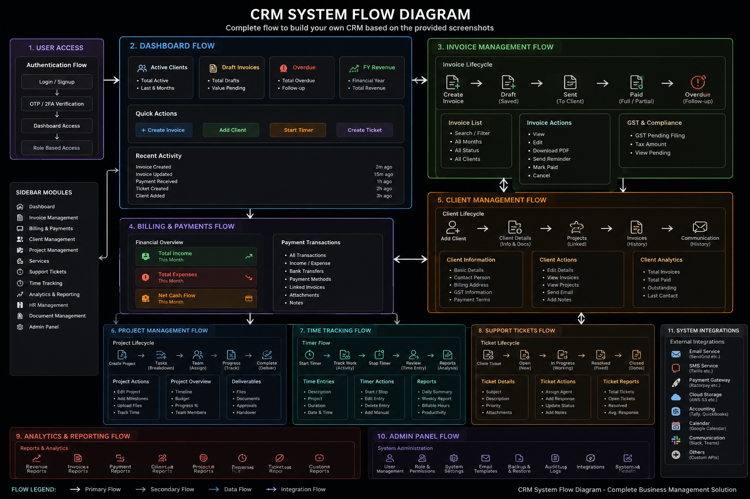
EON8 CRM
Complete Product Blueprint & Business Workflow
A scalable internal CRM for Sales, Clients, Projects, Finance, Team & Analytics
EON8 CRM – Product Blueprint | 1

Slide 2
Vision for Our Own CRM
One unified platform instead of disconnected business tools
Business Problems
Multiple tools
Manual follow-ups
Scattered client data
Invoices separate from projects
Limited productivity visibility
CRM Goal
Single source of truth
Integrated workflows
Real-time dashboard
Automation ready
Role-based access
Expected Outcome
Better client experience
Operational efficiency
Revenue visibility
Team accountability
Scalable architecture
EON8 CRM – Product Blueprint | 2

Slide 3
CRM System Architecture
Complete business management ecosystem
EON8 CRM – Product Blueprint | 4

Slide 4
Primary Business Lifecycle
The central workflow that connects sales to revenue
Lead
Qualified
Client
Project
Tasks
Time
Invoice
Payment
Business Rule
Lead → Client → Project → Tasks → Time → Invoice → Payment. Every operational activity should connect back to the client profile and reporting engine.
EON8 CRM – Product Blueprint | 5

Slide 5
Sidebar Information Architecture
Recommended navigation for employees and management
CORE
• Dashboard
• Leads
• Clients
• Projects
• Services
• Tasks
• Time Tracking
FINANCE
• Invoices
• Payments
• Expenses
• Recurring Billing
OPERATIONS
• Support Tickets
• Documents
• Communication
• Calendar
MANAGEMENT
• Analytics & Reports
• HR Management
• Team Management
• Admin
EON8 CRM – Product Blueprint | 6

Slide 6
Lead Management Module
Capture every opportunity before it becomes a client
Lead Information
Lead ID
Company
Contact Person
Phone
Email
Industry
Source
Service Interest
Estimated Value
NEW
Automation
Assign salesperson
Follow-up reminders
Activity timeline
Proposal history
Next contact date
Convert WON → Client
CONTACTED
QUALIFIED
MEETING
PROPOSAL
NEGOTIATION
WON
EON8 CRM – Product Blueprint | 7

Slide 7
Client 360° Management
One complete customer profile for every department
Client Profile
Company details
Billing details
GST information
Contacts
Payment terms
Communication history
Projects
Connected module
Services
Connected module
Invoices
Connected module
Payments
Connected module
Documents
Connected module
Tickets
Connected module
Notes
Connected module
Activity
Connected module
Golden Rule
Client becomes the single source of truth across Sales, Projects, Finance and Support.
EON8 CRM – Product Blueprint | 8

Slide 8
Project & Task Management
Convert signed clients into structured service delivery
Project
Name
Client
Service
Manager
Budget
Dates
Status
Members
Planning
Active
On Hold
Review
Completed
Archived
Task Capabilities
• Assign employee
• Priority
• Due date
• Comments
• Attachments
• Review workflow
Deliverables
• Milestones
• Files
• Approvals
• Progress %
• Client visibility
• Completion report
EON8 CRM – Product Blueprint | 9

Slide 9
Time Tracking Workflow
Connect employee effort directly to project costing and productivity
Employee
Project
Task
Start
Work
Stop
Entry
Reports
Time Entry
• Date
• Duration
• Description
• Billable status
Manager Review
• Approve
• Edit
• Weekly summary
• Billable hours
Business Impact
• Productivity
• Project costing
• Client billing
• Profitability
EON8 CRM – Product Blueprint | 10

Slide 10
Invoice Management Workflow
From draft creation to payment collection
Create
Lifecycle
Draft
Lifecycle
Sent
Lifecycle
Partial
Lifecycle
Paid
Lifecycle
Overdue
Lifecycle
Invoice Actions
• Create
• Edit
• Send email
• Download PDF
• Cancel
GST & Finance
• GST fields
• Tax calculation
• Payment terms
• Due dates
Collections
• Payment reminder
• Overdue alerts
• Partial payment
• Outstanding balance
EON8 CRM – Product Blueprint | 11

Slide 11
Billing, Payments & Cash Flow
Finance layer connected with invoices and operational expenses
Income
Invoice payments
Advance payments
Recurring revenue
Other income
Expenses
Salary
Marketing
Software
Office rent
Operational expenses
Cash Flow
Bank transfer
UPI
Cash
Payment gateway
Settlement records
Executive Finance KPI
Revenue • Expenses • Outstanding • Net Cash Flow • Profit
EON8 CRM – Product Blueprint | 12

Slide 12
Support Ticket & Communication
Structured customer support improves retention and service quality
Open
Assigned
In Progress
Waiting
Resolved
Closed
Ticket Details
• Subject
• Priority
• Project
• Attachments
• Client messages
Communication
• Email log
• WhatsApp
• Internal notes
• Activity history
SLA Reports
• Response time
• Resolution time
• Open tickets
• Performance
EON8 CRM – Product Blueprint | 13

Slide 13
Dashboard & Analytics
Leadership should understand business health in seconds
Active Clients
25
Open Projects
18
Outstanding
₹4.25L
Monthly Revenue
₹12.5L
Sales Analytics
Lead sources
Conversion rate
Pipeline
Expected revenue
Salesperson performance
Operational Analytics
Project progress
Employee productivity
Billable hours
Outstanding invoices
Cash flow & profitability
EON8 CRM – Product Blueprint | 14

Slide 14
Role-Based Access Control
Secure permissions for every department
Super Admin
• Everything
• Settings
• Audit logs
Admin
• Operations
• Finance
• Reports
Sales
• Leads
• Clients
• Follow-ups
Project Manager
• Projects
• Tasks
• Time review
Employee
• Assigned tasks
• Time tracking
• Tickets
Finance
• Invoices
• Payments
• Expenses
EON8 CRM – Product Blueprint | 15

Slide 15
Database Blueprint
Scalable relational database for reporting and automation
Users
• users
• roles
• permissions
Sales
• leads
• activities
• sources
Clients
• clients
• contacts
• documents
Projects
• projects
• tasks
• members
Finance
• invoices
• items
• payments
• expenses
Support
• tickets
• messages
• attachments
HR
• employees
• attendance
• leave
System
• notifications
• activities
• audit_logs
• settings
Core Relationship
Lead → Client → Project → Task → Time Entry → Invoice → Payment
EON8 CRM – Product Blueprint | 16

Slide 16
Development Roadmap
Build the CRM in phases instead of one massive release
Phase 1
Authentication
Users & Roles
Dashboard
Leads
Clients
Phase 2
Projects
Tasks
Services
Time Tracking
Documents
Phase 3
Invoices
Payments
Expenses
Billing
GST
Phase 4
Support
Calendar
Notifications
Communication
Phase 5
Analytics
Automation
Integrations
Executive Reports
Recommended MVP
Phase 1 + Phase 2 + Basic Invoice = Fully usable internal CRM
EON8 CRM – Product Blueprint | 17

Slide 17
Success Definition
The CRM becomes the operating system of the company
Sales Team
Capture leads
Never miss follow-ups
Increase conversion
Track pipeline
Operations Team
Manage projects
Assign tasks
Track productivity
Deliver on time
Finance & Leadership
Revenue visibility
Outstanding control
Profit insights
Better decisions
One Platform. One Client Database. One Complete Business Workflow.
EON8 CRM – Product Blueprint | 18

